Slide 1
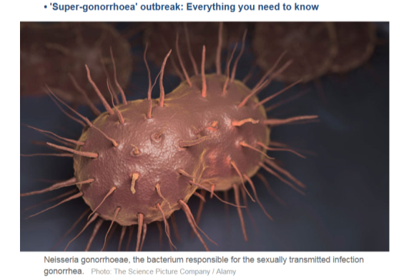
Antimicrobial Resistance (AMR)
Tjandra Yoga Aditama

Slide 2
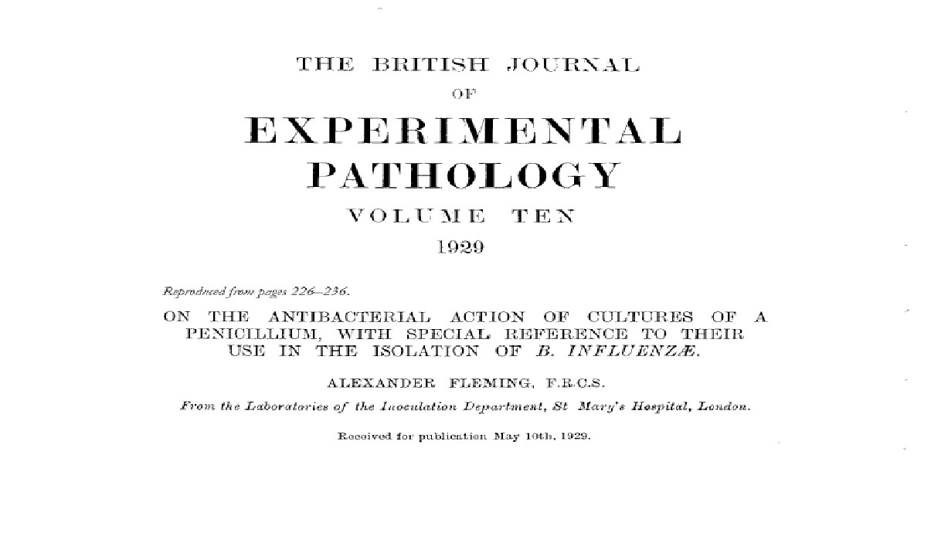

Slide 4
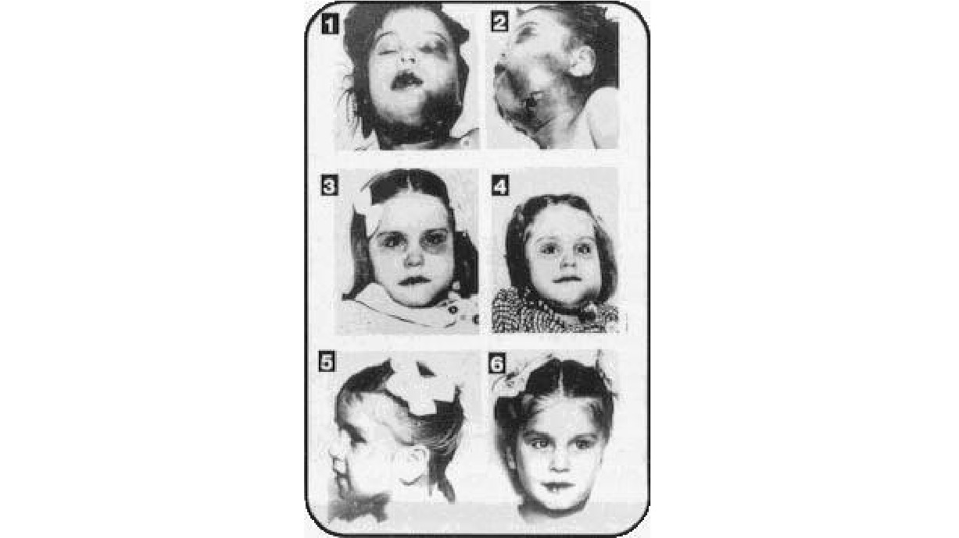

Slide 5
AMR was foreseen early
Alexander Fleming, Nobel Lecture,
“The time may come when penicillin
can be bought by anyone in the
December 1945
shops. Then there is the danger that the ignorant man may easily under
dose himself and by exposing his
microbes to non-lethal quantities of the drug make them resistant”
6| |February 2016

Slide 6
1928 - Sir Alexander Fleming discovered Penicillin - The first of antibiotics that would prove to be some of the most efficacious life-
saving drugs
In the near future - Due to AMR, we are looking at a world without
antibiotics again

Slide 7
No Antimicrobials - What Would That
Mean?
◉ “If antibiotics stopped working, we would find a substantial increase in deaths due to infections”
◉ “In a world with few effective antibiotics, modern medical advances such as surgery, transplants, and chemotherapy
may no longer be viable due to the threat of infection”
~ National Strategy for Combating Antibiotic-Resistant
Bacteria (Sep 2014)

Slide 8
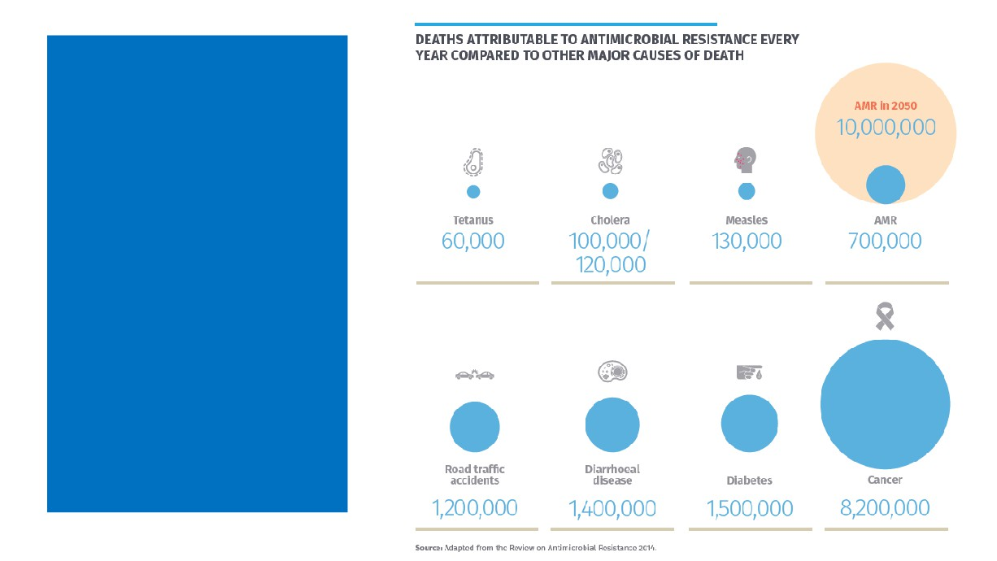
AMR is
already a substantial
killer ... and is
only
becoming
bigger

Slide 9
What is at stake with AMR?
● Safety net shrinking
- Surgery, injuries, cancer, diabetes, malnourishment…..
● Increasing AMR deaths today in all age groups
- Europe 25,000 per year
- Thailand 38,0000 per year
- USA > 23,000 deaths per year among
● By 2050, possibly 10 million deaths per year, more than cancer
3
|
|
February 2016

Slide 10
Why is AMR a Global Health
Concern?
The rate at which microbes are acquiring resistance is
GREATER than the rate at
which antimicrobials are being discovered

Slide 11
What is at stake with AMR?
● Worldwide, common
infections becoming more resistant to antimicrobials
- Blood, urinary tract, pneumonia, sexually transmitted, skin, TB ..
● Children, women & men at higher-risk for severe illness or death
2
|
|
February 2016

Slide 13
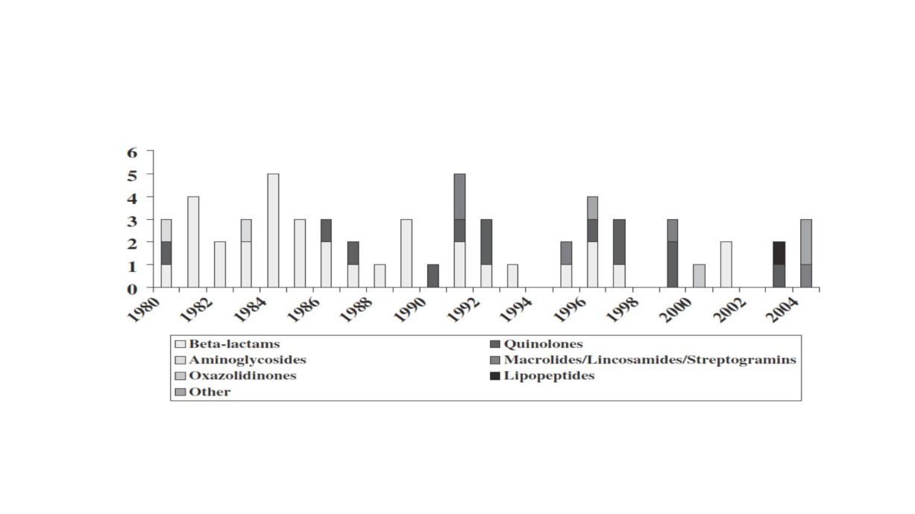
Trends in development of new antibiotics

Slide 14
Laxminarayan, Science, 2014

Slide 15
“The infrastructure of antibiotic discovery both in academia and in industry is at a dangerously low level and needs to be rebuilt”

Slide 16
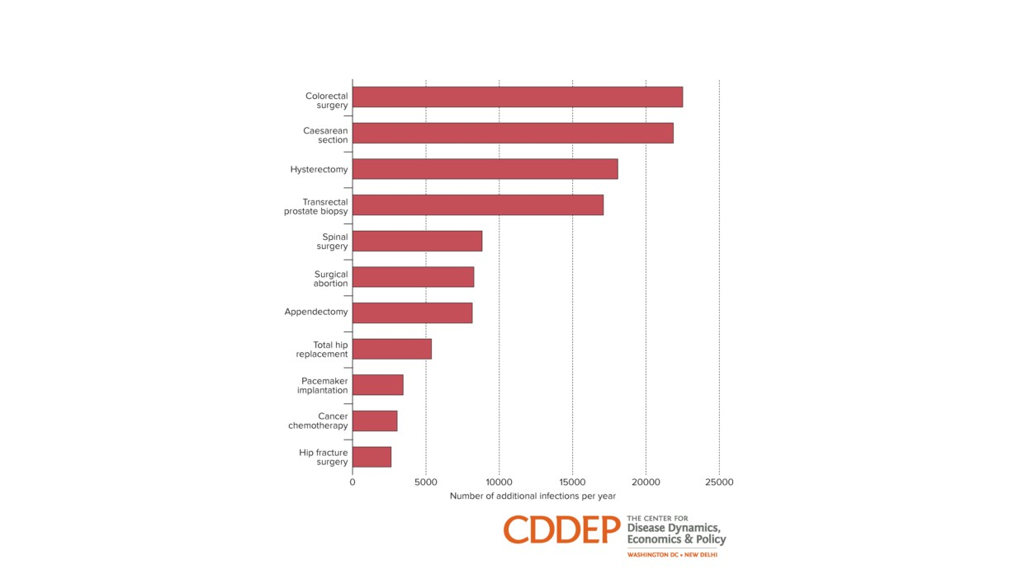
Number of additional deaths per year in the USA under a 30% decreased efficacy of antibiotic prophylaxis
Teillant et al, Lancet Infect Dis, 2015

Slide 17
Huge overall costs
● Estimated yearly US costs today (by CDC)
Treatment costs go up when 1st line antimicrobials can’t be used
- Direct up to $20 billion
- Indirect up to $35
billion
● By 2050, one projection
- Cumulative loss of 2% - 3.5% global GDP
5| |February 2016

Slide 18
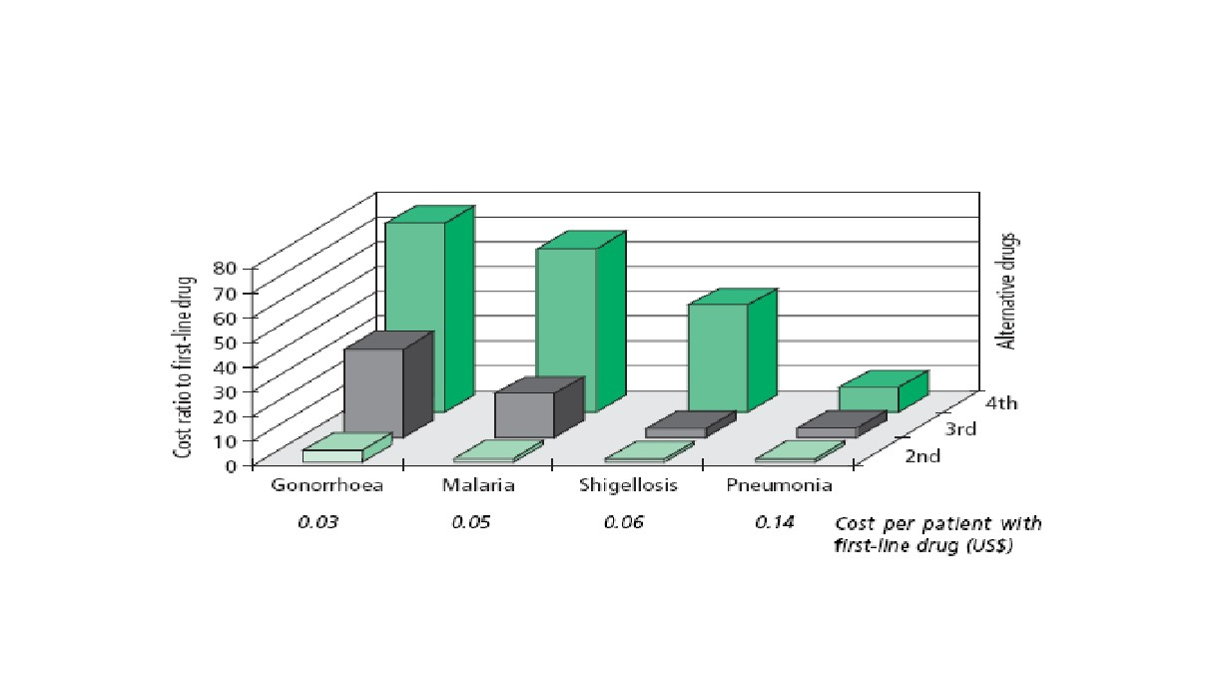
Loss of first line drugs increases drug costs
Source: WHO Policy Perspective 2005, adapted from WHO Model Formulary, WHO Clinical Guidelines and
Management Sciences for Health’s 2004 International Drug Price Indicator Guide (slide courtesy: David Heymann)

Slide 19
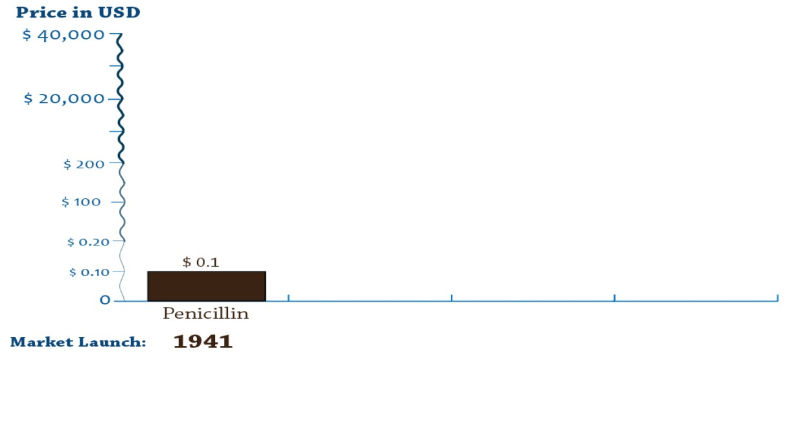

Slide 20
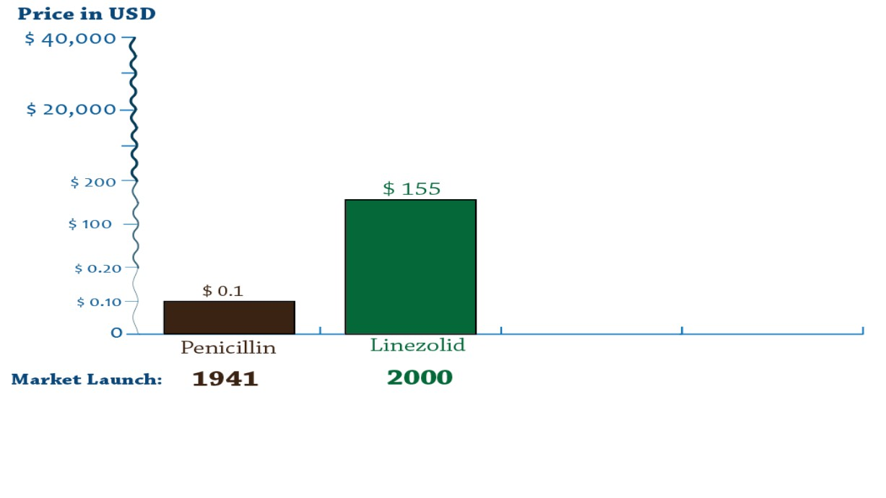

Slide 21
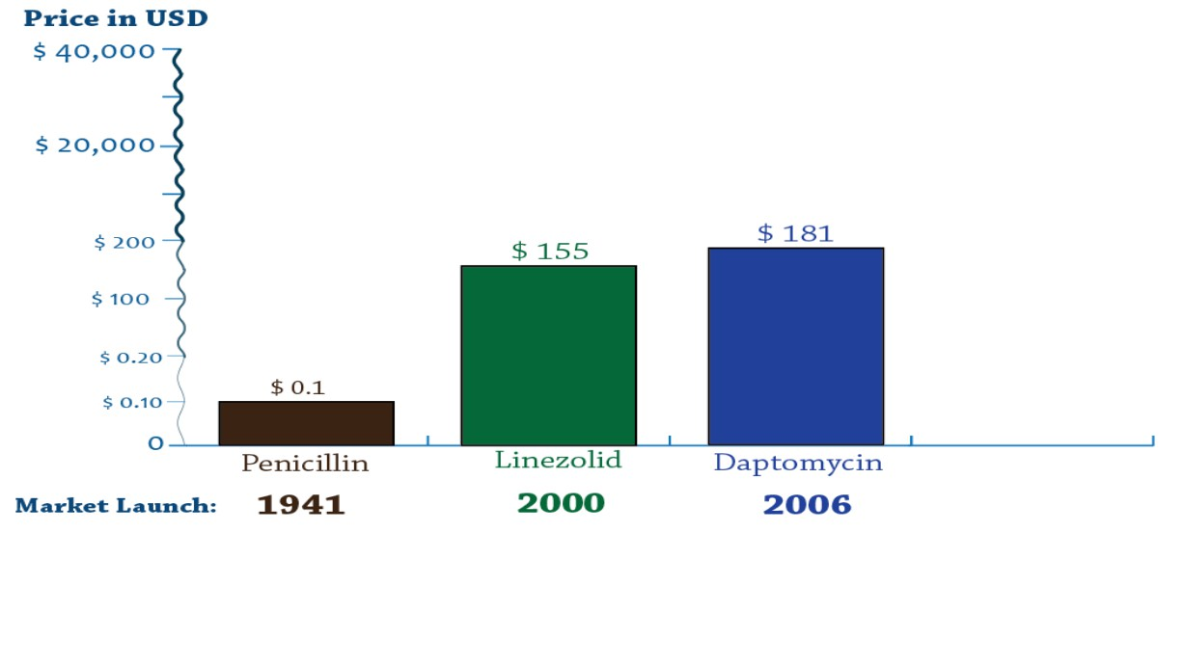

Slide 22
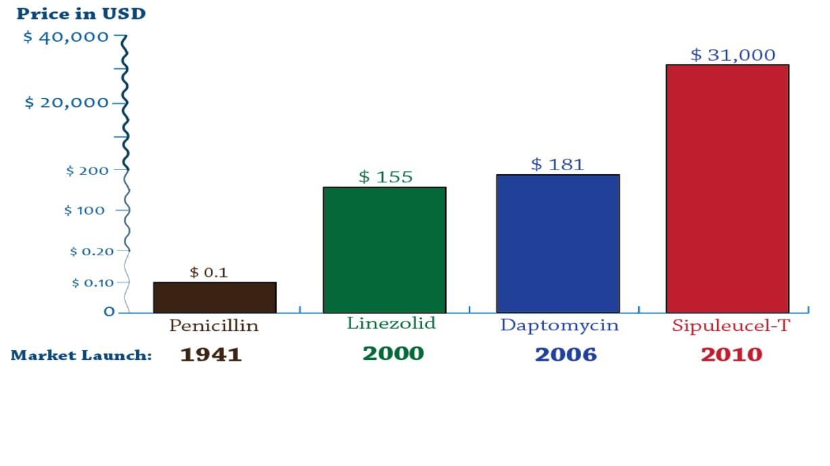

Slide 23
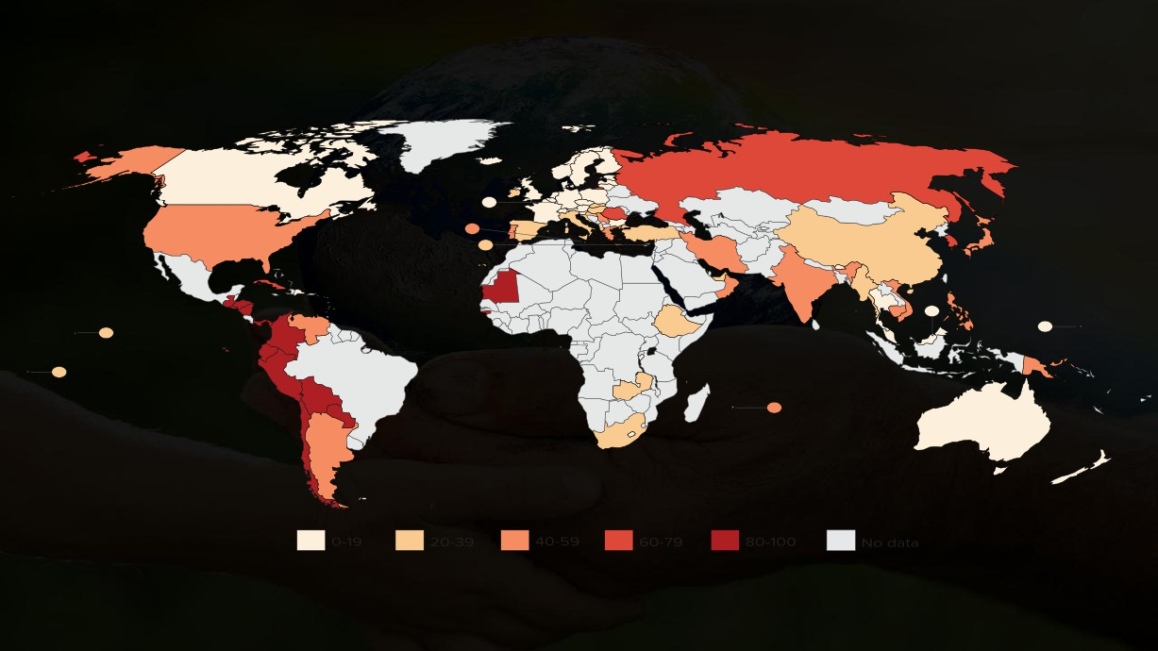
Percentage of Staphylococcus aureus isolates that are methicillin resistant (MRSA), by country (most recent year, 2011-14)
Source: CDDEP 2015, WHO 2014 and PAHO, forthcoming
Where available, data from hospital-associated MRSA and invasive isolates have been used. In their absence, data from community-associated MRSA or all specimen sources are
included. Only countries that reported data for at least 30 isolates are shown. Depending on the country, resistance to one o r more of the following drugs were used to test for MRSA:
Oxacillin, cefoxitin, flucloxacillin, cloxacillin, dicloxacillin, and methicillin. Intermediate-resistant isolates are included as resistant in some calculations, as in the original data source.

Slide 24
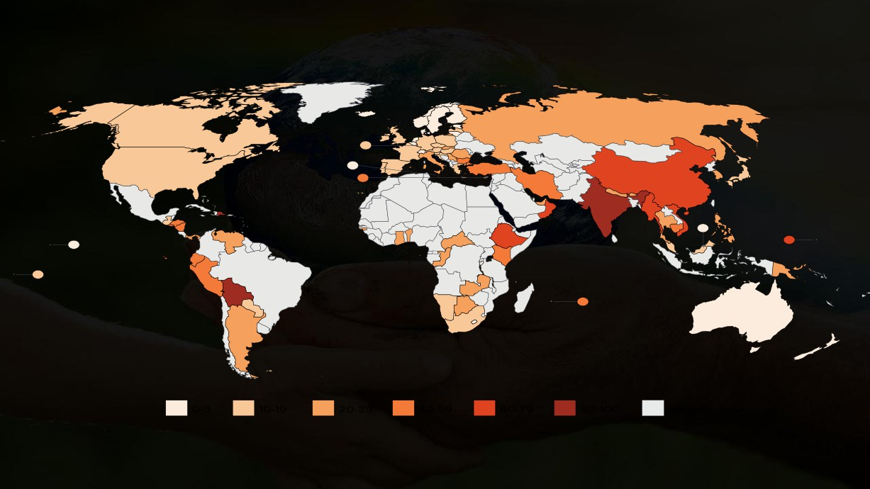
Percentage of extended-spectrum beta-lactamase producing Escherichia coli*, by country (most recent year, 2011-2014)
Source: CDDEP 2015, WHO 2014 and PAHO, forthcoming
Where available, data from invasive isolates have been used. In their absence, data from all specimen sources are included. Only countries that reported data for at least 30 isolates are
shown. Depending on the country, resistance to one or more of the following drugs were used: Ceftazidime, ceftriaxone and cefotaxime. Intermediate-resistant isolates are included as
resistant in some calculations, as in the original data source.
*Indicated by third-generation cephalosporin resistance

Slide 25
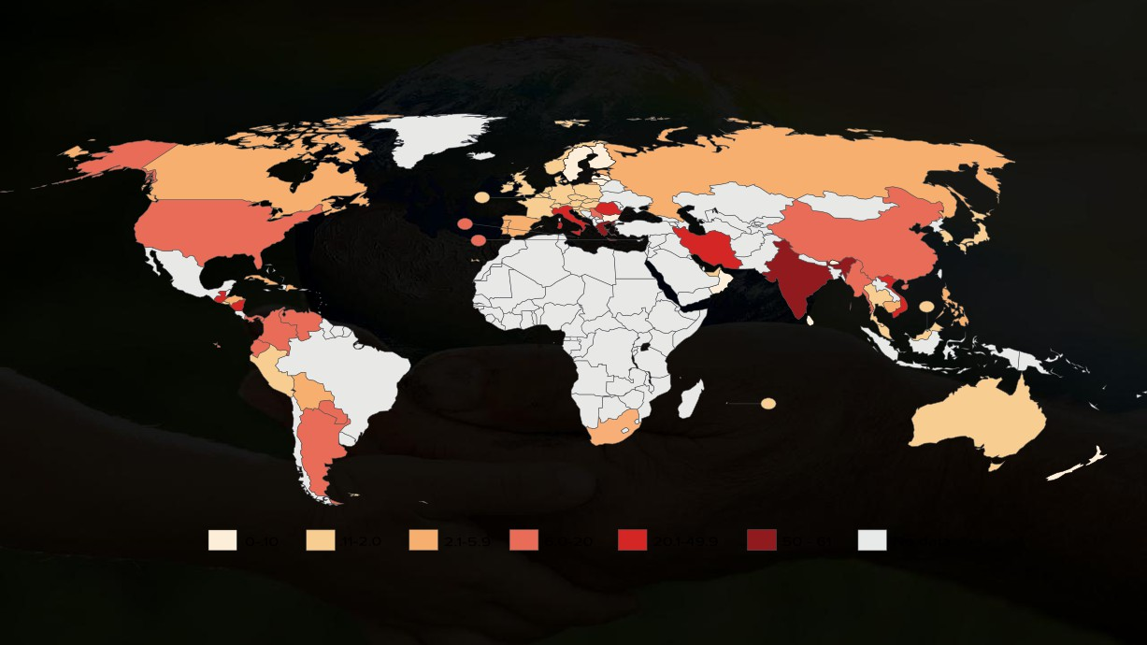
Percentage of carbapenem-resistant Klebsiella pneumoniae, by country (most recent year, 2011-2014)
Source: CDDEP 2015, WHO 2014 and PAHO, forthcoming
Where available, data from invasive isolates have been used. In their absence, data from all specimen sources are included. Only countries that reported data for at least 30 isolates are
shown. Depending on the country, resistance to one or more of the following drugs were used: imipenem, meropenem, ertapenem and doripenem. Intermediate-resistant isolates are
included as resistant in some calculations, as in the original data source.

Slide 26
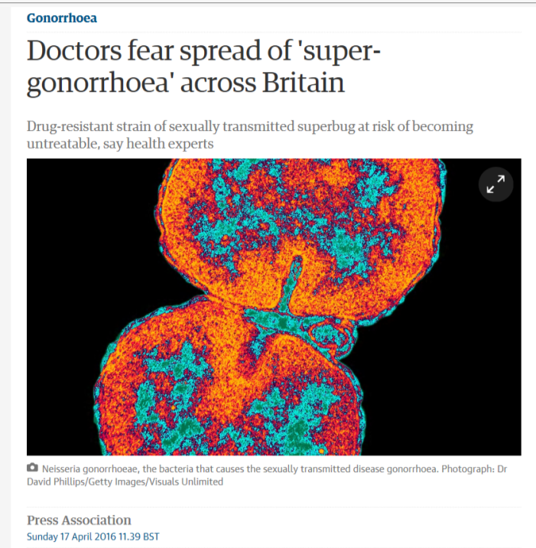

Slide 28
2014 WHO issued “Antimicrobial
resistance: global report on surveillance”
● Survey of 114 countries in all regions
● Selected combinations of hospital & community bacteria - antibiotic resistance patterns
● Limitations
- Surveillance gaps in many countries
- No standard methodology
● But best available global picture
12|
|
February 2016

Slide 29
General Findings
● Very high rates of resistance to key antibiotics by common bacteria in all regions
- E coli, K pneumoniae, S aureus, S pneumoniae, N gonorrhea ….
- 3rd generation cephalosporins, fluoroquinolones, methicillin …..
● Under reporting of major infections like MDR TB  Significant gaps in surveillance & information
13|
|
February 2016

Slide 30
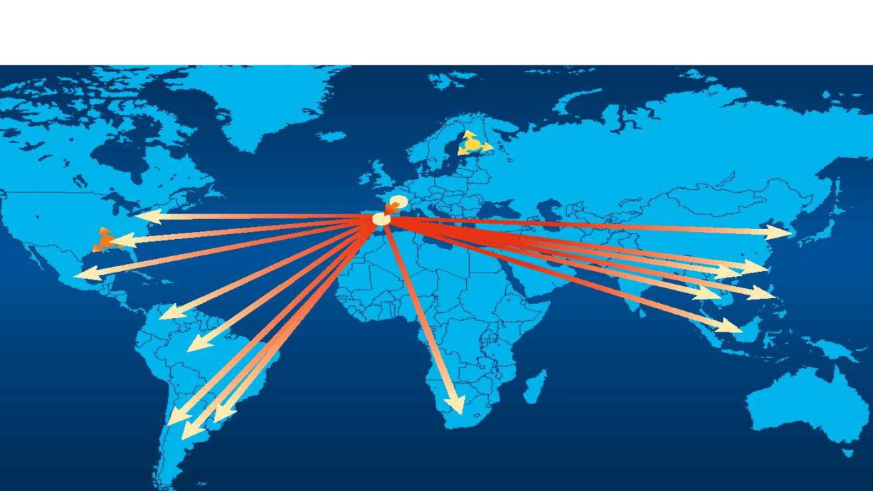
Clonal spread of S. pneumoniae 23F
Finland
France BM4200 1978 ?
Cleveland
Spain
South Korea
Tennessee
Mexico
Taiwan
Hong Kong Philippines
Thailand
Colombia
Malaysia
Singapore
Brazil
Chile
South Africa
Uruguay
Argentina
Slide courtesy: Keith Klugman
1

Slide 31
International travel
Date | Departure | Destination
Today | 14:10 | MULTIDRUG-RESISTANT MICROORGANISMS
Today | 14:35 | MULTIDRUG-RESISTANT MICROORGANISMS
Today | 14:40 | MULTIDRUG-RESISTANT MICROORGANISMS
Today | 14:45 | MULTIDRUG-RESISTANT MICROORGANISMS
Today | 14:55 | Baxjö
Today | 15:00 | Holmen
Today | 15:00 | MULTIDRUG-RESISTANT MICROORGANISMS
Today | 15:00 | MULTIDRUG-RESISTANT MICROORGANISMS
Today | 15:05 | MULTIDRUG-RESISTANT MICROORGANISMS
Today | 15:05 | MULTIDRUG-RESISTANT MICROORGANISMS
Today | 15:10 | Wasserdam
Today | 15:15 | MULTIDRUG-RESISTANT MICROORGANISMS
Today | 15:15 | Mørup
Wasowu
Salhet
Morador
Korobondo
Fuja
Chanbun
Tólos
Pasu Rial
Bolasir
©Istockphoto

Slide 32
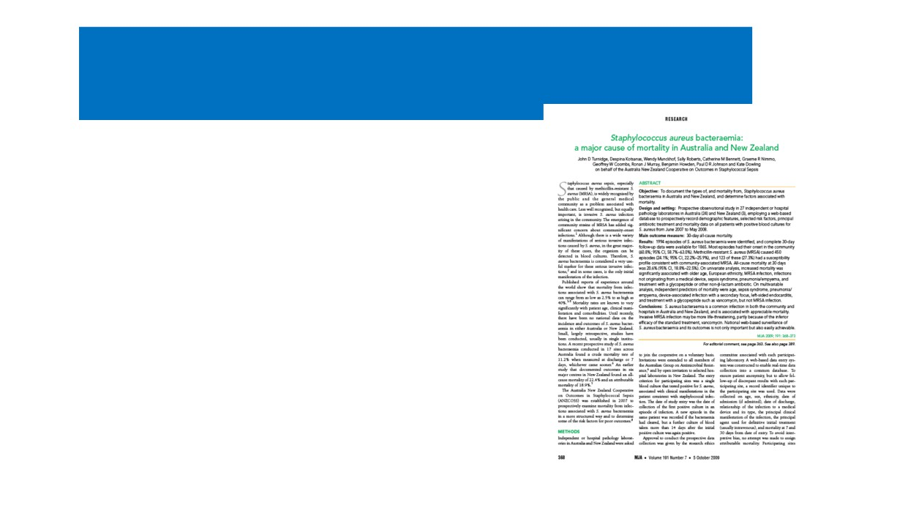
In short…we have a problem !
• Growing rates of resistance
• Inappropriate use of
antibiotics
• Decreasing pipeline of new antibiotics
15. Turnidge J et al. MJA 2009: 191(7): 368-373

Slide 33
Modern Medicine at Risk
• Loss of effective antibiotic treatment
could make routine infections deadly
Cancer Treatment
- Pneumonia
• >600,000 patients will receive
- Urinary tract infections
chemotherapy in 20141
- Wound infections
• Patients who receive specialized care will be at highest risk
• ~60,000 cancer patients will be
hospitalized with neutropenia and infections2
- Cancer chemotherapy
- Complex surgery
- Joint replacements
• 1 in 14 of these will die from this
- Organ transplants
complication2
- Sepsis
1Kantar Health, Cancer Impact 2Caggiano et al, 2005, Cancer
- Dialysis

Slide 34
Antimicrobial resistance
A threat to patient safety
Limited options for treatment
Increased length of
hospital stays
Increased patient morbidity and mortality
Each year, in the EU/EAA:
Limited options for treatment
≈2.5 million attributable extra hospital days
Increased length of hospital stays
≈25,000 attributable deaths
Increased patient morbidity and mortality
NOTE: Based on only 5 MDR bacteria and 4 types of infection
Source: ECDC, 2009.
In: http://ecdc.europa.eu/en/publications/Publications/0909_TER_The_Bacterial_Challenge_Time_to_React.pdf

Slide 35
AR Requires Global Action

Slide 36
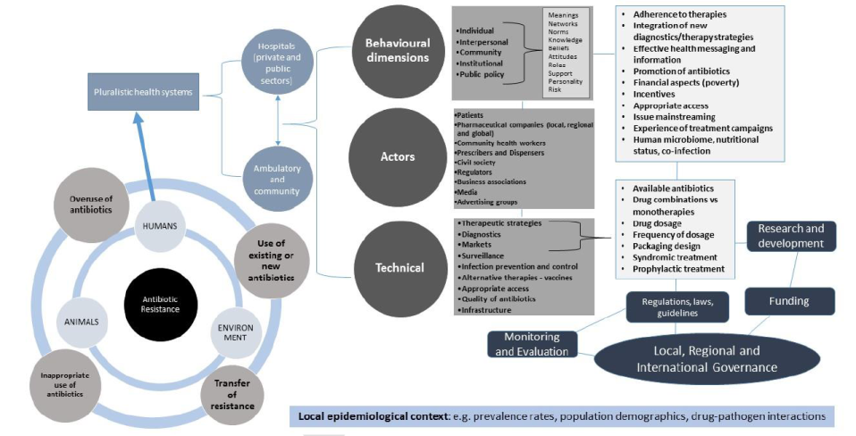
Complex Problem
Lin V. (2016). AMR and UHC. Bi-regional Technical Consultation on AMR in Asia. WHO WPRO. 14-15 April, Tokyo, Japan.

Slide 37
Humans + Animals = One Health
Prudent use of antibiotics: Everyone is responsible!

Slide 38
Action 5. Regulate antibiotic distribution in humans & food animals & agriculture & industry
Agriculture
Antibiotic Injection
H
Antibiotic Spray
Industry
Ethanol production from sugarcane

Slide 39
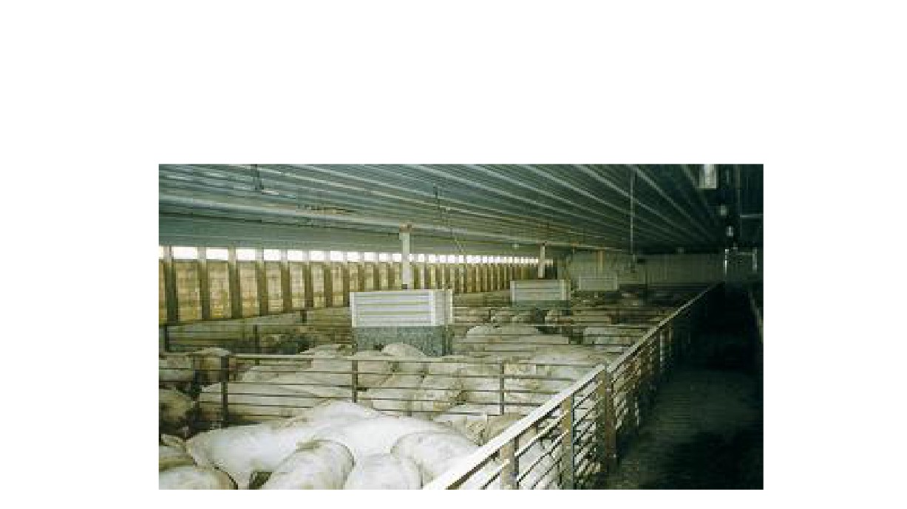
Antibiotic use for growth promotion and disease prevention

Slide 40
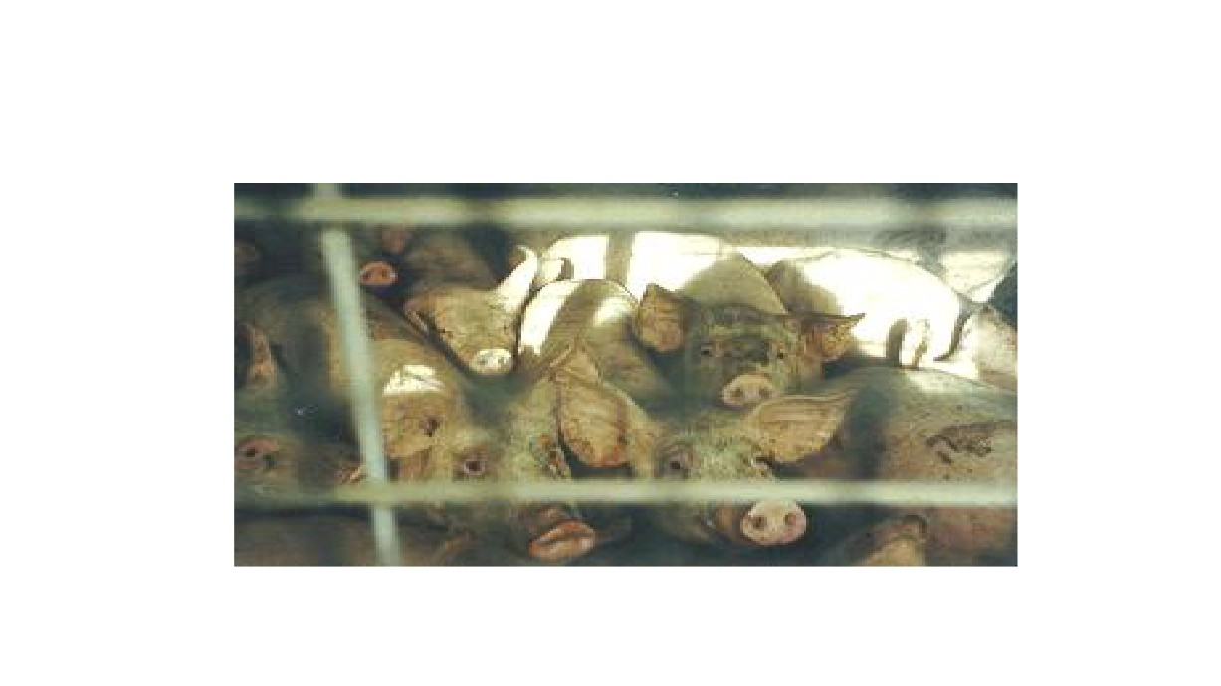
2/3rds of the tonnage of antibiotics sold worldwide are used in agriculture

Slide 41
Thailand AMR Containment and Prevntion Program 2013-2016
AMR Chain in Community in Thailand

Slide 42
Thailand AMR Containment and Prevention Program 2013-2016
AMR Chain in Hospital in Thailand
Infection Prevention & Control (IPC)

Slide 43
Thailand AMR Containment and Prevention Program 2013-2016
AMR chain in community
AMR chain in hospital
IPC
AMR affects all citizens
No matter who you are, you are at risk of being colonized and/or
infected with AMR bacteria
AMR matters everybody

Slide 44
Antimicrobial Resistance

Slide 45
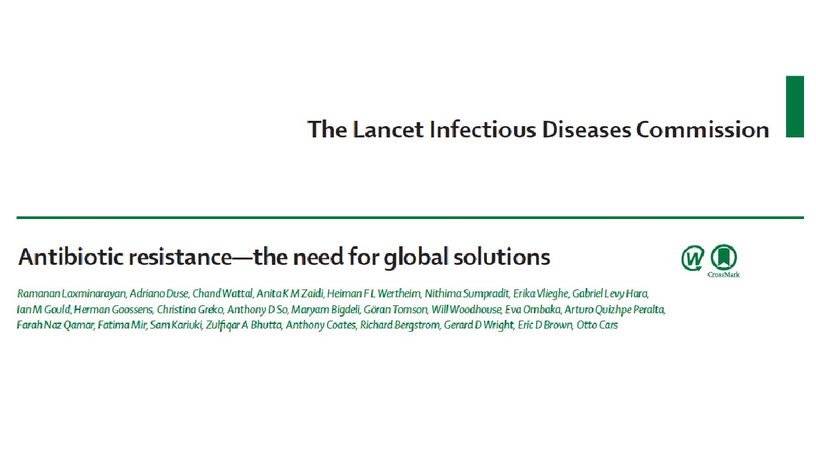

Slide 46
68th World Health Assembly May, 2015
Tackling antimicrobial drug resistance
Delegates at the World Health
Assembly endorsed a global action
plan to tackle antimicrobial resistance
- including antibiotic resistance, the most urgent drug resistance trend. Antimicrobial resistance is occurring everywhere in the world,
compromising our ability to treat
infectious diseases, as well as
undermining many other advances in health and medicine.

Slide 47
WHO Global Action Plan
Antimicrobial Resistance
The plan sets out 5 objectives:
1.
Improve awareness and understanding of antimicrobial resistance;
2.
Strengthen surveillance and research;
3.
Reduce the incidence of infection; Optimize the use of antimicrobial medicines;
4.
5.
Ensure sustainable investment in countering antimicrobial
resistance.

Slide 48
Step-by-step approach for development and implementation of hospital antibiotic policy and standard treatment guidelines

Slide 49
Five strategic objectives
1. Improve awareness and understanding
2. Strengthen knowledge through surveillance & research
3. Reduce incidence of infection
4. Optimize use of antimicrobial medicines
5. Ensure sustainable investment
17|
|
February 2016

Slide 50
AR Requires Global Action
Improve Laboratory
Develop National
Capacity
Tracking Programs
Implement Antibiotic
Expand Infection Control Programs
Stewardship Programs

Slide 51
AMR Core Campaign
Thailand AMR Containment and Prevention Program 2013-2016
Slogan : Stopping AMR is Everybody’s Business

Slide 52
Make better use of existing antibiotics
Image Courtesy of Shutterstock

Slide 53
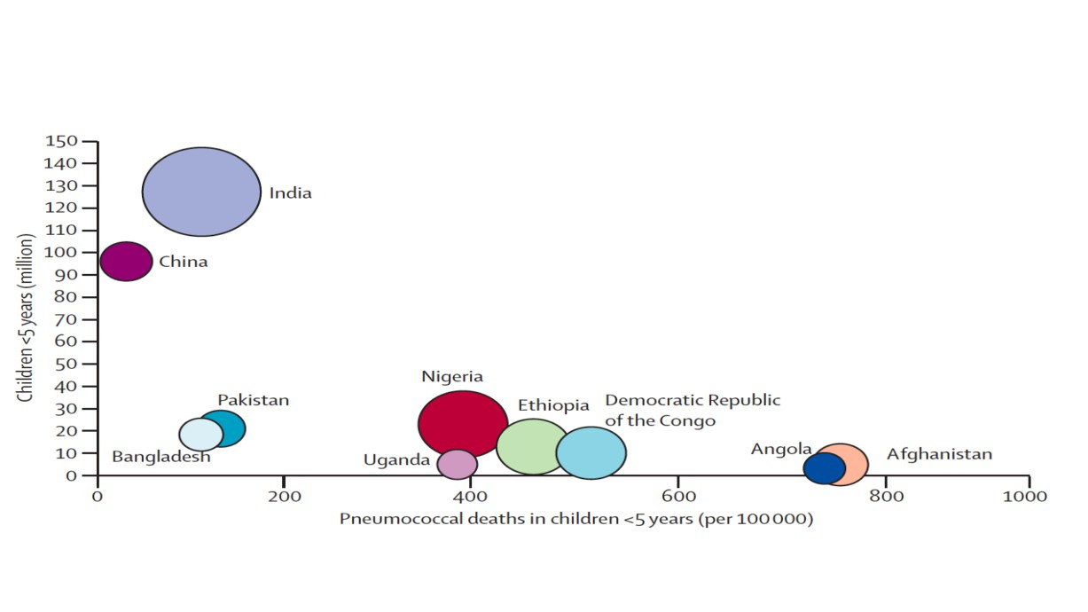
Bacterial diseases are still major killers in developing
countries because of lack of access to antibiotics
O’Brien et al, Lancet 2009

Slide 54
Global Health Security Agenda
Prevent avoidable
catastrophes
Detect threats early
Respond rapidly and effectively

Slide 55
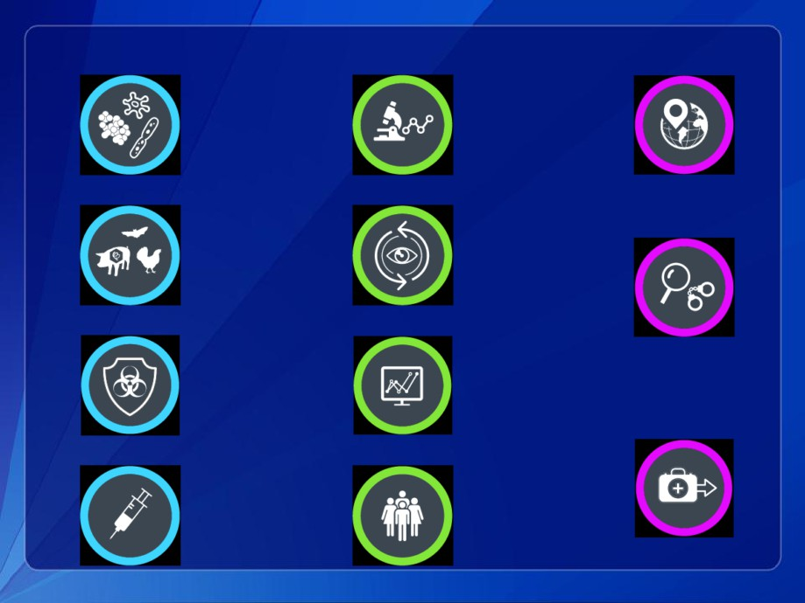
Action Packages to Achieve Targets
Antimicrobial Resistance
National Laboratory Systems
Emergency Operations Centers
Zoonotic Diseases
Surveillance
Linking Public Health with Law Enforcement and Multisectoral Rapid
Response
Biosafety/Biosecurity
Reporting
Medical
Immunization
Workforce Development
Countermeasures and Personnel Deployment

Slide 56
Building resilient health system to contain AMR - UHC
UHC

Slide 57
‘One Health’ – a multisectoral approach to AMR
UHC
‘One Health’

Slide 58
Containment of AMR as a Development Agenda
UHC
‘One Health’
SDGs

Slide 59
National, Regional and Global actions to contain AMR
UHC
‘One Health’
SDGs
GOVERNANCE OF AMR as a development agenda

Slide 60
National, Regional and Global actions to contain AMR
UHC
‘One Health’
SDGs
GOVERNANCE OF AMR as a development agenda
National Regional Global
National Action Plan on AMR
Harmonization of surveillance and regulations
Enhance R&D (new antibiotics and
diagnostics)

Slide 61
Antimicrobial Resistance
A Threat to Sustainable Development

Slide 62
Transforming our world: the 2030 Agenda for Sustainable Development
‘We will equally accelerate the pace of progress made in fighting malaria, HIV/AIDS, tuberculosis, hepatitis, Ebola and other communicable diseases and epidemics, including by addressing growing antimicrobial resistance and the problem of unattended diseases affecting developing countries’

Slide 63
Transforming our world: the 2030 Agenda for Sustainable Development

Slide 64
Antimicrobial Resistance

Slide 65
Antimicrobial Resistance

Slide 66
Antimicrobial Resistance

Slide 67
Antimicrobial Resistance
Awareness and Advocacy

Slide 68
Surveillance is a prerequisite for
Prevention and Control of AMR
Detecting and understanding the problem
Decision making and design
of interventions
Monitoring the effect of interventions and make
corrective actions
20

Slide 69
“Drug resistance follows the
Drug like a faithful shadow.”
- Paul Ehrlich 1854-1915

Slide 70
T E R I M A K A S I H
Antibiotics are
a precious resource
Take antibiotics only as prescribed
Help prevent the emergence of resistance
World Health House Indraprastha Estate, Mahatma Gandhi Marg, New Delhi-110002, India Email: cds@searo.who.int www.searo.who.int
Antimicrobial Resistance
SEA-HLM-414

