Slide 1
PERTEMUAN 4
HOSPITAL HAZARDS

Slide 2
TUJUAN
Mahasiswa dapat menyebutkan tujuan mata ajar Hospital Hazards
Mahasiswa dapat menguraikan topik- topik dan jadwal mata ajar Hospital Hazards
Mahasiswa dapat menggambarkan sistem evaluasi pembelajaran dan buku wajib
Mahasiswa mampu memahami kompetensi yang diharapkan dari mata ajar

Slide 3
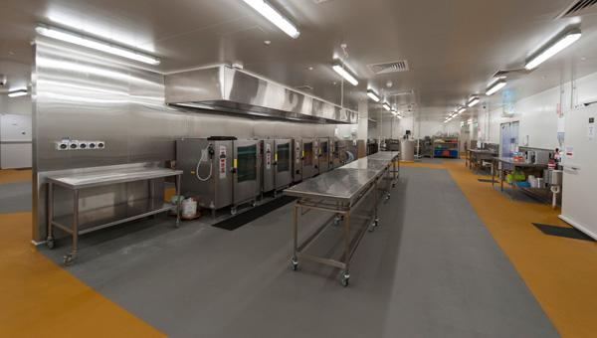
Kitchen
The employees of the hospital dining facility have one of the highest injury rates in the facility.
The kitchen is considered a high interest area and should be on a quarterly high interest inspection schedule.
a. Slips and falls are prevalent in the industrial kitchen environment. It is very important for staff to be attentive and clean up spills promptly.
b. Heavy lifting is common in the hospital kitchen.
c. Safety footwear is a must; the potential is always present that something may be dropped.
d. Heat, cold, sharp knifes, cutting tools, cylinders, and chemicals also add to the hazards found in the kitchen and surrounding areas.
e. Staff working in the kitchen must be trained on hazard recognition and how to report hazards.
f. When workers change job assignment to another part of the kitchen they must be trained to recognize the hazards associated with this new job assignment.
g. Ensure a job safety analysis (JSA) is performed for each employee. Supervisors should conduct an annual review of the JSA and make the appropriate adjustment to ensure a safe environment for their employees.

Slide 4
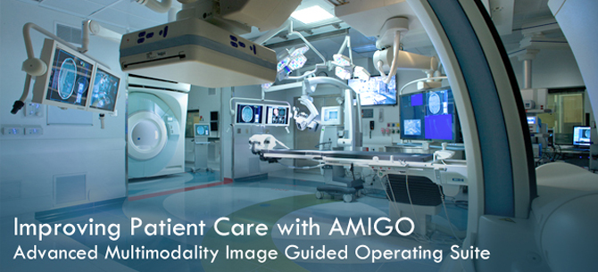
Operating suites - Surgery
Operating suites are locations that employ inhalation anesthetics.
Use of inhalation anesthetics will conform to standards in, Use of Inhalation Anesthetics (Flammable and Nonflammable).
Key requirements checked on a regular basis will include, but are not limited to, the following:
a. The relative humidity in anesthetizing locations will be maintained above 50 percent. Humidity measuring and recording instruments are installed in areas where anesthesia is routinely used.
b. An isolated electrical power supply will be provided for each flammable anesthetizing location.
(1) The system will include either a line isolation monitor (dynamic detector-required for new facilities) or a ground detection alarm (static detector in older existing facilities).
(2) Whichever detector is used, it will be tested by medical maintenance personnel, and a record of these tests will be maintained.
c. Conductive flooring will be provided for each flammable anesthetizing location and will be tested. If conductive flooring is installed in nonflammable locations, it will also be tested according to the referenced manual.
d. Conductive footwear will be worn in flammable anesthetizing locations. Resistance of the footwear will not exceed 500,000 ohms.
e. In flammable or mixed anesthetizing locations, the following materials will not be permitted for outer garments or for non-apparel purposes, unless such materials have been tested and found anti-static:
(1) Silk.
(2) Wool.
(3) Synthetic textile materials.
(4) Blends of synthetic textile materials.
(5) Blends of synthetic textile materials with unmodified cotton or rayon.
(6) Non-woven materials.

Slide 5
f. Portable electrical equipment, such as incubators, X-ray machines, and so forth, used in flammable anesthetizing locations will be “explosion-proof”.
g. Casters on portable conductive equipment will be kept clean and free of wax or other foreign matter.
h. Furniture used in flammable anesthetizing locations will be constructed of electrically conductive material and will be outfitted with conductive wheels, pads, or other conductive floor contact devices.
i. Surfaces should not be painted.
j. Only noncombustible agents will be used for anesthesia or for pre-operative preparation of the surgical field if electrocautery, electric coagulation, or any other electrical equipment employing an open spark is to be used during the operation.
k. Anesthesia equipment should not be covered. Covers may confine small leaks, producing an explosive or flammable atmosphere that could ignite when the cover is removed.
l. Patient electrodes (ground plate) of Radiofrequency (RF) electro-surgical units will be kept free of corrosion and irregular surfaces.
(1) Reusable (non-disposable) patient electrodes should be permanently connected to the patient return cable without the use of clips or clamps.
(2) Disposable patient electrode plates and adhesive electrodes are exempt from this requirement when used with reusable (non-disposable) patient cables.
m. Lint removal pads may be placed at each entrance to the surgical suite. These pads will be replaced frequently.
n. Only ventilators which have a low-pressure alarm system will be used. Periodic maintenance leakage testing will be accomplished as prescribed by the manufacturer.

Slide 6
Operating room suites quarterly inspections
a. Quarterly hospital inspections are mandated for operating room (OR) suites since compressed gas cylinders, patient movement to the OR table (lifting hazard), anesthesia drugs hazards, formaldehyde, glutaraldehyde, waste anesthesia gas (WAG), waste anesthesia gas evacuation (WAGE), extension cords, electrical hazards, wet locations, and ethylene oxide (ETO) gas all present their unique hazards associated with the OR environment.
b. Fires in ORs are not uncommon. Quarterly fire drills will be conducted for all personnel on all shifts; the staff, not the patients or visitors, should participate in the fire drill. Conducting fire drills without disrupting patient care activities must be considered.
c. “Fire Safety in Healthcare Facilities” is recommended to assist hospital safety managers with fire safety programs.
d. Oxygen can be trapped under the drapes and increase the potential for fire ignited from the laser or electrical surgical unit (ESU) when the surgeon starts the procedure.
e. Hazard recognition is an important part of the overall hospital safety program. Documentation of the quarterly, high-interest-area safety inspections or semiannual safety inspections, hazard surveillance or environmental rounds is very important for inspections.
f. The key to remember is patient safety. The staff and visitor’s safety is important as each hospital strides to provide a safe, supportive, functional environment for patient, staff, and visitors.

Slide 7
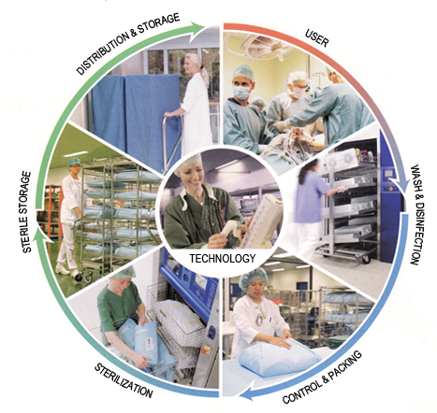
Central material supply
Central material supply (CMS) is there to support OR operations. It ensures the needed supplies are available for the staff to use when needed.
a. Hazards in the CMS might include chemical, ETO, falls, biological, needle sticks, and back injuries.
b. Most hospitals are substituting a less hazardous substance for ETO.
c. Consider including the CMS area as a high-interest area in the spot inspection program. It is a location that deserves some close looks to ensure optimum safety.
d. In addition to the obvious healthcare hazards, survey the area to ensure—
(1) The rooms are well lighted.
(2) Exits and aisles are clear at all times.
(3) Rubbish, empty cartons, and paper are disposed of immediately; and heavy items are always stored on the lower shelves.
(4) Spillage items are stored on the lower shelves.
(5) Flammable liquids are stored in approved containers.
(6) Employees are lifting correctly.
(7) Fire extinguishers are located in the proper place, checked monthly, maintained appropriately, and properly documented..

Slide 8
Radiation
General concepts.
(1) Ionizing and non-ionizing radiation are normally encountered in hospitals, health, dental, and veterinary activities and pose potential risks that must be managed.
(2) To minimize their inherent risks, radiation-producing systems must be used by well-trained personnel and undergo regular inspection, maintenance, and calibration.
(3) In general, the radiation safety program is based on controlling radiation sources to ensure that they are used as intended. This includes control of personnel who work with or are exposed to radiation sources, those who monitor exposures, educate the work force, measure and document radiation emissions, and those who conduct medical surveillance for early detection/remedies for overexposures.
(4) A trained and qualified Radiation Safety Officer (RSO), a written program document, and use of personal protective equipment are some of the more salient elements of healthcare activity radiation protection programs.Complex programs may also require oversight by a radiation safety committee.
(5) All radiation sources in the hospital should be catalogued on an inventory.

Slide 9
b. Nuclear medicine.
(1) Hospitals that provide nuclear medicine services are licensed by the Nuclear Regulatory Commission and possess varying amounts of radioactive material.
(2) Hazards in nuclear medicine include radiation exposure and radioactive contamination.
(3) Nuclear medicine workers generally require personnel dosimetry (thermoluminescent dosimeter /TLD badges), and initial and annual radiation safety training.
(4) Personal protective equipment includes lab coats, latex gloves, and syringe shields, and, where necessary, dedicated exhaust hoods for handling dispersible radioactive material.
(5) Nuclear medicine clinics are routinely checked for radiation and contamination.
(6) Nuclear medicine clinics generate radioactive waste which must be controlled and managed for disposal.
(7) Facility design for nuclear medicine clinics may include lead shielding in walls and doors. Any new construction or modification of nuclear medicine facilities requires a review by a qualified expert.

Slide 10
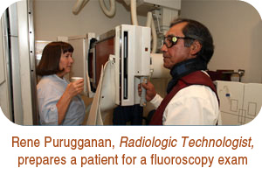
c. Radiology.
(1) Radiology departments are equipped with x-ray generating systems that create potential radiation hazards for workers, patients, and the public.
(2) X-ray systems are routinely inspected for compliance with safety requirements by qualified experts. These inspections are generally referred to as “x-ray surveys.” Other routine inspections are performed by medical maintenance personnel.
(3) X-ray workers require initial and annual radiation safety training, and may require personnel dosimetry (TLD badges).
(4) Personal protective equipment includes protective lead aprons and gloves, and in some cases, thyroid shields and leaded eye ware. Leaded aprons and gloves will be in good condition. Racks will be provided to hang aprons when not in use. Aprons must not be folded because sharp creases result in cracks, lessening the integrity of the protective shield.
(5) Good housekeeping is essential since a considerable amount of work is accomplished under low levels of illumination.
(6) Portable x-ray equipment will be stored to prevent unauthorized use. A leaded apron for the operator should be kept with the machine. When the machine is transported, the tube head should be in a lowered and locked position.
(7) Facility design for radiology clinics may
include lead shielding in walls and doors.
Any new construction or modification of x-ray
facilities requires a review by a qualified expert.

Slide 11
d. Magnetic Resonance Imaging.
(1) Staff must always remember that the magnet is continuously on .All staff must follow the direction of magnetic resonance imaging (MRI) personnel to ensure patient handling is done safely and according to established protocol. There have been instances of items such as buffer, beds, and oxygen cylinders being drawn into the magnet.
(2) Never cross the red line without being escorted by a MRI staff member.
(3) Remove all metal objects before proceeding past the red line.
(4) Follow written instruction posted and always follow the direction of MRI staff.
(5) Use only the gurneys and wheelchairs provided by the MRI staff.
e. Lasers.
(1) Lasers are used throughout the hospital. The principal hazards associated with hospital laser systems include eye injury, skin injury, and fire.
(2) Hospital laser use requires a trained and qualified Laser Safety Officer (LSO), and a written laser safety program.
(3) Laser operators require initial and annual training and baseline eye exams.
(4) Laser personal protective equipment includes eye ware that is specific to the wavelength of the laser light.
(5) Laser systems will be inspected annually by the LSO.

Slide 12
Emergency room
The emergency room (ER) is a very busy place and hazards are abundant .It gets very crowded in and around the ER with doctors, nurses, and others when patients are being treated.
a. Hazards include trips, slips, and falls; strains from staff moving patients; x-rays taken in close vicinity of other patients, visitors, and staff.
b. Before X-ray technicians take an X-ray, they must call “clear” to ensure those around them are aware of the danger and others are warned to take the appropriate protective measures to ensure they are not exposed.
c. Another major concern in the ER is an assault on a staff member, another patient, or a visitor.
d. Most hospitals have their own security and procedures in place to limit or mitigate assaults.
(1) Staff must know the procedures for handling agitated patients, visitors, and staff.
(2) Staff must know what to do and how to report these incidents.
e. Most ERs are considered suites and sometimes it is hard to determine just where the egress routes are located.
However, there must be clear and unobstructed egress from the ER. The safety manager must work closely with the ER staff in following the requirements on keeping these passageways clear.
f. When conducting quarterly fire drills (required for all personnel on all shifts), the staff will simulate patient movement by moving a gurney to the designated area of refuge or the location the ER staff will move patients to, if required to evacuate.
g. The primary purpose of the fire drills is to evaluate the staff, with no disruption to patient care.

Slide 13
Hazard Recognition

Slide 14
Hazards
Some hazards are unique to healthcare/hospital environments, demonstrated by the many different locations mentioned above, in which healthcare activities take place.
This in combination with very different scenarios depending on the location presents many hazards not normally found in the common workplace.
Specialized hazard recognition for these environments is important to ensure optimum safety of our patients as well as our visitors and staff.
a. A patient’s exposure to unique, unfamiliar hazards commonly found in healthcare environments is one of the more critical scenarios.
b. Another scenario is exposure of healthy personnel (visitors or workers) to hazards commonly encountered in healthcare environments.
c. With the visitor, like the patient, there is an element of unfamiliarity with hazards unique to the healthcare environment.
d. Alternatively, the patient/visitor may introduce normally harmless items into the healthcare environment that could cause very serious risks. Items like a hair dryer or a cell phone brought into the healthcare environment could induce electrical interference in critical life support equipment, cause a fire in oxygen enriched atmosphere or contaminate a sterile environment which could lead to nosocomial infections. Medical maintenance must check all electrical items that are present in a patient care area.
e. Some hospital safety managers will check personal electrical appliances that a patient might bring into the hospital.

Slide 15
Healthcare risks
Healthcare activities involve many different risks.
These risks are also commonly encountered in other non Hospital healthcare delivery activities.
All federal standards prescribed by OSHA, the Nuclear Regulatory Commission (NRC), the Federal Aviation Administration (FAA), and CDC pertaining to healthcare activities are applicable.
Also, nongovernmental criteria from the JCAHO, as well as safety criteria found in other national consensus standards are applicable to all healthcare delivery activities.

Slide 16
Joint Commission on Accreditation of Healthcare Organizations
All MTF must comply with the JCAHO standards.
a. Normally the safety manager is the coordinator for JCAHO’s management of the Environment of Care (EC). All MTF safety offices must have the publication “Environment of Care Essentials for Healthcare.” This publication will provide a checklist of all the EC standards. It is a step by step process for compliance.
b. There are seven EC elements: safety, security, emergency management, medical equipment management, fire protection, hazardous material/waste, and utilities management.
Normally the safety manager has responsibility for three of the elements: safety management, fire protection, and hazardous material/waste.
c. A management plan for all seven elements must be developed as well as a written annual evaluation of the management plan/program.
(1) The safety manager will consolidate these annual evaluations from the point of contacts (POCs) of the other elements and forward the annual evaluations to the governing body.
(2) At least one performance improvement measure (PIM) from the seven elements must be forwarded for consideration to the governing body.
(3) In essence, each person that is responsible for one of the elements provides a PIM to the safety committee

Slide 17
Care core processes
The core processes in the environment of care are—
a. Design.
b. Documentation.
c. Staff development.
d. Risk assessment.
e. Emergency response.
f. Inspections, testing, and maintenance.
g. Information collection for system evaluation (ICSE).
h. Performance monitoring.
i. Annual evaluation.
j. Performance improvement.
k. All seven EC elements must have safety management plans.
(1) The safety management plan is typically a comprehensive document describing all safety and occupational health (SOH) aspects of the environment of care in the healthcare setting. The primary focus is on patient’s safety; taking into account the diminished ability of patients to anticipate or respond to risks as well as the unusual nature of the risks commonly encountered in healthcare environments.
(2) The safety management plan generally provides SOH processes for the following:
(a) Maintaining and supervising all grounds and equipment.
(b) Conducting risk assessment that proactively evaluates the impact of buildings, grounds, equipment, occupants, and internal physical systems (especially electrical, water, and HVAC) on patient and public safety.
(c) Examining safety issues by appropriate representatives from administration, clinical services, and support services.
(d) Reporting and investigating all incidents of property damage, occupational illness, and patient, personnel, or visitor injury.
(e) Ongoing surveillance, including response to product safety recalls.

Slide 18
Thank you

