Slide 1
PERTEMUAN MFK II
Medical Facility/Hospital
Physical Plant

Slide 2
General
The medical facility is subject to most of the types of mishaps common to other locations frequented by workers and visitors.
If the nature of the facility creates a false sense of security to many who enter; then there might be a tendency for carelessness.
Patients, especially the sick and the elderly, are more prone to slips and falls.
a. Hospital grounds.
(1) Hospital grounds will be well maintained at all times. Power equipment such as mowers, hedge trimmers, and so forth, will not be left unattended.
(2) Hospital parking lots and walkways will be in good repair, kept free of debris, sand, gravel. They will be illuminated in accordance with Illuminating Standards.
b. Parking areas.
(1) Pedestrian crosswalks will be marked and identified. Crosswalks across ambulance routes in the immediate vicinity of the medical facility will be posted with a warning sign stating, “Emergency Vehicle Route”.
(2) Emergency parking spaces will be established near the emergency room entrance.
(3) Ambulance parking areas should be located to allow best possible egress into the common emergency routes.
Designated ambulance routes should not pass through a parking lot.
Ambulances will be parked for immediate response in a forward direction; backing out of stalls will be avoided.

Slide 3
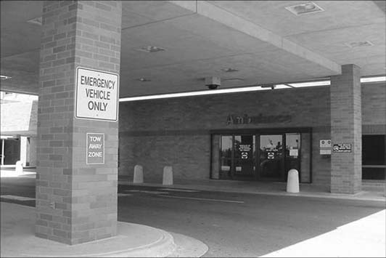
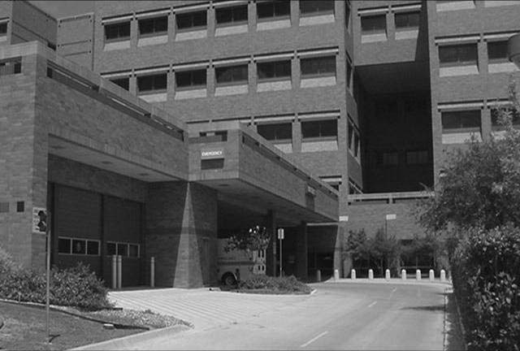
Example of hospital entrance
Example of ambulance parking

Slide 4
Entrances and exits
a. Each entrance to the facility will be appropriately identified.
b. Emergency room entrance signs will be illuminated.
c. Doormats will be in good repair and lie flat.
d. Clear glass doors and panels will be affixed with decals or other visible means to preclude being mistaken for an opening.
e. Elevated thresholds will be eliminated wherever possible.
f. Every exit will be clearly visible or the route to it conspicuously identified, so that every occupant of the building readily knows the direction of escape from all points.
g. Any doorway or passageway, which is not an exit or access to an exit but which may be mistaken for an exit, will be identified by a sign reading “Not an Exit” or a sign indicating its actual use such as “Storeroom.”
h. Exits and accesses to exits will be marked by a readily visible sign. Each exit sign (other than internally illuminated signs) will be illuminated by a reliable light source providing no less than 5 foot-candles on the illuminated surface.
i. Mirrors will not be placed on or near exits in a way that confuses the direction of the exit.
j. At no time will exits be blocked.
k. Identification of exits, illumination of exits, types, and numbers of exits will be in accordance with the National Fire Protection Standard.

Slide 5
Stairs and corridors
a. Stairways will be illuminated to a level of at least 20 foot-candles .
b. Handrails will be installed on each stairway .
c. Bulletin boards or other similar distractions will not be located in or near stairways.
d. Stairs will be maintained in good repair and free from slippery surfaces.
e. Stairways and corridors should be wet mopped only one side at a time. “Caution Wet Floor” signs will be posted and slippery areas blocked off. Path for travel will be clearly identified for people using the corridor or stairs.
f. In stairways, doors at each floor level will be kept closed to provide a fire stop. With the approval of the authority having jurisdiction, doors may be held open with an automatic closing device installed .
g. Corridors and stairways will be kept free of unnecessary obstructions and will not be used as storage space.
Nothing should be located in exit corridors.

Slide 6
Elevators
Facilities classified as healthcare or ambulatory occupancy in which patients are housed on floors other than ground level will have at least one elevator that will accommodate at least one adult size bed.
Elevators will be equipped with a telephone or intercommunication system.
a. If elevators are not self-service, qualified and trained personnel will be assigned to operate them.
b. Elevators will be inspected according to instructions in National Standards, Practice for the Inspection of Elevators, Escalators, and Moving Walks.

Slide 7
Emergency power requirement
The requirement for emergency power is covered in Accreditation Manual.
a. Each medical facility will review and comply with these references. Accreditation standard requires that the hospital have an emergency power backup system .The hospital maintains, tests, and inspects its emergency power systems.
b. The hospital tests each generator 12 times a year with testing intervals not less than 20 days and not more than 40 days apart.
(1) These tests shall be conducted for at least 30 continuous minutes under a dynamic load that is at least 30% of the nameplate rating of the generator.
(2) Hospitals may choose to test to less than 30% of the emergency generator’s nameplate.
However, these hospitals shall (in addition to performing a test for 30 continuous minutes under operating temperature at the intervals described above) revise their existing documented management plan to conform to current testing and maintenance activities.
(3) These activities shall include inspection procedures for assessing the prime movers’ exhaust gas temperature against the minimum temperature recommended by the manufacturer.

Slide 8
(4) If diesel-powered generators do not meet the minimum exhaust gas temperatures as determined during these tests, they shall be exercised for 30 continuous minutes at the intervals described above with available emergency
power supply systems (EPSS) load, and exercised annually with supplemental loads of—
(a) 25% of name plate rating for 30 minutes; followed by.
(b) 50% of name plate rating for 30 minutes; followed by.
(c) 75% of name plate rating for 60 minutes; achieving two continuous hours of testing.
(5) Additionally, the hospital must test all automatic transfer switches (ATS) 12 times a year with testing intervals not less than 20 days and not more than 40 days apart .
The above is just a brief overview of the requirement for generator and ATS testing.
Safety and maintenance personnel should refer to standard, and to ensure that optimum testing occurs and the hospital environment is maintained in a safe and healthy manner during the tests.
Safety and maintenance personnel should work closely with facility management personnel and ensure a risk assessment is done before any testing takes place. The risk assessment is not a one time event for generator testing; it must be evaluated and validated before each monthly test.

Slide 9
Compressed gasses
The handling, care, and storage of compressed gases, cylinders, distribution systems, and devices for administering or otherwise using compressed gases will be in accordance with current codes and standards, Compressed Gas pamphlets, Technical Manuals (TMs), and requirements
A. Applicable specific codes, standards, pamphlets, and technical orders are as follows:
(1) Bulk Oxygen Systems at Consumer Sites.
(2) Fire Hazards in Oxygen Enriched Atmospheres.
(3) Standard for Healthcare Facilities.
(a) Gas and Vacuum Systems.
(b) Laboratories.
(4) Oxygen.
(5) Safe Handling of Compressed Gases in Containers.
(6) Characteristics and Safe Handling of Medical Gases.
(7) Standard for Medical Vacuum Systems in Hospitals.
(8) Safe Handling of Cylinders by Emergency Rescue Squads.
(9) Handbook of Compressed Gas.

Slide 10
B. Medical gas and vacuum systems will be maintained, tested, and inspected.
Key requirements that should be periodically checked are as follows:
(1) Doors or gates to enclosures for the gas supply systems will be locked.
(2) Enclosures for gas supply systems will not be used for storage purposes other than for cylinders containing the
nonflammable gases which are to be distributed through the pipeline.
(3) Storage of empty cylinders disconnected from the supply equipment is permissible.
(4) Empty cylinders will be segregated and identified.
(5) Cylinders not in use will be capped and secured in a vertical position by a chain or similar device.
(6) Cylinders connected to a manifold will also be secured. Plumbing (tubing and so forth) to the manifold will not
suffice for this purpose.
(7) Smoking is prohibited in the gas supply system enclosure. “No Smoking” signs will be posted.
C. Operating and emergency alarm systems and pressure gauges will be utilized to facilitate continuous surveillance.
(1) Each signal gauge will be appropriately labeled.
(2) Local operating instructions will be written regarding actions required upon activation of these alarms.

Slide 11
D. The gas content of pipelines will be readily identifiable by appropriate labeling with the name of the gas contained (see fig 5–9). Labels will appear on exposed pipe at intervals not less than 20 feet and at least once in each room and story traversed by the pipeline.
E. A pressure relief valve set at 50 percent above normal pipeline pressure must be located downstream of the pressure regulating valve and ahead of any shut-off valves in the oxygen system.
F. Piping systems for gases will not be used as grounding point.
G. Shut-off valves accessible to other than authorized personnel will be labeled:
“CAUTION (NAME OF MEDICAL G A S ) D O N O T C L O S E E X C E P T I N
E M E R G E N C Y ; T H I S V A L V E C O N T R O L S S U P P L Y
TO_________________________.”
H. Disaster plans will address operation of oxygen shut-off valves.
I. Medical gas systems will be equipped with manually operated zone shut-off valves labeled with the name of the gas.
J. All pressure gauges, including gauges applied temporarily for testing purposes and manometer for oxygen will be those manufactured expressly for the gas oxygen and labeled:
“OXYGEN—-USE NO OIL.”

Slide 12
Autoclaves and sterilizers
Steam autoclaves and sterilizers may be found in various locations within a medical facility.
The following safety rules are applicable:
a. Preventive maintenance schedules will be in accordance with manufacturer’s schedules/specifications.
b. Safety relief valves and sealing gaskets will be maintained in good condition.
c. Sterilizers will not be opened until steam pressure has dropped to zero. Steam pressure will never be used to blow open a stuck door.
d. Use of autoclaves will be restricted to trained personnel.
e. All autoclaves, sterilizers, and glass-washers (as well as any other major electrical equipment item) will have a main power shut-off switch or breaker switch located near the unit so personnel can quickly shut off power in case of an emergency or malfunction.
f. Ethylene oxide sterilizers present both toxic and fire hazards and will be operated only by personnel trained in their use.
(1) Personnel using these aeration cabinets will be thoroughly familiar with recommended minimum aeration time for various materials in accordance with manufacturer’s instructions in order to reduce residual ethylene oxide contamination.
(2) A copy of the manufacturer’s recommended aeration time schedule will be maintained in the immediate area of the sterilizer.

Slide 13
(3) When sterilizers use ethylene oxide and aerators, exhaust of ethylene oxide will be vented to the exterior of the building. Venting of these units to the interior of the building (for example, into a moistened sponge) is unacceptable.
(4) Ethylene oxide sterilizers will be located in a way that minimizes the length of exterior vent lines.
(a) In no case will vent lines deviate from the manufacturers’ recommended specifications for vent diameter, length, vertical rise, or material.
(b) A guide outlining general techniques applicable to all hospital ethylene oxide systems, “Comprehensive guide to steam sterilization and sterility assurance in health care facilities” is available.

Slide 14
Thank you

