Slide 1
MFK PERTEMUAN 8

Slide 2
Lighting Levels and Medication Dispensing Errors
• shown that lighting levels affect medication dispensing errors
• Higher illumination levels (1500 lux) on task are associated with fewer errors than lower levels (150-500 lux) common in healthcare spaces

Slide 3
Noise in hospitals and patient outcomes
20% of all arousals and awakenings among ICU patients are related to noise.
Sleep disruption can induce sympathetic activation and elevation of blood pressure, which may contribute to patient morbidity.
‘ICU psychosis’ in adult ICUs and in pediatric ICUs has also been partly attributed to a high level of noise in these areas
Common sources of noise in hospitals may include telephones, alarms, trolleys, ice machines, paging systems, nurse shift change, staff caring for other patients, doors closing, staff conversations, and patients crying out or coughing .
Patient safety as it relates to hospital noise can easily be improved if proper design and management measures are in place.

Slide 4
Hospital design and patient falls
Joint Commission on Accreditation of Healthcare Organizations cited the physical environment as a root cause in 50% of patient falls
most patient falls occurred in the patient room and that bedrails were the only design element linked strongly with falls
comprehensive multi-intervention strategies that include environmental modifications could be effective in reducing falls
Among specific interior design elements, flooring can contribute to the incidence of falls and the severity of injuries upon impact
patients suffer more injuries when they fall on vinyl floors compared with carpeted floors.

Slide 5
Impact of the environment on staff working conditions
Noise in hospitals and staff outcomes
noise is strongly related to stress and annoyance among nurses, and that noise-induced stress is related to emotional exhaustion and burnout among critical care nurses
With improved acoustic conditions (using sound-absorbing ceiling tiles), many positive outcomes were observed among staff, including improved speech intelligibility, reduced perceived work demands and perceived pressure and strain .
There is convincing evidence that noise is a latent condition for errors in hospitals and strategies must be adopted to reduce noise.

Slide 8
Variable acuity patient rooms and transfers
Patients are transferred from one room to another as often as three to six times during their short stay in hospital in order to receive the care that matches their level of acuity.
Delays, communication discontinuities, loss of information and changes in computers and systems during patient transfer may contribute to increased medical errors, loss of staff time and productivity
Provide different levels of care in a single patient room to minimize patient transfer as acuity levels changed.
For this, each patient room was equipped with an acuity adaptable headwall, and all nurses on the unit were trained to respond to patients with varying acuity levels.(acuity-adaptable care)

Slide 10
Unit layout and staff effectiveness
Nurses spend a lot of time walking, which includes the time to locate and gather supplies and equipment and to find other staff members
Unnecessary walking leads to a waste of precious staff time and adds to fatigue and stress among staff.
bringing staff and supplies physically and visually closer to the patient may help reduce walking .
many hospitals incorporate decentralized nurses’ stations and supplies’ servers next to patient rooms (as opposed to locating everything at a single central location).

Slide 11
Accessibility to handwashing stations and handwashing
compliance
Surface transmission of pathogens accounts for a majority of nosocomial infections, and low handwashing frequency among healthcare staff (generally below 50%) is a key factor contributing to this problem .
Design factors that discourage handwashing include: difficulty of access, poor visibility, poor height placement, lack of redundancy, and wide spatial separation of resources that are used sequentially while washing hands
easy visual and physical access to sinks, standard locations of sinks in all patient rooms, comfortable sink heights and alcohol-based dispensers may be effective in increasing handwashing compliance

Slide 12
Environmental barriers/defenses to healthcare accidents
Visibility to patients
One important way to avert adverse events related to patients is for the staff to have the ability to observe patients continuously and provide assistance as needed.
Multiple decentralized nurse work areas and charting alcoves next to patient rooms may help facilitate this activity.
Such designs enable the staff to attend patients’ needs without delays.

Slide 14
Design for Reducing Falls
• Bedrails ineffective
• No clear evidence showing any single traditional design measure is consistently effective (lighting, flooring, handrails)
􀂊 But bundles of design measures can be effective
􀂊 Limited evidence suggests design for good visual access reduces falls
􀂊 Electronic sensors are promising, but good research is lacking

Slide 16
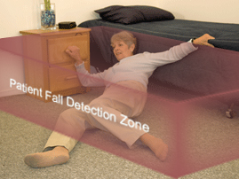
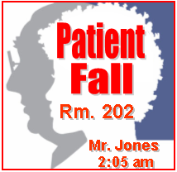
Patient Fall
Nurse assists patient and alert is automatically cleared when patient is moved from fall detection zone. “Fall cleared” event recorded.
“At Risk” patient resting at bedside then falls while attempting to get out of bed
4
1
3
2
“Time Stamped Fallen Patient” Alert is triggered at Nurse station, Nurse dispatched to room to assist patient. Fall event is recorded. Alert escalated if staff not detected in room within given timeframe
System senses fall event in the detection zone. System applies rule processing to determine set of actions, including audio and visual alerts to staff
“Patient Fall detected….
16
Notes:
3/15/2017
IBM Confidential
16

Slide 17
Presence of family
Another effective way to avert adverse events is to allow the patient’s family to be a part of the patient care process.
conduct multidisciplinary collaborative rounds at the patient bedside also involved the patient’s family
In order to include families as active participants in the care process it is important to provide spaces for families in the patient room and on the unit where they can spend extended periods of time.
In addition to these factors, organizational policies such as those that limit family visitation hours may influence family involvement and satisfaction with care.

Slide 18
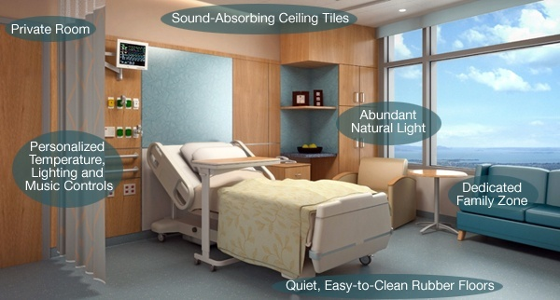
FAMILY ZONE and PATIENT BOARD

Slide 19
Addressing the Problem
The specific safety design principles, intended to specifically address both latent conditions and active failures, included the following:
1. Automate where possible.
2. Design to prevent adverse events (e.g., patient falls, operative/postoperative complications and infections, and deaths associated with restraint use).
3. Design for scalability, adaptability, and flexibility.
4. Place accessibility of information in close proximity to the patient.
5. Improve visibility of patients to staff.
6. Involve patients in their care.
7. Minimize fatigue of staff.
8. Minimize patient transfers/handoffs.
9. Reduce noise.
10.Standardize.

Slide 20
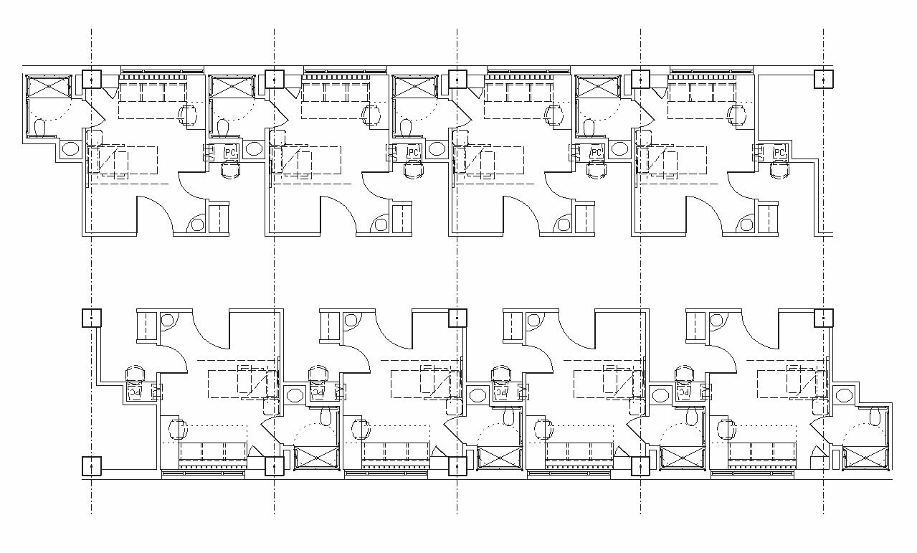
Floor Layout of Single-Patient Rooms

Slide 21
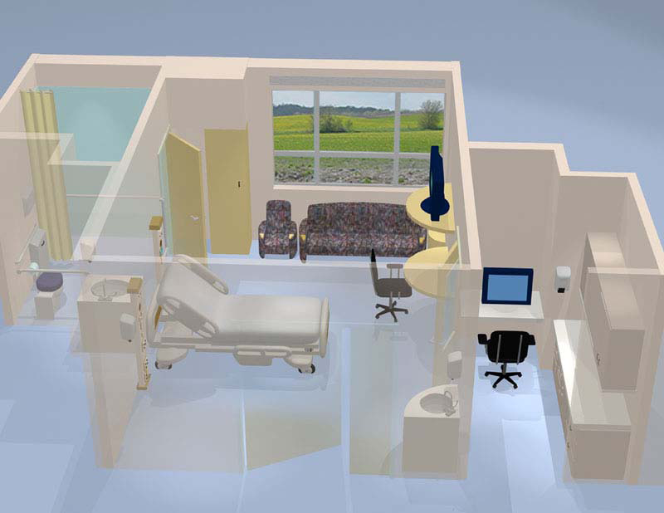
Single-Patient Room

Slide 22
Room for Recovery:
What the Hospital Room of the Future Looks Like
How a better environment can help patients recover faster-and
dramatically cut costs.

Slide 23
Room for Recovery

Slide 24
1. Hand-Sanitizer Pump
alcohol-based hand-rub dispensers,. These pumps could play a major role in controlling the pathogens that add $45 billion to annual healthcare costs.
2. Private Room
Not having a roommate slashes the risk of airborne infection:. Single occupancy means better rest, too
3. Carpeting
certain pathogens don't survive as well on carpet as on vinyl or rubber flooring. Moreover, carpeting helps reduce injuries from trips and falls

Slide 25
4. A View of Nature
The nature gazers needed fewer pain meds, suffered fewer minor complications (such as fever, nausea, and constipation), and stayed an average of .74 fewer days at the hospital.
5. Light-Filled Window
post-op patients who recovered in sunny rooms took 22 percent less pain medication per hour than patients in dim rooms. Another study found that in cardiac ICUs, the death rate runs about 61 percent higher in facilities that lack natural light. This may be because sunlight boosts serotonin, which inhibits pain pathways and alleviates depression.

Slide 26
6. Spacious Bathroom with Double Doors
Patients often struggle (and even fall) while making their way between the bed and the bathroom, or in the bathroom itself; wider doors and more square footage inside the lavatory would allow staff and family to better assist them.
7. Adaptable Headwall
A behind-the-bed unit with outlets and equipment for different levels of care (IV pumps, ventilators, monitors) means patients don't need to be moved around the hospital as much during their stay. Fewer transfers means fewer mistakes caused by delays and miscommunication among staff.
8. Sound-Absorbing Ceiling Tiles
Swedish researchers who installed high-density fiberglass tiles in an ICU discovered that they lowered noise levels slightly. As a result, patients had more restful sleep, and a lower rate of rehospitalization.
9. Soothing Music
Science has demonstrated that music provides a distraction from pain, decreasing stress, depression, and the length of hospital stays

Slide 27
16 Features of a Safe Patient Room

Slide 28
16 Features of a Safe Patient Room
1. Double-sided linen closets, to allow staff to replenish supplies without entering patients' rooms, limiting the spread of infection and allowing rest 2. Bar codes on medications and wristbands, to avoid medication mixups 3. Two-bin supply systems, to have backup supplies available in an emergency 4. Hygiene stations near the patient's bed, to allow providers to wash their hands as close as possible to the patients' beds. 5. Door with a whiteboard, to facilitate communication between patients, providers and family members 6. Hand bars all around the bathroom to help patients move about safely 7. Bed alarms that alert nurses when a patient attempts to get out of bed 8. Disinfecting device that uses ultraviolet light to help prevent common hospital- acquired infections 9. Checklists, or sets of common guidelines for preventing or reducing infection from certain hospital procedures 10. Advanced ventilation systems to draw air from contagious patients' rooms and release it from the building 11. Smart pumps to precisely control the rates of fluids, medications, and nutrients delivered to a patient 12. Fall prevention kits, including color-coded nonslip socks, lap blanket and wristband to alert providers to a patient's need for help with mobility 13. Germ-resistant surfaces 14. Motion sensors in faucets that deliver a reminder to providers to wash their hands when they enter a room 15. Translation technology near a patient's bed 16. Real-time vital signs delivered to nurses' computers outside the patient's room

Slide 29
Conclusion
Hospital design may help improve patient safety directly
by reducing nosocomial infections, patient falls, medication
errors and, sometimes, even by reducing patient morbidity and mortality.
Hospital design may also help improve patient safety indirectly by reducing staff stress, staff walking and patient transfer, and by improving handwashing compliance.
Hospital design also has a role as a barrier to adverse events in hospitals.

Slide 30
FINAL WORD
to “design a space
so that doing the right thing
feels natural.”

Slide 31
TERIMAKASIH
31

