Slide 1
Biostatistic-1

Slide 2
Variable vs Measurement Scale
Variable
a characteristic
Number
quantity
that increases or decreases over time, or takes different values in different situations

Slide 3
Variable vs Measurement Scale
Measurement scale
NOIR

Slide 4
Different, association, descriptive

Slide 10
Correlation

Slide 11
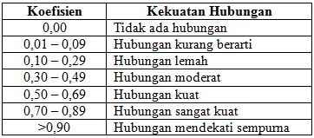

Slide 12
Example
Simulation in SPSS

