Slide 1


STRATEGIC MANAGEMENT & BUSINESS POLICY
13TH EDITION
THOMAS L. WHEELEN J. DAVID HUNGER

Slide 2
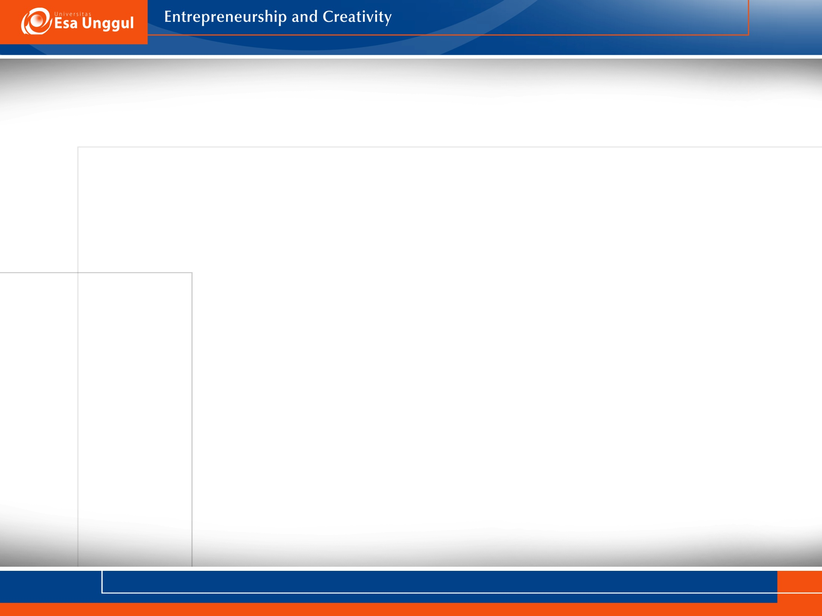

Strategic Management: a set of managerial decisions and actions that determines the long-run performance of a corporation.
Includes:
Internal and external environment scanning
Strategy formulation
Strategy implementation
Evaluation and control

Slide 3
Phases of Strategic Management:
Phase 1: asic financial planning
Phase 2: Forecast-based planning
Phase 3: Externally oriented strategic planning
Phase 4: Strategic management
1
1
1
Prentice Hall, Inc. ©2012

Slide 4
Benefits of Strategic Management:
Clearer sense of strategic vision for the firm
Sharper focus on what is strategically important
Improved understanding of a rapidly changing environment
Prentice Hall, Inc. ©2012
1-4

Slide 5
Additional Benefits of Strategic Management:
Improved organizational performance
Achieves a match between the organization’s environment and its strategy, structure and processes
Important in unstable environments
Strategic thinking
Organizational learning
Prentice Hall, Inc. ©2012
1-5

Slide 6

Impact of Globalization:
Globalization:
The integration and internationalization of markets and corporations
Prentice Hall, Inc. ©2012
1-6

Slide 7
Impact of Environmental Sustainability:
Environmental Sustainability: the use of business practices to reduce a company’s impact on the natural, physical environment
Prentice Hall, Inc. ©2012
1-7

Slide 8
Impact of Environmental Sustainability
Risks of Climate Change include:
Regulatory risk
Supply chain risk
Product and technology risk
Litigation risk
Reputational risk
Physical risk
Prentice Hall, Inc. ©2012
1-8

Slide 9

Population ecology: established organizations are unable to adapt to change
Institution theory: organizations adapt by imitating successful organizations
Prentice Hall, Inc. ©2012
1-9

Slide 10
Strategic choice perspective: organizations adapt to change and have the ability to reshape their environment
Organizational learning theory: organizations adapt defensively and use knowledge to improve their relationship with the environment
Prentice Hall, Inc. ©2012
1-10

Slide 11
Strategic flexibility: the ability to shift from one dominant strategy to another and requires:
Long-term commitment to the development and nurturing of critical resources
Learning organization
Prentice Hall, Inc. ©2012
1-11

Slide 12
Learning organization: an organization skilled at creating, acquiring, and transferring knowledge and at modifying its behavior to reflect new knowledge and insights
Prentice Hall, Inc. ©2012
1-12

Slide 13
Main activities of a learning organization include:
Solving problems systematically
Experimenting with new approaches
Learning from past experience, history and experiences of others
Transferring knowledge quickly and easily throughout the organization
Prentice Hall, Inc. ©2012
1-13

Slide 14

Basic Elements of Strategic Management
Environmental scanning
Strategy formulation
Strategy implementation
Evaluation and control
Prentice Hall, Inc. ©2012
1-14

Slide 15
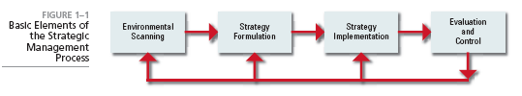
Prentice Hall, Inc. ©2012
1-15

Slide 16
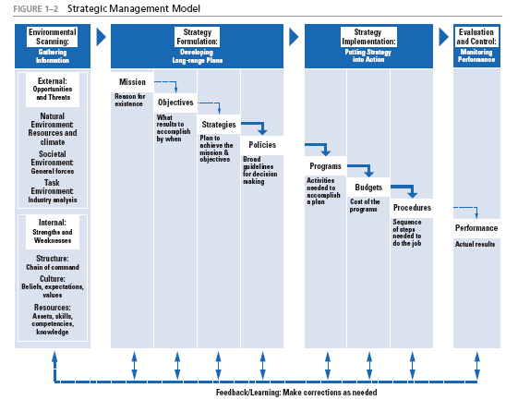
Prentice Hall, Inc. ©2012
1-16

Slide 17
Basic Elements of Strategic Management
Environmental Scanning is the monitoring, evaluating and disseminating of information from the external and internal environments to key people within the organization
Prentice Hall, Inc. ©2012
1-17

Slide 18
Prentice Hall, Inc. ©2012
1-18

Slide 19
Strategy Formulation: the development of long-range plans for the effective management of environmental opportunities and threats in light of organizational strengths and weaknesses (SWOT)
Basic Elements of Strategic Management
Prentice Hall, Inc. ©2012
1-19

Slide 20
Basic Elements of Strategic Management
Mission- the purpose or reason for the organization’s existence
Vision- describes what the organization would like to become
Objectives- the end results of planned activity
Prentice Hall, Inc. ©2012
1-20

Slide 21
Basic Elements of Strategic Management
Strategies- form a comprehensive master plan that states how the corporation will achieve its mission and objectives
  Corporate
  Business
  Functional
Policies- the broad guidelines for decision making that links the formulation of a strategy with its implementation
Prentice Hall, Inc. ©2012
1-21

Slide 22
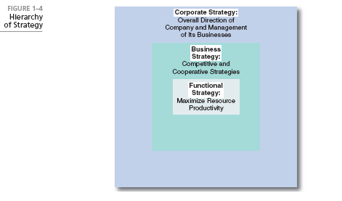
Prentice Hall, Inc. ©2012
1-22

Slide 23
Basic Elements of Strategic Management
Strategy implementation: the process by which strategies and policies are put into action through the development of:
Programs
Budgets
Procedures
Prentice Hall, Inc. ©2012
1-23

Slide 24
Basic Elements of Strategic Management
Evaluation and control: the process in which corporate activities and performance results are monitored so that actual performance can be compared to desired performance
Prentice Hall, Inc. ©2012
1-24

Slide 25
Basic Elements of Strategic Management
Performance: the end result of organizational activities
Feedback/Learning Process: revise or correct decisions based on performance
Prentice Hall, Inc. ©2012
1-25

Slide 26

Triggering event: something that acts as a stimulus for a change in strategy and can include:
New CEO
External intervention
Threat of change of ownership
Performance gap
Strategic inflection point
Prentice Hall, Inc. ©2012
1-26

Slide 27

What Makes a Strategic Decision?
Strategic decision making focuses on the long-run future of the organization
Characteristics of strategic decision making include:
Rare
Consequential
Directive
Prentice Hall, Inc. ©2012
1-27

Slide 28
Mintzberg’s Modes of Strategic Decision Making
Entrepreneurial
Adaptive
Planning
Logical incrementalism (Quinn)
Prentice Hall, Inc. ©2012
1-28

Slide 29
Strategic Decision Making Process:
Evaluate current performance results
Review corporate governance
Scan and assess the external environment
Scan and assess the internal corporate environment
Analyze strategic (SWOT) factors
Generate, evaluate and select the best alternative strategy
Implement selected strategies
Evaluate implemented strategies
Prentice Hall, Inc. ©2012
1-29

Slide 30
Prentice Hall, Inc. ©2012
1-30

Slide 31
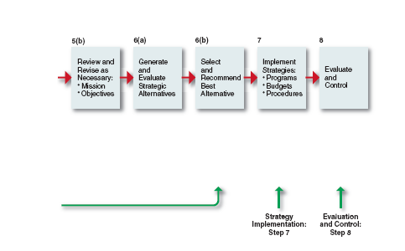
1-31
Prentice Hall, Inc. ©2012

Slide 32

Strategic audit provides a checklist of questions, by area or issue, that enables a systematic analysis to be made of various corporate functions and activities
Prentice Hall, Inc. ©2012

Slide 33
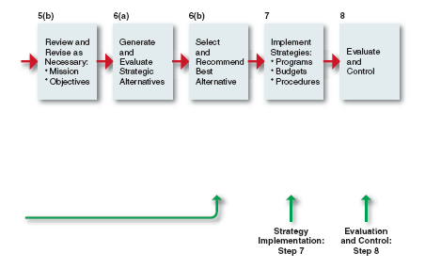
Prentice Hall, Inc. ©2012
1-33

Slide 34
Why has strategic management become so important
to today’s corporations?
How does strategic management typically evolve
in a corporation?
What is a learning organization? Is this approach to
strategic management better than the more traditional
top-down approach in which strategic planning is primarily
done by top management?
Why are strategic decisions different from other kinds
of decisions?
When is the planning mode of strategic decision making
superior to the entrepreneurial and adaptive modes?
Prentice Hall, Inc. ©2012
1-34

Slide 35
PowerPoint created by:
Ronald Heimler
Dowling College- MBA
Georgetown University- BS Business Administration
Adjunct Professor- LIM College, NY
Adjunct Professor- Long Island University, NY
Lecturer- California State Polytechnic University, Pomona, CA
President- Walter Heimler, Inc.
Prentice Hall, Inc. ©2012
1-35

Slide 36

PowerPoint created by:
All rights reserved. No part of this publication may be reproduced, stored in a retrieval system, or transmitted, in any form or by any means, electronic, mechanical, photocopying, recording, or otherwise, without the prior written permission of the publisher. Printed in the United States of America.
Copyright ©2012 Pearson Education, Inc. publishing as Prentice Hall
Prentice Hall, Inc. ©2012
1-36

