Slide 1
STRATEGIC MANAGEMENT & BUSINESS POLICY 13TH EDITION
THOMAS L. WHEELEN J. DAVID HUNGER

Slide 2
Responsibilities of a Business Firm
Social Responsibility: proposes that a private corporation has responsibilities to society that extend beyond making a profit

Slide 3
Responsibilities of a Business Firm
Friedman’s traditional view of a business firm:
Argues against the concept of social responsibility
Primary goal of business is profit maximization not spending shareholder money for the general social interest

Slide 4
Responsibilities of a Business Firm
Carroll’s four responsibilities of business: (in order of priority)
Economic
Legal
Ethical
Discretionary

Slide 5
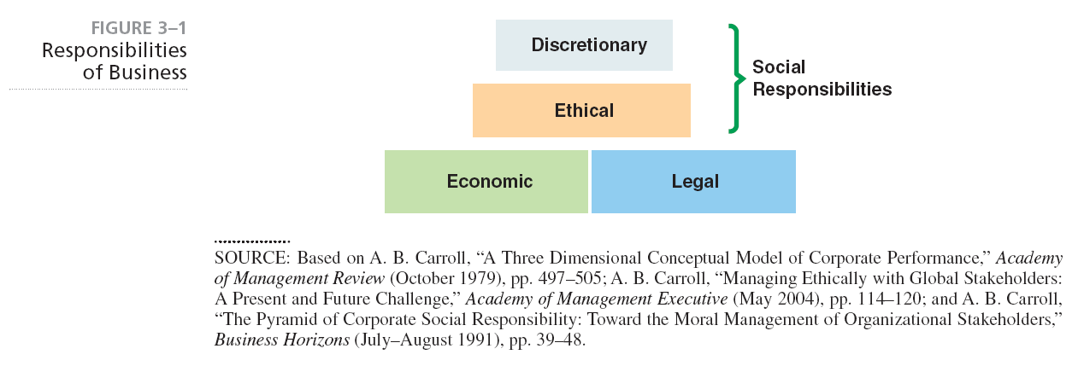
Carroll’s four responsibilities of business:

Slide 6
Responsibilities of a Business Firm
Social capital refers to the goodwill of key stakeholders
and provides a company with:
The ability to enter local and international markets
Enhanced reputation
Competitive advantage
Cost savings
The ability to charge premium prices
Improved relationships with suppliers and distributors
The ability to attract better talent
Goodwill in the eyes of public officials
Access to capital

Slide 7
Responsibilities of a Business Firm
Characteristics of Sustainability
Environmental
Economic
Social

Slide 8
Corporate Stakeholders
Stakeholders have an interest in the business and affect or are affected by the achievement of the firm’s objectives
Enterprise strategy- articulates the firm’s ethical relationship with its stakeholders

Slide 9
Stakeholder Analysis- the identification of corporate stakeholders in 3 steps:
Primary stakeholders have a direct connection with the corporation and have sufficient bargaining power to directly affect corporate activities
Secondary stakeholders have an indirect stake in the corporation but are also affected by corporate activities
Estimate the effect on each stakeholder from a particular strategic decision

Slide 10
Reasons for Unethical Behavior
Unaware that behavior is questionable
Lack of standards of conduct
Different cultural norms and values
Behavior-based or relationship-based governance systems
Different values between business people and stakeholders

Slide 11
Moral Relativism claims that morality is relative to some personal, social, or cultural standard and that there is not a method for deciding whether one decision is better than another

Slide 12
Types of Moral Relativism include:
Naïve relativism
Role relativism
Social group relativism
Cultural relativism

Slide 13
Kohlberg’s Levels of Moral Development
Preconventional level: concern for one’s self
Conventional level: considerations for society’s laws and norms
Principled level: guided by an internal code of ethics

Slide 14
Encouraging Ethical Behavior
Code of Ethics- specifies how an organization expects its employees to behave while on the job
Whistleblowers- employees who report illegal or unethical behavior on the part of others

Slide 15
Key Terms in Ethical Behavior
Ethics- the consensually accepted standards of behavior for an occupation, trade, or profession
Morality- the precepts of personal behavior based on religious or philosophical grounds
Law is the formal codes that permit or forbid certain behaviors and may or may not enforce ethics or morality

Slide 16
Approaches to Ethical Behavior
Utilitarian- actions are judged by consequences
Individual rights- fundamental rights should be respected
Justice- decisions must be equitable, fair and impartial in the distribution of costs and benefits to individuals or groups

Slide 17
Approaches to Ethical Behavior
Cavanagh’s questions to solve ethical problems:
Utility- does it optimize the satisfactions of the stakeholders?
Rights- Does it respect the rights of the individuals involved
Justice- Is it consistent with the canons of justice?

Slide 18
Approaches to Ethical Behavior
Kant’s categorical imperatives:
Actions are ethical only if the person is willing for the same action to be taken by everyone who is in a similar situation
Never treat another person simply as a means but always as an end

Slide 19
What is the relationship between corporate governance and social responsibility?
What is your opinion of GAP International’s having a code of conduct for its suppliers? What would Milton Friedman say? Contrast his view with Archie Carroll’s view.

Slide 20
Does a company have to act selflessly to be considered
socially responsible? For example, when building a new
plant, a corporation voluntarily invested in additional
equipment that enabled it to reduce its pollution emissions
beyond any current laws. Knowing that it would be very
expensive for its competitors to do the same, the firm
lobbied the government to make pollution regulations
more restrictive on the entire industry.
Is this company socially responsible? Were its managers
acting ethically?

Slide 21
Are the people living in a relationship-based governance
system likely to be unethical in business dealings?
5. Given that people rarely use a company’s code of ethics
to guide their decision making, what good are the codes?

Slide 22
PowerPoint created by:
Ronald Heimler
Dowling College- MBA
Georgetown University- BS Business Administration
Adjunct Professor- LIM College, NY
Adjunct Professor- Long Island University, NY
Lecturer- California State Polytechnic University, Pomona, CA
President- Walter Heimler, Inc.

Slide 23
All rights reserved. No part of this publication may be reproduced, stored in a retrieval system, or transmitted, in any form or by any means, electronic, mechanical, photocopying, recording, or otherwise, without the prior written permission of the publisher. Printed in the United States of America.
Copyright ©2012 Pearson Education, Inc. publishing as Prentice Hall
Prentice Hall, Inc. ©2012
3-23

