Slide 1
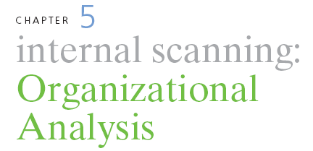
STRATEGIC MANAGEMENT & BUSINESS POLICY 13TH EDITION
THOMAS L. WHEELEN J. DAVID HUNGER

Slide 2
Organizational analysis- concerned with identifying and developing an organization’s resources and competencies

Slide 3
Core and Distinctive Competencies
Resources- an organization’s assets
Tangible
Intangible
Capabilities- a corporation’s ability to exploit its resources

Slide 4
Core and Distinctive Competencies
Competency- a cross-functional integration and coordination of capabilities
Core competency- a collection of competencies that cross divisional boundaries, is wide-spread throughout the corporation and is something the corporation does exceedingly well
Distinctive competency- core competencies that are superior to those of the competition

Slide 7
Core and Distinctive Competencies
VRIO framework (Barney)
Value
Rare
Imitability
Organization

Slide 8
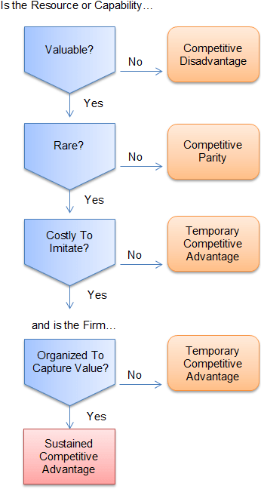

Slide 9
Using Resources to Gain Competitive Advantage
Identify and classify resources in terms of strengths and weaknesses
Combine the firm’s strengths into specific capabilities and core competencies
Appraise profit potential- Are there any distinctive competencies?
Select the strategy that best exploits the firm’s capabilities and competencies relative to external opportunities
Identify resource gaps and invest in upgrading weaknesses

Slide 10
Access to a Distinctive Competency
Asset endowment
Acquired from someone else
Shared with another business
Built and accumulated within the company

Slide 11
Access to a Distinctive Competency
Clusters- geographic concentrations of interconnected companies and industries
Access to:
Employees
Suppliers
Information
Complementary products

Slide 12
Imitability an Advantage
Durability- the rate at which a firm’s underlying resources, capabilities, or core competencies depreciate or become obsolete
Imitability- the rate at which a firm’s underlying resources, capabilities, or core competencies can be duplicated by others

Slide 13
Determining the Sustainability of an Advantage
Transparency- the speed at which other firms under the relationship of resources and capabilities support a successful strategy
Transferability- the ability of competitors to gather the resources and capabilities necessary to support a competitive challenge
Replicability- the ability of competitors to use duplicated resources and capabilities to imitate the other firm’s success

Slide 14
Determining the Sustainability of an Advantage
Explicit knowledge- knowledge that can be easily articulated and communicated
Tacit knowledge- knowledge that is not easily communicated because it is deeply rooted in employee experience or in the company’s culture

Slide 15
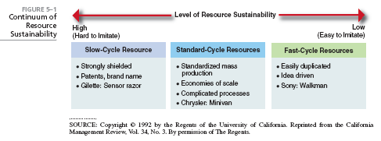

Slide 16
Business models- a company’s method for making money in the current business environment
Includes
Who the company serves
What the company provides
How the company makes money
How the company differentiates and sustains competitive advantage
How the company provides its product/service

Slide 17
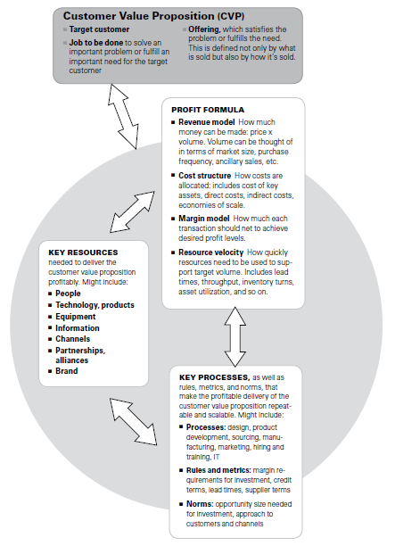

Slide 18
Business Model Canvas
It is a convenient visual framework for talking about a business model.
It is a poster format chart that enables 9 elements of a business model to be captured and discussed by a group of people working together.

Slide 19
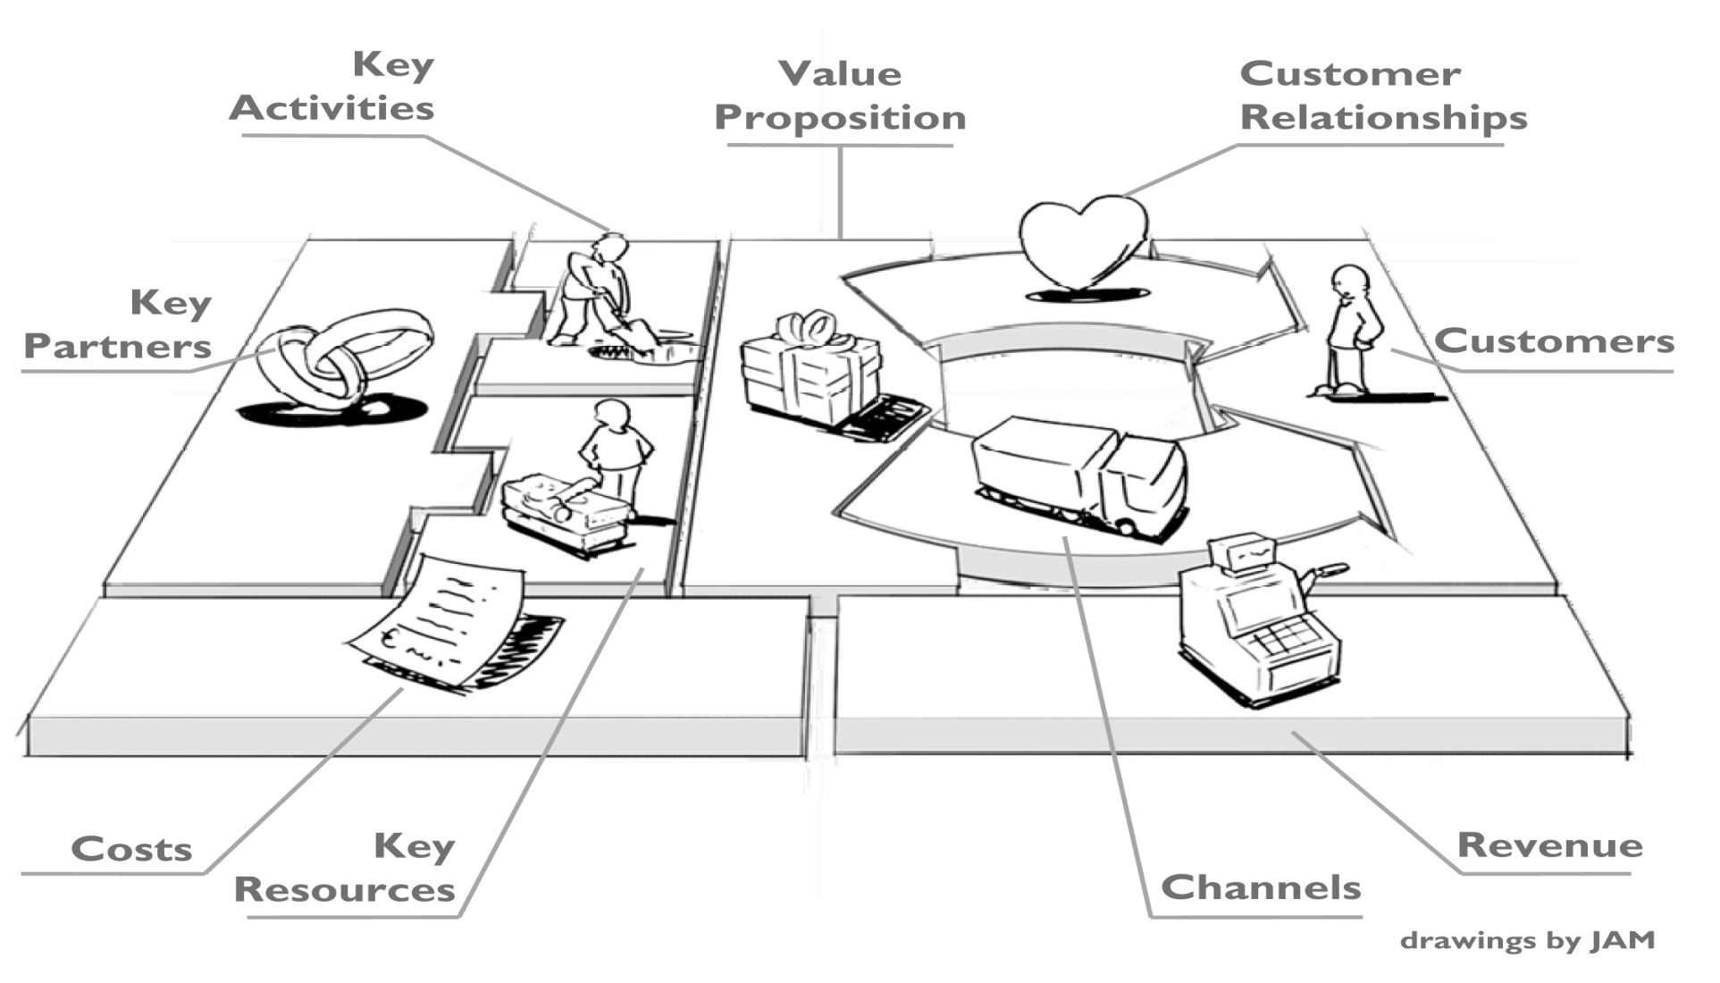
Business Model Canvas

Slide 20
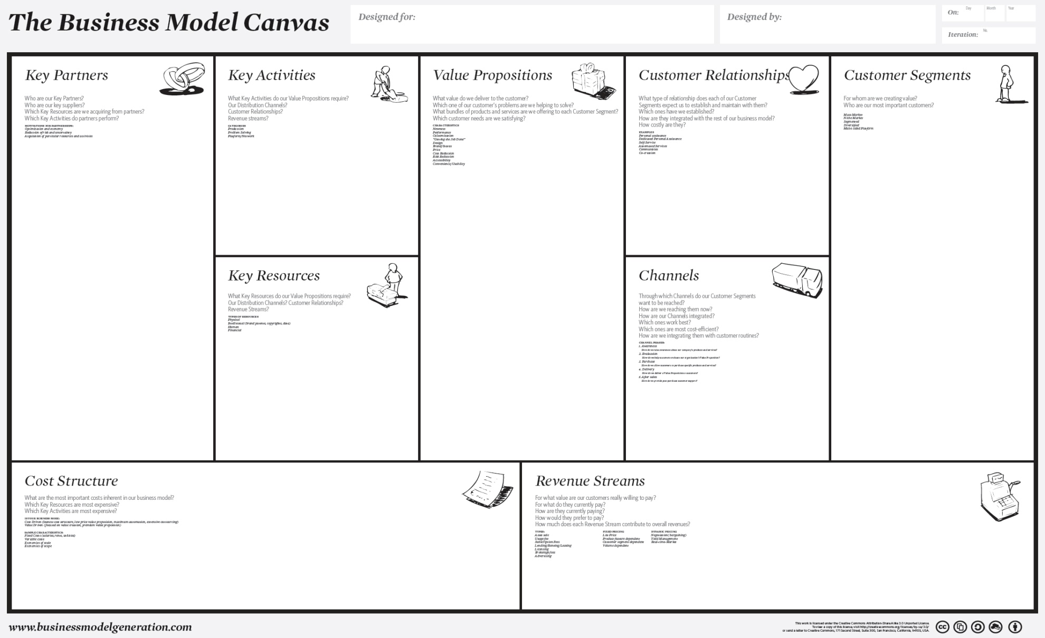

Slide 22
Business models
Customer solutions model
Profit pyramid model
Multi-component system/installed model
Advertising model
Switchboard model

Slide 23
Business models (cont’d)
Efficiency model
Blockbuster model
Profit multiplier model
Entrepreneurial model
De Facto industry standard model

Slide 26
Value chain- a linked set of value creating activities that begin with basic raw materials coming from suppliers, moving on to a series of value-added activities involved in producing and marking a product or service, and ending with distributors getting the final goods into the hands of the ultimate consumer

Slide 27
Industry Value Chain Analysis
Value chain segments include:
Upstream
Downstream
Center of gravity- the part of the chain that is most important to the company and the point where its core competencies lie
Vertical integration

Slide 28
 | Weyerhauser’s | P & G
Center of gravity | Raw material and primary manufacturing (lumbering and pulp mills) | Fabrication and distribution
Integration | Forward by making paper and boxes | Backward by owning timberland and operating pulp mills
Reason of vertical integration |  | To guarantee access to wood pulp it needed to produce diapers, toilet tissue, napkins, etc.

Slide 29
Corporate Value Chain Analysis
Primary activities
Inbound logistics
Operations
Outbound logistics
Support activities
Procurement
Technology development
Human resource management
Firm infrastructure

Slide 31
Corporate Value Chain Analysis
Examine each product line’s value chain in terms of the various activities involved in producing the product or service
Examine the linkages within each product line’s value chain
Examine the potential synergies among the value chains of different product lines or business units

Slide 32
Basic Organizational Structures
Simple
Functional
Divisional
Strategic Business Units
Conglomerate

Slide 34
Corporate Culture: The Company Way
Corporate culture- the collection of beliefs, expectations and values learned and shared by a corporation’s members and transmitted from one generation of employees to another.

Slide 35
Corporate Culture: The Company Way
Cultural intensity- the degree of which members of a unit accept the norms, values and other cultural content associated with the unit
Shows the depth of the culture
Cultural integration- the extent of which units throughout the organization share a common culture
Shows the breadth of the culture

Slide 36
Functions of Corporate Culture
Conveys a sense of identity for employees
Generates employee commitment
Adds to the stability of the organization as a social system
Serves as a frame of reference for employees to understand organizational activities and as a guide for behavior

Slide 37
Strategic Marketing Issues
Market position- Who are our customers?
Marketing Mix- the particular combination of key variables under a corporation’s control that can be used to affect demand and to gain competitive advantage

Slide 38
Market Segmentation
SEGMENTATION BASE
SELECTED SEGMENTATION VARIABLES
Geographic Segmentation
Region
Southwest, Mountain States, Alaska, Hawaii
City Size
Major metropolitan areas, small cities, towns
Density of area
Urban, suburban, exurban, rural
Climate
Temperate, hot, humid, rainy
Demographic Segmentation
Age
Under 11, 12-17, 18-34, 35-49, 50-64, 65-74, 75-99, 100+
Sex
Male, female
Marital status
Single, married, divorced, living together, widowed
Income
Under $25,000, $25,000-$34,999, $35,000-$49,999, $50,000-$74,999, $75,000-$99,999, $100,000 and over
Education
Some high school, high school graduate, some college, college graduate, postgraduate
Occupation
Professional, blue-collar, white-collar, agricultural, military

Slide 39
continued
SEGMENTATION BASE
SELECTED SEGMENTATION VARIABLES
Psychological Segmentation
Needs-motivation
Shelter, safety, security, affection, sense of self-worth
Personality
Extroverts, novelty seeker, aggressives, low dogmatics
Perception
Low-risk, moderate-risk, high-risk
Learning-involvement
Low-involvement, high-involvement
Attitudes
Positive attitude, negative attitude
Psychographic
(Lifestyle) Segmentation
Economy-minded, couch potatoes, outdoors enthusiasts, status seekers
Sociocultural Segmentation
Cultures
American, Italian, Chinese, Mexican, French, Pakistani
Religion
Catholic, Protestant, Jewish, Moslem, other
Subcultures (Race/ethnic)
African-American, Caucasian, Asian, Hispanic
Social class
Lower, middle, upper
Family life cycle
Bachelors, young married, full nesters, empty nesters

Slide 40
SEGMENTATION BASE
SELECTED SEGMENTATION VARIABLES
Use-Related Segmentation
Usage rate
Heavy users, medium users, light users, non users
Awareness status
Unaware, aware, interested, enthusiastic
Brand loyalty
None, some, strong
Use-Situation Segmentation
Time
Leisure, work, rush, morning, night
Objective
Personal, gift, snack, fun, achievement
Location
Home, work, friend’s home, in-store
Person
Self, family members, friends, boss, peers
Benefit Segmentation
Convenience, social acceptance, long lasting, economy, value-for-the-money
Hybrid Segmentation
Demographic/
Psychographics
Combination of demographic and psychographic profiles of consumer segments profiles
Geodemographics
“Money and Brains,” “Black Enterprise,” “Old Yankee Rows,” “Downtown Dixie-Style”
SRI VALSTM
Actualizer, fulfilled, believer, achiever, striver, experiencer, maker, struggler

Slide 42
Product life cycle- product monetary sales over time from introduction through growth and maturity to decline

Slide 43
Brand- a name given to a company’s product which identifies that item in the mind of the consumer
Corporate brand- a type of brand in which the company’s name serves as the brand

Slide 44
Corporate reputation- a widely held perception of a company by the general public
Stakeholders’ perceptions of quality
Corporation’s prominence in the minds of stakeholders

Slide 45
Strategic Financial Issues
Financial leverage- ratio of total debt to total assets
Used to describe how debt is used to increase earnings available to common shareholders
Capital budgeting- the analyzing and ranking of possible investments in fixed assets in terms of additional outlays and receipts that will result from each investment
Hurdle point

Slide 46
Strategic Research and Development Issues
R & D intensity- pending no R & D as a percentage of sales revenue
Technology competence- the development and use of innovative technology
Technology transfer- the process of taking new technology from the laboratory to the marketplace

Slide 47
Strategic Research and Development Issues
R & D Mix- the mix of:
Basic R & D- focuses on theoretical problems
Product R & D- concentrates on marketing and is concerned with product or product packaging improvements
Engineering R & D is concerned with engineering, concentrating on quality control, and the development of design specifications and improved production equipment

Slide 48
Strategic Research and Development Issues
Technology discontinuity- when a new technology cannot be used to enhance current technology, but substitutes for the technology to yield better performance
Moore’s Law

Slide 50
Strategic Operations Issues
Intermittent Systems- item is normally processed sequentially, but the work and sequence of the process vary
Continuous systems- work is laid out in lines on which products can be continuously assembled or processed
Operating leverage- impact of a specific change in sales volume on net operation income

Slide 51
Strategic Operations Issues
Experience curve- unit production costs decline by some fixed percentage each time the total accumulated volume of production units doubles

Slide 52
Strategic Operations Issues
Flexible Manufacturing for Mass Customization
Computer Assisted Design
Computer Assisted Manufacturing
Economies of Scale

Slide 53
Strategic Human Resource Issues
Teams
Autonomous (self-managed)- a group of people working together without a supervisor to plan, coordinate and evaluate their work
Cross-functional work teams- various disciplines are involved in a project from the beginning
Concurrent engineering- specialists work side-by-side and compare notes constantly to design cost-effective products with features customers want

Slide 54
Strategic Human Resource Issues
Virtual Teams- groups of geographically or organizationally dispersed coworkers that are assembled using a combination of telecommunications and information technologies to accomplish organizational tasks- driven by 5 trends

Slide 55
Strategic Human Resource Issues
Flatter organizational structures
Turbulent environments
Increased employee autonomy
Higher knowledge requirements
Increased globalization
Increased employee decision making

Slide 56
Strategic Human Resource Issues
Quality of work life- includes improvements in:
Introducing participative problem solving
Restructuring work
Introducing innovative reward systems
Improving the work environment

Slide 57
Strategic Human Resource Issues
Human diversity- the mix in the workplace of people from different races, cultures and backgrounds
Provides a sustainable competitive advantage

Slide 58
Strategic Information Systems/Technology Issues
Information systems/technology contributions to performance:
Automation of back office processes
Automation of individual tasks
Enhancement of key business functions
Development of a competitive advantage

Slide 59
Strategic Information Systems/Technology Issues
Current trends in Information systems/technology Internet include:
Intranet
Extranet
Web 2.0

Slide 60
Strategic Information Systems/Technology Issues
Supply chain management- networks for sourcing raw materials, manufacturing products or creating services, storing, and distributing goods, and delivering them to customers and consumers

Slide 61
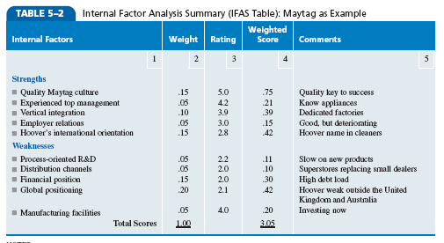

Slide 62
What is the relevance of the resource-based view of the
firm to strategic management in a global environment?
How can value chain analysis help indentify a company’s
strengths and weaknesses?
In what ways can a corporation’s structure and culture
be internal strengths and weaknesses?
What are the pros and cons of management using the
experience curve to determine strategy?
How might a firm’s management decide whether it should
continue to invest in current known technology or
in new, but untested technology? What factors might
encourage or discourage such a shift?

Slide 63
PowerPoint created by:
Ronald Heimler
Dowling College- MBA
Georgetown University- BS Business Administration
Adjunct Professor- LIM College, NY
Adjunct Professor- Long Island University, NY
Lecturer- California State Polytechnic University, Pomona, CA
President- Walter Heimler, Inc.

Slide 64
All rights reserved. No part of this publication may be reproduced, stored in a retrieval system, or transmitted, in any form or by any means, electronic, mechanical, photocopying, recording, or otherwise, without the prior written permission of the publisher. Printed in the United States of America.
Copyright ©2012 Pearson Education, Inc. publishing as Prentice Hall

