Slide 1


STRATEGIC MANAGEMENT & BUSINESS POLICY
13TH EDITION
THOMAS L. WHEELEN J. DAVID HUNGER

Slide 2
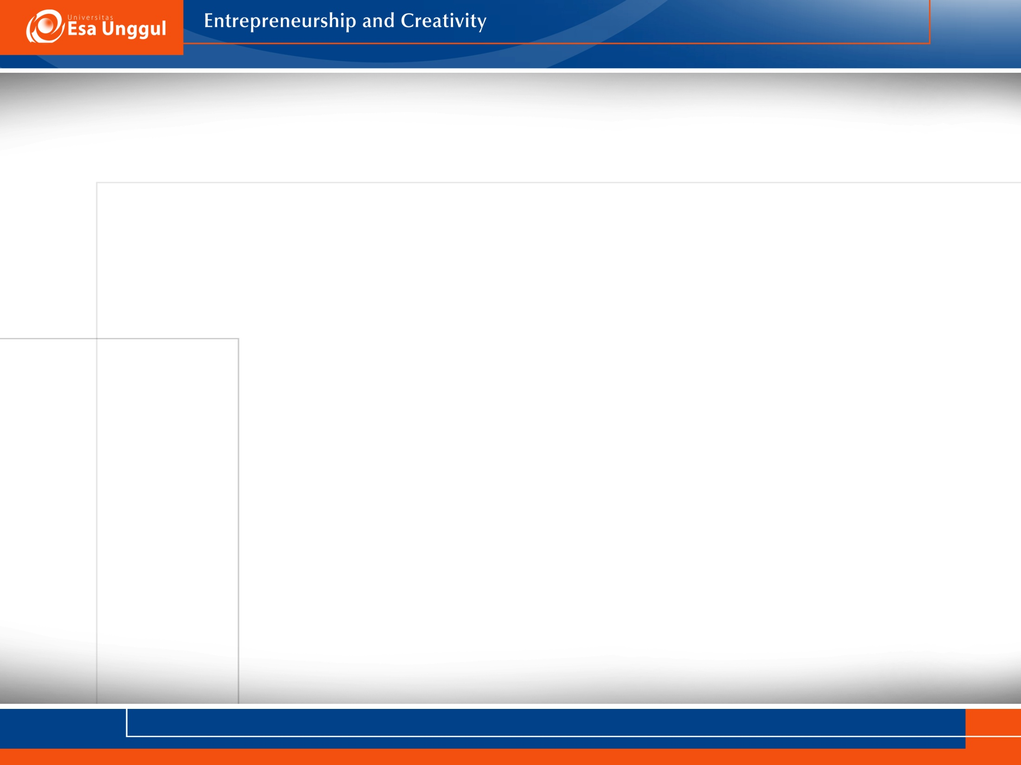

Strategy formulation- concerns developing
a corporation’s mission, objectives, strategies and policies
Situation Analysis- the process of finding a strategic fit
between external opportunities and internal strengths while working around external and internal weaknesses

Slide 3
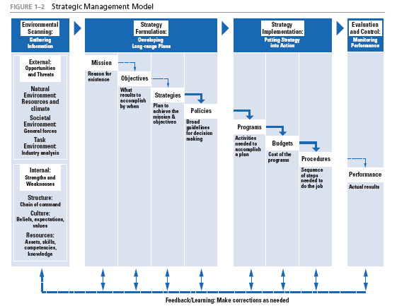

Slide 5
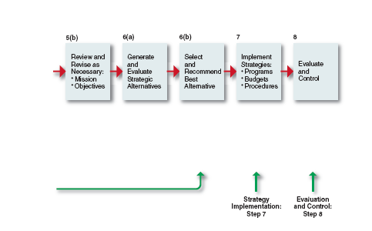

Slide 6
SWOT- Strengths-Weaknesses-Opportunities-Threats
Strategy= opportunity/capacity
Opportunity has no real value unless a company has the capacity to take advantage of that opportunity

Slide 7
Criticisms of SWOT analysis
Generates lengthy lists
Uses no weights to reflect priorities
Uses ambiguous words and phrases
Same factor can be in 2 categories
No obligation to verify opinion with data or analysis
Requires only a single level of analysis
No logical link to strategy implementation

Slide 8
Generating a Strategic Factors Analysis
Summary (SFAS) Matrix
SFAS summarizes an organization’s strategic factors
by combining the external factors from the EFAS Table with the internal factors from the IFAS Table

Slide 9
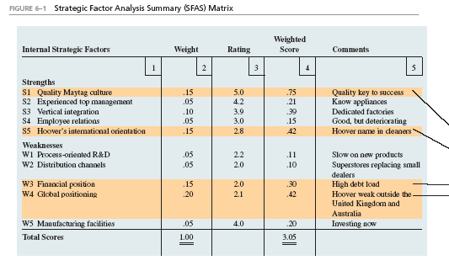
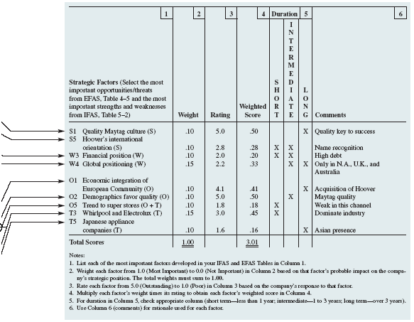
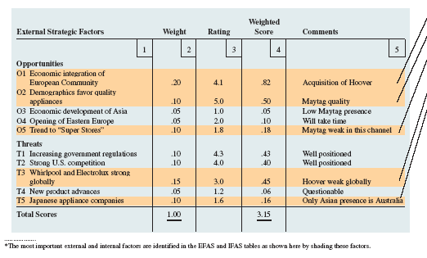

Slide 10
Finding a Propitious Niche
Propitious niche- where an organization can use its core competencies to take advantage of a particular market opportunity and the niche is just large enough for one firm to satisfy its demand
Strategic sweet spot- a company is able to satisfy customers’ needs in a way that rivals cannot
Strategic window- a unique market opportunity that is available for a particular time

Slide 11
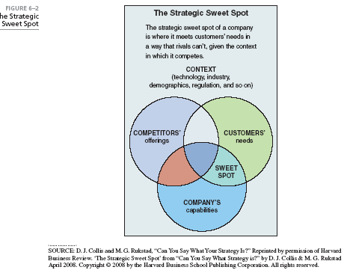

Slide 12

Review of Mission and Objectives
A re-examination of an organization’s current mission and objectives must be made before alternative strategies can be generated and evaluated
Performance problems can derive from inappropriate (narrow or too broad) mission statements and objectives

Slide 13

TOWS Matrix- illustrates how the external opportunities and threats can be matched with internal strengths and weaknesses to result in 4 possible strategic alternatives
Provides a means to brainstorm alternative strategies
Forces managers to create various kinds of growth and retrenchment strategies
Used to generate corporate as well as business strategies

Slide 14
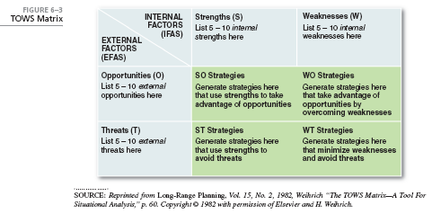

Slide 15

Business strategy focuses on improving the competitive position of a company’s or business unit’s products or services within the specific industry or market segment it serves

Slide 16
Business strategy is comprised of:
        Competitive strategy
        Cooperative strategy

Slide 17
Porter’s competitive strategies
Lower cost strategy- the ability of a company or a business unit to design, produce and market a comparable product more efficiently than its competitors
Differentiation strategy- the ability of a company or a business unit to provide a unique or superior value to the buyer in terms of product quality, special features, or after sale service

Slide 18
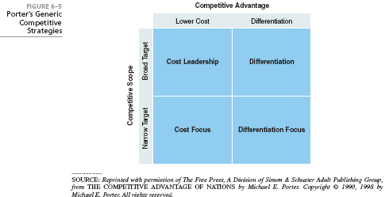

Slide 19
Porter’s competitive strategies
Cost leadership- a lower-cost competitive strategy that aims at the broad mass market and requires efficient scale facilities, cost reductions, cost and overhead control; avoids marginal customers, cost minimization in R&D, service, sales force and advertising
Provides a defense against competitors
Provides a barrier to entry
Generates increased market share

Slide 20
Porter’s competitive strategies
Differentiation- involves the creation of a product or service that is perceived throughout the industry as unique. Can be associated with design, brand image, technology, features, dealer network, or customer service
Lowers customers sensitivity to price
Increases buyer loyalty
Barrier to entry
Can generate higher profits

Slide 21
Porter’s competitive strategies
Cost Focus- low-cost competitive strategy that focuses on a particular buyer group or geographic market and attempts to serve only this niche to the exclusion of others
Differentiation Focus- concentrates on a particular buyer group, product line segment, or geographic market to serve the needs of a narrow strategic market more effectively than its competitors

Slide 22
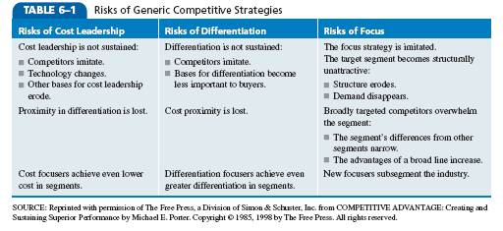

Slide 23
Issues in Competitive Strategies
Stuck in the middle- when a company has no competitive advantage and is doomed to below-average performance

Slide 24
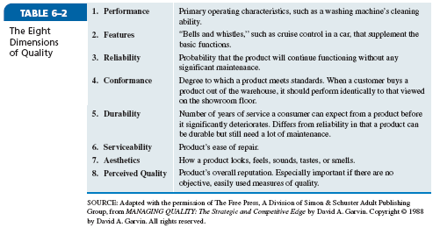

Slide 25
Issues in Competitive Strategies
Entrepreneurial firms follow focus strategies where they focus their product or service on customer needs in a market segment and differentiate based on quality and service

Slide 26
Industry Structure and Competitive Strategy
Fragmented industry- many small- and medium-sized companies compete for relatively small shares of the total market
Products are typically in early stages of product life cycle
Focus strategies are used

Slide 27
Industry Structure and Competitive Strategy
Consolidated industry- domination by a few large companies
Emphasis on cost and service
Economies of scale
Regional and national brands
Slower growth over capacity
Knowledgeable buyers

Slide 28
Hyper-competition and Competitive Advantage Sustainability
Competitive advantage in a hyper-competitive market is characterized by a continuous series of multiple short- term initiatives that replace current products with new products before competitors can do so.
Leads to an over emphasis on short-term tactics

Slide 29
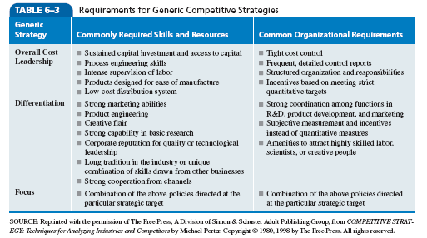

Slide 30
Competitive Tactics
Tactic- a specific operating plan that details how a strategy is going to be implemented in terms of when and where it is to be put into action
Narrower in scope and shorter in time horizon than strategies

Slide 31
Timing Tactics: When to Compete
Timing Tactics- when a company implements a strategy
          First movers
          Late movers

Slide 32
Market Location: Where to Compete
Market location tactics- where a company implements a strategy
Offensive tactics
Frontal assault
Flanking maneuver
Bypass attack
Encirclement
Guerrilla warfare
Defensive tactics
Raise structural barriers
Increase expected retaliation
Lower the inducement for attack

Slide 33
Cooperative Strategies- used to gain a competitive advantage within an industry by working with other firms

Slide 34
Collusion- the active cooperation of firms within an industry to reduce output and raise prices to avoid economic law of supply and demand

Slide 35
Strategic Alliances- a long-term cooperative arrangement between two or more independent firms or business units that engage in business activities for mutual economic gain
Used to:
Obtain or learn new capabilities
Obtain access to specific markets
Reduce financial risk
Reduce political risk

Slide 36
Types of Cooperative Agreements
Mutual Service Consortia
Joint Venture
Licensing Arrangements
Value-Chain Partnerships

Slide 37
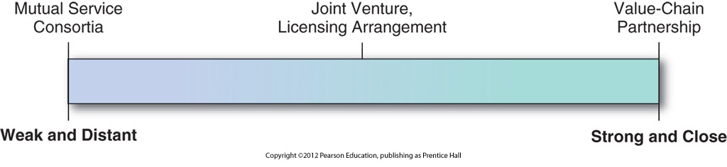

Slide 38
What industry forces might cause a propitious niche
to disappear?
Is it possible for a company or business unit to follow
a cost leadership and a differentiation strategy
simultaneously? Why or why not?
Is it possible for a company to have a sustainable competitive
advantage when its industry becomes hyper-competitive?
What are the advantages and disadvantages of being a
first mover in an industry? Give some examples
of first movers and late mover firms.
Why are strategic alliances temporary?

Slide 39
PowerPoint created by:
Ronald Heimler
Dowling College- MBA
Georgetown University- BS Business Administration
Adjunct Professor- LIM College, NY
Adjunct Professor- Long Island University, NY
Lecturer- California State Polytechnic University, Pomona, CA
President- Walter Heimler, Inc.

Slide 40

All rights reserved. No part of this publication may be reproduced, stored in a retrieval system, or transmitted, in any form or by any means, electronic, mechanical, photocopying, recording, or otherwise, without the prior written permission of the publisher. Printed in the United States of America.
Copyright ©2012 Pearson Education, Inc. publishing as Prentice Hall

