Slide 1

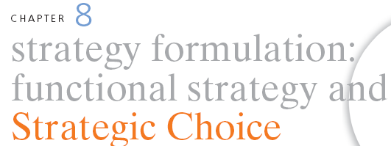
STRATEGIC MANAGEMENT & BUSINESS POLICY
13TH EDITION
THOMAS L. WHEELEN J. DAVID HUNGER

Slide 2
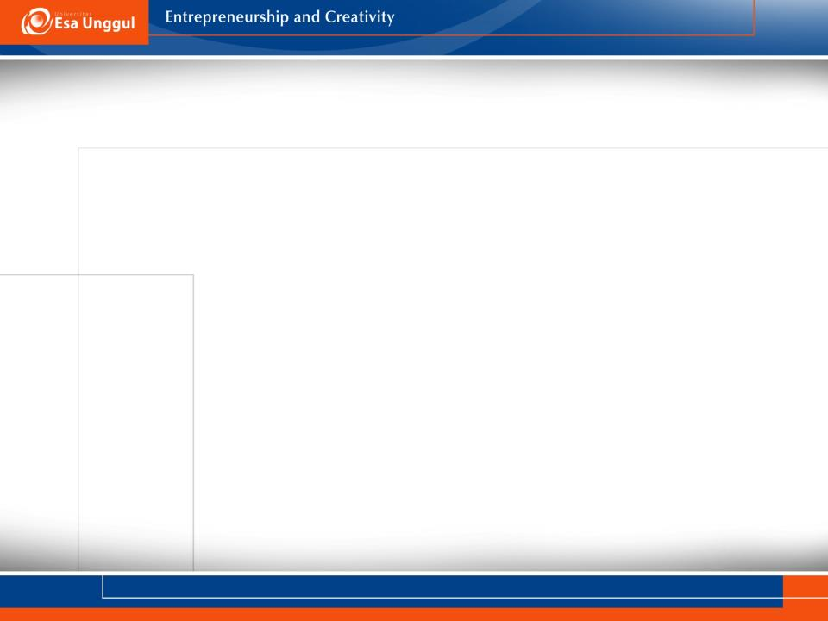
Functional strategy- the approach a functional area takes to achieve corporate and business unit objectives and strategies by maximizing resource productivity

Slide 3
Marketing strategy
Deals with:
pricing,
selling and
distributing a product

Slide 4
Segmentation, Targeting dan Positioning
Segmentation: proses membagi pasar menjadi kelompok konsumen dengan kebutuhan dan karakteristik yang sama
Targeting: memilih satu atau lebih segmen yang akan dikejar
Positioning: membangun sebuah image produk yang berbeda di benak konsumen

Slide 5
Positioning Yang Berhasil
Mengkomunikasikan benefit produk, bukan fiturnya
Mengkomunikasikan unique selling proposition

Slide 6



Slide 7

Apa USP Minuman Isotonik Ini Dibanding Yang Lainnya?

Slide 8
Product Development Strategy
Provides the ability to:
Develop new products for existing markets
Develop new products for new markets

Slide 9
Develop New Products for Existing Markets
product line extention
product form extention

Slide 10

Perluasan Lini Produk

Slide 11


Slide 12

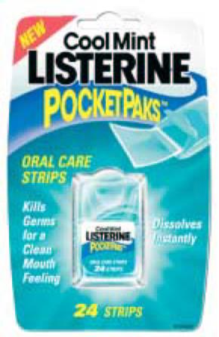
Perluasan Bentuk Produk

Slide 13


Slide 14
Develop New Products for New Markets
Product category extention
Penggunaan merek bersama (family branding)
Pemberian lisensi (licensing)

Slide 15

Perluasan Kategori Produk

Slide 16

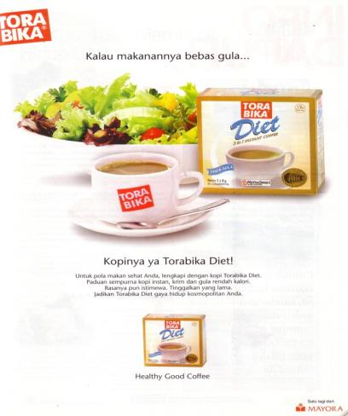
Kategori Produk Baru Untuk Segmen Pasar Yang Berbeda

Slide 17
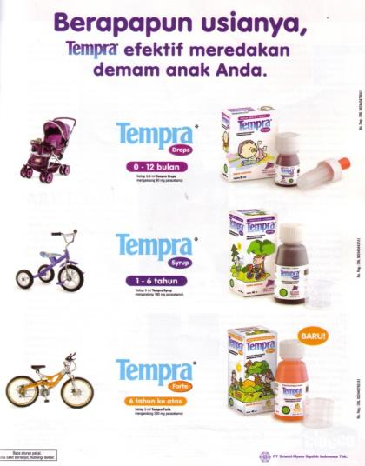

Slide 18


Slide 19
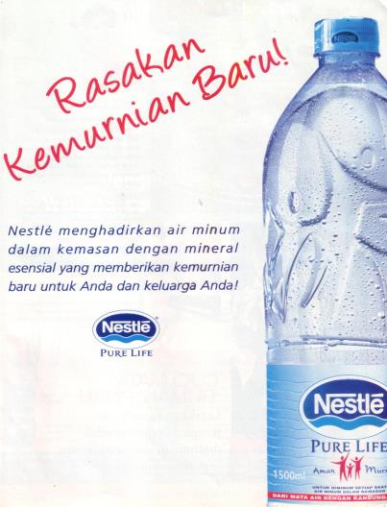
Family Branding

Slide 20

Perusahaan Sepatu Melisensikan Namanya

Slide 21

Licensing Tokoh Kartun

Slide 22


Slide 23
Develop New Products for New Markets
Product category extention
Penggunaan merek bersama (family branding)
Pemberian lisensi (licensing)

Slide 24
Market development strategy- provides the ability to:
Capture a larger market share
  Market saturation
  Market penetration
Develop new uses and/or markets for current products

Slide 25
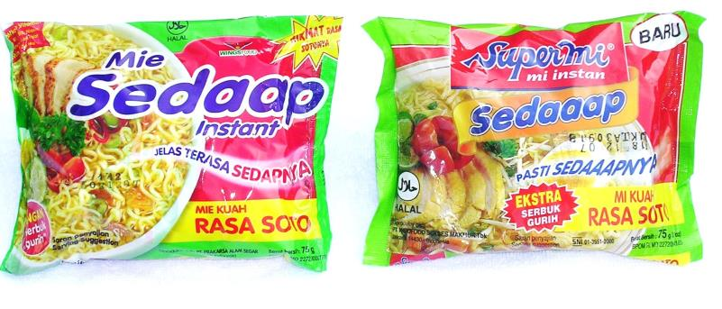
Penetrasi Pasar: Kemasan Mirip

Slide 26
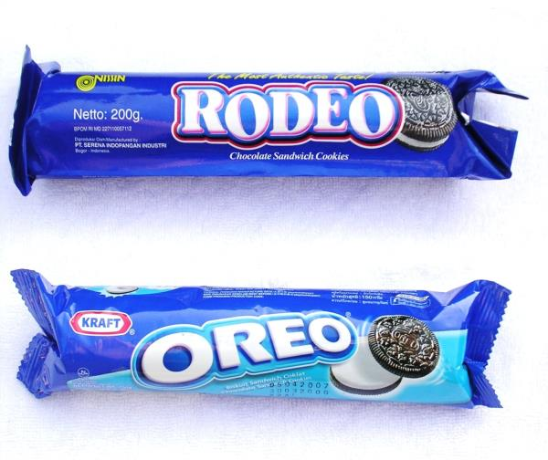

Slide 27

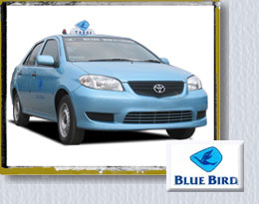
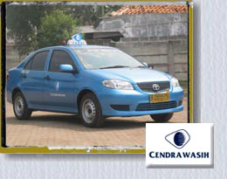
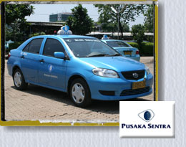
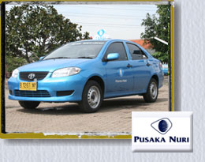

Slide 28
Push Strategy vs. Pull Strategy
Push Strategy: promotions to gain or hold shelf space in retail outlets
Pull Strategy: advertising to “pull” products through the distribution channels

Slide 29
Skim Pricing vs. Penetration Pricing
Skim pricing: offers the opportunity to “skim the cream” from the top of the demand curve with a high price while the product is novel and competitors are few
Penetration pricing: attempts to hasten market development and offers the pioneer the opportunity to use the experience curve to gain market share with low price and then dominate the industry

Slide 30
Konsep Societal Marketing
Menganjurkan pemasar untuk mematuhi prinsip2 tanggung-jawab sosial dalam memasarkan produk yang mereka tawarkan; oleh karenanya mereka harus berusaha untuk terus memuaskan kebutuhan dan keinginan pasar yang menjadi sasarannya dengan cara menjaga dan meningkatkan kesejahteraan konsumen dan masyarakat keseluruhan.

Slide 31
Konsep Societal Marketing
Perusahaan akan sejahtera jika masyarakat sejahtera.
Baik perusahaan ataupun individu akan menjadi lebih baik jika tanggung jawab sosial merupakan bagian yang integral dari setiap keputusan pemasaran
Mensyaratkan semua pemasar untuk mematuhi prinsip2 tanggung jawab sosial.

Slide 32

Pemasaran Sosial

Slide 33


Slide 34
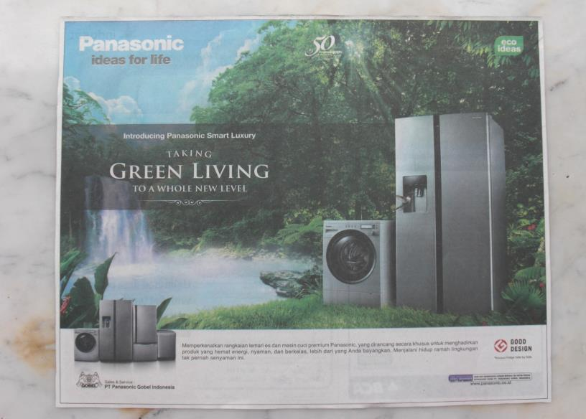

Slide 35
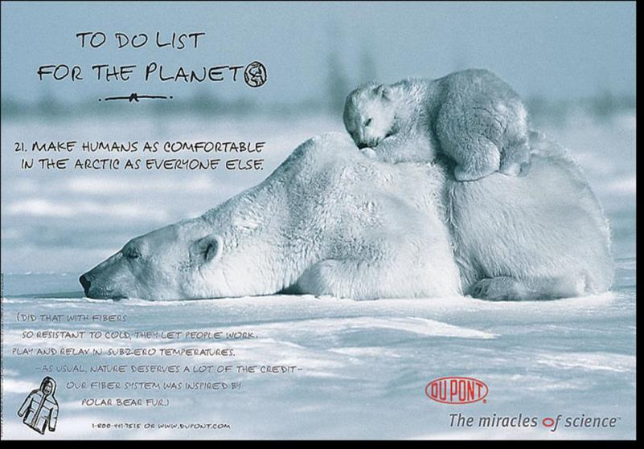

Slide 36



Slide 37

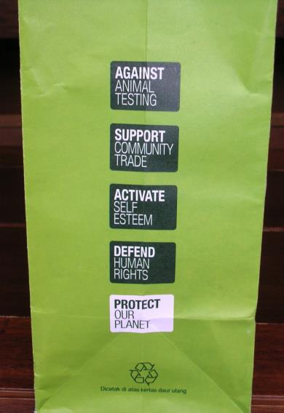

Slide 38
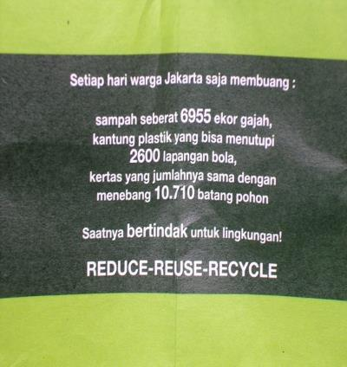
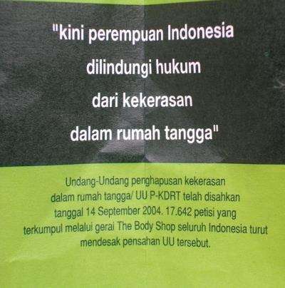

Slide 39


Slide 40


Slide 41
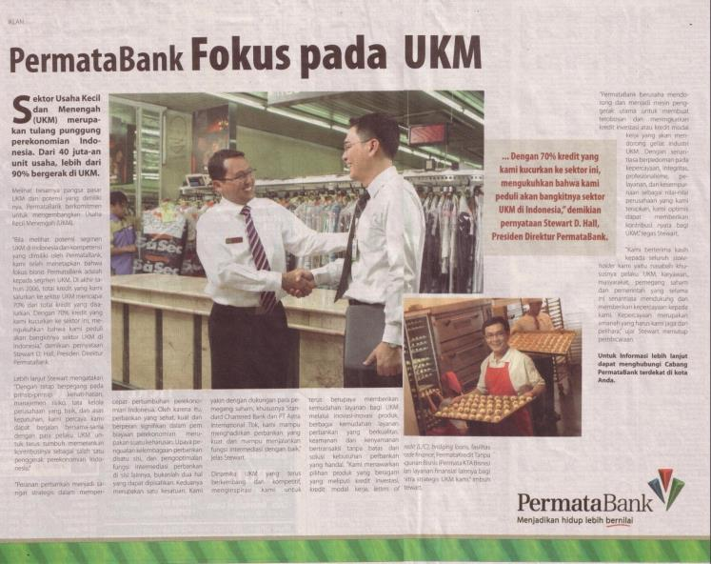

Slide 42
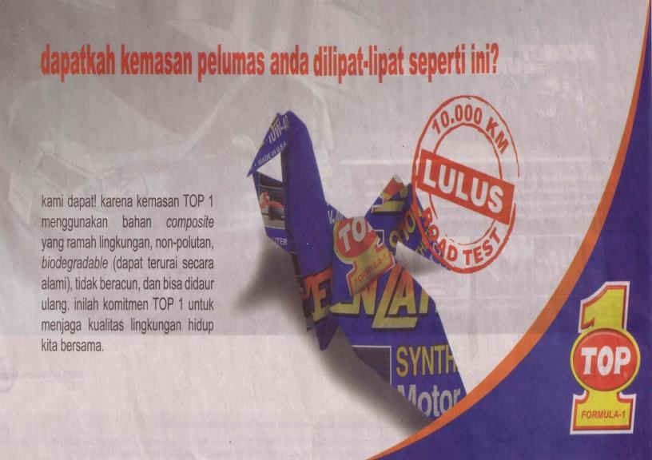

Slide 43


Slide 44


Slide 45


Slide 46
Pemasaran Yang Fokus
Pada Profitabilitas
Tier 1: Platinum
Tier 2: Gold
Tier 3: Iron
Tier 4: Lead

Slide 47
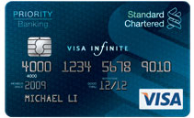

Slide 48





Slide 49

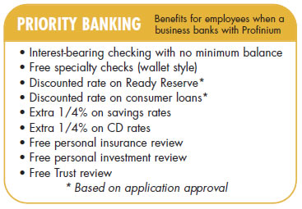


Slide 50
Financial Strategy- examines the financial implications of corporate and business-level strategic options and identifies the best financial course of action
Financial strategy includes the management of:
Dividends
Stock price
Sales of company patents

Slide 51
Leveraged buyout- company is acquired in a transaction financed largely by debt usually obtained from a third party
Reverse stock split- investor’s shares are split in half for the same total amount of money

Slide 52
Research and Development Strategy- deals with product and process innovation and improvement
Technological leader- pioneers innovation
Technological follower- imitates the products of competitors
Open innovation- use of alliances and connections with corporate, government, academic labs and consumers to develop new products and processes

Slide 53
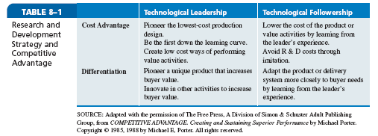

Slide 54
Operations Strategy- determines how and where a product or service is to be manufactured, the level of vertical integration in the production process, the deployment of physical resources and relationships with suppliers
Manufacturing Types include
Job shops
Connected line batch flow
Flexible manufacturing systems
Dedicated transfer lines

Slide 55
Purchasing Strategy- deals with obtaining raw materials, parts and supplies needed to perform the operations function
Options include:
Sole suppliers (Deming)
Just-in-time
Parallel sourcing

Slide 56
Logistics Strategy- deals with the flow of products into and out of the manufacturing process
Trends include:
Centralization
Outsourcing
Internet

Slide 57
Human Resource Strategy
Trends include:
Self-managed teams
360-degree appraisal
Diverse workforce

Slide 58
Information Technology Strategy
Trends include:
Follow the sun management
Internet
Extranet
Intranet

Slide 59

Outsourcing- purchasing from someone else a product or service that had been previously provided internally
Avoid outsourcing distinctive competencies
Offshoring- the outsourcing of an activity or a function to a wholly-owned company or an independent provider in another country

Slide 60
Disadvantages of outsourcing and offshoring
Customer complaints
Long-term contracts
Ability to learn new skills and develop new core competencies
Lack of cost savings
Poor product quality
Increased transportation costs

Slide 61
Errors in Outsourcing Efforts
Outsourcing the wrong activities
Selecting the wrong vendor
Poor contracts
Personnel issues
Lack of control
Hidden costs
Lack of an exit strategy

Slide 62
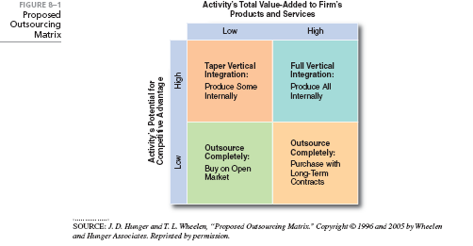

Slide 63

Follow the leader
Hit another home run
Arms race
Do everything
Losing hand

Slide 64

Constructing Corporate Scenarios- pro forma balance sheets and income statements that forecast the effect of each alternative strategy/its various programs will have on division and corporate return on investment

Slide 65
Steps include
Use industry scenarios to develop assumptions about the task environment
Develop common size financial statements for prior years
Construct detailed pro forma financial statements for each strategic alternative

Slide 66
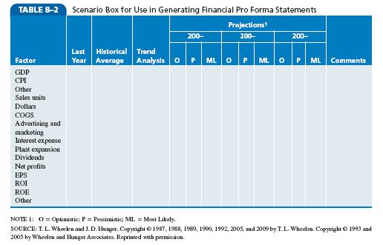

Slide 67
Management’s Attitude Toward Risk
Risk- composed not only of the probability that the strategy will be effective but also of the amount of assets the corporation must allocate to the strategy and the length of time the assets will be unavailable for other uses
Real options approach- a broad range of options used in environments
of high uncertainty
Net present value- calculates the value of a project by predicting its payouts, adjusting them for risk and subtracting the amount invested

Slide 69
How to Access the importance of stakeholder concerns
How will this decision affect each stakeholder?
How much of what stakeholders want are they likely to get under the alternative?
What are the stakeholders likely to do if they don’t get what they want?
What is the probability that they will do it?

Slide 70
Corporate Culture Options
Take a chance on ignoring the culture
Manage around the culture and change the implementation plan
Try to change the culture to fit the strategy
Change the strategy to fit the culture

Slide 71
Needs and Desires of Key Managers
Personnel characteristics and experience
Industry and cultural backgrounds
Tendency to maintain the status quo

Slide 72
Process of Strategic Choice
Strategic choice- the evaluation of alternative strategies and selection
of the best alternative
Consensus
Devil’s advocate
Dialectical inquiry

Slide 73
Process of Strategic Choice
Criteria for evaluating alternatives includes:
Mutual exclusivity
Success
Completeness
Internal Consistency

Slide 74

Effective Policies Accomplish
Forces trade-offs between competing resource demands
Tests the strategic soundness of a particular action
Sets clear boundaries within which employees must operate while granting them freedom to experiment within those constraints

Slide 75
Are the functional strategies interdependent, or can they
be formulated independently of other functions?
Why is penetration pricing more likely than skim pricing
to raise a company’s or a business unit’s operating
profit in the long run?
How does mass customization support a business unit’s
competitive strategy?
When should a corporation or business unit outsource a
function or an activity?
What is the relationship of policies to strategies?

Slide 76
PowerPoint created by:
Ronald Heimler
Dowling College- MBA
Georgetown University- BS Business Administration
Adjunct Professor- LIM College, NY
Adjunct Professor- Long Island University, NY
Lecturer- California State Polytechnic University, Pomona, CA
President- Walter Heimler, Inc.

Slide 77

All rights reserved. No part of this publication may be reproduced, stored in a retrieval system, or transmitted, in any form or by any means, electronic, mechanical, photocopying, recording, or otherwise, without the prior written permission of the publisher. Printed in the United States of America.
Copyright ©2012 Pearson Education, Inc. publishing as Prentice Hall

