Slide 1
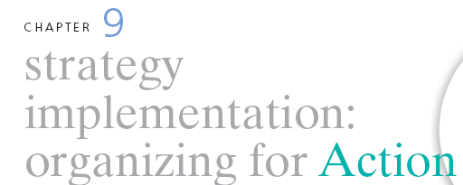
STRATEGIC MANAGEMENT & BUSINESS POLICY 13TH EDITION
THOMAS L. WHEELEN J. DAVID HUNGER

Slide 2
Strategy implementation- the sum total of all activities and choices required for the execution of a strategic plan
Who are the people to carry out the strategic plan?
What must be done to align company operations in the intended direction?
How is everyone going to work together to do what is needed?

Slide 3
Common Strategy Implementation Problems
Took more time than planned
Unanticipated major problems
Poor coordination
Competing activities and crises created distractions
Employees with insufficient capabilities
Poor subordinate training
Uncontrollable external environmental factors
Poor departmental leadership and direction
Inadequately defined implementation tasks and activities
Inefficient information system to monitor activities

Slide 4
Developing Programs, Budgets and Procedures
Programs make strategies action-oriented

Slide 5
Developing Programs, Budgets and Procedures
Matrix of Change- provides guidance on where, when and how fast to implement change
Budget- provides the last real check on the feasibility of the strategy
Procedures (organizational routines)- detail the various activities that must be carried out to complete a corporation’s programs

Slide 6
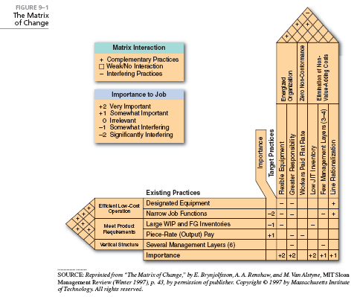

Slide 7
Achieving Synergy
Synergy– exists for a divisional corporation if the return on investment is greater than what the return would be if each division were an independent business
Forms of Synergy include
Shared know-how
Coordinated strategies
Shared tangible resources

Slide 8
Structure Follows Strategy- changes in corporate strategy lead to changes in organizational structure
New strategy is created
New administrative problems emerge
Economic performance declines
New appropriate structure is invented
Profit returns to its previous level

Slide 9
Stages of Corporate Development
Simple Structure
Flexible and dynamic
Functional Structure
Entrepreneur is replaced by a team of managers

Slide 10
Stages of Corporate Development
Divisional Structure
Management of diverse product lines in numerous industries
Decentralized decision making
Beyond SBU’s
Matrix
Network

Slide 11
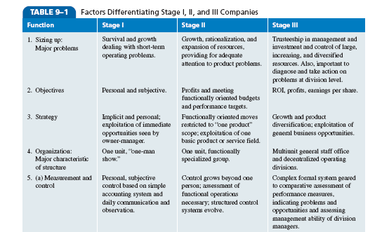

Slide 12
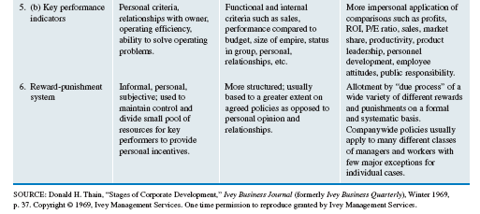

Slide 13
Blocks to Changing Stages
Internal
Lack of resources
Lack of ability
Refusal of top management to delegate
External
Economy
Labor shortages
Lack of market growth

Slide 14
Blocks to Changing Stages
(Entrepreneurs)
Loyalty
Task orientation
Single-mindedness
Working in isolation

Slide 15
Organizational Life Cycle- describes how organizations grow, develop and decline
Stages include:
Birth
Growth
Maturity
Decline
Death

Slide 17
Advanced Types of Organizational Structures
Matrix structures- functional and product forms are combined simultaneously at the same level of the organization

Slide 18
Advanced Types of Organizational Structures
Conditions for Matrix structures include:
Ideas need to be cross-fertilized across projects or products
Scarcity of resources
Abilities to process information and to make decisions needs to be improved

Slide 19
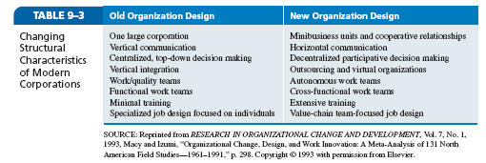

Slide 20
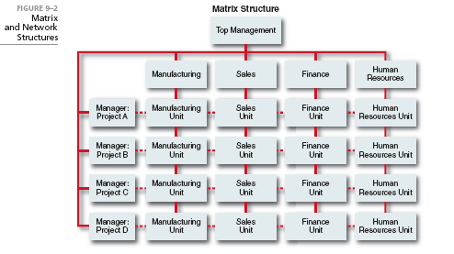

Slide 21
Market development strategy- provides the ability to:
Capture a larger market share
Market saturation
Market penetration
Develop new uses and/or markets for current products

Slide 22
Advanced Types of Organizational Structures
Phases of Matrix Structure Development (Davis and Lawrence)
Temporary cross-functional task forces
Product/brand management
Mature matrix

Slide 23
Advanced Types of Organizational Structures
Network Structure- eliminates in-house business functions
Cellular/Modular Structure- composed of a series of project groups or collaborations linked by constantly changing non-hierarchical electronic networks
Useful in unstable environments that require innovation and
quick response

Slide 24
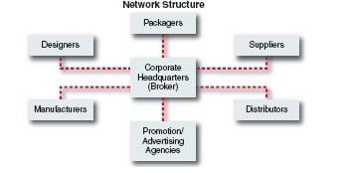

Slide 25
Network Structure
Advantages:
Increased flexibility and adaptability
Ability to concentrate on distinctive competencies
Disadvantages:
Transitional structure
Availability of numerous partners
Overspecialization

Slide 26
Reengineering and Strategy Implementation
Reengineering- the radical redesign of business processes to
achieve major gains in cost, service, or time
Program to implement a turnaround strategy

Slide 27
Principles for Reengineering (Hammer)
Organize around outcomes, not tasks
Have those who use the output of the process perform the process
Subsume information-processing work into real work that produces information
Treat geographically-dispersed resources as though they were centralized
Link parallel activities instead of integrating their results
Put the decision point where the work is performed and build control into the process
Capture information once and at the source

Slide 28
Six Sigma- an analytical method for achieving near perfect results on a production line
Define a process where results are below average
Measure the process to determine current performance
Analyze the information to determine problems
Improve the process and eliminate the error
Establish preventive controls

Slide 29
Lean Six Sigma- incorporates Six Sigma with lean manufacturing- removes unnecessary production steps and fixes the remaining steps

Slide 30
Designing Jobs to Implement Strategy
Job Design- the study of individual tasks in an attempt to make them more relevant to the company and to the employees
Job enlargement
Job rotation
Job enrichment model

Slide 31
International Issues in Strategy Implementation
Multinational Corporation- a highly developed international company with a deep involvement throughout the world with a worldwide perspective in its management and decision making

Slide 32
Forces for Standardization
Convergence of customer preferences and incomes
Competition from other global products
Growing customer awareness of international brands
Economies of scale
Falling trading costs across countries
Cultural exchange and business interactions among countries

Slide 33
Forces for Customization
Differences in customer preferences
Differences in customer incomes
Need to build local brand reputation
Competition from domestic companies
Variations in trading costs
Local regulatory requirements

Slide 34
International Strategic Alliances
Drivers for strategic fit among alliance partners
Partners must agree on values and vision
Alliance must be derived from business, corporate and functional strategy
Alliance must be important to partners, especially top management
Partners must be mutually dependent for achieving objectives
Activities must add value
Alliance must be accepted by stakeholders
Partners contribute strengths while protecting core competencies

Slide 35
Stages of International Development
Stage 1: Domestic company
Stage 2: Domestic company with export division
Stage 3: Primarily domestic company with international division
Stage 4: Multinational corporation with multidomestic emphasis
Stage 5: Multinational corporation with global emphasis

Slide 36
Centralization versus Decentralization
Product group structure- enables the company to introduce and manage a similar line of products around the world
Geographic area structure- allows the company to tailor products to regional differences and to achieve regional coordination
Multinational corporations are moving from geographic area to product group structures

Slide 37
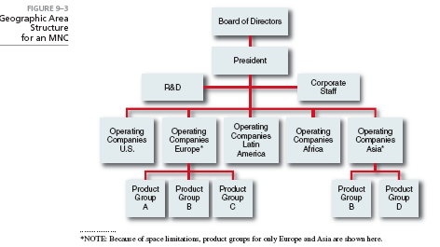

Slide 38
How should a corporation attempt to achieve synergy
among functions and business units?
How should an owner-manager prepare a company for
its movement from Stage I to Stage II?
How can a corporation keep from sliding into the Decline
stage of the organizational life cycle?
Is reengineering just another fad, or does it offer
something of lasting value?
How is the cellular/modular structure different from the
network structure?

Slide 39
PowerPoint created by:
Ronald Heimler
Dowling College- MBA
Georgetown University- BS Business Administration
Adjunct Professor- LIM College, NY
Adjunct Professor- Long Island University, NY
Lecturer- California State Polytechnic University, Pomona, CA
President- Walter Heimler, Inc.

Slide 40
All rights reserved. No part of this publication may be reproduced, stored in a retrieval system, or transmitted, in any form or by any means, electronic, mechanical, photocopying, recording, or otherwise, without the prior written permission of the publisher. Printed in the United States of America.
Copyright ©2012 Pearson Education, Inc. publishing as Prentice Hall

