Slide 1
“Studio Lighting Console”
LIGHTING FOR TELEVISI
PERTEMUAN - 8

Slide 2
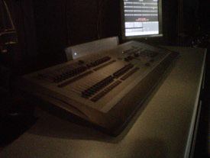
Studio Lighting Console
The Light Console in MZ 180 (TV Stage)

Slide 3
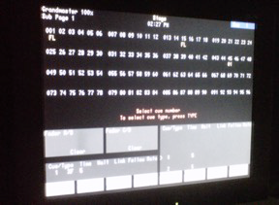
Studio Lighting Console
The Control Display shows the intensity of every channel.

Slide 4
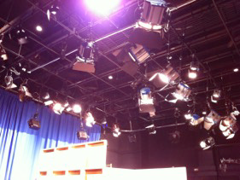
Studio Lighting Console
All of the Studio Lights use Stage Pin (Bates) power connections.

Slide 5
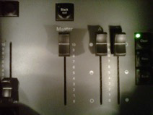
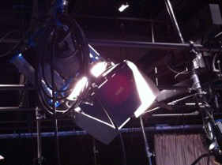
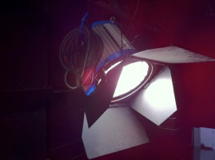
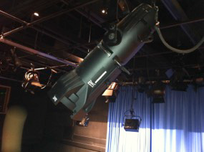
Studio Lighting Console
Master Fader
ARRI 1K
ARRI 2K
575w Ellipsoidal (Leko)

