Slide 1
LIGHTING FOR TELEVISI
PERTEMUAN - 9
“Merencanakan Dan Menggambar Lighting Floor Plan”

Slide 2
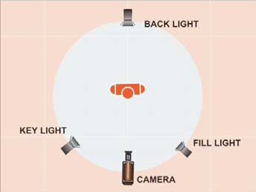
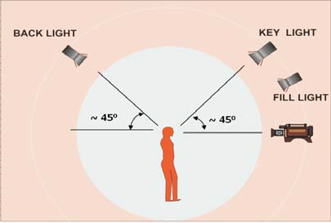
THREE POINT SYSTEM LIGHTING

Slide 3
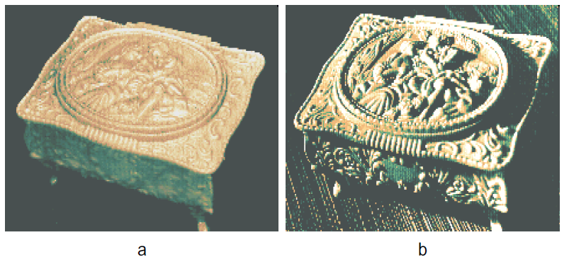
LIGHTING RATIO

Slide 4
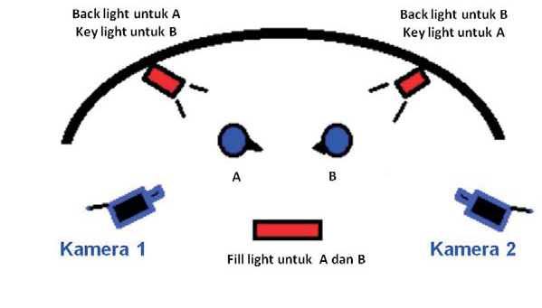
MULTIPURPOSE LIGHTING

Slide 5
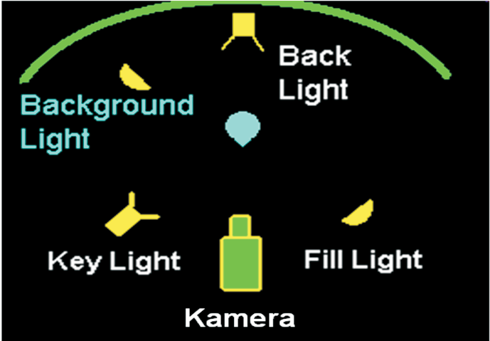
BACKGROUND LIGHTING

Slide 6
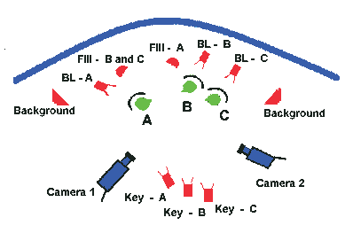
BACKGROUND LIGHTING

Slide 7
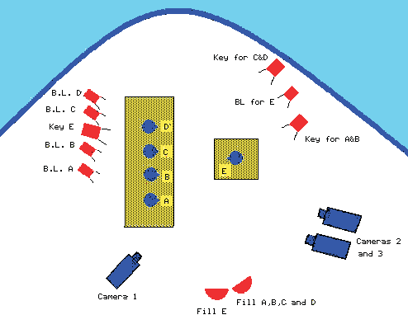
BACKGROUND LIGHTING

