Slide 1
Director Script
Tata Fotografi Elektronik
Arie Nugraha, M.Si

Slide 2
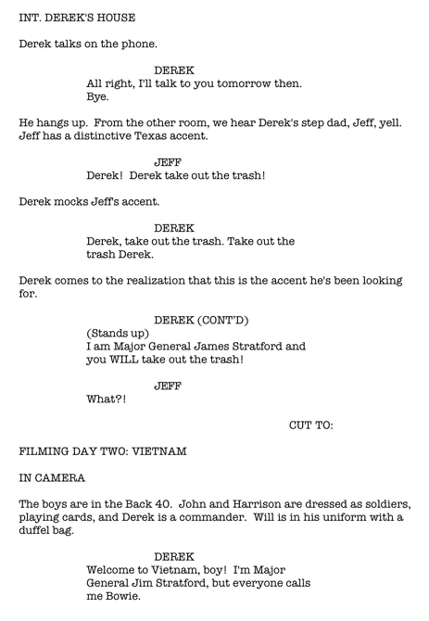
Script

Slide 3
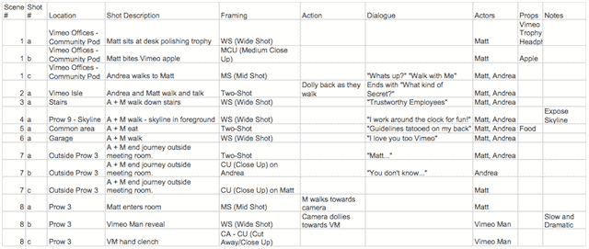
Director Script

Slide 4
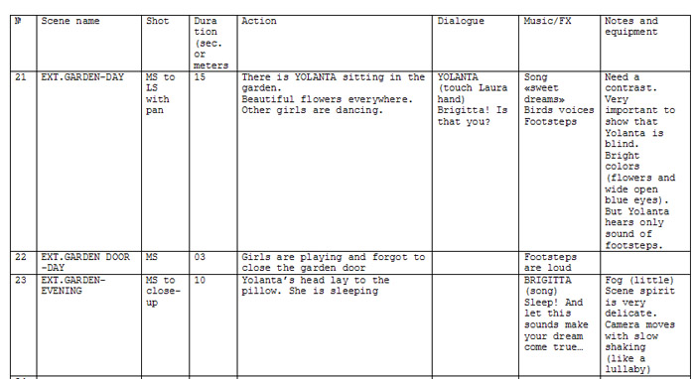
Director Script

