Slide 1
THE GRAMMAR OF TV
Tata Fotografi Elektronik
Arie Nugraha, M.Si

Slide 2
Picture Composition
Picture Composition
Headroom
Looking room
Walking room
Edge of frame
Cutting on joints
Juxtaposition
Cutoff

Slide 3
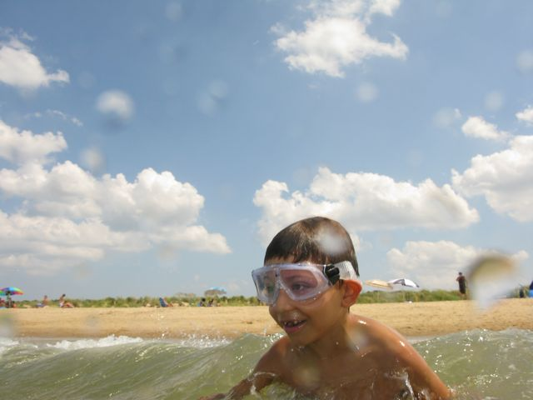
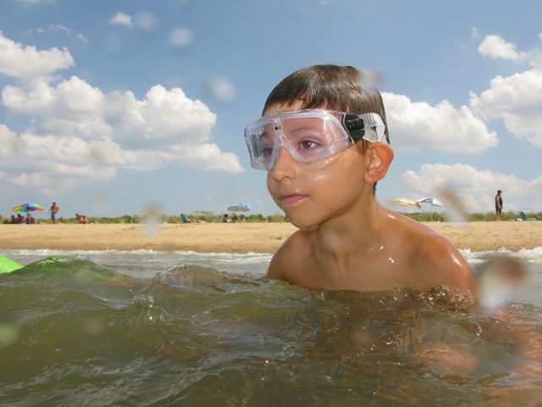
Head Room

Slide 4
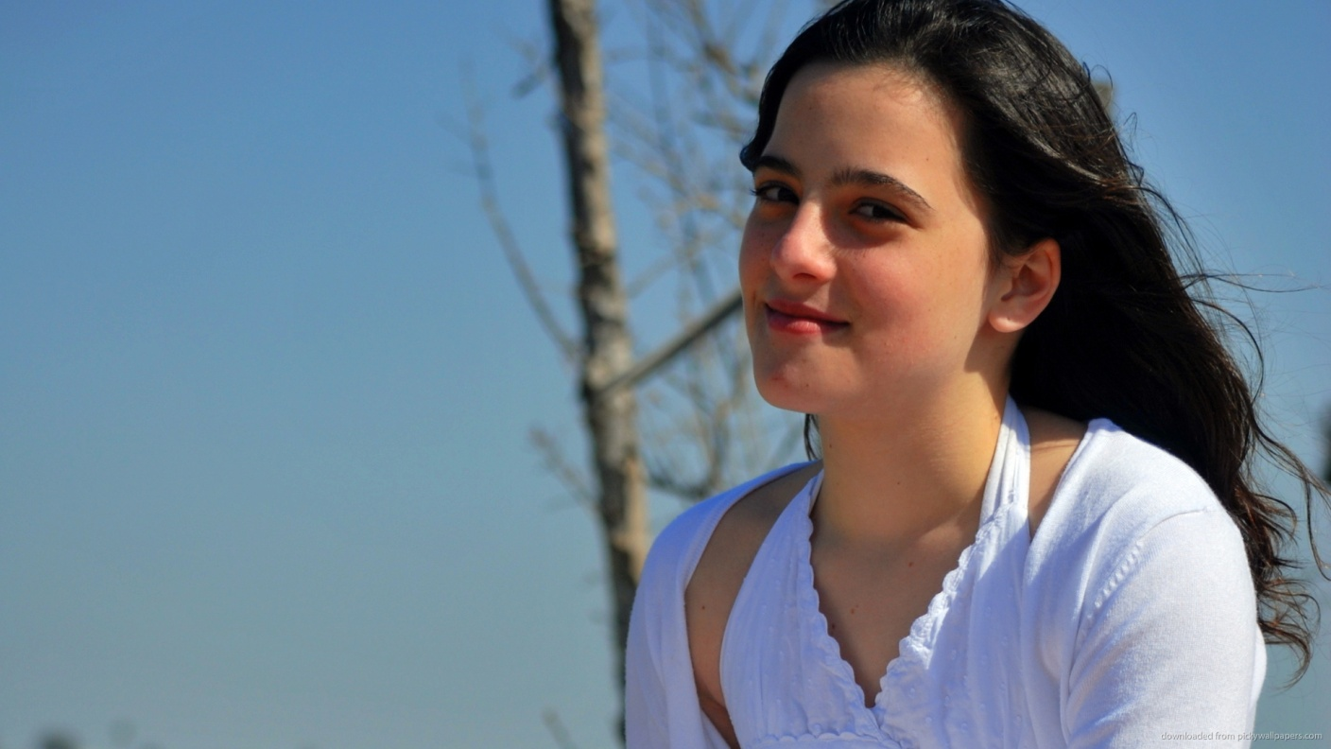
Looking Room

Slide 5
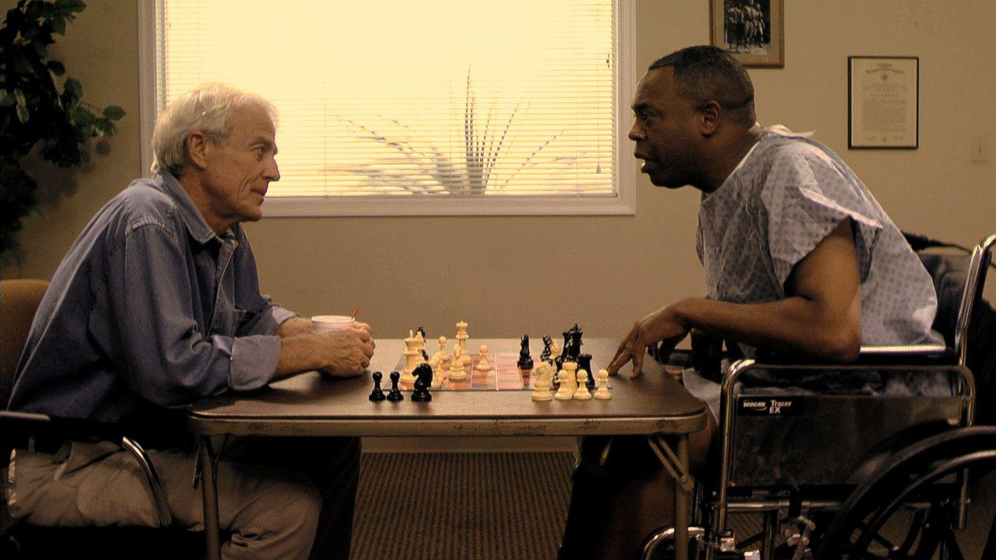
Edge of Frame

Slide 6
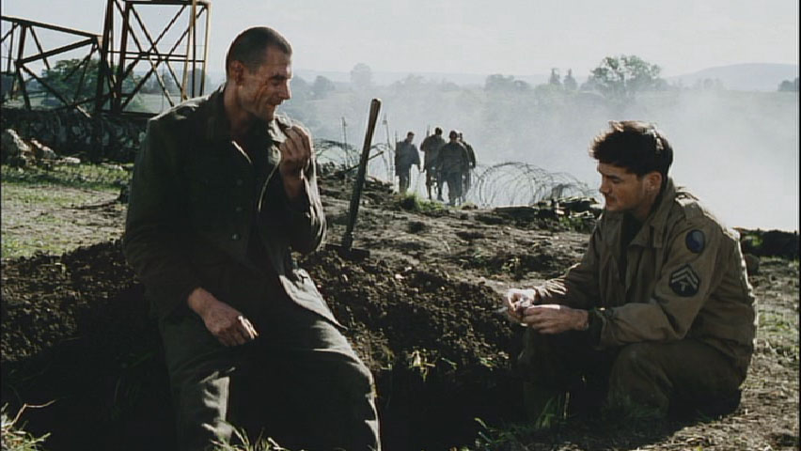
Cutting on Joints

Slide 7
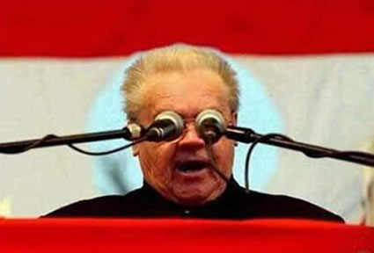
Juxtaposition

Slide 8
Cut Off

