Slide 1
DASAR SISTEM INFORMASI
Dosen Pengampu : KARTINI S.Kom.,MMSI
Prodi Sistem Informasi - Fakultas Ilmu Komputer

Slide 2
Pert.11 :
Managing knowledge and
Data Resource Management

Slide 3
Learning Outcomes
Managing Data, the Database Approach,
Database management system,
Fundamental Data Concepts
data warehousing, data governance
Database Management Approach
Types of Databases

Slide 4
Learning Objectives
Explain the business value of implementing data resource management processes and technologies in an organization.
Outline the advantages of a database management approach to managing the data resources of a business, compared to a file processing approach.
Explain how database management software helps business professionals and supports the operations and management of a business.

Slide 5
Learning Objectives
Provide examples to illustrate each of the following concepts:
  Major types of databases
  Data warehouses and data mining
  Logical data elements
  Fundamental database structures
  Database development

Slide 6
Case 1: Harrah’s Entertainment and Others
Managing Data, the Database Approach
For casinos, one of their most important assets is the data about the high-roller customers
What steps can be taken to prevent employees from stealing this data?
  Managerial
  Legal
  Technical

Slide 7
Case Study Questions
Managing Data, the Database Approach
Why have developments in IT helped to increase the value of the data resources of many companies?
How have these capabilities increased the security challenges associated with protecting a company’s data resources?
How can companies use IT to meet the challenges of data resource security?

Slide 8
Real World Internet Activity
Managing Data, the Database Approach
Companies are increasingly adopting a position that data is an asset that must be managed with the same level of attention as that of cash and other capital. Using the Internet,
  See if you can find examples of how companies treat their data.
  Does there seem to be any relationship between companies that look at their data as an asset and companies that are highly successful in their respective industries?

Slide 9
Real World Group Activity
Managing Data, the Database Approach
The case illustrates how valuable data resources are to the casino industry. In small groups,
  Discuss other industries where their data are clearly their lifeblood.
  For example, it has been estimated that any firm in the financial industry would have a life expectancy of less than 100 hours if they were placed in a position where they could not access their organizational data. Do you agree with this estimate?

Slide 10
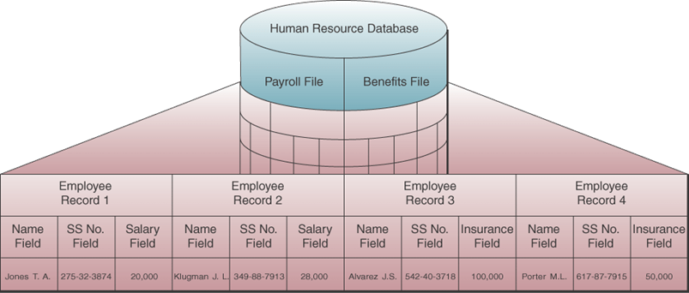
Examples of logical data elements
Managing Data, the Database Approach

Slide 11
Fundamental Data Concepts
Character: single alphabetic, numeric or other symbol
Field or data item: a grouping of related characters
  Represents an attribute (a characteristic or quality) of some entity (object, person, place or event)
  Example: salary
Record: grouping of all the fields used to describe the attributes of an entity
  Example: payroll record with name, SSN and rate of pay

Slide 12
Fundamental Data Concepts
File or table: a group of related records
Database: an integrated collection of logically related data elements

Slide 13
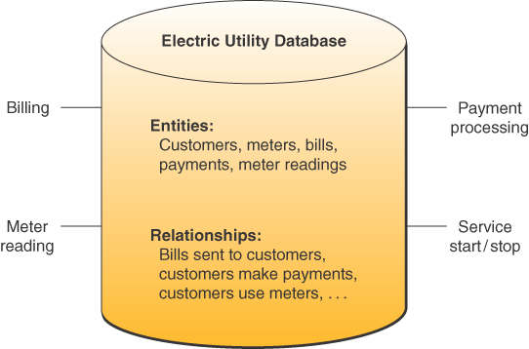
Electric Utility Database
Fundamental Data Concepts
Source: Adapted from Michael V. Mannino, Database Application Development and Design
(Burr Ridge, IL: McGraw-Hill/Irwin, 2001), p. 6.

Slide 14
Database Structures
Fundamental Data Concepts
Hierarchical
Network
Relational
Object-oriented
Multidimensional

Slide 15
Hierarchical Structure
Fundamental Data Concepts
Early DBMS structure
Records arranged in tree-like structure
Relationships are one-to-many
Notes:
Access data elements by moving progressively downward from the root and along the branches of the tree

Slide 16
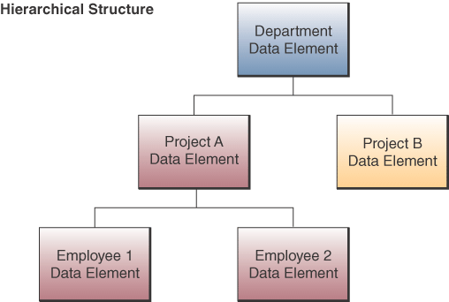
Hierarchical Structure

Slide 17
Network Structure
Fundamental Data Concepts
Used in some mainframe DBMS packages
Many-to-many relationships
Notes:
Any data element can be related to any number of other data elements

Slide 18
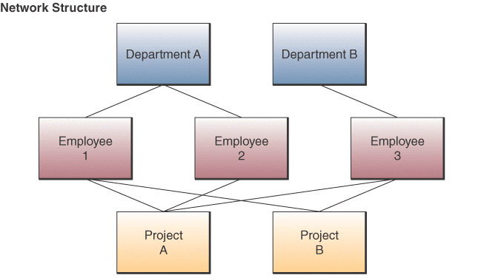
Network Structure
Fundamental Data Concepts

Slide 19
Relational Structure
Database management system
Most widely used structure
Data elements are viewed as being stored in tables
Row represents record
Column represents field
Can relate data in one file with data in another file if both files share a common data element

Slide 20
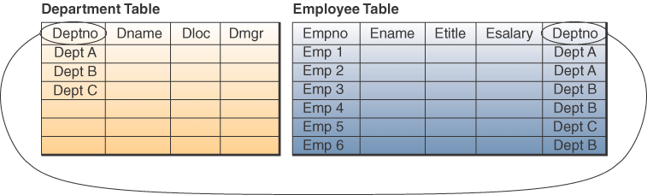
Relational Structure
Database management system

Slide 21
Relational Operations
Database management system
Select:
  Create a subset of records that meet a stated criterion
  Example, select employees who make more than $30,000
Join
  Combine two or more tables temporarily
  Looks like one big table
Project
  Create a subset of columns in a table
Notes:
Three basic operations on relational databases

Slide 22
Multidimensional Structure
Database management system
Variation of relational model
Uses multidimensional structures to organize data
Data elements are viewed as being in cubes
Popular for analytical databases that support Online Analytical Processing (OLAP)
Notes:
OLAP is used for answers to complex business queries, discussed in detail in chapter 9

Slide 23
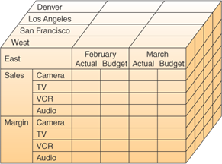
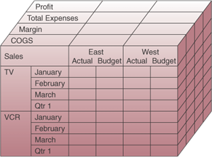
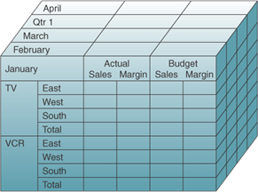
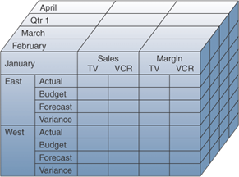
Multidimensional Model

Slide 24
Object-oriented Structure
Object consists of
  Data values describing the attributes of an entity
  Operations that can be performed on the data
Encapsulation:
  Combine data and operations
Inheritance:
  New objects can be created by replicated some or all of the characteristics of parent objects

Slide 25
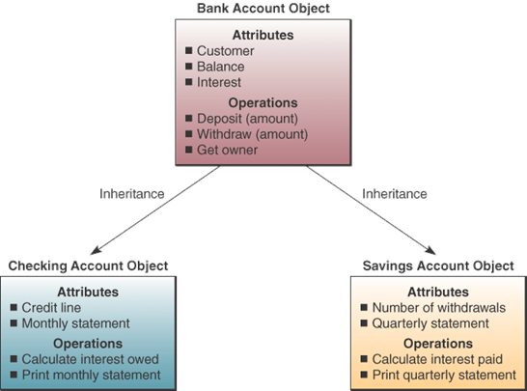
Object-oriented Structure
Source: Adapted from Ivar Jacobsen, Maria Ericsson, and Ageneta Jacobsen, The Object Advantage: Business Process
Reengineering with Object Technology (New York: ACM Press, 1995), p. 65.
Copyright @ 1995, Association for Computing Machinery. By permission.

Slide 26
Object-oriented Structure
OODatabase management system
Used in Object-oriented database management systems (OODBMS)
Supports complex data types
  Examples, graphic images, video clips, web pages

Slide 27
Evaluation of Database Structures
Hierarchical
  Worked for structured routine transaction processing
  Can’t handle many-to-many relationships
Network
  More flexible than hierarchical
  Unable to handle ad hoc requests
Relational
  Easily respond to ad hoc requests
  Easier to work with and maintain
  Not as efficient or quick as hierarchical or network
Notes:
Gap in performance between relational and hierarchical and network is rapidly narrowing

Slide 28
Database Development
Database Administrator (DBA)
  In charge of enterprise database development
Data Definition Language (DDL)
  Develop and specify the data contents, relationships and structure
  These specifications are stored in data dictionary
Data dictionary
  Data base catalog containing metadata
  Metadata – data about data

Slide 29
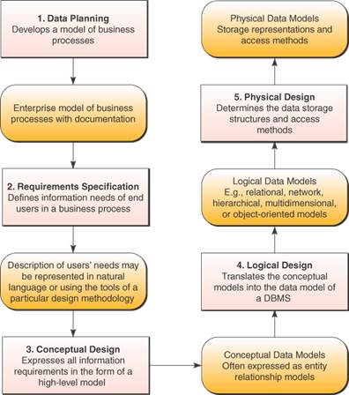
Database Development

Slide 30
Data Planning Process
Enterprise Model
  Defines basic business process of the enterprise
  Defined by DBAs and designers with end users
Data Modeling
  Relationships between data elements
  Entity Relationship Diagram (ERD) common tool for modeling

Slide 31
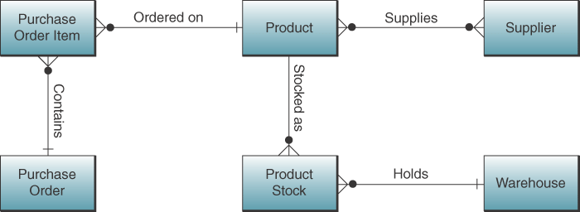
Entity Relationship Diagram

Slide 32
Database Design Process
Logical design
  Schema – overall logical view of relationships
  Subschema – logical view for specific end users
  Data models for DBMS
Physical design
  How data are to be stored and accessed on storage devices

Slide 33
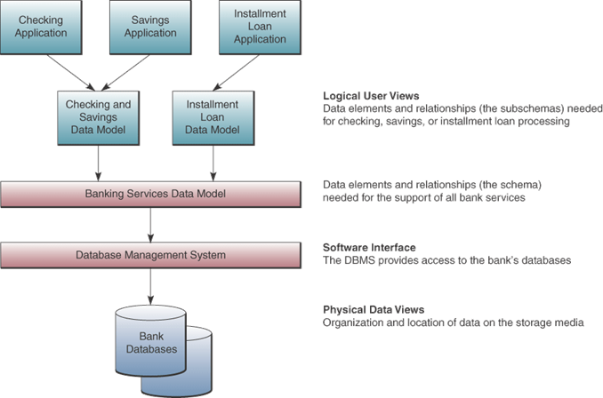
Logical and Physical Database Views

Slide 34
Case 2: Emerson and Sanofi
Data stewards seek data conformity
Data stewards: dedicated to establishing and maintaining the quality of data
Data quality team requires business, technology and diplomatic skills
Focus on data content

Slide 35
Case Study Questions
Why is the role of a data steward considered to be innovative? Explain.
What are the business benefits associated with the data steward program at Emerson?
How does effective data resource management contribute to the strategic goals of an organization? Provide examples from Emerson and others.

Slide 36
Real World Internet Activity
The role of data steward is relatively new, and its creation is motivated by the desire to protect the valuable data assets of the firm. There are many job descriptions in the modern organization associated with the strategic management of data resources. Using the Internet,
  See if you can find evidence of other job roles that are focused on the management of an organization’s data.
  How might a person train for these new jobs?

Slide 37
Real World Group Activity
As more and more data are collected, stored, processed, and disseminated by organizations, new and innovative ways to manage them must be developed. In small groups,
  Discuss how the data resource management methods of today will need to evolve as more types of data emerge.
  Will we ever get to the point where we can manage our data in a completely automated manner?

Slide 38
Data Resource Management
Managerial activity
Applies IS technologies like data management and data warehousing to manage data resources to meet the information needs of business stakeholders

Slide 39
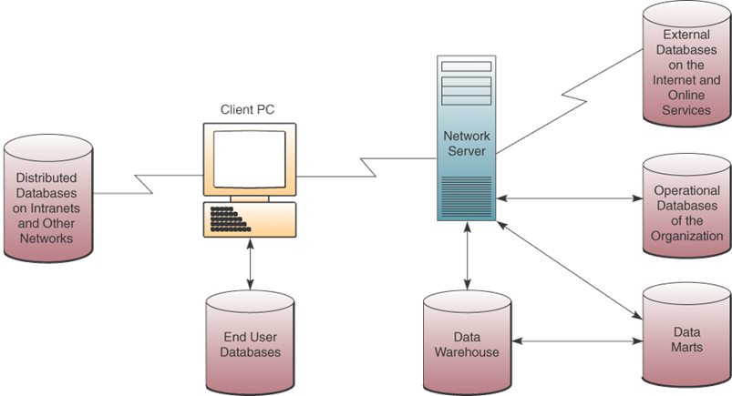
Types of databases

Slide 40
Operational Databases
Store detailed data to support business processes
Examples, customer database, inventory database

Slide 41
Distributed Databases
Copies or parts of databases on servers at a variety of locations
Challenge: any data change in one location must be made in all other locations
Replication:
  Look at each distributed database and find changes
  Apply changes to each distributed database
  Very complex
Duplication
  One database is master
  Duplicate that database after hours in all locations
  Easier

Slide 42
External Databases
Databases available for a fee from commercial online services or
For free from World Wide Web
Examples, statistical databanks, bibliographic and full text databases

Slide 43
Hypermedia Database
Website database
Consists of hyperlinked pages of multimedia (text, graphics, video clips, audio segments)

Slide 44
Data Warehouse
Stores data that has been extracted from the operational, external and other databases
Data has been cleaned, transformed and cataloged
Used by managers and professionals for
  Data mining,
  Online analytical processing,
  Business analysis,
  Market research,
  Decision support
Data mart is subset of warehouse for specific use of department

Slide 45
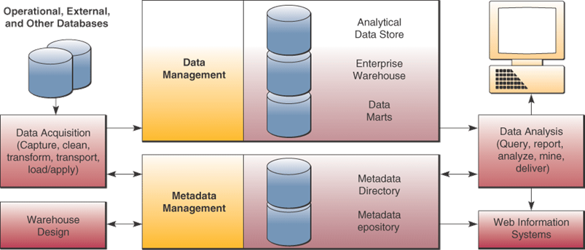
Data Warehouse
Source: Adapted courtesy of Hewlett-Packard.

Slide 46
Data Mining
Data in data warehouse are analyzed to reveal hidden patterns and trends
Examples:
  Perform market-basket analysis to identify new business processes
  Find root causes to quality problems
  Cross sell to existing customers
  Profile customers with more accuracy
Notes:
Discussed in more detail in chapter 9

Slide 47
Traditional File Processing
Data stored in independent files
Problems:
  Data redundancy
  Lack of data integration
  Data dependence – files, storage devices, and software are dependent on each other
  Lack of data integrity or standardization
Notes:
Traditional file processing leads to not being able to find data because it’s in multiple files. Or it’s too costly to combine and clean.
Data redundancy – duplicated data in several files
Data is not integrated across files.
Data dependence – software had references to format of data. So maintenance was difficult.
Inconsistency across files.
Problems resolved with Database Management Approach

Slide 48
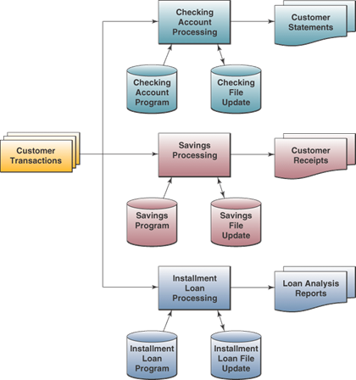
Traditional File Processing

Slide 49
Database Management Approach
Consolidate data into databases that can be accessed by different programs
Use a database management system (DBMS)
DBMS serves as interface between users and databases

Slide 50
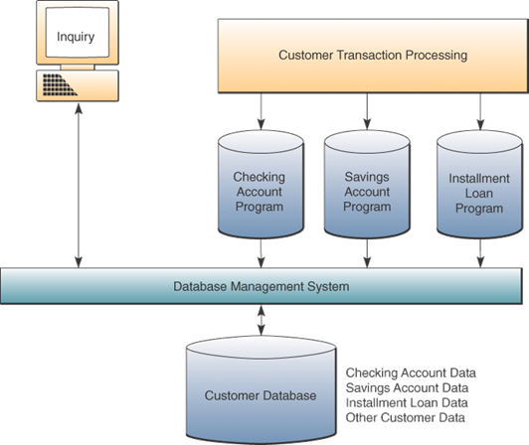
Database Management Approach

Slide 51
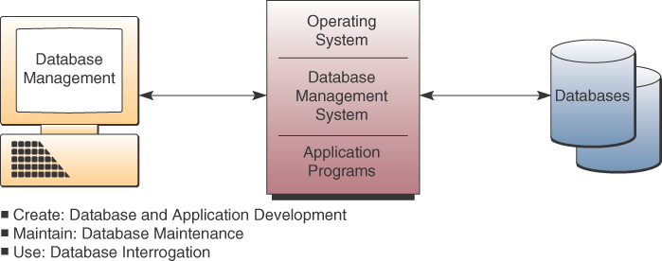
DBMS Major Functions

Slide 52
Database Interrogation
End users use a DBMS by asking for information via a query or a report generator
Query language – immediate responses to ad hoc data requests
  SQL (Structured Query Language) an international standard query language
  Graphical Queries -- Point-and-click methods
  Natural Queries – similar to conversational English
Report generator – quickly specify a report format for information you want printed in a report
Notes:
Database interrogation is major advantage of DBMS approach
SQL is pronounced Sequel

Slide 53
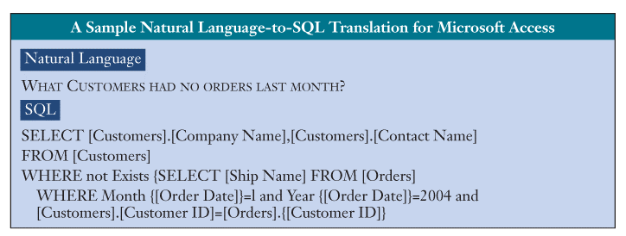
Natural Language versus SQL

Slide 54
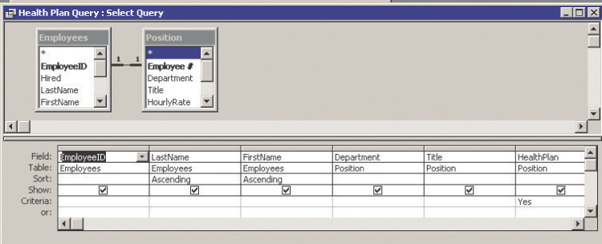
Graphical Query
Source: Courtesy of Microsoft Corp.

Slide 55
Database Maintenance
Updating database to reflect new business transactions such as a new sale
Done by transaction processing systems with support of DBMS

Slide 56
Application Development
Use DBMS software development tools to develop custom application programs
Data Manipulation Language (DML)

Slide 57
Case 3: Acxiom Corporation
Data Demands Respect
Acxiom does three things:
  Managing large volumes of data
  Cleaning, transforming, and enhancing that data
  Distilling business intelligence from that data to drive smart decisions
Provides information products
Manages clients’ data

Slide 58
Case Study Questions
Acxiom is in a unique type of business. How would you describe the business of Acxiom? Are they a service- or a product-oriented business?
From the case, it is easy to see that Acxiom has focused on a wide variety of data from different sources. How does Acxiom decide which data to collect and for whom?
Acxiom’s business raises many issues related to privacy. Is the data collected by Acxiom really private?

Slide 59
Real World Internet Activity
In the case, it was stated that Acxiom started as the result of a spin-off from a bus company. Using the Internet,
  See if you can find the history of Acxiom.
  How does a bus company evolve into a data collection and dissemination company?

Slide 60
Real World Group Activity
The privacy problems faced by Acxiom were associated with the accidental dissemination of data deemed sensitive by a third party. In small groups,
  Discuss the privacy issues associated with Acxiom’s business.
  Do you think they are doing anything wrong?

Slide 61
Terima Kasih
Good Luck

