Slide 1
DASAR SISTEM INFORMASI
Dosen Pengampu : KARTINI S.Kom.,MMSI
Prodi Sistem Informasi - Fakultas Ilmu Komputer

Slide 2
DASAR SISTEM INFORMASI
Pert.14 :
STUDI KASUS Aquiring information systems and Aplication

Slide 3
Case 1:
In-House Development is Alive and Well
Proprietary software can give companies an competitive edge
But in-house development isn’t cheap
H&R Block, Morgan Stanley and others still choose in-house development
When and why?

Slide 4
Case Study Questions
Jeff Brandmaier, senior VP and CIO at H&R Block Inc., describes in-house developed applications as “the stuff that gives you competitive advantage.” Why do you think he feels this way?
Can a modern organization be competitive without developing any applications in-house? Why or why not?
The case points out that despite the use of vendor applications, there is “still a lot of manually intensive work that goes on in the development process.” Why do you think vendor applications still require in-house developers?

Slide 5
Real World Internet Activity
Despite all the media coverage concerning the loss of jobs in IS/IT, there is still a strong and growing need for in-house developers. Using the Internet,
  See if you can find examples, beyond those discussed in the case, of companies that are doing their development in-house.
  Are they using the SDLC or some other method?

Slide 6
Real World Group Activity
In-house development is costly, to be sure. Yet many companies believe that their core applications require personal attention by their developers. In small groups,
  Discuss how an organization determines what applications to buy from a vendor and what applications to develop in-house.
  What are the criteria for making the decision?

Slide 7
The Systems Approach
A problem solving technique that uses a systems orientation to define problems and opportunities and develop appropriate and feasible solutions.
Analyzing a problem and formulating a solution involves the following interrelated activities:
  Recognize and define a problem or opportunity using systems thinking
  Develop and evaluate alternative system solutions
  Select the system solution that best meets your requirements
  Design the selected system solution
  Implement and evaluate the success of the designed system

Slide 8
What is Systems Thinking?
Seeing the forest and the trees in any situation by:
  Seeing interrelationships among systems rather than linear cause-and-effect chains whenever events occur
  Seeing processes of change among systems rather than discrete snapshots of change, whenever changes occur
See the system in any situation:
  Find the input, processing, output, feedback and control components
Notes:
Going back to the components we learned in chapter 1.

Slide 9
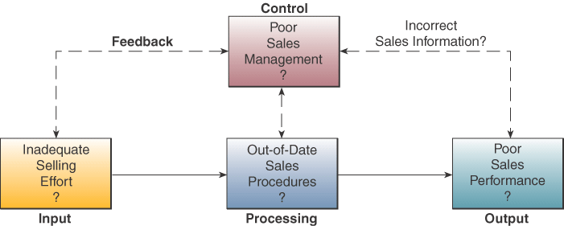
Systems Thinking Example
Notes:
You can better understand a sales problem or opportunity by identifying the components of a sales system

Slide 10
Case 2: Implementation Success or Failure
Success or failure is in the eye of beholder
At Indiana University, implementation of PeopleSoft ERP
  Left students without access to promised financial aid
  Problem was not with software
  What was the problem?

Slide 11
Case Study Questions
As with any story, there are always two sides. Indiana University sees the problem as a surprise; outside observers see the problem as predictable and preventable. What do you think? Why?
Is it possible that some implementation problems cannot be easily foreseen or prevented? Give some examples.
What could Indiana University have done differently to prevent this unfortunate event from occurring? Is there evidence to suggest that they learned from this experience?

Slide 12
Real World Internet Activity
In many cases, we tend to hear about implementation failures more often than implementation successes. Using the Internet,
  See if you can find some examples of implementation success stories.
  Why were they successful?

Slide 13
Real World Group Activity
The project described in the case was an example of a large-scale software deployment of vendor software. In small groups,
  Discuss the differences between implementing vendor-supplied software and in-house developed software.
  Should an in-house project be implemented differently than a vendor supplied application? Why or why not?

Slide 14
Systems Implementation
Hardware and software acquisition
Software development
Testing of programs and procedures
Conversion of data resources
Conversion alternatives
Education and training of end users and specialists who will operate a new system

Slide 15
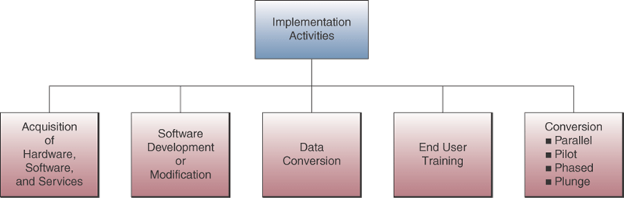
Implementation Process

Slide 16
Case 3: There’s Nothing Like a Good Process
Nothing derails an IT development project faster than sloppy project management
Process management is the art and science of creating and continuously improving the process of developing and delivering systems
Best practices in process management:
  Industry best practices
  Within-the-company best practices

Slide 17
Case Study Questions
What is process management? How does it differ from project management or traditional development methodologies like the SDLC?
Is the SDLC an example of good process management?
What is meant in the case by the phrase:
  “implementing a standard approach to systems development helps experienced staff and new hires to be more productive, because they spend less time wondering how to do something and more time doing it?”

Slide 18
Real World Internet Activity
We know that good project and process management are keys to successful systems development and implementation projects. Using the Internet,
  See if you can find examples of companies that subscribe to the tenets set forth in the case.
  Is there evidence to suggest that such companies are realizing competitive benefits as a result?

Slide 19
Real World Group Activity
We discussed issues related to user resistance, involvement, and change management in this chapter. In small groups,
  Discuss how these issues relate to good process management.
  What specific change management approaches are involved in ensuring high quality process management?

Slide 20
Terima Kasih
Good Luck

