Slide 1
DASAR SISTEM INFORMASI
Dosen Pengampu : KARTINI S.Kom.,MMSI
Prodi Sistem Informasi - Fakultas Ilmu Komputer

Slide 2
DASAR SISTEM INFORMASI
Pert.12 :
Enterprise and Global Management of Information Technology

Slide 3
Learning Outcomes
Management of Information Technology
Business/IT Planning Process and Components of Business/IT Planning
Information Technology Architecture
Organizational Components of IT at Avnet Marshall
Application Development Management
Outsourcing and Offshoring
Global Business/IT Strategy
Global IT Management Dimensions

Slide 4
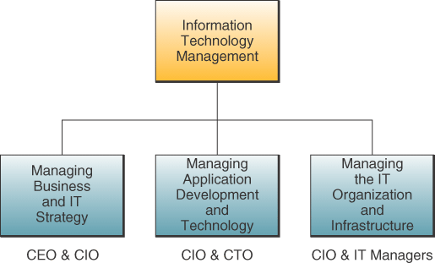
Components of IT Management

Slide 5
Managing Information Technology
Mengelola pengembangan bersama, pelaksanaan bisnis dan strategi TI.
Gunakan IT untuk mendukung prioritas strategis bisnis .
  Menyelaraskan antara TI dan strategis bisnis.
  Mengelola pengembangan dan implementasi baru aplikasi bisnis / TI dan teknologi
  Pengembangan sistem pengelolaan informasi
  Mengelola organisasi IT dan infrastruktur IT
  Hardware, software, database, networks and other resources

Slide 6
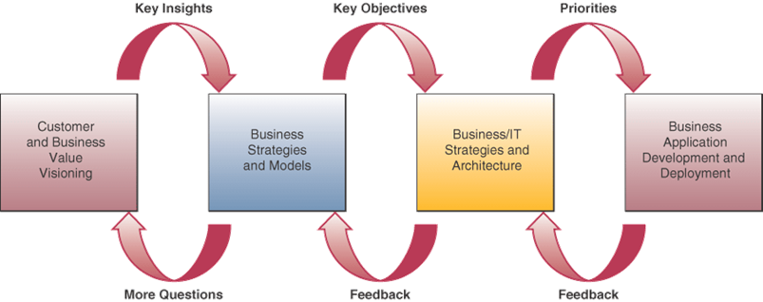
Business/IT Planning Process
Notes:
key insights deployment = wawasan kunci penyebaran

Slide 7
Components of Business/IT Planning (Komponen Perencanaan Bisnis / IT )
Strategy Development
  Pengembangkan strategi bisnis yang mendukung visi bisnis perusahaan
Resource Management
  Mengembangkan rencana strategis untuk mengelola sumber daya atau outsourcing perusahaan IT
Technology Architecture
  Membuat pilihan strategis TI yang mencerminkan arsitektur teknologi informasi yang dirancang untuk mendukung inisiatif bisnis / IT perusahaan

Slide 8
Information Technology Architecture
Technology Platform
  Networks, computer systems, system software and integrated enterprise application software
Data Resources
  Database operasional dan khusus
  Menyimpan dan menyediakan data dan informasi untuk proses bisnis dan pendukung keputusan

Slide 9
Information Technology Architecture
Applications Architecture
  Arsitektur terpadu dari sistem perusahaan yang mendukung inisiatif bisnis, strategis serta proses bisnis lintas fungsional
IT Organization
  Struktur organisasi fungsi IS dalam perusahaan dan distribusi spesialis IS in company

Slide 10
Organizing IT
Awal tahun : sentralisasi komputasi dengan mainframe besar
Next : perampingan tren dengan pindah kembali ke desentralisasi
Sekarang : kontrol terpusat atas pengelolaan TI sementara melayani kebutuhan strategis
  Hybrid dari kedua komponen sentralisasi dan desentralisasi

Slide 11
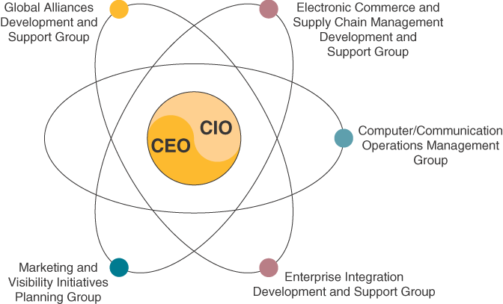
Organizational Components of IT at Avnet Marshall
(Komponen Organisasi TI di Avnet Marshall )
Notes:
Centralized control but business-focused development and support groups

Slide 12
Application Development Management
Managing activities such as:
  Analisis sistem dan desain, prototyping, pemrograman aplikasi, manajemen proyek, jaminan kualitas, dan pemeliharaan sistem untuk semua bisnis / IT proyek-proyek pembangunan besar
  Systems analysis and design, prototyping, applications programming, project management, quality assurance, and system maintenance for all major business/IT development projects

Slide 13
IS Operations Management
Use of hardware, software, network, and sumber daya personil di pusat data perusahaan atau data bisnis dari suatu organisasi
Termasuk sistem operasi komputer, manajemen jaringan, pengendalian produksi dan pendukung produksi
(Includes computer systems operations, network management, production control and production support)
Data centers are the computer centers of an organization (pusat komputer dari sebuah organisasi )

Slide 14
System Performance Monitors
Software packages that :
  Memantau pengolahan pekerjaan komputer.
  Membantu mengembangkan jadwal yang direncanakan operasi komputer yang dapat mengoptimalkan kinerja sistem komputer, dan
  Menghasilkan statistik rinci yang berharga untuk perencanaan dan pengendalian kapasitas komputasi yang efektif

Slide 15
Features of Systems Performance Monitors
Chargeback Systems (tagihan sistem)
  Mengalokasikan biaya kepada pengguna berdasarkan layanan informasi yang diberikan
Process Control Capabilities (proses mengontrol kapasitas)
  Sistem yang tidak hanya memantau tapi secara otomatis mengendalikan operasi komputer di pusat data yang besar
  (Systems that not only monitor but automatically control computer operations at large data centers)

Slide 16
IT Staff Planning (Perencanaan Staff IT)
Merekrut, melatih dan mempertahankan personil IS berkualitas
Evaluasi kinerja kerja karyawan dan penghargaan kinerja yang luar biasa dengan kenaikan gaji dan promosi
Mengatur gaji dan tingkat upah dan jalur karir, desain sehingga individu dapat pindah ke pekerjaan baru melalui promosi dan transfer seperti mereka peroleh di senioritas dan keahlian

Slide 17
IT Executives
Chief Information Officer (CIO)
  Mengawasi semua penggunaan teknologi informasi di banyak perusahaan, dan membawa mereka ke sejalan dengan tujuan bisnis or strategis perusahaan
Chief Technology Officer (CTO)
  Bertanggung jawab atas technology management: semua perencanaan teknologi informasi dan penyebaran
  Mengelola the IT platform
  Second in command

Slide 18
Managing User Services
Unit-unit bisnis yang mendukung dan mengelola end user dan komputasi workgroup
(Can be done with information centers) Dapat dilakukan dengan pusat-pusat informasi staf dengan spesialis menjadi/sebagai penghubung pengguna
Atau dengan Web-enabled intranet sebagai meja bantuan

Slide 19
Outsourcing
Pembelian barang atau jasa dari mitra pihak ketiga yang sebelumnya diberikan secara internal

Slide 20
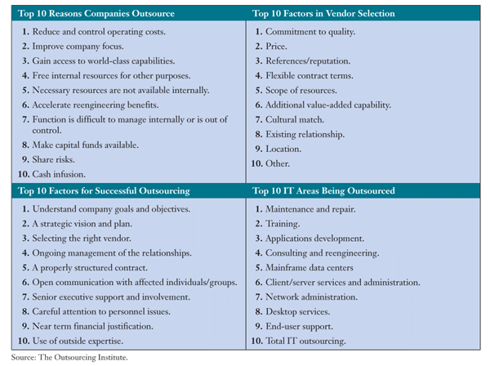
Outsourcing’s Top Ten
Notes:
reason reduce =Alasan mengurangi, , justification=pembenaran
improv, infusion, outside expertise, affected, involvement, attention= improvisasi, infus, keahlian luar, terpengaruh, keterlibatan, perhatian,
existing relationship. area being outsourcing=hubungan yang ada. wilayah menjadi outsourcing

Slide 21
Why outsource?
Hemat (save mony) - mencapai ROI yang lebih besar
Fokus pada kompetensi inti - organisasi dapat fokus pada bisnis yang mereka kelola/jalankan
Mencapai tingkat staf fleksibel
Mendapatkan akses ke sumber daya global
Mengurangi waktu market/pasar

Slide 22
Offshoring
Relokasi proses bisnis organisasi
Untuk lokasi-biaya yang lebih rendah, biasanya di luar negeri

Slide 23
IT Management Failures
IT not used effectively (TI tidak digunakan secara efektif )
  Komputerisasi proses bisnis tradisional
  Alih-alih mengembangkan proses e-bisnis yang inovatif
IT not used efficiently
  Waktu respon yang buruk dan sering downtime
  Kurang berhasil proyek pengembangan aplikasi

Slide 24
Management Involvement and Governance
Managerial and end user involvement
  Key ingredient (bahan kunci atau bahan utama) to high-quality information systems performance (kinerja sistem informasi kerkwalitas tinggi)
Involve managers in the management of IT
  Struktur pemerintahan seperti komite pengarah (Governance structures such as steering committees)

Slide 25
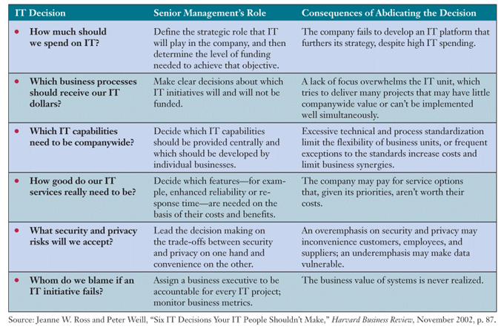
Senior management’s involvement in business/IT decisions
(Keterlibatan manajemen senior dalam keputusan bisnis/IT)
Notes:
decisions, spend , of abdicating, privacy risk , accept = keputusan, menghabiskan, dari abdicating, risiko privasi, menerima,
funded, decide, provide, developed, reliabilitty=didanai, memutuskan, menyediakan, mengembangkan, reliabilitty
convenience, despite, a lack , overwhelms =kenyamanan, meskipun, kurangnya a, menguasai.
excessive, frequent, aception, under emphasis =berlebihan, sering, aception, di bawah penekanan,
overemphasis, vulnerable=lebih penekanan, rentan

Slide 26
Case 2: CIOs Need to Think/berfikir Globally and Act/bertindak Locally
Enterprises globalize for different reasons/alasan
  Examples: global customers, mencari peluang pertumbuhan, efisiensi biaya/cost efficiencies
CIO’s IT globalization decisions should : (Keputusan globalisasi CIO TI haruslah : )
  Tentukan oleh keseimbangan integrasi global terhadap respon lokal
  Sejajarkan proses utama TI dengan orientasi tata kelola perusahaan.
  Menetapkan staf, peran, dan kompetensi yang tepat

Slide 27
Case Study Questions
Ada beberapakah kekuatan pendorong organisasi TI untuk mengglobal?
Ada beberapakah kekuatan lokal dan tantangan yang dihadapi organisasi TI modern?
Bagaimana seorang CIO mengelola persyaratan untuk kedua globalisasi dan melokalisasi fungsi IT?

Slide 28
Real World Internet Activity
Salah satu masalah yang dihadapi CIO adalah penilaian TI jatuh tempo di negara-negara mereka beroperasi or awal masuk. Menggunakan Internet,.
  Lihat jika Anda dapat menemukan contoh dari negara-negara di mana kematangan TI masih rendah, namun tantangan yang dihadapi lebih besar.
  Apa karakteristik suatu negara yang kematangan IT nyarendah?

Slide 29
Real World Group Activity
Salah satu resep yang ditawarkan dalam hal ini adalah untuk "menyelaraskan proses utama TI dengan orientasi tata kelola perusahaan.” In small groups,
  Diskusikan arti dari resep ini.
  Yang dimaksud dengan "orientasi pemerintahan?"
  Bagaimana TI dapat menjadi lebih selaras dengan organisasi dalam hal ini?
  Apakah ada satu cara yang tepat untuk mengatur IT?

Slide 30
Global IT Management
Develop appropriate business and IT strategies for the global marketplace
Develop the portfolio of business applications needed to support business/IT strategies
Determine the technology platform needed
Determine the systems development projects that will produce the required global information systems

Slide 31
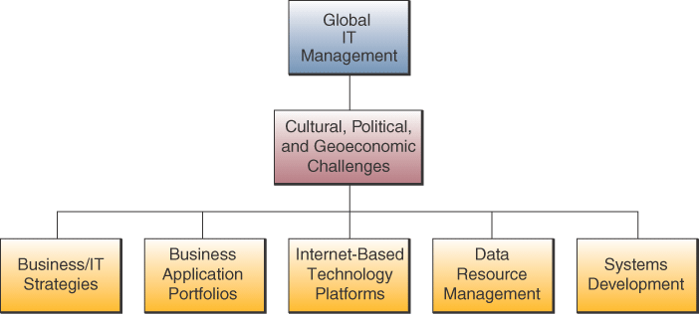
Global IT Management Dimensions

Slide 32
Global IT Management Challenges
Political
Geoeconomic – effects of geography on the economic realities of international business activities
Cultural

Slide 33
Political Challenges
Rules regulating or prohibiting transfer of data across national boundaries
Severely restricted, taxed, or prohibited imports of hardware and software
Local content laws that specify the portion of the value of a product that must be added in that country if it is to be sold there
Reciprocal trade agreements that require a business to spend part of the revenue they earn in a country in that nation’s economy

Slide 34
Geoeconomic Challenges
Sheer physical distances
Difficult to get good-quality telephone and telecommunications services
Differences in the cost of living and labor costs

Slide 35
Cultural Differences
Languages
Cultural Interests
Religions
Customs
Social Attitudes
Political Philosophies

Slide 36
Transnational Strategies
Business depends heavily on its information systems and Internet technologies to help integrate global business activities
Develop an integrated and cooperative worldwide IT platform

Slide 37
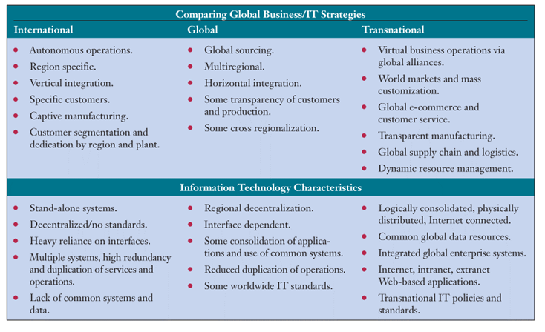
Transnational Business/IT strategies

Slide 38
Global Business Drivers
Business requirements caused by the nature of the industry and its competitive or environmental forces
Examples of drivers:
  Global Customers
  Global Products
  Global Operations
  Global Resources
  Global Collaboration

Slide 39
Global IT Platform
Managing the hardware, software, data resources, telecommunications networks, and computing facilities that support global business operations
Technically complex with major political and cultural implications

Slide 40
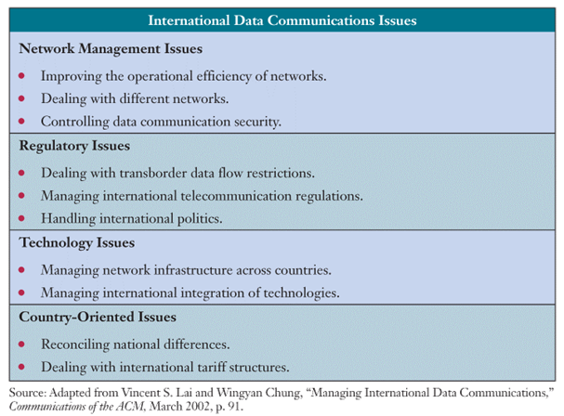
International Data Communications Top 10 Issues

Slide 41
Internet as a Global IT Platform
Technology platform free of many traditional international boundaries and limits
Expand markets, reduce communications and distribution costs, and improve profit margins without massive cost outlays for telecommunications

Slide 42
Key Questions for Global Websites
Will you have to develop a new navigational logic to accommodate cultural preferences?
What content will you translate, and what content will you create from scratch to address regional competitors or products that differ from those in the U.S.?
Should your multilingual effort be an adjunct to your main site, or will you make it a separate site, perhaps with a country-specific domain?

Slide 43
Key Questions for Global Websites
What kinds of traditional and new media advertising will you have to do in each country to draw traffic to your site?
Will your site get so many hits that you’ll need to set up a server in a local country?
What are the legal ramifications of having your website targeted at a particular country, such as laws on competitive behavior, treatment of children, or privacy?

Slide 44
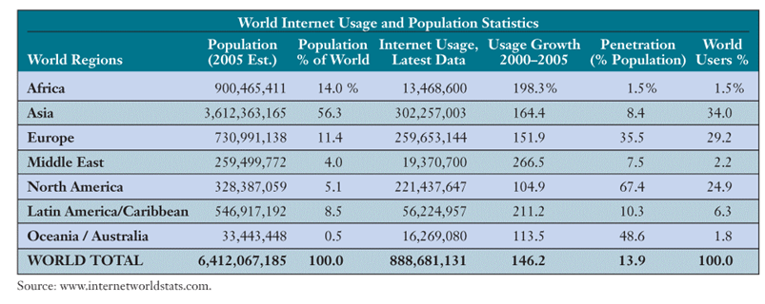
Internet Users by World Region

Slide 45
Global Data Access Issues
Transborder Data Flows
  Business data flow across international borders over the telecommunications networks of global information systems
  May be viewed as violating a nation’s sovereignty because avoids custom duties
  Or violating their laws to protect local IT industry from competition or their labor regulations for protecting local jobs

Slide 46
U.S.-E.U Data Privacy Requirements
Notice of purpose and use of data collected
Ability to opt out of third-party distribution of data
Access for consumers to their information
Adequate security, data integrity and enforcement provisions
Notes:
In order for US companies to do e-commerce in EU, this agreement was reached
Self-regulatory rather than subject to EU Data Privacy Directive

Slide 47
Internet Access Issues in Most Restrictive Countries
High Government Access Fees
Government Monitored Access
Government Filtered Access
No Public Access Allowed

Slide 48
Global Systems Development
Conflicts over local versus global system requirements
Difficulties in agreeing on common system features
Disturbances caused by systems implementation and maintenance activities
Global standardization of data definitions

Slide 49
Systems Development Strategies
Transform an application used by the home office into a global application
System used by a subsidiary that has the best version of an application will be chosen for global use
Set up a multinational development team with key people from several subsidiaries to ensure that the system design meets the needs of local sites as well as corporate headquarters

Slide 50
Systems Development Strategies
Parallel Development – parts of the system are assigned to different subsidiaries and the home office to develop at the same times based on the expertise and experience at each site
Centers of Excellence – an entire system may be assigned for development to a particular subsidiary based on their expertise in the business or technical dimensions needed for successful development
Offshore Development – outsource the development work to a global development company

Slide 51
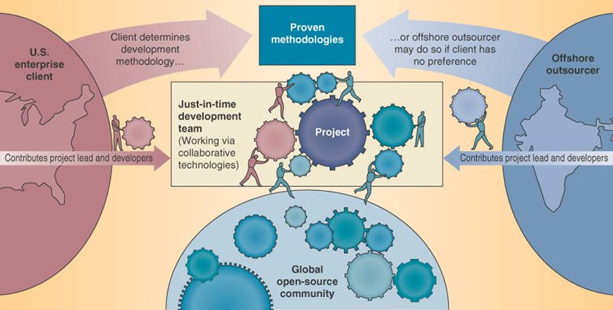
Internet-enabled Collaboration in IT Development
Source: Adapted from Jon Udell, “Leveraging a Global Advantage,” Infoworld, April 21, 2003, p. 35.

Slide 52
IT Careers
Outsourcing of basic programming to India, the Middle-East and Asia-Pacific countries
Strong employment opportunities in other areas in IS
Shortage of qualified IS personnel
Long-term job outlook positive and exciting

Slide 53
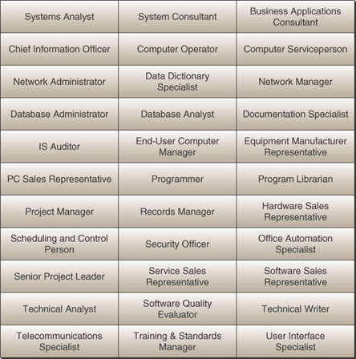
Career Opportunities in IS

Slide 54
Job growth
Among the fastest growing occupations through 2012
  Systems Analyst,
  Database administrators,
  Other managerial-level positions
  Network specialists
  Information security

Slide 55
IS Function represents
Major functional area of business
Important contributor to operational efficiency, employee productivity, morale, customer service and satisfaction
Major source of information and support for effective decision making
Vital ingredient in developing competitive products and services in the global marketplace
Dynamic and challenging career opportunity
Key component of today’s networked business

Slide 56
Terima Kasih
Good Luck

