Slide 1
DASAR SISTEM INFORMASI
Dosen Pengampu : KARTINI S.Kom.,MMSI
Prodi Sistem Informasi - Fakultas Ilmu Komputer

Slide 2
DASAR SISTEM INFORMASI
Pert.13 :
Electronic Business Systems and Electronic Commerce Systems
e-Commerce trends
e-Commerce processes
e-Commerce success factors
e-Commerce categories

Slide 3
Learning Outcomes
e-Commerce trends
e-Commerce processes
e-Commerce success factors
e-Commerce categories
Collaboration and Trading
e-Commerce Portals
Electronic Payment Processes
Securing Electronic Payments

Slide 4
Learning Objectives
Identify the major categories and trends of e-commerce applications
Identify the essential processes of an e-commerce system, and give examples of how they are implemented in e-commerce applications.
Identify and give examples of several key factors and Web store requirements needed to succeed in e-commerce.

Slide 5
Learning Objectives
Identify and explain the business value of several types of e-commerce marketplaces.
Discuss the benefits and trade-offs of several e-commerce clicks and bricks alternatives.

Slide 6
Case 1 eBay: Running the Right Play in the Right Company
eBay has 31 sites around the world
They generated $1.1 billion in 2004 sales, 46% of eBay’s overall trading revenues
Playbook: collective wisdom of eBay’s worldwide managers

Slide 7
Case Study Questions
Why has eBay become such a successful and diverse online marketplace? Visit the eBay website to help with your answer, and check out the many trading categories, specialty sites, and other features.
What do you think of eBay’s playbook concept? Why do they call it a playbook?
Is eBay’s move into the international arena a good long-term strategy? Why or why not?

Slide 8
Real World Internet Activity
eBay is aggressively, and successfully, moving into new international markets. Using the Internet,
  See if you can find one or two of eBay’s international sites.
  How do they differ from the eBay site in North America?
  Can you find products that are unique to the international site?
  How about services and features?

Slide 9
Real World Group Activity
The eBay playbook is designed to assist in making the decisions necessary to tailor eBay’s presence to the unique nature of an international arena. In most cases, however, the playbook cannot tell them what to expect when moving into a new country. In small groups,
  Brainstorm some of the challenges of opening an eBay site in a new country.
  Pick a country and see if you can imagine the playbook for that new market.

Slide 10
Electronic commerce
Electronic commerce adalah proses pembelian & penjualan, pemasaran & pelayanan, pengiriman & pembayaran dari suatu produk, jasa atau informasi melalui jaringan komputer, antara suatu enterprise dan calon pelanggan, pelanggan, pemasok, atau patner bisnis lainnya.

Slide 11
Electronic Commerce
More than just buying and selling products online
Includes the entire online process of
  Developing, marketing, selling, delivering, servicing and paying for products and services
  Transacted on the internetworked global marketplaces of customers
  With the support of a worldwide network of business partners

Slide 12
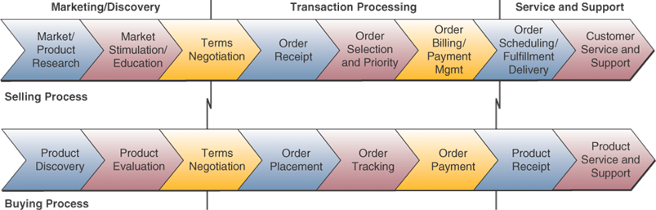
Processes involved in E-commerce

Slide 13
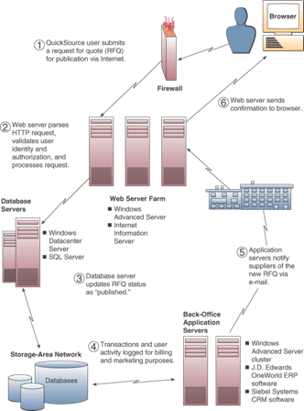
E-commerce technologies

Slide 14
Categories of e-Commerce
Business-to-Consumer (B2C) – businesses develop attractive electronic marketplaces to sell products and services to consumers
Business-to-Business (B2B) – involves both electronic business marketplaces and direct market links between businesses
Consumer-to-Consumer (C2C) – online auctions where consumers can buy and sell with each other
Notes:
There is also Business-to-Government (B2G) and e-government applications

Slide 15
Kategori E-Commerce
Business to Consumer Commerce
  transaksi terjadi antara suatu perusahaan dengan konsumen
Business to Business Commerce
  transaksi terjadi antar suatu perusahaan dengan perusahaan lainnya

Slide 16
Business to Consumer Commerce
GUI harus lebih menarik
Virtual storefronts
Virtual shopping mall
Interactive order processing
Secure electronic payment systems

Slide 17
Business to Business Commerce (I)
Mendukung proses pengelolaan
“supply chain”:
  Supplier management
  Inventory management
  Distribution management
  Channel management
  Payment management
  Financial management
  Salesforce management

Slide 18
Business to Business Commerce (II)
Wholesaling on the web
EDI (Electronic Data Interchange)
Keuntungan:
- Pengurangan dalam penggunaan kertas
    Arus transaksi lebih cepat
    Pengurangan kesalahan
    Produktifitas meningkat
    Mendukung “Jusi in time”
    Pengurangan dalam level persediaan
Internal Business Process

Slide 19
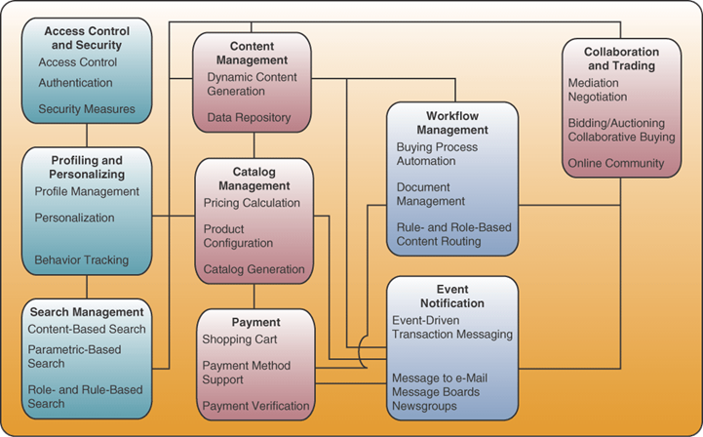
Essential e-commerce process architecture
Notes:
Processes are typically used in e-commerce applications but can also be used in internal non-commerce e-business applications

Slide 20
Access Control and Security
E-commerce processes must establish mutual trust and secure access
Between the parties in an e-commerce transaction
By authenticating users, authorizing access, and enforcing security features

Slide 21
Profiling and Personalizing
Gather data on you and your website behavior and choices
Build electronic profiles of your characteristics and preferences
Profiles are used to recognize you and provide you with a personalized view of the contents of the site with product recommendations and personalized advertising
One-to-one marketing strategy

Slide 22
Search Management
Search processes that helps customers find the specific product or service they want to evaluate or buy

Slide 23
Content and Catalog Management
Content Management – software that helps e-commerce companies develop, generate, deliver, update, and archive text data and multimedia information at e-commerce websites
Catalog Management – software that helps generate and manage catalog content
May support customer self-service and mass-customization of products, e.g., Dell Computer configuration management
Notes:
E-commerce content is frequently in the form of multi-media catalogs. So catalog management is a subset of content management.

Slide 24
Workflow Management
Software that helps employees electronically collaborate to accomplish structured work tasks within knowledge-based business processes
Ensure proper transactions, decisions, and work activities are performed and the correct data and documents are delivered to the right employee, customer, or supplier

Slide 25
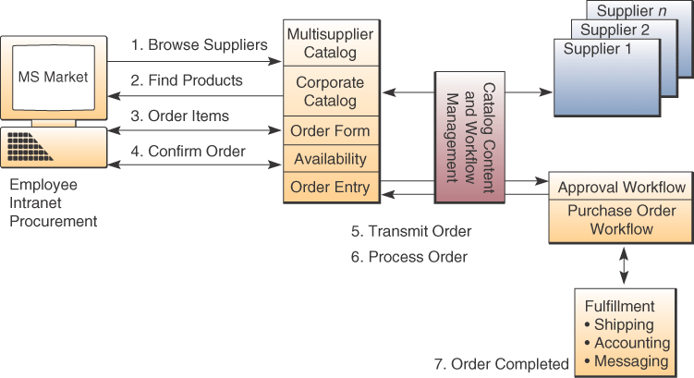
Catalog/content management and workflow example

Slide 26
Event Notification
Most e-commerce applications are event-driven
Respond to events such as customer’s first website access, payment, delivery
Event notification software monitors e-commerce processes
Records all relevant events including problem situations
Notifies all involved stakeholders

Slide 27
Collaboration and Trading
Processes that support the vital collaboration arrangements and trading services
Needed by customers, suppliers, and other stakeholders
Online communities of interest
  E-mail, chat, and discussion groups
  Enhance customer service and build customer loyalty
Notes:
Help support a customer-focused business (refer back to chapter 2)

Slide 28
Electronic Data Interchange (EDI)
Merupakan salah satu bentuk pertama dari penerapan electronic commerce
EDI meliputi pertukaran dokumen transaksi bisnis perusahaan melalui Internet dan jaringan antara pemasok (organisasi dan konsumen2 dan supplier2nya.)

Slide 29
E-Commerce dan Customer Value
Perusahaan memanfaatkan Internet untuk:
  Membuat pelanggan menjadi loyal
  Mengantisipasi kebutuhan pelanggan
  Merespon keinginan pelanggan
  Meningkatkan layanan pelanggan

Slide 30
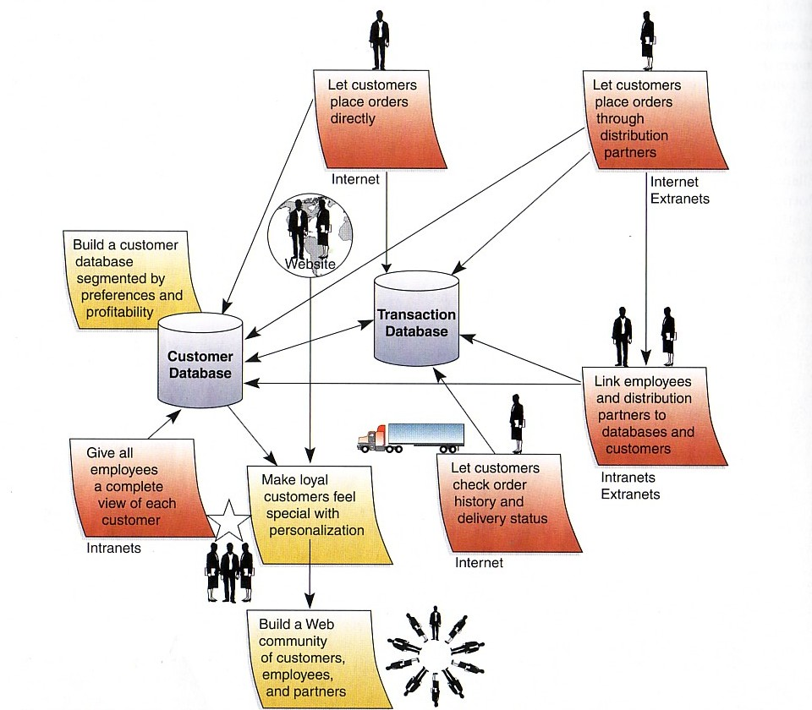
E-Commerce dan nilai pelanggan (customer value)
Dari gambar di atas dapat terlihat bagaimana penerapan e-business yang berfokus pada pelanggan dapat meningkatkan nilai dan loyalitas pelanggan dalam penerapan e-Commerce
Notes:
Source :

Slide 31
Manfaat Internet untuk Customer Value
Biaya dukungan relatif lebih rendah
Akses yang lebih luas ke Customer Service
Memperkuat patner bisnis melalui layanan informasi online
Interaktif
Layanan proaktif dan program pemasaran
Memudahkan respon yang lebih cepat dan tanggap

Slide 32
Sistem Pengolahan Transaksi
Transaksi adalah kejadian (event) yang terjadi sebagai bagian dari aktivitas bisnis seperti penjualan, pembelian, penyim-panan, penarikan, penggantian, dan pembayaran.
Sistem Pengolahan Transaksi (Transaction Processing System = TPS) adalah sistem informasi yang mengolah data yang dihasilkan dari aktivitas transaksi bisnis.

Slide 33
Siklus Pengolahan Transaksi
Entri Data/ memasukkan data
    Traditional Data Entry
    Source Data Automation
    Electronic Data Interchange (EDI)
    Electronic Fund Transfer (EFT)
Pengolahan transaksi
Perawatan basis data
Pencetakan dolumen dan laporan
Pengolahan permintaan laporan, etc (inquiry)

Slide 34
Data Entri secara Tradisional
FORM TRANSAKSI
EDITING
ENTRI
WORKSTATION
FILE TRANSAKSI
DATABASE
PENGOLAHAN

Slide 35
Source Data Automation
MAGNETIC STRIPE CARD
BARCODED CARD
OCR WAND
FILE TRANSAKSI
EDITING
DATABASE
PENGOLAHAN

Slide 36
Pengolahan transaksi
Batch Processing
BUNDEL TRANSAKSI
ALAT BACA
FILE TRANSAKSI
FILE MASTER BARU
PENGOLAHAN
LAPORAN
FILE MASTER LAMA
DOKUMEN TRANSAKSI

Slide 37
Pengolahan transaksi
Real time/online Transaction Processing
TRANSAKSI
ONLINE WORKSTATION
POS TERMINAL
PENGOLAHAN TRANSAKSI
UPDATING DATABASE
PENGOLAHAN INQUIRY
DATABASE PRODUK
DATABASE PELANGGAN
DATABASE PENJUALAN

Slide 38
Electronic Payment Processes
Web Payment Processes
  Shopping cart process
  Credit card payment process
  Other more complex payment processes
Electronic Funds Transfer (EFT)
  Capture and process money and credit transfers between banks and businesses and their customers

Slide 39
Electronic Payments
Electronic Funds Transfer
  Adalah sistem pembayaran dana secara elektronik tanpa uang kas maupun dokumen kertas
  Contoh: Credit cards, debit cards, ATM
Secure Electronic Payments pada Internet
  Transaksi melalui Internet rawan terhadap intersepsi
  Perlu penerapan sekuriti melalui enkrispsi data
  Contoh : SET (Secure Electronic Transaction)

Slide 40
Contoh
Secure Electronic Payment Systems
PELANGGAN
PEDAGANG
REQUEST
BROWSER
PELANGGAN
SERVER
PEDAGANG
VERIFIKASI PEDAGANG
TERIMA INFO PESANAN
TERIMA INFO PEMBAYARAN
KONFIRMASI PESANAN
VERIFIKASI PELANGGAN
PERIKSA INFO PEMBAYARAN
TOLAK/TERIMA PEMBAYARAN
SERVER
PEMBAYARAN
KOMPUTER ON-LINE DARI PIHAK KETIGA YANG DI-LINK KE BERBAGAI SISTEM PEMBAYARAN
KARTU KRIDIT:
-VISA
KARTU
CHARGE:
-Diner’s Club
REKENING:
Kartu Debit
KARTU LABEL
PRIBADI:
-JCPenny
ELECTRONIC
CASH:
E-Cash

Slide 41
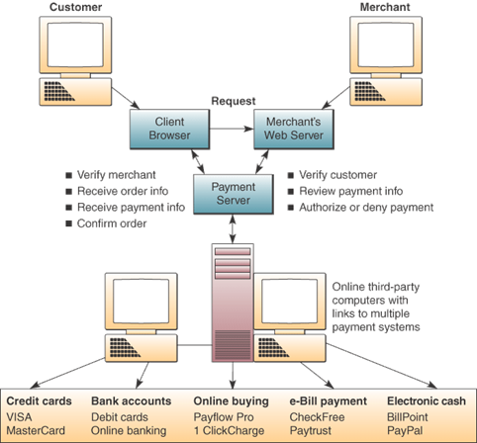
Secure Electronic Payment Example

Slide 42
Securing Electronic Payments
Network sniffers
  Software that recognizes and intercepts credit card number formats
Security measures to combat
  Encrypt (code and scramble) data between customer and merchant
  Encrypt credit card authorizations
  Take sensitive information off-line

Slide 43
Case 2: Google and Others
In search of the Future
The search engine has become the Internet’s “killer app”
Selling ads linked to search results has become a growth business
Demand for new ways of searching digital information
Goal:
  Extract information from databases, Web pages, documents, or audio and video clips automatically
  Recognize names, dates and dollar amounts
  Find the relationships among them

Slide 44
Case Study Questions
What is the driver behind the development of new and more powerful search engines
Why can human beings still do much better at assessing the relevance of a website than sophisticated search engines? What are the modern search engines failing to include?
What is the difference between looking for search terms and looking for “expressions of human language?”

Slide 45
Real World Internet Activity
Search engines exist for just about any type of Internet search you may wish to conduct. The big ones like Google, Yahoo, and MSN are commonly used. Using the Internet,
  See if you can find some lesser-known search engines.
  What are their special features and benefits?
  Why aren’t more people using them?
  Check out www.kartoo.com to see a unique approach to Internet search.

Slide 46
Real World Group Activity
Each day, data is becoming more and more complex. Adding to its complexity is its sheer volume, which is monumental. In small groups,
  Brainstorm how some of the complex data we commonly generate can be sorted and searched.
  How would we go about searching for a picture of something? How about a particular color?

Slide 47
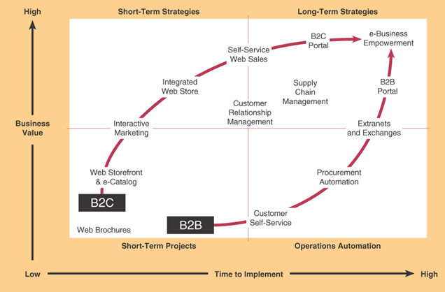
e-Commerce Trends
Source: Adapted from Jonathan Rosenoer, Douglas Armstrong, and J. Russell Gates, The Clickable Corporation:
Successful Strategies for Capturing the Internet Advantage (New York: The Free Press, 1999), p. 24.
Notes:
Note how Business-to-consumer moves from simple storefronts to interactive marketing capabilities to a totally integrated web store that supports a variety of customer shopping experiences.
Similarly business-to-business moving from storefront to configurations and customization capabilities with extranets connecting trading partners

Slide 48
e-Commerce Success Factors
Selection and Value
  Attractive product selections, competitive prices, satisfaction guarantees, and customer support after the sale
Performance and Service
  Fast, easy navigation, shopping, and purchasing, and prompt shipping and delivery
Look and Feel
  Attractive web storefront, website shipping areas, multimedia product catalog pages, and shopping features

Slide 49
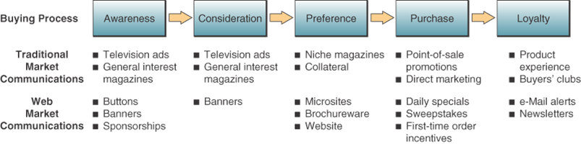
e-Commerce Success Factors
Advertising and Incentives
  Targeted web page advertising and e-mail promotions, discounts and special offers, including advertising at affiliate sites

Slide 50
e-Commerce Success Factors
Personal Attention
  Personal web pages, personalized product recommendations, Web advertising and e-mail notices, and interactive support for all customers
Community Relationships
  Virtual communities of customers, suppliers, company representatives, and others via newsgroups, chat rooms, and links to related sites
Security and Reliability
  Security of customer information and website transactions, trustworthy product information, and reliable order fulfillment

Slide 51
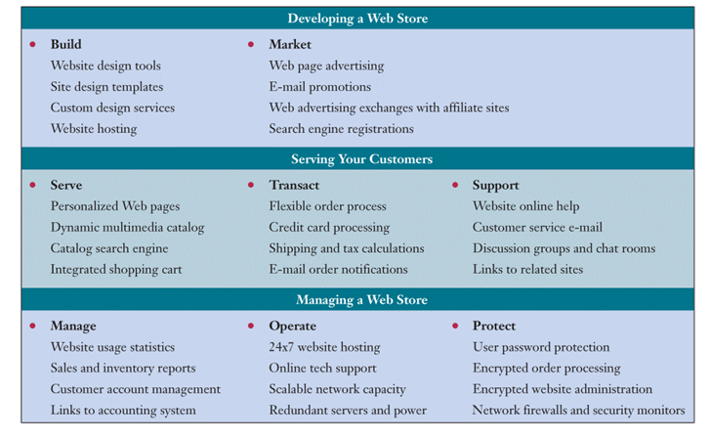
Web Store Requirements

Slide 52
Developing a Web Store
Build website
  Use simple website design tools
  Predesigned templates
  Build your own website or use outside contractor
Market website to attract visitors and transform them into loyal customers

Slide 53
Serving Customers
Serve customers by creating user profiles, personal Web pages and promotions that help develop a one-to-one relationship
Transact with customers by providing an attractive, friendly, and efficient Web store
Support customers with
  Self-help menus, tutorials, FAQs
  E-mail correspondence with customer service representatives

Slide 54
Managing a Web Store
Manage both the business and the website
  Record and analyze traffic, inventory and sales
  Link to accounting system
Operate twenty-four hours a day, seven days a week
Protect transactions and customer records, use firewalls, and repel hacker attacks

Slide 55
B2B e-Commerce
B2B e-commerce is the wholesale and supply side of the commercial process, where businesses buy, sell, or trade with other businesses.
Factors for building a successful retail website also apply to websites for B2B e-commerce.

Slide 56
e-Commerce Marketplaces
One to Many – sell-side marketplaces host one major supplier who dictates product catalog offerings and prices
Many to One – buy-side marketplaces attract many suppliers that flock to these exchanges to bid on the business of a major buyer
Some to Many – distribution marketplaces unite major suppliers who combine their product catalogs to attract a larger audience of buyers

Slide 57
e-Commerce Marketplaces
Many to Some – procurement marketplaces unite major buyers who combine their purchasing catalogs to attract more suppliers and thus more competition and lower prices
Many to Many – auction marketplaces used by many buyers and sellers that can create a variety of buyers’ or sellers’ auctions to dynamically optimize prices

Slide 58
e-Commerce Portals
B2B e-commerce portal can provide several types of marketplaces in one site
Often developed and hosted by third-party market-maker companies who serve as infomediaries that bring buyers and sellers together in catalog, exchange, and auction markets.

Slide 59
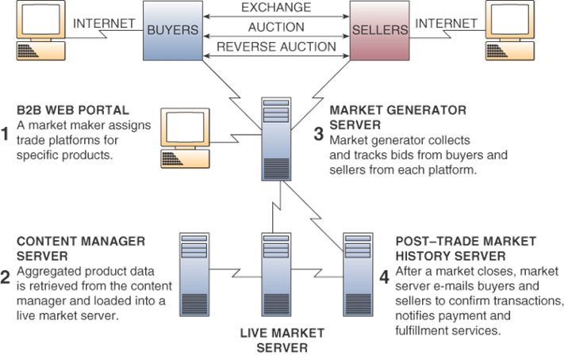
B2B e-Commerce Web Portal
Notes:
Portal includes several different business models

Slide 60
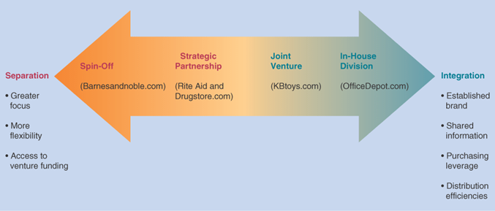
Clicks and Bricks
Should we integrate our e-commerce business operations with our traditional physical business operations
Or should we keep them separate?

Slide 61
e-Commerce Channel
The marketing or sales channel created by a company to conduct and manage its chosen e-commerce activities
Issue is whether the e-commerce channel should be integrated with traditional sales channel.

Slide 62
Checklist for Channel Development
What audiences are attempting to reach?
What action do we want these audiences to take?
  Learn about us, give us information, make an inquiry, to buy something from website, or buy through another channel?
Who owns the e-commerce channel within the organization?
Is the e-commerce channel planned alongside other channels?

Slide 63
Checklist for Channel Development
Do we have a process for generating, approving, releasing, and withdrawing content?
Will our brands translate to the new channel or will they require modification?
How will we market the channel itself?

Slide 64
Case 3: The WWW is Anything but Business as Usual
Microsoft.com attracts 8 million visitors a day and handles 40 to 50,000 requests per second
  Customers are now part of Microsoft’s communities
Federated is using what they’ve learned in e-commerce for internal use
Dell has launched a major redesign of their site so that it will work in many countries

Slide 65
Case Study Questions
What are the primary driver behind the Web upgrade activities of Microsoft and Dell?
What is the business value of Microsoft’s Web-based live feedback program?
What lessons on developing successful e-commerce projects can be gained from the information in this case?

Slide 66
Real World Internet Activity
The concept of building a community on the Internet is still in its infancy. Using the Internet,
  See if you can find other companies that are doing the same things that Microsoft, Federated, and Dell are doing to build customer communities as outlined in the case.

Slide 67
Real World Group Activity
Advertisers have learned that running banner ads on websites is profitable despite the fact that most web surfers claim they do not like to see them. In small groups,
  Brainstorm ways in which advertisers can take advantage of the Internet by providing advertising an Internet surfer might want to see. In other words, how can Internet advertising be more targeted and relevant?

Slide 68
Terima Kasih
Good Luck

