Slide 1
DASAR SISTEM INFORMASI
Dosen Pengampu : KARTINI S.Kom.,MMSI
Prodi Sistem Informasi - Fakultas Ilmu Komputer

Slide 2
DASAR SISTEM INFORMASI
Pert.13 :
Electronic Business Systems and Electronic Commerce Systems
Cross-functional Enterprise Systems and
Functional Business Systems

Slide 3
Learning Outcomes
Cross-functional Enterprise Systems,
Functional Business Systems, ethical and Legal Issues in E-Bussines
Cross-functional Systems
Mobile computing and mobile commerce, and electronic Payment

Slide 4
Learning Objectives
Identify the following cross-functional enterprise systems, and give examples of how they can provide significant business value to a company:
  Enterprise resource planning
  Customer relationship management
  Supply chain management
  Enterprise application integration
  Transaction processing systems
  Enterprise collaboration systems

Slide 5
Learning Objectives
Give examples of how Internet and other information technologies support business processes within the business functions of accounting, finance, human resource management, marketing, and production and operations management.
Understand the need for enterprise application integration to improve support of business interactions across multiple e-business applications.

Slide 6
Case 1: Hilton Hotels Corporation
Data-Driven Hospitality
OnQ the IT piece of a “customers really matter” strategy
Goal to
  Build customer loyalty
  More revenue per visit
Customer profiles

Slide 7
Case Study Questions
What are the benefits and drawbacks of the OnQ system at Hilton?
What does Hilton have to do to create a competitive advantage through OnQ? Provide some specific examples.
Is it possible to have too much information about a customer? Explain.

Slide 8
Real World Internet Activity
The concept of customer relationship management is rooted in the idea that more information about a customer will ultimately result in better service to the customer. Using the Internet,
  See if you can find examples of other companies that have found ways in which to apply the gathering of customer data to the management of customer relationships?

Slide 9
Real World Group Activity
CRM raises issues of invasion of privacy since conclusions can be drawn about a customer’s behavior from the data commonly collected. In small groups,
  Discuss these potential privacy issues.
  How can an organization meet the needs of serving its customers while simultaneously protecting their privacy?

Slide 10
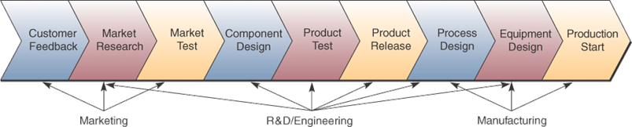
Cross-functional Systems
Cross the boundaries of traditional business functions
In order to reengineer and improve vital business processes all across the enterprise

Slide 11
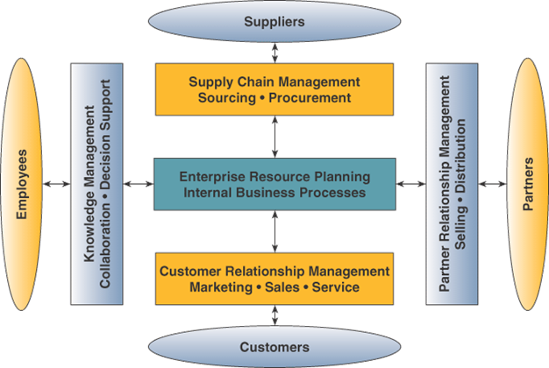
Enterprise Application Architecture
Source: Adapted from Mohan Sawhney and Jeff Zabin, Seven Steps to Nirvana: Strategic
Insights into e-Business Transformation (New York: McGraw-Hill,2001), p. 175.

Slide 12
Customer Relationship Management (CRM)
CRM uses technology to
  Create a cross-functional enterprise system
  That integrates and automates many of the processes in sales, marketing and customer service that interact with customers
  Create a framework of web-enabled software and databases that integrate these processes with the rest of the company’s processes

Slide 13
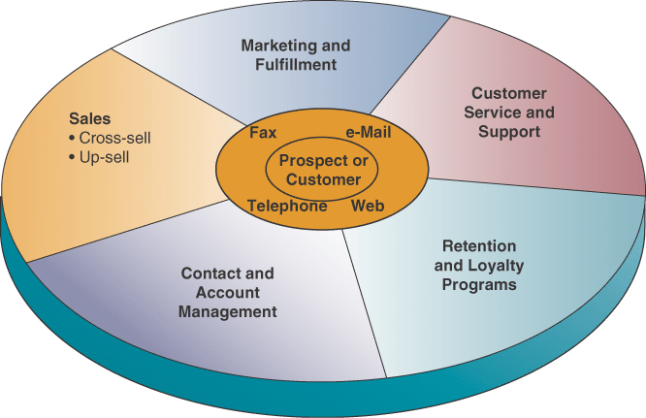
CRM Applications Clusters

Slide 14
CRM applications
Contract and Account Management
  Helps sales, marketing and service professionals
  Capture and track data about past and planned contacts with customers and prospects
Sales
  Provides sales reps with software tools and data they need to support and manage sales activities
  Cross-selling is trying to sell a customer of one product with a related product
  Up-selling is trying to sell customer a better product than they are currently seeking

Slide 15
CRM applications
Marketing and Fulfillment
  Help marketing professionals accomplish direct marketing campaigns by tasks such as
  Qualifying leads for targeted marketing and scheduling and tracking direct marketing mailings

Slide 16
CRM applications
Customer Service and Support
  Provides sales reps with software tools and database access to customer database shared by sales and marketing professions
  Helps create, assign and manage requests for service
  Call center software routes calls to customer support agents based upon their skills and type of call
  Help desk software provides relevant service data and suggestions for resolving problems for customer service reps helping customers with problems

Slide 17
CRM applications
Retention and Loyalty Programs
  Try to help a company identify, reward, and market to their most loyal and profitable customers
  Data mining tools and analytical software
  Customer data warehouse

Slide 18
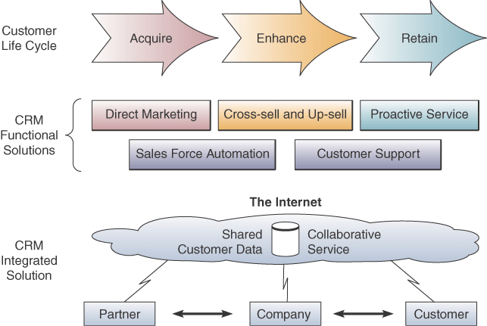
CRM supports customer life cycle
Notes:
Customer life cycle: Three phases of the relationship between the company and its customers:
Acquire – acquire new customers
Enhance – keep customers happy, cross sell and up-sell
Retain – identify and reward most loyal and profitable customers

Slide 19
CRM benefits
Identify and target best customers
Real-time customization and personalization of products and services
Track when a customer contacts a company
Provide consistent customer experience and superior service and support

Slide 20
Reasons for CRM failures
Lack of understanding and preparation
Rely on application to solve a problem without first changing the business processes
Business stakeholders not participating and not prepared
Notes:
Over 50% of CRM projects did not produce results that were promised
20% of businesses report that CRM has damaged customer relationships

Slide 21
Enterprise Resource Planning (ERP)
Cross-functional enterprise system
  with an integrated suite of software modules
  that support the basic internal business processes of a company

Slide 22
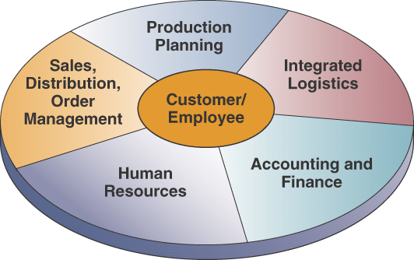
ERP application components
Notes:
Note the truly cross-functional aspect of these systems

Slide 23
Business benefits of ERP
Quality and efficiency
Decreased costs
Decision support
Enterprise agility
Notes:
Improvements in quality and efficiency
Significant reductions in transaction processing costs and IT support
Provides cross-functional information for making better decisions
ERP breaks down functional wall making a more flexible organization

Slide 24
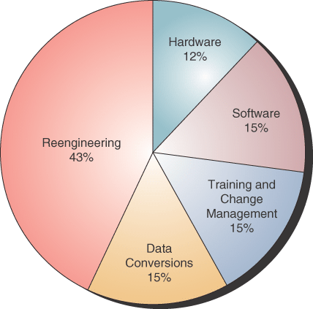
Costs of implementing a new ERP

Slide 25
Causes of ERP failure
Underestimating the complexity of planning, development and training
Failure to involve affected employees in planning and development
Trying to do too much too fast
Insufficient training in new work tasks
Failure to do enough data conversion and testing
Over reliance on ERP vendor or consulting companies

Slide 26
Supply Chain Management (SCM)
A cross-functional interenterprise system
To help support and manage the links between a company’s key business processes
And those of its suppliers, customers and business partners

Slide 27
SCM goal
Fast, efficient, low-cost network of business relationships or supply chain to get a company’s products from concept to market
A supply chain:
  Interrelationships with suppliers, customers, distributors, and other businesses that are needed to design, build and sell a product
Notes:
A supply chain adds value to the products and services a company produces so it is also a value chain (see chapter 2). But not all value chains are supply chains.

Slide 28
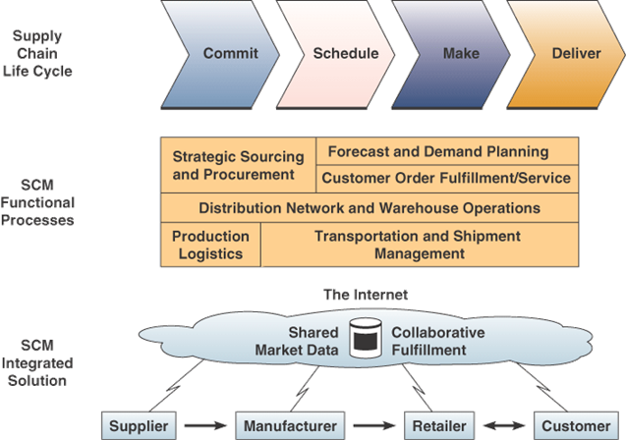
SCM

Slide 29
Electronic Data Interchange (EDI)
EDI:
  The electronic exchange of business transactions
  Over the Internet and other networks
  Between supply chain trading partners

Slide 30
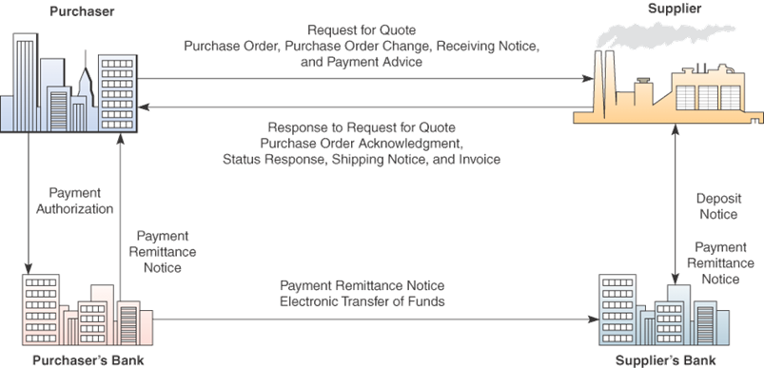
EDI Examples

Slide 31
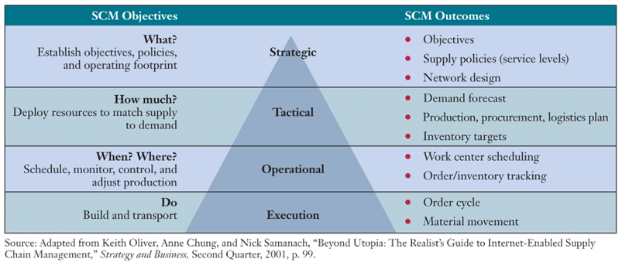
Role of SCM

Slide 32
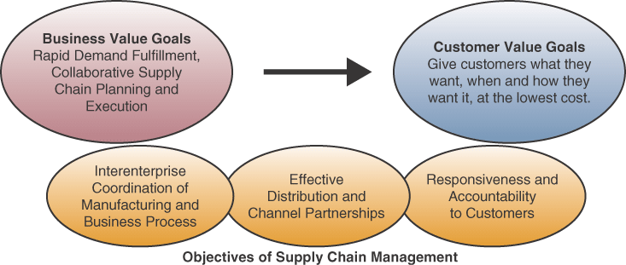
Goals and Objectives of SCM

Slide 33
Causes of problems in SCM
Lack of proper demand-planning knowledge, tools and guidelines
Inaccurate or overoptimistic demand forecasts
Inaccurate production, inventory, and other data
Lack of adequate collaboration within the company and between partners
SCM software considered immature, incomplete and hard to implement

Slide 34
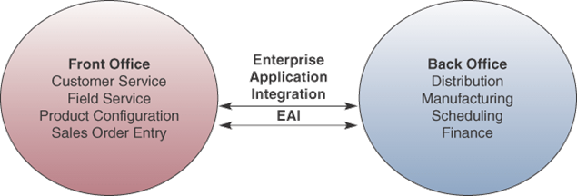
Enterprise Application Integration (EAI)
EAI connects cross-functional systems
Serves as middleware to
    Provide data conversion
    Communication between systems
    Access to system interfaces

Slide 35
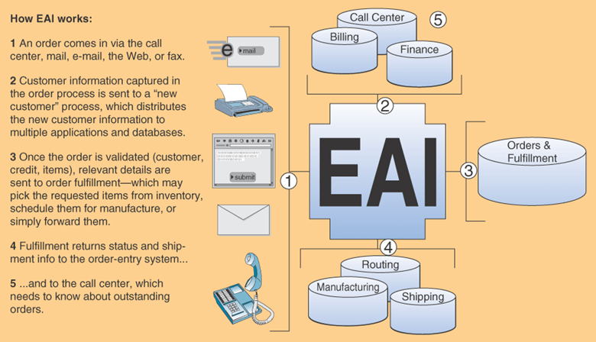
How EAI works

Slide 36
Enterprise Collaboration Systems (ECS)
ECS
  Cross-functional IS that enhance communication, coordination and collaboration among the members of business teams and workgroups

Slide 37
ECS Goals
Communicate: share information with each other
Coordinate: coordinate individual work efforts and use of resources with each other
Collaborate: work together cooperatively on joint projects and assignments

Slide 38
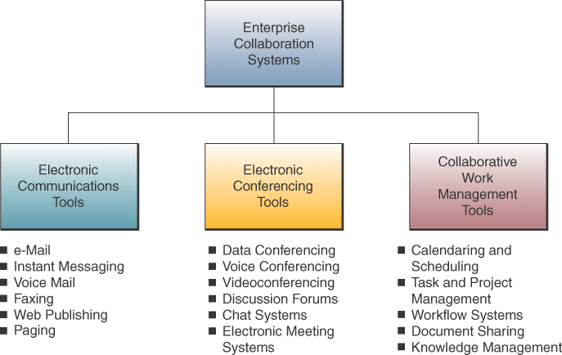
ECS Tools

Slide 39
Case 2: The Business Case for EAI
EAI involves using software to connect a variety of applications into a cohesive unit
Helps enterprises align systems more closely with business processes
Expect to spend $200,000 - $400,000 on an EAI project
EAI is costly and complex
Technical staff need lots of training

Slide 40
Case Study Questions
Why has EAI recently “become a critical part of the IT strategy at many organizations,” and a high-ranking project of top IT executives? Use Baxter International, GE Power and Corporate Express as examples.
What is the major difference in the business value of the EAI projects at Baxter International, GE Power and Corporate Express?
What are some of the challenges in developing and implementing EAI systems? How can companies meet this challenge?

Slide 41
Real World Internet Activity
Integrating applications at the enterprise level, while desirable, is often associated with many significant challenges to the organization. Using the Internet,
  See if you can find examples of other companies that have found ways to meet these challenges and successfully integrate their applications on an enterprise level.
  Are there companies that specialize in assisting such integration projects?

Slide 42
Real World Group Activity
One of the challenges associated with application integration on an enterprise level is determining which applications to integrate and which to leave as is. In small groups,
  Discuss how an organization should approach an integration project.
  What criteria should be used in determining a candidate application for enterprise integration?

Slide 43
Functional Business Systems
A variety of information systems (transaction processing, management information systems, decision support, etc.)
That support the business functions of
  Accounting, finance, marketing, operations management and human resource management

Slide 44
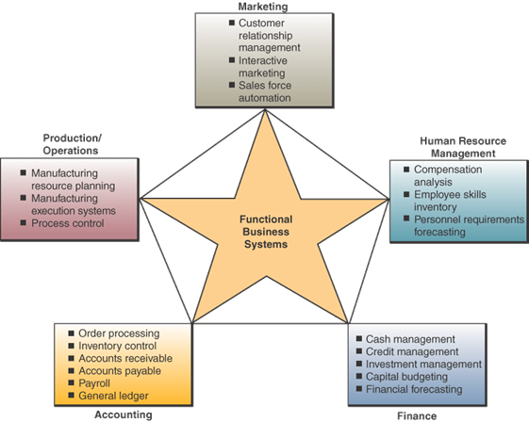
Examples of functional information systems

Slide 45
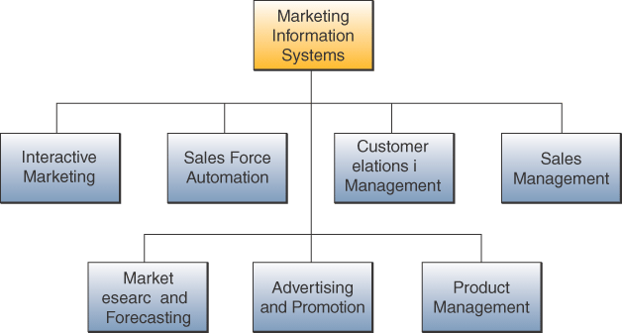
Marketing Information Systems

Slide 46
Interactive marketing
Interactive marketing:
  A customer-focused marketing process
  Using the Internet, intranets, and extranets
  To establish two-transactions
  Between a company and its customers or potential customers
Goal:
  to profitably attract and keep customers
  who will become partners with the business
  in creating, purchasing and improving products and services

Slide 47
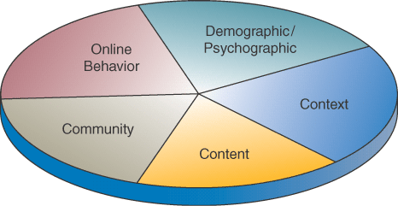
Targeted Marketing
An advertising and promotion management concept that includes five targeting components

Slide 48
Targeted Marketing Components
Community – customize advertising to appeal to people of specific virtual communities
Content – advertising placed on a variety of selected websites aimed at a specific audience
Context – advertising placed on web pages that are relevant to the content of a product or service
Demographic/Psychographic – web marketing efforts aimed at specific types or classes or people
Online Behavior – promotion efforts tailored to each visit to a site by an individual, e.g., using cookies files

Slide 49
Sales Force Automation
Outfit sales force with notebook computers, web browsers and sales contract management software
Connect them to marketing websites and company intranet
Goal:
  Increase personal productivity
  Speeds up capture and analysis of sales data from the field to marketing managers
  Gain strategic advantage

Slide 50
Manufacturing Information Systems
Support the production/operations function
Includes all activities concerned with planning and control of producing goods or services

Slide 51
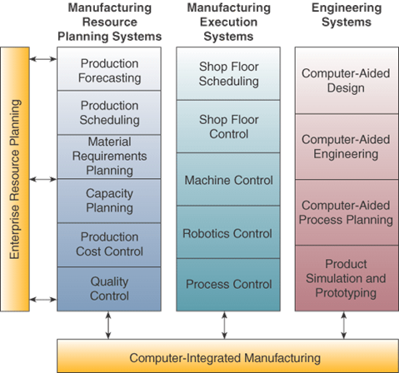
Computer-Integrated Manufacturing

Slide 52
CIM Objectives
Simplify production processes, product designs, and factory organization as a vital foundation to automation and integration
Automate production processes and the business functions that support them with computers, machines, and robots
Integrate all production and support processes using computer networks, cross-functional business software, and other information technologies

Slide 53
CIM Systems
Computer-aided manufacturing (CAM) - automate the production process
Manufacturing execution systems (MES) – performance monitoring information systems for factory floor operations
Process Control – control ongoing physical processes
Machine Control – controls the actions of machines

Slide 54
Human Resource Management (HRM)
Information systems designed to support
  Planning to meet the personnel needs of the business
  Development of employees to their full potential
  Control of all personnel policies and programs
Notes:
Began to produce paychecks and payroll reports, manage personnel records and analyze the use of personnel in the business.
Has gone far beyond that as shown in next slide.

Slide 55
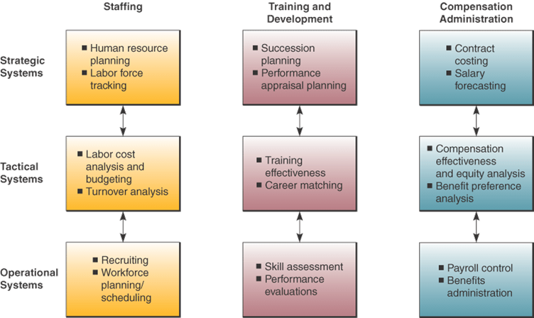
HRM Systems

Slide 56
HRM and the Internet
Recruiting employees using the corporate website and commercial recruiting services
Posting messages in selected Internet newsgroups
Communicating with job applicants via e-mail

Slide 57
HRM and Corporate Intranets
Process common HRM applications
Allow HRM department to provide around-the-clock services
Disseminate valuable information faster than through previous company channels
Collect information from employees online
Allow managers and other employees to perform HRM tasks with little intervention by the HRM department
Training tool

Slide 58
Employee Self-Service (ESS)
Intranet applications that allow employees to
  View benefits
  Enter travel and expense reports
  Verify employment and salary information
  Update their personal information
  Enter data that has a time constraint to it

Slide 59
Accounting Information Systems
Record and report the flow of funds through an organization
Produce financial statements
Forecasts of future conditions
Notes:
Oldest and most widely used information systems

Slide 60
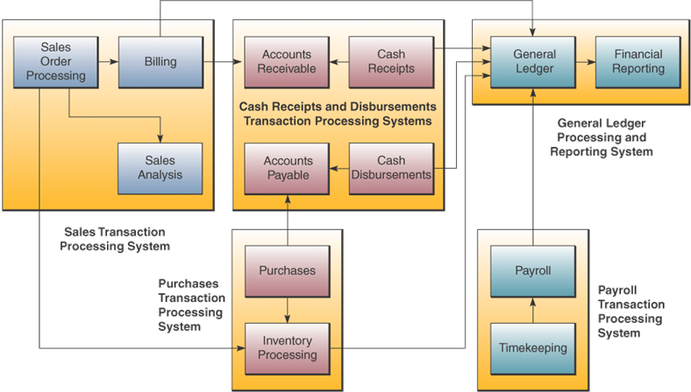
Accounting Information Systems

Slide 61
Six essential Accounting Information Systems
Order Processing – Captures and processes customer orders and produces data for inventory control and accounts receivable
Inventory Control – Processes data reflecting changes in inventory and provides shipping and reorder information
Accounts Receivable – Records amounts owed by customers and produces customer invoices, monthly customer statements, and credit management reports

Slide 62
Six essential Accounting Information Systems
Accounts Payable – Records purchases from, amounts owed to, and payments to suppliers, and produces cash management reports
Payroll – Records employee work and compensation data and produces paychecks and other payroll documents and reports
General Ledger – Consolidates data from other accounting systems and produces the periodic financial statements and reports of the business

Slide 63
Financial Management Systems
Support business managers and professionals in decisions concerning
  The financing of a business
  The allocation and control of financial resources within a business

Slide 64
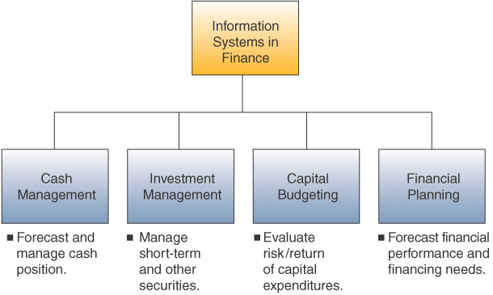
Financial Management System Examples

Slide 65
Case 3: Improving Supply-Chain Results
Supply chains are a kludge of systems including
  Internally: manufacturing, warehousing, inventory control, planning, shipping, and logistics
  Relationships with suppliers and partners
  Increasing dependence on the input of customers
Companies are replacing this kludge with state-of-the-art software
Two major software types:
  Supply-chain execution
  Supply-chain planning

Slide 66
Case Study Questions
What is the business value of SCM systems for Brunswick and Whirlpool?
Does the business value of SCM depend upon what type of business a company is in? Explain.
How does Brunswick’s approach to SCM differ from that of Whirlpool’s? Is one approach superior to all others? Why or why not?

Slide 67
Real World Internet Activity
Supply chain management involves more than simply automating and networking all of the participants and stakeholders. Often the first step is to rationalize the various steps in the supply chain to determine their necessity. Using the Internet,
  See if you can find examples of other companies that have reengineered their supply chains by first looking at the current method and changing its steps before automating and networking the partners.

Slide 68
Real World Group Activity
When supply chain relationships are reviewed for streamlining, longtime supply chain partners may no longer be viable. Then the organization must decide between:
  preserving a longstanding relationship with a supply chain partner and sacrificing the benefits of a more rational process,
  or terminating a longtime relationship in favor of a more beneficial supply chain.
In small groups,
  Discuss the pros and cons of this decision.
  What criteria should an organization use in determining the appropriate action with regard to longstanding supply chain partners?

Slide 69
Terima Kasih
Good Luck

