Slide 1
DASAR SISTEM INFORMASI
Dosen Pengampu : KARTINI S.Kom.,MMSI
Prodi Sistem Informasi - Fakultas Ilmu Komputer

Slide 2
DASAR SISTEM INFORMASI
Pert.14 :
Aquiring information systems and Aplication

Slide 3
Learning Outcomes
The Systems Approach and Systems Thinking
Project Manajement, Planning for and justifying IT Aplication
Dua metodologi utama untuk membangun mereka :
  Enterprise Analysis (Business Systems Planning)
  Strategic Analysis (Critical Success Factors)
Strategic for aquiring It Aplications
The traditional systems Development Life Cycle
Using CSFs to Develop IS and Using CSFs to Develop IS
Systems Development and Organizational Change
Capital Budgeting Models
Alternative Methods and Tools for systems developmment
Vendor and software Selection

Slide 4
The Systems Approach
A problem solving technique that uses a systems orientation to define problems and opportunities and develop appropriate and feasible solutions.
Analyzing a problem and formulating a solution involves the following interrelated activities:
  Recognize and define a problem or opportunity using systems thinking
  Develop and evaluate alternative system solutions
  Select the system solution that best meets your requirements
  Design the selected system solution
  Implement and evaluate the success of the designed system

Slide 5
What is Systems Thinking?
Seeing the forest and the trees in any situation by:
  Seeing interrelationships among systems rather than linear cause-and-effect chains whenever events occur
  Seeing processes of change among systems rather than discrete snapshots of change, whenever changes occur
See the system in any situation:
  Find the input, processing, output, feedback and control components
Notes:
Going back to the components we learned in chapter 1.

Slide 6
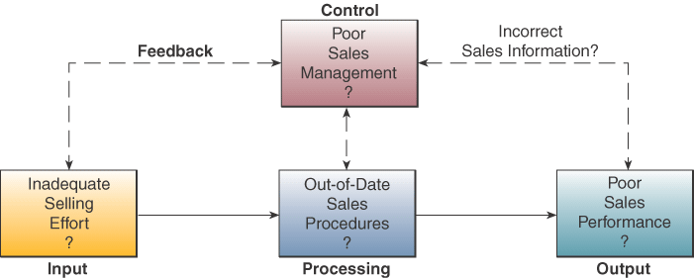
Systems Thinking Example
Notes:
You can better understand a sales problem or opportunity by identifying the components of a sales system

Slide 7
Project Management
IT and business unit managers
enforce a project plan which includes
  job responsibilities,
  time lines for major stages of development, and
  financial budgets

Slide 8
Managing a project
To manage a project need:
  Process
  Tools
  Techniques

Slide 9
Project
A project
  Is a set of activities with a clear beginning and end
Each project has
  Goals
  Objectives
  Tasks
  Limitations

Slide 10
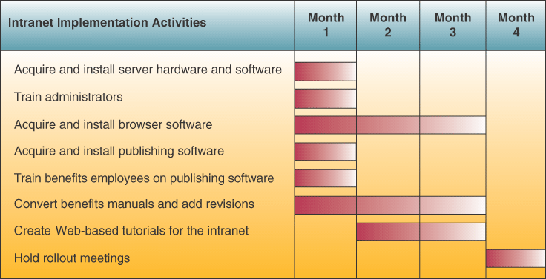
Sample Implementation Process Plan

Slide 11
Five phases of project management
Initiating/defining
  State the problems/goals
  Identify the objectives
  Secure resources
  Explore costs/benefits in feasibility study
Notes:
Foundation for the entire project
Need to define the problem that the project is supposed to solve or achieve or dooms the project
Needed for any project: but this is exactly what is done in systems investigation phase of SDLC

Slide 12
Five phases of project management
Planning
  Identify and sequence activities
  Identify the “critical path”
  Estimate time and resources needed for completion
  Write a detailed project plan
Executing
  Commit resources to specific tasks
  Add additional resources/personnel if necessary
  Initiate project work
Notes:
Analysis and Design are associated with project execution in the SDLC

Slide 13
Five phases of project management
Controlling
  Establish reporting obligations
  Create reporting tools
  Compare actual progress with baseline
  Initiate control interventions if necessary

Slide 14
Five phases of project management
Closing
  Install all deliverables
  Finalize all obligations/commitments
  Meet with stakeholders
  Release project resources
  Document the project
  Issue final report

Slide 15
Evaluating Hardware, software and services
Must acquire hardware, software
How do we evaluate and select it?
Companies may ask suppliers to present bids and proposals
May score different products
  Determine evaluation factors
  Assign each product points on each factor
  May require benchmark tests
    Simulate processing of task and evaluates the performance

Slide 16
Hardware Evaluation Factors
Performance
Cost
Reliability
Compatibility
Technology
Ergonomics
Connectivity
Scalability
Software
Support
Notes:
Note that don’t just choose hardware on what’s fastest and cheapest

Slide 17
Software Evaluation Factors
Quality
Efficiency
Flexibility
Security
Connectivity
Maintenance
Documentation
Hardware

Slide 18
Examples of IS Services
Developing a company website
Installation or conversion of hardware or software
Employee training
Hardware maintenance
System integration
System design
Contract programming
Consulting services

Slide 19
IS Services Evaluation Factors
Performance
Systems development
Maintenance
Conversion
Training
Backup
Accessibility
Business Position
Hardware
Software

Slide 20
System Testing
Testing and debugging software
Testing website performance
Testing new hardware
Review of prototypes of displays, reports and other output

Slide 21
Data Conversion
Converting data elements from old database to new database
Correcting incorrect data
Filtering out unwanted data
Consolidating data from several databases
Organizing data into new data subsets

Slide 22
Importance of Data Conversion
Improperly organized and formatted data is major causes of failures in implementing new systems.

Slide 23
Documentation
User documentation
  Sample data entry screens, forms, reports
Systems documentation
  Communication among people responsible for developing, implementing and maintaining system
  Important in diagnosing errors and making changes

Slide 24
Training
End users must be trained to operate new system
Educate managers and end users in how the new technology impacts the company’s business operations and management

Slide 25
Conversion
Conversion from use of present system to operation of new system

Slide 26
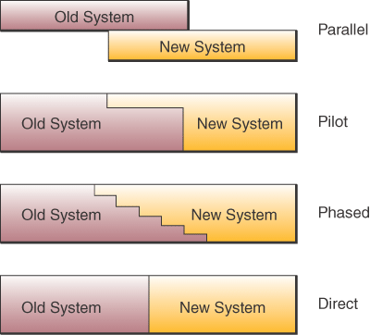
Four major forms of conversion

Slide 27
Direct Conversion
Turn off old system
Turn on new system
Direct is least expensive method
Riskiest method

Slide 28
Parallel Conversion
New and old systems run simultaneously
until end users and project coordinators are satisfied that the new system is functioning correctly
Low risk
Highest cost method: perform all functions with both systems

Slide 29
Pilot Conversion
When new system is installed in multiple locations
Convert to new system in single location
Once complete in pilot location,
  Evaluate and make any necessary changes
Notes:
In the pilot site, you can either use direct or parallel method

Slide 30
Phased Conversion
Incremental approach to conversion
Bring in new system as a series of functional components
Lower risk
Takes the most time

Slide 31
Systems maintenance
Corrective: fix bugs and logical errors
Adaptive: add new functionality to accommodate changes in business or environment
Perfective: improve performance
Preventive: reduce chances of failure

Slide 32
Post-implementation review
Ensure new system meets the business objectives
Periodic review or audit

Slide 33
Implementation Challenges
Tantangan Implementasi
New system involves major organizational change
Manage changes to
  Business processes
  Organizational structures
  Managerial roles
  Work assignments
  Stakeholder relationships

Slide 34
User Resistance
New way of doing things generates resistance
Key to solving is
  User involvement in organizational changes and development of new systems
User involvement
  End users on systems development teams
  End user ownership of new system

Slide 35
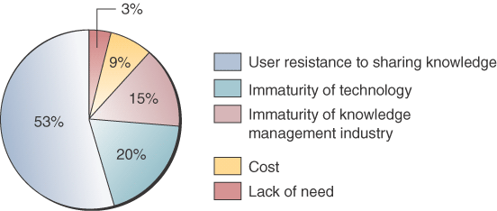
Reasons for User Resistance to Knowledge Management Systems

Slide 36
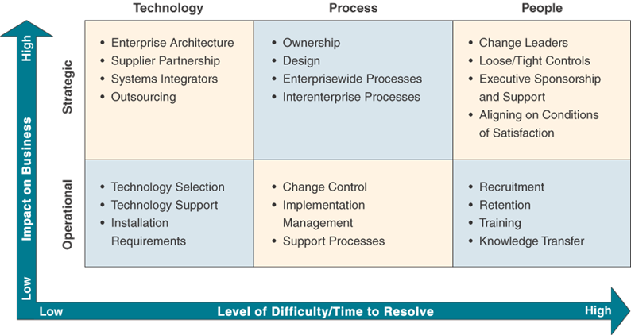
Change Management Dimensions
Source: Adapted from Grant Norris, James Hurley, Kenneth Harley, John Dunleavy, and John Balls, E-Business and ERP:
Transforming the Enterprise, p. 120. Copyright @2000 by John Wiley & Sons Inc. Reprinted by permission.

Slide 37
Change Management
Involve as many people as possible in planning and application development
Make constant change an expected part of the culture
Tell everyone as much as possible about everything as often as possible
Make liberal use of financial incentives and recognition
Work within the company culture, not around it

Slide 38
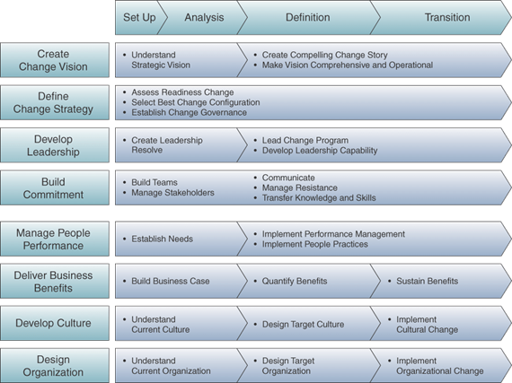
Process of Change Management
Source: Adapted from Martin Diese, Conrad Nowikow, Patric King, and Amy Wright, Executive’s Guide to E-Business: From Tactics to Strategy, p. 190. Copyright @ 2000 by John Wiley & Sons Inc. Reprinted by permission.

Slide 40
Talk about...
Memahami mengapa membangun sistem baru adalah proses perubahan organisasi
Menjelaskan bagaimana organisasi dapat mengembangkan sistem informasi yang sesuai dengan rencana bisnis
Mengidentifikasi kegiatan inti dalam proses pengembangan sistem
Menjelaskan berbagai model untuk menentukan nilai bisnis dari sistem informasi

Slide 41
Systems as Planned Organizational Change
(Sistem seperti Rencana Perubahan Organisasi )
An IS is a sociotechnical entity
  Menyiratkan perubahan dalam pekerjaan, keterampilan, manajemen dan organisasi.
  IS seperti yang direncanakan dalam perubahan organisasi
  Sistem dapat menjadi teknik keberhasilan tetapi juga kegagalan organisasi.

Slide 42
Linking IS to the Business Plan
(Menghubungkan IS Rencana Bisnis)
Information Systems Plan - Sebuah peta jalan yang menunjukkan arah pengembangan sistem, dasar pemikiran, situasi saat ini, strategi manajemen, rencana pelaksanaan, dan anggaran
Contents of an IS plan
  Tujuan dari rencana
  Rencana Bisnis Strategis (situasi saat ini, perubahan lingkungan)
  Sistem saat ini (kesulitan memenuhi kebutuhan bisnis)
  Perkembangan baru (rasional, kemampuan baru Bisnis diperlukan)
  Strategi manajemen (rencana Akuisisi, reorganisasi internal)
  Rencana Pelaksanaan
  Kebutuhan anggaran

Slide 43
Establishing Organizational Information Requirements
Untuk mengembangkan rencana efektif IS, organisasi harus memiliki pemahaman yang jelas dari kedua kebutuhan informasi jangka panjang dan pendek.
Dua metodologi utama untuk membangun mereka :
  Enterprise Analysis (Business Systems Planning)
  Strategic Analysis (Critical Success Factors)

Slide 44
Enterprise Analysis
Analisis kebutuhan informasi organisasi yang luas dengan melihat seluruh organisasi dalam hal unit organisasi, fungsi, proses, dan elemen data, membantu mengidentifikasi entitas dan atribut kunci dalam data organisasi
Developed by IBM in the 1960s
Method: Ambil sampel besar, manajer meminta mereka bagaimana mereka menggunakan informasi, di mana mereka mendapatkannya, seperti apa lingkungan mereka, apa tujuan mereka, bagaimana mereka membuat keputusan dan apa kebutuhan data mereka
(mereka = Group/timWork in organization involve menejer)

Slide 45
Enterprise Analysis
Memberikan pandangan yang komprehensif dari organisasi.
Menghasilkan sejumlah besar informasi, mahal untuk mengumpulkan dan sulit untuk menganalisa
Bias terhadap manajemen puncak dan pengolahan data
Fokus pada tujuan tidak penting tetapi lebih fokus pada apa informasi yang ada digunakan
Hasilnya adalah kecenderungan untuk mengotomatisasi apa pun yang ada (The result is a tendency to automate whatever exists)

Slide 46
Critical Success Factors (CSF)
Sejumlah kecil tujuan mudah diidentifikasi tujuan operasional yang dibentuk oleh industri, perusahaan, dan manajer, serta lingkungan yang lebih luas sekalipun mudah di indentifikasi yang diyakini untuk menjamin keberhasilan suatu organisasi.
Notes:
Personal interviews with a number of top managers to identify their goals and the resulting CSFs
These personal CSFs are AGGREGATED to develop a picture of the firm’s CSFs
Then systems are built to deliver information on these CSFs

Slide 47
Using CSFs to Develop IS

Slide 48
Critical Success Factors
Menghasilkan satu set data yang lebih kecil untuk menganalisis
Dapat disesuaikan dengan struktur masing-masing industri
Memperhitungkan perubahan lingkungan
Pengumpulan data dan analisis yang 'bentuk seni'
Kebingungan antara CSF individu dan organisasi
Bias terhadap manajer puncak
Mengasumsikan bahwa sukses TPS sudah ada
Seperti Metode analisis Perusahaan memberikan gambaran statis (Like the Enterprise Analysis method provides a static picture)

Slide 49
Systems Development and Organizational Change
Global networks (tenaga kerja divisi Internasional, jangkauan global perusahaan)
Enterprise networks (collaborative work)
Distributed Computing (empowerment/pemberdayaan)
Portable Computing (virtual organizations)
Graphical User Interfaces (everybody has access to information/ semua orang memiliki akses terhadap informasi)

Slide 50
The Spectrum/Spektrum of Organizational Change (1)
Automation: nakan komputer untuk mempercepat kinerja tugas-tugas yang ada
  bentuk paling umum dari perubahan IT-enabled
  melibatkan membantu karyawan melakukan tugas-tugas mereka secara lebih efisien dan efektif
  mirip dengan menempatkan motor yang lebih besar dalam kendaraan yang ada (akin to putting a larger motor in an existing vehicle)

Slide 51
The Spectrum of Organizational Change (2)
Rationalization of procedures/Rasionalisasi prosedur : perampingan prosedur operasi yang ada, menghilangkan kemacetan sehingga otomatisasi yang membuat prosedur operasi yang lebih efisien
  berikut dengan cepat awal otomatisasi
  Toshiba harus merasionalisasi prosedur sampai ke tingkat manual instalasi dan instruksi perangkat lunak dan harus membuat nama standar dan format untuk item data dalam gudang data global
  Pikirkan: tanpa sejumlah besar proses bisnis rasionalisasi, teknologi komputer akan menjadi sia-sia di Toshiba (apa ERPs lakukan/what ERPs do)

Slide 52
The Spectrum of Organizational Change (3)
Business Process Re-engineering (BPR)/Proses Bisnis Re-engineering (BPR) : The disain ulang radikal suatu proses bisnis, menggabungkan langkah-langkah untuk mengurangi limbah dan menghilangkan berulang, tugas kertas-intensif untuk meningkatkan biaya, kualitas, dan pelayanan dan untuk memaksimalkan manfaat dari teknologi informasi
  Melibatkan pemikiran ulang yang radikal
  Dapat mengubah cara organisasi melakukan bisnis
  IT memungkinkan Baxter untuk menjadi manajer pasokan pelanggan nya
  Pemogokan takut, yang mahal, yang sangat berisiko dan yang sangat sulit untuk melaksanakan dan mengelola

Slide 53
Business Process Reengineering
Mengembangkan visi bisnis dan proses yang obyektif
Mengidentifikasi proses yang harus dirancang ulang (inti dan payback tertinggi)
Memahami dan mengukur kinerja proses yang ada
Mengidentifikasi peluang untuk menerapkan teknologi informasi
Membangun prototipe dari proses baru

Slide 54
The Spectrum of Organizational Change (4)
Paradigm Shift: Radical reconceptualization of the nature of the business and the nature of the organization
  akin to rethinking not only the automobile, but transportation itself
  e-business is a paradigm shift
  Deciding which business process to get right is half the challenge
  70% of time programmatic reengineering efforts fail
  Why then change? Because the rewards are high!

Slide 55
Information Systems Development
Systems Development: the activities that go into producing an information systems solution to an organizational problem or opportunity
Structured kind of problem with distinct activities

Slide 56
Systems Analysis (1)
Systems Analysis : Analisis masalah bahwa organisasi akan mencoba untuk memecahkan dengan IS
  pemahaman yang mendalam tentang organisasi yang ada dan sistem
  mengidentifikasi pemilik primer dan pengguna data dalam organisasi
  identifikasi rincian masalah sistem yang ada

Slide 57
Systems Analysis (2)
Feasibility Study/Studi Kelayakan : cara untuk menentukan apakah solusi dapat dicapai, mengingat sumber daya organisasi dan kendala
  Kelayakan teknis
  Kelayakan ekonomi
  Kelayakan operasional
  Information Requirements

Slide 58
Systems Design
Systems Design/Desain Sistem : rincian bagaimana suatu sistem akan memenuhi kebutuhan informasi sebagaimana ditentukan oleh analisis sistem.
  Output, Input, User Interface, Database Design, Processing, Manual Procedures, Controls, Security, Documentation, Conversion, Training, Organizational Changes

Slide 59
Completing the Design Process
Programming
Testing
  Unit testing
  System testing
  Acceptance testing
  Conversion
  Parallel strategy
  Direct cut-over strategy
  Pilot study strategy
  Phased approach strategy
  Maintenance

Slide 60
Completing the Design Process
Pemrograman
Pengujian
Unit pengujian
Pengujian sistem
Penerimaan pengujian
Konversi
Strategi paralel
Strategi cut-over Direct
Strategi studi percontohan
Strategi pendekatan bertahap
Pemeliharaan

Slide 61
The Business Value of Information Systems
Notes:
improved . enhanced=membaik, ditingkatka

Slide 62
Capital Budgeting Models
(Model penganggaran modal)
Information Systems are considered long-term capital investment projects
(Sistem Informasi dianggap proyek investasi modal jangka panjang)
Capital budgeting/Penganggaran modal : Proses menganalisis dan memilih berbagai usulan untuk belanja modal. Perbedaan antara arus kas keluar dan arus kas masuk yang digunakan untuk menghitung nilai finansial dari investasi.
Tingginya tingkat keusangan teknologi dalam penganggaran untuk sistem hanya berarti bahwa waktu pengembalian modal harus lebih pendek, dan tingkat pengembalian yang lebih tinggi daripada modal khas proyek-proyek dengan (with much longer useful lives) hidup lebih panjang/berguna lagi

Slide 63
Capital Budgeting Models (2)
The Payback Method- ukuran waktu yang diperlukan untuk membayar kembali investasi awal proyek
Accounting Rate of Return on Investment (ROI) - Perhitungan tingkat pengembalian dari investasi dengan menyesuaikan arus kas yang dihasilkan oleh investasi untuk depresiasi
Net Present Value (NPV) - Jumlah uang investasi bernilai sama dengan mempertimbangkan biaya, laba, dan nilai waktu dari uang
Cost-Benefit Ratio - Sebuah metode untuk menghitung kembali belanja modal dengan membagi total manfaat dengan biaya total

Slide 64
Non-financial and Strategic Considerations
Notes:
The general risks are as follows:
Benefits may not be obtained
Cost of implementation may exceed budgets
Implementation time frames are exceeded
Technical performance is less than expected
The system is incompatible with existing software or hardware

Slide 66
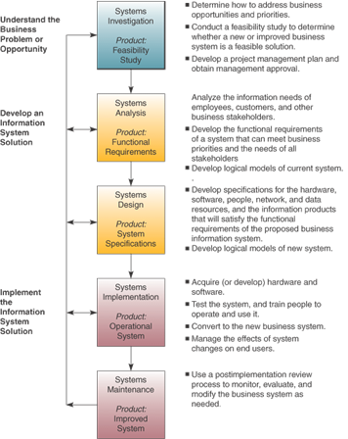
Systems Development Lifecycle (SDLC)
Notes:
Five stages. Will discuss each of them in turn

Slide 67
Systems Investigation Stage
Do we have business opportunities?
What are our business priorities?
How can information technologies provide information systems solutions that address our business priorities?

Slide 68
Feasibility Study
A preliminary study where
  the information needs of prospective users
  the resource requirements, costs, benefits,
  and feasibility of a proposed project
are determined

Slide 69
Feasibility Categories
Operational Feasibility
Economic Feasibility
Technical Feasibility
Human Factors Feasibility
Legal/Political Feasibility

Slide 70
Operational Feasibility
How well the proposed system
  supports the business priorities of the organization.
  solves the identified problem.
  fits within the existing organizational structure.
Schedule feasibility – can we solve the problem in a reasonable period

Slide 71
Economic Feasibility
Assess:
  Cost savings
  Increased revenue
  Decreased investment requirements
  Increased profits
Cost/benefit analysis

Slide 72
Cost/Benefit Analysis
Costs versus Benefits
Tangible costs and benefits can be quantified with a high degree of certainty
  Example: decrease in operating costs
Intangible costs and benefits are harder to estimate
  Example: improved customer service

Slide 73
Technical Feasibility
Determine if reliable hardware and software capable of meeting the needs of a proposed system can be acquired or developed by the business in the required time
  Hardware
  Software
  Network

Slide 74
Human Factors Feasibility
Assess
  Employee, customer, supplier acceptance
  Management support
  The right people for the various new or revised roles
Notes:
No matter how elegant the technology, the system will not work if the end users and managers do not support it.

Slide 75
Legal/Political Feasibility
Assess
  Possible patent or copyright violations
  Software licensing for developer side only
  Governmental restrictions
  Changes to existing reporting structure

Slide 76
Systems Analysis
An in-depth study of end user information needs
That produces functional requirements that are used as the basis for the design of a new information system

Slide 77
Systems Analysis
Detailed study of
  The information needs of a company and end users.
  The activities, resources, and products of one or more of the present information systems being used.
  The information system capabilities required to meet information needs of users and stakeholders
End users are important members of the development team

Slide 78
Organizational Analysis
Study of the organization including:
  Management Structure
  People
  Business Activities
  Environmental Systems
  Current Information Systems
    Document input, processing, output, storage and control

Slide 79
Logical Analysis
Construction of a logical model of the current system
Logical model
  A blueprint of what the current system does

Slide 80
Functional Requirements Analysis and Determination
Determine specific business information needs
  Determine what type of information each business activity requires.
  Determine the information processing each system activity is needed to meet these needs.

Slide 81
Functional Requirements
End user information requirements that are not tied to the hardware, software, network, data, and people resources that end users presently use or might use in the new system
What the system must do
Functional Requirement categories
  User Interface
  Processing
  Storage
  Control

Slide 82
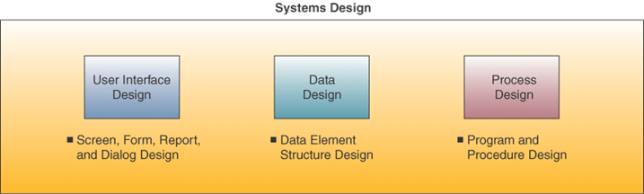
Systems Design
Modify the logical model until it represents a blueprint for what the new system will do
Physical design:
  How the system will accomplish its objectives

Slide 83
Prototyping
The rapid development and testing of working models
Used in design phase
Especially useful when end user requirements are hard to define

Slide 84
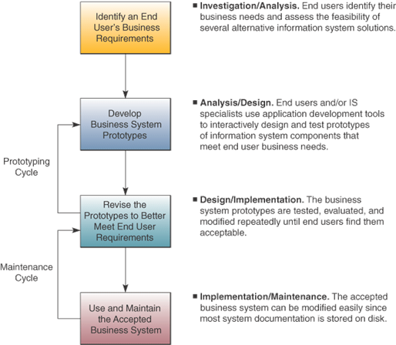
Prototyping Life Cycle
Notes:
When prototyping is used, life cycle is changed. Design phase is split between analysis and implementation.

Slide 85
Prototyping
Can be used for small and large systems
  But if system is large, usually prototype just parts
Develop quickly
Refine until acceptable

Slide 86
User Interface Design
Focuses on supporting the interactions between end users and their computer-based applications
Frequently prototype the user interface

Slide 87
Checklist for Corporate Websites
Remember the customer – successful websites are built solely for the customer, not to make company vice presidents happy
Aesthetics – successful designs combine fast-loading graphics and simple color palettes for pages that are easy to read
Broadband Content – the Web’s coolest stuff can’t be accessed by most Web surfers; don’t make it the focus of a site

Slide 88
Checklist for Corporate Websites
Easy to navigate – make sure it’s easy to get from one part of site to another
Searchability – make sure to have a useful search engine
Incompatibilities – test site with target web browsers
Registration forms – short registration forms are a useful way to gather customer data
Dead links – be sure to keep links updated

Slide 89
System Specifications
Formalize design of
  User interface methods
  Products
  Database structures
  Processing
  Control procedures
Specifications for hardware, software, network, data, and personnel

Slide 90
End User Development
IS professional plays a consulting role
End user does his/her own application development
Contrast in traditional life cycle:
  End user is customer
  IS profession does development

Slide 91
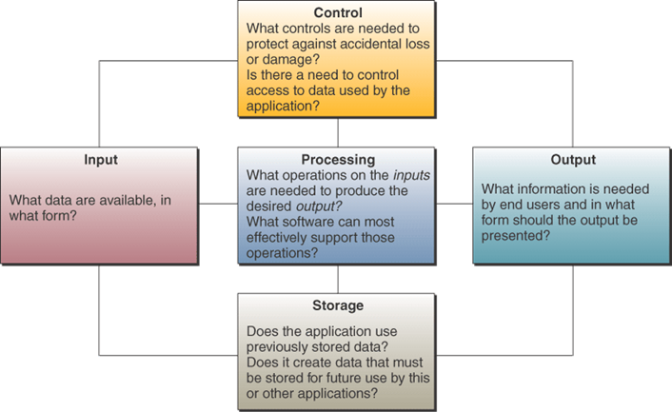
End User Development
Source: Adapted from James N. Morgan, Application Cases in MIS, 4th ed. (New York: Irwin/McGraw-Hill, 2002), p. 31.

Slide 92
Encouraging End User Web Development
Look for tools that make sense
Spur creativity
Set some limits
Give managers responsibility
Make users comfortable

Slide 93
Terima Kasih
Good Luck

