Slide 1
DASAR SISTEM INFORMASI
Dosen Pengampu : KARTINI S.Kom.,MMSI
Prodi Sistem Informasi - Fakultas Ilmu Komputer

Slide 2
DASAR SISTEM INFORMASI
Pert.06
Competing with Technology Information system
Bagaimana sebuah bisnis menggunakan SI untuk bersaing ? Serta Kekuatan dan Strategi Competitive

Slide 3
Learning Outcomes
Apa itu Jaringan komputer
Tujuan membangun Jaringan komputer
Manfaat Jaringan Komputer
Komponen-komponen dalam komunikasi data
Kategori Jaringan

Slide 4
Strategic IT
Teknologi tidak lagi sebuah renungan dalam membentuk strategi bisnis, but the actual cause and driver (tetapi penyebab nyata dan penggerak).
IT can change the way businesses compete.
A strategic information system is
  Any kind of information system
  That uses IT to help an organization, sehingga :
    Mendapatkan a competitive advantage
    Mengurangi a competitive disadvantage/kerugian
    Mewujudkan tujuan strategis perusahaan lainnya

Slide 5
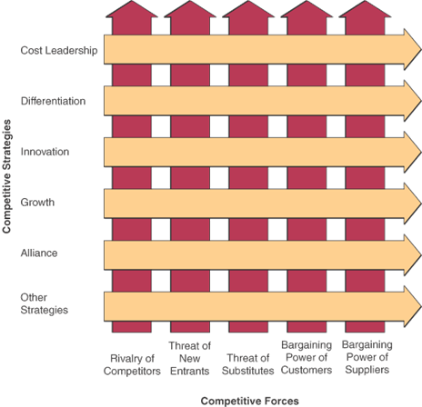
Competitive Forces and Strategies (Streategis dan kemampuan kompetitive)

Slide 6
Competitive Forces
Jika bisnis ingin berhasil harus mengembangkan strategi untuk melawan kekuatan-kekuatan berikut : strategies to counter these forces:
  dari pesaing dalam industri
  Ancaman pendatang baru ke dalam industri dan pasar yang
  Ancaman produk pengganti yang mungkin
  menangkap pangsa pasar
  Bargaining/tawar power of customers
Bargaining/tawar power of suppliers
Notes:
According to Michael Porter’s classic model of competition, any business that wants to succeed must develop strategies to counter these 5 forces

Slide 7
Five Competitive Strategies
Cost Leadership
  Become low-cost producers
  Help suppliers or customers reduce/mengurangi costs
  Increase cost to competitors/pesaing
  Example, Priceline uses online seller bidding so buyer sets the price
Differentiation Strategy
  Mengembangkan cara untuk membedakan produk perusahaan dari para pesaing
  Dapat fokus pada segmen tertentu atau niche pasar
  Contoh, Moen menggunakan desain pelanggan online
  Example, Moen uses online customer design
Notes:
To counter the threats of competitive forces

Slide 8
Competitive Strategies (cont.)
Innovation Strategy
  Find new ways of doing business
    Unique products or services/jasa
    Or unique markets
    Radical changes to business processes to mengubah struktur dasar industri
  Example, Amazon menggunakan online penuh-sistem layanan pelanggan
Growth Strategy
  Expand company’s capacity to produce (Memperluas kapasitas perusahaan untuk memproduksi)
  Expand into global markets
  Diversify into new products or services
  Example, Wal-Mart menggunakan pemesanan barang melalui pelacakan satelit global

Slide 9
Competitive strategies (cont.)
Alliance Strategy
  Menetapkan hubungan and alliances with :
    Customers, suppliers, competitors, consultants and other companies
  Includes mergers, acquisitions, joint ventures, virtual companies
  Example, Wal-Mart uses automatic inventory replenishment by supplier (pengisian persediaan otomatis oleh pemasok)

Slide 10
Using these strategies
The strategies are not mutually exclusive
Organizations use one, some or all
Notes:
Notice that Wal-Mart was an example in both growth and alliance
A strategy can fall into one or more categories.

Slide 11
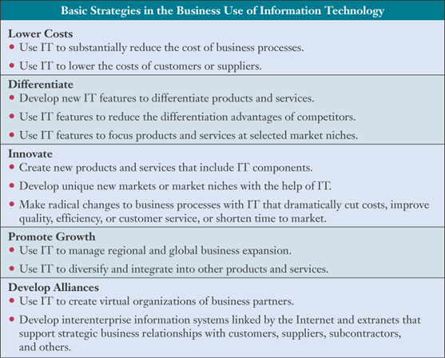
Using IT for these strategies
Notes:
Often use the Internet as the foundation for such strategies

Slide 12
Other competitive strategies
Lock in customers and suppliers (mengunci agar tidak pindah)
  And lock out competitors
  Mencegah mereka dari beralih ke pesaing/competitors
  Build in switching costs
  Make customers and suppliers dependent on the use of innovative IS
Barriers/hambatan to entry
  Mencegah atau menunda perusahaan lain untuk memasuki pasar
  Meningkatkan teknologi atau investasi yang diperlukan untuk memasuki pasar

Slide 13
Other competitive strategies (cont.)
Include IT components in products (Sertakan IT komponen dalam produk)
  Membuat Pengganti produk Persaing lebih sulit
Leverage investment in IT (Meningkatkan investasi di IT)
Mengembangkan produk baru atau jasa tidak mungkin tanpa TI

Slide 14
Customer-focused business
(Berfokus pada pelanggan bisnis)
Apa nilai bisnis yang berfokus pada pelanggan?
  Keep customers loyal
  Anticipate their future needs
  Respond to customer concerns/kekawatiran
  Menyediakan top-quality customer service
Focus on customer value
bukan harga menjadi penentu nilai utama tapi Kualitas.
Notes:
For classroom discussion:
Do you agree that quality and not price is the customer’s primary determinant of value?
Are there limits?
Is it always quality rather than price?

Slide 15
How can we provide customer value? (Bagaimana kita bisa memberikan nilai pelanggan)
Track individual preferences
Mengikuti market trends
Supply products, services and information anytime, anywhere
Menyediakan layanan pelanggan yang disesuaikan dengan kebutuhan individu
Gunakan sistem Customer Relationship Management (CRM) to focus on customer

Slide 16
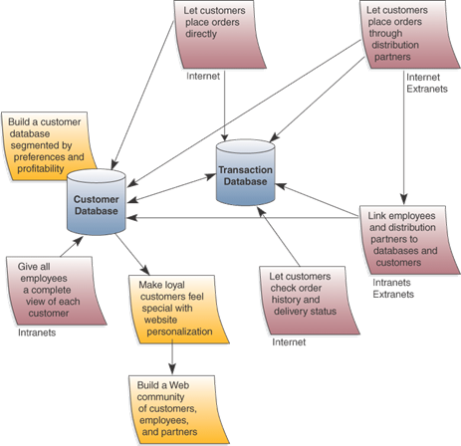
Building customer value using the Internet
Notes:
The Internet and Intranets create new channels for interactive communications within a company, with customers, with suppliers.
Allows customers to ask questions, make complaints, evaluate products, request support, and make and track purchases

Slide 17
Value Chain
Lihat perusahaan sebagai rangkaian kegiatan
that add value to its products and services
Activities are either
  Primary processes directly related to manufacturing or delivering products
  Support processes mendukung aktivitas perusahaan sehari-hari dan secara tidak langsung contribute to products or services
Gunakan rantai nilai untuk menyorot mana strategi kompetitif terbaik yang dapat diterapkan to add value of the firm

Slide 18
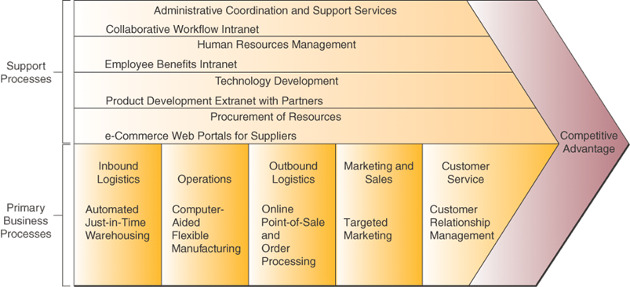
Using IS in the value chain
Notes:
Examples of where IS can be used to provide value in both support and primary business processes
Contoh di mana IS dapat digunakan untuk memberikan nilai baik dalam dukungan dan proses bisnis utama

Slide 19
Business Process Reengineering
Called BPR or Reengineering
  Fundamental rethinking and radical redesign
  Of business processes
  To achieve improvements in cost, quality, speed and service
Potential payback high
Risk of failure is also high

Slide 20
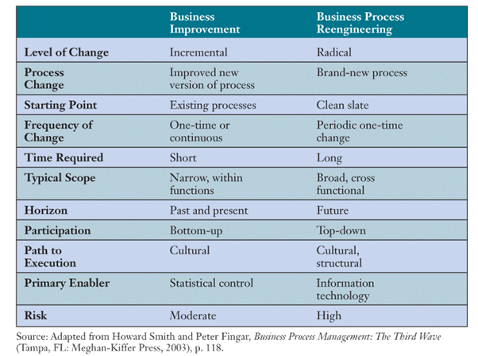
How BPR differs from business improvement

Slide 21
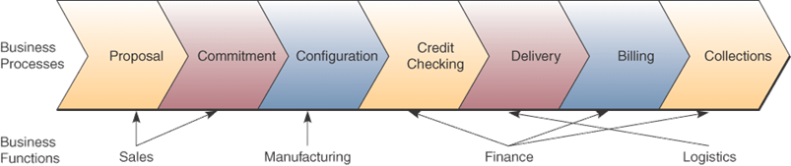
A cross-functional process
Notes:
Order management consists of several business processes
Crosses the boundaries of traditional business functions

Slide 22
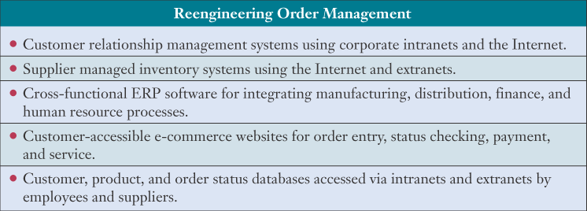
Reengineering order management

Slide 23
Agility
Agility is the ability of a company to prosper
  In a rapidly changing, continually fragmenting
  Global market for high-quality, high-performance, customer-configured products and services
An agile company can make a profit with
  Broad product ranges
  Short model lifetimes
  Mass customization
    Individual products in large volumes
Notes:
An agile company often uses the Internet to integrate and manage business processes while providing the processing power to treat masses of customers as individuals

Slide 24
Four strategies for agility
An agile company:
Provides products as solutions to their customers’ individual problems
Cooperates with customers, suppliers and competitors to bring products to market as quickly and cost-effectively as possible
Organizes so that it thrives on change and uncertainty
Leverages the impact of its people and the knowledge they possess

Slide 25
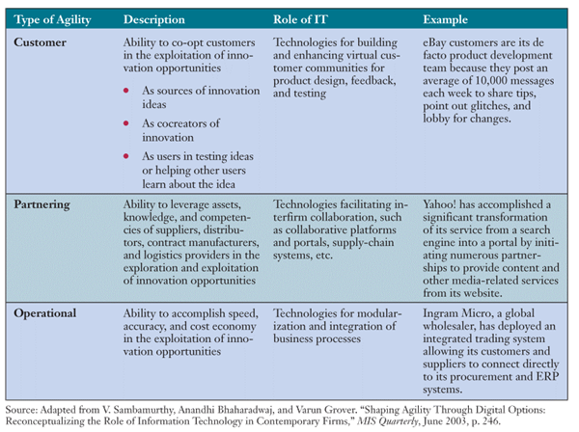
How IT helps a company be agile

Slide 26
Virtual Company
A virtual company uses IT to link
  People,
  Organizations,
  Assets,
  And ideas
Creates interenterprise information systems
  to link customers, suppliers, subcontractors and competitors

Slide 27
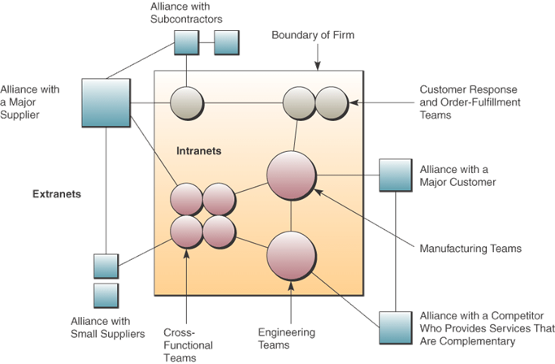
A virtual company
Notes:
This company is using the Internet, intranet and extranets to link to business partners
This creates interenterprise information systems to link customers, suppliers, subcontractors and competitors
Flexible and adaptable virtual workgroups

Slide 28
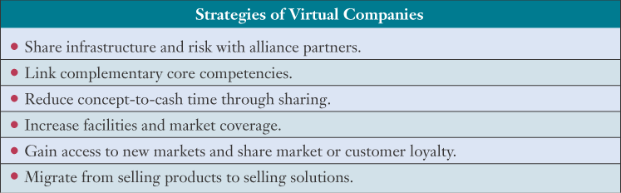
Strategies of virtual companies
Notes:
A company facing a new market opportunity might not have the time or resources to develop the manufacturing and distribution infrastructures, the competencies or the IT needed. By forming a virtual company with an alliance with others it can quickly provide the solution needed.

Slide 29
Knowledge Creation
Knowledge-creating company or learning organization
  Consistently creates new business knowledge
  Disseminates it throughout the company
  And builds in the new knowledge into its products and services
Notes:
To have lasting competitive advantage, a company must be a knowledge creating company or learning organization

Slide 30
Two kinds of knowledge
Explicit knowledge
  Data, documents and things written down or stored on computers
Tacit knowledge
  The “how-to” knowledge which reside in workers’ minds
A knowledge-creating company makes such tacit knowledge available to others
Notes:
Tacit knowledge is often some of the most important information within a firm. But its not recorded anywhere since it’s in the employee’s mind.

Slide 31
Knowledge issues
What is the problem with organizational knowledge being tacit?
Why are incentives to share this knowledge needed?
Notes:
Issues:
What if the person who has the knowledge leaves the company?
What if someone in another part of the company could use the expertise?
How do you know who knows what you need to know?
How do you find what you need to know
Company wastes money “re-inventing the wheel”
Unless people are given incentive to share the knowledge,
They won’t want to spend time doing something that they are not rewarded for
They will worry about losing their status of having the expertise

Slide 32
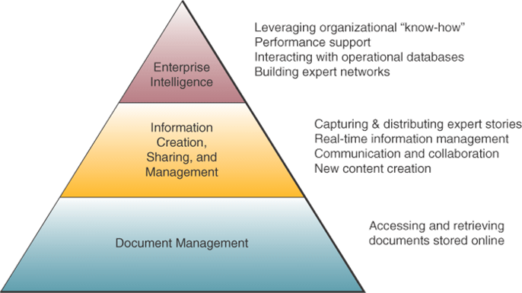
Knowledge management techniques
Source: Adapted from Marc Rosenberg, e-Learning: Strategies for Delivering Knowledge in the Digital Age
(New York: McGraw-Hill, 2001), p.70.
Notes:
Three levels of techniques, technologies, and systems that promote the collection, organization, access, sharing and use of workplace and enterprise knowledge
Create techniques, technologies, systems and rewards for getting employees to share what they know.

Slide 33
Knowledge management systems (KMS)
KMS manage organizational learning and business know-how
Goal:
  Help knowledge workers to create, organize, and make available knowledge
  Whenever and wherever it’s needed in an organization

Slide 34
Terima Kasih
Good Luck

