Slide 1
DASAR SISTEM INFORMASI
Dosen Pengampu : KARTINI S.Kom.,MMSI
Prodi Sistem Informasi - Fakultas Ilmu Komputer

Slide 2
DASAR SISTEM INFORMASI
Pert.08B :
Enterprise Resource Planning Systems

Slide 3
Learning Outcomes
Functional Area Information Systems
Characteristics of Functional Information Systems
Management Information Systems
Transaction Processing System
Characteristics of TPS aand Process of TPS
How to Integrated Information Systems
Enterprise Resource Palnning System

Slide 4
Learning Outcomes
Functionality and key elements of ERP systems
ERP configurations--servers, databases, and bolt-on software
Data warehousing as a strategic tool and issues related to the design, maintenance, and operation of a data warehouse
Risks associated with ERP implementation
Key considerations related to ERP implementation
Internal control and auditing implications of ERPs
The leading ERP products and their distinguishing features
Notes:
31

Slide 5
Problems with Non-ERP Systems
In-house design limits connectivity outside the company
Tendency toward separate IS’s within firm
  lack of integration limits communication within the company
Strategic decision-making not supported
Long-term maintenance costs high
Limits ability to engage in process reengineering

Slide 6
Traditional IS Model:
Closed Database Architecture
Similar in concept to flat-file approach
  data remains the property of the application
  fragmentation limits communications
Existence of numerous distinct and independent databases
  redundancy and anomaly problems
Paper-based
  requires multiple entry of data
  status of information unknown at key points

Slide 7
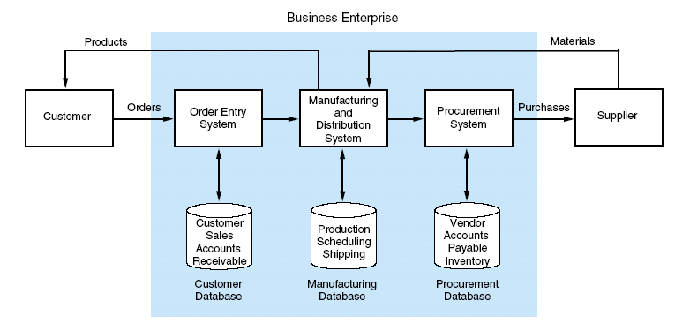
Traditional IS Model:
Closed Database Architecture

Slide 8
Business Enterprise
Products
Materials
Order Entry
System
Manufacturing
and
Distribution
System
Procurement
System
Customer
Supplier
Orders
Purchases
Customer
Sales
Account Rec
Production
Scheduling
Shipping
Vendor
Accts Pay
Inventory
Customer Database
Manufacturing Database
Procurement Database
Traditional Information System with Closed Database Architecture

Slide 9
What is an ERP System?
Multi-module application software that helps a company manage the important parts of its business in an integrated fashion.
Key features include:
  smooth and seamless flow of information across organizational boundaries
  standardized environment with shared database independent of applications and integrated applications

Slide 10
ERP System
Business Enterprise
Data Warehouse
Legacy
Systems
ERP System
On-Line Analytical Processing
(OLAP)
Bolt-On Applications
(Industry Specific Functions)
Customers
Suppliers
Core Functions [On-Line Transaction Processing (OLTP)]
Sales
&
Distribution
Business
Planning
Shop Floor
Control
Logistics
Operational Database
Customers, Production,
Vendor, Inventory, etc.

Slide 11
Two Main ERP Applications
Core applications
a.k.a. On-line Transaction Processing (OLTP)
transaction processing systems
support the day-to-day operational activities of the business
support mission-critical tasks through simple queries of operational databases
include sales and distribution, business planning, production planning, shop floor control, and logistics modules

Slide 12
Two Main ERP Applications
Business analysis applications
a.k.a. On-line Analytical Processing (OLAP)
decision support tool for management-critical tasks through analytical investigation of complex data associations
supplies management with “real-time” information and permits timely decisions to improve performance and achieve competitive advantage
includes decision support, modeling, information retrieval, ad-hoc reporting/analysis, and what-if analysis

Slide 13
OLAP
Supports management-critical tasks through analytical investigation of complex data associations captured in data warehouses:
  Consolidation is the aggregation or roll-up of data.
  Drill-down allows the user to see data in selective increasing levels of detail.
  Slicing and Dicing enables the user to examine data from different viewpoints to uncover trends and patterns.

Slide 14
ERP System Configurations:
Client-Server Network Topology
Two-tier
  common server handles both application and database duties
  used especially in LANs

Slide 15
Two-Tier Client Server
First Tier
User Presentation Layer
Application and Database Layer
Server
Server
Second Tier
Applications
Database

Slide 16
ERP System Configurations:
Client-Server Network Topology
Three-tier
  client links to the application server which then initiates a second connection to the database server
  used especially in WANs

Slide 17
Three-Tier Client Server
User Presentation Layer
First Tier
Applications
Application
Server
Second Tier
Application Layer
Database
Database
Server
Database Layer
Third Tier

Slide 18
ERP with OLTP and OLAP Client Server using Data Warehouse
User Presentation Layer
First Tier
OLTP
Applications
OLTP
Server
OLAP
Server
OLAP
Applications
Second Tier
Application Layer
Operations
Database
Operations
Database
Server
Data
Warehouse
Third Tier
Data
Warehouse
Server
Database Layer

Slide 19
ERP System Configurations:
Databases and Bolt-Ons
Database Configuration
  selection of database tables in the thousands
  setting the switches in the system
Bolt-on Software
  third-party vendors provide specialized functionality software
  Supply Chain Management (SCM) links vendors, carriers, logistics companies, and IS providers

Slide 20
What is a Data Warehouse?
A multi-dimensional database often using hundreds of gigabytes or even terabytes of memory
  Data are extracted periodically from operational databases or from public information services.
A database constructed for quick searching, retrieval, ad-hoc queries, and ease of use
ERP systems can exist without data warehouses.
  However, most large ERP implementations include separate operational and data warehouse databases.
  Otherwise, management data analysis may result in pulling system resources away from operational use.
  Also, there are many sophisticated data-mining tools.

Slide 21
Data Warehouse Process
The five stages of the data warehousing process:
    modeling data for the data warehouse
    extracting data from operational databases
    cleansing extracted data
    transforming data into the warehouse model
    loading data into the data warehouse database

Slide 22
Data Warehouse Process:
Stage 1
Modeling data for the data warehouse
  Because of the vast size of a data warehouse, the warehouse database consists of de-normalized data.
    Relational theory does not apply to a data warehousing system.
    Normalized tables pertaining to selected events may be consolidated into de-normalized tables.

Slide 23
Data Warehouse Process:
Stage 2
Extracting data from operational databases
  The process of collecting data from operational databases, flat-files, archives, and external data sources.
  Snapshots vs. stabilized data
    A key feature of a data warehouse is that the data contained in it are in a non-volatile (stable) state.

Slide 24
Data Warehouse Process:
Stage 3
Cleansing extracted data
  Involves filtering out or repairing invalid data prior to being stored in the warehouse
    Operational data are “dirty” for many reasons: clerical, data entry, computer program errors, misspelled names and blank fields.
  Also involves transforming data into standard business terms with standard data values

Slide 25
Data Warehouse Process:
Stage 4
Transforming data into the warehouse model
  To improve efficiency, data are transformed into summary views before being loaded.
  Unlike operational views, which are virtual in nature with underlying base tables, data warehouse views are physical tables.
    OLAP permits users to construct virtual views.

Slide 26
Data Warehouse Process:
Stage 5
Loading data into the data warehouse database
  Data warehouses must be created & maintained separately from the operational databases.
    internal efficiency
    integration of legacy systems
    consolidation of global data

Slide 27
Data Warehouse System
Legacy Systems
Order
Entry
System
VSAM Files
Hierarchical DB
Network DB
Purchases
System
The Data Warehouse
Previous
Years
ERP
System
Previous Quarters
Sales Data Summarized Annually
Previous Weeks
Sales Data Summarized Quarterly
Data Cleansing
Process
Operations
Database
Archived over Time
Current (this weeks) Detailed Sales Data

Slide 28
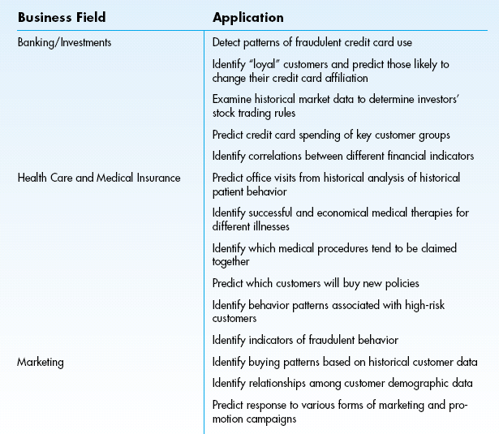
Applications of Data Mining

Slide 29
Risks Associated with ERP Implementation
Pace of implementation
  ‘Big Bang’--switch operations from legacy systems to ERP in a single event
  ‘Phased-In’--independent ERP units installed over time, assimilated, and integrated
Opposition to change
  user reluctance and inertia
  need of upper management support

Slide 30
Risks Associated with ERP Implementation
Choosing the wrong ERP
  goodness of fit: no one ERP product is best for all industries
  scalability: system’s ability to grow
Choosing the wrong consultant
  common to use a third-party (the Big Four)
  thoroughly interview potential consultants
  establish explicit expectations

Slide 31
Risks Associated with ERP Implementation
High cost and cost overruns
  common areas with high costs:
    training
    testing and integration
    database conversion
Disruptions to operations
  ERP implementations usually involve business process reengineering (BPR)
    expect major changes in business processes

Slide 32
Implications for Internal Control and Auditing
Transaction authorization
  Controls are needed to validate transactions before they are accepted by other modules.
  ERPs are more dependent on programmed controls than on human intervention.
Segregation of duties
  Manual processes that normally require segregation of duties are often eliminated.
  User role: predefined user roles limit a user’s access to certain functions and data.

Slide 33
Implications for Internal Control and Auditing
Supervision
  Supervisors need to acquire a technical and operational understanding of the new system.
  Employee-empowered philosophy should not eliminate supervision.
Accounting records
  Corrupted data may be passed from external sources and from legacy systems.
  loss of paper audit trail

Slide 34
Implications for Internal Control and Auditing
Access controls
  critical concern with confidentiality of information
  Who should have access to what?
Access to data warehouse
  Data warehouses often involve sharing information with suppliers and customers.

Slide 35
Implications for Internal Control and Auditing
Contingency planning
  keeping a business going in case of disaster
  key role of servers requires backup plans: redundant servers or shared servers
Independent verification
  traditional verifications are meaningless
  need to shift from transaction level to overall performance level

Slide 36
Terima Kasih
Good Luck

