Slide 1
The Impact of Environment
Understanding the Theory & Design of Organizations
Eleventh Edition
Richard L. Daft
©2013 Cengage Learning. All Rights Reserved. May not be scanned, copied or duplicated, or posted to a publicly accessible website, in whole or in part.

Slide 2
The Organization Environment
All the elements that exist outside the boundary of the organization
Potential to affect all or part of the organization
Domain is the chosen environmental field of action
Sectors or subdivisions that contain similar elements
©2013 Cengage Learning. All Rights Reserved. May not be scanned, copied or duplicated, or posted to a publicly accessible website, in whole or in part.

Slide 3
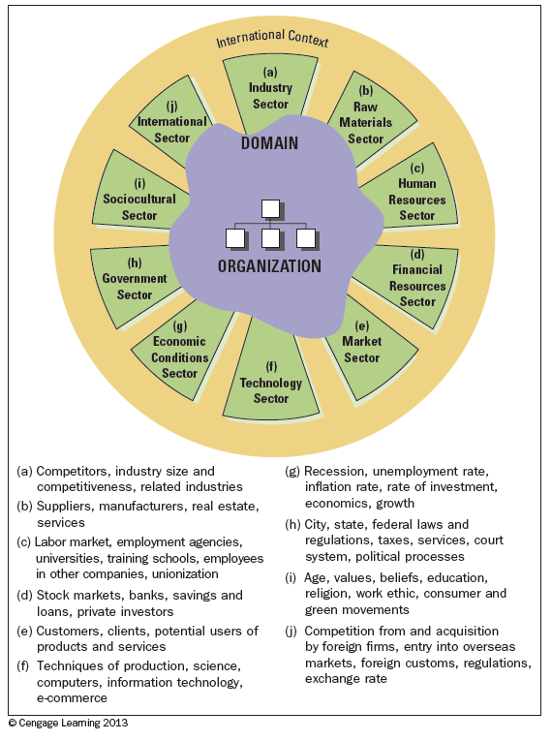
An Organization’s Environment
©2013 Cengage Learning. All Rights Reserved. May not be scanned, copied or duplicated, or posted to a publicly accessible website, in whole or in part.

Slide 4
The Task Environment
Sectors that the organization interacts with directly to achieve goals
Typically the “industry” and market sectors
Human Resources
International Sector
Raw Materials Sector
©2013 Cengage Learning. All Rights Reserved. May not be scanned, copied or duplicated, or posted to a publicly accessible website, in whole or in part.

Slide 5
General Environment
Sectors that might not have a direct impact on the daily operations of a firm
Government sector: regulation
Sociocultural sector: the green movement
Economic conditions: global recession
Technology sector: massive and constant changes
Financial resources
Extremely important to entrepreneurs
©2013 Cengage Learning. All Rights Reserved. May not be scanned, copied or duplicated, or posted to a publicly accessible website, in whole or in part.

Slide 6
International Environment
Can directly affect many organizations
Has grown in importance
Distinction between foreign and domestic operations
All organizations face domestic and global uncertainty
©2013 Cengage Learning. All Rights Reserved. May not be scanned, copied or duplicated, or posted to a publicly accessible website, in whole or in part.

Slide 7
The Changing Environment
The dimensions of the environment range:
Unstable
Homogeneous
Heterogeneous
Simple
Complex
The dimensions boil down to:
The need for information about the environment
The need for resources from the environment
Organizations must cope with and manage uncertainty to be effective.
©2013 Cengage Learning. All Rights Reserved. May not be scanned, copied or duplicated, or posted to a publicly accessible website, in whole or in part.

Slide 8
Dimensions of the Environment
Simple-complex: heterogeneity; the number of dissimilarity of external elements
Stable-Unstable: whether elements in the environment are dynamic
©2013 Cengage Learning. All Rights Reserved. May not be scanned, copied or duplicated, or posted to a publicly accessible website, in whole or in part.

Slide 9
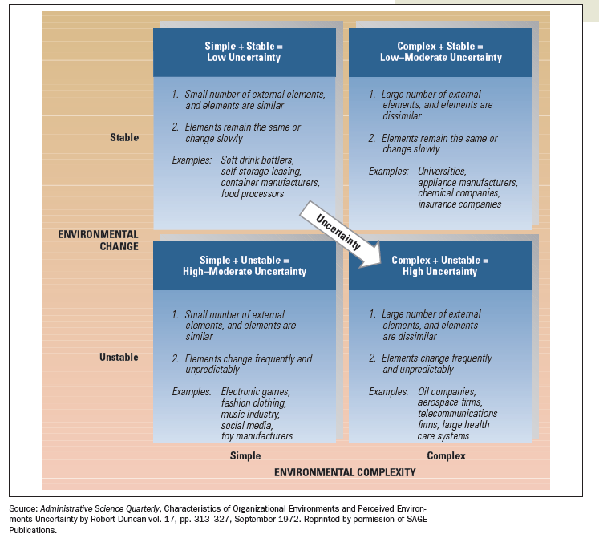
Framework for Assessing Environmental Uncertainty
©2013 Cengage Learning. All Rights Reserved. May not be scanned, copied or duplicated, or posted to a publicly accessible website, in whole or in part.

Slide 10
Adapting to a Changing Environment
Organizations need the right fit between internal structure and the external environment
Adding Positions and Departments
Building Relationships
Boundary-spanning roles
Business intelligence
Differentiation and Integration
Organic vs. Mechanistic Management Process
Planning, Forecasting, and Responsiveness
©2013 Cengage Learning. All Rights Reserved. May not be scanned, copied or duplicated, or posted to a publicly accessible website, in whole or in part.

Slide 11
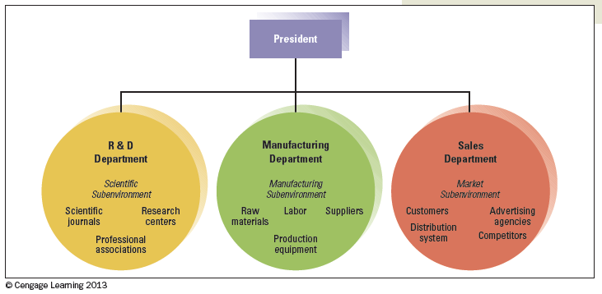
Organizational Departments Differentiate to Meet Needs of Sub-environments
©2013 Cengage Learning. All Rights Reserved. May not be scanned, copied or duplicated, or posted to a publicly accessible website, in whole or in part.

Slide 12
Different Goals and Orientations among Departments
©2013 Cengage Learning. All Rights Reserved. May not be scanned, copied or duplicated, or posted to a publicly accessible website, in whole or in part.

Slide 13
Environmental Uncertainty and Organizational Integrators
©2013 Cengage Learning. All Rights Reserved. May not be scanned, copied or duplicated, or posted to a publicly accessible website, in whole or in part.

Slide 14
Mechanistic and Organic Forms
Tasks are specialized
Tasks are rigidly defined
Strict hierarchy of authority and control
Knowledge and control of tasks are centralized
Communication is vertical
Employees contribute to the common task of the department
Tasks are adjusted and redefined through teamwork
Less hierarchy of authority and control
Knowledge and control of tasks are located anywhere in the organization
Communication is horizontal
©2013 Cengage Learning. All Rights Reserved. May not be scanned, copied or duplicated, or posted to a publicly accessible website, in whole or in part.

Slide 15
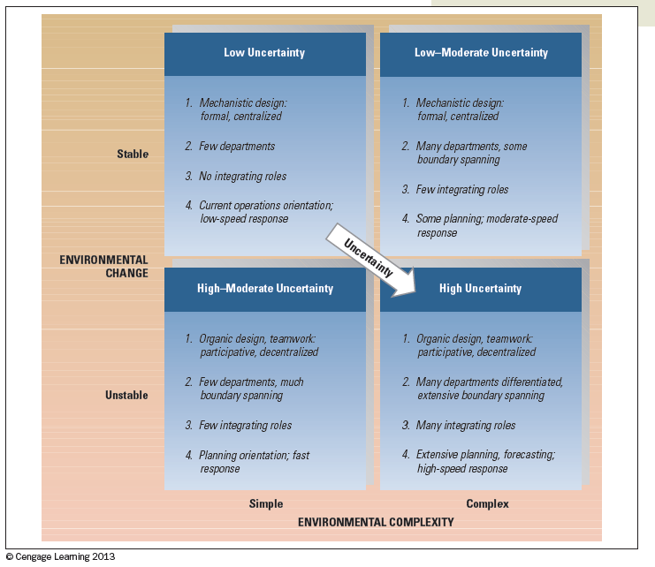
Contingency Framework for Uncertainty and Organizational Responses
©2013 Cengage Learning. All Rights Reserved. May not be scanned, copied or duplicated, or posted to a publicly accessible website, in whole or in part.

Slide 16
Dependence on External Resources
Resource-dependence perspective means organizations depend on the environment
Strive to acquire control over resources to minimize dependence
Organizations are vulnerable if resources are controlled by other organizations
Minimize vulnerabilities
Will team up with others when resources are scarce
©2013 Cengage Learning. All Rights Reserved. May not be scanned, copied or duplicated, or posted to a publicly accessible website, in whole or in part.

Slide 17
Influencing External Resources
Balance linkages and independence
Reach out and change or control elements in the environment
Establish favorable relationships with key elements of the environment
Shape the environment by influencing key sectors
©2013 Cengage Learning. All Rights Reserved. May not be scanned, copied or duplicated, or posted to a publicly accessible website, in whole or in part.

Slide 18
Organizing Strategies for Controlling the External Environment
©2013 Cengage Learning. All Rights Reserved. May not be scanned, copied or duplicated, or posted to a publicly accessible website, in whole or in part.

Slide 19
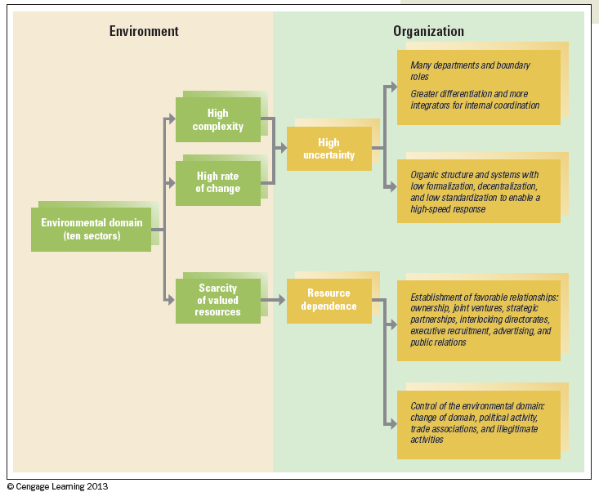
Environmental Characteristics and Organizational Actions
©2013 Cengage Learning. All Rights Reserved. May not be scanned, copied or duplicated, or posted to a publicly accessible website, in whole or in part.

Slide 20
Design Essentials
Change and complexity have major implications for organizations
Organizational environment differs regarding uncertainty and resource dependence
The goal for organizations is managing efficiencies and survival
Managers must understand how the environment influences the structure of an organization
When risk is great, organizations can attempt to change or influence the environment
Organizations can learn and adapt to the environment
©2013 Cengage Learning. All Rights Reserved. May not be scanned, copied or duplicated, or posted to a publicly accessible website, in whole or in part.

Slide 21
Corporate Culture and Values
Understanding the Theory & Design of Organizations
Eleventh Edition
Richard L. Daft
©2013 Cengage Learning. All Rights Reserved. May not be scanned, copied or duplicated, or posted to a publicly accessible website, in whole or in part.

Slide 22
What is Culture?
Values, norms, guiding beliefs, and understandings that are shared by members of an organization
Taught to new members as the correct way to think, feel, and behave
Organizational culture exists at two levels
Observable symbols
Underlying values
©2013 Cengage Learning. All Rights Reserved. May not be scanned, copied or duplicated, or posted to a publicly accessible website, in whole or in part.

Slide 23
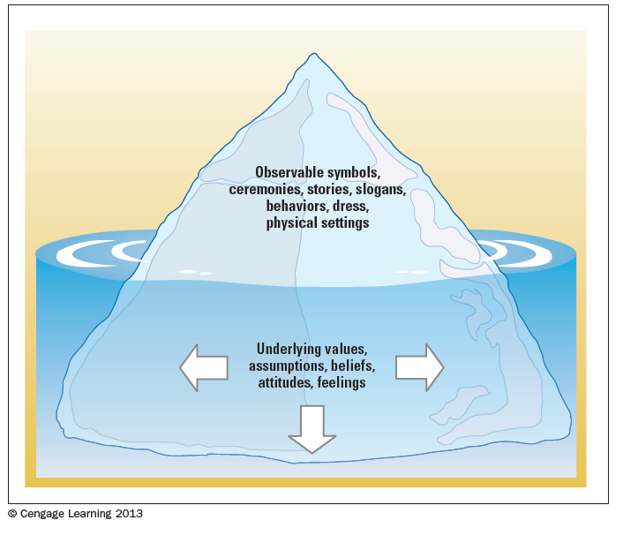
Levels of Corporate Culture
©2013 Cengage Learning. All Rights Reserved. May not be scanned, copied or duplicated, or posted to a publicly accessible website, in whole or in part.

Slide 24
Emergence and Purpose of Culture
Provides sense of organizational identity
Two critical functions in organizations:
To integrate members so they know how to relate to one another
To help organization adapt to external environment
Internal Integration – collective identity and know how to work together
External Adaption – how the organization meets goals and deals with outsiders
©2013 Cengage Learning. All Rights Reserved. May not be scanned, copied or duplicated, or posted to a publicly accessible website, in whole or in part.

Slide 25
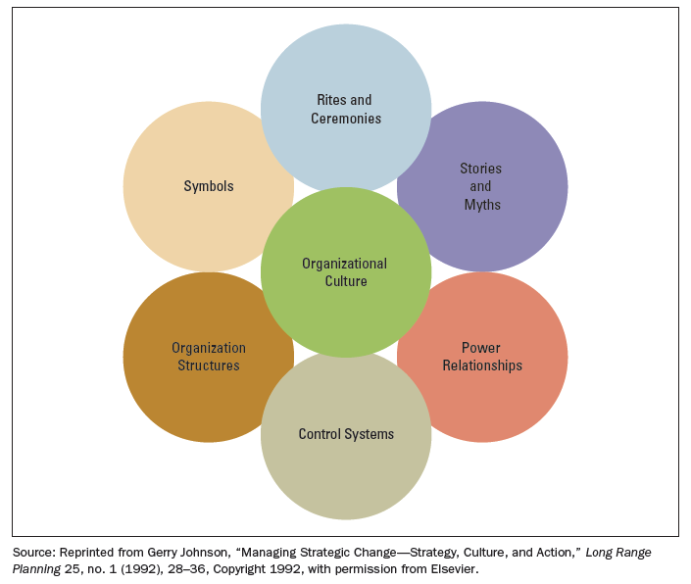
Observable Aspects of Organizational Culture
©2013 Cengage Learning. All Rights Reserved. May not be scanned, copied or duplicated, or posted to a publicly accessible website, in whole or in part.

Slide 26
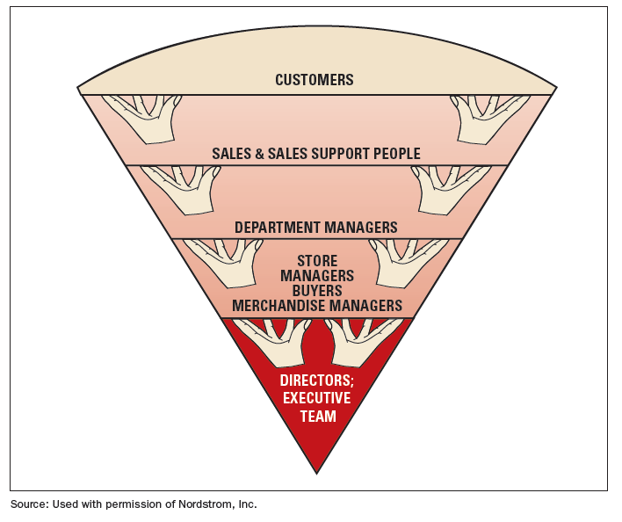
Organizational Chart for Nordstrom
Nordstrom’s structure reflects the emphasis the department store chain puts on empowering and supporting lower-level employees.
©2013 Cengage Learning. All Rights Reserved. May not be scanned, copied or duplicated, or posted to a publicly accessible website, in whole or in part.

Slide 27
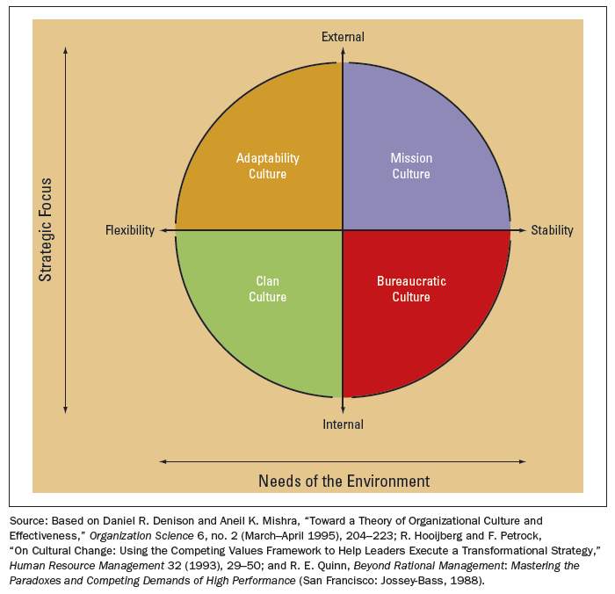
Organizational Design and Culture
Managers want a corporate culture that reinforces the strategy and structural design the organization needs to be effective within environment.
©2013 Cengage Learning. All Rights Reserved. May not be scanned, copied or duplicated, or posted to a publicly accessible website, in whole or in part.

Slide 28
Culture Strength and Organizational Subcultures
Culture strength is the degree of agreement among members of an organization about specific values
Subcultures reflect the common problems, goals, and experiences of a team or department
Different departments may have their own norms
©2013 Cengage Learning. All Rights Reserved. May not be scanned, copied or duplicated, or posted to a publicly accessible website, in whole or in part.

Slide 29
Organizational Culture, Learning, and Performance
Culture is important to learning and innovation during challenging times
Strong adaptive cultures often incorporate the following values:
The whole is more important than the parts
Equality and trust are primary values
The culture encourages risk taking, change, and improvement
©2013 Cengage Learning. All Rights Reserved. May not be scanned, copied or duplicated, or posted to a publicly accessible website, in whole or in part.

Slide 30
Ethical Values and Social Responsibility
Ethics
Ethics refer to the code of moral principles and values that govern the behaviors of a person or group with respect to what is right or wrong
Managerial Ethics
Ethical decisions go far beyond behaviors governed by law
Managerial ethics guide the decisions and behaviors of managers
©2013 Cengage Learning. All Rights Reserved. May not be scanned, copied or duplicated, or posted to a publicly accessible website, in whole or in part.

Slide 31
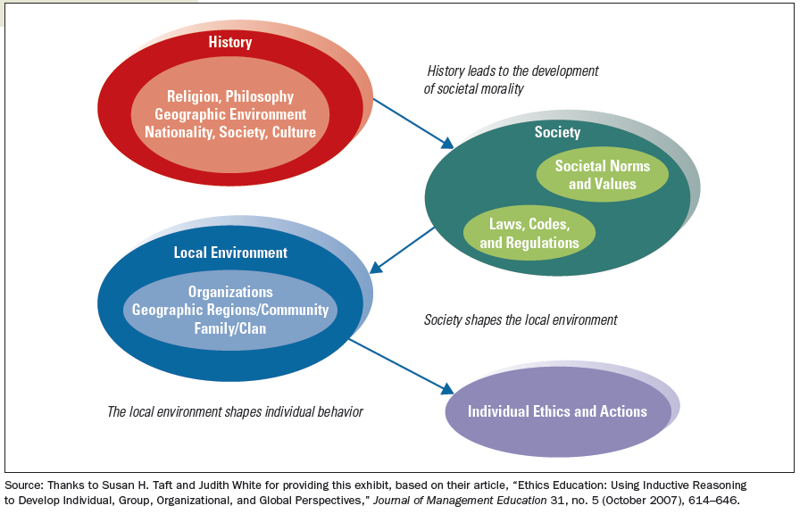
Sources of Individual Ethical Principles and Actions
©2013 Cengage Learning. All Rights Reserved. May not be scanned, copied or duplicated, or posted to a publicly accessible website, in whole or in part.

Slide 32
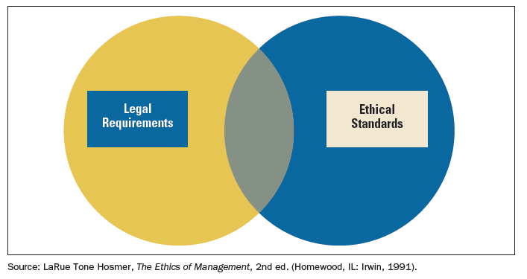
Relationship between the Rule of Law and Ethical Standards
©2013 Cengage Learning. All Rights Reserved. May not be scanned, copied or duplicated, or posted to a publicly accessible website, in whole or in part.

Slide 33
How Managers Shape Culture and Ethics
Value-Based Leadership
Formal Structure and Systems
Structure
Disclosure Mechanisms
Code of Ethics
Training Programs
Managers play key role in providing leadership and examples of ethical behavior
©2013 Cengage Learning. All Rights Reserved. May not be scanned, copied or duplicated, or posted to a publicly accessible website, in whole or in part.

Slide 34
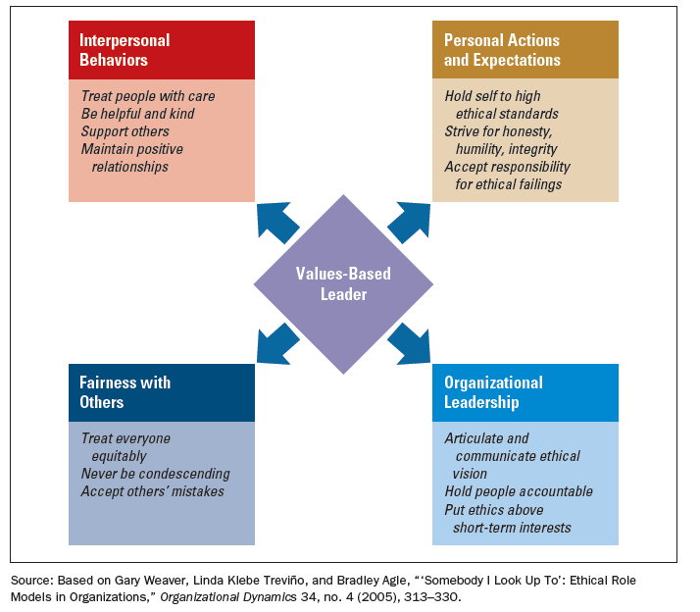
Characteristics of Values-Based Leaders
©2013 Cengage Learning. All Rights Reserved. May not be scanned, copied or duplicated, or posted to a publicly accessible website, in whole or in part.

Slide 35
Corporate Culture and Ethics in a Global Environment
The global environment presents tough ethical challenges
Countries have varied attitudes and beliefs
Components that characterize a global culture:
Multicultural rather than national values
Basing status on merit rather than nationality
Managers must think broadly about ethics
Social audits measure and report ethical, social, and environmental impact of a company’s operation
©2013 Cengage Learning. All Rights Reserved. May not be scanned, copied or duplicated, or posted to a publicly accessible website, in whole or in part.

Slide 36
Design Essentials
Cultural and ethical values help determine the organization’s social capital and can contribute to success
Managers can use rites and ceremonies, stories, symbols, structures, control systems, and power relationships to influence culture
Subcultures may emerge even in strong cultures
Strong cultures can be constructive or non-constructive
Managerial ethics and corporate responsibility are important aspects of organizational values
Managers can shape culture and ethics through formal systems
Social audits are important tools for companies trying to maintain high ethical standards
©2013 Cengage Learning. All Rights Reserved. May not be scanned, copied or duplicated, or posted to a publicly accessible website, in whole or in part.

