Slide 1
Chapter 1
Introduction
M. Bahrul Ulum, M.Kom
Informatics Engineering
Computer Science Faculty

Slide 2
Procedural versus object-oriented programming
Procedural programming approach concentrates on what a program has to do and involves identifying and organising the processes in the program solution. It is usually broken down into separate tasks, which include:
Top-down development
Modular design
Object-oriented programming

Slide 3
Procedural versus object-oriented programming
Top-down development:
General solution to a problem is outlined
This is then broken down into more detailed steps until the most detailed levels have been completed
Finally, programmer starts to code
Results in a systematic approach to a program design

Slide 4
Procedural versus object-oriented programming
Modular design:
Grouping task together
Connected directly to top-down development
Assists in the reading and understanding of the program

Slide 5
Procedural versus object-oriented programming
Object-oriented programming
Based on breaking down the problem, but the primary focus is on the things that make up the program
Breaks the program into a set of separate objects that perform actions and relate to each other

Slide 6
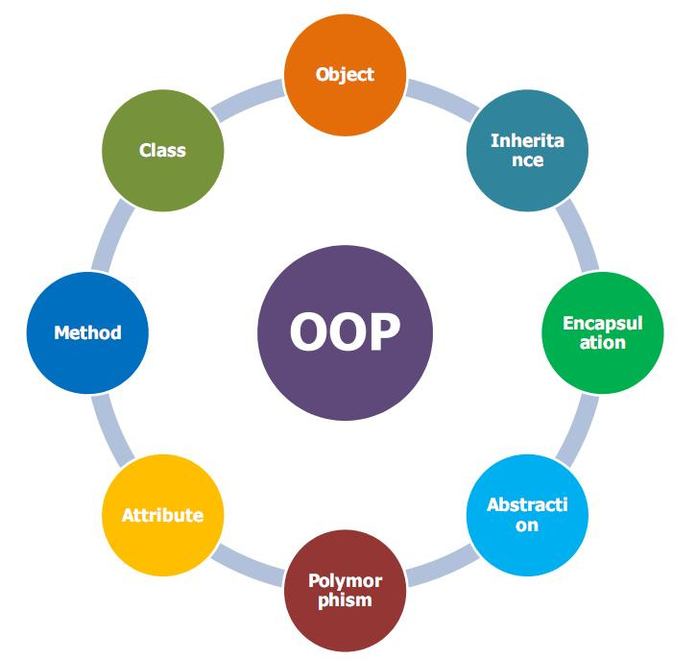
Concept OOP

Slide 7
Programming Language
Description
It is a set of instructions for commanding the computer to perform some operations.
Programmers write various programming languages.
Language Categories
Machine Language
Assembly Languages
High-Level Languages

Slide 8
Programming Language
Machine Language
It is a numeric language specifically understood by a computer’s processor
Machine language is machine dependent (not portable).
It makes humans cumbersome, slow, and error-prone to develop system.

Slide 9
Programming Language
Assembly Languages
Represent elementary operations of computer in English-like abbreviations
Assemblers are developed to convert assembly to machine language.
It has a one-to-one relationship with machine language.
1 0000 E8 MOV A,R0
2 0001 FA MOV R2,A
3 0002 2D ADD A,R5

Slide 10
Programming Language
High-Level Languages
They speed up the programming process.
Compilers convert them to machine language
Instructions is comprehensible to humans
Looks mostly like everyday English
Contain common mathematical notation
1 int sum, i, j;
2 i=100;
3 j=50;
4 sum = i + j

Slide 11
What is Java?
History
Green Project Announced by Sun in 1991
Motivation: intelligent consumer-electronic devices
Creator: James Gosling
New Language: Oak
Announcement in 1995
Industry Conference in May 1995
Netscape announced an agreement to integrate Java into its browser.

Slide 12
What is Java?
Properties
It is a high-level programming language
It is simple and purely object-oriented.
It is portable, that is, executable at different kinds of platform.
It is developed in world wide web applications.

Slide 13
What is Java?
Java Virtual Machine (JVM)
JAVA PROGRAM EXECUTION
Java
source code
Java
compiler
byte-code
.class
.java
byte-code
interpreter
JVM
EXECUTION

Slide 14
What is Java
Java Class Libraries
Java has built huge amount of libraries,
These libraries are is known as Java APIs (Application Programming Interface).
Most of them are available over the Internet and at no charge.

Slide 15
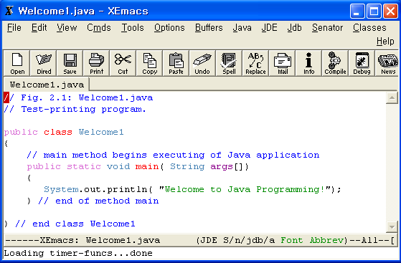
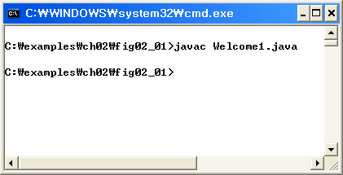
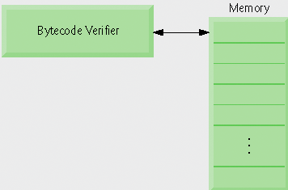
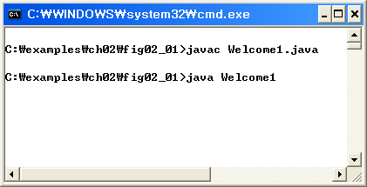
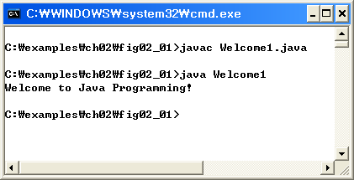
Java Development Environment
Edit
Compile
Edit & Store a file
- Extension . java
Creates bytecodes &
Stores a file
- Extension .class
Verify
Load
Verify bytecodes &
Validate for Java’s
security violations
Class loader
put . Class file
In memory
Translate bytecodes into a machine language
Execute the program
- display or store data values

Slide 16
Java Development Environment
JDK (Java Development Kit)
Java Standard Edition (J2SE): develop client-side standalone applications or applets.
Java Enterprise Edition (J2EE): develop server-side applications such as Java servlets.
Java Micro Edition (J2ME): develop applications for mobile devices such as cell phones
We use J2SEDK 6.0 in this course and
you can download it from ftp site

Slide 17
Java Development Environment
IDE (Integrated Development Environment)
There are number of free and commercial IDEs
We use NetBeans in this course

