Slide 1
Selection Control Structure
Chapter 3
M. Bahrul Ulum, M.Kom
Informatics Engineering
Computer Science Faculty

Slide 2
Objectives
Elaborate on the uses of simple selection, multiple selection, and nested selection in algorithms
Introduce the case construct in pseudocode
Develop algorithms using variations of the selection control structure

Slide 3
Selection Control Structure
You can use the selection control structure in pseudocode to illustrate a choice between two or more actions, depending on whether a condition is true or false
IF condition THEN
statement1
statement2
…
…
ENDIF
Selection control structure

Slide 4
Relational Expression
The condition in the IF statement is based on a comparison of two items, and is usually expressed with one of the following relational operators:
Operator | Meaning | Example | Value
== | equals | 1 + 1 == 2 | true
!= | does not equal | 3.2 != 2.5 | true
< | less than | 10 < 5 | false
> | greater than | 10 > 5 | true
<= | less than or equal to | 126 <= 100 | false
>= | greater than or equal to | 5.0 >= 5.0 | true

Slide 5
Interlude: Flowintt
Symbol
Flowintt
Pseudocode
start
Terminator
Input/Output
READ x, y, z
READ x, y, z
COMPUTE SUM (s) as x+y+z
COMPUTE AVERAGE (a) as s/3
COMPUTE PRODUCT (p) as x*y*z
DISPLAY SUM, AVERAGE, and PRODUCT
Process
s = x + y + z
a = s/3
p = x * y * z
Decision
WRITE s, a, p
Connector
Repetition
stop

Slide 6
1. Simple Selection
Simple selection occurs when a choice is made between two alternate paths, depending on the result of a condition being true or false
The structure is represented in pseudocode using the keywords IF, THEN, ELSE, and ENDIF
Only one of the THEN or ELSE paths will be followed, depending on the result of the condition in the IF clause

Slide 7
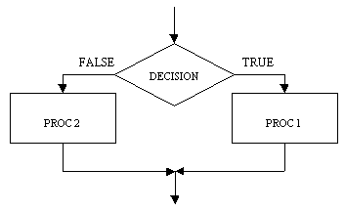
1. Simple Selection
The IF ... THEN ... ELSE ... construct has a process at each branch of the decision symbol.
IF condition THEN
statementA
ELSE
statementB
ENDIF

Slide 8
1. Simple Selection
The IF ... THEN ... ELSE ... construct has a process at each branch of the decision symbol.
Example
IF account_balance < $300 THEN
service_intge = $5.00
ELSE
service_intge = $2.00
ENDIF

Slide 9
2. Simple Selection with Null false branch
The null ELSE structure is a variation of the simple IF structure
It is used when a task is performed only when a particular condition is true
If the condition is false, then no processing will take place and the IF statement will be bypassed

Slide 10
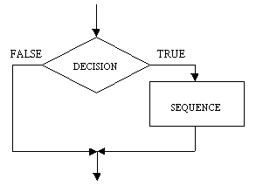
2. Simple Selection with Null false branch
The IF ... THEN construct is shown here and is also known as the NULL ELSE, meaning that there is no ELSE part.
IF condition THEN
statementA
…
…
ENDIF

Slide 11
2. Simple Selection with Null false branch
NULL ELSE
Example
IF student_attendance = part_time THEN
add 1 to part_time_count
ENDIF

Slide 12
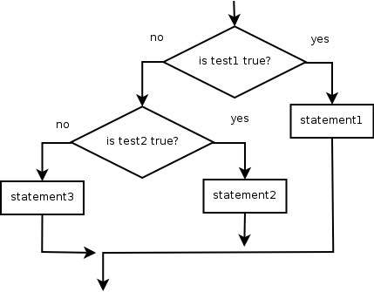
3. Nested Selection
Nested selection occurs when the word IF appears more than once within an IF statement
IF test1 THEN
statement1
ELSE IF test2 THEN
statement2
ELSE
statement3
ENDIF

Slide 13
3. Nested Selection
Nested IF statements can be classified as linear or non-linear
The linear nested IF statement is used when a field is being tested for various values and a different action is to be taken for each value.
A non-linear nested IF occurs when a number of different conditions need to be satisfied before a particular action can occur

Slide 14
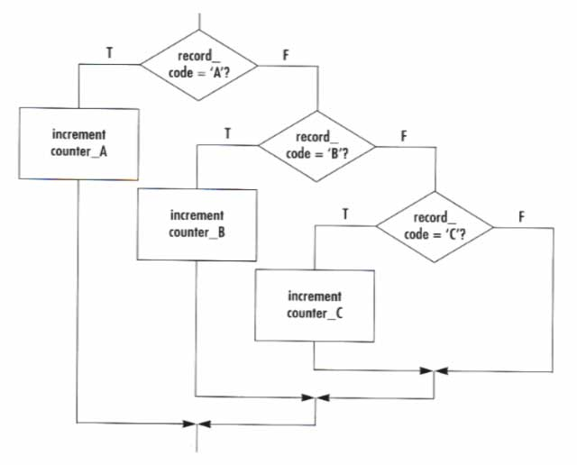
Linear Nested Selection
IF record_code = ‘A’ THEN
increment counter_A
ELSE
IF record_code = ‘B’ THEN
increment counter_B
ELSE
IF record_code = ‘C’ THEN
increment counter_C
ELSE
increment error_counter
ENDIF

Slide 15
Non-Linear Nested Selection
IF student_attendance = part_time THEN
IF student_gender = female THEN
IF student_age > 21 THEN
add 1 to mature_fem_pt_studs
ELSE
add 1 to young_fem_pt_studs
ENDIF
ELSE
add 1 to male_pt_studs
ENDIF
ELSE
add 1 to full_time_studs
ENDIF

Slide 16
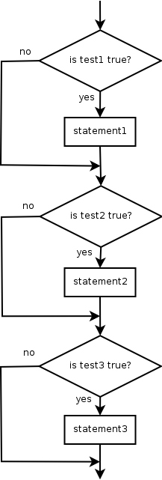
Misuse of IF: Get Grade
What's wrong with the following code?
READ score
IF (score >= 90)
DISPLAY "You got an A!"
ENDIF
IF (score >= 80)
DISPLAY "You got a B!"
ENDIF
IF (score >= 70)
DISPLAY "You got a C!"
ENDIF
IF (score >= 60)
DISPLAY "You got a D!"
ENDIF
IF (score < 60)
DISPLAY "You got an E!"
ENDIF

Slide 17
Refine use of IF: Get Grade
What's wrong with the following code?
READ score
IF (score >= 90)
DISPLAY "You got an A!"
ELSE
IF (score >= 80)
DISPLAY "You got a B!"
ELSE
IF (score >= 70)
DISPLAY "You got a C!"
ELSE
IF (score >= 60)
DISPLAY "You got a D!"
ELSE
IF (score < 60)
DISPLAY "You got an E!"
ENDIF

Slide 18
Combined Selection
A combined IF statement is one that contains multiple conditions, each connected with the logical operators AND or OR
If the connector AND is used to combine the conditions, then both conditions must be true for the combined condition to be true
If the connector OR is used to combine any two conditions, then only one of the conditions needs to be true for the combined condition to be considered true

Slide 19
Combined Selection
Examples
IF student_attendance = part_time
AND student_gender = male THEN
add 1 to male_part_time_count
ENDIF
IF student_attendance = part_time
OR student_gender = female THEN
add 1 to female_part_time_count
ENDIF

Slide 20
Logical Operator
Tests can be combined using logical operators:
"Truth tables" for each, used with logical values p and q:
Description | Example | Result
AND | (2 == 3) AND (-1 < 5) | false
OR | (2 == 3) OR (-1 < 5) | true
NOT | NOT(2 == 3) | true
p | q | p AND q | p OR q
true | true | true | true
true | false | false | true
false | true | false | true
false | false | false | false
p | NOT p
true | false
false | true

Slide 21
Evaluating Logic Expression
Relational operators have lower precedence than math.
5 * 7 >= 3 + 5 * (7 - 1)
5 * 7 >= 3 + 5 * 6
35 >= 3 + 30
35 >= 33
true
Relational operators cannot be "chained" as in algebra.
2 <= x <= 10
true <= 10 (assume that x is 15)
error!
Instead, combine multiple tests with AND or OR
2 <= x AND x <= 10
true AND false
false

Slide 22
Logical Question
What is the result of each of the following expressions?
int x = 42;
int y = 17;
int z = 25;
y < x AND y <= z
x % 2 == y % 2 OR x % 2 == z % 2
x <= y + z AND x >= y + z
!(x < y AND x < z)
(x + y) % 2 == 0 OR !((z - y) % 2 == 0)
Answers: true, false, true, true, false

Slide 23
Reference
Simple Design Program: A Step by Step Approach, Lesley Anne Robertson

