Slide 1
MAIL AND SECURITY
PERTEMUAN 13
AGUNG MULYO WIDODO DAN HOLDER S.
TEKNIK INFORMATIKA FAKULTAS ILMU KOMPUTER

Slide 2
KEMAMPUAN AKHIR YANG DIHARAPKAN
Mahasiswa mampu menguasai konsep electronic mail dan keamanan

Slide 3
Outline
Pretty good privacy
S/MIME
Recommended web sites

Slide 4
Pretty Good Privacy
Philip R. Zimmerman is the creator of PGP.
PGP provides a confidentiality and authentication service that can be used for electronic mail and file storage applications.

Slide 5
Why Is PGP Popular?
It is availiable free on a variety of platforms.
Based on well known algorithms.
Wide range of applicability
Not developed or controlled by governmental or standards organizations

Slide 6
Operational Description
Consist of five services:
Authentication
Confidentiality
Compression
E-mail compatibility
Segmentation

Slide 7
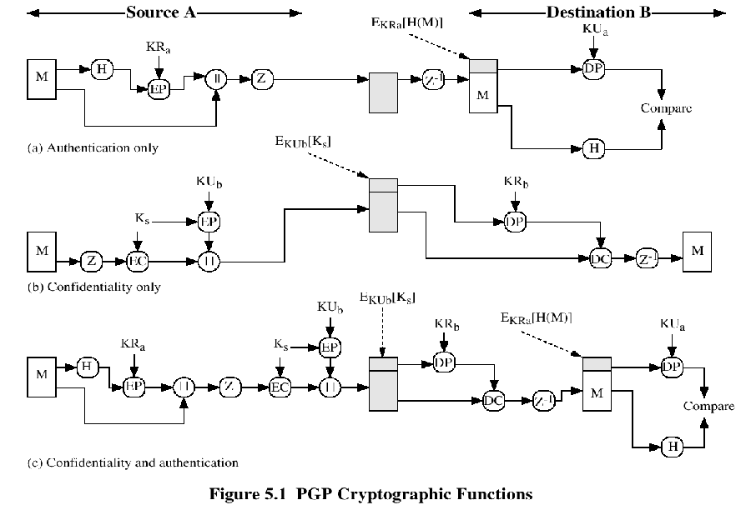

Slide 8
Compression
PGP compresses the message after applying the signature but before encryption
The placement of the compression algorithm is critical.
The compression algorithm used is ZIP (described in appendix 5A)

Slide 9
E-mail Compatibility
The scheme used is radix-64 conversion (see appendix 5B).
The use of radix-64 expands the message by 33%.

Slide 10
Segmentation and Reassembly
Often restricted to a maximum message length of 50,000 octets.
Longer messages must be broken up into segments.
PGP automatically subdivides a message that is to large.
The receiver strip of all e-mail headers and reassemble the block.

Slide 11
Sumary of PGP Services

Slide 12
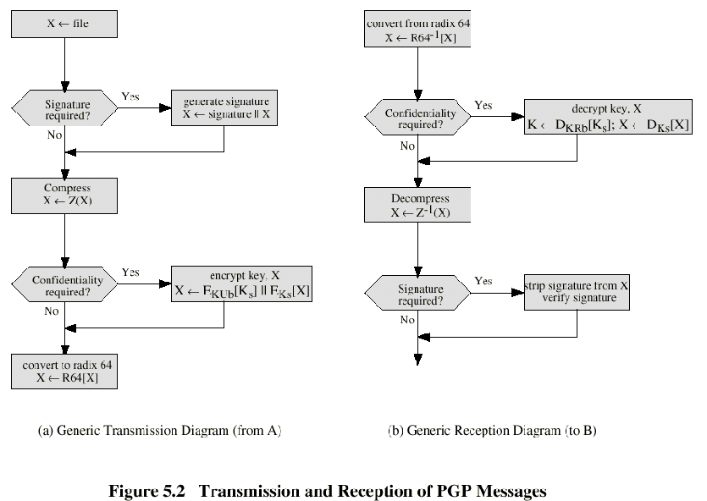

Slide 13
Format of PGP Message

Slide 14
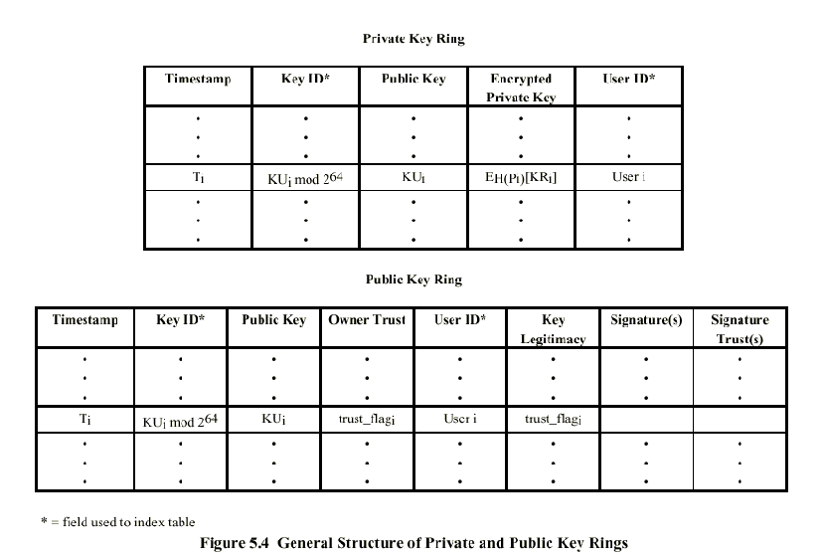

Slide 15
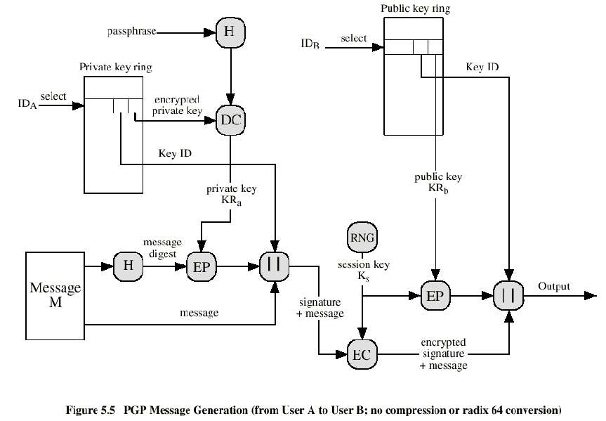

Slide 16
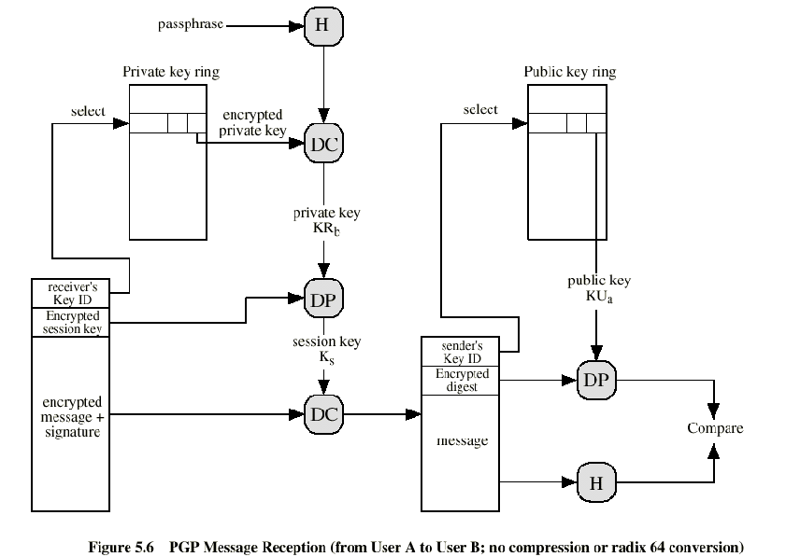

Slide 17
The Use of Trust
Key legitimacy field
Signature trust field
Owner trust field

Slide 18
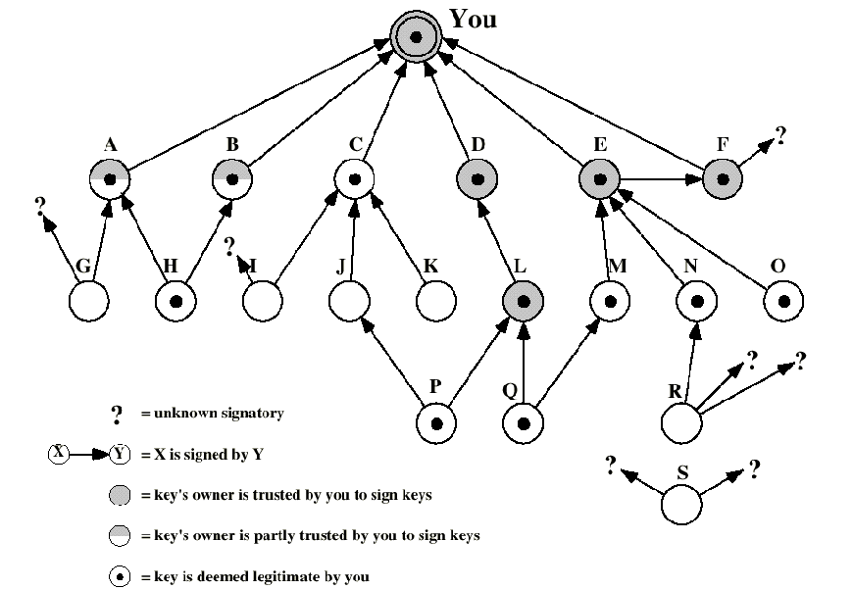

Slide 19
Revoking Public Keys
The owner issue a key revocation certificate.
Normal signature certificate with a revote indicator.
Corresponding private key is used to sign the certificate.

Slide 20
S/MIME
Secure/Multipurpose Internet Mail Extension
S/MIME will probably emerge as the industry standard.
PGP for personal e-mail security

Slide 21
Simple Mail Transfer Protocol (SMTP, RFC 822)
SMTP Limitations - Can not transmit, or has a problem with:
executable files, or other binary files (jpeg image)
“national language” characters (non-ASCII)
messages over a certain size
ASCII to EBCDIC translation problems
lines longer than a certain length (72 to 254 characters)

Slide 22
Header fields in MIME
MIME-Version: Must be “1.0” -> RFC 2045, RFC 2046
Content-Type: More types being added by developers (application/word)
Content-Transfer-Encoding: How message has been encoded (radix-64)
Content-ID: Unique identifying character string.
Content Description: Needed when content is not readable text (e.g.,mpeg)

Slide 23
S/MIME Functions
Enveloped Data: Encrypted content and encrypted session keys for recipients.
Signed Data: Message Digest encrypted with private key of “signer.”
Clear-Signed Data: Signed but not encrypted.
Signed and Enveloped Data: Various orderings for encrypting and signing.

Slide 24
Algorithms Used
Message Digesting: SHA-1 and MDS
Digital Signatures: DSS
Secret-Key Encryption: Triple-DES, RC2/40 (exportable)
Public-Private Key Encryption: RSA with key sizes of 512 and 1024 bits, and Diffie-Hellman (for session keys).

Slide 25
User Agent Role
S/MIME uses Public-Key Certificates - X.509 version 3 signed by Certification Authority
Functions:
Key Generation - Diffie-Hellman, DSS, and RSA key-pairs.
Registration - Public keys must be registered with X.509 CA.
Certificate Storage - Local (as in browser application) for different services.
Signed and Enveloped Data - Various orderings for encrypting and signing.

Slide 26
User Agent Role
Example: Verisign (www.verisign.com)
Class-1: Buyer’s email address confirmed by emailing vital info.
Class-2: Postal address is confirmed as well, and data checked against directories.
Class-3: Buyer must appear in person, or send notarized documents.

Slide 27
Recommended Web Sites
PGP home page: www.pgp.com
MIT distribution site for PGP
S/MIME Charter
S/MIME Central: RSA Inc.’s Web Site

Slide 28
TERIMA KASIH

