Slide 1
OVERVIEW OF RELATIONAL DBMS
PERTEMUAN 1
IR. NIZIRWAN ANWAR, MT
PROGRAM STUDI TEKNIK INFORMATIKA
FAKULTAS ILMU KOMPUTER

Slide 2

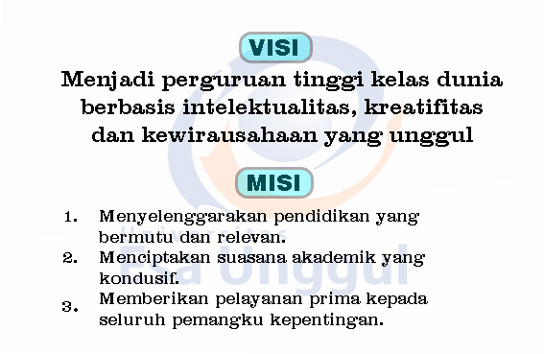
VISI DAN MISI UNIVERSITAS ESA UNGGUL

Slide 3
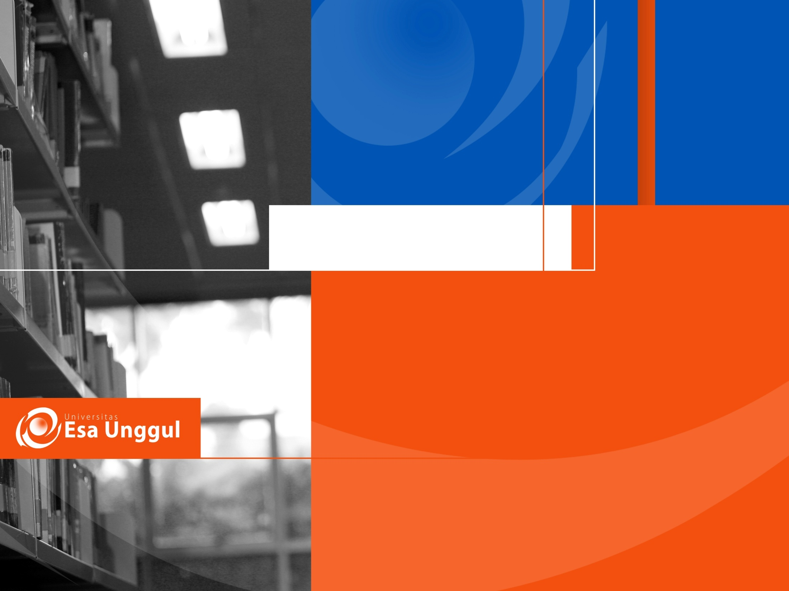
Materi Sebelum UTS
01. Overview of Relational DBMS
02. Review Of Computer Networks
03. Distributed DTD and Design
04. Distributed DBU and Design
05. Fragmentation, Allocation and Data Directory
06. Data Access Control, Management Data and Security
07. Semantic Integrity Control Centralized and Distributed

Slide 4
Materi Sesudah UTS
09. Query Optimization, Translation and Execution
10. Transaction Management and Architecture
11. Distributed Concurrency and DBMS Reliability
12. Distributed DBMS Reliability
13. Data Replication
14. Distributed Object Database Management
15. Data Management – peer to peer and web data

Slide 5
Daftar Pustaka
Ebook ;
Peter L Dordal (2017), An Introduction to Computer Networks Release 1.9.4,
P M. Tamer Özsu and Patrick Valduriez, (2011), Principles of Distributed Database Systems, Third Edition, Springer Publishing ISBN 978-1-4419-8833-1
Abraham Silberschatz, (2011), Database System Concepts, Sixth Edition, Published by McGraw-Hill, ISBN 978-0-07-352332-3
Ajay D. Kshemkalyani and Mukesh Singhal, (2008), Distributed Computing - Principles, Algorithms, and Systems, Cambridge University Press, ISBN-13 978-0-511-39341-9
New Algorithms for Fragmentation, Allocation and Redistribution in DDBSs (2011) http://fac.ksu.edu.sa/sites/default/files/Sample%20of%20MS%20Research%20Proposal.pdf (sample proposal research)
Youtube ;
Top Down vs Bottom Up Design, https://www.youtube.com/watch?v=otBgANxooPI
Query Processing & Optimization Introduction https://www.youtube.com/watch?v=GPz7RgBNEYE
Distribution System Reliability Analysis https://www.youtube.com/watch?v=S70BIoEXLlk

Slide 6
What is a distributed DBMS
A distributed database (DDB) is a collection of multiple, logically interrelated databases distributed over a computer network.
A distributed database management system (D – DBMS) is the software that manages the DDB and provides an access mechanism that makes this distribution transparent to the users.
Distributed database system (DDBS) = DDB + ( D – DBMS)

Slide 7
File Systems
program 1
File 1
data description 1
program 2
data description 2
File 2
program 3
data description 3
File 3

Slide 8
Database Management
Application
program 1
(with data
semantics)
DBMS
description
Application
program 2
(with data
semantics)
manipulation
database
control
Application
program 3
(with data
semantics)

Slide 9
Distributed DBMS
Database
Technology
Computer
Networks
integration
distribution
Distributed
Database
Systems
integration
integration ≠ centralization

Slide 10
What is not a DDBS?
A timesharing computer system
A loosely or tightly coupled multiprocessor system
A database system which resides at one of the nodes of a network of computers - this is a centralized database on a network node

Slide 11
Centralized DBMS on a Network
Site 1
Site 2
Site 5
Communication
Network
Site 4
Site 3

Slide 12
Distributed DBMS Environment
Site 1
Site 2
Site 5
Communication
Network
Site 4
Site 3

Slide 13
Transparent Access
Tokyo
Boston
Paris
Paris projects
Paris employees
Paris assignments
Boston employees
SELECT ENAME,SAL
FROM EMP,ASG,PAY
WHERE DUR > 12
AND EMP.ENO = ASG.ENO
AND PAY.TITLE = EMP.TITLE
Communication
Network
Boston projects
Boston employees
Boston assignments
Montreal
New
York
Montreal projects
Paris projects
New York projects
with budget > 200000
Montreal employees
Montreal assignments
Boston projects
New York employees
New York projects
New York assignments

Slide 14
Distributed Database - User View
Distributed Database

Slide 15
Distributed DBMS - Reality
User
Query
DBMS
Software
User
Application
DBMS
Software
DBMS
Software
Communication
Subsystem
User
Application
DBMS
Software
User
Query
DBMS
Software
User
Query

Slide 16
Relationship Between Issues
Directory
Management
Query
Processing
Distribution
Design
Reliability
Concurrency
Control
Deadlock
Management

