Slide 1
REVIEW OF COMPUTER NETWORKS
PERTEMUAN 2
IR. NIZIRWAN ANWAR, MT
PROGRAM STUDI TEKNIK INFORMATIKA
FAKULTAS ILMU KOMPUTER

Slide 2
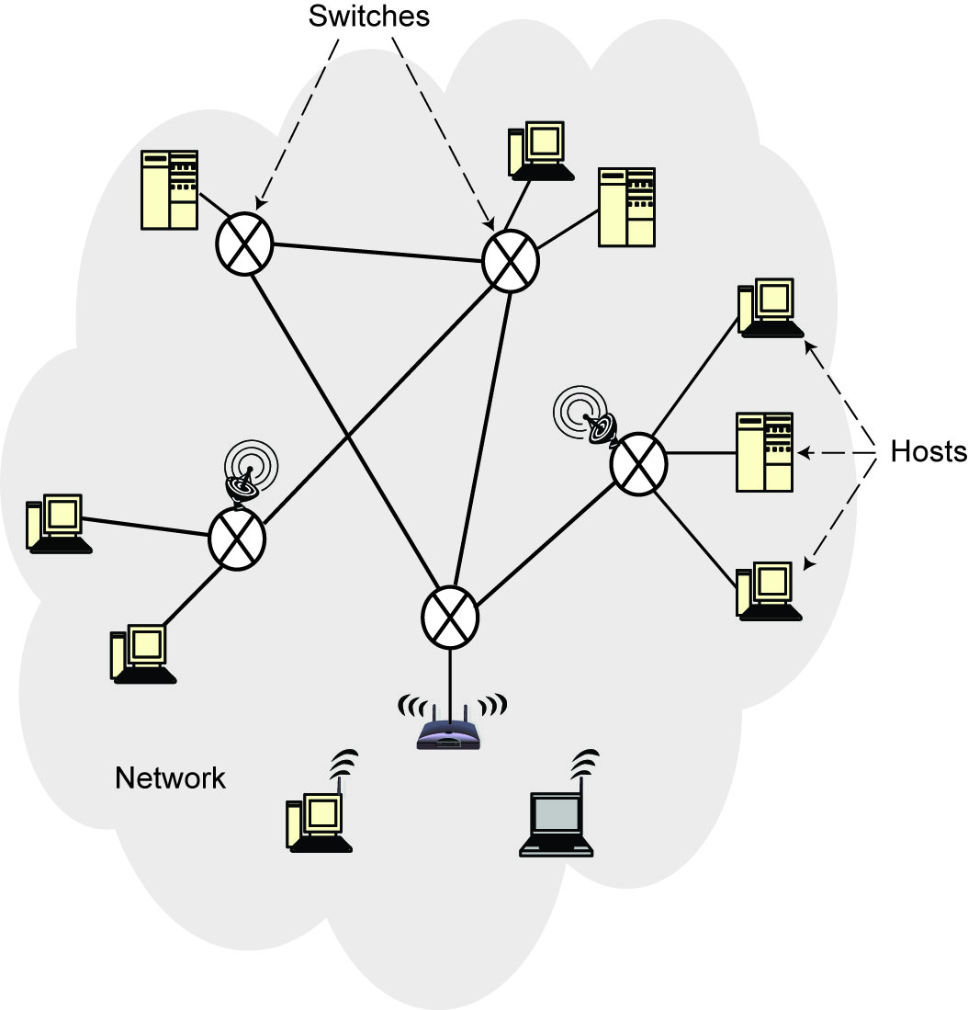
Computer Network
An interconnected collection of autonomous computers that are capable of exchanging information among themselves.
Components
Hosts (nodes, end systems)
Switches
Communication link

Slide 3
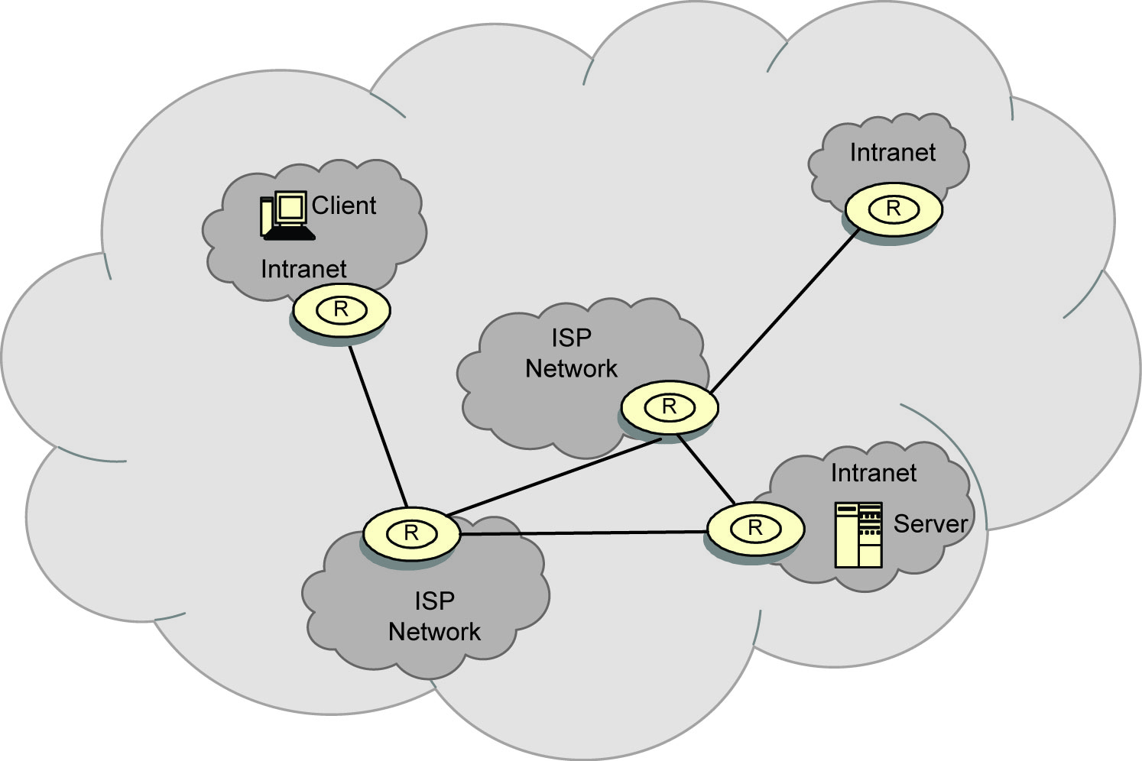
Internet (Network of networks)

Slide 4
Types of Networks
According to scale (geographic distribution)
Wide are network (WAN)
Distance between any two nodes > 20km and can go as high as thousands of kms
Long delays due to distance traveled
Heterogeneity of transmission media
Speeds of 150Mbps to 10Gbps (OC192 on the backbone)
Local area network (LAN)
Limited in geographic scope (usually < 2km)
Speeds 10-1000 Mbps
Short delays and low noise
Metropolitan area network (MAN)
In between LAN and WAN

Slide 5
Types of Networks (continued)
Topology
Irregular
No regularity in the interconnection – e.g., Internet
Bus
Typical in LANs – Ethernet
Using Carrier Sense Medium Access with Collision Detection (CSMA/CD)
Listen before and while you transmit
Star
Ring
Mesh

Slide 6
Topology Network

Slide 7
Communication Schemes
Point-to-point (unicast)
One or more (direct or indirect) links between each pair of nodes
Communication always between two nodes
Receiver and sender are identified by their addresses included in the message header
Message may follow one of many links between the sender and receiver using switching or routing
Broadcast (multi-point)
Messages are transmitted over a shared channel and received by all the nodes
Each node checks the address and if it not the intended recipient, ignores
Multi-cast: special case
Message is sent to a subset of the nodes

Slide 8
Communication Alternatives
Twisted pair
Coaxial
Fiber optic cable
Satellite
Microwave
Wireless

Slide 9
Data Communication
Hosts are connected by links, each of which can carry one or more channels
Link: physical entity; channel: logical entity
Digital signal versus analog signal
Capacity – bandwidth
The amount of information that can be trnsmitted over the channel in a given time unit
Alternative messaging schemes
Packet switching
Messages are divided into fixed size packets, each of which is routed from the source to the destination
Circuit switching
A dedicated channel is established between the sender and receiver for the duration of the session

Slide 10
Communication Protocols
Software that ensures error-free, reliable and efficient communication between hosts
Layered architecture – hence protocol stack or protocol suite
TCP/IP is the best-known one
Used in the Internet

Slide 11
Protocols TCP/IP vs OSI (compare)

Slide 12
Message Transmission using TCP/IP

Slide 13
Classes IP

