Slide 1
DISTRIBUTED DATABASE TOP DOWN & DESIGN
PERTEMUAN 3
IR. NIZIRWAN ANWAR, MT
PROGRAM STUDI TEKNIK INFORMATIKA
FAKULTAS ILMU KOMPUTER

Slide 2
Design Problem
In the general setting :
Making decisions about the placement of data and programs across the sites of a computer network as well as possibly designing the network itself.
In Distributed DBMS, the placement of applications entails
placement of the distributed DBMS software; and
placement of the applications that run on the database

Slide 3
Dimensions of the Problem
Access pattern behavior
dynamic
static
partial
information
data
Level of knowledge
data +
program
complete
information
Level of sharing

Slide 4
Distribution Design
Top-down
mostly in designing systems from scratch
mostly in homogeneous systems
Bottom-up
when the databases already exist at a number of sites

Slide 5
Top-Down Design a Distributed
Requirements
Analysis
Objectives
User Input
Conceptual
Design
View Integration
View Design
GCS
Access
Information
ES’s
Distribution
Design
User Input
LCS’s
Physical
Design
LIS’s

Slide 6
Distribution Design Issues
Why fragment at all?
How to fragment?
How much to fragment?
How to test correctness?
How to allocate?
Information requirements?

Slide 7
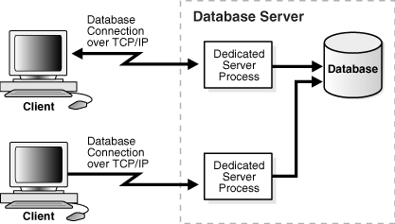
Database Server

Slide 8
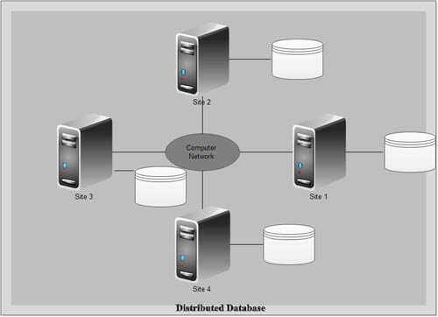
Distributed Database Servers

Slide 9
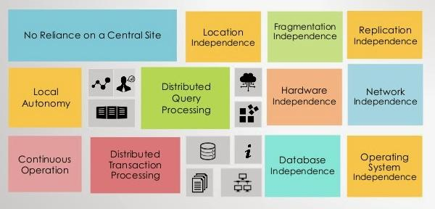
Date's Twelve Rules for Distributed Database Systems
Sumber informasi http://www.exploredatabase.com/2015/03/dates-twelve-rules-for-distributed-database.html

Slide 10
Distributed Database Design – Top-Down Design Ileana ŞTEFAN and Maricel POPA
Paper ( bahan diskusi) tittle Distributed Database Design… link url https://ie.utcluj.ro/files/acta/2007/Number1/Paper11_Stefan.pdf

