Slide 1
DISTRIBUTED DATABASE BOTTOM UP & DESIGN
PERTEMUAN 4
IR. NIZIRWAN ANWAR, MT
PROGRAM STUDI TEKNIK INFORMATIKA
FAKULTAS ILMU KOMPUTER

Slide 2
Dimensions of the Problem
Access pattern behavior
dynamic
static
partial
information
data
Level of knowledge
data +
program
complete
information
Level of sharing

Slide 3
Distributed Database Design
Level of sharing
  no sharing - each application and its data execute at one site,
  data sharing - all the programs are replicated at all the sites, but data files are not,
  data plus program sharing - both data and programs may be shared.
Behavior of access patterns
  static - access patterns of user requests do not change over time,
  dynamic - access patterns of user requests change over time.
Level of knowledge on access pattern behavior
  complete information - the access patterns can reasonably be predicted and do not deviate significantly from the predictions,
  partial information - there are deviation from the predictions.

Slide 4
Top-Down vs. Bottom-Up Design
Database applications, like other complex systems, can be designed by either of two strategies, or approaches, called the "top-down" strategy and the "bottom-up" strategy.
In practice, a designer or design team rarely uses solely one or the other of these strategies. Nevertheless, their differences are worth noting.
Top-Down Design
  This approach starts by identifying the entities in the problem and their relationships, and then working down to the attributes and their details.
Bottom-Up Design
  This approach starts with the attributes in the problem, and then works up by identifying the entities to which the attributes need to be linked and, in turn, the relationships among the entities

Slide 5
Top-Down vs. Bottom-Up Design (continued)
Rob and Coronel comment quite carefully about these two somewhat different strategies, saying:
  "Although these two methodologies are complementary rather than mutually exclusive, a primary emphasis on a bottom-up approach may be [emphasis added] more productive for small databases with few entities, attributes, relations, and transactions. For situations in which the number, variety, and complexity of entities, relations, and transactions is overwhelming, a primarily top-down approach may be [emphasis added] more easily managed."

Slide 6
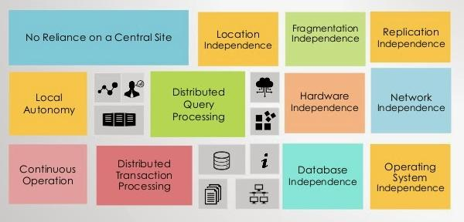
Date's Twelve Rules for Distributed Database Systems
Sumber informasi http://www.exploredatabase.com/2015/03/dates-twelve-rules-for-distributed-database.html

Slide 7
Bottom Up design
bottom-up design
PL-B
PL-A
PL-A
PL-B
PL-C
PL-C
bottom-up architecture
AL-B
AL-C
AL-D
AL-B
AL-A
AL-C
wrapper
wrapper
wrapper
AL-D
AL-A
wrapper
wrapper
wrapper
legacy
application
legacy
application
legacy
system
legacy
system
legacy
system

Slide 8
Top down design (review)
The functionality of a system is divided among several modules. Modules cannot act as a separate component, their functionality depends on the functionality of other modules.
Hardware is typically homogeneous and the system is designed to be distributed from the beginning.
top-down architecture
PL-B
PL-A
PL-C
top-down design
PL-A
PL-B
AL-B
PL-C
AL-C
AL-D
AL-B
AL-C
AL-D
AL-A
AL-A
RM-1
RM-2
RM-1
RM-2

Slide 9
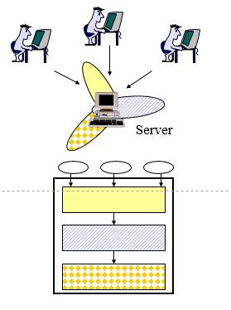
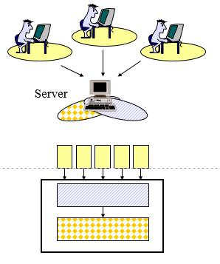
One tier: fully centralized
Two tier: client/server

Slide 10
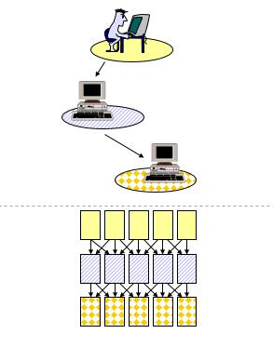
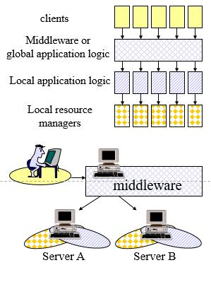
Three tier: middleware
Middleware

Slide 11
Analysis of a Top-Down Bottom-Up Data Analysis Framework and Software Architecture Design
Paper ( bahan diskusi) tittle Distributed Database Design Bottom Up … link url http://web.mit.edu/smadnick/www/wp/2014-08.pdf

