Slide 1
FRAGMENTATION AND ALLOCATION (CIB125)
PERTEMUAN 5
IR. NIZIRWAN ANWAR, MT
PROGRAM STUDI TEKNIK INFORMATIKA
FAKULTAS ILMU KOMPUTER

Slide 2
Fragmentation
Can't we just distribute relations?
What is a reasonable unit of distribution?
relation
views are subsets of relations ➔locality
extra communication
fragments of relations (sub-relations)
concurrent execution of a number of transactions that access different portions of a relation
views that cannot be defined on a single fragment will require extra processing
semantic data control (especially integrity enforcement) more difficult

Slide 3
Fragmentation Alternative (FA)
Fragmentation Alternatives
Fragmentation Alternatives – Vertical
Fragmentation Alternatives – Horizontal

Slide 4
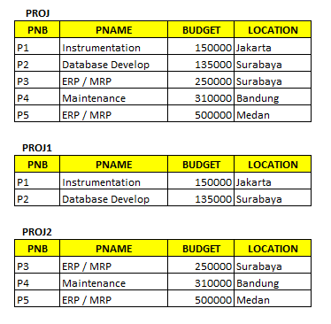
Fragmentation Alternatives – Horizontal
PROJ₁ : projects with budgets less than $200,000
PROJ₂ : projects with budgets greater than or equal to $200,000

Slide 5
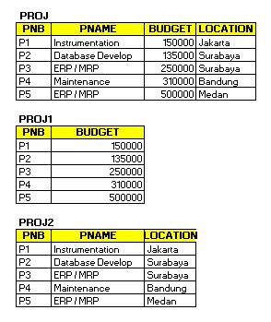
Fragmentation Alternatives – Vertical
PROJ₁: information about project budgets
PROJ₂: information about project names and locations

Slide 6
Degree of Fragmentation
finite number of alternatives
Tuples or attributes
relations
Finding the suitable level of partitioning within this range

Slide 7
Allocation Alternatives
Non-replicated
partitioned : each fragment resides at only one site
Replicated
fully replicated : each fragment at each site
partially replicated : each fragment at some of the sites
Rule of thumb:

Slide 8
Comparison of Replication Alternatives
FULL-REPLICATION
PARTIAL-REPLICATION
PARTITIONING
QUERY
PROCESSING
Easy
Same Difficulty
DIRECTORY
MANAGEMENT
Easy or
Non-existant
Same Difficulty
CONCURRENCY
CONTROL
Moderate
Difficult
Easy
RELIABILITY
Very High
High
Low
REALITY
Possible
Application
Realistic
Possible
Application

Slide 9
Information Requirements
4 (four) categories:
Database information
Application information
Communication network information
Computer system information

Slide 10
Latihan soal
Jelaskan konsep fragmentation berdasarkan information requirements dan buat contoh sederhana pada masing approach di bawah ini
Primary Horizontal Fragmentation (PHF)
Derived Horizontal Fragmentation (DHF)

