Slide 1
Introduction to Routing and Packet Forwarding
CCNA 2
Routing Protocols and Concepts – Chapter 1

Slide 2
Objectives
Identify a router as a computer with an OS and hardware designed for the routing process.
Demonstrate the ability to configure devices and apply addresses.
Describe the structure of a routing table.
Describe how a router determines a path and switches packets

Slide 3
Router as a Computer
Describe the basic purpose of a router
-Computers that specialize in sending packets over the data network. They are responsible for interconnecting networks by selecting the best path for a packet to travel and forwarding packets to their destination
Routers are the network center
-Routers generally have 2 connections:
-WAN connection (Connection to ISP)
-LAN connection

Slide 4
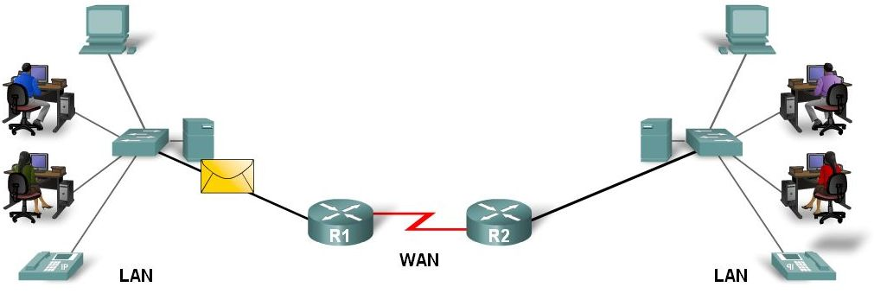
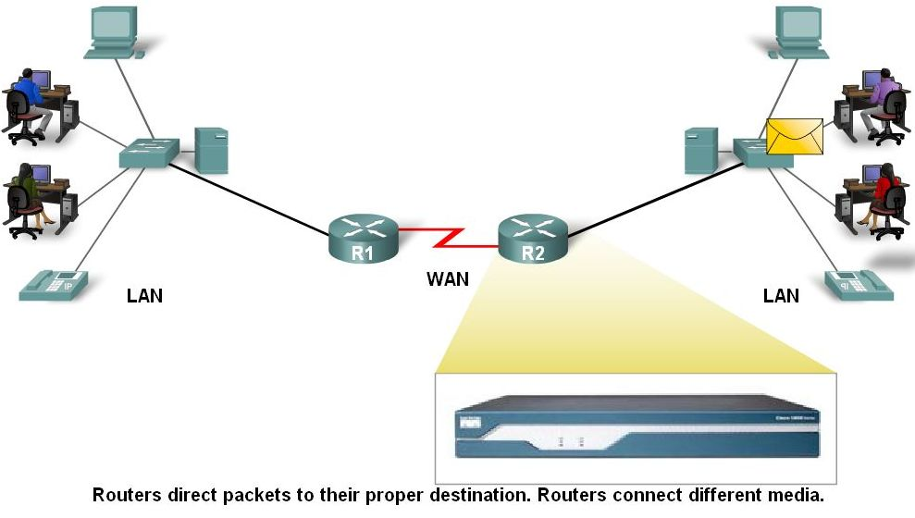
Router as a Computer
Data is sent in form of packets between 2 end devices
Routers are used to direct packet to its destination

Slide 5
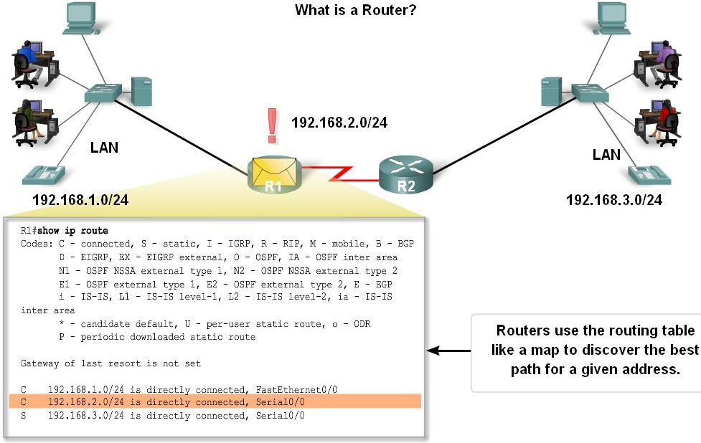
Router as a Computer
Routers examine a packet’s destination IP address and determine the best path by enlisting the aid of a routing table

Slide 6
Router as a Computer
Router components and their functions”
CPU - Executes operating system instructions
Random access memory (RAM) - Contains the running copy of configuration file. Stores routing table. RAM contents lost when power is off
Read-only memory (ROM) - Holds diagnostic software used when router is powered up. Stores the router’s bootstrap program.
Non-volatile RAM (NVRAM) - Stores startup configuration. This may include IP addresses (Routing protocol, Hostname of router)
Flash memory - Contains the operating system (Cisco IOS)
Interfaces - There exist multiple physical interfaces that are used to connect network. Examples of interface types:
-Ethernet / fast Ethernet interfaces
-Serial interfaces
-Management interfaces

Slide 7
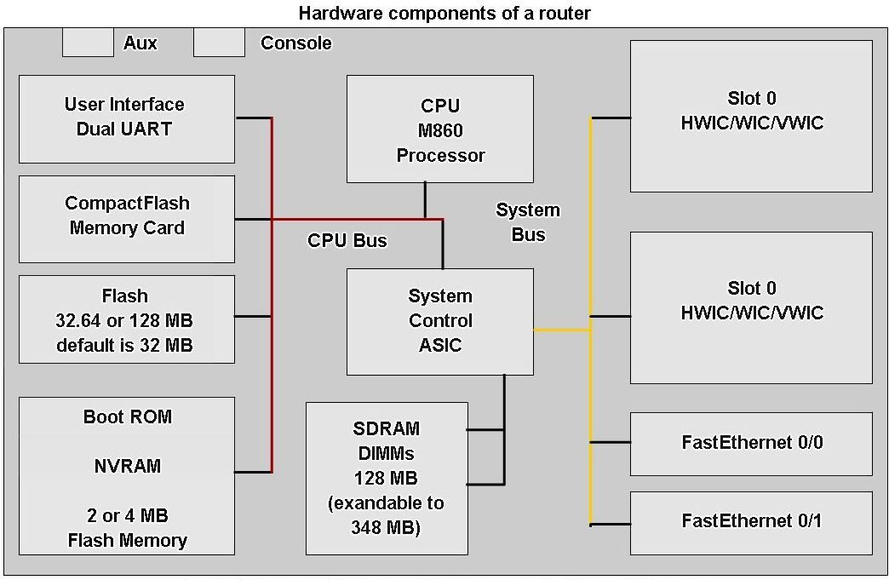
Router as a Computer
Router components

Slide 8
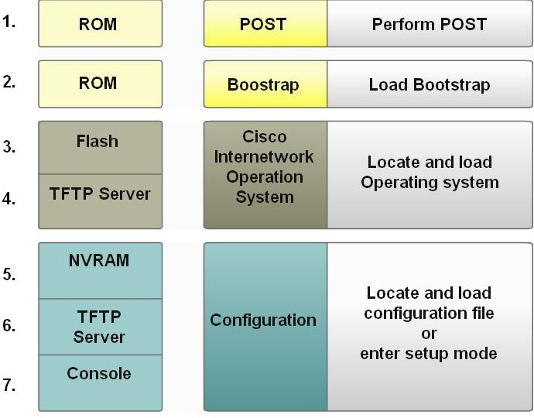
Router as a Computer
Major phases to the router boot-up process
Test router hardware
Power-On Self Test (POST)
Execute bootstrap loader
Locate & load Cisco IOS software
-Locate IOS
-Load IOS
Locate & load startup configuration file or enter setup mode
-Bootstrap program looks for configuration file

Slide 9
Router as a Computer
Verify the router boot-up process:
-The show version command is used to view information about the router during the bootup process. Information includes:
Platform model number
Image name & IOS version
Bootstrap version stored in ROM
Image file name & where it was loaded from
Number & type of interfaces
Amount of NVRAM
Amount of flash
Configuration register

Slide 10
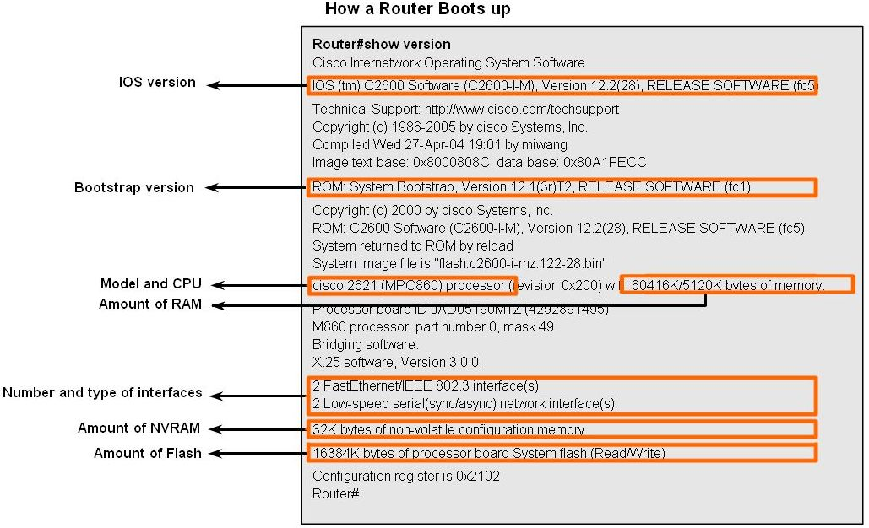
Router as a Computer

Slide 11
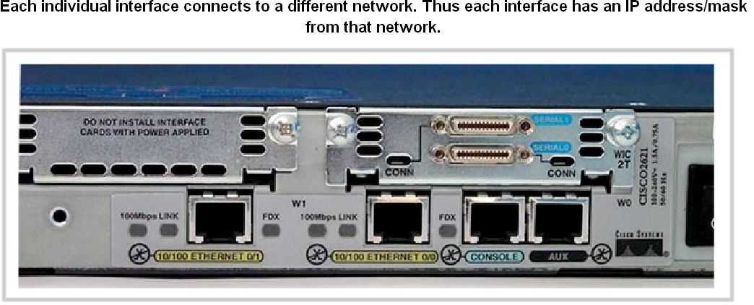
Router as a Computer
Router Interface is a physical connector that enables a router to send or receive packets
Each interface connects to a separate network
Consist of socket or jack found on the outside of a router
Types of router interfaces:
-Ethernet
-Fastethernet
-Serial
-DSL
-ISDN
-Cable

Slide 12
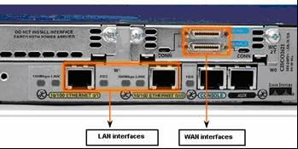
Router as a Computer
Two major groups of Router Interfaces
LAN Interfaces:
Are used to connect router to LAN network
Has a layer 2 MAC address
Can be assigned a Layer 3 IP address
Usually consist of an RJ-45 jack
WAN Interfaces
Are used to connect routers to external networks that interconnect LANs.
Depending on the WAN technology, a layer 2 address may be used.
Uses a layer 3 IP address

Slide 13
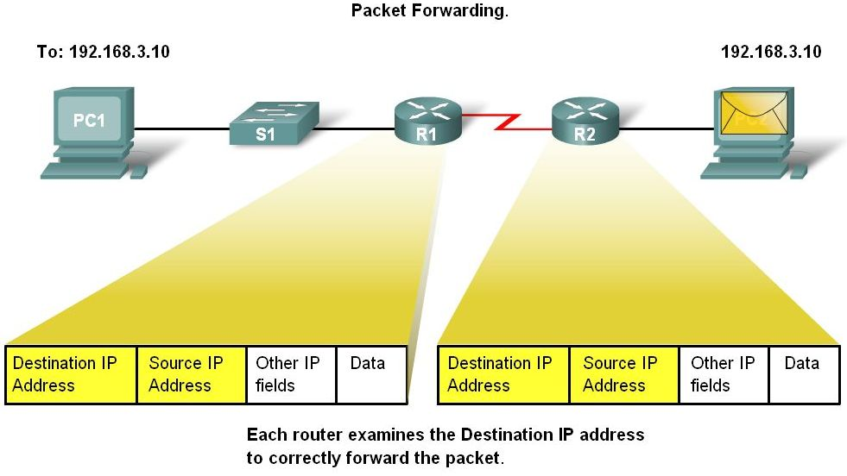
Router as a Computer
Routers and the Network Layer
Routers use destination IP address to forward packets
The path a packet takes is determined after a router consults information in the routing table.
After router determines the best path
Packet is encapsulated into a frame
Frame is then placed on network medium in form of Bits

Slide 14
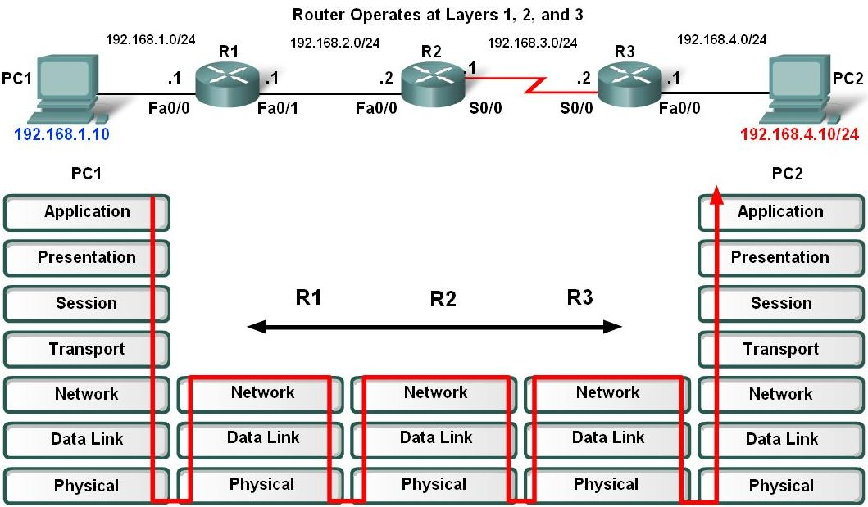
Router as a Computer
Routers Operate at Layers 1, 2 & 3
Router receives a stream of encoded bits
Bits are decoded and passed to layer 2
Router de-encapsulates the frame
Remaining packet passed up to layer 3
-Routing decision made at this layer by examining destination IP address
Packet is then re-encapsulated & sent out outbound interface

Slide 15
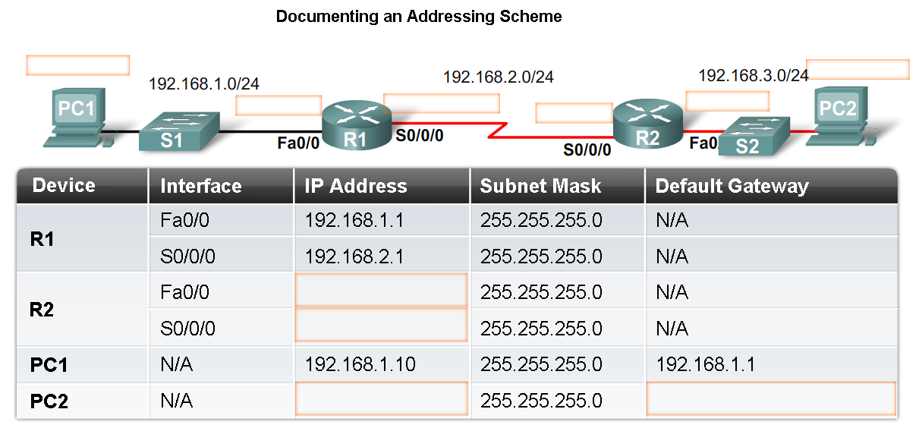
Configure Devices and Apply Addresses
Implementing Basic Addressing Schemes
When designing a new network or mapping an existing network you must provide the following information in the form of a document:
-Topology drawing that Illustrates physical connectivity
Address table that provides the following information:
Device name
Interfaces used
IP addresses
Default gateway

Slide 16
Configure Devices and Apply Addresses
Basic Router Configuration
A basic router configuration should contain the following:
-Router name - Host name should be unique
-Banner - At a minimum, banner should warn against unauthorized use
-Passwords - Use strong passwords
-Interface configurations - Specify interface type, IP address and subnet mask. Describe purpose of interface. Issue no shutdown command. If DCE serial interface issue clock rate command.
After entering in the basic configuration the following tasks should be completed
-Verify basic configuration and router operations.
-Save the changes on a router

Slide 17
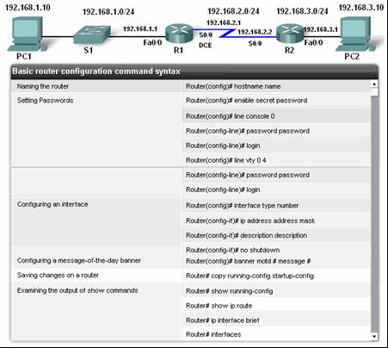
Configure Devices and Apply Addresses

Slide 18
Configure Devices and Apply Addresses
Verify Basic Router Configuration
-Issue the show running-config command
-Save the basic router configuration by Issuing the copy running-config startup-config command
-Additional commands that will enable you to further verify router configuration are:
Show running-config - Displays configuration currently in RAM
Show startup-config - Displays configuration file NVRAM
Show IP route - Displays routing table
Show interfaces - Displays all interface configurations
Show IP int brief - Displays abbreviated interface configuration information

Slide 19
Routing Table Structure
Routing Table is stored in ram and contains information about:
Directly connected networks - this occurs when a device is connected to another router interface
Remotely connected networks - this is a network that is not directly connected to a particular router
Detailed information about the networks include source of information, network address & subnet mask, and Ip address of next-hop router
Show ip route command is used to view a routing table

Slide 20
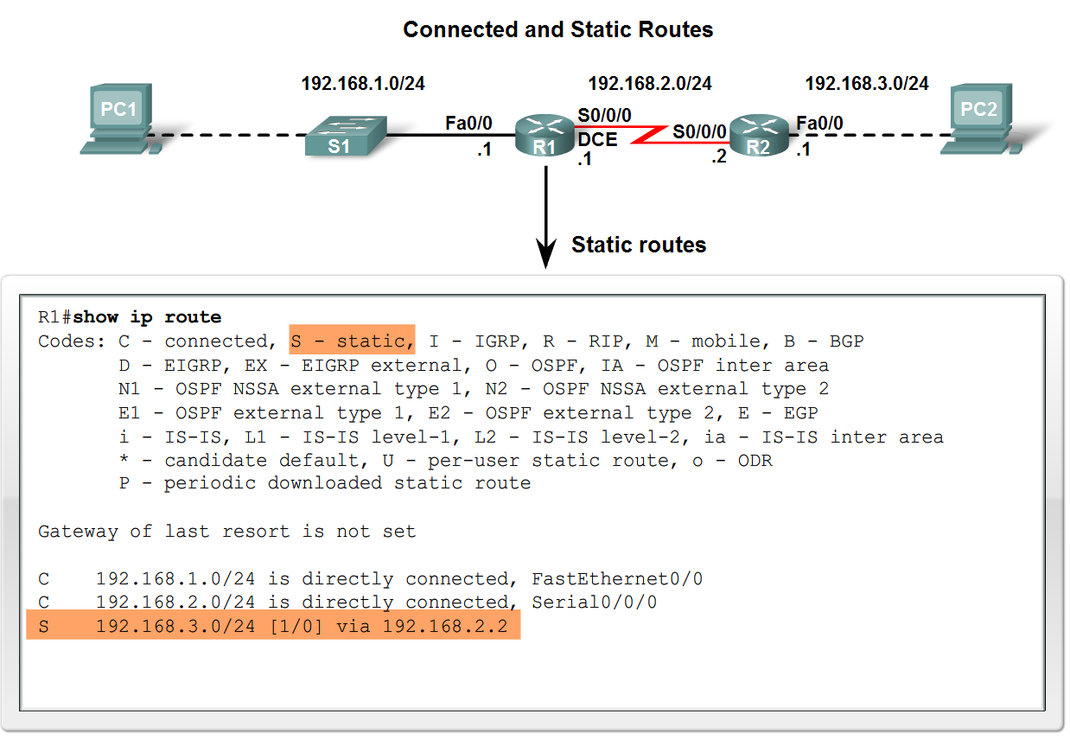
Routing Table Structure
Adding a connected network to the routing table
-Router interfaces
Each router interface is a member of a different network
Activated using the no shutdown command
In order for static and dynamic routes to exist in routing table you must have directly connected networks

Slide 21
Routing Table Structure
Static routes in the routing table
-Includes: network address and subnet mask and IP address of next hop router or exit interface
-Denoted with the code S in the routing table
-Routing tables must contain directly connected networks used to connect remote networks before static or dynamic routing can be used
When to use static routes
-When network only consists of a few routers
-Network is connected to internet only through one ISP
-Hub & spoke topology is used on a large network

Slide 22
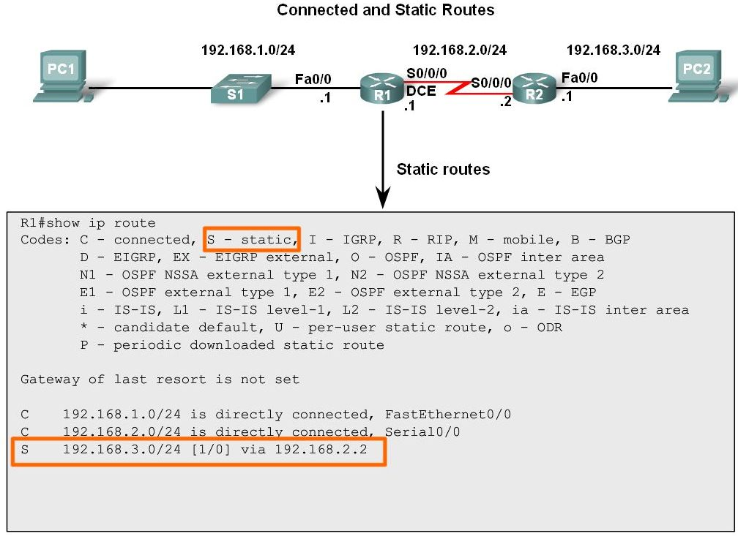
Routing Table Structure
Connected and Static routes

Slide 23
Routing Table Structure
Dynamic routing protocols
-Used to add remote networks to a routing table
-Are used to discover networks
-Are used to update and maintain routing tables
Automatic network discovery
-Routers are able discover new networks by sharing routing table information

Slide 24
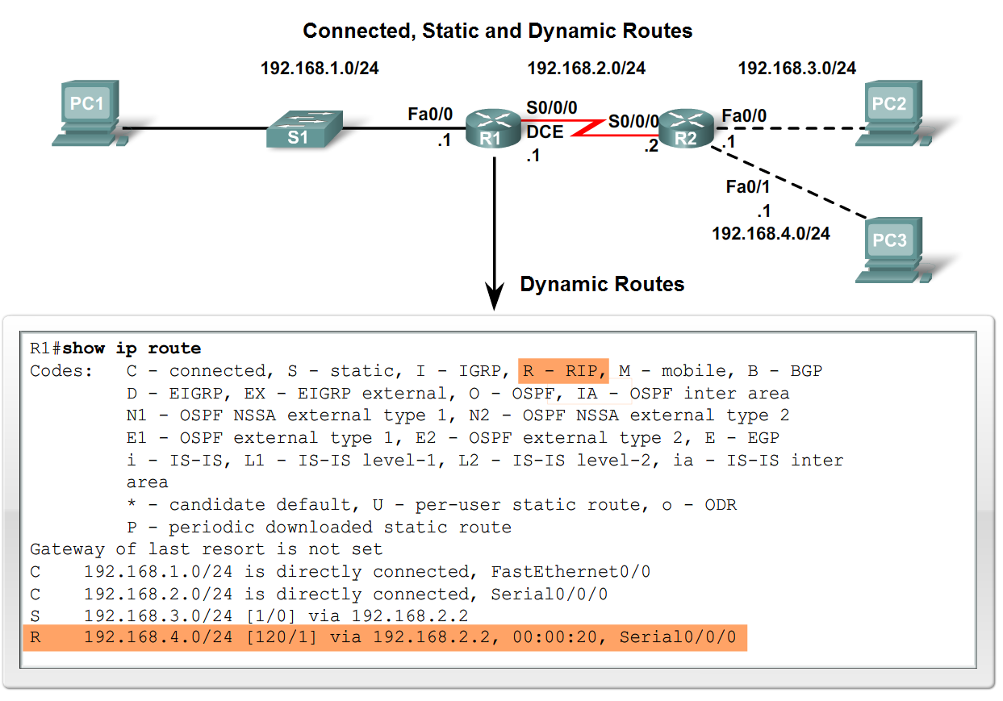
Routing Table Structure
Maintaining routing tables
-Dynamic routing protocols are used to share routing information with other router & to maintain and up date their own routing table.
IP routing protocols. Example of routing protocols include:
-RIP
-IGRP
-EIGRP
-OSPF

Slide 25
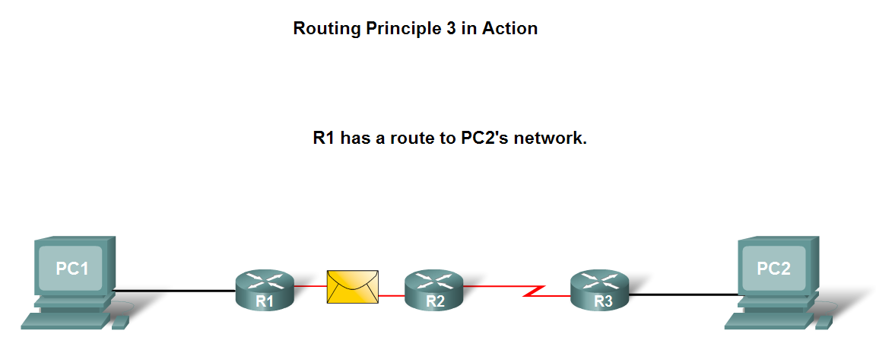
Routing Table Structure
Routing Table Principles
-3 principles regarding routing tables:
Every router makes its decisions alone, based on the information it has in its routing table.
Different routing table may contain different information
A routing table can tell how to get to a destination but not how to get back

Slide 26
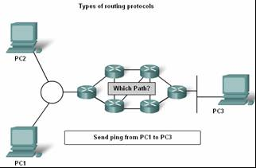
Routing Table Structure
Effects of the 3 Routing Table Principles
-Packets are forwarded through the network from one router to another, on a hop by hop basis.
-Packets can take path “X” to a destination but return via path “Y” (Asymmetric routing).

Slide 27
Router Paths and Packet Switching
Internet Protocol (IP) packet format contains fields that provide information about the packet and the sending and receiving hosts
Fields that are importance for CCNA students:
-Destination IP address
-Source IP address
-Version & TTL
-IP header length
-Precedence & type of service
-Packet length

Slide 28
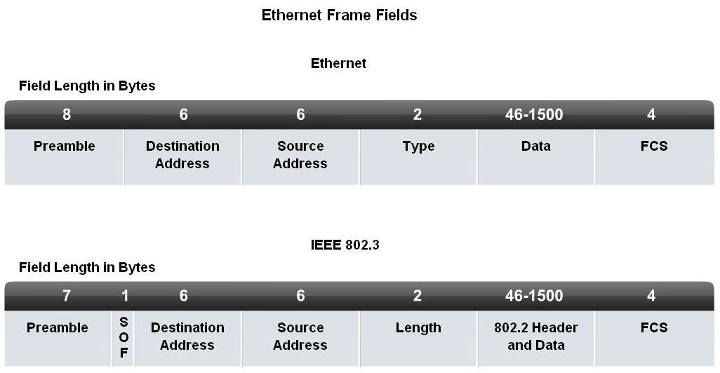
Router Paths and Packet Switching
MAC Layer Frame Format
MAC Frames are also divided into fields. They include:
-Preamble
-Start of frame delimiter
-Destination MAC address
-Source MAC address
-Type/length
-Data and pad
-Frame check sequence

Slide 29
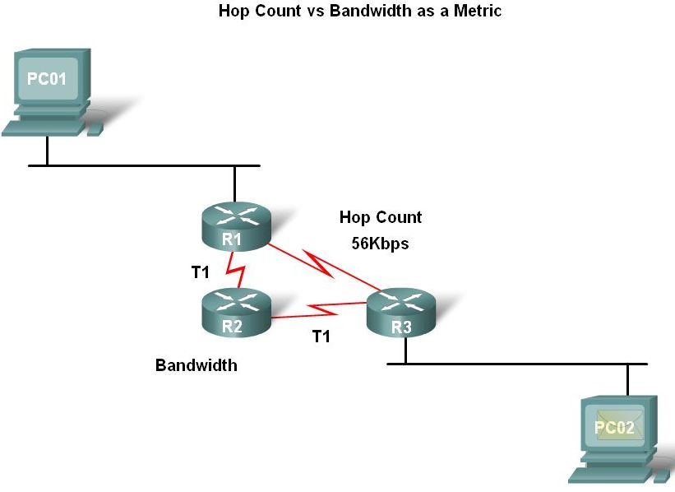
Router Paths and Packet Switching
A Metric is a numerical value used by routing protocols help determine the best path to a destination
The smaller the metric value the better the path
2 types of metrics used by routing protocols are:
-Hop count - this is the number of routers a packet must travel through to get to its destination
-Bandwidth - this is the “speed” of a link also known as the data capacity of a link

Slide 30
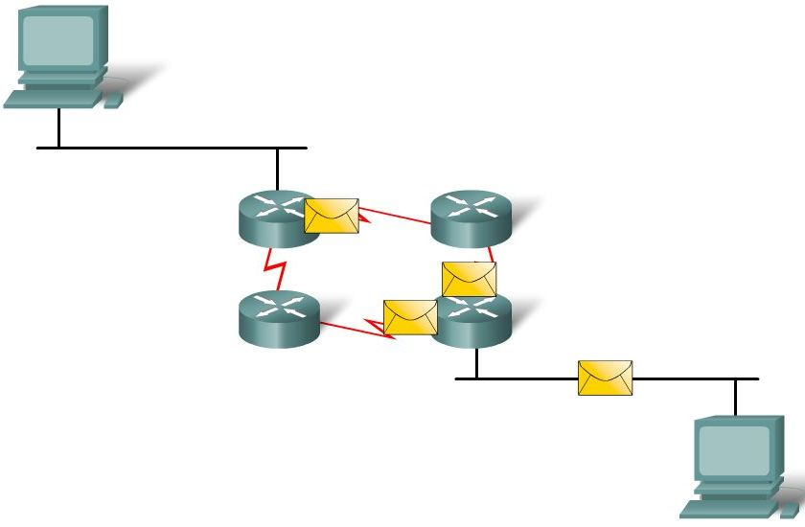
Router Paths and Packet Switching
Equal cost metric is a condition where a router has multiple paths to the same destination that all have the same metric
To solve this dilemma, a router will use Equal Cost Load Balancing. This means the router sends packets over the multiple exit interfaces listed in the routing table.

Slide 31
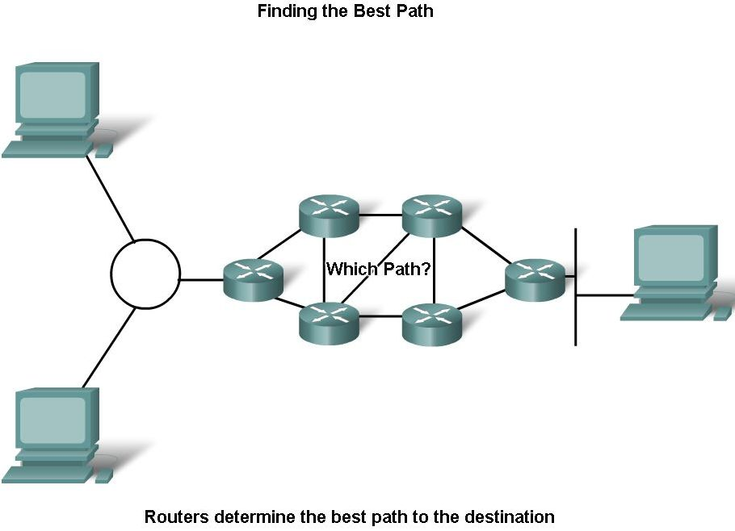
Router Paths and Packet Switching
Path determination is a process used by a router to pick the best path to a destination
One of 3 path determinations results from searching for the best path
Directly connected network
Remote network
No route determined

Slide 32
Router Paths and Packet Switching
Switching Function of Router is the process used by a router to switch a packet from an incoming interface to an outgoing interface on the same router.
-A packet received by a router will do the following:
Strips off layer 2 headers.
Examines destination IP address located in Layer 3 header to find best route to destination.
Re-encapsulates layer 3 packet into layer 2 frame.
Forwards frame out exit interface.

Slide 33
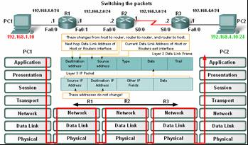
Router Paths and Packet Switching
As a packet travels from one networking device to another
-The Source and Destination IP addresses NEVER change
-The Source & Destination MAC addresses CHANGE as packet is forwarded from one router to the next.
-TTL field decrement by one until a value of zero is reached at which point router discards packet (prevents packets from endlessly traversing the network)

Slide 34
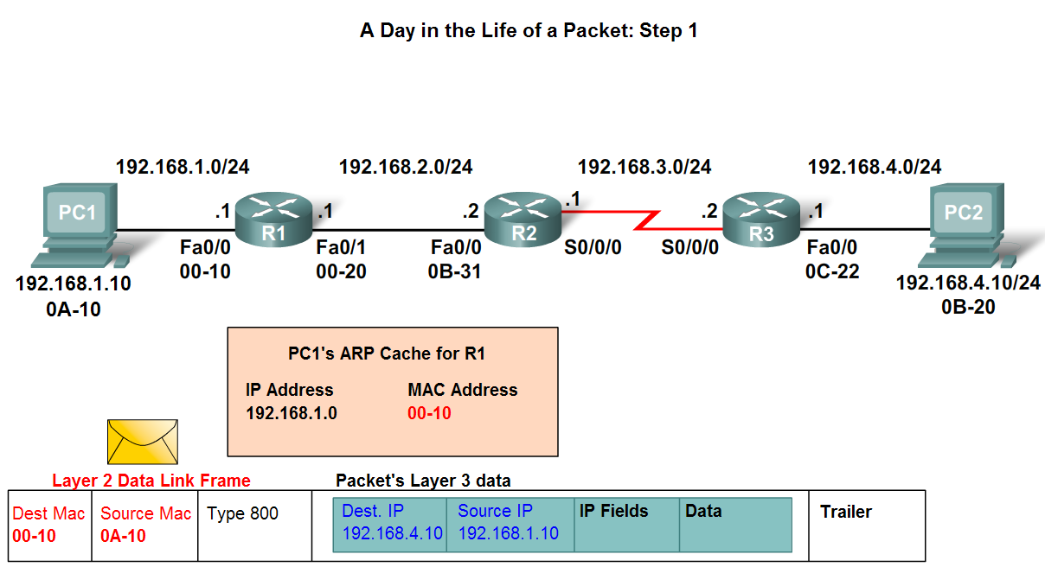
Router Paths and Packet Switching
Path determination and switching function details. PC1 Wants to send something to PC 2 here is part of what happens
Step 1 - PC1 encapsulates packet into a frame. Frame contains R1’s destination MAC address

Slide 35
Router Paths and Packet Switching
Step 2 - R1 receives Ethernet frame.
R1 sees that destination MAC address matches its own MAC.
R1 then strips off Ethernet frame.
R1 Examines destination IP.
R1 consults routing table looking for destination IP.
After finding destination IP in routing table, R1 now looks up next hop IP address.
R1 re-encapsulates IP packet with a new Ethernet frame.
R1 forwards Ethernet packet out Fa0/1 interface.

Slide 36
Router Paths and Packet Switching

Slide 37
Router Paths and Packet Switching
Path determination and switching function details. PC1 Wants to send something to PC 2 here is part of what happens
Step 3 - Packet arrives at R2
R2 receives Ethernet frame
R2 sees that destination MAC address matches its own MAC
R2 then strips off Ethernet frame
R2 Examines destination IP
R2 consults routing table looking for destination IP
After finding destination IP in routing table, R2 now looks up next hop IP address
R2 re-encapsulates IP packet with a new data link frame
R2 forwards Ethernet packet out S0/0 interface

Slide 38
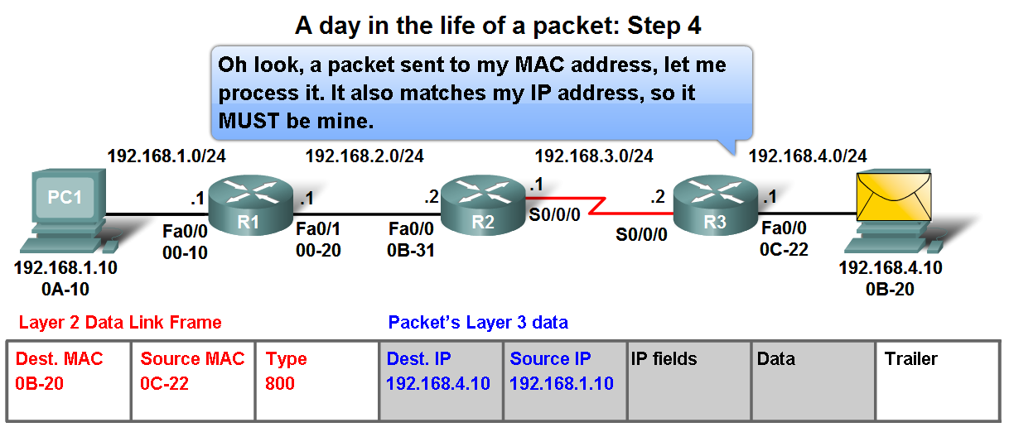
Router Paths and Packet Switching
Path determination and switching function details. PC1 Wants to send something to PC 2 here is part of what happens
Step 4 - Packet arrives at R3
R3 receives PPP frame
R3 then strips off PPP frame
R3 Examines destination IP
R3 consults routing table looking for destination IP
After finding destination IP in routing table, R3 is directly connected to destination via its fast Ethernet interface
R3 re-encapsulates IP packet with a new Ethernet frame
R3 forwards Ethernet packet out Fa0/0 interface
Step 5 - IP packet arrives at PC2. Frame is decapsulated & processed by upper layer protocols.

Slide 39
Summary
Routers are computers that specialize in sending data over a network.
Routers are composed of:
-Hardware i.e. CPU, Memory, System bus, Interfaces
-Software used to direct the routing process
IOS
Configuration file
Routers need to be configured. Basic configuration consists of:
-Router name
-Router banner
-Password(s)
-Interface configurations i.e. IP address and subnet mask
Routing tables contain the following information
-Directly connected networks
-Remotely connected networks
-Network addresses and subnet masks
-IP address of next hop address

Slide 40
Summary
Routers determine a packets path to its destination by doing the following
Receiving an encapsulated frame & examining destination MAC address.
If the MAC address matches then Frame is de-encapsulated so that router can examine the destination IP address.
If destination IP address is in routing table or there is a static route then Router determines next hop IP address. Router will re-encapsulate packet with appropriate layer 2 frame and send it out to next destination.
Process continues until packet reaches destination.
Note - only the MAC addresses will change the source and destination IP addresses do not change.

