Slide 1
Static Routing
CCNA
Routing Protocols and Concepts – Chapter 2

Slide 2
Objectives
Define the general role a router plays in networks.
Describe the directly connected networks, different router interfaces
Examine directly connected networks in the routing table and use the CDP protocol
Describe static routes with exit interfaces
Describe summary and default route
Examine how packets get forwarded when using static routes
Identify how to manage and troubleshoot static routes

Slide 3
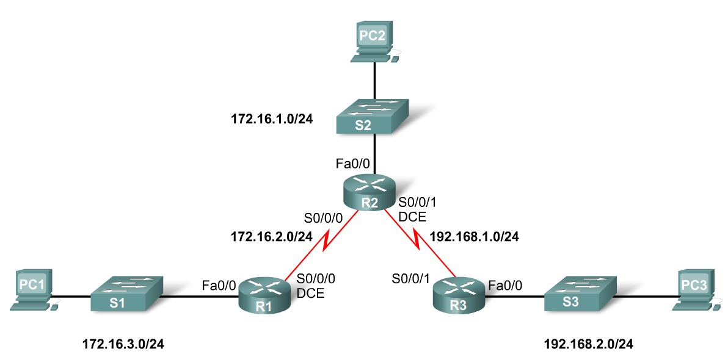
General Role of the Router
Functions of a Router
Best Path Selections
Forwarding packets to destination
Introducing the Topology
3 1800 series routers connected via WAN links
Each router connected to a LAN represented by a switch and a PC

Slide 4
General Role of the Router
Connections of a Router for WAN
-A router has a DB-60 port that can support 5 different cabling standards
Connections of a Router for Ethernet
-2 types of connectors can be used: Straight through and Cross-over
Straight through used to connect:
-Switch-to-Router, Switch-to-PC, Router-to-Server, Hub-to-PC, Hub-to-Server
Cross-over used to connect:
-Switch-to-Switch, PC-to-PC, Switch-to-Hub, Hub-to-Hub, Router-to-Router
Notes:
Use Graphic 2.1.3.1

Slide 5
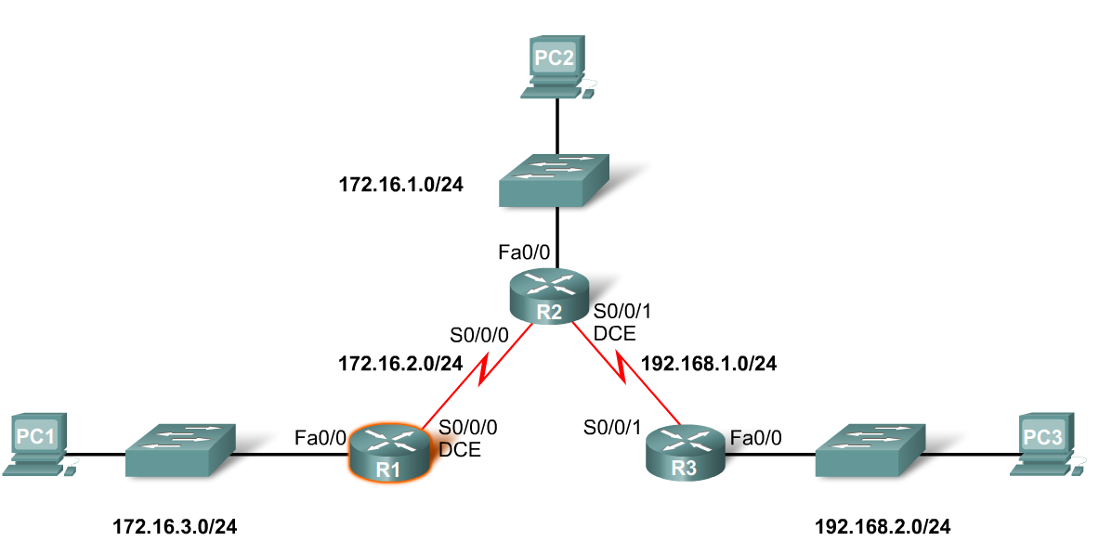
Interfaces
Examining Router Interfaces
-Show IP router command – used to view routing table
-Show Interfaces command – used to show status of an interface
-Show IP Interface brief command – used to show a portion of the interface information
-Show running-config command – used to show configuration file in RAM

Slide 6
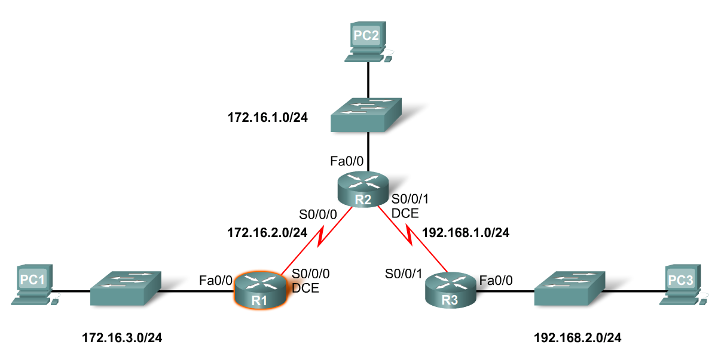
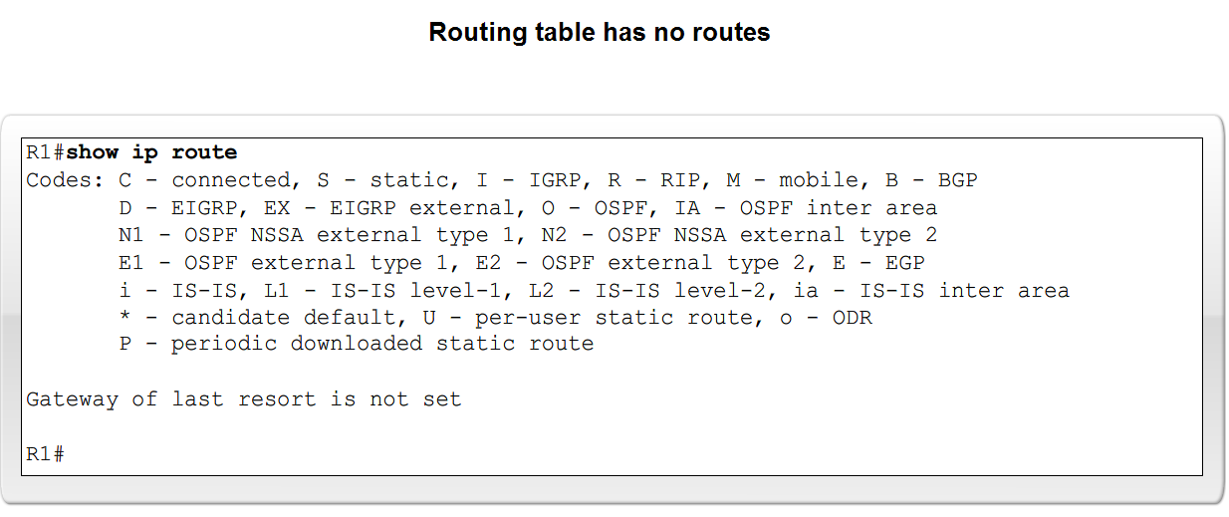
Interfaces
Configuring an Ethernet interface
-By default all serial and Ethernet interfaces are down
-To enable an interface use the No Shutdown command

Slide 7
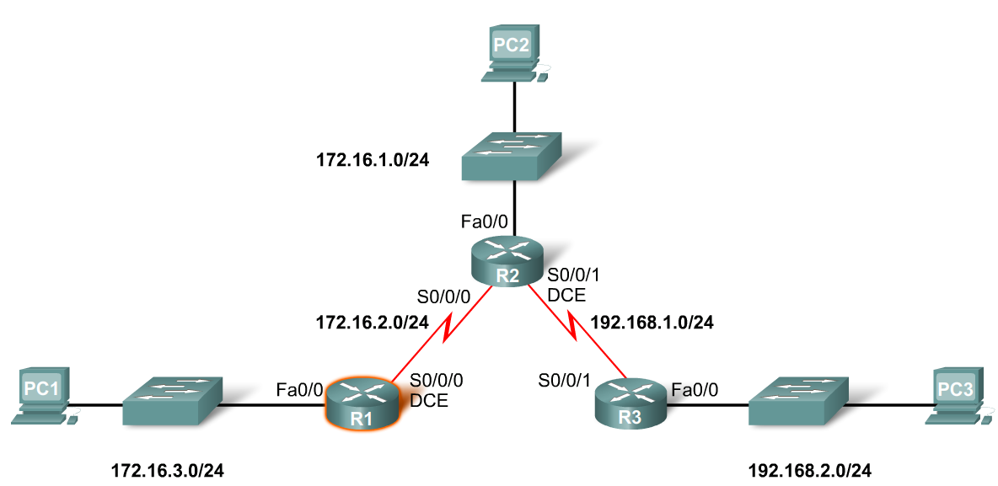
Interfaces
Verifying Ethernet interface
-Show interfaces for fastEthernet 0/0 – command used to show status of fast Ethernet port
-Show ip interface brief
-Show running-config
Ethernet interfaces participate in ARP

Slide 8
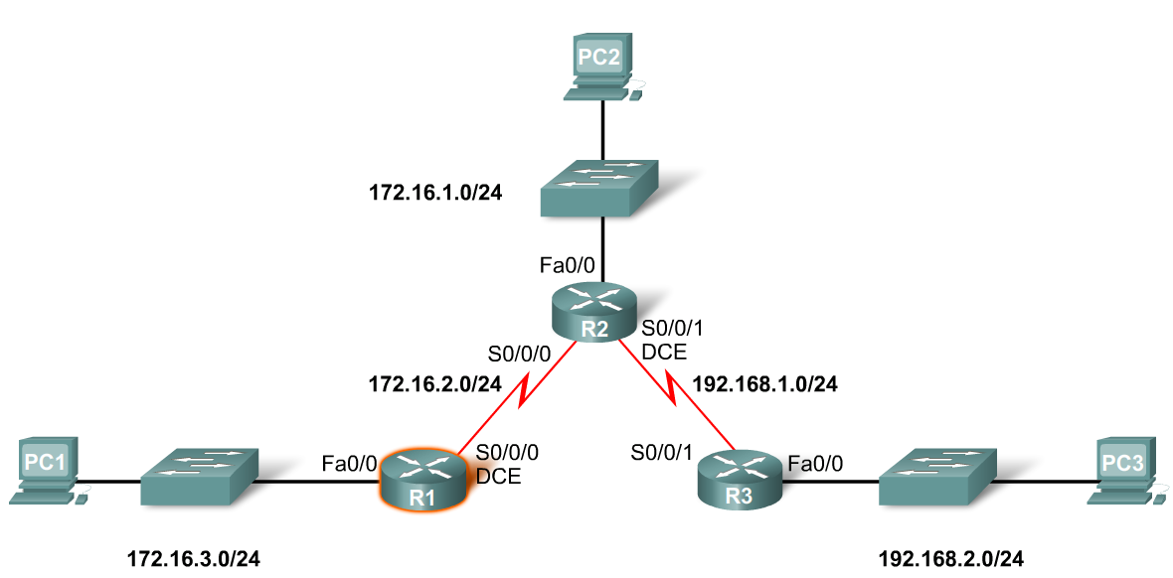
Interfaces
Configuring a Serial interface
-Enter interface configuration mode
-Enter in the ip address and subnet mask
-Enter in the no shutdown command
Example:
-R1(config)#interface serial 0/0
-R1(config-if)#ip address 172.16.2.1 255.255.255.0
-R1(config-if)#no shutdown

Slide 9
Interfaces
Examining Router Interfaces
-Physically connecting a WAN Interface.
-A WAN Physical Layer connection has sides:
Data Circuit-terminating Equipment (DCE) – This is the service provider. CSU/DSU is a DCE device.
Data Terminal Equipment (DTE) – Typically the router is the DTE device.
Notes:
Use graphic 2.2.5.1….would suggest modifying graphic such that each component is identified prior to placing on slide

Slide 10
Interfaces
Configuring serial links in a lab environment
One side of a serial connection must be considered a DCE
This requires placing a clocking signal – use the clock rate command.
Example:
-R1(config)#interface serial 0/0
-R1(config-if)#clockrate 64000
Serial Interfaces require a clock signal to control the timing of the communcations.
Notes:
Use graphic 2.2.5.2 topology. If you can fit the router output that would be great but if not just use the topology

Slide 11
Routing Table and CDP Protocol
Purpose of the debug ip routing command
Allows you to view changes that the router performs when adding or removing routes
Example:
-R2#debug ip routing
-IP routing debugging is on
Notes:
Use graphic 2.3.1.2….in particular the “debug 1”

Slide 12
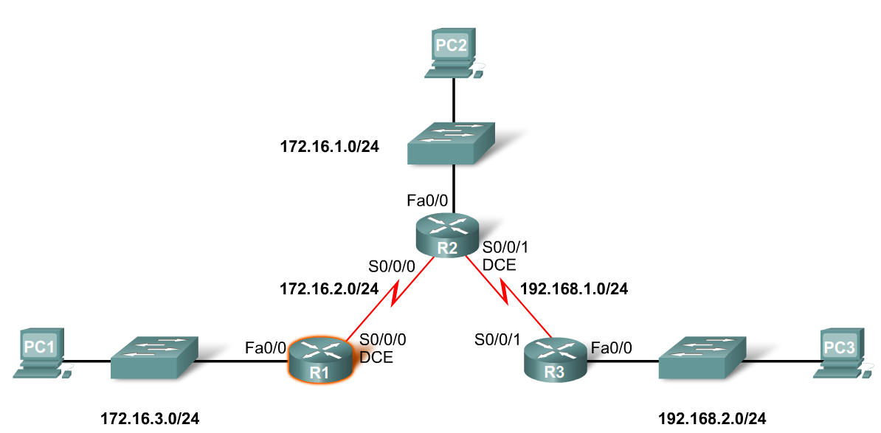
Routing Table and CDP Protocol
To configure an Ethernet interface
Example:
-R2(config)#interface fastethernet 0/0
-R2(config-if)#ip address 172.16.1.1 255.255.255.0
-R2(config-if)#no shutdown

Slide 13
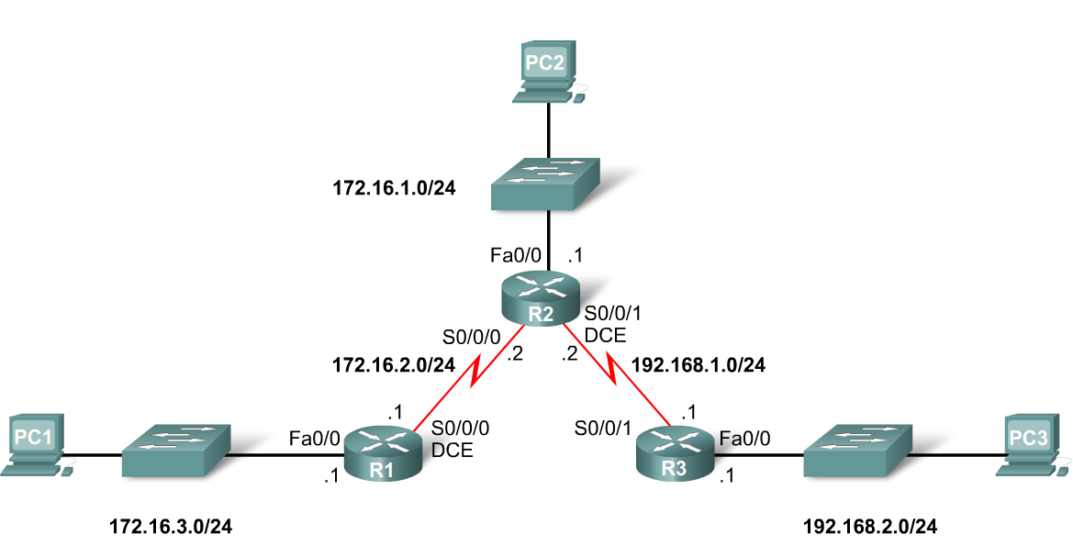
Routing Table and CDP Protocol
When a router only has its interfaces configured & no other routing protocols are configured then:
-The routing table contains only the directly connected networks
-Only devices on the directly connected networks are reachable

Slide 14
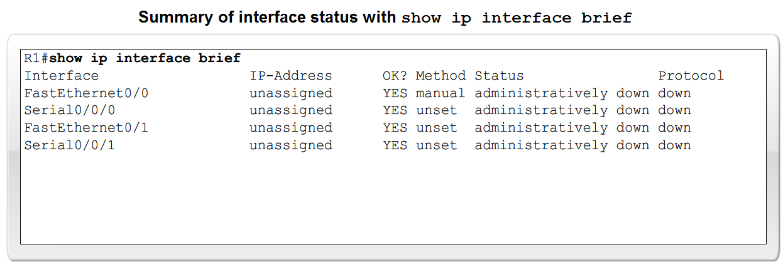
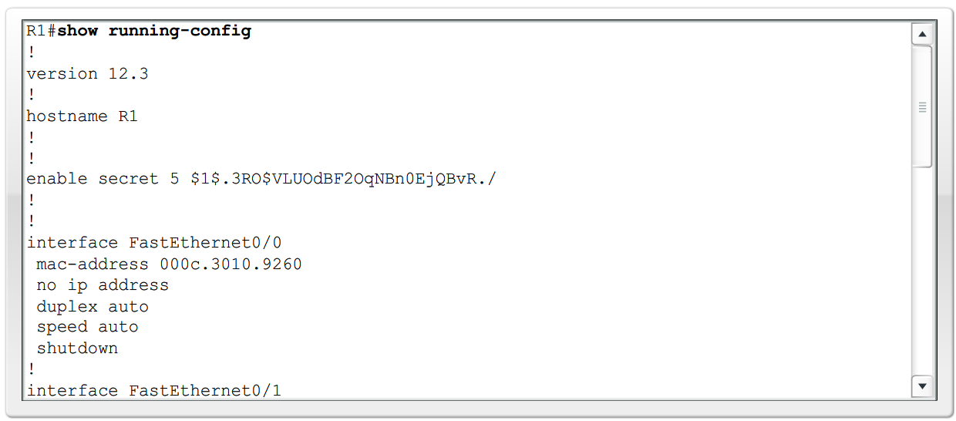
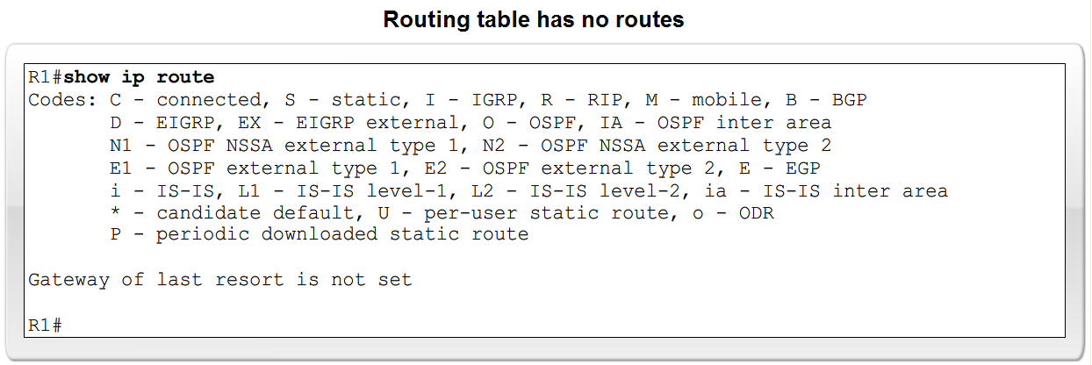
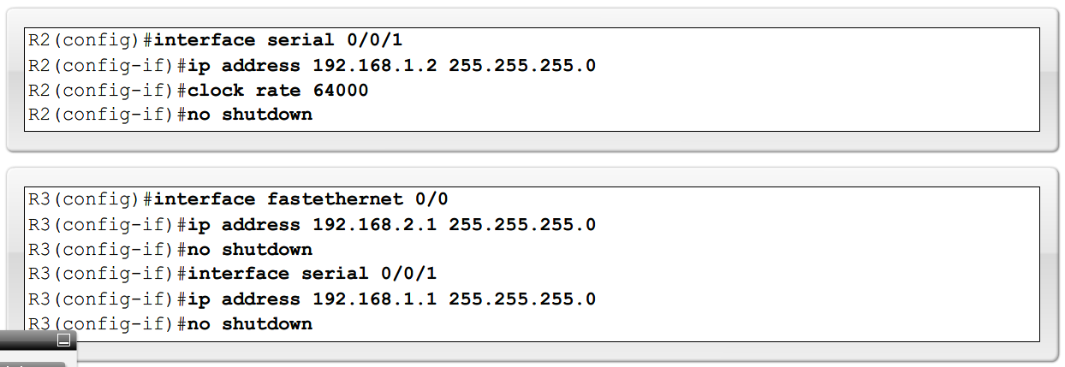
Routing Table and CDP Protocol

Slide 15
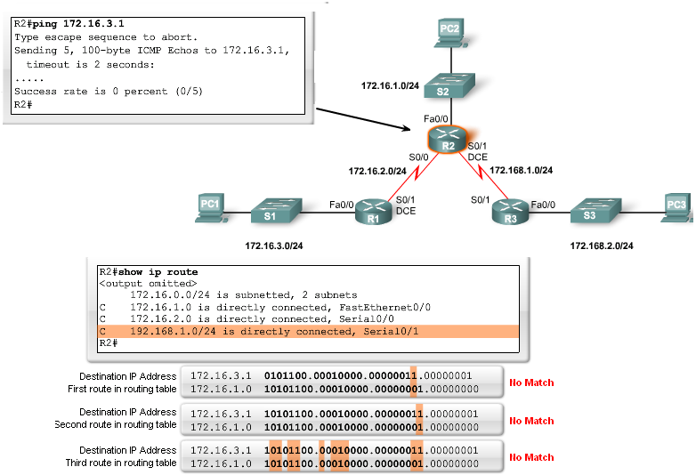
Routing Table and CDP Protocol
Checking each route in turn
The ping command is used to check end to end connectivity

Slide 16
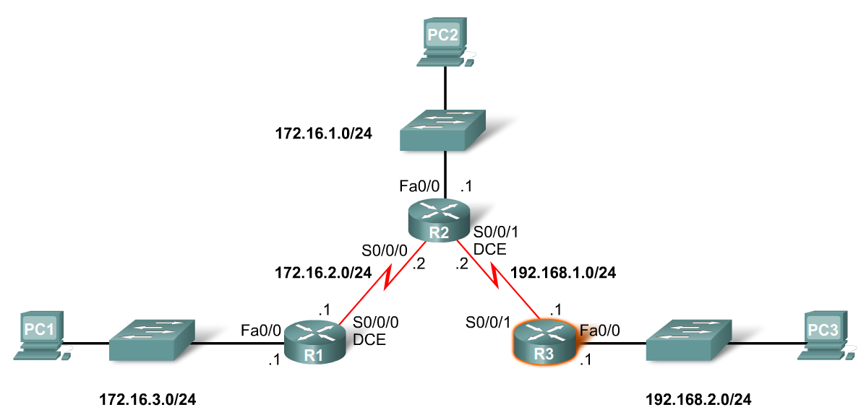
Routing Table and CDP Protocol
Purpose of CDP
A layer 2 cisco proprietary tool used to gather information about other directly connected Cisco devices.
Concept of neighbors
-2 types of neighbors
Layer 3 neighbors
Layer 2 neighbors
Notes:
Use graphic associated with CDP protocols (graphic 2.3.3.1)

Slide 17
Routing Table and CDP Protocol
CDP show commands
Show cdp neighbors command
-Displays the following information:
Neighbor device ID
Local interface
Holdtime value, in seconds
Neighbor device capability code
Neighbor hardware platform
Neighbor remote port ID
Show cdp neighbors detail command
-Useful in determining if an IP address configuration error

Slide 18
Routing Table and CDP Protocol
Disabling CDP
To disable CDP globally use the following command
Router(config)#no cdp run
Notes:
Use router output graphic 2.3.4.1 (all 3) – this will cover this slide and the previous slide

Slide 19
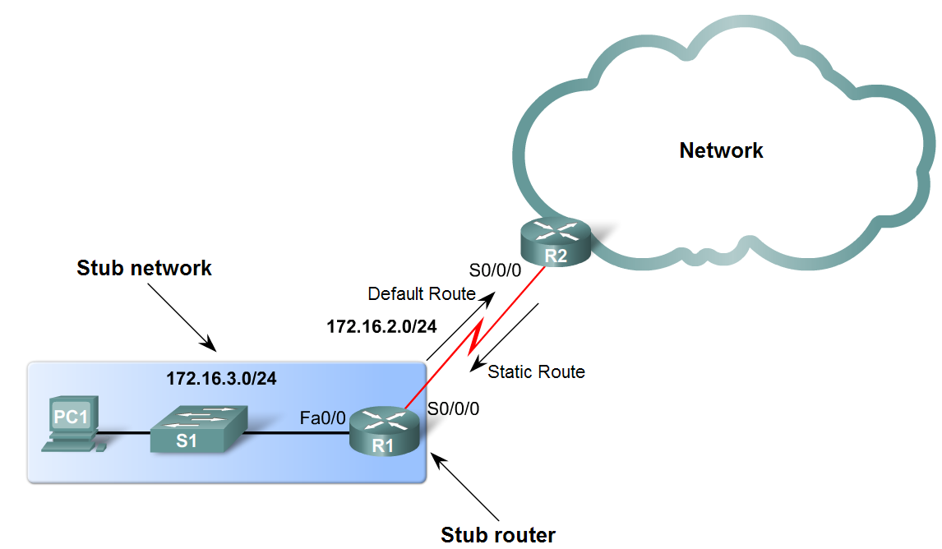
Static Routes with Exit Interfaces
Purpose of a static route
A manually configured route used when routing from a network to a stub network

Slide 20
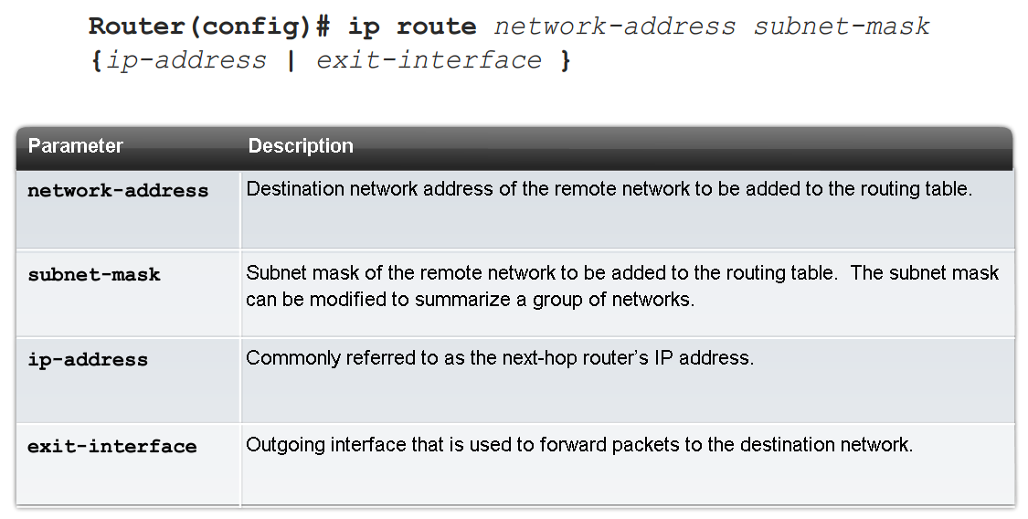
Static Routes with Exit Interfaces
IP route command
To configure a static route use the following command: ip route
Example:
-Router(config)# ip route network-address subnet-mask {ip-address | exit-interface }

Slide 21
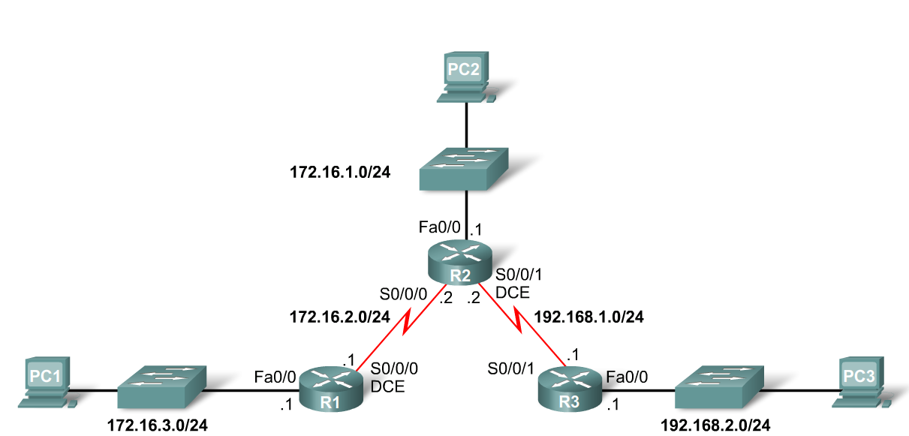
Static Routes with Exit Interfaces
Dissecting static route syntax
ip route - Static route command
172.16.1.0 – Destination network address
255.255.255.0 - Subnet mask of destination network
172.16.2.2 - Serial 0/0/0 interface IP address on R2, which is the "next-hop" to this network

Slide 22
Static Routes with Exit Interfaces
Configuring routes to 2 or more remote networks
Use the following commands for R1
-R1(config)#ip route 192.168.1.0 255.255.255.0 172.16.2.2
-R1(config)#ip route 192.168.2.0 255.255.255.0 172.16.2.2

Slide 23
Static Routes with Exit Interfaces
Zinin’s 3 routing principles
Principle 1: "Every router makes its decision alone, based on the information it has in its own routing table.“
Principle 2: "The fact that one router has certain information in its routing table does not mean that other routers have the same information.“
Principle 3: "Routing information about a path from one network to another does not provide routing information about the reverse, or return path."

Slide 24
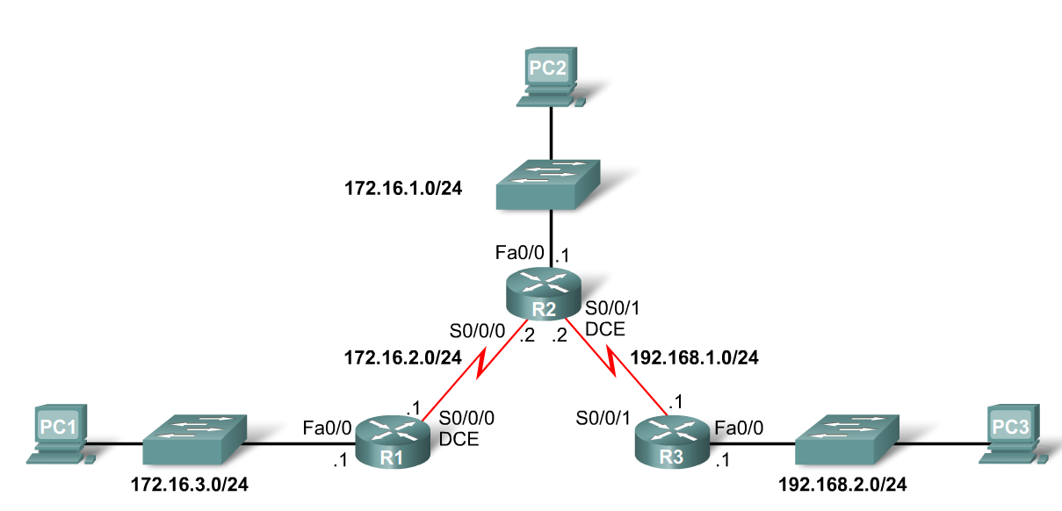
Static Routes with Exit Interfaces
Using Zinin’s 3 routing principles, how would you answer the following?
-Would packets from PC1 reach their destination?
Yes, packets destined for 172.16.1.0/24 and 192.168.1.0/24 networks would reach their destination.
-Does this mean that any packets from these networks destined for 172.16.3.0/24 network will reach their destination?
No, because neither R2 nor R3 router has a route to the 172.16.3.0/24 network.

Slide 25
Static Routes with Exit Interfaces
Resolving to an Exit Interface
-Recursive route lookup - Occurs when the router has to perform multiple lookups in the routing table before forwarding a packet. A static route that forwards all packets to the next-hop IP address goes through the following process (reclusive route lookup)
The router first must match static route’s destination IP address with the Next hop address
The next hop address is then matched to an exit interface

Slide 26
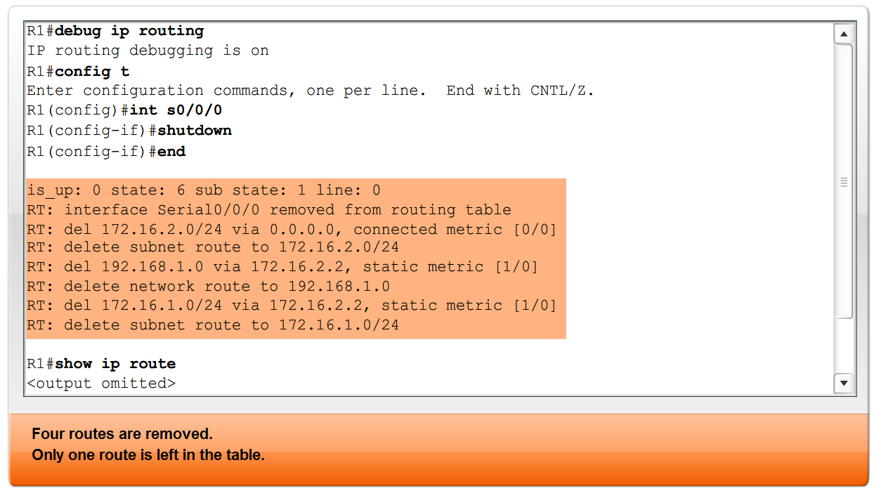
Static Routes with Exit Interfaces
Configuring a Static route with an Exit Interface
-Static routes configured with an exit interface are more efficient because the routing
The routing table can resolve the exit interface in a single search instead of 2 searches
-Example of syntax require to configure a static route with an exit interface

Slide 27
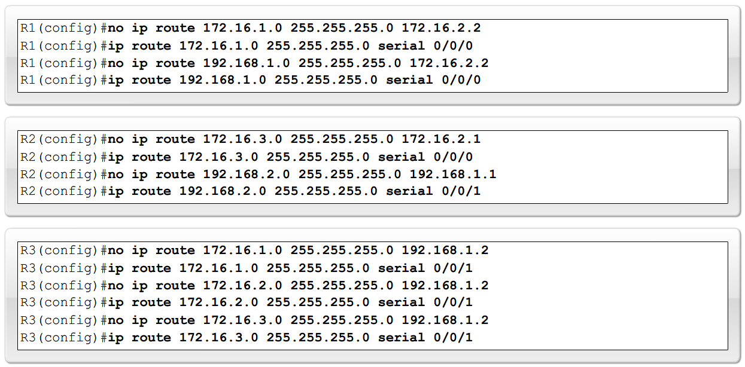
Static Routes with Exit Interfaces
Modifying Static routes
Existing static routes cannot be modified. The old static route must be deleted by placing no in front of the ip route
Example:
-no ip route 192.168.2.0 255.255.255.0 172.16.2.2
A new static route must be rewritten in the configuration

Slide 28
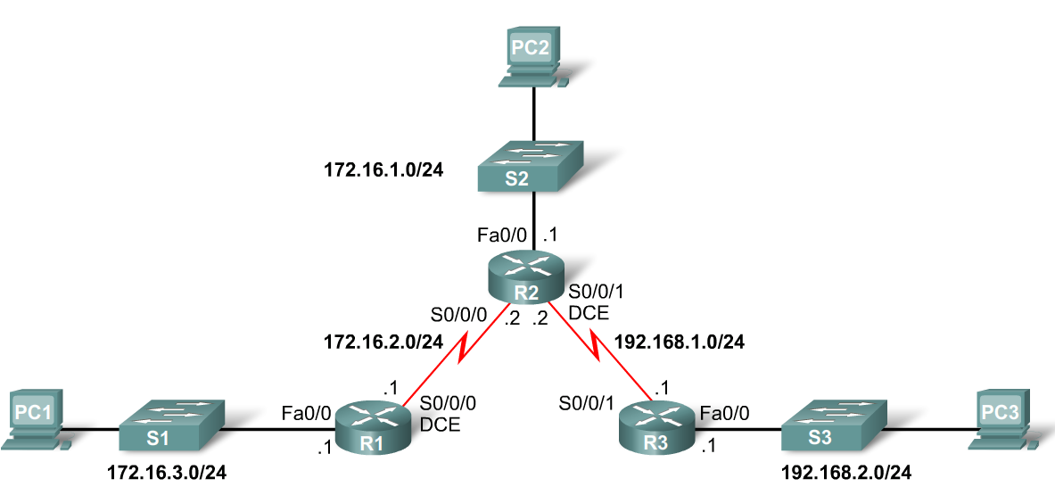
Static Routes with Exit Interfaces
Verifying the Static Route Configuration
-Use the following commands
Step 1 show running-config
Step 2 verify static route has been entered correctly
Step 3 show ip route
Step 4 verify route was configured in routing table
Step 5 issue ping command to verify packets can reach destination and that Return path is working

Slide 29
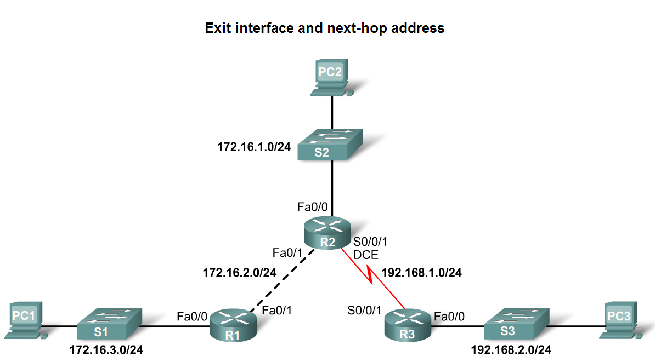
Static Routes with Exit Interfaces
Ethernet interfaces and ARP.
If a static route is configured on an Ethernet link
-If the packet is sent to the next-hop router then…
the destination MAC address will be the address of the next hop’s Ethernet interface
This is found by the router consulting the ARP table. If an entry isn’t found then an ARP request will be sent out

Slide 30
Summary and Default Route
Summarizing routes reduces the size of the routing table.
Route summarization is the process of combining a number of static routes into a single static route.
Notes:
Use graphic 2.6.1.1.

Slide 31
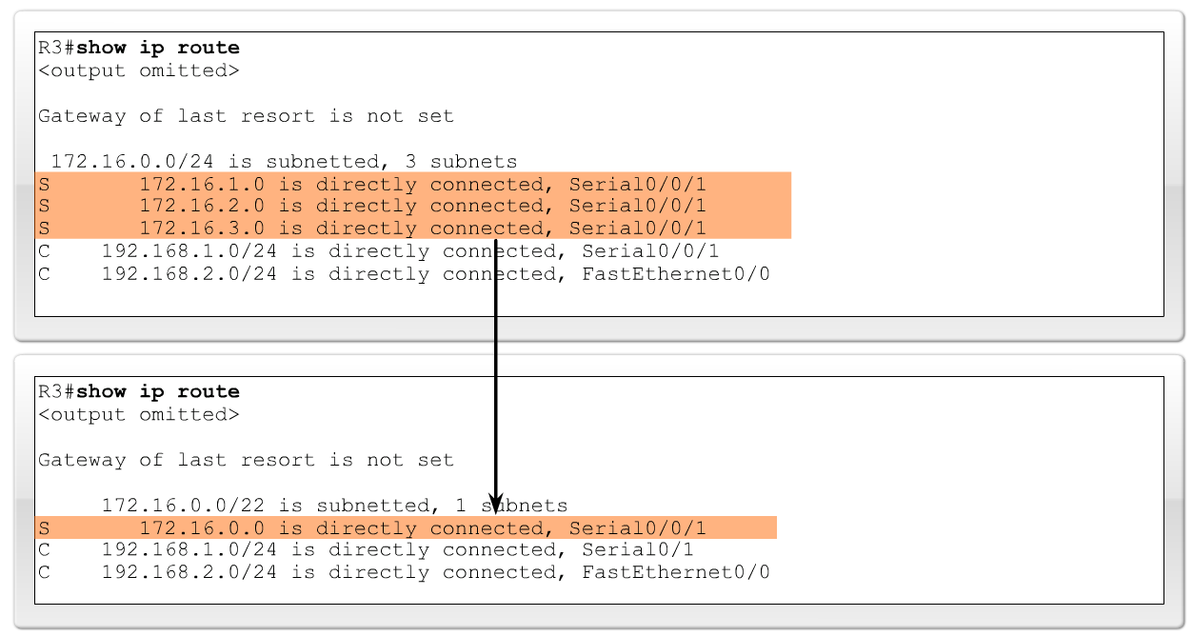
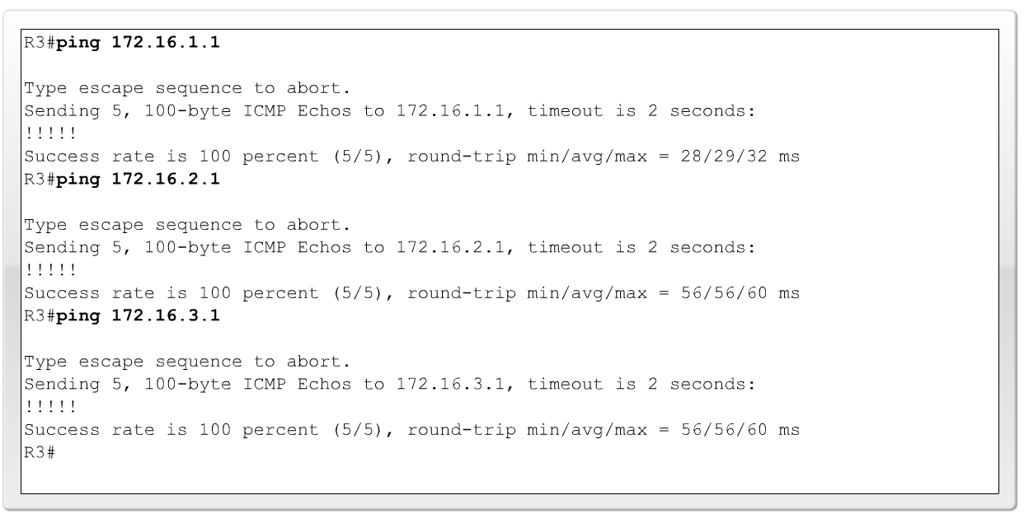
Summary and Default Route
Configuring a summary route
Step 1: Delete the current static route
Step 2: Configure the summary static route
Step 3: Verify the new static route

Slide 32
Summary and Default Route
Default Static Route
This is a route that will match all packets. Stub routers that have a number of static routes all exiting the same interface are good candidates for a default route.
-Like route summarization this will help reduce the size of the routing table
Configuring a default static route
Similar to configuring a static route. Except that destination IP address and subnet mask are all zeros
Example:
-Router(config)#ip route 0.0.0.0 0.0.0.0 [exit-interface | ip-address ]

Slide 33
Summary and Default Route
Static routes and subnet masks
The routing table lookup process will use the most specific match when comparing destination IP address and subnet mask
Default static routes and subnet masks
Since the subnet mask used on a default static route is 0.0.0.0 all packets will match.
Notes:
Use graphic 2.6.2.2

Slide 34
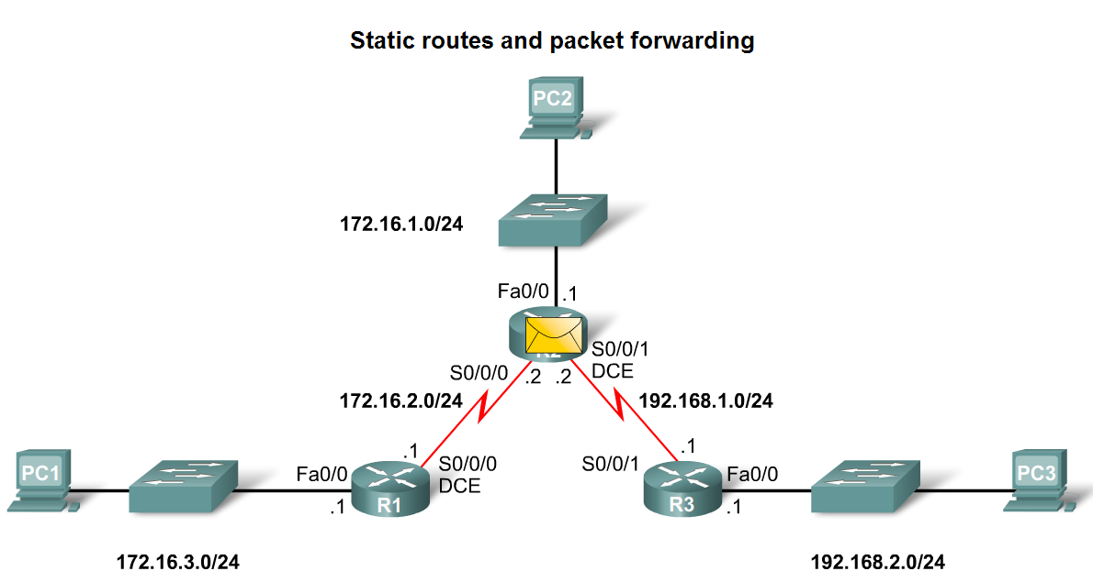
Static Routes and Packet Forwarding
Packet forwarding with static routes. (recall Zinin’s 3 routing principles)
Router 1
Packet arrives on R1’s Fastethernet 0/0 interface
R1 does not have a route to the destination network,192.168.2.0/24
R1 uses the default
static route.

Slide 35
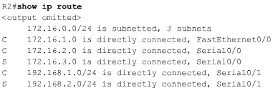
Static Routes and Packet Forwarding
Packet forwarding with static routes. (recall Zinin’s 3 routing principles)
Router 2
The packet arrives on the Serial 0/0/0 interface on R2.
R2 has a static route to 192.168.2.0/24 out Serial0/0/1.

Slide 36
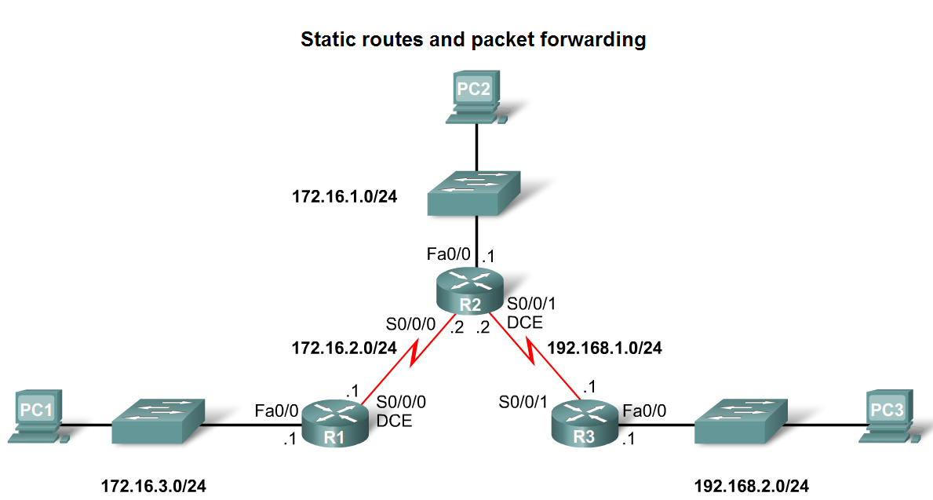
Static Routes and Packet Forwarding
Packet forwarding with static routes. (recall Zinin’s 3 routing principles)
Router 3
The packet arrives on the Serial0/0/1 interface on R3.
R3 has a connected route to 192.168.2.0/24 out Fastethernet 0/1.

Slide 37
Static Routes and Packet Forwarding
Troubleshooting a Missing Route
Tools that can be used to isolate routing problems include:
-Ping– tests end to end connectivity
-Traceroute– used to discover all of the hops (routers) along the path between 2 points
-Show IP route– used to display routing table & ascertain forwarding process
-Show ip interface brief- used to show status of router interfaces
-Show cdp neighbors detail– used to gather configuration information about directly connected neighbors

Slide 38
Static Routes and Packet Forwarding
Solving a Missing Route
Finding a missing or mis-configured route requires methodically using the correct tools
-Start with PING. If ping fails then use traceroute to determine where packets are failing to arrive
Issue: show ip route to examine routing table.
-If there is a problem with a mis-configured static route remove the static route then reconfigure the new static route

Slide 39
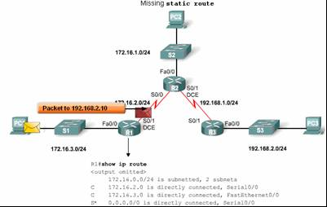
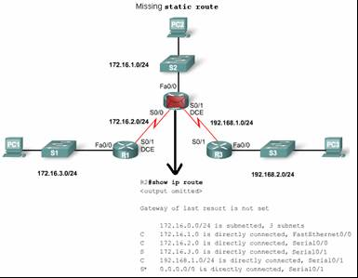
Static Routes and Packet Forwarding
Solving a Missing Route

Slide 40
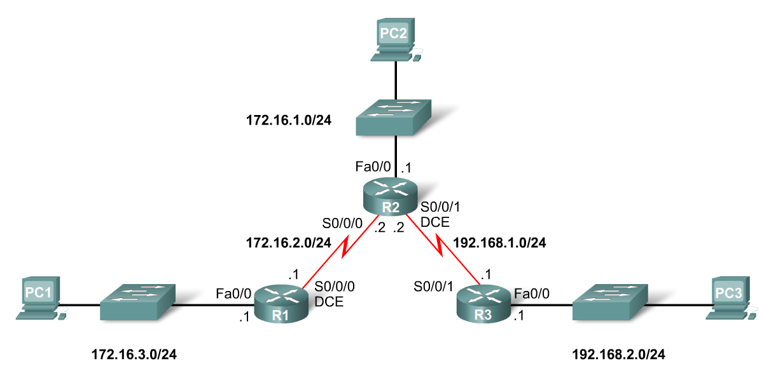
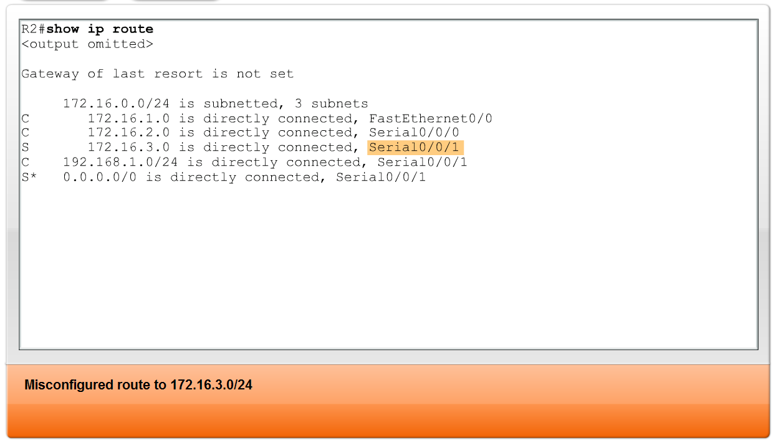
Static Routes and Packet Forwarding
Solving a Missing Route

Slide 41
Summary
Routers
-Operate at layer 3
-Functions include best path selection & forwarding packets
Connecting Networks
WANs
Serial cables are connected to router serial ports.
In the lab environment clock rates must be configured for DCE
LANs
Straight through cables or cross over cables are used to connect to fastethernet port. (The type of cable used depends on what devices are being connected)
Cisco Discovery Protocol
A layer 2 proprietary protocol
Used to discover information about directly connected Cisco devices

Slide 42
Summary
Static Routes
-This is a manually configured path that specifies how the router will get to a certain point using a certain path.
Summary static routes
-This is several static routes that have been condensed into a single static route.
Default route
-It is the route packets use if there is no other possible match for their destination in the routing table.
Forwarding of packets when static route is used
-Zinin’s 3 routing principles describe how packets are forwarded
Troubleshooting static routes may require some of the following commands:
-Ping
-Traceroute
-Show IP route
-Show ip interface brief
-Show cdp neighbors detail

