Slide 1
Introduction to Dynamic Routing Protocol
CCNA 2
Routing Protocols and Concepts – Chapter 3

Slide 2
Objectives
Describe the role of dynamic routing protocols and place these protocols in the context of modern network design.
Identify several ways to classify routing protocols.
Describe how metrics are used by routing protocols and identify the metric types used by dynamic routing protocols.
Determine the administrative distance of a route and describe its importance in the routing process.
Identify the different elements of the routing table.

Slide 3
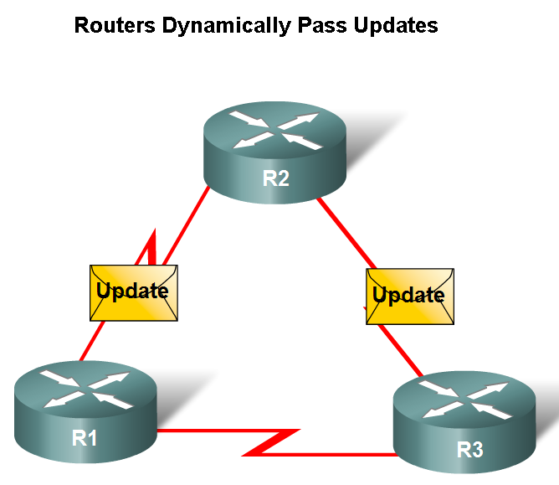
Dynamic Routing Protocols
Function(s) of Dynamic Routing Protocols:
-Dynamically share information between routers.
-Automatically update routing table when topology changes.
-Determine best path to a destination.

Slide 4
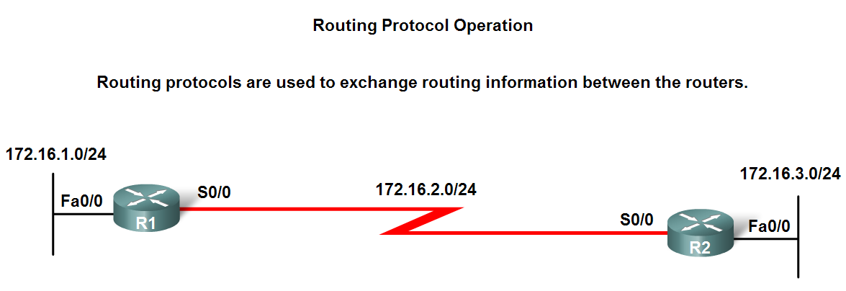
Dynamic Routing Protocols
The purpose of a dynamic routing protocol is to:
-Discover remote networks
-Maintaining up-to-date routing information
-Choosing the best path to destination networks
-Ability to find a new best path if the current path is no longer available

Slide 5
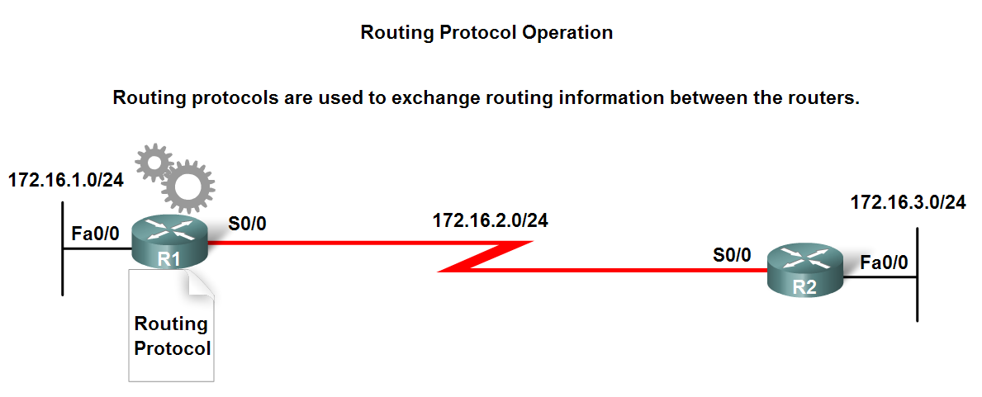
Dynamic Routing Protocols
Components of a routing protocol
Algorithm
In the case of a routing protocol algorithms are used for facilitating routing information and best path determination
Routing protocol messages
These are messages for discovering neighbors and exchange of routing information

Slide 6
Dynamic Routing Protocols
Advantages of static routing
-It can backup multiple interfaces/networks on a router
-Easy to configure
-No extra resources are needed
-More secure
Disadvantages of static routing
-Network changes require manual reconfiguration
-Does not scale well in large topologies

Slide 7
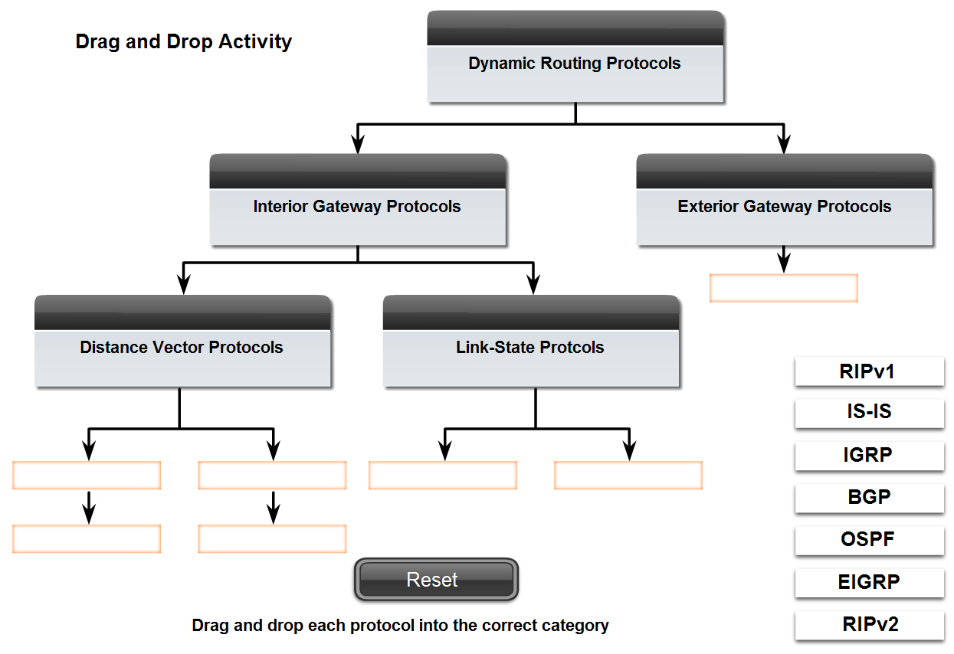
Classifying Routing Protocols
Dynamic routing protocols are grouped according to characteristics. Examples include:
-RIP
-IGRP
-EIGRP
-OSPF
-IS-IS
-BGP
Autonomous System is a group of routers under the control of a single authority.

Slide 8
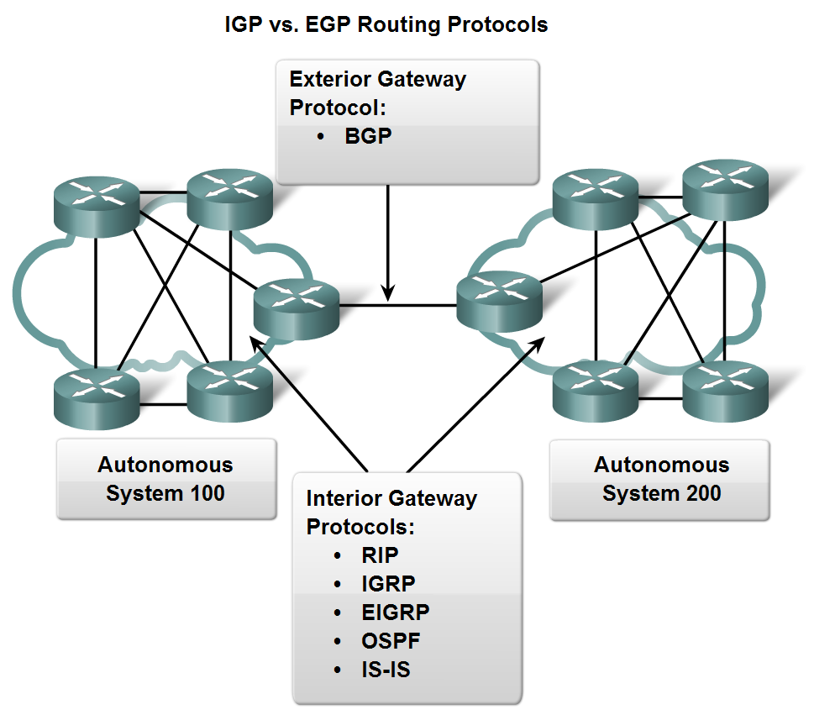
Classifying Routing Protocols
Types of routing protocols:
-Interior Gateway Protocols (IGP)
-Exterior Gateway Protocols (EGP)

Slide 9
Classifying Routing Protocols
Interior Gateway Routing Protocols (IGP)
-Used for routing inside an autonomous system & used to route within the individual networks themselves.
-Examples: RIP, EIGRP, OSPF
Exterior Routing Protocols (EGP)
-Used for routing between autonomous systems
-Example: BGPv4

Slide 10
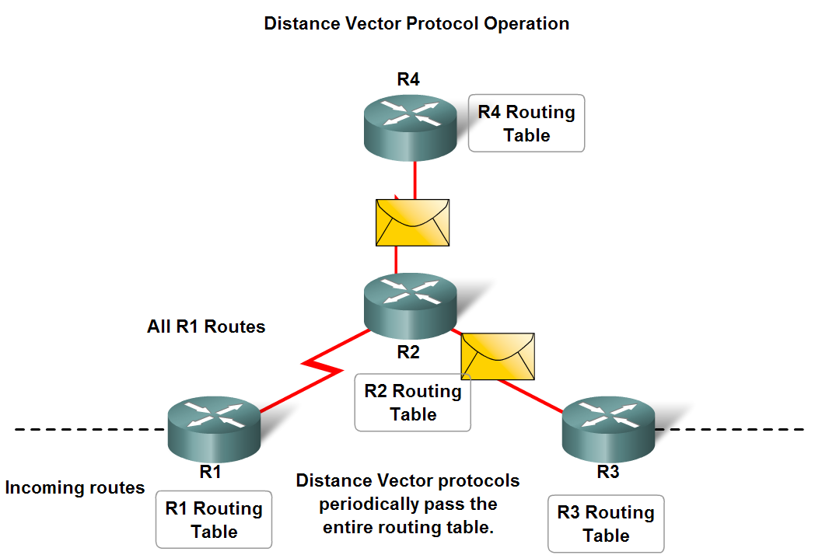
Classifying Routing Protocols
IGP: Comparison of Distance Vector & Link State Routing Protocols
Distance vector
routes are advertised as vectors
of distance & direction.
incomplete view of network
topology.
Generally, periodic
updates.
Link state
complete view of network
topology is created.
updates are not
periodic.

Slide 11
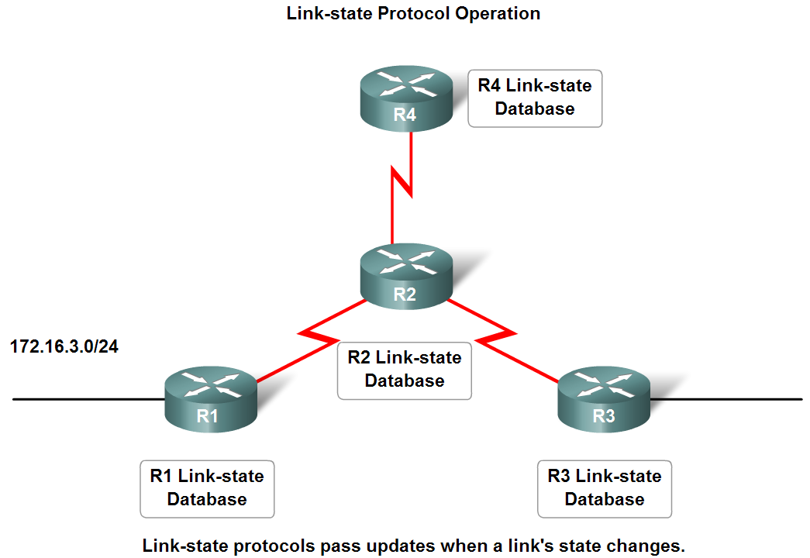
Classifying Routing Protocols

Slide 12
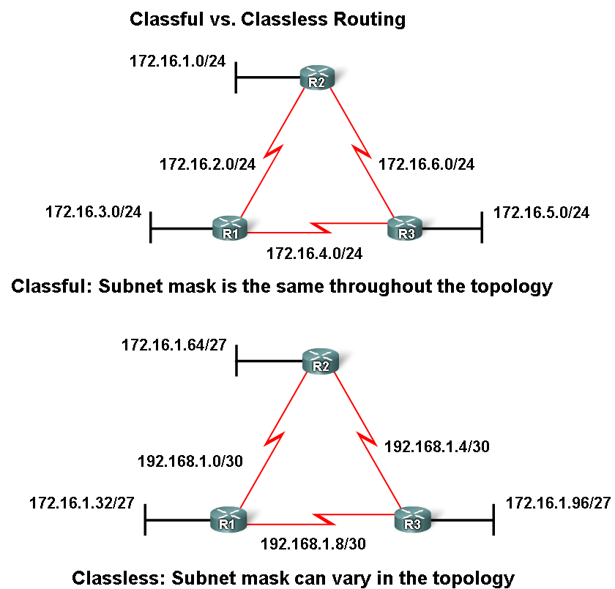
Classifying Routing Protocols
Classful routing protocols
Do NOT send subnet mask in routing updates
Classless routing protocols
Do send subnet mask in
routing updates.

Slide 13
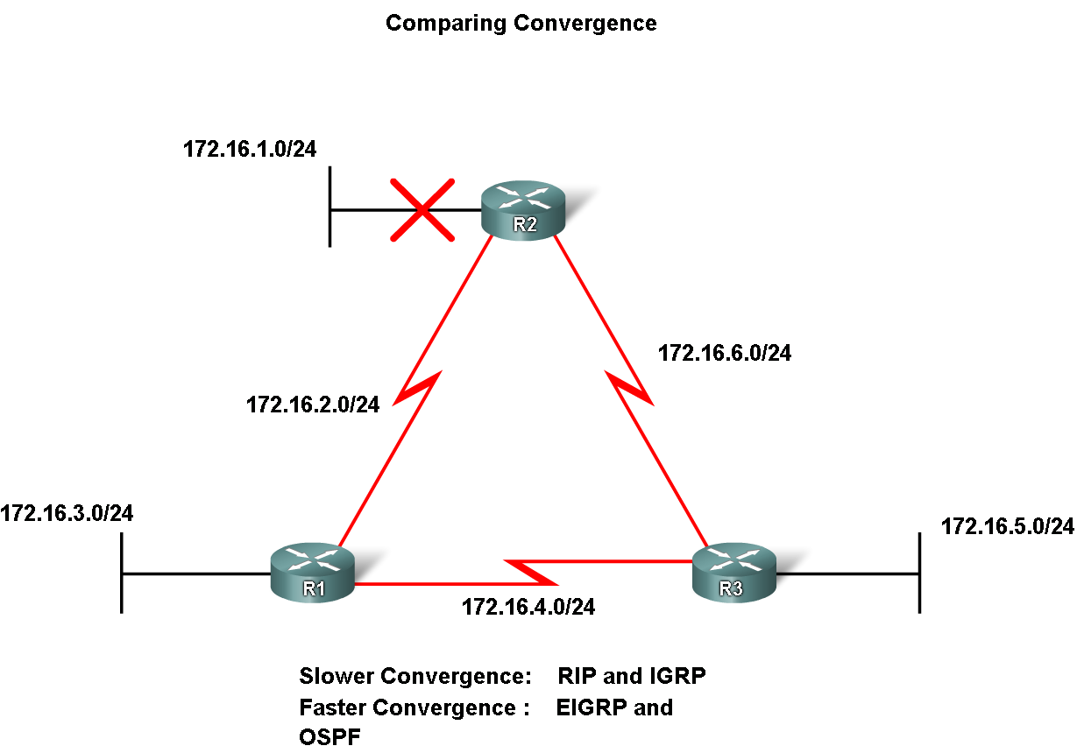
Classifying Routing Protocols
Convergence is defined as when all routers’ routing tables are at a state of consistency

Slide 14
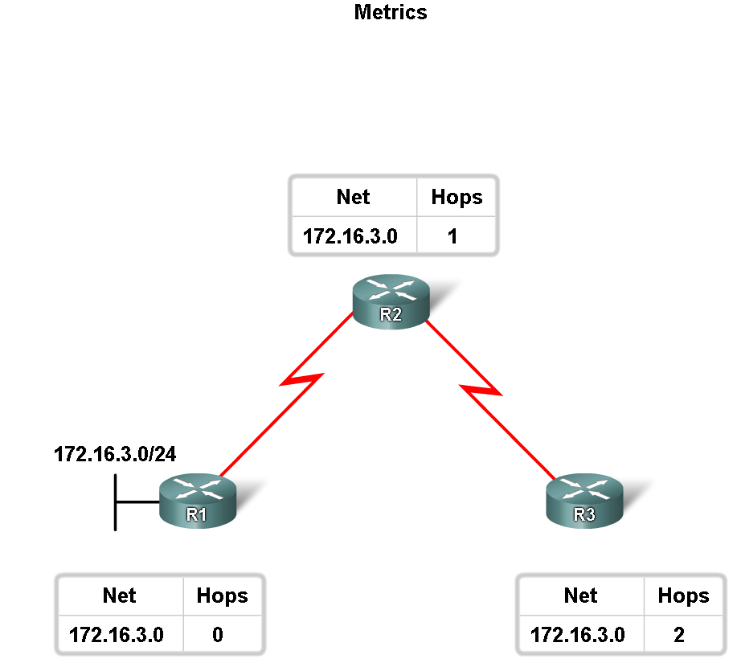
Routing Protocols Metrics
Metric
A value used by a routing protocol to determine which routes are better than others.

Slide 15
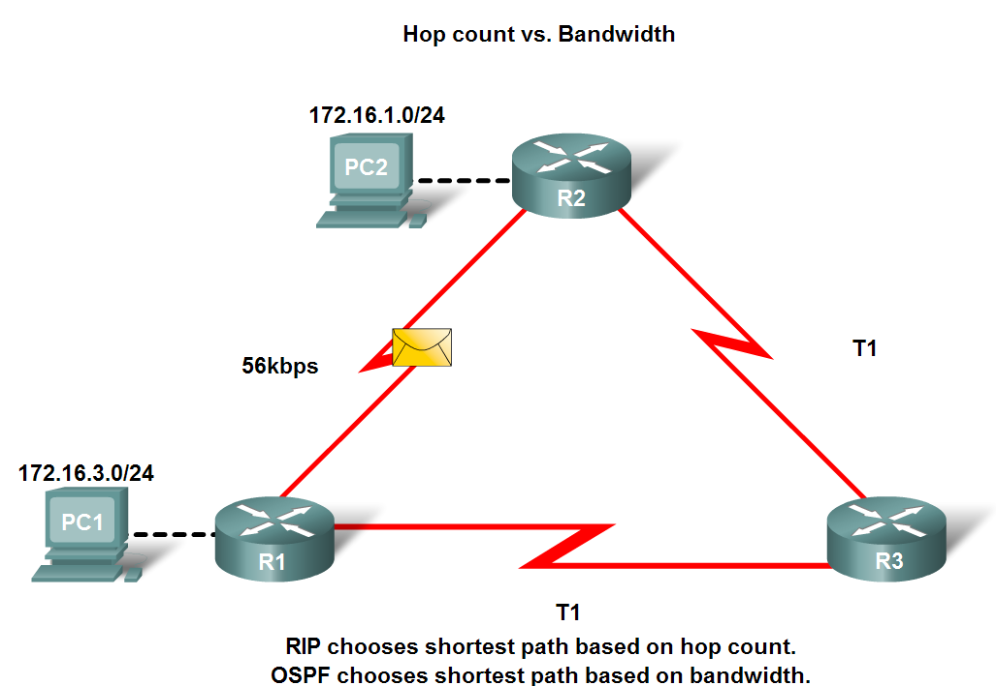
Routing Protocols Metrics
Metrics used in IP routing protocols
-Bandwidth
-Cost
-Delay
-Hop count
-Load
-Reliability

Slide 16
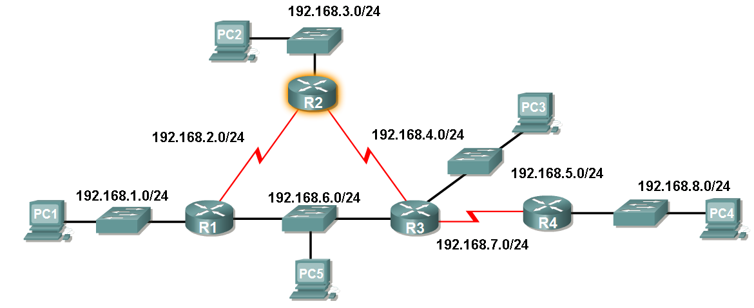
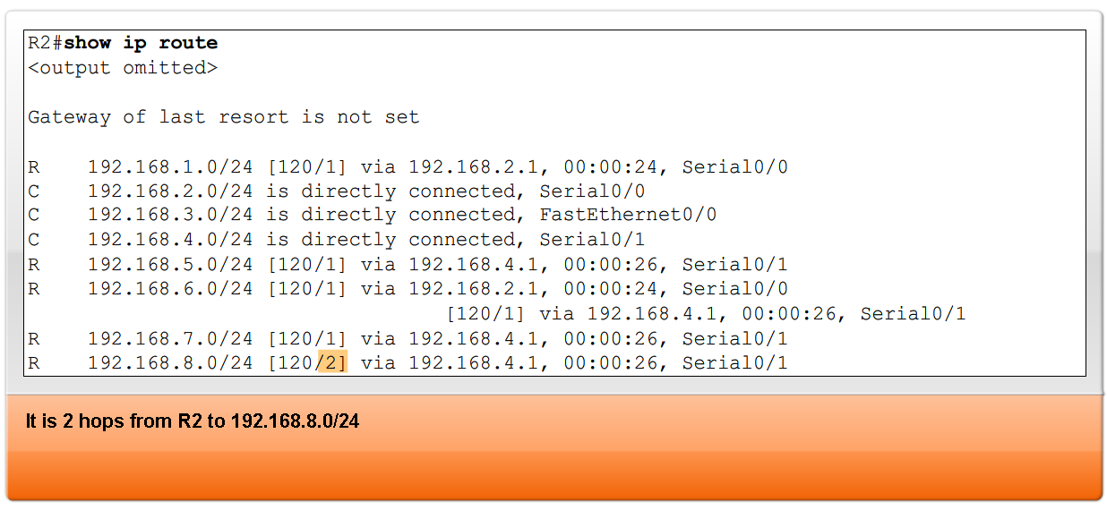
Routing Protocols Metrics
The Metric Field in the Routing Table
Metric used for each routing protocol
-RIP - hop count
-IGRP & EIGRP - Bandwidth (used by default), Delay (used by default), Load, Reliability
-IS-IS & OSPF – Cost, Bandwidth (Cisco’s implementation)

Slide 17
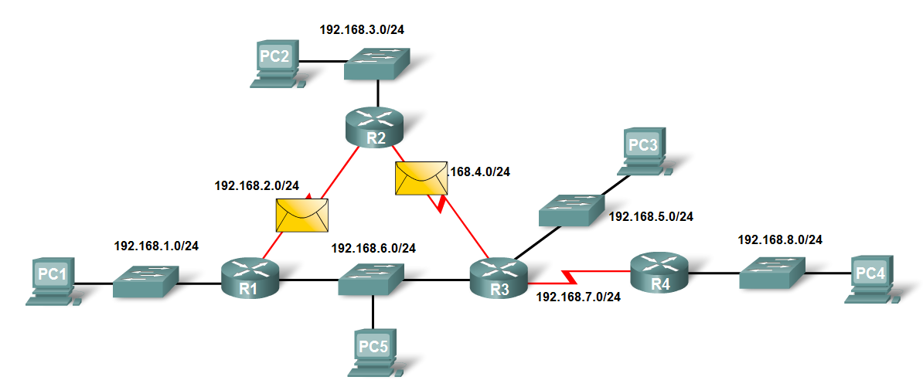
Routing Protocols Metrics
Load balancing
This is the ability of a router to distribute packets among multiple same cost paths

Slide 18
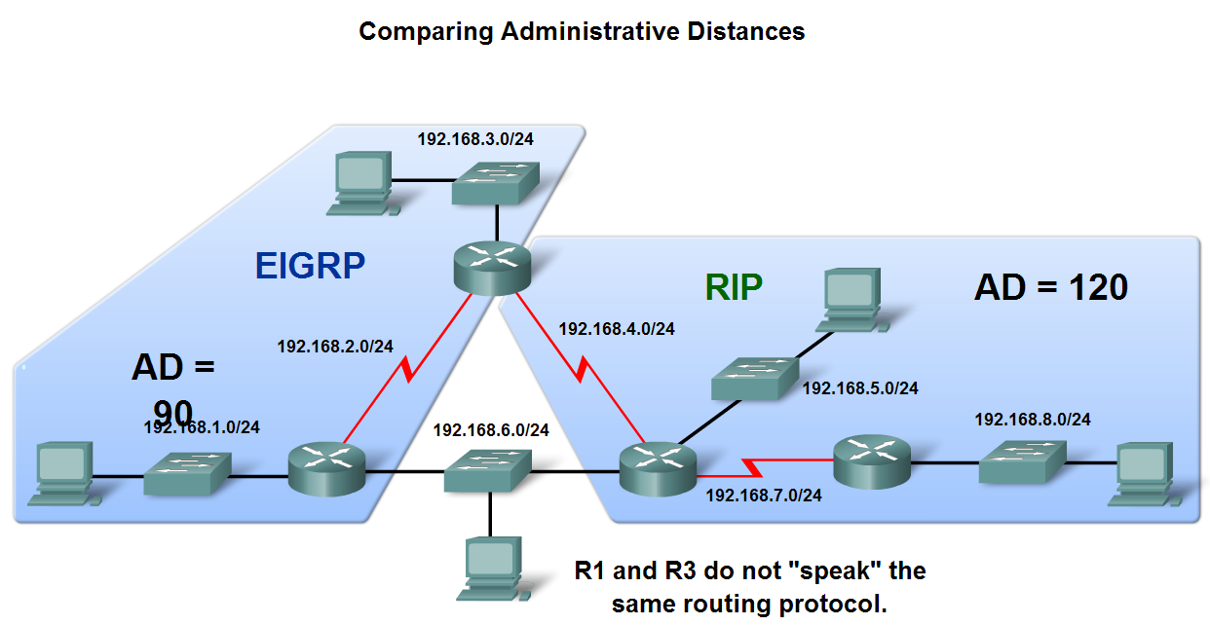
Administrative Distance of a Route
Purpose of a metric
It’s a calculated value used to determine the best path to a destination
Purpose of Administrative Distance
It’s a numeric value that specifies the preference of a particular route

Slide 19
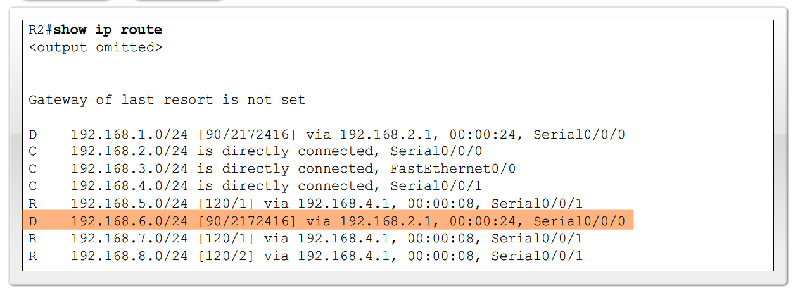
Administrative Distance of a Route
Identifying the Administrative Distance (AD) in a routing table
It is the first number in the brackets in the routing table

Slide 20
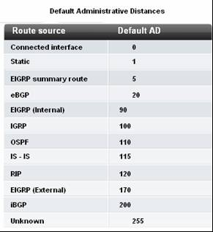
Administrative Distance of a Route
Dynamic Routing Protocols

Slide 21
Administrative Distance of a Route
Directly connected routes
Have a default AD of 0
Static Routes
Administrative distance of a static route has a default value of 1

Slide 22
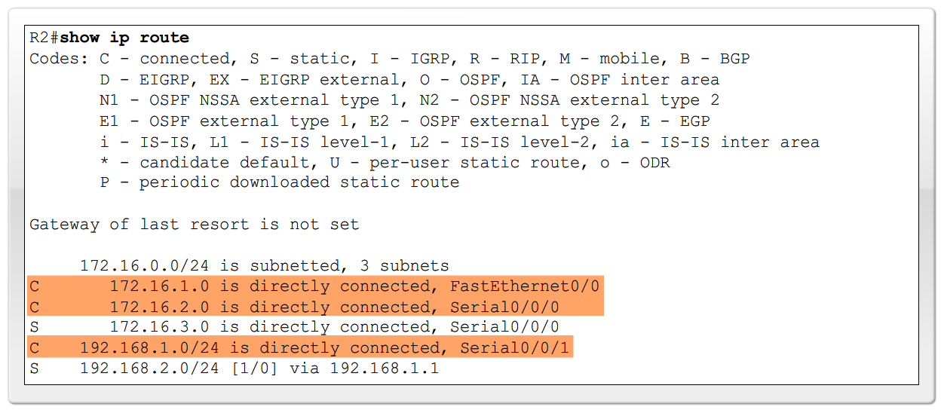
Administrative Distance of a Route
Directly connected routes
-Immediately appear in the routing table as soon as the interface is configured

Slide 23
Summary
Dynamic routing protocols fulfill the following functions
-Dynamically share information between routers
-Automatically update routing table when topology changes
-Determine best path to a destination
Routing protocols are grouped as either
-Interior gateway protocols (IGP)Or
-Exterior gateway protocols(EGP)
Types of IGPs include
-Classless routing protocols - these protocols include subnet mask in routing updates
-Classful routing protocols - these protocols do not include subnet mask in routing update

Slide 24
Summary
Metrics are used by dynamic routing protocols to calculate the best path to a destination.
Administrative distance is an integer value that is used to indicate a router’s “trustworthiness”
Components of a routing table include:
-Route source
-Administrative distance
-Metric

