Slide 1
MOBILE COMPUTING
Dosen Pengampu: Hendry Gunawan S.Kom, MM
Prodi Sistem Informasi - Fakultas Ilmu Komputer

Slide 2
Arsitektur Android
Stack of software components
Terbagi ke dalam 5 section dan 4 Layers
    Linux kernel
    Libraries & Android Runtime
    Application Framework
    Applications

Slide 3
Introduction
What is Android?
  A software platform and operating system for mobile devices
  Based on the Linux kernel
  Developed by Google and later the Open Handset Alliance (OHA)
  Allows writing managed code in the Java language
  Unveiling of the Android platform was announced on 5 November 2007 with the founding of OHA

Slide 4
History of Android
Google acquired the startup company Android Inc. in 2005 to start the development of the Android Platform. The key players at Android Inc. included Andy Rubin, Rich Miner, Nick Sears, and Chris White.
In late 2007, a group of industry leaders came together around the Android Platform to form the Open Handset Alliance (http://www.openhandsetalliance.com).
The Android SDK was first issued as an “early look” release in November 2007.
In September 2008 T-Mobile announced the availability of the T-Mobile G1, the first smartphone based on the Android Platform.
A few days after that, Google announced the availability of Android SDK Release Candidate 1.0.
In October 2008, Google made the source code of the Android Platform available under Apache’s open source license.

Slide 5
History of Android

Slide 6
What is Open Handset Alliance?
Quoting from www.OpenHandsetAlliance.com page
“… Open Handset Alliance™, a group of 47 technology and mobile companies have come together to accelerate innovation in mobile and offer consumers a richer, less expensive, and better mobile experience.
Together we have developed Android™, the first complete, open, and free mobile platform.
We are committed to commercially deploy handsets and services using the Android Platform. “

Slide 7

Introduction
What is the Open Handset Alliance (OHA)?
  → It's a consortium of several companies
Google Android

Slide 8
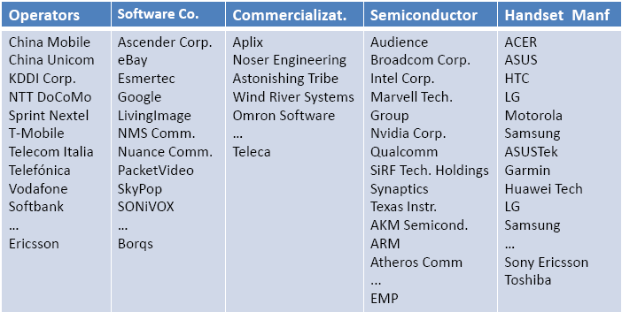
Open Handset Alliance Members

Slide 9
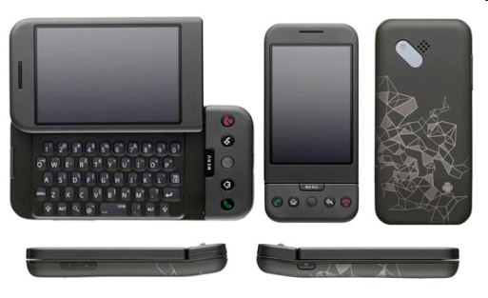
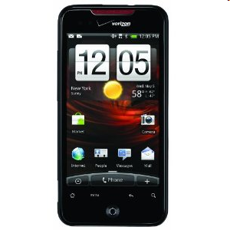


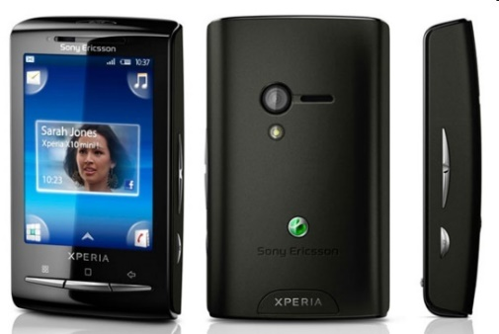

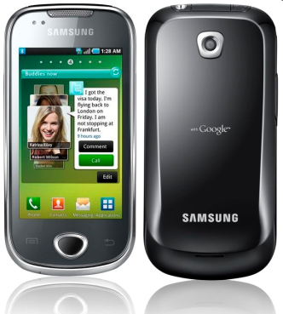
Phones
HTC G1,
Droid,
Tattoo
Motorola Droid (X)
Suno S880
Samsung Galaxy
Sony Ericsson
@2010 Mihail L. Sichitiu
9

Slide 10
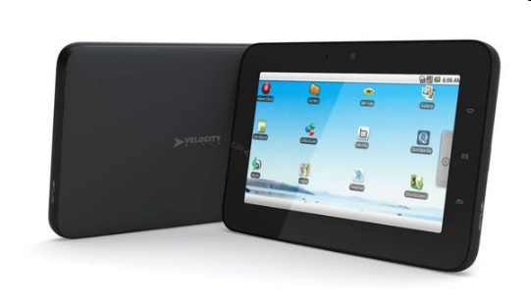

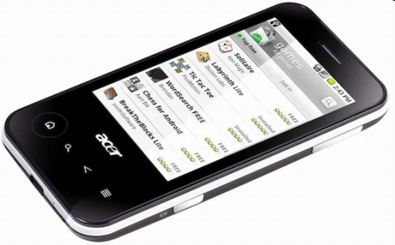
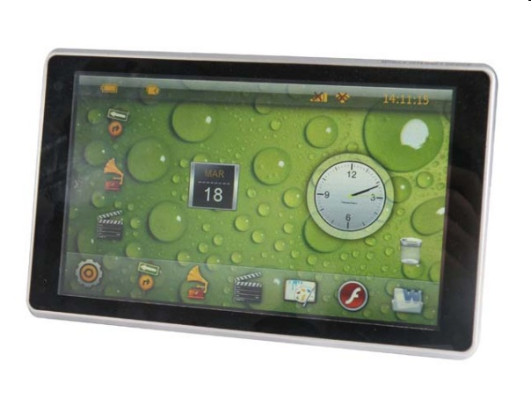


Tablets
Velocity Micro Cruz
Gome FlyTouch
Acer beTouch
Toshiba Android
SmartBook
Cisco Android Tablet
Dawa D7
@2010 Mihail L. Sichitiu
10

Slide 11
Platform
Hardware
Android is not a single piece of hardware; it's a complete, end-to-end software platform that can be adapted to work on any number of hardware configurations. Everything is there, from the bootloader all the way up to the applications.
Google Android

Slide 12
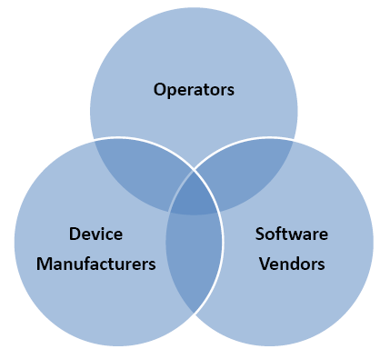
Android’s Context: Mobile Market Player$
Stakeholders:
Mobile network operators want to lock down their networks, controlling and metering traffic.
Device manufacturers want to differentiate themselves with features, reliability, and price points.
Software vendors want complete access to the hardware to deliver cutting-edge applications.

Slide 13
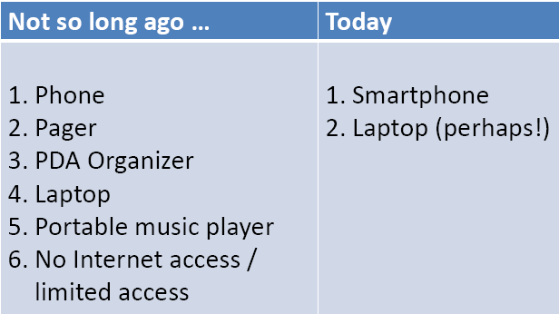
The Maturing Mobile Experience
Tomorrow?

Slide 14
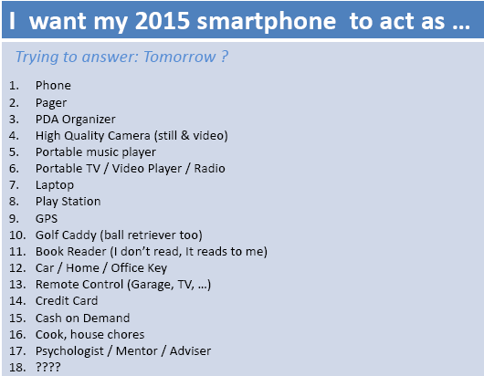
The Maturing Mobile Experience

Slide 15
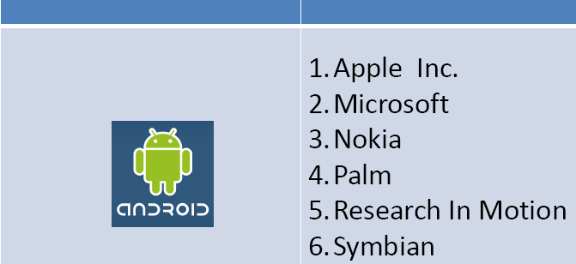
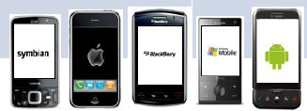
Android vs. Competitors

Slide 16
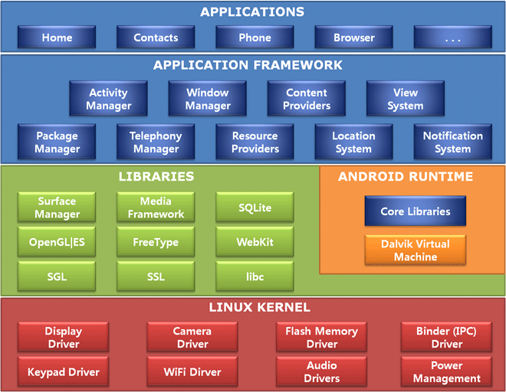
Diagram Arsitektur Android

Slide 17
Arsitektur Android
Linux kernel
  Linux versi 3.6 dengan ±115 patches (Linux versi 2.6 pada Android 4.0 Ice Cream Sandwich dan pendahulunya)
  Menyediakan level abstraksi antar hardware dan berisi semua driver hardware penting seperti camera, keypad, display dll.
  Layanan sistem inti seperti keamanan, manajemen memori, manajemen proses, Network stack,dan model driver.
  Kernel juga bertindak sebagai lapisan antara hardware dan seluruh software.
Libraries
  Satu set library dalam bahasa C/C++ yang digunakan oleh berbagai komponen pada sistem Android.
  Open-source Web browser engine WebKit, library libc yang biasa dipakai, SQLite database -> repository untuk storage & sharing data aplikasi, library untuk play & record audio & video, SSL libraries untuk Internet security dll.

Slide 18
Arsitektur Android
Android Runtime
  Menyediakan komponen penting Dalvik Virtual Machine semacam Java Virtual Machine yang didesain & dioptimasi khusus untuk Android
  Dalvik VM akan memanfaatkan funngsi inti Linux seperti memory management & multi-threading
  Dalvik VM memungkinkan setiap aplikasi Android berjalan sebagai proses sendiri, dengan instance tersendiri dari Dalvik virtual machine.
  Android runtime juga menyediakan library inti untuk developer Android menulis program menggunakan standar Bahasa pemograman Java

Slide 19
Arsitektur Android
Application Framework
  Menyediakan service higher-level untuk aplikasi dalam bentuk class Java yang dapat dimanfaatkan developer aplikasi
  Semua aplikasi memiliki akses penuh yang sama baik aplikasi inti maupun aplikasi tambahan
  Pengembang dapat dengan mudah mengakses informasi lokasi, mengatur alarm, menambahkan pemberitahuan ke situs bar dan lain sebagainya

Slide 20
Arsitektur Android
Applications
  Serangkaian aplikasi yang terdapat pada perangkat mobile.
  Aplikasi inti yang telah terdapat pada Android termasuk kalender, kontak, SMS, dan lain sebagainya
  Aplikasi-aplikasi ini ditulis dengan bahasa pemrograman java.

Slide 21
PERSIAPAN
Yang dibutuhkan
  JDK
  Android Studio
    Android SDK
    ADT

Slide 22
PERSIAPAN 1
Langkah Pertama:
INSTAL Java Development Kit (JDK) : untuk membuat program dalam bahasa Java (& Android)
  Bukan Java Runtime Environment (JRE);
  JDK & JRE berbeda!
Download JDK di http://java.oracle.com

Slide 23
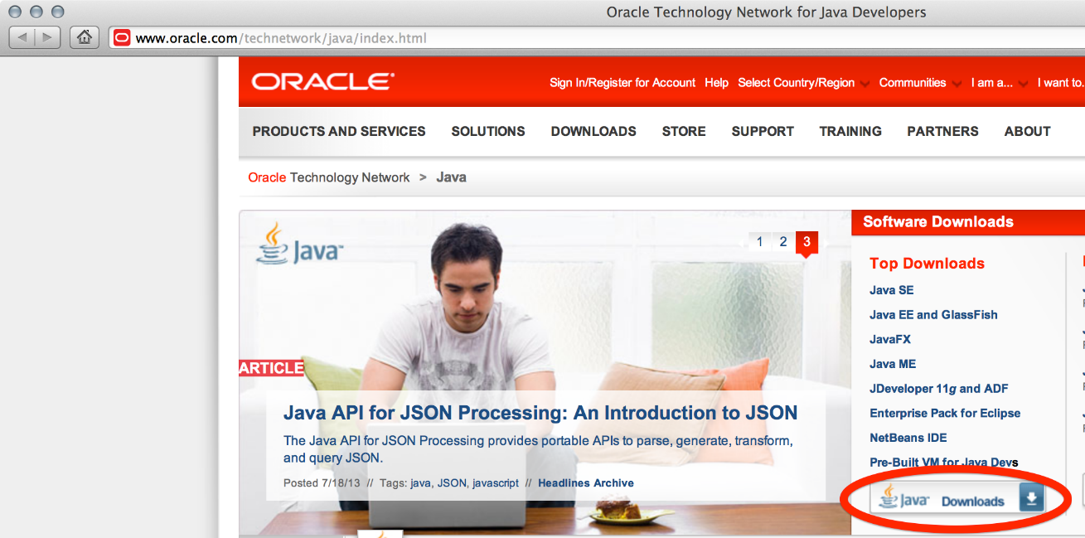

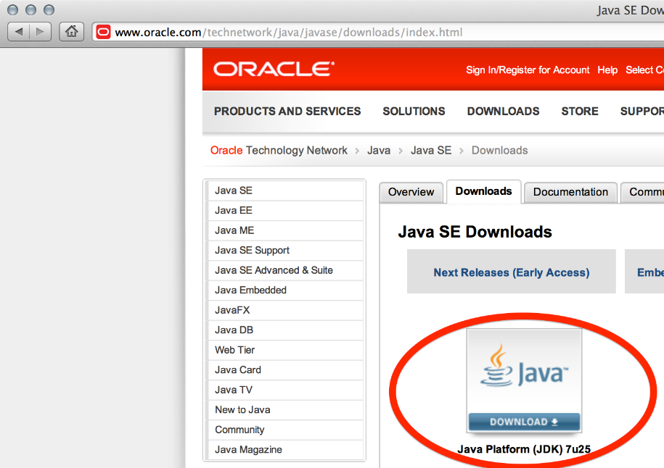
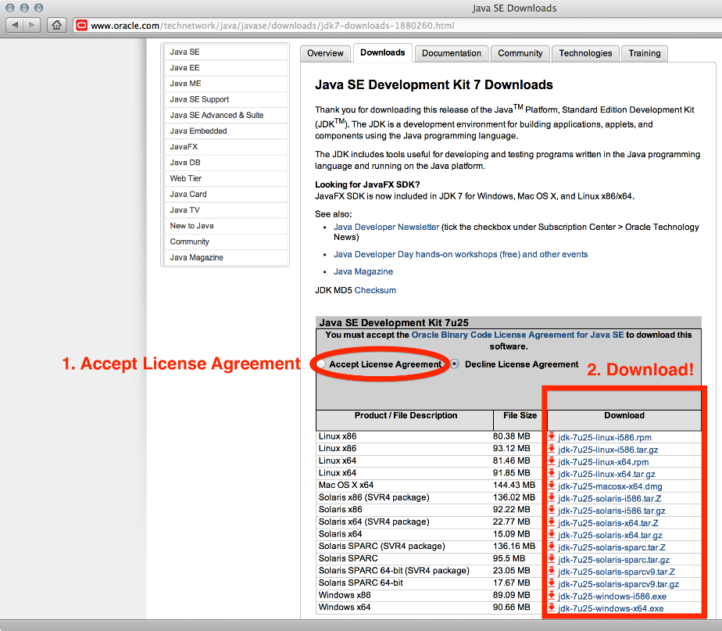
Install!

Slide 24
PERSIAPAN 2
CARA PERTAMA:
  Setelah menginstall JDK, download Android SDK http://developer.android.com
  CARA PALING MUDAH: download dan install Android Studio bundle (sudah termasuk Android SDK)
CARA KEDUA:
  Download/install Android Developer Tools (Eclipse)
  Install Android SDK tool tersendiri, kemudian install ADT untuk Eclipse terpisah

Slide 25
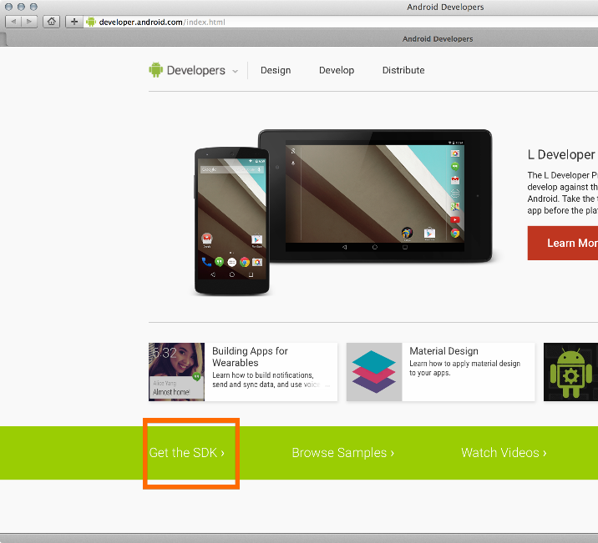
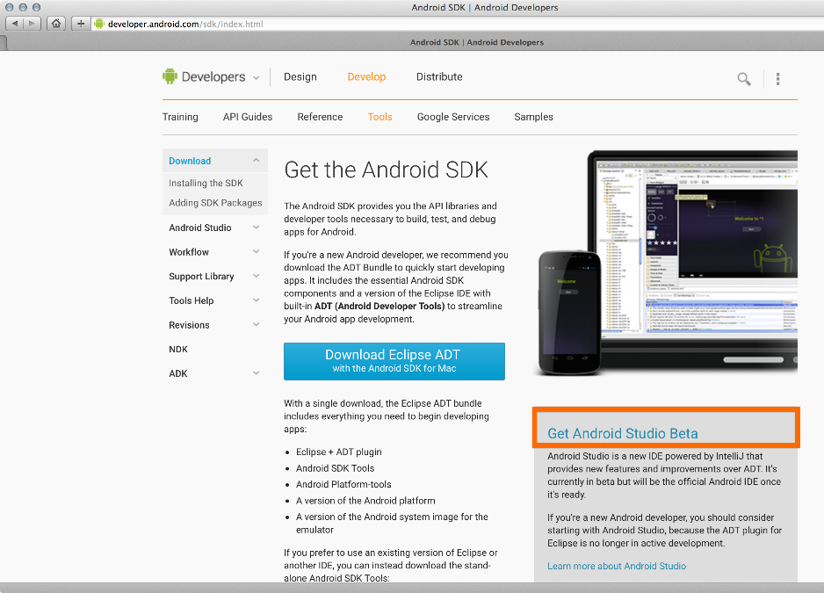
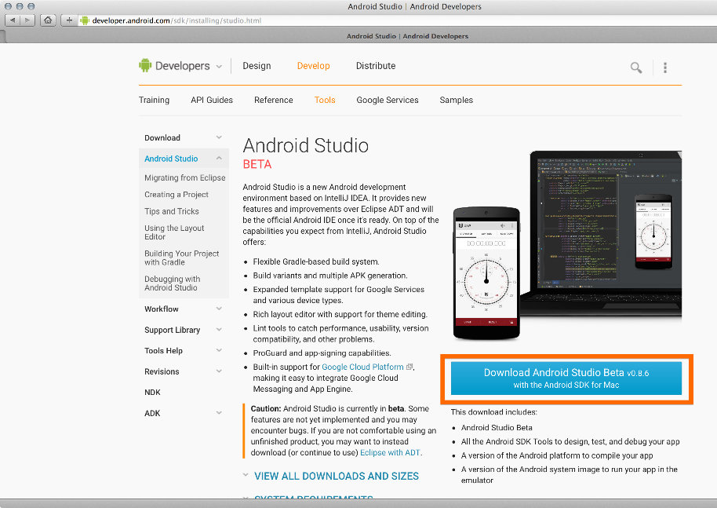
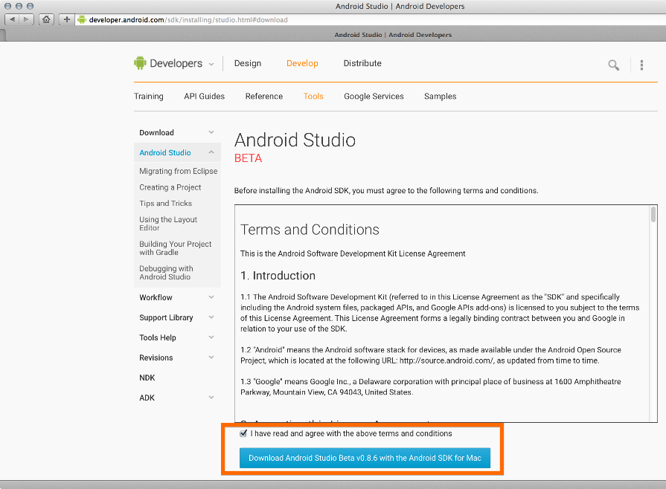
Install!

Slide 26
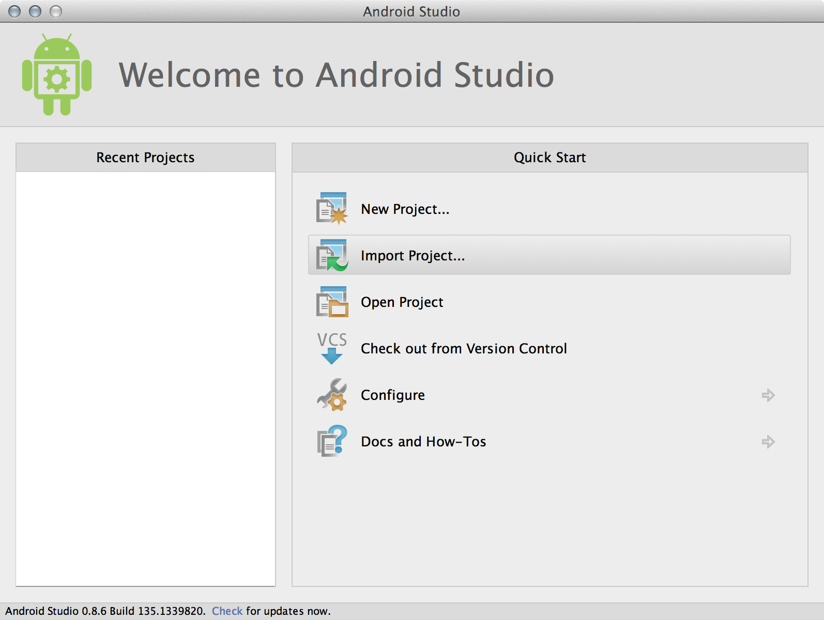
PERSIAPAN 3
Install Android Studio

Slide 27
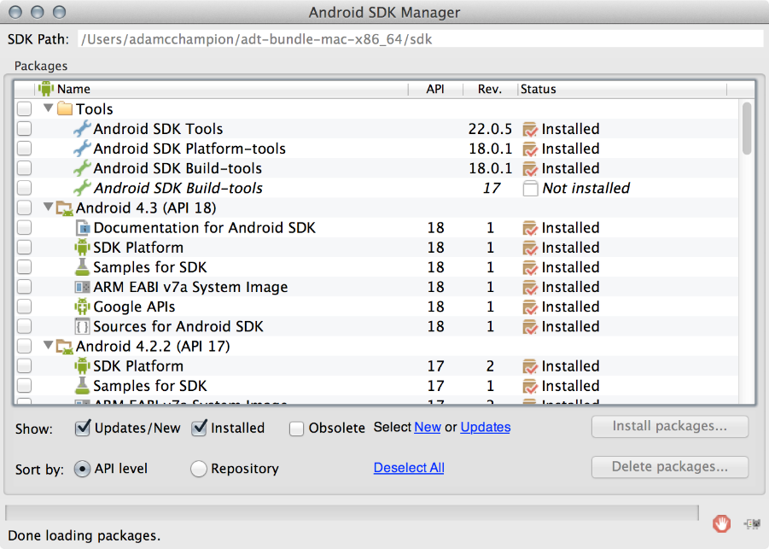
PERSIAPAN 4
Disarankan testing dengan device Android sebenarnya
  Harus Install USB drivers untuk Android device!
  Bisa memakai Android emulator: cukup lambat
Buka Android SDK Manager
  Rekomendasi: Install Android 2.2, 2.3.3 APIs and 4.x API
Settings
Siap untuk Android development!

Slide 28
ERROR1
Error:CreateProcess error=216, This version of %1 is not compatible with the version of Windows you're running. Check your computer's system information and then contact the software publisher← Karena JDK default yang dipakai dalam Android Studio 2.2.2 hanya berisi versi 64 bit
Solusi: jangan memakai embedded JDK
  Dari menu Project Structure, uncheck pilihan “use embedded JDK” dan pilih lokasi instalasi JDK

Slide 29
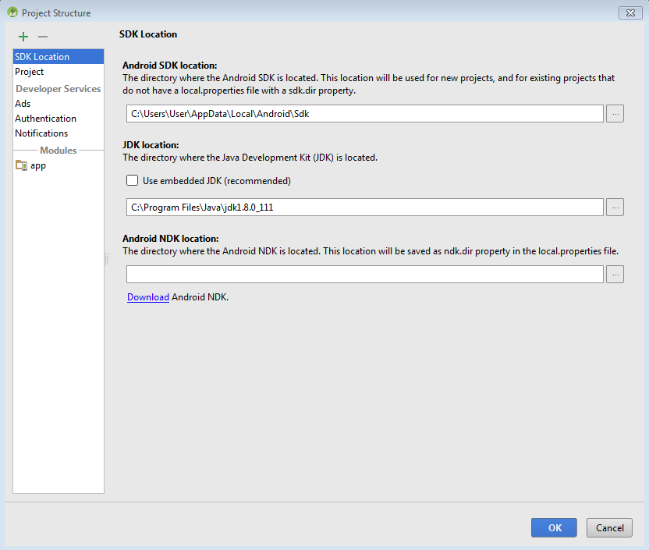

Slide 30
ERROR2
Gradle sync failed: CreateProcess error=216, This version of %1 is not compatible with the version of Windows you're running. Check your computer's system information to see whether you need a x86 (32-bit) or x64 (64-bit) version of the program, and then contact the software publisher
Solusi:
  Setelah Android Studio selesai load project, pilih gradle.properties dari project tab sebelah kiri. Buka file gradle.properties dan lakukan perubahan nilainya ke -Xmx768m.

Slide 31
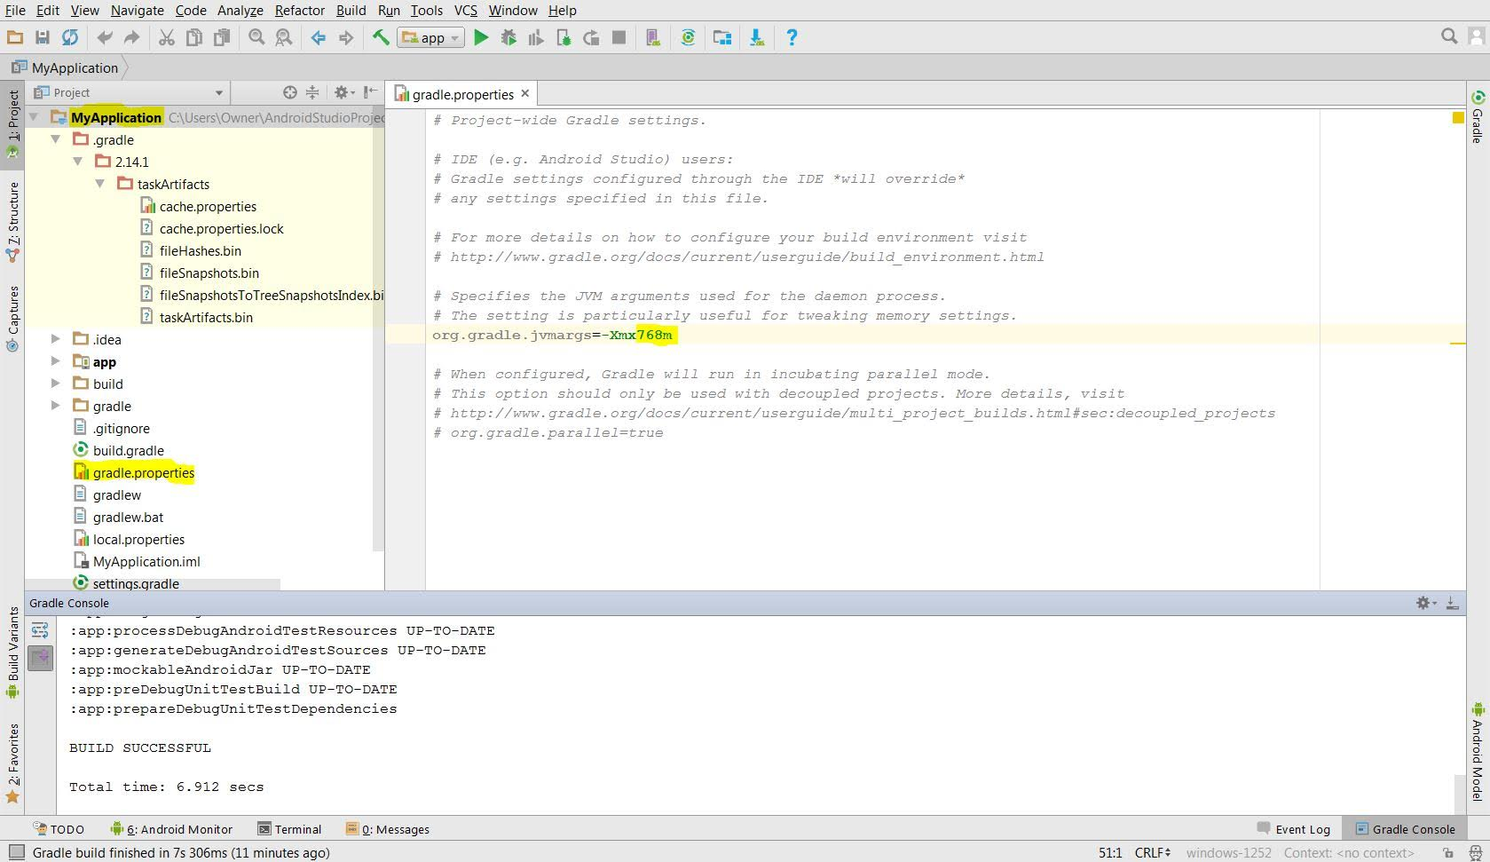

Slide 32
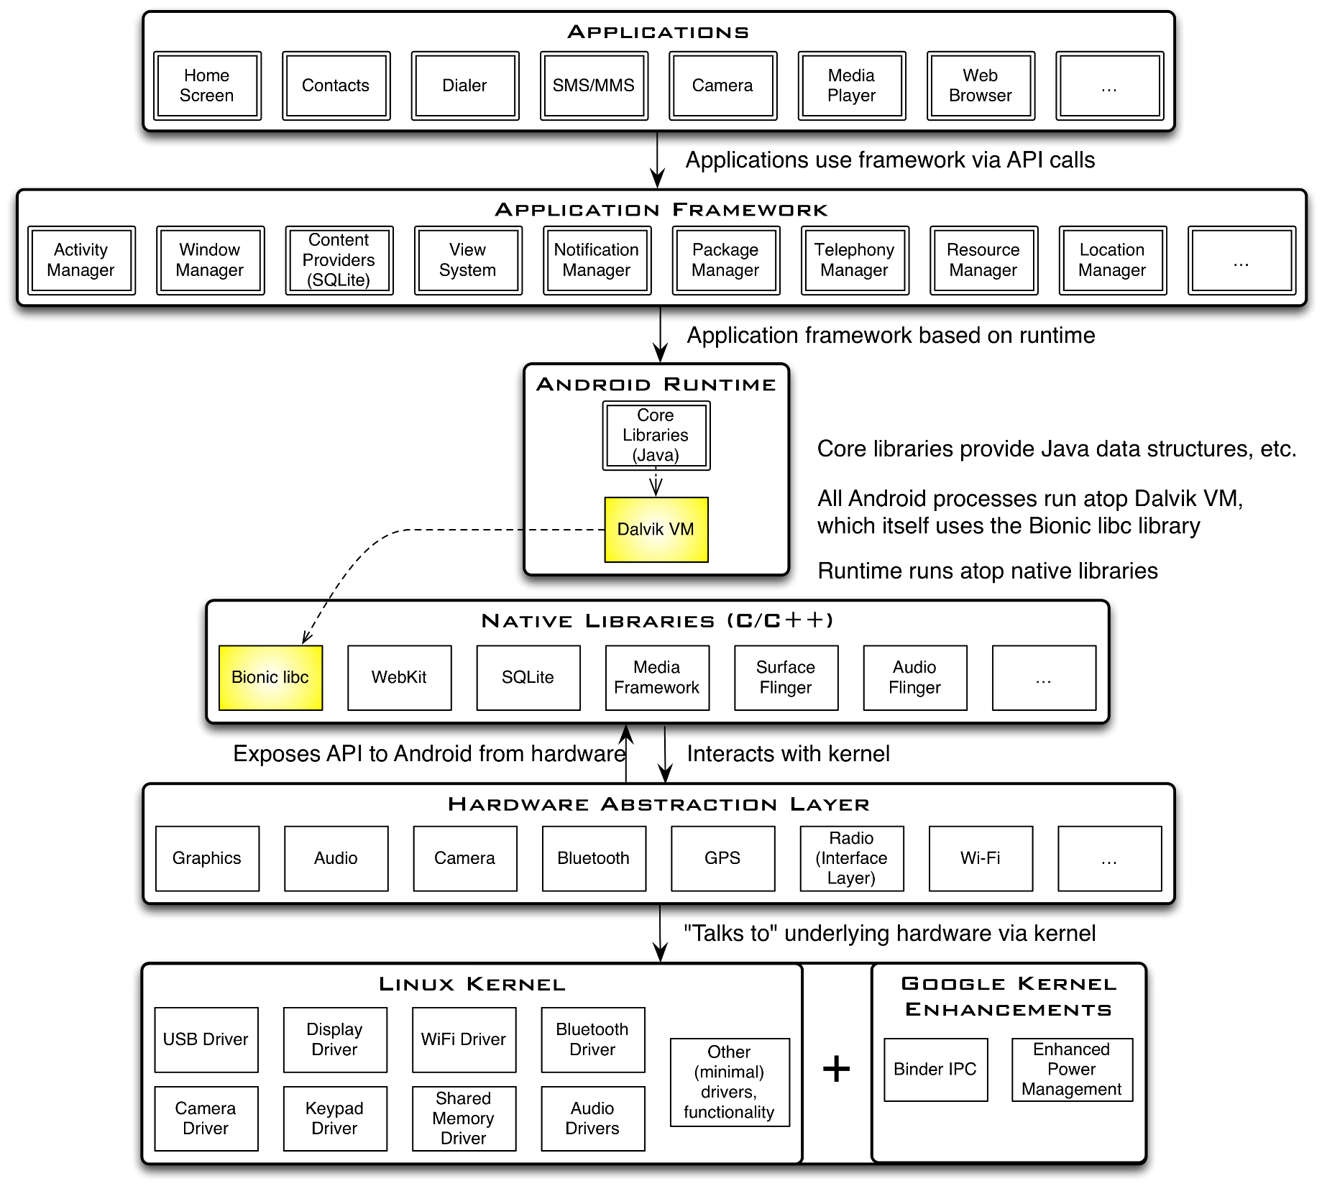

Slide 33
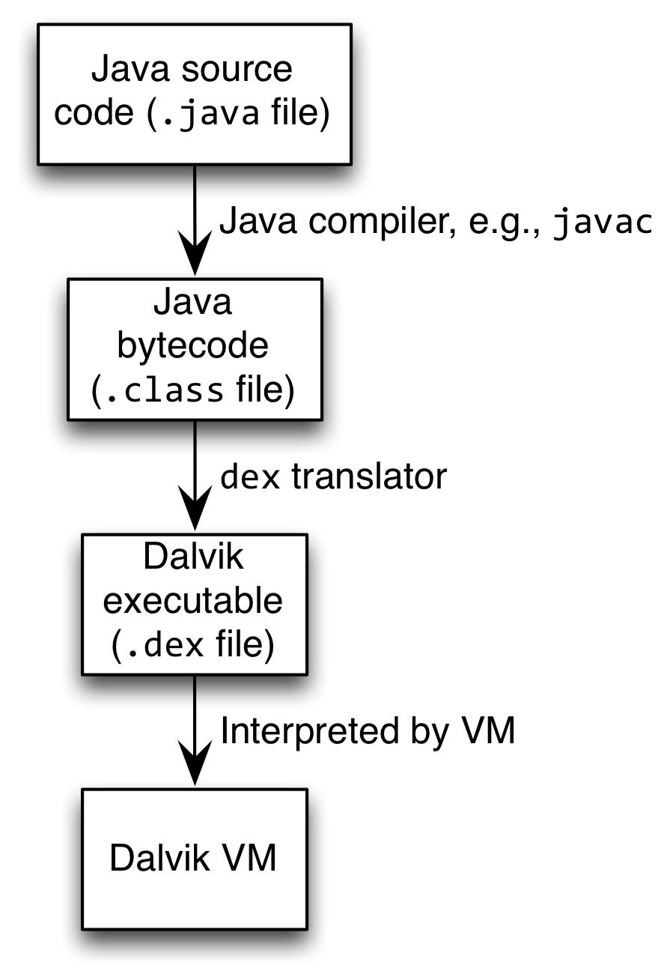
Android Highlights (1)
Android apps execute on Dalvik VM, a “clean-room” implementation of JVM
  Dalvik optimized for efficient execution
  Dalvik: register-based VM, unlike Oracle’s stack-based JVM
  Java .class bytecode translated to Dalvik EXecutable (DEX) bytecode, which Dalvik interprets

Slide 34
Android Highlights (2)
Android apps written in Java 5
  Actually, a Java dialect (Apache Harmony)
  Everything we’ve learned still holds
Apps use four main components:
  Activity: A “single screen” that’s visible to user
  Service: Long-running background “part” of app (not separate process or thread)
  ContentProvider: Manages app data (usually stored in database) and data access for queries
  BroadcastReceiver: Component that listens for particular Android system “events”, e.g., “found wireless device”, and responds accordingly

Slide 35
App Manifest
Every Android app must include an AndroidManifest.xml file describing functionality
The manifest specifies:
  App’s Activities, Services, etc.
  Permissions requested by app
  Minimum API required
  Hardware features required, e.g., camera with autofocus
  External libraries to which app is linked, e.g., Google Maps library

Slide 36
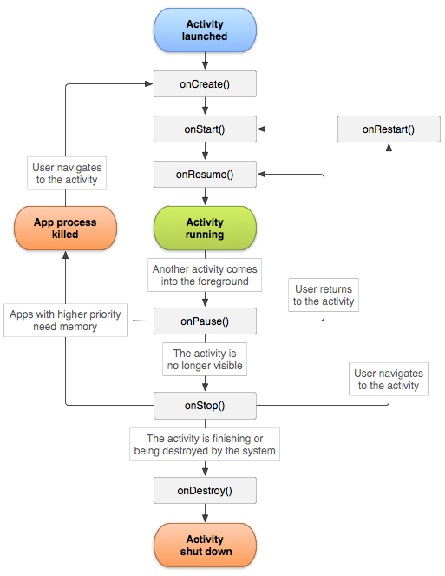
Activity Lifecycle
Activity: key building block of Android apps
Extend Activity class, override onCreate(), onPause(), onResume() methods
Dalvik VM can stop any Activity without warning, so saving state is important!
Activities need to be “responsive”, otherwise Android shows user “App Not Responsive” warning:
  Place lengthy operations in Runnable Threads, AsyncTasks

Slide 37
App Creation Checklist
If you own an Android device:
  Ensure drivers are installed
  Enable developer options on device under Settings, specifically USB Debugging
    Android 4.2+: Go to Settings→About phone, press Build number 7 times to enable developer options
For Android Studio:
  Under File→Settings→Appearance, enable “Show tool window bars”; the Android view shows LogCat, devices
  Programs should log states via android.util.Log’s Log.d(APP_TAG_STR, “debug”), where APP_TAG_STR is a final String tag denoting your app
  Other commands: Log.e() (error); Log.i() (info); Log.w() (warning); Log.v() (verbose) – same parameters

Slide 38
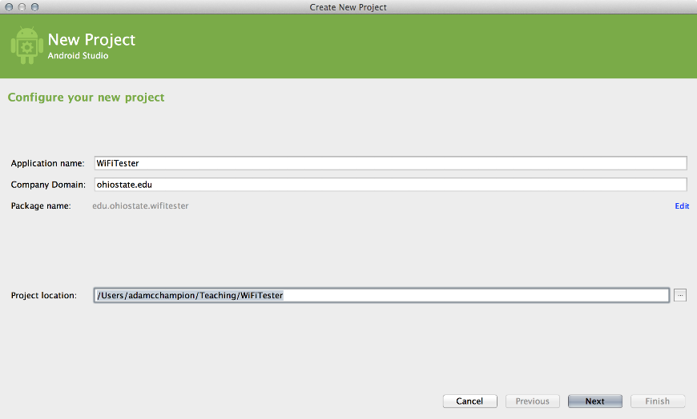
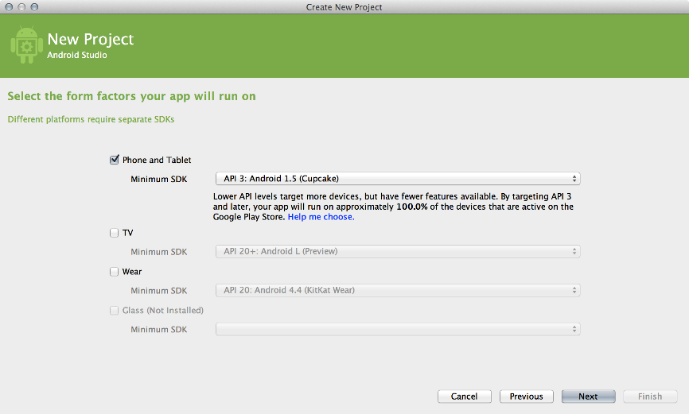
Creating Android App (1)
Creating Android app project in Android Studio:
  Go to File→New Project
  Enter app, project name
  Choose package name using “reverse URL” notation, e.g., edu.osu.myapp
  Select APIs for app, then click Next

Slide 39
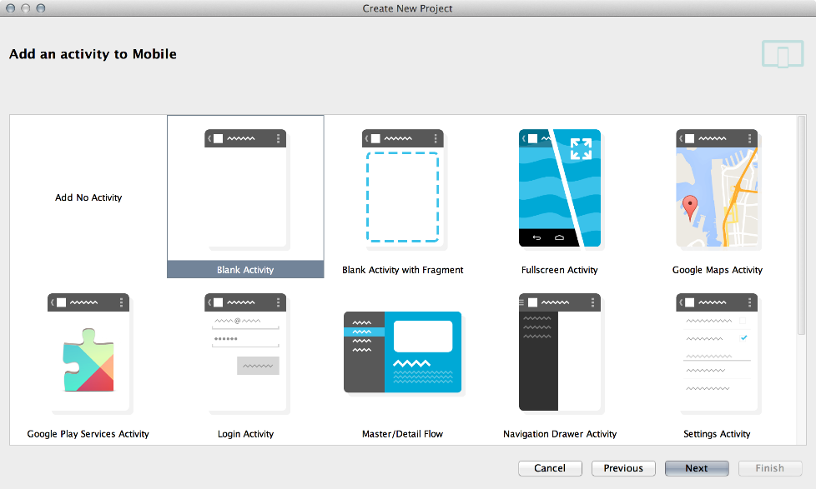
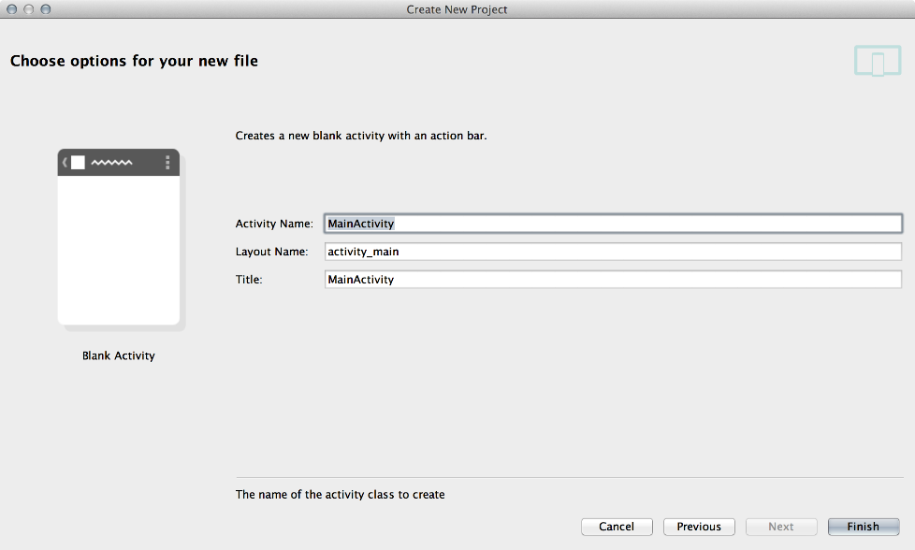
Creating Android App (2)
Determine what kind of Activity to create; then click Next
  We’ll choose a Blank Activity for simplicity
Enter information about your Activity, then click Finish
This creates a “Hello World” app

Slide 40
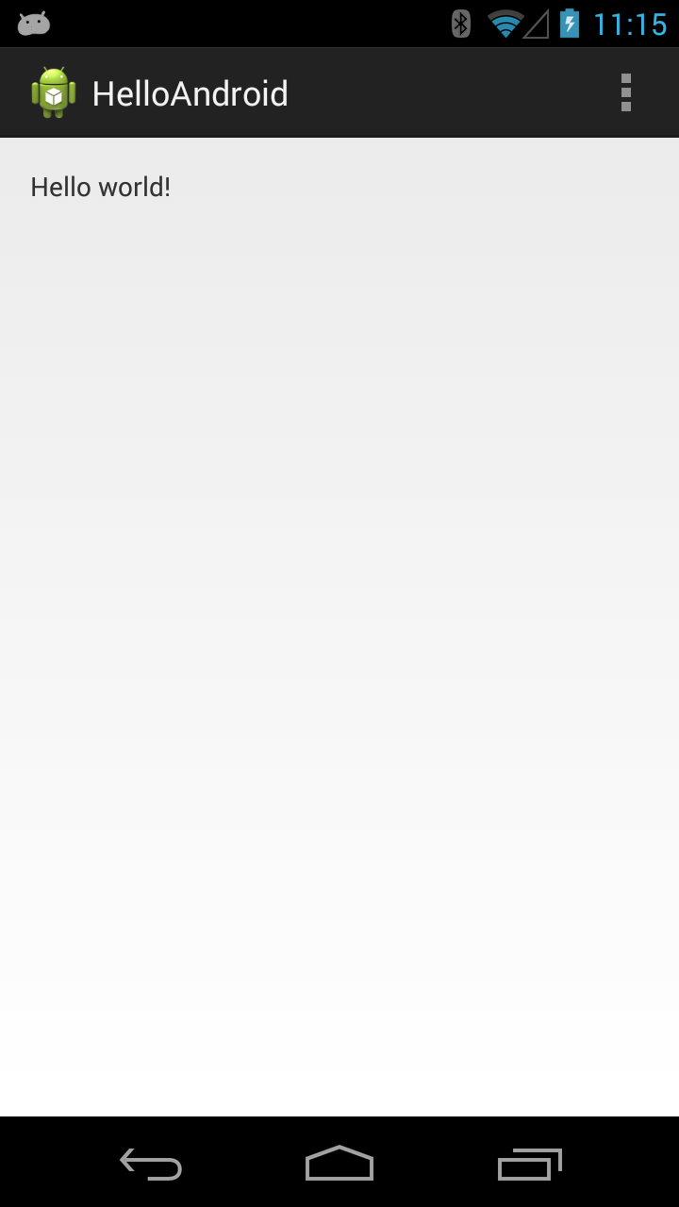
Deploying the App
Two choices for deployment:
  Real Android device
  Android virtual device
Plug in your real device; otherwise, create an Android virtual device
Emulator is slow. Try Intel accelerated version, or perhaps
http://www.genymotion.com/
Run the app: press “Run” button in toolbar

Slide 41
Underlying Source Code
src/…/MainActivity.java
package edu.osu.helloandroid;
import android.os.Bundle;
import android.app.Activity;
import android.view.Menu;
public class MainActivity extends Activity
{
@Override
protected void onCreate(Bundle savedInstanceState)
{
super.onCreate(savedInstanceState);
setContentView(R.layout.activity_main);
}
@Override
public boolean onCreateOptionsMenu(Menu menu)
{
// Inflate the menu; this adds items to the action bar if it is present.
getMenuInflater().inflate(R.menu.main, menu);
return true;
}
}

Slide 42
Underlying GUI Code
res/layout/activity_main.xml
<RelativeLayout xmlns:android="http://schemas.android.com/apk/res/android"
xmlns:tools="http://schemas.android.com/tools"
android:layout_width="match_parent"
android:layout_height="match_parent"
android:paddingBottom="@dimen/activity_vertical_margin"
android:paddingLeft="@dimen/activity_horizontal_margin"
android:paddingRight="@dimen/activity_horizontal_margin"
android:paddingTop="@dimen/activity_vertical_margin"
tools:context=".MainActivity" >
<TextView
android:layout_width="wrap_content"
android:layout_height="wrap_content"
android:text="@string/hello_world" />
</RelativeLayout>
– RelativeLayouts are quite complicated. See [13] for details

Slide 43
The App Manifest
AndroidManifest.xml
<?xml version="1.0" encoding="utf-8"?>
<manifest xmlns:android="http://schemas.android.com/apk/res/android"
package="edu.osu.helloandroid"
android:versionCode="1"
android:versionName="1.0" >
<uses-sdk
android:minSdkVersion="8"
android:targetSdkVersion="17" />
<application
android:allowBackup="true"
android:icon="@drawable/ic_launcher"
android:label="@string/app_name"
android:theme="@style/AppTheme" >
<activity
android:name="edu.osu.helloandroid.MainActivity"
android:label="@string/app_name" >
<intent-filter>
<action android:name="android.intent.action.MAIN" />
<category android:name="android.intent.category.LAUNCHER" />
</intent-filter>
</activity>
</application>
</manifest>

Slide 44
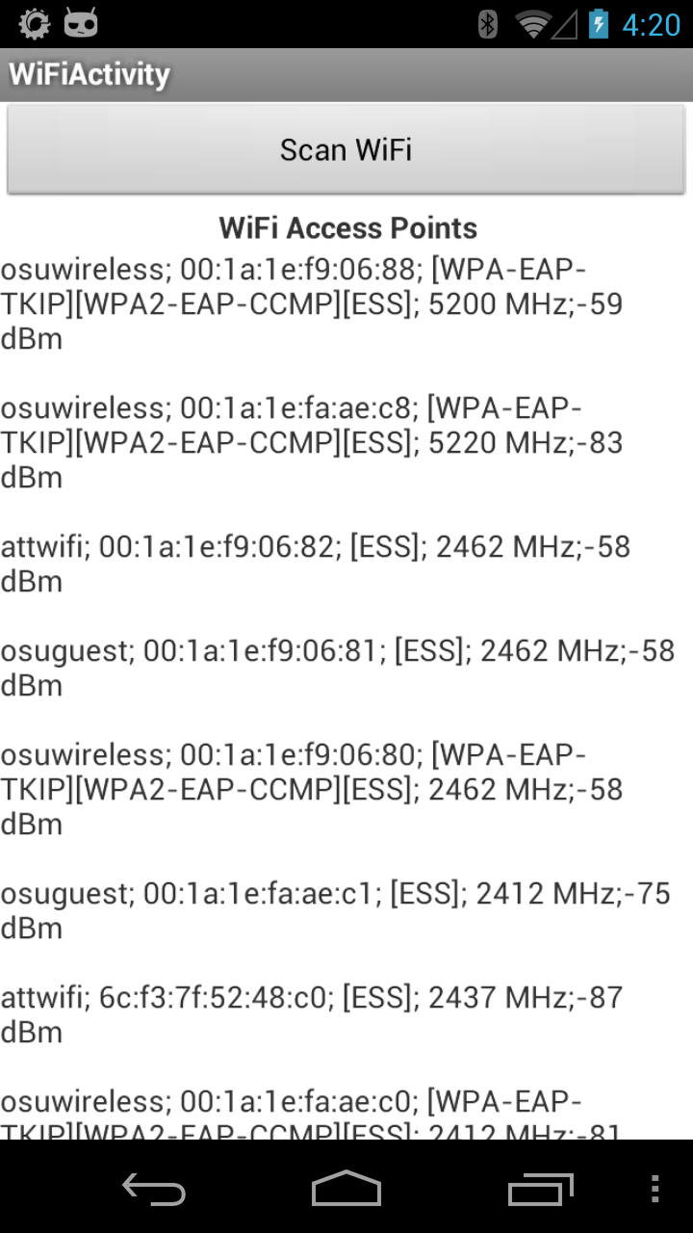
A More Interesting App
We’ll now examine an app with more features: WiFi Tester (code on class website)
Press a button, scan for WiFi access points (APs), display them

Slide 45
Underlying Source Code (1)
@Override
public void onCreate(Bundle savedInstanceState)
{
super.onCreate(savedInstanceState);
setContentView(R.layout.activity_wi_fi);
// Set up WifiManager.
mWifiManager = (WifiManager) getSystemService(Context.WIFI_SERVICE);
// Create listener object for Button. When Button is pressed, scan for
// APs nearby.
Button button = (Button) findViewById(R.id.button);
button.setOnClickListener(new View.OnClickListener()
{
public void onClick(View v)
{
boolean scanStarted = mWifiManager.startScan();
// If the scan failed, log it.
if (!scanStarted) Log.e(TAG, "WiFi scan failed...");
}
});
// Set up IntentFilter for "WiFi scan results available" Intent.
mIntentFilter = new IntentFilter();
mIntentFilter.addAction(WifiManager.SCAN_RESULTS_AVAILABLE_ACTION);
}

Slide 46
Underlying Source Code (2)
Code much more complex
First get system WifiManager
Create listener Object for button that performs scans
We register Broadcast Receiver, mReceiver, to listen for WifiManager’s “finished scan” system event (expressed as Intent WifiManager.SCAN_RESULTS_
AVAILABLE_ACTION)
Unregister Broadcast Receiver when leaving Activity
@Override
protected void onResume()
{
super.onResume();
registerReceiver(mReceiver, mIntentFilter);
}
@Override
protected void onPause()
{
super.onPause();
unregisterReceiver(mReceiver);
}

Slide 47
The Broadcast Receiver
private final BroadcastReceiver mReceiver = new BroadcastReceiver()
{
@Override
public void onReceive(Context context, Intent intent)
{
String action = intent.getAction();
if (WifiManager.SCAN_RESULTS_AVAILABLE_ACTION.equals(action))
{
Log.e(TAG, "Scan results available");
List<ScanResult> scanResults = mWifiManager.getScanResults();
mApStr = "";
for (ScanResult result : scanResults)
{
mApStr = mApStr + result.SSID + "; ";
mApStr = mApStr + result.BSSID + "; ";
mApStr = mApStr + result.capabilities + "; ";
mApStr = mApStr + result.frequency + " MHz;";
mApStr = mApStr + result.level + " dBm\n\n";
}
// Update UI to show all this information.
setTextView(mApStr);
}
}
};

Slide 48
User Interface
Updating UI in code
UI Layout (XML)
private void setTextView(String str)
{
TextView tv = (TextView) findViewById(R.id.textview);
tv.setMovementMethod(new ScrollingMovementMethod());
tv.setText(str);
}
This code simply has the UI display all collected WiFi APs, makes the text information scrollable
<LinearLayout xmlns:android="http://schemas.android.com/apk/res/android"
xmlns:tools="http://schemas.android.com/tools"
android:layout_width="fill_parent"
android:layout_height="fill_parent"
android:orientation="vertical">
<Button
android:layout_width="fill_parent"
android:layout_height="wrap_content"
android:id="@+id/button"
android:text="@string/button_text"/>
<TextView
android:id="@+id/header"
android:layout_width="fill_parent"
android:layout_height="wrap_content"
android:text="@string/ap_list"
tools:context=".WiFiActivity"
android:textStyle="bold"
android:gravity="center">
</TextView>
<TextView
android:layout_width="fill_parent"
android:layout_height="fill_parent"
tools:context=".WiFiActivity"
android:id="@+id/textview"
android:scrollbars="vertical">
</TextView>
</LinearLayout>

Slide 49
Android Programming Notes
Android apps have multiple points of entry: no main() method
  Cannot “sleep” in Android
  During each entrance, certain Objects may be null
  Defensive programming is very useful to avoid crashes, e.g.,
  if (!(myObj == null)) { // do something }
Java concurrency techniques are required
  Don’t block the “main” thread in Activities
  Implement long-running tasks such as network connections asynchronously, e.g., as AsyncTasks
  Recommendation: read [4]; chapter 20 [10]; [11]
Logging state via android.util.Log throughout app is essential when debugging (finding root causes)
Better to have “too many” permissions than too few
  Otherwise, app crashes due to security exceptions!
  Remove “unnecessary” permissions before releasing app to public
Event handling in Android GUIs entails many listener Objects

Slide 50
Concurrency: Threads (1)
Thread: program unit (within process) executing independently
Basic idea: create class that implements Runnable interface
  Runnable has one method, run(), that contains code to be executed
  Example:
  public class OurRunnable implements Runnable
  {
  public void run()
  {
  // run code
  }
  }
Create a Thread object from Runnable and start() Thread, e.g.,
Runnable r = new OurRunnable();
Thread t = new Thread(r);
t.start();
Problem: this is cumbersome unless Thread code is reused

Slide 51
Concurrency: Threads (2)
Easier approach: anonymous inner classes, e.g.,
Thread t = new Thread(new Runnable(
{
public void run()
{
// code to run
}
});
t.start();
Idiom essential for one-time network connections in Activities
However, Threads can be difficult to synchronize, especially with UI thread in Activity. AsyncTasks are better suited for this

Slide 52
Concurrency: AsyncTasks
AsyncTask encapsulates asynchronous task that interacts with UI thread in Activity:
public class AsyncTask<Params, Progress, Result>
{
protected Result doInBackground(ParamType param)
{
// code to run in background
publishProgress(ProgressType progress); // UI
…
return Result;
}
protected void onProgressUpdate(ProgressType progress)
{
// invoke method in Activity to update UI
}
}
Extend AsyncTask with your own class
Documentation at http://developer.android.com

Slide 53
References (1)
C. Horstmann, Big Java Late Objects, Wiley, 2012. Online: http://proquest.safaribooksonline.
com.proxy.lib.ohio–state.edu/book/–/9781118087886
J. Bloch, Effective Java, 2nd ed., Addison–Wesley, 2008. Online: http://proquest.
safaribooksonline.com.proxy.lib.ohio–state.edu/book/programming/java/9780137150021
S.B. Zakhour, S. Kannan, and R. Gallardo, The Java® Tutorial: A Short Course on the Basics, 5th ed., Addison–Wesley, 2013. Online: http://proquest.safaribooksonline.com.proxy.lib.
ohio–state.edu/book/programming/java/9780132761987
C. Collins, M. Galpin, and M. Kaeppler, Android in Practice, Manning, 2011. Online: http://proquest.safaribooksonline.com.proxy.lib.ohio–state.edu/book/programming/android/9781935182924
M.L. Sichitiu, 2011, http://www.ece.ncsu.edu/wireless/MadeInWALAN/AndroidTutorial/PPTs/
javaReview.ppt
Oracle, http://docs.oracle.com/javase/1.5.0/docs/api/index.html
Wikipedia, https://en.wikipedia.org/wiki/Vehicle_Identification_Number
Nielsen Co., “Smartphone Milestone: Half of Mobile Subscribers Ages 55+ Own Smartphones”, 22 Apr. 2014, http://www.nielsen.com/us/en/insights/news/2014/
smartphone-milestone-half-of-americans-ages-55-own-smartphones.html
Android Open Source Project, http://www.android.com

Slide 54
References (2)
http://bcs.wiley.com/he-bcs/Books?action=index&itemId=1118087887&bcsId=7006
B. Goetz, T. Peierls, J. Bloch, J. Bowbeer, D. Holmes, and D. Lea, Java Concurrency in Practice, Addison-Wesley, 2006, online at http://proquest.safaribooksonline.com/book/programming/java/0321349601
https://developer.android.com/guide/components/activities.html
https://developer.android.com/guide/topics/ui/declaring-layout.html#CommonLayouts
https://cloud.genymotion.com/page/doc/#collapse4
http://blog.zeezonline.com/2013/11/install-google-play-on-genymotion-2-0/

