Slide 1
MOBILE COMPUTING
Wireless Local Area Networks 802.11
Pertemuan 4
Dosen Pengampu: Hendry Gunawan S.Kom, MM
Prodi Sistem Informasi - Fakultas Ilmu Komputer

Slide 2
Learning Outcomes
Memahami sejarah keluarga teknologi wireless 802
Memahami cara kerja teknologi 802.11
Membahas issue-issue terkait teknologi 802.11
Membahas aplikasi dan perkembangan teknologi 802.11

Slide 3
IEEE 802 wireless network technology options
Network definition
Wireless personal area network (WPAN)
Low-rate WPAN (LR-WPAN)
Wireless local area network (WLAN)
Wireless metroplitan area network (WMAN)
IEEE standard
IEEE 802.15.1
IEEE 802.15.4
IEEE 802.11
IEEE 802.16
Known as
Bluetooth
ZigBee
WiFi
WiMAX

Slide 4
Brief History
IEEE (Institute of Electrical and Electronics Engineers) established the 802.11 Group in 1990. Specifications for standard written in 1997.
Initial speeds were 1 and 2 Mbps.
IEEE modified the standard in 1999 to include:
  802.11b
  802.11a
  802.11g was added in 2003.
IEEE created standard, but Wi-Fi Alliance certifies products

Slide 5
IEEE 802 Organization
IEEE Standards Association
Standards Activities Board
Sponsor
IEEE 802
Local and Metropolitan Area Networks
(LMSC)
Sponsor
Sponsor
Sponsor
802.1
Higher
Layer
LAN
Protocols
802.3
CSMA/CD
Ethernet
802.5
Token
Passing
Ring
802.11
Wireless
WLAN
802.15
Wireless
Personal
Area
Networks
802.17
Resilient
Packet
Ring
802.19
Co-existence
TAG
802.21
Media
Independent
Handoff
802.16
Broadband
Wireless
Broadband
Access
802.18
Radio
Regulatory
TAG
802.20
Mobile
Broadband
Wireless
Access
802.22
Wireless
Regional
Area
Networks

Slide 6
IEEE 802 standardisation framework
802.1
Manage-ment
802.2 Logical Link Control (LLC)
802.3
MAC
802.5
MAC
802.11 Medium Access Control (MAC)
CSMA/CA
802.3
PHY
802.5
PHY
802.11
PHY
802.11a
PHY
802.11b
PHY
802.11g
PHY
CSMA/CD
(Ethernet)
Token Ring
CSMA/CA (Wireless LAN)

Slide 7

Activity History
Feb 14, 1876: Bell files telephone patent
June 1897: Marconi work- “Signaling through Space without Wires”
1970: ALOHAnet operational (Abramson, 9600 baud)
1976: Metcalf & Boggs: “Ethernet: Distributed Packet-Switching for Local Computer Networks”
1980: Project 802 formed (1 Mbps initially, revised to 20 Mbps 1982) (Feb 1980 , 125+ attendees)
1980: Ethernet Bluebook published (September , Digital. Intel, Xerox)
1981: FCC issues NOI for unlicensed spectrum
1983: First version of 802.3 10Base5 spec completed
1985: FCC opens ISM Band- spread spectrum allowed
1985: First version of 802.3 published (10 Mbps)
1987: Project 802.4L – Wireless Token Bus begins
1990: IEEE 802 drops 802.4L starts 802.11 project
1990: 802.3 10BASE-T (802.3i) released
1997: IEEE 802.11 standard approved (2.4GHz – 1Mbps)
1999: Apple IBook introduced with integrated 802.11 (AirPort)
4-Mar-18
Notes:
7
3/4/2018

Slide 8
Activity History
1997: IEEE 802.11 standard approved (2.4GHz – 1Mbps)
1998: UNII (Unlicensed National Information Infrastructure) Band - 5 GHz
1999: IEEE 802.11 standard achieved ISO/IEC approval
1999: IEEE 802.11a (5GHz – 54Mbps) - approved
IEEE 802.11b (2.4GHz- 11Mbps)- approved
1999: Formation of WECA (now Wi-Fi Alliance)
2001: IEEE 802.11d Regulatory Domains - approved
2003: IEEE 802.11g (Higher rate 2.4GHz PHY) – approved
IEEE 802.11i (Security) - approved
IEEE 802.11h (Spectrum Mgmt) - approved
IEEE 802.11f (interaccess point protocol) – approved
2005: IEEE 802.11e (MAC enhancements – QoS) – approved
Notes:
8
3/4/2018

Slide 9
Market Size and Trends
900
2 million
Units
per day
  Market size & segment diversity continues to increase
800
700
600
1 million
Units
per day
500
400
Devices (million)
300
200
Enterprise APs
100
Home/SOHO
CE
0
Phones
Source: In-Stat
2006
2010
PCs
9
4-Mar-18
Notes:
9
3/4/2018

Slide 10
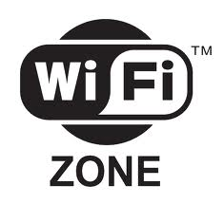

Wi-Fi Alliance
Founded 1999
400 member companies
The Wi-Fi Alliance provides:
Interoperability certification programs
  Over 9000 products certified
Market messaging
http://www.wi-fi.org/

Slide 11

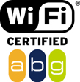
Wi-Fi Alliance
Non-profit standards organization.
Global organization that created the Wi-Fi brand name.
Formerly the Wireless Ethernet Compatibility Alliance.
Logo:

Slide 12









































Konsorsium WiFi
Beberapa perusahaan yang tergabung pada konsorsium WiFi

Slide 13
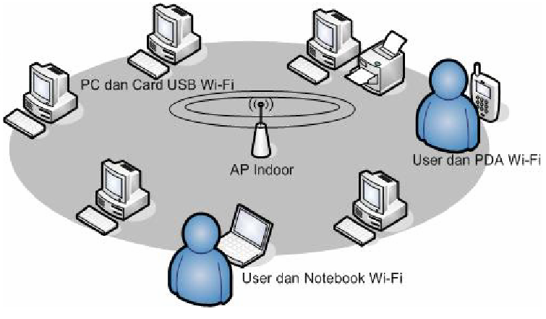
Hotspot

Slide 14

Wi-Fi Hotspot Public Access
  517,242 hot spots in 144 countries
    Source: JiWire http://v4.jiwire.com/search-hotspot-locations.htm
  87% of US hotels offer Wi-Fi
    Source: American Hotel & Lodging Assn

Slide 15
The 802 LAN Architecture
OSI reference model
End station
End station
7
6
5
4
3
2
1
Application
(Higher
Layers)
(Higher
Layers)
Presentation
Session
LLC sublayer
Transport
MAC Bridge
Network
Link
LLC
LLC
MAC service
user
MAC
MAC
RELAY
MAC
MAC
MAC service
provider
MAC sublayer
Physical
Phy
Phy
Phy
Phy
Physical layer
LAN
LAN
Medium

Slide 16
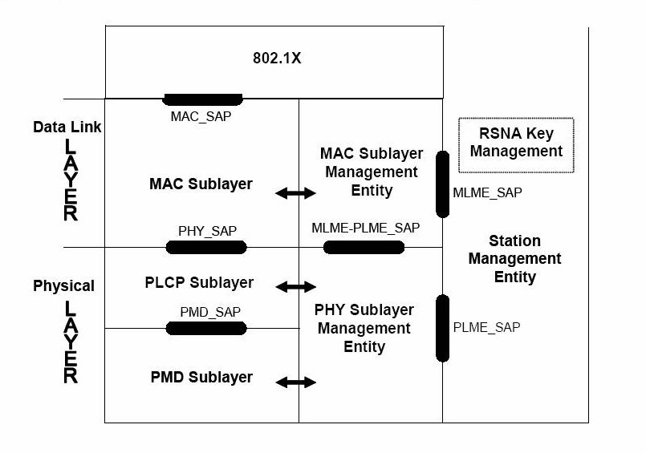
802.11 Project Scope

Slide 17
Basic Access Method - Protocol Behavior
The 802.11 family uses a MAC layer known as CSMA/CA (Carrier Sense Multiple Access/Collision Avoidance)
Ethernet uses CSMA/CD - collision detection).
Concept
Listen on the channel.
If the channel is quiet (no active transmitters) - send a packet.
If channel is occupied- wait longer (exponential backoff)
20 micro sec for DS systems.
If the channel is still idle at the end of the CONTENTION period the node transmits its packet otherwise it repeats the waiting process

Slide 18
Basic Service Protocol - Listen Before Talk
1Mbps example
Listen
Talk
Listen
Talk
Listen
Talk
Listen
Talk
1500 Byte User DATA
PPDU
1500 Byte User DATA
PPDU
12192 μs
12192 μs
DIFS
(listen)
DIFS
(listen)
50 μs
50 μs
SIFS
ACK
PPDU
SIFS
ACK
PPDU
10 μs
304 μs
10 μs
304 μs
D = DCF Inter Frame Space (DIFS)
S = Short Inter Frame Space (SIFS)

Slide 19
CSMA/CD Ethernet
802.1
Manage-ment
Widely used wired LAN technology
CSMA/CD = Carrier Sense Multiple Access with Collision Detection
LAN stations compete for accessing the shared medium (wired network). If a collision is detected, transmitting stations stop their transmissions and wait a random time before starting transmission again.
802.3
MAC
802.3
PHY
CSMA/CD
(Ethernet)

Slide 20
CSMA/CA Wireless LAN
CSMA/CA = Carrier Sense Multiple Access with Collision Avoidance
Unlike wired LAN stations, WLAN stations cannot detect collisions
=>
avoid collisions (use ”backoff procedure” as described later)
802.11 Medium Access Control (MAC)
CSMA/CA
802.11
PHY
802.11a
PHY
802.11b
PHY
802.11g
PHY
A common MAC layer, but many PHY options

Slide 21
WLAN physical layer (1)
The original physical layer specified in 802.11 defines two signal formats:
FHSS (Frequency Hopping Spread Spectrum)
802.11 Medium Access Control (MAC)
CSMA/CA
Outdated, never implemented
DSSS (Direct Sequence Spread Spectrum)
802.11
PHY
802.11a
PHY
802.11b
PHY
802.11g
PHY
Data rates supported:
1 and 2 Mbit/s.
ISM band: 2.4 … 2.4835 GHz

Slide 22
WLAN physical layer (2)
The first widely implemented physical layer was 802.11b that uses:
DSSS (Direct Sequence Spread Spectrum) like in 802.11 but with larger bit rates:
1, 2, 5.5, 11 Mbit/s
802.11 Medium Access Control (MAC)
CSMA/CA
Becoming outdated
802.11
PHY
802.11a
PHY
802.11b
PHY
802.11g
PHY
Automatic fall-back to lower speeds in case of bad radio channel.
ISM band: 2.4 … 2.4835 GHz

Slide 23
WLAN physical layer (3)
802.11a operates in the 5.8 GHz band. This poses some problems in Europe*
The signal format is OFDM (Orthogonal Frequency Division Multiplexing)
Data rates supported:
Various bit rates from 6 to 54 Mbit/s.
802.11 Medium Access Control (MAC)
CSMA/CA
Not used in Europe
802.11
PHY
802.11a
PHY
802.11b
PHY
802.11g
PHY
*more in later presentation
5 GHz frequency band

Slide 24
WLAN physical layer (4)
802.11g is the most recent physical layer, operating in the same band as 802.11b
The signal format is OFDM (Orthogonal Frequency Division Multiplexing)
Data rates supported:
Various bit rates from 6 to 54 Mbit/s (same as 802.11a)
802.11 Medium Access Control (MAC)
CSMA/CA
802.11
PHY
802.11a
PHY
802.11b
PHY
802.11g
PHY
ISM band: 2.4 … 2.4835 GHz

Slide 25
Wireless Fidelity (WiFi)
The WiFi certification program of the Wireless Ethernet
Compatibility Alliance (WECA) addresses compatibility of IEEE 802.11 equipment
=>
WiFi ensures interoperability of equipment from different vendors.
802.11 Medium Access Control (MAC)
CSMA/CA
802.11
PHY
802.11a
PHY
802.11b
PHY
802.11g
PHY
WiFi5
WiFi

Slide 26
Wireless Personal Area Network (WPAN)
802.1
Manage-ment
802.2 LLC
802.3
MAC
802.5
MAC
802.11
MAC
802.15.1
MAC
+
PHY
802.15.4
MAC
+
PHY
802.16
MAC
+
PHY
Data rates up to 700 kbit/s (2.1 Mbit/s)
802.3
PHY
802.5
PHY
802.11
PHY
ISM band: 2.4 … 2.4835 GHz
Bluetooth Special Interest Group (SIG)

Slide 27
Low-rate WPAN (LR-WPAN)
802.1
Manage-ment
802.2 LLC
802.3
MAC
802.5
MAC
802.11
MAC
802.15.1
MAC
+
PHY
802.15.4
MAC
+
PHY
802.16
MAC
+
PHY
Data rates up to 250 kbit/s
802.3
PHY
802.5
PHY
802.11
PHY
ISM band: 2.4 … 2.4835 GHz
ZigBee Alliance

Slide 28
Wireless Metropolitan Area Network (WMAN)
802.1
Manage-ment
802.2 LLC
802.3
MAC
802.5
MAC
802.11
MAC
802.15.1
MAC
+
PHY
802.15.4
MAC
+
PHY
802.16
MAC
+
PHY
Various data rates up to 100 Mbit/s and more
802.3
PHY
802.5
PHY
802.11
PHY
Various frequency bands (not only ISM)
WiMAX

Slide 29
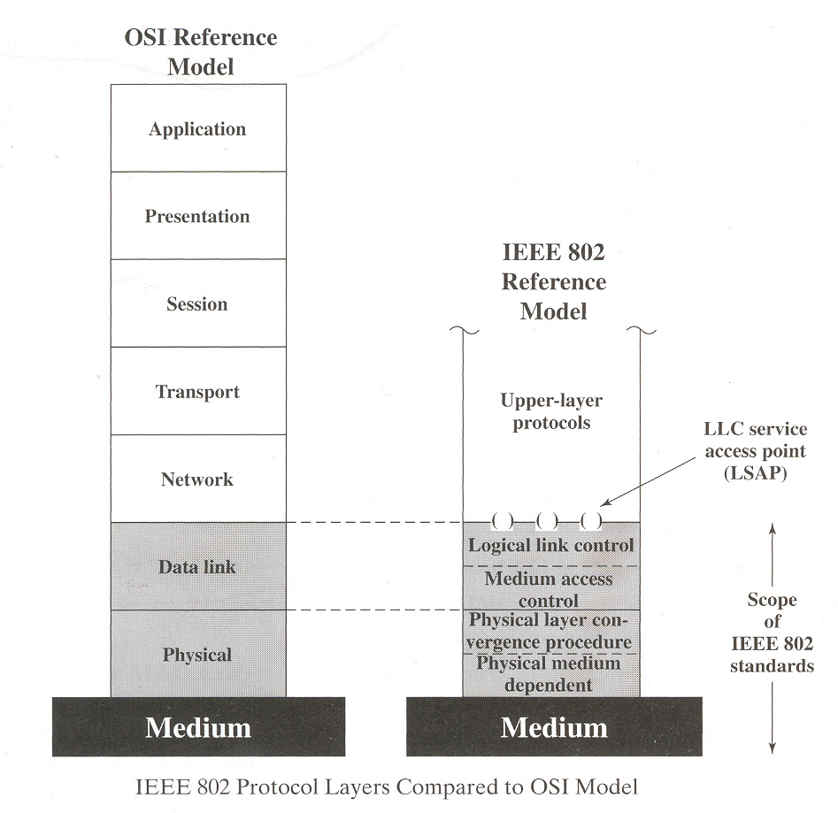
802.11 Standard
802.11 is primarily concerned with the lower layers of the OSI model.
Data Link Layer
  Logical Link Control (LLC).
  Medium Access Control (MAC).
Physical Layer
  Physical Layer Convergence Procedure (PLCP).
  Physical Medium Dependent (PMD).

Slide 30
802.11b Standard
Well-supported, stable, and cost effective, but runs in the 2.4 GHz range that makes it prone to interference from other devices (microwave ovens, cordless phones, etc) and also has security disadvantages.
Limits the number of access points in range of each other to three.
Has 11 channels, with 3 non-overlapping, and supports rates from 1 to 11 Mbps, but realistically about 4-5 Mbps max.
Uses direct-sequence spread-spectrum technology.

Slide 31
802.11g Standard
Extension of 802.11b, with the same disadvantages (security and interference).
Has a shorter range than 802.11b.
Is backwards compatible with 802.11b so it allows or a smooth transition from 11b to 11g.
Flexible, because multiple channels can be combined for faster throughput, but limited to one access point.
Runs at 54 Mbps, but realistically about 20-25 Mbps and about 14 Mbps when b associated
Uses frequency division multiplexing

Slide 32
802.11a Standard
Completely different from 11b and 11g.
Flexible, because multiple channels can be combined for faster throughput and more access points can be co-located.
Shorter range than 11b and 11g.
Runs in the 5 GHz range, so less interference from other devices.
Has 12 channels, 8 non-overlapping, and supports rates from 6 to 54 Mbps, but realistically about 27 Mbps max
Uses frequency division multiplexing

Slide 33
Network topology (1)
Infrastructure network:
The wireless network has a fixed central element (base station, access point) that manages the network and through which all communication takes place.
Ad hoc network:
The wireless network has no (or a dynamically allocated) central element, so that the network topology can change over time without user intervention. Such a network is more flexible but also more difficult to manage.

Slide 34
Network topology (2)
Network
IEEE 802.15.1 WPAN (Bluetooth)
IEEE 802.15.4 LR-WPAN (ZigBee)
IEEE 802.11 WLAN (WiFi)
IEEE 802.16 WMAN (WiMAX)
Network topology
Ad hoc (with dynamically allocated central element)
Ad hoc
Infrastructure
(ad hoc also possible)
Infrastructure

Slide 35
Multiplexing / multiple access / duplexing (1)
Multiplexing / multiple access
Signals to/from different users share a common channel using time division methods (TDM/TDMA, CSMA), frequency division methods (FDM/FDMA), or CDMA.
Duplexing:
The signals moving between two elements in opposite directions can be separated using time division duplexing (TDD) or frequency division duplexing (FDD). In the case of CSMA, duplexing is not relevant.

Slide 36
Multiplexing / multiple access / duplexing (2)
Network
IEEE 802.15.1 WPAN (Bluetooth)
IEEE 802.15.4 LR-WPAN (ZigBee)
IEEE 802.11 WLAN (WiFi)
IEEE 802.16 WMAN (WiMAX)
Multiplexing / MA / duplexing
TDMA / TDD
CSMA/CA
CSMA/CA
TDM/TDMA (down/uplink) /
TDD or (semi-duplex) FDD

Slide 37
Maximum channel data rates
Network
IEEE 802.15.1 WPAN (Bluetooth)
IEEE 802.15.4 LR-WPAN (ZigBee)
IEEE 802.11 WLAN (WiFi)
IEEE 802.16 WMAN (WiMAX)
Maximum data rate
1 Mbit/s (Bluetooth v. 1.2)
3 Mbit/s (Bluetooth v. 2.0)
250 kbit/s
11 Mbit/s (802.11b)
54 Mbit/s (802.11g)
134 Mbit/s

Slide 38
Addressing
In a LAN environment, devices are logically separated using 48-bit globally unique MAC addresses:
Example: 00:90:4B:00:0C:72
Four bits in a hexadecimal number
00
90
4B
00
0C
72
In IPv4 networks (e.g. Internet), nodes are logically separated using 32-bit globally unique IP addresses:
Example: 124.2.10.57
Eight bits in a decimal number
124
2
10
57

Slide 39
Routing in a (W)LAN
Routing in a (W)LAN is based on MAC addresses, never IP addresses. A router (e.g. integrated with an access point) performs mapping between these two address types:
(W)LAN
IP network
(W)LAN device
Router
Server
00:90:4B:00:0C:72
124.2.10.57
⬄
00:90:4B:00:0C:72
124.2.10.57

Slide 40
Address allocation
MAC addresses are associated with the hardware devices.
IP addresses can be allocated to (W)LAN devices either on a permanent basis or dynamically from an address pool using the Dynamic Host Configuration Protocol (DHCP).
The DHCP server may be a separate network element (or for example integrated into a RADIUS server that offers a set of additional features), or may be integrated with the address-mapping router and/or access point.
RADIUS = Remote Authentication Dial-In User Service

Slide 41
Network Address Translation (NAT)
On the (W)LAN side of the network address translator (NAT device), different (W)LAN users are identified using private (reusable, globally not unique) IP addresses.
On the Internet side of the NAT device, only one (globally unique) IP address is used. Users are identified by means of different TCP/UDP port numbers.
In client - server type of communication, the application on the server is usually behind a certain TCP/UDP port number (e.g. 80 for HTTP) whereas clients can be allocated port numbers from a large address range.

Slide 42
NAT example
(W)LAN
IP network
User 1
NAT device
IP address for all users in (W)LAN:
Server
User 2
124.0.6.12
User 1 IP address
User 2 IP address
10.2.1.57
User 1 TCP port number
User 2 TCP port number
14781
10.2.1.58
14782

Slide 43
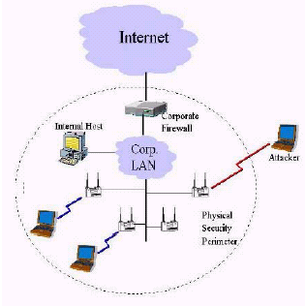
Is WLAN Secure ?
The Parking Lot attack
Man in the middle attack
Freely available tools like Air Snort, WEP crack to snoop into a WLAN

Slide 44
Basic Security Strategies
Block your Service Set Identifier (SSID) from being broadcast.
Change the default network name in the access point.
Change the default access point password.
Center the access point in the middle of the building/house.

Slide 45
Media Access Control (MAC) Filtering
Every network device has a unique MAC address
  Allocated by the manufacturer.
MAC Filtering only allows certain addresses access.
Mostly for home use.
  Tedious to implement on a large scale

Slide 46
Wired Equivalency Protocol (WEP)
Basic encryption technology.
  Uses an RC4 stream cipher.
    Pseudo-random bytes.
  Two versions: 64-bit and 128-bit versions.
Built into Wi-Fi certified equipment.
  Implemented at the MAC level.
Protects radio signal between device and access point.
  Does not protect data beyond the access point.
Uses static encryption keys.
  Easy to crack.
    Still better then nothing.

Slide 47
Wi-Fi Protected Access (WPA)
Designed to replace WEP.
  Firmware update.
  128-bit Temporal Key Integrity Protocol (TKIP) encryption.
    Uses a master key that is regularly changed.
  User authentication.
  Data Integrity.
Protects radio signal between device and access point.
Built into Wi-Fi certified equipment.
  Implemented at the MAC level.
Available in two versions:
  WPA2 Personal.
  WPA2 Enterprise.

Slide 48
Wi-Fi Protected Access 2 (WPA2)
Designed to replace WEP.
  128-bit Advanced Encryption Standard (AES).
Based on the IEEE 802.11i standard.
Provides government level security.
Also available in two versions:
  WPA2 Personal.
  WPA2 Enterprise.

Slide 49
Virtual Private Network (VPN)
Creates a secure virtual “tunnel” from remote device to VPN server.
  Creates an encryption scheme.
  Requires authentication.
Works across the internet.
Many types and levels of VPN technology.
  May include hardware and software components.
  Some very expensive.
  Windows provides a basic implementation in its server software.

Slide 50
Firewall
Can make the network or computer invisible to the internet.
Block unauthorized users.
Monitor and control flow of data to/from a network or computer.
Many types and levels of firewall technology.
  Hardware and software combinations
  Software only versions.
    ZoneAlarm
Many devices provide basic firewall capability.
  Gateways and access points.
    Network address translation.
  Windows XP operating system.

