Slide 1
MOBILE COMPUTING
SECURITY
Pertemuan 11
Dosen Pengampu: Hendry Gunawan S.Kom, MM
Prodi Sistem Informasi - Fakultas Ilmu Komputer

Slide 2
Mobile and Wireless Security
Various Security Risks
Traditional Security Issues
Mobile and Wireless Security Issues
Problems in Ad Hoc Networks
Additional Types of Attacks

Slide 3
Various Security Risks
  Physical Security
  Communications Security
  Emission Security (Electronic Signals)
  Computer Security
  Network Security
  Information Security

Slide 4
Traditional Security Issues
Integrity
Confidentiality
Nonrepudiation
Availability

Slide 5
Traditional Security Issues
Integrity
  System Integrity: perform its intended functions in an unimpaired manner, free from deliberate or inadvertent unauthorized manipulation of the system
  Data Integrity: the receiver of the data can verify that the data have not been modified; in addition, no one should be able to substitute fake data
  Integrity of Files and Information in transmission
Confidentiality
  Only intended recipient (s) can read the provided data
  Access mechanism protection or encryption
  Confidentiality of Files and Information in transmission
  Traffic flow confidentiality

Slide 6
Traditional Security Issues
Nonrepudiation
  The sender should not be able to falsely deny (i.e. repudiate) sending data
  Examples
Availability
  A third party with no access should not be able to block legitimate parties from using a resource
  Denial-of-Service Attacks (DoS)

Slide 7
Types of Attacks
Access Attacks
Modification Attacks
Denial-of-Service Attacks (DoS)
Repudiation Attacks

Slide 8
Types of Attacks
Access Attacks
  Snooping (looking through)
  Eavesdropping (listens)
  Interception (active)
Modification Attacks
  Changes
  Insertion
  Deletion

Slide 9
Types of Attacks
Denial-of-Service Attacks (DoS)
  Denial of access to information
  Denial of access to applications
  Denial of access to systems
  Denial of access to communications
Repudiation Attacks
  Masquerading
  Denying an event

Slide 10
DoS Attacks - Information
The Computer Emergency Response Team Coordination Center (CERT/CC) www.cert.org/advisories/, Denial of Services: http://www.cert.org/tech_tips/denial_of_service.html
SecurityFocus’s bugtraq, http://www.securityfocus.com/archive/1
SecuriTeam, http://www.securiteam.com/

Slide 11
DoS Attacks
Syn_flood, http://www.cert.org/advisories/CA-1996-21.html
  TCP SYNC Flooding and IP Spoofing Attacks
Smurf, http://www.cert.org/advisories/CA-1998-01.html
  Smurf IP Denial-of-Service Attacks
Ping_of_death, http://www.cert.org/advisories/CA-1996-26.html
  Denial-of-Service via ping
Teardrop, http://www.cert.org/advisories/CA-1997-28.html

Slide 12
Distributed DoS Attacks
Distributed Denial of Service (DDos) Attacks/Tools, http://staff.washington.edu/dittrich/misc/ddos/
“mstream” Distributed DoS, http://www.cert.org/incident_notes/IN-2000-05.html
Distributed DOS attack software, http://www.tenebril.com/src/spyware/distributed-dos-attack-software.php

Slide 13
Mobile and Wireless Security
Physical Security
Information Security
  Email
  Contact database
  Price lists
  Personal Information Manager
  Business plan, documents

Slide 14
Mobile and Wireless Security Issues
Physical Security
  Detectability
    RF signal
    Changing frequencies
    Use very directional antenna
    Use minimal power
  Resource Depletion/Exhaustion attack
    Shortens the lifespan of the battery, consumes all the power in a battery
    In Ad Hoc networks – attacks cause key routing nodes to fail, and leaving parts of the network unreachable

Slide 15
Mobile and Wireless Security Issues
Physical Intercept Problems
  Wireless/broadcast
  Mitigation:
    Directional antenna
    Low-power transmissions
    Frequency-hopping/spread spectrum technology
    Encryption techniques at higher layers

Slide 16
Mobile and Wireless Security Issues
Theft of Services
War Driving
  Wireless card running some detection software
  GPS
  Driving around: detect the presence of wireless networks, and GPS gives the location for later reference
References (detection software):
  http://www.netstumbler.com/
  http://www.kismetwireless.net/
  http://www.wardriving.com/

Slide 17
Mobile and Wireless Security Issues
War Walking
  Lightweight computer: PDA PocketPC, laptop
  Walking around
War Chalking (symbols)
  Open network
  Closed networks
  WEP (Wired Equivalent Privacy) password protected network

Slide 18
Problems in Ad Hoc Networks
Problems in Ad Hoc Networks
  Data pass through several other Ad Hoc networks
  Man in the middle attack to copy or corrupt data in transit
Routing (risks)
  Spoofing
    ARP Spoofing: request an address and pass data to impersonator
  ARP cache poisoning: actively corrupt data as it pass through
  Resource-exhaustion attack

Slide 19
Problems in Ad Hoc Networks
Key management
  Encryption and Authentication
  Creating, sharing, storing, encryption keys
Private key encryption (symmetric)
P – plaintext C - ciphertext
C = E_{k}(P) P = D_{k}(C)
Public key encryption (asymmetric)
    C = E_{private}(P) P = D_{public}(C)
    C = E_{public}(P) P=D_{private}( C )
Prekeying: not practical

Slide 20
Problems in Ad Hoc Networks
Reconfiguring
  Dynamic nature
  Topology changes over time
  Route may no longer work
Hostile Environment
  Unsecured physical locations (coffee shops, airports, etc)
  Ad Hoc networks of soldiers

Slide 21
Additional Types of Attacks
“Man in the Middle” Attacks
Traffic Analysis
Replay Attacks
  Reusing data in a packet observed by a malicious node
Buffer-Overflow Attacks
  Extra data cause the program to execute different code by changing variables values, program flow, or similar

Slide 22




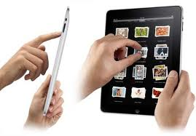
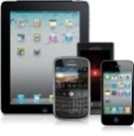


Uniqueness of Mobile…
Mobile devices are shared more often
Mobile devices have multiple personas
Mobile devices are diverse
Mobile devices are used in more locations
Mobile devices prioritize the user
.
Personal phones and tablets shared with family
Enterprise tablet shared with co-workers
Social norms of mobile apps vs. file systems
Work tool
Entertainment device
Personal organization
Security profile per persona?
OS immaturity for enterprise mgmt
BYOD dictates multiple OSs
Vendor / carrier control dictates multiple OS versions
A single location could offer public, private, and cell connections
Anywhere, anytime
Increasing reliance on enterprise WiFi
Conflicts with user experience not tolerated
OS architecture puts the user in control
Difficult to enforce policy, app lists
“Why would anyone want to limit the iPhone?”
Notes:
Of course these are all facts we inherently know about our smartphones and tablets, but lets consider what they mean in context of enterprise security and management.
Certainly BYOD devices are likely to be shared with family members and friends, explicitly or implicity adopting multiple personas. This means BYOD users are even more resistant to strong device access passwords and will have a wide-variety of apps downloaded. Corporate apps and data must be protected from accidental corruption and unauthorized access
While many organizations were all, or nearly all, Microsoft Windows shops when it came to their desktops and laptops, the mobile device revolution has forced IT departments to deal with a much wider variety of operating systems, OS capabilities, management capabilities, and network access support.
Finally, perhaps the most critical factor is that today's most commonly used mobile operating systems prioritize the end user experience, putting the user in complete control over that device. This prevents enterprise IT shops from performing many of the functions they would like to do - silent install of apps, preventing users from removing security controls, forcibly un-installing apps regardless of where they came from - even on enterprise-owned devices. Often work-arounds such as alerting and disabling of corporate access is needed to enforce policy.
And the solutions to these challenges will vary depending on who owns the device and what it's being used for.
22

Slide 23

Mobile Presents Management and Security Challenges
1 in 20 Mobile devices stolen in 2010
155% by which mobile malware increased 2011
70% of Mobile device
spam is fraudulent
financial services
77% growth in Google Android malware from Jun 2010 to Jan 2011
350% by which WiFi
hotspots are set to increase by
2015, providing more opportunities
for “man-in-the middle” attacks
10 Billion Android app downloads reached by
the end of 2011 – over 90%
of the top 100 have been hacked
Source: Evans Data Mobile Developer Survey Mobile Development Report 2012 Volume
Source: Business Insider (September 2012)
Notes:
Twice as appealing to hackers – both corporate and personal data

Slide 24
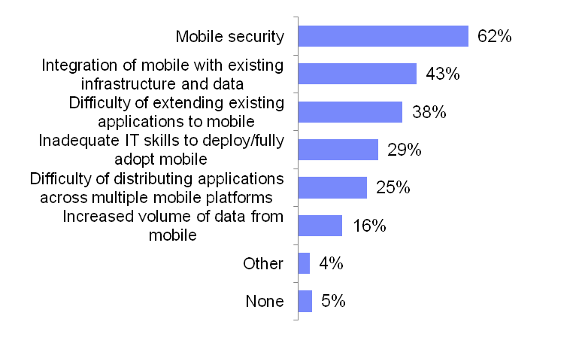
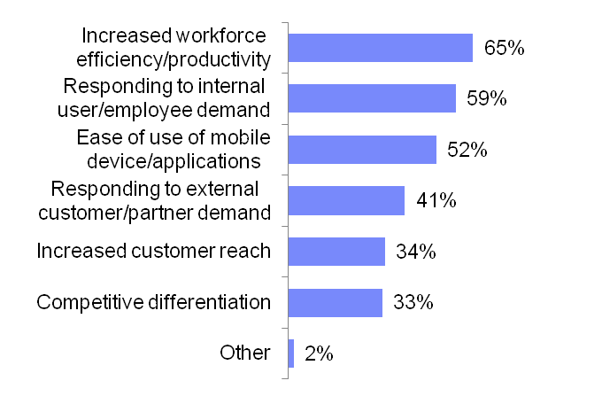
Security is the leading barrier to mobile adoption
Drivers for Adopting Mobile
Barriers to Adopting Mobile
Base: Those who deployed/piloted/plan to adopt mobile, excluding don’t know (n=1117)
Base: Those who deployed/piloted/plan to adopt mobile, excluding don’t know (n=1115)
24
October 2012
2012 Tech Trends Report (Weighted by GMV – IBM Proprietary) | IBM Market Insights | IBM Confidential
Notes:
According to IBM Market Insights team who commissioned a Tech Trends Report October 2012 - increasing workforce efficiency and productivity is the top driver for adopting mobile, but security is the leading barrier and inhibitor for mobile adoption
The leading security concern for mobile is the handling of confidential data. Around one-half are concerned about identity and access management and vulnerability to virus and malware.
IT is more concerned about identity and access management, insufficient policy/governance/compliance, support for fragmented mobile standards/platforms, and unmanaged roll outs of service packs/updates.
24
Drivers for Adopting Mobile Computing
Q. What drives your organization to adopt Mobile Computing? Please check all that apply.
Barriers to Adopting Mobile Computing
Q. What are the major barriers to adopting Mobile Computing in your organization? Please select up to three.

Slide 25
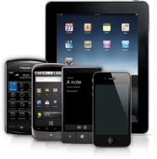




Mobile Security Challenges Faced By Enterprises
Achieving Data Separation & Providing Data Protection
  Personal vs corporate
  Data leakage into and out of the enterprise
  Partial wipe vs. device wipe vs legally defensible wipe
  Data policies
  Multiple device platforms and variants
  Multiple providers
  Managed devices (B2E)
  Unmanaged devices (B2B,B2E, B2C)
  Endpoint policies
  Threat protection
Adapting to the BYOD/
Consumerization of IT Trend
Providing secure access to enterprise applications & data
  Identity of user and devices
  Authentication, Authorization and Federation
  User policies
  Secure Connectivity
I n t e r r e l a t e d
Developing Secure Applications
  Application life-cycle
  Static & Dynamic analysis
  Call and data flow analysis
  Application policies
Designing & Instituting an Adaptive Security Posture
  Policy Management: Location, Geo, Roles, Response, Time policies
  Security Intelligence
  Reporting
Notes:
There is a broad spectrum of security challenges from managing the data, the application, to the device. Many of the challenges are interrelated. For example, you can’t secure mobile application data unless you develop a secure application.
Mobile application security must be able to detect security risks and vulnerabilities by understanding how data enters an application and where it goes. By understanding data and call flow information inside an application, developers can better ensure that when data leaves the application it is appropriately secured.
According to ComScore 88% of mobile interaction occurs via a mobile application while 12% is mobile browser only. The applications must be doing something on the device.
“Designing & Instituting an Adaptive Security Posture” is a focus for more mature customers. These customers understand they need a more proactive approach to security mobile computing.

Slide 26










Visualizing Mobile Security
WiFi
Mobile apps
Develop, test and deliver safe applications
Web sites
Internet
Secure endpoint device and data
Telecom Provider
Security Gateway
Corporate Intranet & Systems
Achieve Visibility and Enable Adaptive Security Posture
Secure access to enterprise applications and data
Notes:
Here‘s how IBM visualizes mobile security. There are really three points of control.
On the left you have device security, protecting both the device and the data.
On the top right you have mobile application security which includes secure application development and analyzing applications for security risk. Note the reference to web sites; you also need to protect the server-side web-based application.
The bottom right highlights the need for to provide secure access to applications and data.
They are all interlinked and interconnected.
To achieve visibility and enable an adaptive security posture you need security intelligence. For example, if you see an incorrect login attempt for a mobile device 50 time, you might choose to lock down the device.

Slide 27
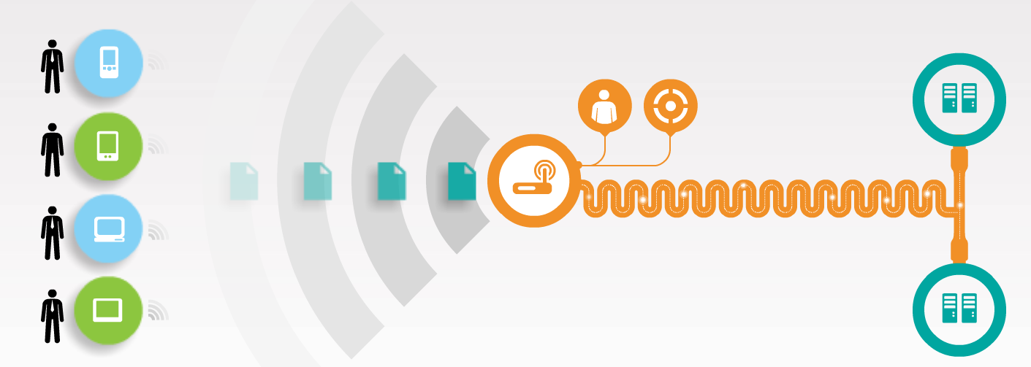
Addressing Security Imperatives and Challenges?
Device Management
and Security
Network and Data Management and Security
Application Management
and Security
How do I handle BYOD and ensure compliance for new devices?
How do I protect the corporation from data leakage and intrusions?
How do I secure, control and service applications?
Multiple device platforms and variants
Managed devices (B2E)
Data separation and protection
Threat protection
Identity management and mobile entitlements
Policy management and enforcement
Secure connectivity
Security intelligence and reporting
Application lifecycle and performance
Vulnerability and penetration testing
Policy management: location, geo, roles, response, time policies
Notes:
IBM IOD 2012
12/9/2017
27

Slide 28





Thinking Through Mobile Management and Security
Management and safe use of smartphones and tablets in the enterprise
Secure access to corporate data and supporting privacy
Visibility and security of enterprise mobile platform
IBM Mobile Management and Security Strategy
At the Device
On the Network
For the Mobile App
Enroll
Register owner and services
Configure
Set appropriate security policies
Monitor and Manage
Ensure device compliance and mange Telecom expenses
Reconfigure
Add new policies over-the-air
De-provision
Remove services and wipe
Authenticate
Properly identify mobile users
Encrypt
Secure network connectivity
Monitor and Manage
Log network access and events manage network performance
Control
Allow or deny access to apps
Block
Identify and stop mobile threats
Develop
Utilize secure coding practices
Test
Identify application vulnerabilities
Monitor and Manage
Correlate unauthorized activity and Manage app performance
Protect
Defend against application attacks
Update
Patch old or vulnerable apps
Internet
Corporate Intranet

Slide 29

Getting Started with Mobile Security Solutions…
What are your operational priorities?
Business Need:
Protect Data & Applications on the Device
Prevent Loss or Leakage of Enterprise Data
  Wipe
  Local Data Encryption
Protect Access to the Device
  Device lock
Mitigate exposure to vulnerabilities
  Anti-malware
  Push updates
  Detect jailbreak
  Detect non-compliance
Protect Access to Apps
  App disable
  User authentication
Enforce Corporate Policies
Business Need:
Protect Enterprise Systems & Deliver Secure Access
Provide secure access to enterprise systems
  VPN
Prevent unauthorized access to enterprise systems
  Identity
  Certificate management
  Authentication
  Authorization
  Audit
Protect users from Internet borne threats
  Threat protection
Enforce Corporate Policies
  Anomaly Detection
  Security challenges for access to sensitive data
Business Need:
Build, Test and Run Secure Mobile Apps
Enforce Corporate Development Best Practices
  Development tools enforcing security policies
Testing mobile apps for exposure to threats
  Penetration Testing
  Vulnerability Testing
Provide Offline Access
  Encrypted Local Storage of Credentials
Deliver mobile apps securely
  Enterprise App Store
Prevent usage of compromised apps
  Detect and disable compromised apps
Notes:
Reference:
http://www.nfl.com/qs/ipadplaybook/index.jsp?module=HP11_cp&utm_source=loopinsight.com&utm_medium=referral&utm_campaign=Feed%3A+loopinsight%2FKqJb+%28The+Loop%29
Where you start is based on your operational priorities.
In our previous example we talked about the NFL using an iPad for team playbooks. The NFL teams who developed these apps wanted to start with security on the device and mobile device management. They were concerned about players losing their iPads. They were concerned about what happened after players got cut or traded. They required a way to Wipe the playbook.
A bank or financial services company may choose to start on the right. They cannot control or manage consumer devices, however this doesn‘t obviate the need to develop secure mobile applications. These organizations need to ensure no corporate or personal data is “leaked“. They can enforce and control secure mobile application development best practices.
In almost almost allmost scenarios providing secure access is a requirement.

Slide 30
Android Security Architecture
Security goals
Protect user data
Protect system resources (hardware, software)
Provide application isolation
Foundations of Android Security
Application Isolation and Permission Requirement
Mandatory application sandbox for all applications
Secure inter-process communication
System-built and user-defined permissions
Application signing

Slide 31
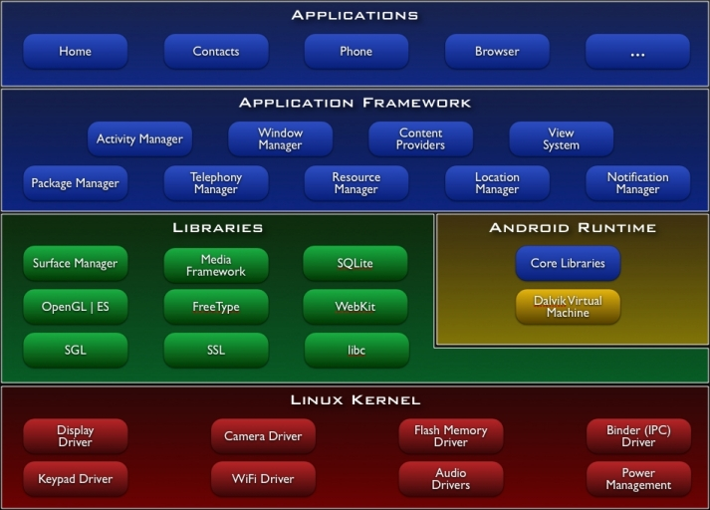

Slide 32
Android software stack
Each component assumes that the components below are properly secured.
All code above the Linux Kernel is restricted by the Application Sandbox
Linux kernel is responsible sandboxing application
  “mutually distrusting principals”
  Default access to only its own data
The app Sandbox apps can talk to other apps only via Intents (message) , IPC, and ContentProviders
To escape sandbox, permissions is needed

Slide 33
Security at the Linux kernel
A user-based permissions model
Process isolation: Each application has its sandbox based on separation of processes: to protect user resources from each another; each runs in its own Linux process to secure Inter-Process communication (IPC)
Ex:
Prevents user A from reading user B's files
Ensures that user A does not access user B's CPU, memory resources
Ensures that user A does not access user B's devices (e.g. telephony, GPS, Bluetooth)

Slide 34
Application Sandbox
The Android system assigns a unique user ID (UID) to each Android application and runs it as that user in a separate process.
When launching a new Activity, the new process isn’t going to run as the launcher but with its own identity with the permission specified by the developer.
The developer of that application has ensured that it will not do anything the phone’s user didn’t intend. Any program can ask Activity Manager to launch almost any other application, which runs with that application’s UID.
Ex. application A is not allowed to do something malicious like to read application B's data or dial the phone without permission.
All libraries, application runtime, and all applications run within the Application Sandbox in the kernel.

Slide 35
Permissions and Encryption
Permissions
In Android, each application runs as its own user. Unless the developer explicitly exposes files to other applications, files created by one application cannot be read or altered by another application.
Password Protection
Android can require a user-supplied password prior to providing access to a device. In addition to preventing unauthorized use of the device, this password protects the cryptographic key for full file system encryption.

Slide 36
Encryption
Encryption
Android 3.0+ provides full filesystem encryption, so all user data can be encrypted in the kernel
For a lost or stolen device, full filesystem encryption on Android devices uses the device password to protect the encryption key, so modifying the bootloader or operating system is not sufficient to access user data without the user’s device password.

