Slide 1
DEVELOPMENT OF THE
MARKET OF RESOURCES
PERTEMUAN 11
AGUNG MULYO WIDODO
TEKNIK INFORMATIKA

Slide 2
KEMAMPUAN AKHIR YANG DIHARAPKAN
Technological Support for the Market of Resources: E-Marketplace Software Platform Providers
How Does the Available Technology Support the Functionalities of the Market of Resources?
Developing a Prototype for the Market of Resources
Notes:
a

Slide 3
REFERENSI
Mehandjiev N, Grefen P.(Eds), “Dynamic Busisness Process Formation for Instant Virtual Enterprises” Springer,Verlag-Limited London, 2010.
Wolf C., Halter E.M,”Virtualization from the Desktop to The Eterprises”, Springer,Verlag-Limited London, 2005.
CunhaCruz M.M, Putnik G.D,” Agile Virtual Enterprise”, Idea Group Inc., 2006.
Protogeros N.,”Agent and Web Service Technologies in Virtual Enterprises”, IGI Global 2008.

Slide 4
Technological Support for the Market of Resources: E-Marketplace Software Platform Providers

Slide 5
We have selected four leading forerunner vendors (Ariba, Broadvision, Commerce One and i2 Technologies) and two emerging e-marketplace software platform from soft- ware giants (Microsoft and Oracle), to be analysed from their ability to support some of the Market of Resources’ functionalitie

Slide 6
ARIBA
Ariba (http://www.ariba.com) has set the standard for Internet-based user interface and workflow solutions for buy-side e-commerce.
Ariba offers a suite of solutions to help companies manage spending, so that expenses fall faster than revenues in down times, and grow more slowly than revenues in up times. Ariba Spend Management Solutions significantly improves the bottom line results of a business.
Since its founding in 1996, Ariba has remained at the forefront of the Internet evolution, providing easy-to-implement, robust online commerce solutions for proven cost savings and return on investment. Ariba now leads the Enterprise Spend Management (ESM) market. Enterprise Spend Management is a new class of solutions that focus on delivering a closed loop of control and leverage over a company’s spend, including assessing spending activities, conducting effective sourcing and capturing and reconciling spend enterprise-wide. The Ariba Spend Management Suite provides a single point of visibility and control allowing companies to engage, manage, and leverage the entire spend lifecycle from analysis, through sourcing, to procurement across the enterprise, while providing systematic measurement, tracking and reporting of best practices. Ariba also runs a public e-marketplace, the Ariba Supplier Network.

Slide 7
BROADVISION
Broadvision (http://www.broadvision.com) provides an array of business solutions from content management to enterprise business portal applications. BroadVision is the leading provider of portal software to Fortune 500 companies; they use BroadVision to power their enterprise business portal initiatives leveraging the Web and wireless devices to unify and extend their enterprise applications, information and business processes, to collaborate with over 50 million users. BroadVision’s customer base represents a broad spectrum of organizations, including British Telecom, The Boeing Company, E*Trade, Ericsson, FleetBoston Financial, General Electric Supply, Home Depot, Rockwell Automation, Sears, State of California, Renault, Toyota and Vodafone .

Slide 8
COMMERCE ONE
Commerce One (http://www.commerceone.com) is one of the world’s leading providers of solutions that connect and optimise the interactions between buyers and suppliers. They streamline sourcing and procurement to reduce both costs and time-to-market. And they offer enterprises heightened control over, and visibility into, their entire purchasing process from source to pay. Since 1996, Commerce One has been helping the world’s leading companies — Boeing, Deutsche Telekom, General Motors, Daimler Chrysler, and others drive costs out of their sourcing and procurement processes. Initially focusing on the supply chain, where customer demand is greatest, Commerce One solutions utilize Web services technology to streamline the sourcing and procurement process, and make the supply chain more flexible. Commerce One solutions have been implemented in more than 550 customers worldwide, supporting complex requirements for industries such as automotive, utilities/energy, healthcare, metals and mining, aerospace, and consumer packaged goods. Commerce One runs CommerceOne.Net (http://www.commerceone.net), a focused market- place serving the North American MRO market.

Slide 9
i2 Technologies
i2 Technologies (http://www.i2.com) offers several package applications for e- business and supply/demand chain management, which they call Value Chain Management. i2 Technologies is a leading provider of supply chain manage- ment solutions. i2’s supply chain management solutions help companies plan and execute the activities involved in managing supply and demand. These solutions span the entire scope of supply chain interactions, including supplier relationship management, supply chain management and demand chain management. They have prominent customers in all main industries, such as Continental, Daimler Chrysler, Dell, Ford, Philips, Samsung, and Volkswagen.

Slide 10
MICROSOFT
Microsoft (http://www.microsoft.com), far the major software company, is also providing solutions for the e-business market. Nowadays, Microsoft is a leading enabler of business-to-business e-commerce (e.g., over 50% of the Forbes B2B
200 run Microsoft) with offerings ranging from e-procurement and supplier enablement to e-marketplace and supply chain solutions with various platform partners (Commerce One, SAP, Clarus, Ariba, Manugistics, etc.). The MS Commerce Server 2002 is the Microsoft’s weapon for conquer a place in the e-marketplaces platform battlefield.

Slide 11
ORACLE CORPORATION
Oracle Corporation (http://www.oracle.com) is the world’s largest enterprise software company. Oracle offers its database, tools and application products, along with related consulting, education, and support services. Oracle has developed and deployed 100 percent Internet-enabled enterprise software across its entire product line: database, server, enterprise business applications, application development, and decision support tools. Oracle is capable of implementing complete global e-business solutions that extend from front office customer relationship management to back office operational applications to platform infrastructure. At present, over 35 active e-marketplaces were built on Oracle Exchange Technology. Examples are Sears and Carrefour, and Auto- Xchange supported by Ford Motor Company. Oracle, like Ariba or Commerce One, developed its own e-marketplaces, Oracle Exchange Services, on its technology.

Slide 12
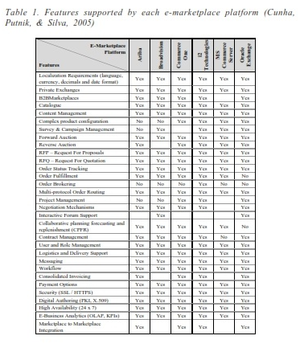

Slide 13
How Does the Available Technology Support the Functionalities of the Market of Resources?

Slide 14
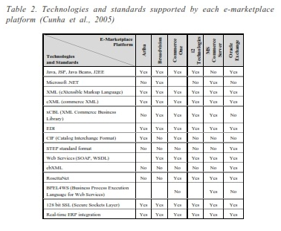

Slide 15
Developing a Prototype for the
Market of Resources

Slide 16
The prototype of the Market of Resources, based on the data architecture developed for the Market (IDEF1x Diagrams), intends:
To show how some of the operations of A/VE creation/reconfiguration take place in the Market of Resources, and
To enable the estimation of the amount of time required to perform some operations, to be used as constants in the cost and effort models.

Slide 17
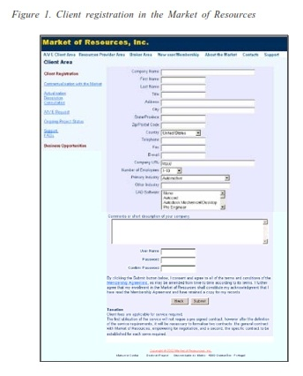
Client Registration

Slide 18
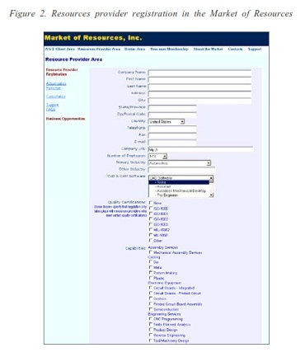
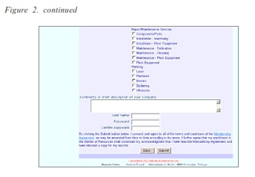
Resources Provider Registration

Slide 19
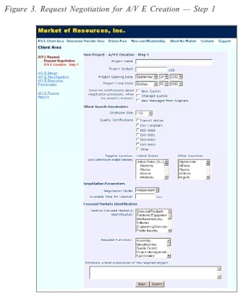
Client Request for A/VE Creation

Slide 20
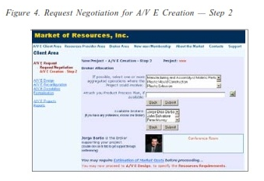
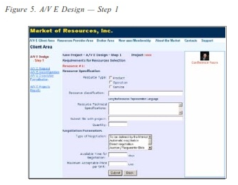
Client Request for A/VE Creation (Contd..)

Slide 21
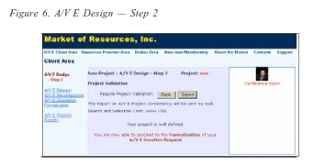
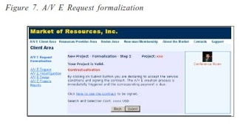
Client Request for A/VE Creation (Contd..)

Slide 22
Client Request for A/VE Creation (Contd..)

Slide 23
THANK YOU

