Slide 1
PERFORMANCE ANALYSIS
PERTEMUAN 12
AGUNG MULYO WIDODO
TEKNIK INFORMATIKA

Slide 2
KEMAMPUAN AKHIR YANG DIHARAPKAN
The Cost-and-Effort Analysis
Market of Resources Versus Traditional Internet-Based Search and Selection: Determination of Time Constants
Notes:
a

Slide 3
REFERENSI
Mehandjiev N, Grefen P.(Eds), “Dynamic Busisness Process Formation for Instant Virtual Enterprises” Springer,Verlag-Limited London, 2010.
Wolf C., Halter E.M,”Virtualization from the Desktop to The Eterprises”, Springer,Verlag-Limited London, 2005.
CunhaCruz M.M, Putnik G.D,” Agile Virtual Enterprise”, Idea Group Inc., 2006.
Protogeros N.,”Agent and Web Service Technologies in Virtual Enterprises”, IGI Global 2008.

Slide 4
The Cost-and-Effort Analysis

Slide 5
This section explains the cost-and-effort analysis, based on the two cost-and-effort models previously developed and presents a situation (a case) of a project to create an A/VE, which is used to apply the cost-and-effort models. This situation or case is used: (1) to identify some of the time constants to use in the cost-and-effort model of the Market of Resources, based on the prototype already presented, and (2) to identify some of the time constants to use in the cost-and-effort model of the Internet-based traditional tools.

Slide 6
Main Activities in Agile/Virtual Enterprise Integration
In Table 1 we compare the main activities and sub-activities associated with search and selection of basic/complex resources, conducing to search and contracting costs, under both methods.
Search costs correspond to the first two activities (A/VE Request and Resources Search and Selection) and contracting costs to the third (A/VE Integration)

Slide 7
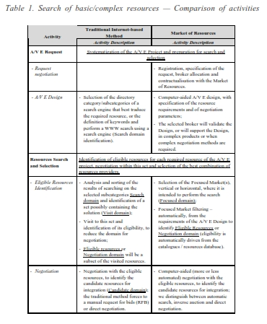
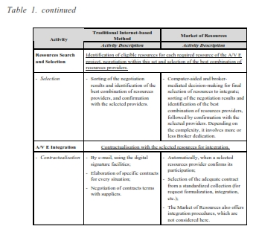

Slide 8
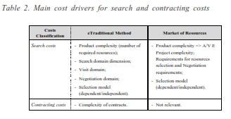
Cost Drivers
A cost driver is a transaction that determines the amount of work and consequently the cost of an activity.
When calculating the cost of an activity, several cost drivers can be used.

Slide 9
To simplify, it is considered that the A/VE complexity (which is a not a quantifiable cost driver) corresponds to the number of required resources for integration (K), and also that this number is small, to avoid the introduction of a complexity factor.
Cost drivers impact differently the A/VE integration performance. The main variables to be considered in the model are:
Product complexity (and consequently project complexity), corresponding to the number of required resources for integration (K).
The Search Domain dimension (SD) (i.e., the number of potential resources providers where the first step of the search is to take place); to simplify, we assume that the Search Domain dimension in the Market of Resources (designated Focused Domain (FD) dimension), for the same situation, is 20% of Search Domain dimension using the eTraditional way.
The dimension of subsequent domains, Visit Domain (VD), Negotiation Domain (ND), etc., will result from the application of a ratio to the previous.

Slide 10
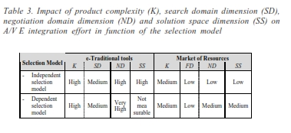
If we consider as main cost drivers: (1) the product complexity (traduced by the number of required resources) — K —; (2) the search domain dimension — SD or FD —, (3) the negotiation domain dimension — ND —, and (4) the solution space dimension — SS —, and their expected impact on e-traditional or market-based A/VE integration performance, in function of the selection model, is presented in Table 3.

Slide 11
The Cost-and-Effort Models
To make easier the application of the cost and effort models, we have tried to use the same designation for the variables common to both cost models, which are distinguished by an index T or M whether belonging to the e-traditional’s or to the Market’s cost model. These variables and corresponding abbreviations are listed in Table 4.

Slide 12
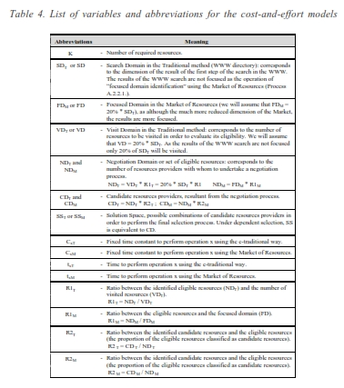

Slide 13
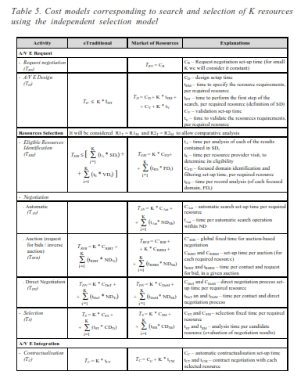

Slide 14
The difference between searching basic or complex resources relies on the value of some constants (time to perform some of the operations), namely A/VE design time and negotiation time, but we feel that most of it relies on the dimension of search domains and on the ratios R1 and R2. The complexity of the required resources affects the dimension of the search domain and focused domain dimension; the tightening of the negotiation requirements (traduced by the defined ratios) determines the negotiation domain dimension and the number of candidate resources.
Both cost and effort models corresponding to search and selection of K resources using dependent selection model are presented in Table 6.

Slide 15
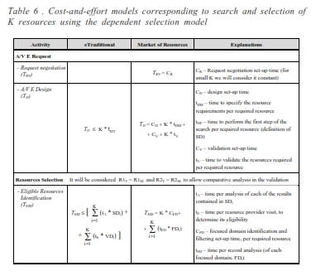

Slide 16
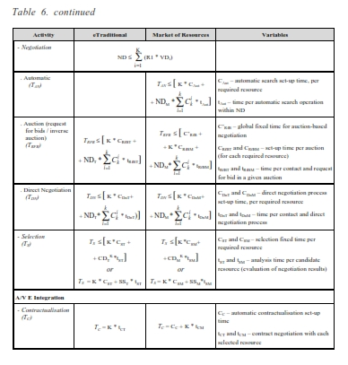

Slide 17
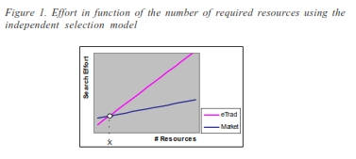
Expected Results
We feel that, independently of the Search Domain dimension, the relation between the A/VE complexity (traduced by the number of required re- sources) and the effort (and hence the cost) of integrating an A/VE, following an independent selection model using the Market and using the traditional Internet-based method, follows a representation similar to the one represented in Figure 1

Slide 18
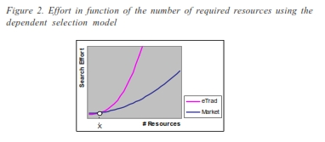
When following a dependent selection model, it is expected that, independently of the Solution Space dimension, the effort using the Market and the traditional method, may have a representation similar to the one of Figure 2.

Slide 19
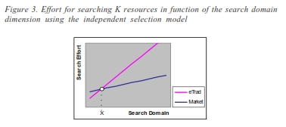
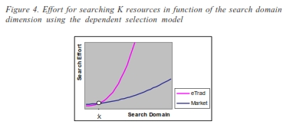
In Figure 3 and Figure 4 it is represented as the effort of searching a given number of resources, in function of the Search Domain dimension, for the independent and dependent selection models respectively.

Slide 20
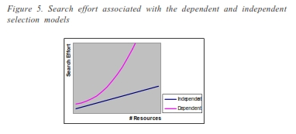
The objective of the cost-and-effort analysis is to identify the X point (decision point) in terms of A/VE complexity (Figure 1 and Figure 2) and in terms of the Search Domain and Focused Domain dimension (Figure 3 and Figure 4).
The relation between the effort of using the independent and the dependent model is supposed to follow the curves represented in Figure 5, both for the traditional Internet-based tools and for the Market of Resources.

Slide 21
Objective of Reconfigurability Dynamics Analysis
Given the costs of evaluating the need to reconfigure the A/VE and given the complexity of the process of selection and integration, in many cases the reconfiguration is overtaken, with sacrifice of the A/VE performance, the reason for the fact that dynamics is not as high as it should be expected (ideal reconfigurability dynamics is not achieved) and that partnerships do not achieve as high of performances as should be expected, unless there exists an environ- ment to support dynamic reconfiguration and integration.
Reconfiguration implies technical and behavioral adaptation inside the resources provider, besides the organizational aspect of preparing the integration.
Reconfiguration cannot happen instantaneously after the resources selection and formalization of the integration in the A/VE. Besides the time-intensive operations of search, negotiation, selection and contractualisation, integration procedures need to be set, human resources need to be adapted to the new environment, machines need set up, etc., and this would require extra time.

Slide 22
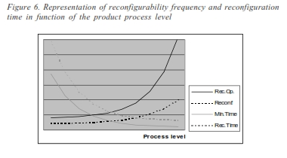
The minimum required reconfiguration time is given by the line “Min.Time” in
Figure 6, and is inversely proportional to the product (resource) process level. One of the objectives of the Market of Resources is to allow the line of the real
reconfigurability dynamics (represented by “Reconf” line in Figure 6) to remain
as close as possible to the line of reconfigurability opportunities or optimal reconfigurability (represented by “Rec.Op.” line), which means, to assure that the required time to perform the reconfiguration (represented by “Rec.Time” line) can decrease until its minimum (“Min.Time”).

Slide 23
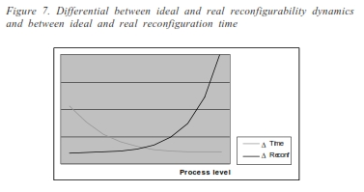
We are imagining that both the differential between: (1) ideal and real reconfigurability dynamics in function of the product process level, and (2) ideal and real reconfiguration time in function of the product process level, to have a behavior similar to the representation of Figure 7.

Slide 24
THANK YOU

