Slide 1
PERFORMANCE ANALYSIS (Lanjt..)
PERTEMUAN 13
AGUNG MULYO WIDODO
TEKNIK INFORMATIKA

Slide 2
KEMAMPUAN AKHIR YANG DIHARAPKAN
The Cost-and-Effort Analysis
Market of Resources Versus Traditional Internet-Based Search and Selection: Determination of Time Constants
Notes:
a

Slide 3
REFERENSI
Mehandjiev N, Grefen P.(Eds), “Dynamic Busisness Process Formation for Instant Virtual Enterprises” Springer,Verlag-Limited London, 2010.
Wolf C., Halter E.M,”Virtualization from the Desktop to The Eterprises”, Springer,Verlag-Limited London, 2005.
CunhaCruz M.M, Putnik G.D,” Agile Virtual Enterprise”, Idea Group Inc., 2006.
Protogeros N.,”Agent and Web Service Technologies in Virtual Enterprises”, IGI Global 2008.

Slide 4
Market of Resources Versus Traditional Internet-Based Search and Selection: Determination of Time Constants

Slide 5
The Case to Support the Validation
In this section we outline a hypothetical situation of creating an A/VE to produce intelligent automatic soap dispensers to install in public lavatories. The situation was used to prepare the analytical simulations as follows:
Via the traditional Internet-based tools, WWW searches were performed in order to get information about the number of potential providers of some parts of the project and visit to some of these, followed by simulation of negotiation and selection effort, until integration, using the cost and effort model. We have also tried the search for some resources on an industry directory, Global Sources (http://www.globalsources.com).
Via the Market of Resources, the time to present the A/VE Request, to specify some of the required resources, to design the corresponding A/VE and to the validation by the broker was obtained using the prototype interfaces. Subsequent operations were simulated using the cost-and- effort model.

Slide 6
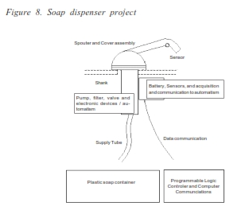
Supposing that we are in the role of the A/VE owner, we have the product project (a CAD drawing file) and the specification of all components and operations required. A simple draft of the project is given in Figure 8.

Slide 7
Each eligible resources provider receives the part of the project and specifications (materials and/or operations) corresponding to the resources under their scope of activity.
Soap dispensers are mounted in all the lavatories and share a common soap container. Each dispenser automatically detects the presence of hands and dispenses a portion of soap.
We present as example, some technical specifications (materials) to be provided to eligible resources providers, when defining the requirements for resources selection (if using the Market of Resources).
Product Technical Specifications - Materials:
Spout and Cover — stainless steel with bright polished finish.
Body and Shank — high-impact resistant ABS recipient with the maximum of 50mm diameter or side, and 100 mm long, where filter, pump, valve and other mechanical devices must be installed.
Pump — Stainless steel inside ABS Cylinder; corrosion-resistant to most soaps and detergents.
Flexible Hose (supply tube) — 15 mm diameter, black, flexible PVC.
Soap Container — Multi-lavatory soap reservoir in resistant PVC, with capacity for 4 litres of soap. A visible indicator of capacity should be provided.

Slide 8
We identify values for some of the variables of our cost and effort models. Variables as time to perform operations and set-up times must be transformed in time constants, while the variables of the models should only be the dimension of domains where each operation takes place (Search Domain dimension, Negotiation Domain dimension, Solution Space dimension, etc.).
Concerning the traditional Internet-based way, we have performed exhaustive searches (using WWW search engines or directories), for some of the required resources corresponding to the soap dispenser project, trying to identify the time to select between the list of solutions obtained from a search engine or a WWW directory, time to visit these and evaluating their eligibility for negotiation.

Slide 9
Using the Market of Resources, the objective consists of performing the firsts steps (A/VE Request and A/VE Design), which are the most (human) effort consuming, based on the physical demonstrator. We assume that the user is familiarized with the interfacing with the Market of Resources and that it is already a member of the Market of Resources (to overtake the registration activity) and that he is able at specifying what he wants using a given resources representation language, whatever its interfacing implementation.
We will suppose that the difference between searching basic or complex resources relies essentially on the solution space size, more than on the time to perform elementary operations of search, negotiation, etc.

Slide 10
Using of the Traditional Internet-Based Way
In order to identify the Search Domain size and the time to visit potential providers, for some resources required for the soap dispenser project presented previously, we decided to use:
A WWW directory (Yahoo2)
A search engine (Google3) and
An e-marketplace (Global Sources4) for industrial products search.
The selection of Yahoo and Google is due, in the case of Yahoo to its recognized richness of contents, and in the case of Google (which is a partner of Yahoo) because after some tests (with AltaVista, HotBot, etc.), it was the search engine offering a larger number of results.

Slide 11
It is important to notice two aspects when using electronic marketplaces: first, we must select an adequate e-marketplace for each resource search (e.g., electronic components) and second, there exist many e-marketplaces for products but very few for operations or functions (e.g., design, plastic injection molding). This is why we consider the traditional method of limited utilization and have decided to use World Wide Web searches instead of e-marketplaces, in the identification of time constants for the cost and effort model
The resources used in the experience were: infrared sensors for the soap dispenser and production of the mold to be used in the plastic container manufacturing.

Slide 12
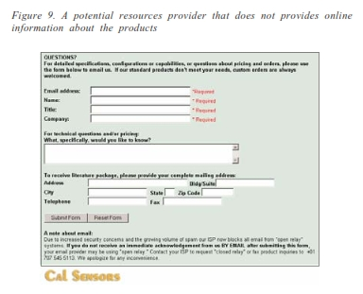
A limitation of the traditional way
A limitation of the traditional way is the impossibility that sometimes happens when deciding about resource providers’ eligibility, after losing time in visiting them. This situation happens when it is not found information available online concerning the resource we are looking for (see Figure 9 for example)

Slide 13
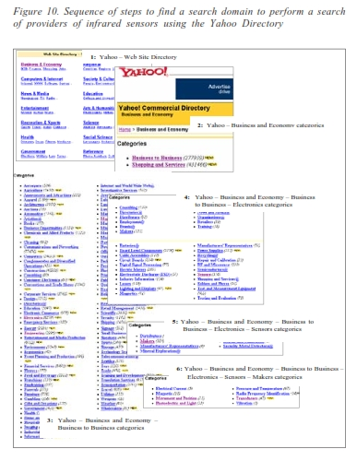
Search for Infrared Sensors Manufacturers Using Yahoo
In Figure 10 it is presented an example of using the Yahoo Directory to identify the Search Domain to start the search of providers of infrared sensors, from the Web Site Directory (Step 1) until the selection of types of sensors (Step 6).

Slide 14
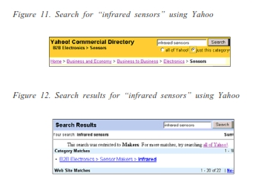
Search for Infrared Sensors Manufacturers Using Yahoo (Contd..)
In Step 5 or 6, we could have performed a search with keywords (Figure 11) instead of selecting a sensor type. The obtained search domain dimension would be 22 (Figure 12).

Slide 15
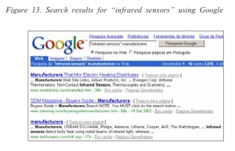
Search for Infrared Sensors Manufacturers Using Google
The difficulty in using a search engine concerns the high number of results obtained, requiring deeper and deeper search conditions. The first iteration produced 2,010 results, as shown in Figure 13

Slide 16
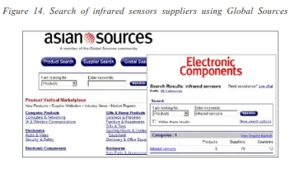
Search for Infrared Sensors Manufacturers Using Global Sources
This e-marketplace has a special category for electronic components and produced as result (Figure 14) six products and a short description and contact of 78 potential suppliers (Search Domain dimension) of the six products.

Slide 17
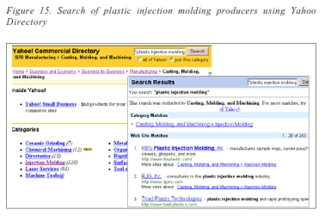
Search for Infrared Sensors Manufacturers Using Global Sources (Contd…)
Without major effort, the Yahoo Directory gives a search domain of 243 potential providers of the service of producing injection moulds (Figure 15)

Slide 18
Using the Market of Resources
The estimation of time constants when using the Market of Resources was the result of several experiments in the definition of requirements for resources selection, using the prototype for the A/VE Request activity, considering the specification of all resources requirements and negotiation parameters definition, the attachment of specifications and drawings when applicable.
Time Estimation
From the experiences performed, we are able to estimate values for the time variables of the A/VE Request activity for both models, to be used as constants in the analytical simulations. The time associated with the other activities (Resources Selection and A/VE Integration) was only estimated, as there is no support for its measurement in the Market of Resources (the Physical Parameter does not yet include these activities), nor have we undertaken any negotiation or contractualisation activity within the experiences using the traditional Internet- based tools.

Slide 19
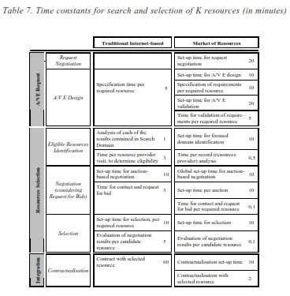
Time Estimation
In the case of the Market of Resources, the estimated values can be considered overestimated, especially when considering simple projects (low complexity), with a small number of required resources (2 or 3 resources). The values of these constants are presented in Table 7, expressed in minutes.

Slide 20
Comparative Study on Performance
The objective of this section is to identify the circumstances where the Market of Resources gives more efficient results and to verify if the Market is able to offer the opportunity for increased dynamics.
The Market of Resources can contribute to longer supply chains and to increase dynamics, but we are conscientious that coordination costs would also increase, and hence, a deep cost benefits analysis, for should be required for each situation.
As the benefits of using the Market of Resources instead of subcontracting in the traditional Internet-based way in the market do not disappear, by the contrary, we think they will increase, we intend only to analyze and compare the common costs between the Market of Resources and the traditional Internet-based way.

Slide 21
Comparative Study on Performance ( Contd…)
We present the simulation results for the search and selection time and cost, using independent and dependent selection methods, for different dimensions of Search and Focused Domains and different values of K.
Some previous considerations:
The user of the traditional way can decide the dimension of the set of resources for visiting (VD); we considered this set to be 20% of the Search Domain (SD), but according to SD quality, he can reduce or increase this percentage.
We are assuming that the Focused Domain dimension is 20% of the World Wide Web Directory search results (search domain). This way, Visit Domain dimension (VD) equals the Focused Domain dimension (FD) and comparisons will be possible.
The cost of User time is 1 Cost Unit (CU) per minute. Our model does not consider subscription taxes, fees, etc., but considers that the Market of Resources cost is 3 CU per minute (includes the Broker cost, and is calculated on the basis of Broker utilization time).
The negotiation method used in both situations (e-traditional way and market of resources) is request for bids.

Slide 22
Comparative Study on Performance ( Contd…)
The comparative study on performance is made based on time and on cost. Even if in certain situations a Market of Resources solution can present higher cost when compared with the e-traditional way cost, the available time to reconfigure an A/VE could force to the utilization of the Market of Resources

Slide 23
Search and Selection of K Resources Using Independent Selection Model
The objective of this section is to identify the circumstances where the Market of Resources gives more efficient results and to verify if the Market is able to offer the opportunity for increased dynamics.
Using the estimations of Table 7 and the above considerations, Table 8 presents search, selection and integration time for different values of K, considering Search Domain dimensions varying between 10 and 1,000, both for the traditional way and for the Market of Resources, under independent selection method. In the e-traditional way, cost corresponds to 1 Cost Unit (CU) per minute and using the Market of Resources, time is calculated separately for the user and broker and cost corresponds to 1 CU/minute for user time and 3 CU/minute for broker time.
The difficulty consists of identifying the Visit Domain and performing the visits. A Search Domain of 100 records will produce a Visit Domain of 20 (and corresponds to a Focused Domain of 20 potential resources providers), which applying the ratios R1 and R2 stipulated in Table 7, correspond to a Negotiation Domain of 10 eligible resources providers and 5 candidate resources. A Search Domain of less than 20 records (or a Focused Domain of less than 4) will be assumed to provide 1 candidate resource.

Slide 24
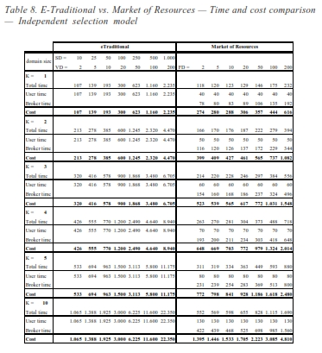
Search and Selection of K Resources Using Independent Selection

Slide 25
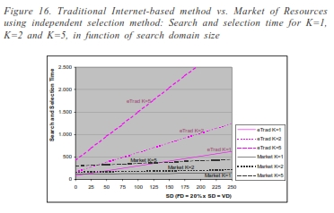
Search and Selection of K Resources Using Independent Selection (Contd…)
Figure 16 represents the time associated to the search of 1, 2 and 5 resources
(K=1, K=2 and K=5), in function of the Search Domain size (SD), both for the traditional method and the Market of Resources. We are considering the
Focused Domain (FD) size to be 20% of SD as well as the Visit Domain (VD). For K=1, the line representing time (Figure 16) for the traditional method
intersects the corresponding line for the Market of Resources, determining the
point at the left of which the traditional Internet-based method is faster and to the right of which the Market of Resources is faster. This only happens for K=1 in the other situations the Market of Resources presents less time independently of the Search Domain and Focused Domain dimension

Slide 26
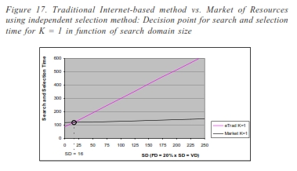
Search and Selection of K Resources Using Independent Selection (Contd…)
For K=1 it is possible to have a more reduced search time using the traditional way, which corresponds to a Search Domain of less of 16 records, meaning a Visit Domain of 3 eligible resources providers (20% x 16) and a Focused Domain with 3 records, as represented in Figure 17. As we can see in Figure 16, the line representing search, selection and integration time using the Market of Resources has a little slope, traducing a weaker dependency of Search Domain size, due to the automation that the Market offers.

Slide 27
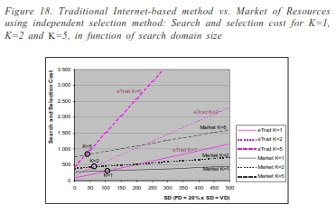
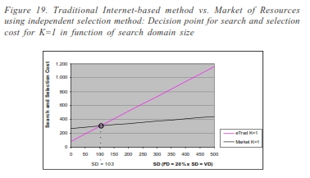
Search and Selection of K Resources Using Independent Selection (Contd…)
Considering search, selection and integration cost instead of time, we can see that the traditional way presents advantages for small Search Domain sizes, both for K=1, 2 and 5, as represented in Figure 18, due to the higher cost of the Market per unit of time (Broker time). These decision points, considering cost instead of time, for K=1 and K=5, are presented in Figure 19 and Figure 20, respectively.

Slide 28
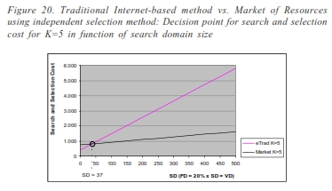
Search and Selection of K Resources Using Independent Selection (Contd…)
This situation of a Search Domain of 16 corresponds (in the traditional way) to visiting 3 possible suppliers (Visit Domain) and considering 50% of them as eligible for negotiation (let us consider 2). The negotiation (auction based, in our example) within this set of 2 leads to 1 candidate resource, for the selection of the best solution to provide the required resource.
The Search Domain dimension of 103 (Figure 19) corresponds to a Visit Domain and a Focused Domain dimension of 21 (21 potential resources providers) and using the ratios R1 and R2, corresponds to 11 eligible resources providers and
5 candidate resources providers.
A Search Domain dimension of 37 for each of the 5 required resources (K=5), as represented in Figure 20, corresponds to 7 potential resources providers, 4 eligible and 2 candidate resources providers.

Slide 29
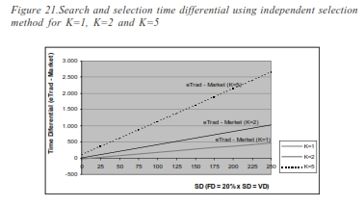
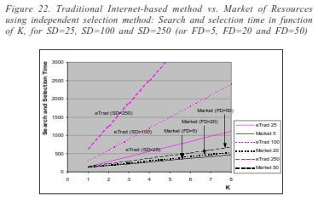
Search and Selection of K Resources Using Independent Selection (Contd…)
The differential between the traditional way and the Market of Resources in terms of time (i.e., time savings) when using the Market, is presented in Figure 21. It is also of interest to analyze time and cost for different average Search Domain sizes in function of K. Figure 22 represents search and selection time in function of K, for average Selection Domain sizes of 25, 100 and 250 (corresponding to Focused Domain dimensions of 5, 20 and 50, respectively).

Slide 30
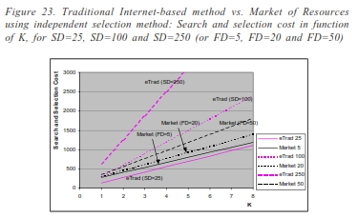
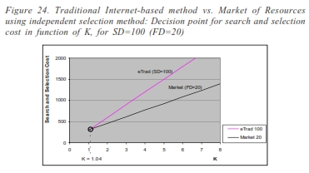
Search and Selection of K Resources Using Independent Selection (Contd…)
Due to the automation offered by the Market of Resources, the Search Domain dimension does not affect search complexity with the same intensity as in the traditional Internet-based way. Also the dependency of search, selection and integration time in function of K is more reduced in the Market than in the traditional way.
Figure 23 is equivalent, but considering cost instead of time. It is possible to see that for SD = 25 (FD = 5) the cost of using the Market of Resources is higher than the utilization of the traditional way, for small K; intersection should occur for K = 16. For SD = 100 (FD = 20), the intersection is close to K = 1 (Figure 24

Slide 31
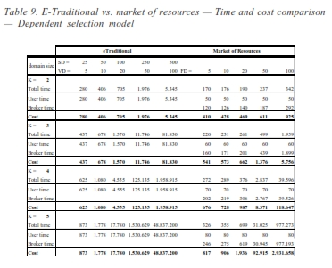
Search and Selection of K Resources Using Dependent Selection Model
Using the estimations of Table 7, which are common to both selection models, and the considerations introduced at the beginning of this section, Table 9 presents search and selection time for different values of K, considering Search Domain sizes varying between 25 and 500, both for the traditional way and the Market of Resources, considering dependent selection method. In the traditional way, cost corresponds to 1 Cost Unit per minute and using the Market, time is calculated separately for the user and broker and cost corresponds to 1 CU /
minute for user time and 3CU /minute for broker time

Slide 32
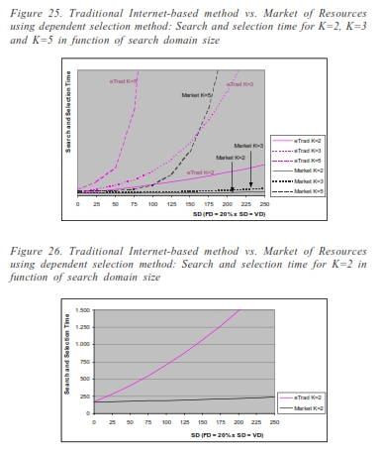
Search and Selection of K Resources Using Dependent Selection Model (Contd…)
Figure 25 represents the time associated to the search of 2, 3 and 5 resources (K=2, K=3 and K=5)1, in function of the search domain size (SD), both for the traditional method and the Market of Resources. Again, we are considering the Focused Domain (FD) size to be 20% of SD as well as the Visit Domain (VD). There are no intersections between Search and Selection time using the Market and the e-traditional way for corresponding values of K, not even for K=2 (Figure 26). The Market of Resources is faster for all the represented situations of K and SD. Considering search and selection cost instead of time, we can see that the traditional way presents advantages for small Search Domain dimensions, both for K=2, 3 and 5, as represented in Figure 27, due to the higher cost per unit of time of broker utilization. These decision points, considering cost instead of time, for K=2 and K=5 are presented in Figure 28 and Figure 29, respectively.

Slide 33
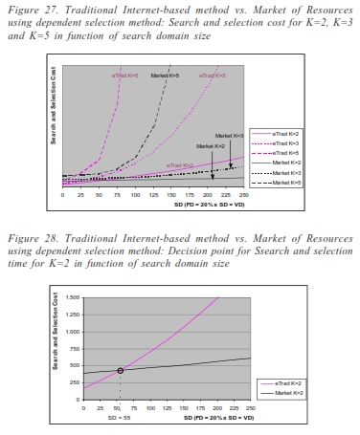
Search and Selection of K Resources Using Dependent Selection Model (Contd…)

Slide 34
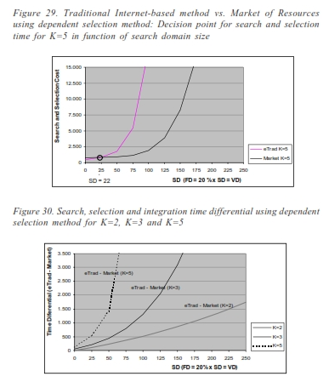
Search and Selection of K Resources Using Dependent Selection Model (Contd…)
The differential between the traditional way and the Market of Resources both in terms of time (i.e., time savings when using the Market) and in terms of cost (i.e., cost savings when using the Market) are presented in Figure 30 and Figure 31, respectively. In terms of time, the Market of Resources is faster in all the situations, while in terms of cost, for small SD, the traditional Internet-based way is slightly advantageous.

Slide 35
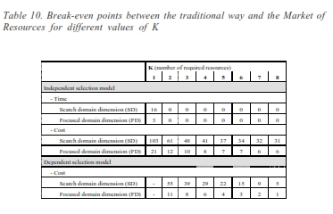
Domain of Opportunities for the Market of Resources
Table 10 summarizes the break-even points between the traditional way and the Market efficiency, considering the two selection models, the number of required resources (K), and the Search Domain dimension (Focused Domain dimension is considered 20% of search domain dimension). For each value of K it is presented the Search Domain dimension (and Focused Domain dimension) where the search, selection and integration times, using the traditional way, equals the corresponding times by using the Market

Slide 36
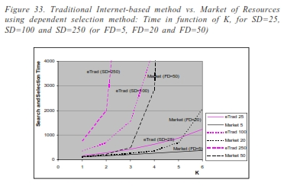
Domain of Opportunities for the Market of Resources (Contd…)
Figure 32 represents search and selection time in function of K, for a very small Selection Domain, with a dimension of 25, corresponding to a Focused Domain dimension of 5. In Figure 33 we use larger Search Domain dimensions (SD = 100 and SD = 250). Again, due to the automation offered by the Market of Resources, search time is not affected by the Search Domain dimension with the same intensity than in the traditional way, as well as the relation between search effort and the number of required resources (K). The dependency of search and selection time in relation with K is more reduced in the Market than in the traditional way.
In the case of independent selection model, it was also considered the time variable, for K=1, where the Market is more efficient only if the Focused Domain dimension exceeds 3. For the dependent selection model considering search and selection time, the Market is always more advantageous.
When considering time, we are able to identify the situations where the Market copes with increased dynamics, which are all except for K=1 and FD < 3 using independent selection, and all the situations using dependent selection method.

Slide 37
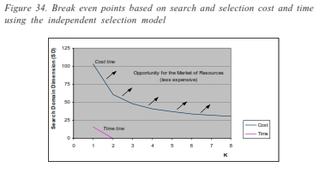
Domain of Opportunities for the Market of Resources (Contd…)
For the independent selection model, as represented in Figure 34 , the area under the cost line corresponds to the situations where the traditional way is less expensive and the situations under the time line corresponds to the situations where the traditional way is faster. Considering the dependent selection model, as represented in Figure 35, the area under the cost line corresponds to the situations where the traditional way is less expensive and the Market of Resources is always faster, independently of the number of required resources and search domain dimension.

Slide 38
Domain of Opportunities for the Market of Resources (Contd…)
The Market of Resources contributes to the possibility of reconfigure an A/VE within a few hours. If dealing with simpler projects, broker intervention could be reduced and reconfiguration could be faster. However, it is possible to search, negotiate, contactualise an A/VE creation or reconfiguration, for example for K=3 and an average Focused Domain of size 50, in less than 5 hours (300 minutes) using independent selection, or in 8.3 hours (500 minutes) using dependent selection. For the same situations, the values offered by the traditional way are respectively 31 hours (1,868 minutes) and 196 hours (11,746 minutes), an unbearable value.
This way, it is demonstrated that the Market of Resources allows an efficient integration of resources in an A/VE and that the Market is able to cope with the requirements intrinsic to the A/VE model. It was also demonstrated that the Market of Resources can be implemented with the existing technologies, and that it is the environment assuring the attainment of the full potential of the A/VE model.

Slide 39
THANK YOU

