Slide 1
Dr. Fransiskus Adikara, S.Kom, MMSI
IT Resource Management
Sesi 12
Kompetensi SDM TI

Slide 2
COBIT 5 Introduction
Presented by

Slide 3
© 2012 ISACA. All rights reserved. No part of this publication may be used, copied, reproduced, modified, distributed, displayed, stored in a retrieval system or transmitted in any form by any means (electronic, mechanical, photocopying, recording or otherwise) without the prior written authorisation of ISACA. Use of this publication is permitted solely for personal use and must include full attribution of the material’s source. No other right or permission is granted with respect to this work.

Slide 4
COBIT 5 Executive Summary

Slide 5
Information!
Information is a key resource for all enterprises.
Information is created, used, retained, disclosed and destroyed.
Technology plays a key role in these actions.
Technology is becoming pervasive in all aspects of business and personal life.
What benefits do information and technology bring to enterprises?

Slide 6
Enterprise Benefits
Enterprises and their executives strive to:
Maintain quality information to support business decisions.
Generate business value from IT-enabled investments, i.e., achieve strategic goals and realise business benefits through effective and innovative use of IT.
Achieve operational excellence through reliable and efficient application of technology.
Maintain IT-related risk at an acceptable level.
Optimise the cost of IT services and technology.
How can these benefits be realised to create enterprise stakeholder value?

Slide 7
Stakeholder Value
Delivering enterprise stakeholder value requires good governance and management of information and technology (IT) assets.
Enterprise boards, executives and management have to embrace IT like any other significant part of the business.
External legal, regulatory and contractual compliance requirements related to enterprise use of information and technology are increasing, threatening value if breached.
COBIT 5 provides a comprehensive framework that assists enterprises to achieve their goals and deliver value through effective governance and management of enterprise IT.

Slide 8
The COBIT 5 Framework
Simply stated, COBIT 5 helps enterprises create optimal value from IT by maintaining a balance between realising benefits and optimising risk levels and resource use.
COBIT 5 enables information and related technology to be governed and managed in a holistic manner for the entire enterprise, taking in the full end-to-end business and functional areas of responsibility, considering the IT-related interests of internal and external stakeholders.
The COBIT 5 principles and enablers are generic and useful for enterprises of all sizes, whether commercial, not-for-profit or in the public sector.

Slide 9
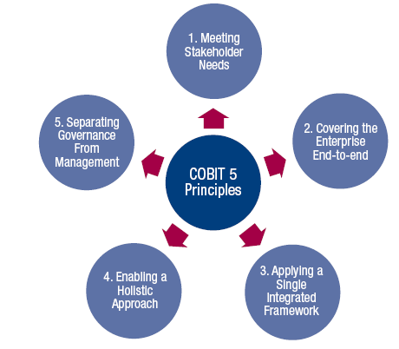
COBIT 5 Principles
Source: COBIT® 5, figure 2. © 2012 ISACA® All rights reserved.

Slide 10
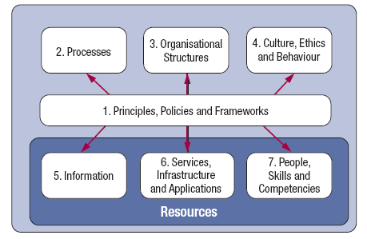
COBIT 5 Enablers
Source: COBIT® 5, figure 12. © 2012 ISACA® All rights reserved.

Slide 11
Governance and Management
Governance ensures that enterprise objectives are achieved by evaluating stakeholder needs, conditions and options; setting direction through prioritisation and decision making; and monitoring performance, compliance and progress against agreed-on direction and objectives (EDM).
Management plans, builds, runs and monitors activities in alignment with the direction set by the governance body to achieve the enterprise objectives (PBRM).

Slide 12
In Summary …
COBIT 5 brings together the five principles that allow the enterprise to build an effective governance and management framework based on a holistic set of seven enablers that optimises information and technology investment and use for the benefit of stakeholders.

