Slide 1
Dr. Fransiskus Adikara, S.Kom, MMSI
IT Resource Management
Sesi 13
Indikator Kinerja SDM TI

Slide 2
COBIT 5

Slide 3
COBIT 5: Now One Complete Business Framework for
Governance of Enterprise IT
Evolution of scope
IT Governance
Val IT 2.0
(2008)
Management
Control
Risk IT
(2009)
Audit
COBIT1
COBIT2
COBIT3
COBIT4.0/4.1
COBIT 5
1996
1998
2000
2005/7
2012
An business framework from ISACA, at www.isaca.org/cobit
© 2012 ISACA® All rights reserved.

Slide 4
COBIT 5 Framework
COBIT 5:
The main, overarching COBIT 5 product
Contains the executive summary and the full description of all of the COBIT 5 framework components:
The five COBIT 5 principles
The seven COBIT 5 enablers plus
An introduction to the implementation guidance provided by ISACA (COBIT 5 Implementation)
An introduction to the COBIT Assessment Programme (not specific to COBIT 5) and the process capability approach being adopted by ISACA for COBIT

Slide 5
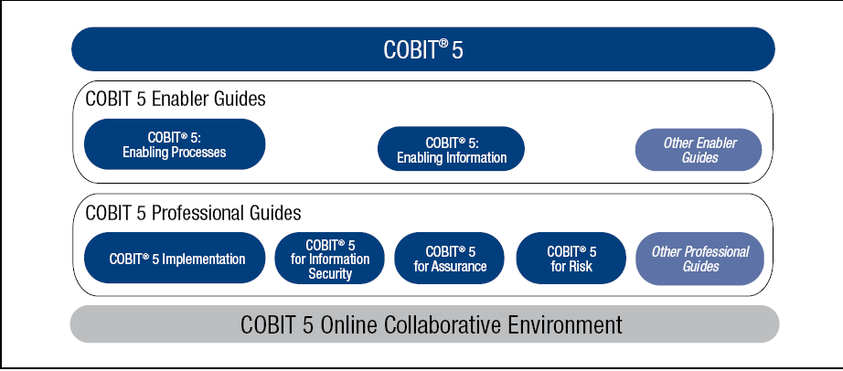
COBIT 5 Product Family
Source: COBIT® 5, figure 11. © 2012 ISACA® All rights reserved.

Slide 6
Five COBIT 5 Principles
The five COBIT 5 principles:
Meeting Stakeholder Needs
Covering the Enterprise End-to-end
Applying a Single Integrated Framework
Enabling a Holistic Approach
Separating Governance From Management

Slide 7
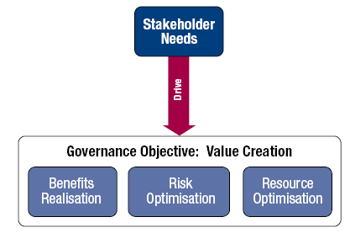
1. Meeting Stakeholder Needs
Principle 1. Meeting Stakeholder Needs
Enterprises exist to create value for their stakeholders.
Source: COBIT® 5, figure 3. © 2012 ISACA® All rights reserved.

Slide 8
1. Meeting Stakeholder Needs (cont.)
Principle 1. Meeting Stakeholder Needs:
Enterprises have many stakeholders, and ‘creating value’ means different—and sometimes conflicting—things to each of them.
Governance is about negotiating and deciding amongst different stakeholders’ value interests.
The governance system should consider all stakeholders when making benefit, resource and risk assessment decisions.
For each decision, the following can and should be asked:
Who receives the benefits?
Who bears the risk?
What resources are required?

Slide 9
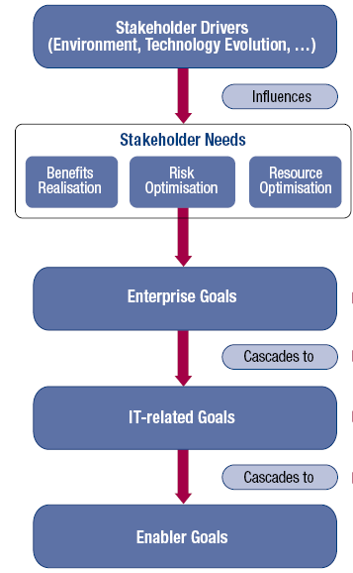
1. Meeting Stakeholder Needs (cont.)
Principle 1. Meeting Stakeholder Needs:
Stakeholder needs have to be transformed into an enterprise’s practical strategy.
The COBIT 5 goals cascade translates stakeholder needs into specific, practical and customised goals within the context of the enterprise, IT-related goals and enabler goals.
Source: COBIT® 5, figure 4. © 2012 ISACA® All rights reserved.

Slide 10
1. Meeting Stakeholder Needs (cont.)
Principle 1. Meeting Stakeholder Needs:
Benefits of the COBIT 5 goals cascade:
It allows the definition of priorities for implementation, improvement and assurance of enterprise governance of IT based on (strategic) objectives of the enterprise and the related risk.
In practice, the goals cascade:
Defines relevant and tangible goals and objectives at various levels of responsibility.
Filters the knowledge base of COBIT 5, based on enterprise goals to extract relevant guidance for inclusion in specific implementation, improvement or assurance projects.
Clearly identifies and communicates how (sometimes very operational) enablers are important to achieve enterprise goals.

Slide 11
2. Covering the Enterprise End-to-end
Principle 2. Covering the Enterprise End-to-end:
COBIT 5 addresses the governance and management of information and related technology from an enterprisewide, end-to-end perspective.
This means that COBIT 5:
Integrates governance of enterprise IT into enterprise governance, i.e., the governance system for enterprise IT proposed by COBIT 5 integrates seamlessly in any governance system because COBIT 5 aligns with the latest views on governance.
Covers all functions and processes within the enterprise; COBIT 5 does not focus only on the ‘IT function’, but treats information and related technologies as assets that need to be dealt with just like any other asset by everyone in the enterprise.

Slide 12
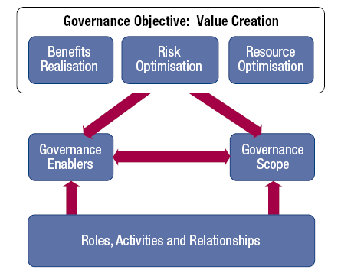
2. Covering the Enterprise End-to-end (cont.)
Principle 2. Covering the Enterprise End-to-end
Key components of a governance system
Source: COBIT® 5, figure 8. © 2012 ISACA® All rights reserved.
Source: COBIT® 5, figure 9. © 2012 ISACA® All rights reserved.

Slide 13
3. Applying a Single Integrated Framework
Principle 3. Applying a Single Integrated Framework:
COBIT 5 aligns with the latest relevant other standards and frameworks used by enterprises:
Enterprise: COSO, COSO ERM, ISO/IEC 9000, ISO/IEC 31000
IT-related: ISO/IEC 38500, ITIL, ISO/IEC 27000 series, TOGAF, PMBOK/PRINCE2, CMMI
This allows the enterprise to use COBIT 5 as the overarching governance and management framework integrator.
ISACA plans a capability to facilitate COBIT user mapping of practices and activities to third-party references.

Slide 14
4. Enabling a Holistic Approach
Principle 4. Enabling a Holistic Approach
COBIT 5 enablers are:
Factors that, individually and collectively, influence whether something will work—in the case of COBIT, governance and management over enterprise IT
Driven by the goals cascade, i.e., higher-level IT-related goals define what the different enablers should achieve
Described by the COBIT 5 framework in seven categories

Slide 15
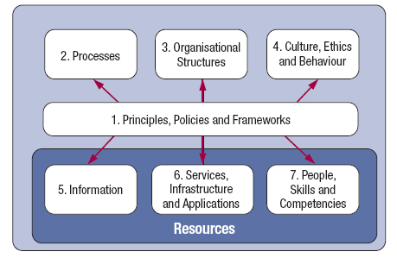
4. Enabling a Holistic Approach (cont.)
Principle 4. Enabling a Holistic Approach
Source: COBIT® 5, figure 12. © 2012 ISACA® All rights reserved.

Slide 16
4. Enabling a Holistic Approach (cont.)
Principle 4. Enabling a Holistic Approach:
Processes—Describe an organised set of practices and activities to achieve certain objectives and produce a set of outputs in support of achieving overall IT-related goals
Organisational structures—Are the key decision-making entities in an organisation
Culture, ethics and behaviour—Of individuals and of the organisation; very often underestimated as a success factor in governance and management activities
Principles, policies and frameworks—Are the vehicles to translate the desired behaviour into practical guidance for day-to-day management
Information—Is pervasive throughout any organisation, i.e., deals with all information produced and used by the enterprise. Information is required for keeping the organisation running and well governed, but at the operational level, information is very often the key product of the enterprise itself.
Services, infrastructure and applications—Include the infrastructure, technology and applications that provide the enterprise with information technology processing and services
People, skills and competencies—Are linked to people and are required for successful completion of all activities and for making correct decisions and taking corrective actions

Slide 17
4. Enabling a Holistic Approach (cont).
Principle 4. Enabling a Holistic Approach:
Systemic governance and management through interconnected enablers—To achieve the main objectives of the enterprise, it must always consider an interconnected set of enablers, i.e., each enabler:
Needs the input of other enablers to be fully effective, e.g., processes need information, organisational structures need skills and behaviour
Delivers output to the benefit of other enablers, e.g., processes deliver information, skills and behaviour make processes efficient
This is a KEY principle emerging from the ISACA development work around the Business Model for Information Security (BMIS).

Slide 18
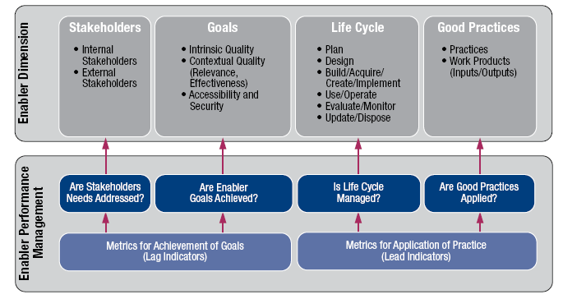
4. Enabling a Holistic Approach (cont).
Principle 4. Enabling a Holistic Approach
COBIT 5 Enabler Dimensions:
All enablers have a set of common dimensions. This set of common dimensions:
Provides a common, simple and structured way to deal with enablers
Allows an entity to manage its complex interactions
Facilitates successful outcomes of the enablers
Source: COBIT® 5, figure 13. © 2012 ISACA® All rights reserved.

Slide 19
5. Separating Governance From Management
Principle 5. Separating Governance From Management:
The COBIT 5 framework makes a clear distinction between governance and management.
These two disciplines:
Encompass different types of activities
Require different organisational structures
Serve different purposes
Governance—In most enterprises, governance is the responsibility of the board of directors under the leadership of the chairperson.
Management—In most enterprises, management is the responsibility of the executive management under the leadership of the CEO.

Slide 20
5. Separating Governance From Management (cont.)
Principle 5. Separating Governance From Management:
Governance ensures that stakeholders needs, conditions and options are evaluated to determine balanced, agreed-on enterprise objectives to be achieved; setting direction through prioritisation and decision making; and monitoring performance and compliance against agreed-on direction and objectives (EDM).
Management plans, builds, runs and monitors activities in alignment with the direction set by the governance body to achieve the enterprise objectives (PBRM).

Slide 21
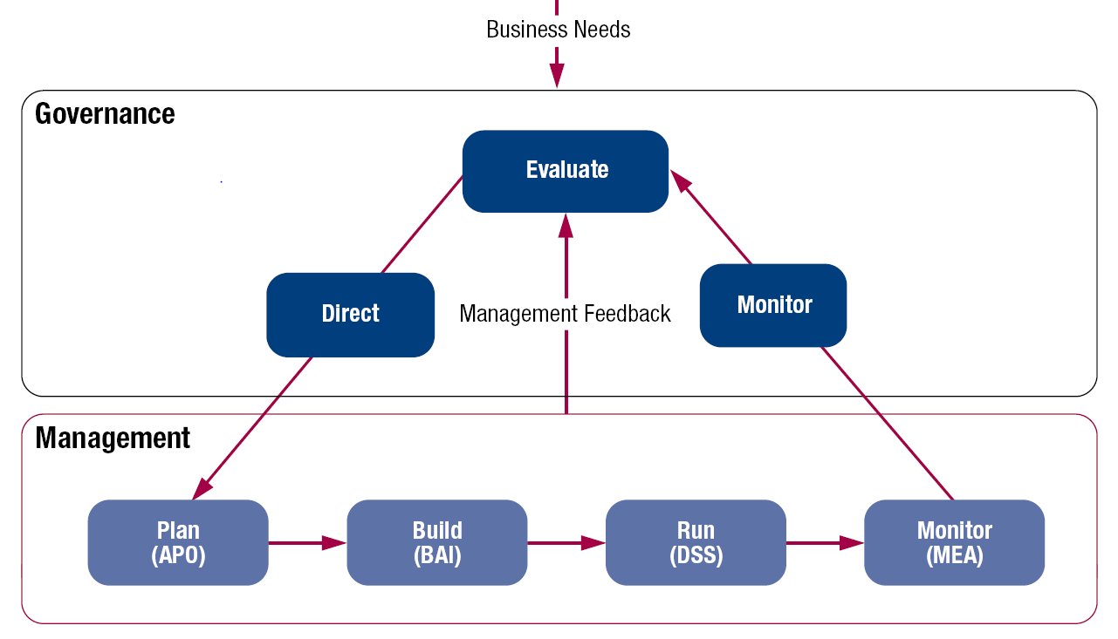
5. Separating Governance From Management (cont.)
Principle 5. Separating Governance From Management:
COBIT 5 is not prescriptive, but it advocates that organisations implement governance and management processes such that the key areas are covered, as shown.
Source: COBIT® 5, figure 15. © 2012 ISACA® All rights reserved.

Slide 22
5. Separating Governance From Management (cont.)
Principle 5. Separating Governance from Management:
The COBIT 5 framework describes seven categories of enablers (Principle 4). Processes are one category.
An enterprise can organise its processes as it sees fit, as long as all necessary governance and management objectives are covered. Smaller enterprises may have fewer processes; larger and more complex enterprises may have many processes, all to cover the same objectives.
COBIT 5 includes a process reference model (PRM), which defines and describes in detail a number of governance and management processes. The details of this specific enabler model can be found in the COBIT 5: Enabling Processes volume.

