Slide 1
Dr. Fransiskus Adikara, S.Kom, MMSI
IT Resource Management
Sesi 04
Information Management System

Slide 2
Learning Objectives
Identify and describe important features of organizations that managers need to know about in order to build and use information systems successfully.
Demonstrate how Porter’s competitive forces model helps companies develop competitive strategies using information systems.
Explain how the value chain and value web models help businesses identify opportunities for strategic information system applications.
Notes:
You could ask students to recall some concepts from the previous chapters that might help managers build and use information systems successfully. Answers could include what business processes the company performs, the size of the company, or the organization of the information systems function.

Slide 3
Learning Objectives (cont.)
Demonstrate how information systems help businesses use synergies, core competencies, and network-based strategies to achieve competitive advantage.
Assess the challenges posed by strategic information systems and management solutions.
Notes:
Recall the business objectives that allow firms to achieve competitive advantage, discussed in Chapter 1: operational excellence, new products, services, and business models, customer and supplier intimacy, and improved decision making.

Slide 4
Will Sears’s Technology Strategy Work This Time?
Problem: Fading brand, powerful competitors, technology costs
Solutions:
  Customer data mining to improve customer intimacy, design sales floors, implement customer programs and promotions
Demonstrates IT’s central role in defining competitive strategy
Notes:
In 2013 Sears continues to have a difficult time breaking even, let alone making a profit. Ask if any of your students shop at Sears? Did they ever? What is the reputation of the firm?

Slide 5
Organizations and Information Systems
Information technology and organizations influence each other
  Relationship influenced by organization’s
    Structure
    Business processes
    Politics
    Culture
    Environment
    Management decisions
Notes:
This concept was briefly discussed in Chapter 1. Figure 1-2 and 1-3 as well as the figure on the next slide, 3-1, display this interdependent relationship graphically.

Slide 6
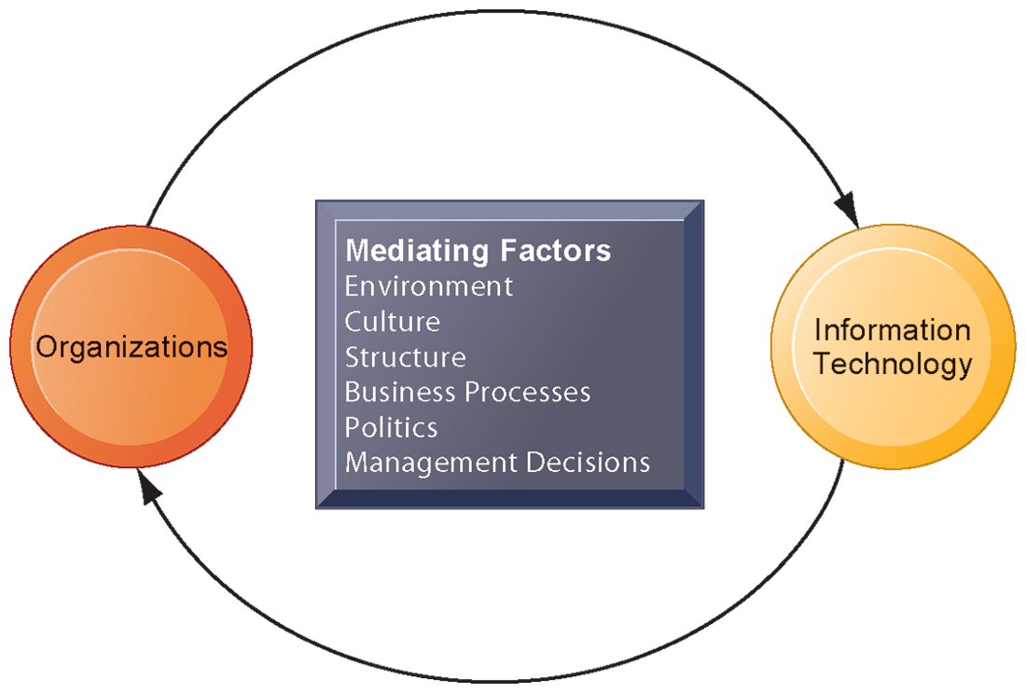
THE TWO-WAY RELATIONSHIP BETWEEN ORGANIZATIONS AND INFORMATION TECHNOLOGY
This complex two-way relationship is mediated by many factors, not the least of which are the decisions made—or not made—by managers. Other factors mediating the relationship include the organizational culture, structure, politics, business processes, and environment.
FIGURE 3-1
Notes:
Ask students to explain how each factor might affect the relationship between organizations and information technology. Emphasize to students that the relationship between these two and its effects on the future of a business are difficult to predict. For example, very few people could have predicted the prominence of e-mail and instant messaging in business communication 15 years ago.

Slide 7
Organizations and Information Systems
What is an organization?
  Technical definition:
    Formal social structure that processes resources from environment to produce outputs
    A formal legal entity with internal rules and procedures, as well as a social structure
  Behavioral definition:
    A collection of rights, privileges, obligations, and responsibilities that is delicately balanced over a period of time through conflict and conflict resolution
Notes:
Which of the two definitions do students find more accurate and why? It is important to consider both definitions rather than exclusively use one at the expense of the other. The two definitions are complementary.

Slide 8
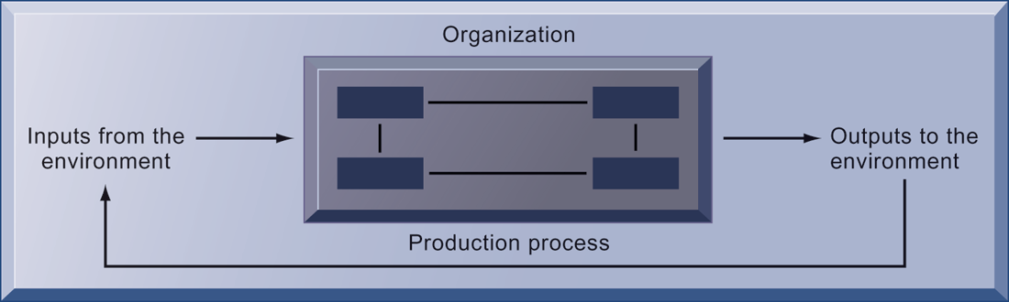
THE TECHNICAL MICROECONOMIC DEFINITION OF THE ORGANIZATION
FIGURE 3-2
In the microeconomic definition of organizations, capital and labor (the primary production factors provided by the environment) are transformed by the firm through the production process into products and services (outputs to the environment). The products and services are consumed by the environment, which supplies additional capital and labor as inputs in the feedback loop.
Notes:
Ask students what are the inputs from the environment? What do organizations output (goods and services). In this view, the organization or business firm is rather easily changed, and malleable. The organization is a collection of parts, like a machine, that can be rearranged as needed. There are no humans in this model, or if there are, they are assumed to be relatively simple.

Slide 9
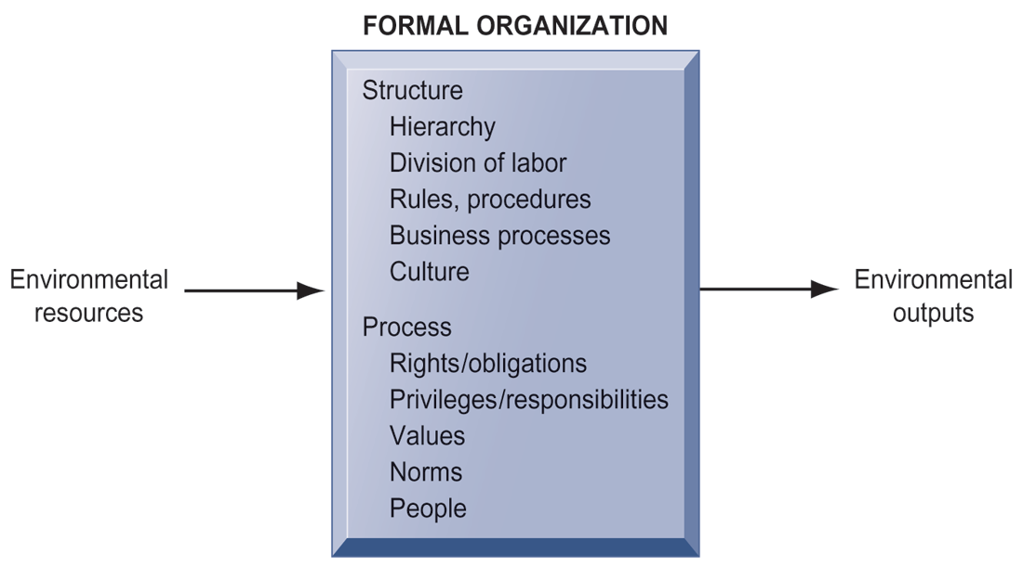
THE BEHAVIORAL VIEW OF ORGANIZATIONS
The behavioral view of organizations emphasizes group relationships, values, and structures.
FIGURE 3-3
Notes:
In this view, the business firm is a little more difficult to change rapidly or on command because it is a very complex machine populated with human beings. Firms operate with an existing hierarchy, job definitions, business rules, legal contracts, procedures, and processes. Efficient organizations become very good at these elements of business. Changing these elements takes more time.

Slide 10
Organizations and Information Systems
Features of organizations
    Use of hierarchical structure
    Accountability, authority in system of impartial decision making
    Adherence to principle of efficiency
    Routines and business processes
    Organizational politics, culture, environments, and structures
Notes:
You could ask students to envision what would happen to an organization that did not use a hierarchical structure (would anything get done?), did not adhere to the principle of efficiency (would they provide any good or service worth using at an affordable price?), and so on.

Slide 11
Organizations and Information Systems
Routines and business processes
  Routines (standard operating procedures)
    Precise rules, procedures, and practices developed to cope with virtually all expected situations
  Business processes: Collections of routines
  Business firm: Collection of business processes
Notes:
You could ask students to describe examples of situations where a business they have interacted with has had a well-understood set of routines. One such example is at the doctor’s office, where the receptionist, nurses, and doctors all have a defined set of routines. Ask students to think about and describe routines they performed on their jobs.

Slide 12
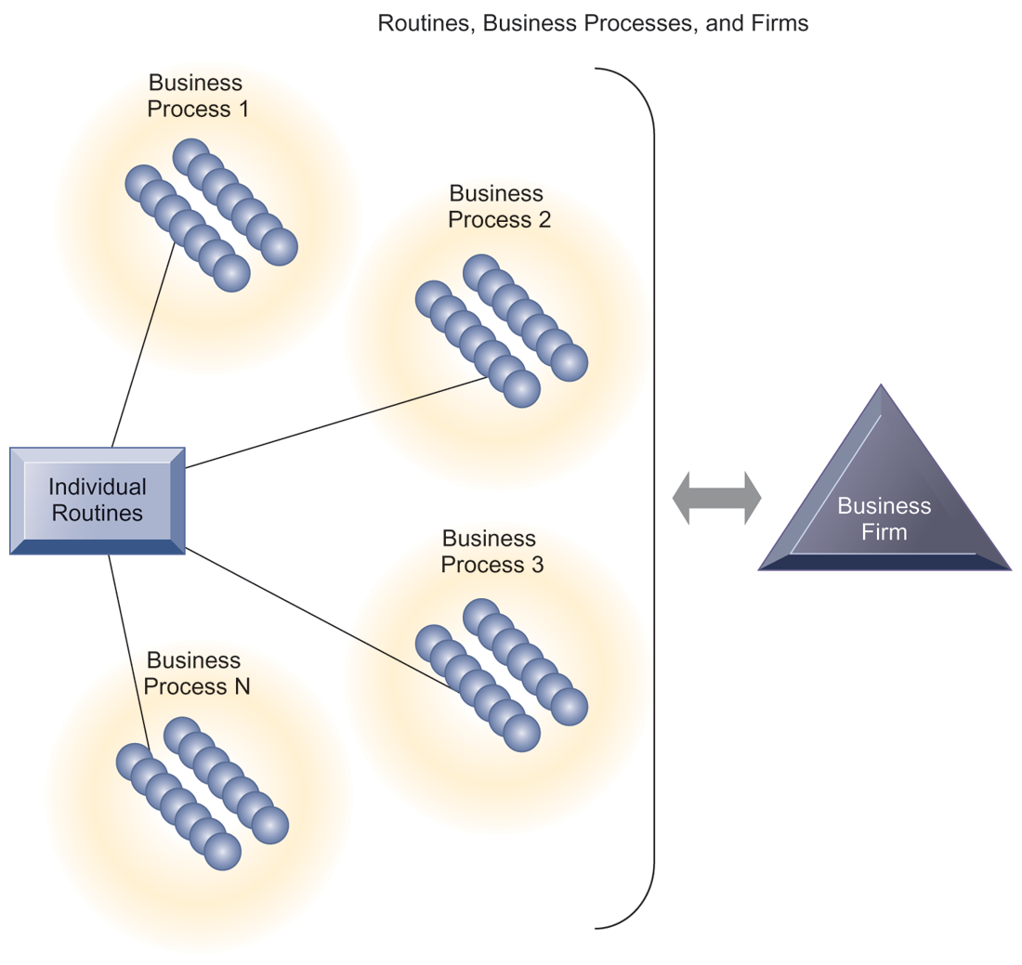
ROUTINES, BUSINESS PROCESSES, AND FIRMS
All organizations are composed of individual routines and behaviors, a collection of which make up a business process. A collection of business processes make up the business firm. New information system applications require that individual routines and business processes change to achieve high levels of organizational performance.
FIGURE 3-4
Notes:
Explain to students that the blue spheres are individual routines, which together constitute a business process. A firm can be seen as a collection of these processes.

Slide 13
Organizations and Information Systems
Organizational politics
  Divergent viewpoints lead to political struggle, competition, and conflict.
  Political resistance greatly hampers organizational change.
Notes:
You could ask students to describe examples where organizational politics might hamper a firm’s ability to succeed, or examples where effectively managed organizational politics helps a company to undergo a smoother transition or make more intelligent decisions. Ask students to describe their personal experiences with “organizational politics.”

Slide 14
Organizations and Information Systems
Organizational culture:
  Encompasses set of assumptions that define goal and product
    What products the organization should produce
    How and where it should be produced
    For whom the products should be produced
  May be powerful unifying force as well as restraint on change
Notes:
Culture may seem like a pretty abstract idea to many students. On the other hand, students with work experiences will easily be able to describe the cultures of firms where they have worked. Ask students to describe organizational cultures they have experienced while on the job, or other areas of their lives. What kind of organizational culture do students prefer and why? Ask students to describe different kinds of cultures and what types of firms are more likely to have them.

Slide 15
Organizations and Information Systems
Organizational environments:
  Organizations and environments have a reciprocal relationship.
  Organizations are open to, and dependent on, the social and physical environment.
  Organizations can influence their environments.
  Environments generally change faster than organizations.
  Information systems can be instrument of environmental scanning, act as a lens.
Notes:
Explain that environmental scanning involves searching for and determining external changes that may require an organizational response. The current economic climate represents an example of external change that requires sweeping organizational responses to ensure survival.

Slide 16
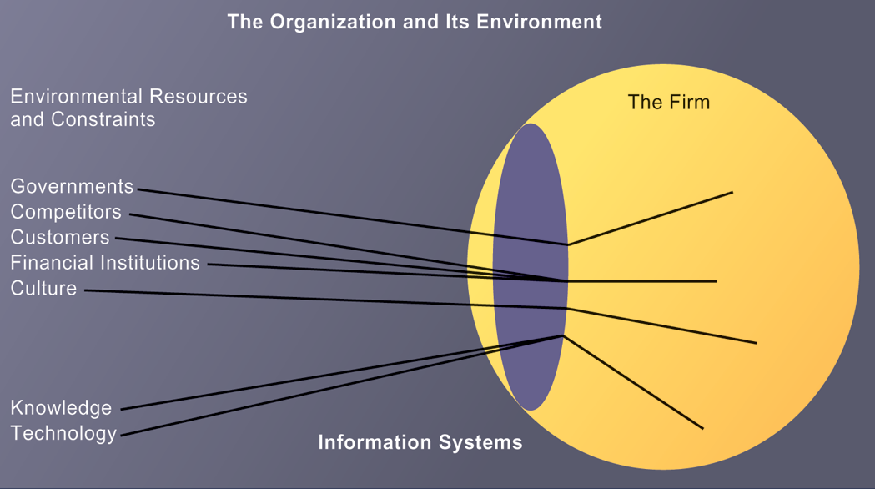
ENVIRONMENTS AND ORGANIZATIONS HAVE A RECIPROCAL RELATIONSHIP
FIGURE 3-5
Environments shape what organizations can do, but organizations can influence their environments and decide to change environments altogether. Information technology plays a critical role in helping organizations perceive environmental change and in helping organizations act on their environment.
Notes:
This graphic further establishes information systems as the “lens” of the firm, observing external factors and filtering information back in to the firm. To some extent, organizations “see” only what their systems will let them see. If systems are poorly built, they may blind managers to difficulties and problems.

Slide 17
Organizations and Information Systems
Disruptive technologies
  Technology that brings about sweeping change to businesses, industries, markets
  Examples: personal computers, word processing software, the Internet, the PageRank algorithm
  First movers and fast followers
    First movers—inventors of disruptive technologies
    Fast followers—firms with the size and resources to capitalize on that technology
Notes:
Ensure that students understand that the PageRank algorithm is the underlying technology behind Google search. Ask students if they can give examples of any first movers that invented a disruptive technology, yet failed to last (examples might include the Altair personal computer, the Netscape Navigator Internet browser, etc.).

Slide 18
Organizations and Information Systems
5 basic kinds of organizational structure
  Entrepreneurial:
    Small start-up business
  Machine bureaucracy:
    Midsize manufacturing firm
  Divisionalized bureaucracy:
    Fortune 500 firms
  Professional bureaucracy:
    Law firms, school systems, hospitals
  Adhocracy:
    Consulting firms
Notes:
Do students agree with the classification of these types of organizational structure? Can they come up with examples for each type of organization?

Slide 19
Organizations and Information Systems
Other organizational features
  Goals
    Coercive, utilitarian, normative, and so on
  Constituencies
  Leadership styles
  Tasks
  Surrounding environments
Notes:
Ask students to give some examples of each organizational feature listed above. For example, different organizations (prisons, businesses, colleges) have different types of goals (coercive, utilitarian, normative, respectively).

Slide 20
How Information Systems Impact Organizations and Business Firms
Economic impacts
  IT changes relative costs of capital and the costs of information
  Information systems technology is a factor of production, like capital and labor
  IT affects the cost and quality of information and changes economics of information
    Information technology helps firms contract in size because it can reduce transaction costs (the cost of participating in markets)
      Outsourcing
Notes:
IT figures to replace the function of more middle managers as time passes, as well as reduce the need for other forms of capital (buildings, machinery). Ensure that students understand what is meant by “economics of information” and why outsourcing is a possibility due to IT.

Slide 21
How Information Systems Impact Organizations and Business Firms
Transaction cost theory
  Firms seek to economize on transaction costs (the costs of participating in markets).
    Vertical integration, hiring more employees, buying suppliers and distributors
  IT lowers market transaction costs for firm, making it worthwhile for firms to transact with other firms rather than grow the number of employees.
Notes:
Explain that using the market can be expensive. If you depend on the market, rather than hiring employees, you will need to search for talent, research the quality of providers and workers, write contracts for work to be performed, monitor the work, and so forth. When participation in markets is expensive, firms would rather hire employees to accomplish their work. But the Internet makes it less expensive to use the marketplace. With the Internet, firms find it more cost effective to use the marketplace and contract for work in a market, rather than hire employees. Ask your students why the Internet can make participating in markets less expensive than before.

Slide 22
How Information Systems Impact Organizations and Business Firms
Agency theory:
  Firm is nexus of contracts among self-interested parties requiring supervision.
  Firms experience agency costs (the cost of managing and supervising) which rise as firm grows.
  IT can reduce agency costs, making it possible for firms to grow without adding to the costs of supervising, and without adding employees.
Notes:
By characterizing employees as independent agents requiring constant supervision, agency theory underscores a key reason that costs increase as firms grow in size and scope—the need to expend more effort managing their employees.

Slide 23
How Information Systems Impact Organizations and Business Firms
Organizational and behavioral impacts
  IT flattens organizations
    Decision making is pushed to lower levels.
    Fewer managers are needed (IT enables faster decision making and increases span of control).
  Postindustrial organizations
    Organizations flatten because in postindustrial societies, authority increasingly relies on knowledge and competence rather than formal positions.
Notes:
Ask students to explain what is meant by authority relying on knowledge and competence rather than formal positions. Why might this “flatten” the organization? The idea here is that with sufficient IT, competent workers will be able to accomplish more on their own than they would under a more hierarchical arrangement.

Slide 24
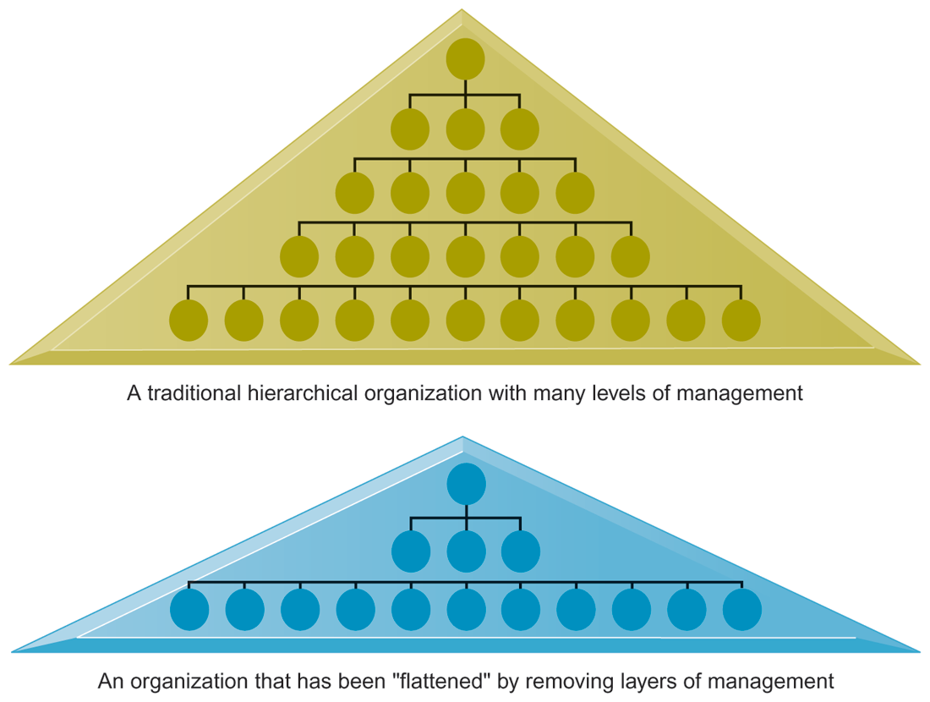
FLATTENING ORGANIZATIONS
Information systems can reduce the number of levels in an organization by providing managers with information to supervise larger numbers of workers and by giving lower-level employees more decision-making authority.
FIGURE 3-6
Notes:
Ask students to explain some of the benefits of the flattened organization as opposed to the more complicated hierarchy in the top of the diagram. Information travels through fewer levels to its intended recipients; there are fewer managers, so agency costs are smaller, and firms can act faster (less decision delay).

Slide 25
How Information Systems Impact Organizations and Business Firms
Organizational resistance to change
  Information systems become bound up in organizational politics because they influence access to a key resource—information.
  Information systems potentially change an organization’s structure, culture, politics, and work.
  Most common reason for failure of large projects is due to organizational and political resistance to change.
Notes:
Explain what is meant by changes in culture and politics of the firm. For example, workers may resist changes that disrupt their routines. Also explain to students that as important as technical understanding of information systems may be for potential managers, it is equally important to understand the people and organizational structures and customs affected by information systems.

Slide 26
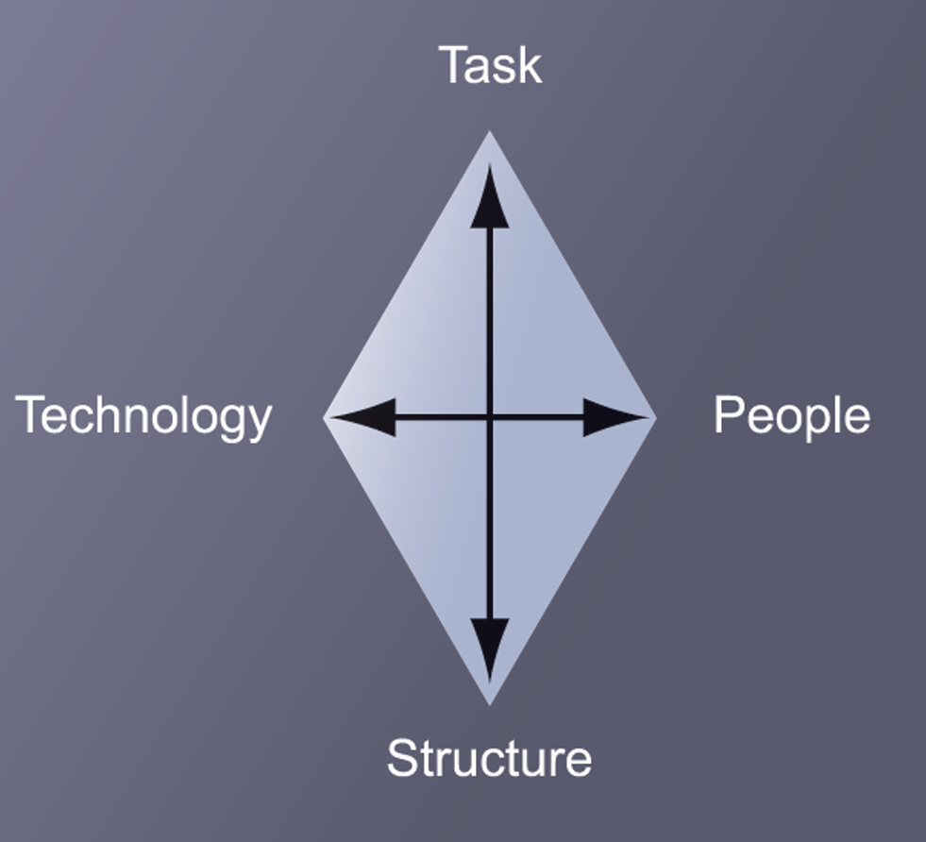
ORGANIZATIONAL RESISTANCE AND THE MUTUALLY ADJUSTING RELATIONSHIP BETWEEN TECHNOLOGY AND THE ORGANIZATION
Implementing information systems has consequences for task arrangements, structures, and people. According to this model, to implement change, all four components must be changed simultaneously.
FIGURE 3-7
Notes:
The diamond shape in the figure represents the mutual relationship between the concepts shown. You could emphasize that implementing a new system might be like changing the diamond into a square, thus requiring some degree of change on the part of all four participants in the relationship.

Slide 27
How Information Systems Impact Organizations and Business Firms
The Internet and organizations
  The Internet increases the accessibility, storage, and distribution of information and knowledge for organizations.
  The Internet can greatly lower transaction and agency costs.
    Example: Large firm delivers internal manuals to employees via a corporate Web site, saving millions of dollars in distribution costs
Notes:
The Internet should also have a flattening effect on many organizations. Can students describe any businesses that have become more efficient and flat thanks to successful incorporation of the Internet in their operations? Some older students may remember the “bad old days” when seven or more levels of management needed to decide even simple issues in a typical firm.

Slide 28
How Information Systems Impact Organizations and Business Firms
Organizational factors in planning a new system:
  Environment
  Structure
    Hierarchy, specialization, routines, business processes
  Culture and politics
  Type of organization and style of leadership
  Main interest groups affected by system; attitudes of end users
  Tasks, decisions, and business processes the system will assist
Notes:
Ask students to consider the results of an information system implemented without properly considering each of the above factors. For example, an information system designed without an understanding of the company’s culture and politics is likely to be unpopular, perhaps forcing employees to drastically deviate from their previous routines.

