Slide 1
Dr. Fransiskus Adikara, S.Kom, MMSI
IT Resource Management
Sesi 05
Information Evolution Model

Slide 2
Using Information Systems to Achieve Competitive Advantage
Why do some firms become leaders in their industry?
Michael Porter’s competitive forces model
  Provides general view of firm, its competitors, and environment
  Five competitive forces shape fate of firm:
    Traditional competitors
    New market entrants
    Substitute products and services
    Customers
    Suppliers
Notes:
Porter’s competitive forces model is intended to explain why some firms do better than others. Do students believe that this model captures this idea effectively? Which factor is most important to a firm’s success? You can make a list of five well-known firms on the blackboard or screen and ask students, for each firm, which do they think are the most important competitive forces.

Slide 3
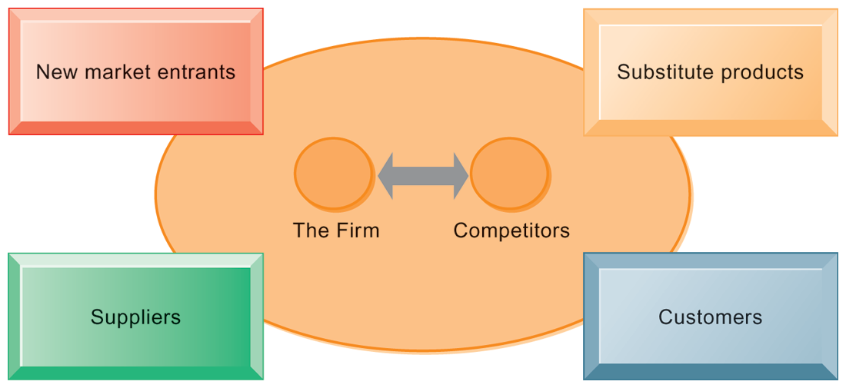
PORTER’S COMPETITIVE FORCES MODEL
FIGURE 3-8
In Porter’s competitive forces model, the strategic position of the firm and its strategies are determined not only by competition with its traditional direct competitors but also by four other forces in the industry’s environment: new market entrants, substitute products, customers, and suppliers.
Notes:
Notice that in the graphic, competitors are represented differently than the other four competitive forces influencing a firm. Why do students think this is the case? One answer might be that competitors are firms in the same industry and are under similar pressures as other firms in the industry.

Slide 4
Using Information Systems to Achieve Competitive Advantage
Traditional competitors
  All firms share market space with competitors who are continuously devising new products, services, efficiencies, and switching costs.
New market entrants
  Some industries have high barriers to entry, for example, computer chip business.
  New companies have new equipment, younger workers, but little brand recognition.
Notes:
Ask students to name different industries and describe the benefits and drawbacks of being a new market entrant in each industry.

Slide 5
Using Information Systems to Achieve Competitive Advantage
Substitute products and services
  Substitutes customers might use if your prices become too high, for example, iTunes substitutes for CDs
Customers
  Can customers easily switch to competitor’s products? Can they force businesses to compete on price alone in transparent marketplace?
Suppliers
  Market power of suppliers when firm cannot raise prices as fast as suppliers
Notes:
Ask students to name different businesses and describe whether or not customers have great control over the business or vice versa, or whether substitute products are a large or insignificant threat to the success of the business.

Slide 6
Using Information Systems to Achieve Competitive Advantage
Four generic strategies for dealing with competitive forces, enabled by using IT:
  Low-cost leadership
  Product differentiation
  Focus on market niche
  Strengthen customer and supplier intimacy
Notes:
Here you can make a list of five well-known firms and then analyze with students the major thrust of their strategy. Walmart is a good example to start with because of its emphasis on low-cost leadership.

Slide 7
Using Information Systems to Achieve Competitive Advantage
Low-cost leadership
  Produce products and services at a lower price than competitors
  Example: Walmart’s efficient customer response system
Product differentiation
  Enable new products or services, greatly change customer convenience and experience
  Example: Google, Nike, Apple
  Mass customization
Notes:
Do students believe it is possible both to design information systems that focus both on low-cost leadership and product differentiation? Some may say it is with sufficient planning and innovation; perhaps a new product is even cheaper to produce than older ones. Some may say that the investment in innovation required for product differentiation precludes that firm from maintaining low-cost leadership.

Slide 8
Using Information Systems to Achieve Competitive Advantage
Focus on market niche
  Use information systems to enable a focused strategy on a single market niche; specialize
  Example: Hilton Hotels’ OnQ system
Strengthen customer and supplier intimacy
  Use information systems to develop strong ties and loyalty with customers and suppliers
  Increase switching costs
  Example: Netflix, Amazon
Notes:
You could ask students to provide other examples from their own experience of companies that exemplify strong focus on market niche as well as excellent customer and supplier intimacy.

Slide 9
Using Information Systems to Achieve Competitive Advantage
The Internet’s impact on competitive advantage
  Transformation or threat to some industries
    Examples: travel agency, printed encyclopedia, media
  Competitive forces still at work, but rivalry more intense
  Universal standards allow new rivals, entrants to market
  New opportunities for building brands and loyal customer bases
Notes:
Do students believe it is easier or harder to gain a competitive advantage via the Internet as opposed to more traditional means? Table 3-5 describes the impact of the Internet on various competitive forces.

Slide 10
Using Information Systems to Achieve Competitive Advantage
Value chain model
  Firm as series of activities that add value to products or services
  Highlights activities where competitive strategies can best be applied
    Primary activities vs. support activities
  At each stage, determine how information systems can improve operational efficiency and improve customer and supplier intimacy
  Utilize benchmarking, industry best practices
Notes:
How does the value chain model differ from the Porter model? (It offers more specific detail about what exactly to do to achieve competitive advantages.) How do primary activities differ from support activities?

Slide 11
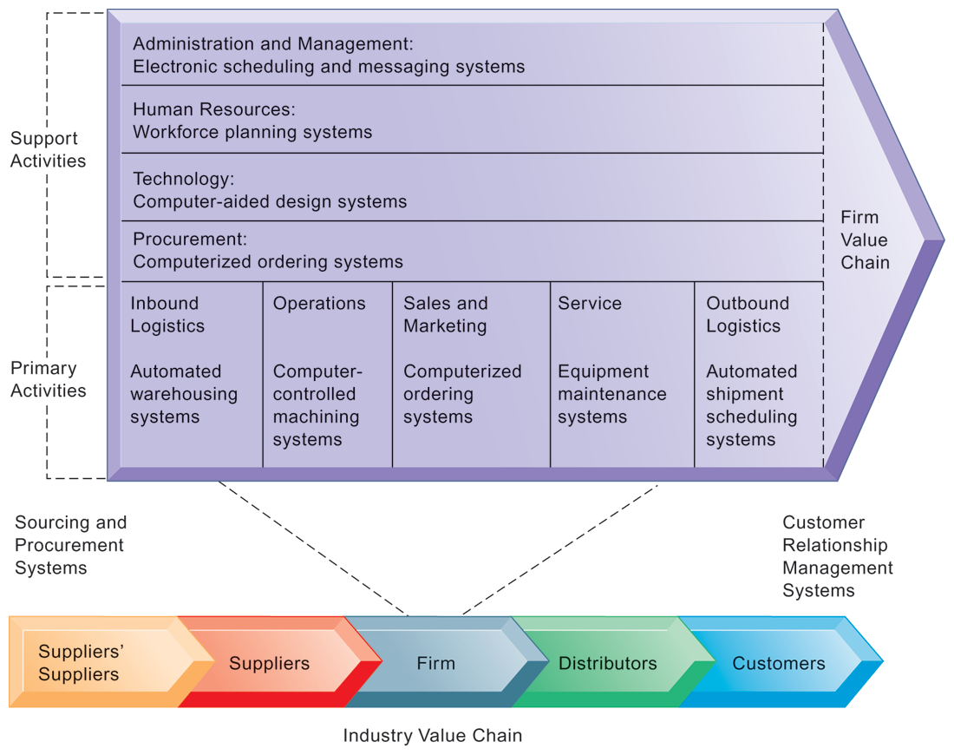
THE VALUE CHAIN MODEL
This figure provides examples of systems for both primary and support activities of a firm and of its value partners that can add a margin of value to a firm’s products or services.
FIGURE 3-9
Notes:
Emphasize the relationship between the primary and support activities of this firm and explain how information systems are critical to the success of each activity.

Slide 12
Using Information Systems to Achieve Competitive Advantage
Value web:
  Collection of independent firms using highly synchronized IT to coordinate value chains to produce product or service collectively
  More customer driven, less linear operation than traditional value chain
Notes:
Explain that a value web extends beyond the boundaries of an individual firm and represents the coordination of value chains across multiple independent firms. A value web is flexible and adapts to changes in supply and demand and changing market conditions.

Slide 13
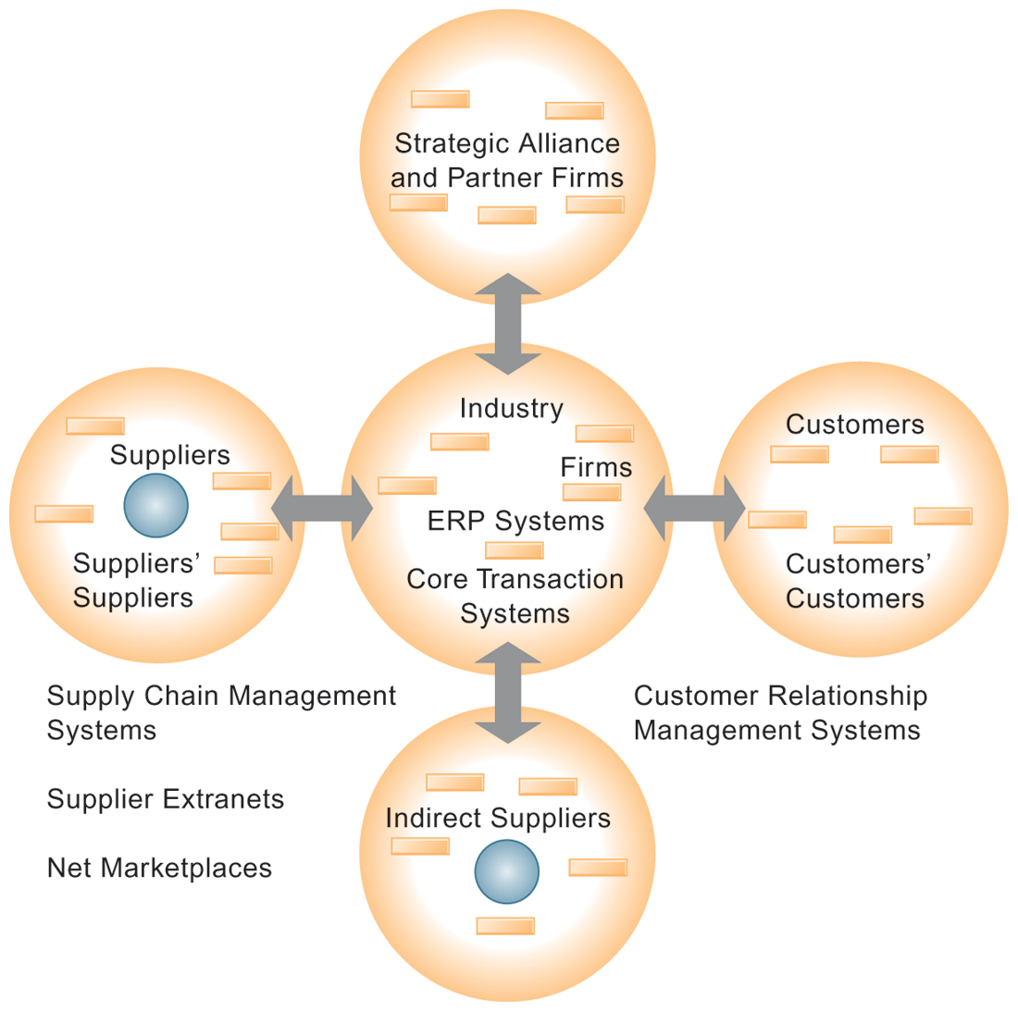
THE VALUE WEB
The value web is a networked system that can synchronize the value chains of business partners within an industry to respond rapidly to changes in supply and demand.
FIGURE 3-10
Notes:
Ask students why a model like the one displayed in the figure might be more likely to adapt quickly to changes in supply and demand. Also emphasize the networking between the different segments of the value web.

Slide 14
Using Information Systems to Achieve Competitive Advantage
Information systems can improve overall performance of business units by promoting synergies and core competencies
  Synergies
    When output of some units used as inputs to others, or organizations pool markets and expertise
    Example: merger of Bank of NY and JPMorgan Chase
    Purchase of YouTube by Google
Notes:
Explain that information technology’s role in promoting synergy is often tying together operations of disparate business units so that they can act as a whole. Why might this lead to reduced costs and increased efficiency?

Slide 15
Using Information Systems to Achieve Competitive Advantage
Core competencies
  Activity for which firm is world-class leader
  Relies on knowledge, experience, and sharing this across business units
  Example: Procter & Gamble’s intranet and directory of subject matter experts
Notes:
Can students name any other notable examples of core competencies among firms? (Google: search, Microsoft: office productivity software; Intel processors, and so on)

Slide 16
Using Information Systems to Achieve Competitive Advantage
Network-based strategies
  Take advantage of firm’s abilities to network with each other
  Include use of:
    Network economics
    Virtual company model
    Business ecosystems
Notes:
Examples of firms that use this type of strategy to achieve an advantage are eBay and iVillage. Many other companies are following suit in using a network-based strategy—can students name any? eBay, iVillage, and social networking firms such as Facebook, are based on networks of millions of users. These companies have used the Web and Internet communication tools to build communities. The more people who join these communities, the more benefit members receive.

Slide 17
Using Information Systems to Achieve Competitive Advantage
Traditional economics: Law of diminishing returns
  The more any given resource is applied to production, the lower the marginal gain in output, until a point is reached where the additional inputs produce no additional outputs
Network economics:
  Marginal cost of adding new participant almost zero, with much greater marginal gain
  Value of community grows with size
  Value of software grows as installed customer base grows
Notes:
Explain the difference between these two schools of economics. What aspect of network economics allows value to continue to increase with the size of the community?

Slide 18
Using Information Systems to Achieve Competitive Advantage
Virtual company strategy
  Virtual company uses networks to ally with other companies to create and distribute products without being limited by traditional organizational boundaries or physical locations
  Example: Li & Fung manages production, shipment of garments for major fashion companies, outsourcing all work to more than 7,500 suppliers
Notes:
Explain to students that companies like this are “virtual” because they do not actually own any factories, machines, or other similar infrastructure. Instead, they offer a series of services, aided by information systems and uninhibited by geographical boundaries.

Slide 19
Using Information Systems to Achieve Competitive Advantage
Business ecosystems
  Industry sets of firms providing related services and products
    Microsoft platform used by thousands of firms
    Walmart’s order entry and inventory management
  Keystone firms: Dominate ecosystem and create platform used by other firms
  Niche firms: Rely on platform developed by keystone firm
  Individual firms can consider how IT will help them become profitable niche players in larger ecosystems
Notes:
Can students see the similarities between business ecosystems and value webs? Can they appreciate the key difference (that business ecosystems extend across industries as opposed to just firms within the same industry)?

Slide 20
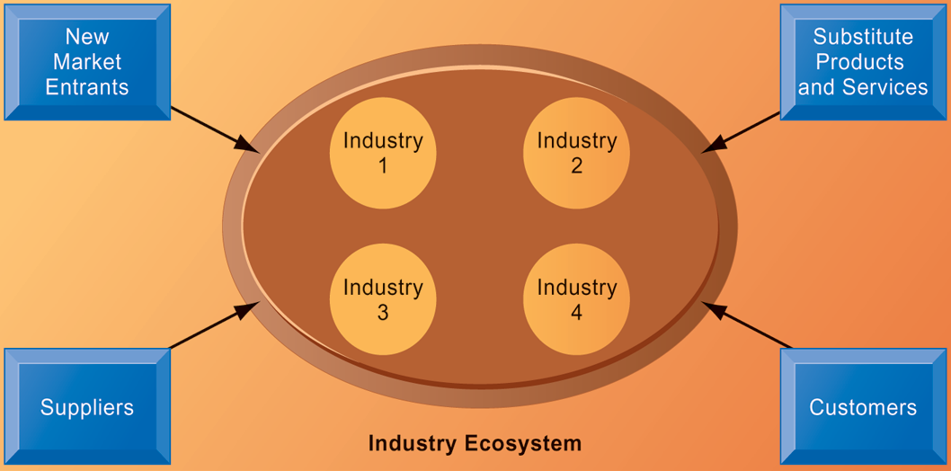
AN ECOSYSTEM STRATEGIC MODEL
FIGURE 3-11
The digital firm era requires a more dynamic view of the boundaries among industries, firms, customers, and suppliers, with competition occurring among industry sets in a business ecosystem. In the ecosystem model, multiple industries work together to deliver value to the customer. IT plays an important role in enabling a dense network of interactions among the participating firms.
Notes:
Emphasize how important IT is in bringing disparate industries together to deliver value to the customer. What are the challenges of coordinating the flow of information across, for example, four different industries, as shown in the figure?

Slide 21
Using Information Systems for Competitive Advantage: Management Issues
Sustaining competitive advantage
  Competitors can retaliate and copy strategic systems
  Systems may become tools for survival
Aligning IT with business objectives
  Performing strategic systems analysis
    Structure of industry
    Firm value chains
Managing strategic transitions
  Adopting strategic systems requires changes in business goals, relationships with customers and suppliers, and business processes
Notes:
Emphasize the importance and difficulty of aligning information technology with the business. What does this phrase mean? It seems pretty simple. Why do so many companies fail at this critical task? Can students think of any other important questions that management should ask about their company before designing their IT systems? What is a solution for the fact that many competitive advantages can be copied? This fact highlights the importance of continuous innovation in order to stay ahead.

