Slide 1
Dr. Fransiskus Adikara, S.Kom, MMSI
IT Resource Management
Sesi 06
Information Evaluation Model Assessment

Slide 2
Definition
“Evaluation models either describe what evaluators do or prescribe what they should do” (Alkin and Ellett, 1990, p.15)

Slide 3
Prescriptive Models
“Prescriptive models are more specific than descriptive models with respect to procedures for planning, conducting, analyzing, and reporting evaluations” (Reeves & Hedberg, 2003, p.36).
Examples:
Kirpatrick: Four-Level Model of Evaluation (1959)
Suchman: Experimental / Evaluation Model (1960s)
Stufflebeam: CIPP Evaluation Model (1970s)

Slide 4
Descriptive Models
They are more general in that they describe the theories that undergird prescriptive models (Alkin & Ellett, 1990)
Examples:
Patton: Qualitative Evaluation Model (1980s)
Stake: Responsive Evaluation Model (1990s)
Hlynka, Belland, & Yeaman: Postmodern Evaluation Model (1990s)

Slide 5
Formative evaluation
An essential part of instructional design models
It is the systematic collection of information for the purpose of informing decisions to design and improve the product / instruction (Flagg, 1990)

Slide 6
Why Formative Evaluation?
The purpose of formative evaluation is to improve the effectiveness of the instruction at its formation stage with systematic collection of information and data (Dick & Carey, 1990; Flagg, 1990).
So that Learners may like the Instruction
So that learners will learn from the Instruction

Slide 7
When?
Early and often
Before it is too late

Slide 8
Revise Instruction
Conduct Instructional Analysis
Assess Needs to Identify Goals
Write Performance Objectives
Develop Assessment Instruments
Develop Instructional Strategy
Develop and Select Instructional Materials
Design and Conduct Formative Evaluation
Analyze Learners and Contexts
Design and Conduct Summative Evaluation
The Dick and Carey Model

Slide 9
What questions to be answered?
Feasibility: Can it be implemented as it is designed?
Usability: Can learners actually use it?
Appeal: Do learners like it?
Effectiveness: Will learners get what is supposed to get?

Slide 10
Strategies
Expert review
Content experts: the scope, sequence, and accuracy of the program’s content
Instructional experts: the effectiveness of the program
Graphic experts: appeal, look and feel of the program
Notes:
Experts: content, SME, graphic designers, teaching and training experts
Accuracy, completeness, user-freiendliness, effectiveness, efficiency, and feasibility
User: target audience, observations and interviewing

Slide 11
Strategies II
User review
A sample of targeted learners whose background are
similar to the final intended users;
Observations: users’ opinions, actions, responses, and suggestions

Slide 12
Strategies III
Field tests
Alpha or Beta tests

Slide 13
Who is the evaluator?
Internal
Member of design and development team

Slide 14
When to stop?
Cost
Deadline
Sometimes, just let things go!

Slide 15
Summative evaluation
The collection of data to summarize the strengths and weakness of instructional materials to make decision about whether to maintain or adopt the materials.

Slide 16
Strategies I
Expert judgment

Slide 17
Strategies II
Field trials

Slide 18
Evaluator
External evaluator

Slide 19
Outcomes
Report or document of data
Recommendations
Rationale

Slide 20
Comparison of Formative & Summative
 | Formative | Summative
Purpose: | Revision | Decision
How: | Peer review, one-to-one, group review, & field trial | Expert judgment, field trial
Materials: | One set of materials | One or several competing instructional materials
Evaluator | Internal | External
Outcomes | A prescription for revising materials | Recommendations and rationale
Source: Dick and Carey (2003). The systematic design of instruction.

Slide 21
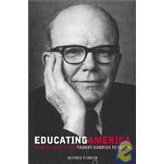
Objective-Driven Evaluation Model (1930s):
R.W. Tyler
A professor in Ohio State University
The director of the Eight Year Study (1934)
Tyler’s objective-driven model is derived from his Eight-Year Study

Slide 22
Objective-Driven Evaluation Model (1930s):
The essence:
The attainment of objectives is the only criteria to
determine whether a program is good or bad.
His Approach:
In designing and evaluating a program: set goals, derive specific behavioral objectives from the goal, establish measures to the objectives, reconcile the instruction to the objectives, and finally evaluate the program against the attainment of these objectives.

Slide 23
Tyler’s Influence
Influence: Tyler’s emphasis on the importance of objectives has influenced many aspects of education.
The specification of objectives is a major factor in virtually all instruction design models
Objectives provide the basis for the development of measurement procedures and instruments that can be used to evaluate the effectiveness of instruction
It is hard to proceed without specification of objectives

Slide 24
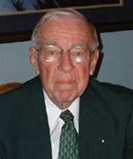
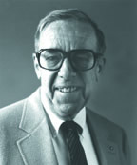
Four-Level Model of Evaluation (1959):
D. Kirpatrick

Slide 25
Kirkpatrick’s four levels:
The first level (reactions)
the assessment of learners’ reactions or attitudes toward the learning experience
The second level (learning)
an assessment how well the learners grasp of the instruction. Kirkpatrick suggested that a control group, a pre-test/posttest design be used to assess statistically the learning of the learners as a result of the instruction
The third level (behavior)
follow-up assessment on the actual performance of the learners as a result of the instruction. It is to determine whether the skills or knowledge learned in the classroom setting are being used, and how well they are being used in job setting.
The final level (results)
to assess the changes in the organization as a result of the instruction

Slide 26
Kirkpatrick’s model
“Kirkpatrick’s model of evaluation expands the application of formative evaluation to the performance or job site” (Dick, 2002, p.152).

Slide 27
Experimental Evaluation Model (1960s):
The experimental model is a widely accepted and employed approach to evaluation and research.
Suchman was identified as one of the originators and the strongest advocate of experimental approach to evaluation.
This approach uses such techniques as pretest/posttest, experimental group vs. control group, to evaluate the effectiveness of an educational program.
It is still popularly used today.

Slide 28
CIPP Evaluation Model (1970s):
D. L. Stufflebeam .
CIPP stands for Context, Input, Process, and Product.

Slide 29
CIPP Evaluation Model
Context is about the environment in which a program would be used. This context analysis is called a needs assessment.
Input analysis is about the resources that will be used to develop the program, such as people, funds, space and equipment.
Process evaluation examines the status during the development of the program (formative)
Product evaluation that assessments on the success of the program (summative)

Slide 30
CIPP Evaluation Model
Stufflebean’s CIPP evaluation model was the most influential model in the 1970s.
(Reiser & Dempsey,2002)

Slide 31
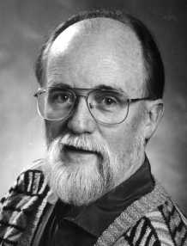
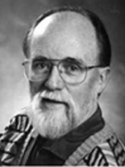
Qualitative Evaluation Model (1980s)
Michael Quinn Patton, Professor, Union Institute and University & Former President of the American Evaluation Association

Slide 32
Qualitative Evaluation Model
Patton’s model emphases the qualitative methods, such as observations, case studies, interviews, and document analysis.
Critics of the model claim that qualitative approaches are too subjective and results will be biased.
However, qualitative approach in this model is accepted and used by many ID models, such as Dick & Carey model.

Slide 33
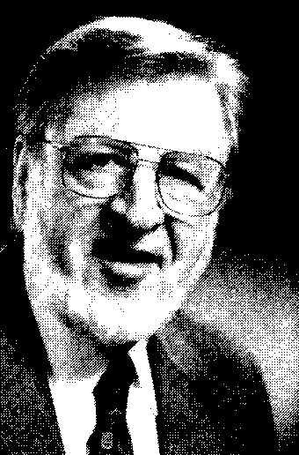
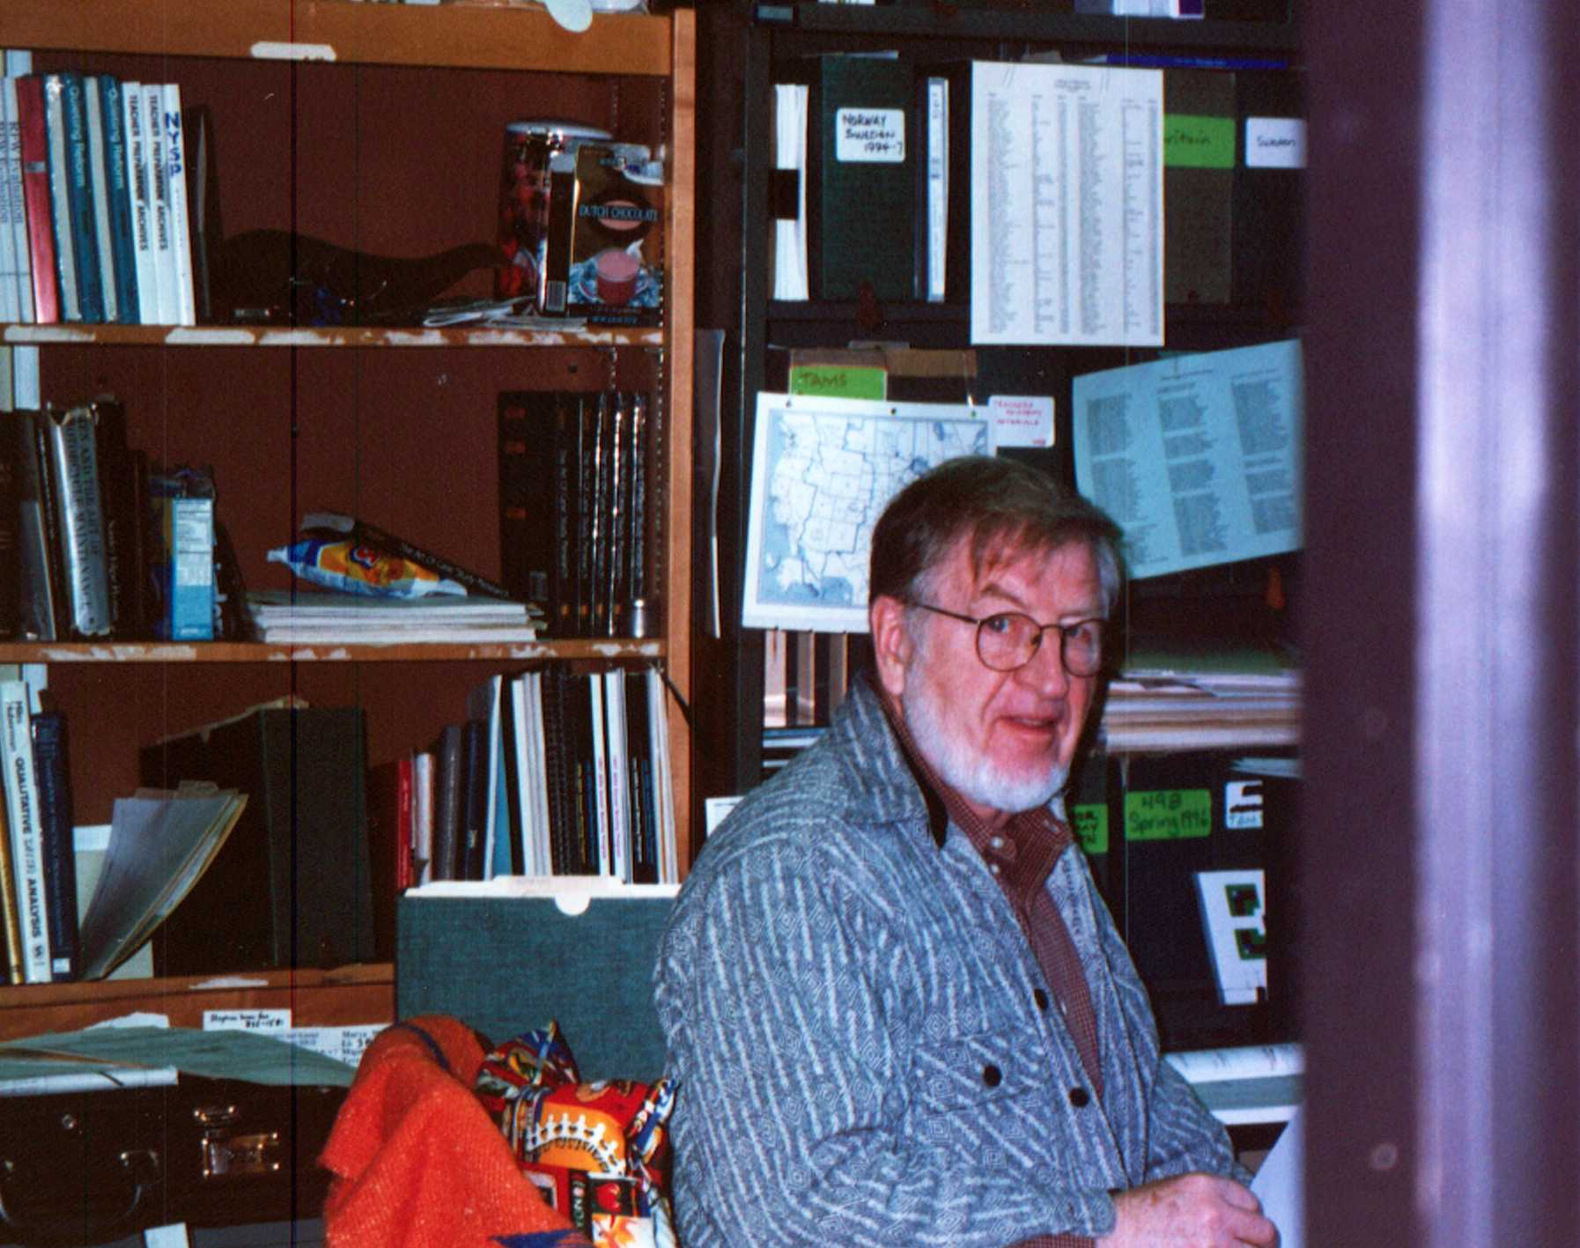
Responsive Evaluation Model (1990s)
Robert E. Stake
He has been active in the program evaluation profession
He took up a qualitative perspective, particularly case study methods, in order to represent the complexity of evaluation study

Slide 34
Responsive Evaluation Model
It emphasizes the issues, language, contexts, and standards of stakeholders
Stakeholders: administrators, teachers, students, parents, developers, evaluators…
His methods are negotiated by the stakeholders in the evaluation during the development
Evaluators try to expose the subjectivity of their judgment as other stakeholders
The continuous nature of observation and reporting

Slide 35
Responsive Evaluation Model
This model is criticized for its subjectivity.
His response: subjectivity is inherent in any evaluation or measurement.
Evaluators endeavor to expose the origins of their subjectivity while other types of evaluation may disguise their subjectivity by using so-called objective tests and experimental designs

Slide 36
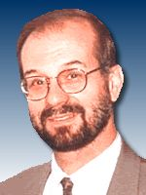
Postmodern Evaluation Model (1990s):
Dennis Hlynka
Andrew R. J. Yeaman

Slide 37
The postmodern evaluation model
Advocates criticized the modern technologies and positivist modes of inquiry.
They viewed educational technologies as a series of failed innovations.
They opposed the systematic inquiry and evaluation.
ID is a tool of positivists who hold onto the false hope of linear progress

Slide 38
How to be a postmodernist
Consider concepts, ideas and objects as texts. Textual meanings are open to interpretation
Look for binary oppositions in those texts. Some usual oppositions are good/bad, progress/tradition, science/myth, love/hate, man/woman, and truth/fiction
Consider the critics, the minority, the alternative view, do not assume that your program is the best

Slide 39
The postmodern evaluation model
Anti-technology, anti-progress , and anti-science
Hard to use,
Some evaluation perspectives, such as race, culture and politics can be useful in evaluation process (Reeves & Hedberg, 2003).

Slide 40
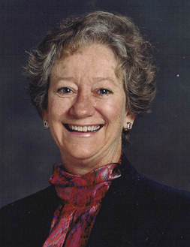
Fourth generation model
E.G. Guba
S. Lincoln

Slide 41
Fourth generation model
Seven principles that underlie their model (constructive perspective)
Evaluation is a social political process
Evaluation is a collaborative process
Evaluation is a teaching/learning process
Evaluation is a continuous, recursive, and highly divergent process
Evaluation is an emergent process
Evaluation is a process with unpredictable outcomes
Evaluation is a process that creates reality

Slide 42
Fourth generation model
Outcome of evaluation is rich, thick description based on extended observation and careful reflection
They recommend negotiation strategies for reaching consensus about the purposes, methods, and outcomes of evaluation

Slide 43
Multiple methods evaluation model
M.M. Mark and R.L. Shotland

Slide 44
Multiple methods evaluation model
One plus one are not necessarily more beautiful than one
Multiple methods are only appropriate when they are chosen for a particularly complex program that cannot be adequately assessed with a single method

Slide 45
REFERENCES
Dick, W. (2002). Evaluation in instructional design: the impact of Kirkpatrick’s four-level model. In Reiser, R.A., & Dempsey, J.V. (Eds.). Trends and issues in instructional design and technology. New Jersey: Merrill Prentice Hall.
Dick, W., & Carey, L. (1990). The systematic design of instruction. Florida: HarperCollinsPublishers.
Reeves, T. & Hedberg, J. (2003). Interactive Learning Systems Evaluation. Educational Technology Publications.
Reiser, R.A. (2002). A history of instructional design and technology. In Reiser, R.A., & Dempsey, J.V. (Eds.). Trends and issues in instructional design and technology. New Jersey: Merrill Prentice Hall.
Stake, R.E. (1990). Responsive Evaluation. In Walberg, H.J. & Haetel, G.D.(Eds.), The international encyclopedia of educational evaluation (pp.75-77). New York: Pergamon Press.

