Slide 1
Dr. Fransiskus Adikara, S.Kom, MMSI
IT Resource Management
Sesi 07
Review Topics and Model

Slide 2
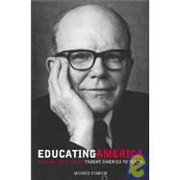
Objective-Driven Evaluation Model (1930s):
R.W. Tyler
A professor in Ohio State University
The director of the Eight Year Study (1934)
Tyler’s objective-driven model is derived from his Eight-Year Study

Slide 3
Objective-Driven Evaluation Model (1930s):
The essence:
The attainment of objectives is the only criteria to
determine whether a program is good or bad.
His Approach:
In designing and evaluating a program: set goals, derive specific behavioral objectives from the goal, establish measures to the objectives, reconcile the instruction to the objectives, and finally evaluate the program against the attainment of these objectives.

Slide 4
Tyler’s Influence
Influence: Tyler’s emphasis on the importance of objectives has influenced many aspects of education.
The specification of objectives is a major factor in virtually all instruction design models
Objectives provide the basis for the development of measurement procedures and instruments that can be used to evaluate the effectiveness of instruction
It is hard to proceed without specification of objectives

Slide 5
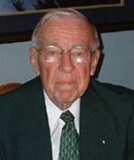
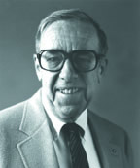
Four-Level Model of Evaluation (1959):
D. Kirpatrick

Slide 6
Kirkpatrick’s four levels:
The first level (reactions)
the assessment of learners’ reactions or attitudes toward the learning experience
The second level (learning)
an assessment how well the learners grasp of the instruction. Kirkpatrick suggested that a control group, a pre-test/posttest design be used to assess statistically the learning of the learners as a result of the instruction
The third level (behavior)
follow-up assessment on the actual performance of the learners as a result of the instruction. It is to determine whether the skills or knowledge learned in the classroom setting are being used, and how well they are being used in job setting.
The final level (results)
to assess the changes in the organization as a result of the instruction

Slide 7
Kirkpatrick’s model
“Kirkpatrick’s model of evaluation expands the application of formative evaluation to the performance or job site” (Dick, 2002, p.152).

Slide 8
Experimental Evaluation Model (1960s):
The experimental model is a widely accepted and employed approach to evaluation and research.
Suchman was identified as one of the originators and the strongest advocate of experimental approach to evaluation.
This approach uses such techniques as pretest/posttest, experimental group vs. control group, to evaluate the effectiveness of an educational program.
It is still popularly used today.

Slide 9
CIPP Evaluation Model (1970s):
D. L. Stufflebeam .
CIPP stands for Context, Input, Process, and Product.

Slide 10
CIPP Evaluation Model
Context is about the environment in which a program would be used. This context analysis is called a needs assessment.
Input analysis is about the resources that will be used to develop the program, such as people, funds, space and equipment.
Process evaluation examines the status during the development of the program (formative)
Product evaluation that assessments on the success of the program (summative)

Slide 11
CIPP Evaluation Model
Stufflebean’s CIPP evaluation model was the most influential model in the 1970s.
(Reiser & Dempsey,2002)

Slide 12
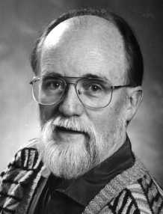
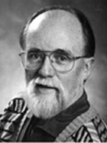
Qualitative Evaluation Model (1980s)
Michael Quinn Patton, Professor, Union Institute and University & Former President of the American Evaluation Association

Slide 13
Qualitative Evaluation Model
Patton’s model emphases the qualitative methods, such as observations, case studies, interviews, and document analysis.
Critics of the model claim that qualitative approaches are too subjective and results will be biased.
However, qualitative approach in this model is accepted and used by many ID models, such as Dick & Carey model.

Slide 14
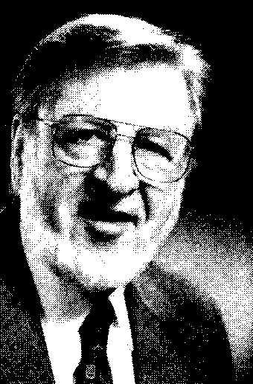
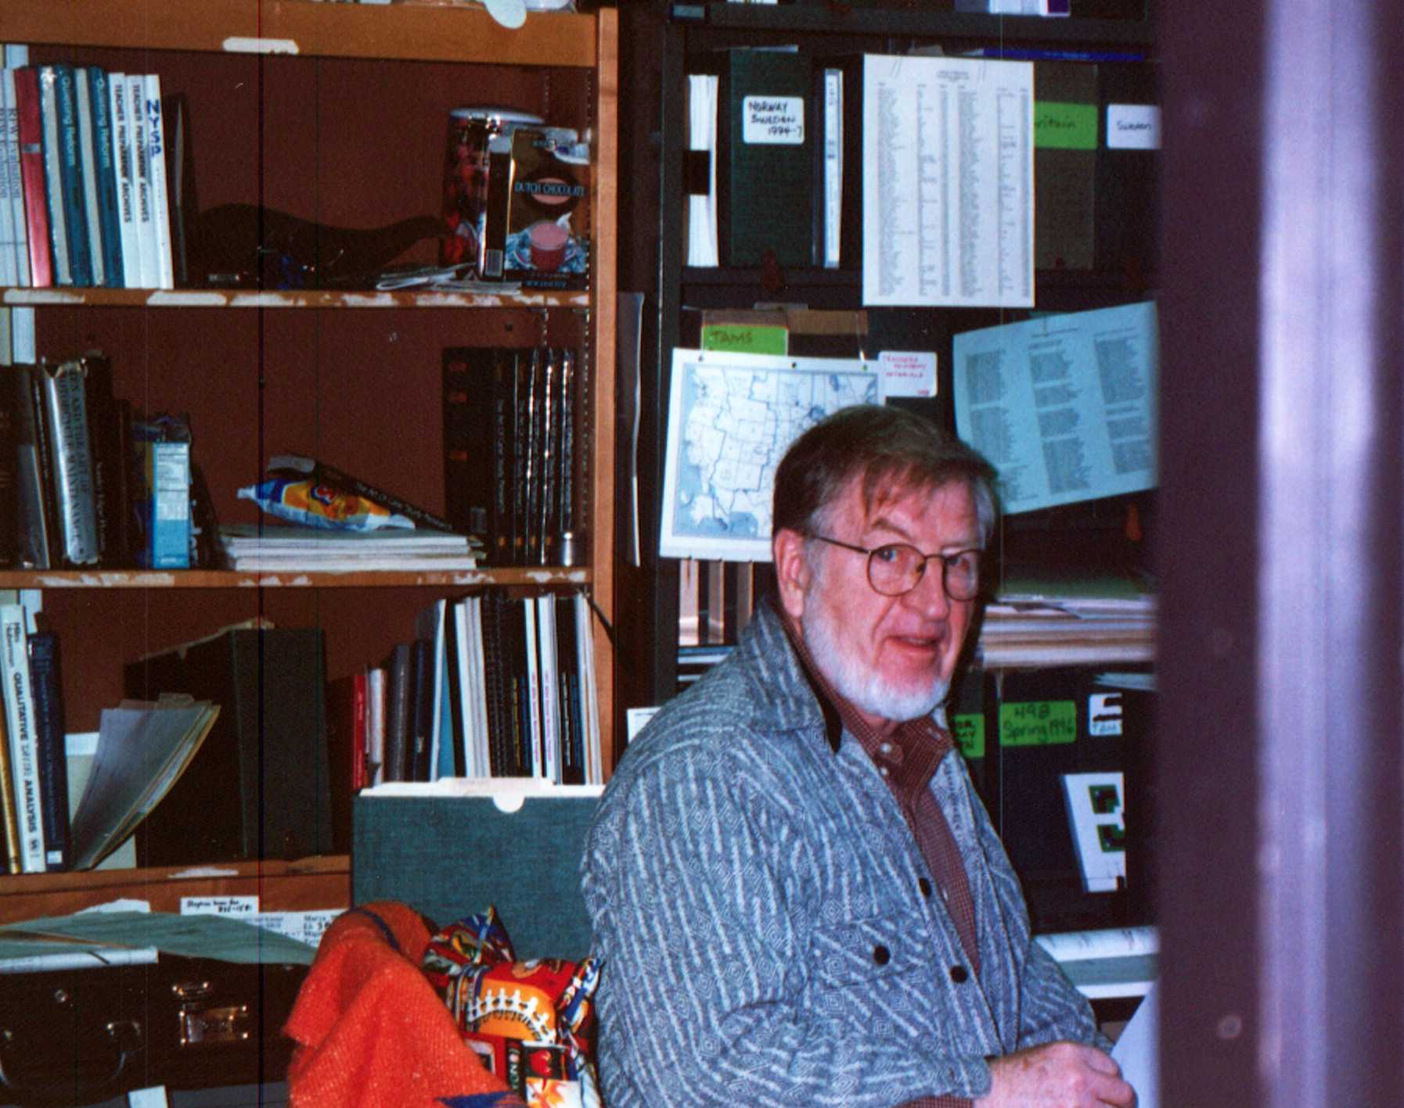
Responsive Evaluation Model (1990s)
Robert E. Stake
He has been active in the program evaluation profession
He took up a qualitative perspective, particularly case study methods, in order to represent the complexity of evaluation study

Slide 15
Responsive Evaluation Model
It emphasizes the issues, language, contexts, and standards of stakeholders
Stakeholders: administrators, teachers, students, parents, developers, evaluators…
His methods are negotiated by the stakeholders in the evaluation during the development
Evaluators try to expose the subjectivity of their judgment as other stakeholders
The continuous nature of observation and reporting

Slide 16
Responsive Evaluation Model
This model is criticized for its subjectivity.
His response: subjectivity is inherent in any evaluation or measurement.
Evaluators endeavor to expose the origins of their subjectivity while other types of evaluation may disguise their subjectivity by using so-called objective tests and experimental designs

Slide 17
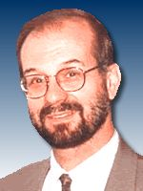
Postmodern Evaluation Model (1990s):
Dennis Hlynka
Andrew R. J. Yeaman

Slide 18
The postmodern evaluation model
Advocates criticized the modern technologies and positivist modes of inquiry.
They viewed educational technologies as a series of failed innovations.
They opposed the systematic inquiry and evaluation.
ID is a tool of positivists who hold onto the false hope of linear progress

Slide 19
How to be a postmodernist
Consider concepts, ideas and objects as texts. Textual meanings are open to interpretation
Look for binary oppositions in those texts. Some usual oppositions are good/bad, progress/tradition, science/myth, love/hate, man/woman, and truth/fiction
Consider the critics, the minority, the alternative view, do not assume that your program is the best

Slide 20
The postmodern evaluation model
Anti-technology, anti-progress , and anti-science
Hard to use,
Some evaluation perspectives, such as race, culture and politics can be useful in evaluation process (Reeves & Hedberg, 2003).

Slide 21
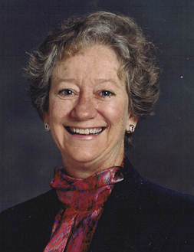
Fourth generation model
E.G. Guba
S. Lincoln

Slide 22
Fourth generation model
Seven principles that underlie their model (constructive perspective)
Evaluation is a social political process
Evaluation is a collaborative process
Evaluation is a teaching/learning process
Evaluation is a continuous, recursive, and highly divergent process
Evaluation is an emergent process
Evaluation is a process with unpredictable outcomes
Evaluation is a process that creates reality

Slide 23
Fourth generation model
Outcome of evaluation is rich, thick description based on extended observation and careful reflection
They recommend negotiation strategies for reaching consensus about the purposes, methods, and outcomes of evaluation

Slide 24
Multiple methods evaluation model
M.M. Mark and R.L. Shotland

Slide 25
Multiple methods evaluation model
One plus one are not necessarily more beautiful than one
Multiple methods are only appropriate when they are chosen for a particularly complex program that cannot be adequately assessed with a single method

Slide 26
REFERENCES
Dick, W. (2002). Evaluation in instructional design: the impact of Kirkpatrick’s four-level model. In Reiser, R.A., & Dempsey, J.V. (Eds.). Trends and issues in instructional design and technology. New Jersey: Merrill Prentice Hall.
Dick, W., & Carey, L. (1990). The systematic design of instruction. Florida: HarperCollinsPublishers.
Reeves, T. & Hedberg, J. (2003). Interactive Learning Systems Evaluation. Educational Technology Publications.
Reiser, R.A. (2002). A history of instructional design and technology. In Reiser, R.A., & Dempsey, J.V. (Eds.). Trends and issues in instructional design and technology. New Jersey: Merrill Prentice Hall.
Stake, R.E. (1990). Responsive Evaluation. In Walberg, H.J. & Haetel, G.D.(Eds.), The international encyclopedia of educational evaluation (pp.75-77). New York: Pergamon Press.

