Slide 1
GOAL MODELING AND GRL
AGUNG MULYO WIDODO
TEKNIK INFORMATIKA

Slide 2
KEMAMPUAN AKHIR YANG DIHARAPKAN
Martha can’t write requirements because…
Anatomy of a Good / Bad User Requirement
Standard for Writing a Requirement
Writing Pitfalls to Avoid
A Few Simple Tests…
The greatest challenge to any thinker is stating the problem in a way that will allow a solution.¹
Notes:
a

Slide 3

BUKU PEMBELAJARAN
Jeremy Dick, Elizabeth Hull, Ken Jackson, Requirements Engineering, Springer-Verlag, 2004
Soren Lauesen Software Requirements - Styles and Techniques, Addison Wesley, 2002
Ian K. Bray , An Introduction to Requirements Engineering, Addison Wesley,
2002
Colin Hood, Simon Wiedemann , Stefan FichtingerUrte Pautz ,Requirements Management, Springer-Verlag, 2008

Slide 4
REFERENSI
B. A. Nuseibeh and S. M. Easterbrook, Requirements Engineering: A Roadmap. In A. C. W. Finkelstein (ed) The Future of Software Engineering, ACM Press, 2000
http://www.cs.toronto.edu/~sme/papers/2000/ICSE2000.pdf
Simson Garfinkel, History's Worst Software Bugs, Wired News, 2005
http://www.wired.com/news/technology/bugs/0,2924,69355,00.html
INCOSE Requirements Working Group
http://www.incose.org/practice/techactivities/wg/rqmts/
Tools Survey: Requirements Management (RM) Tools
http://www.incose.org/productspubs/products/rmsurvey.aspx
http://www.volere.co.uk/tools.htm
IEEE (1993) Recommended Practice for Software Requirements Specifications. IEEE Std 830-1993, NY, USA.
IEEE (1995) Guide for Developing System Requirements Specifications. IEEE Std P1233/D3, NY, USA.
Requirements Engineering Conference
http://www.requirements-engineering.org/

Slide 5
Goal Modeling

Slide 6
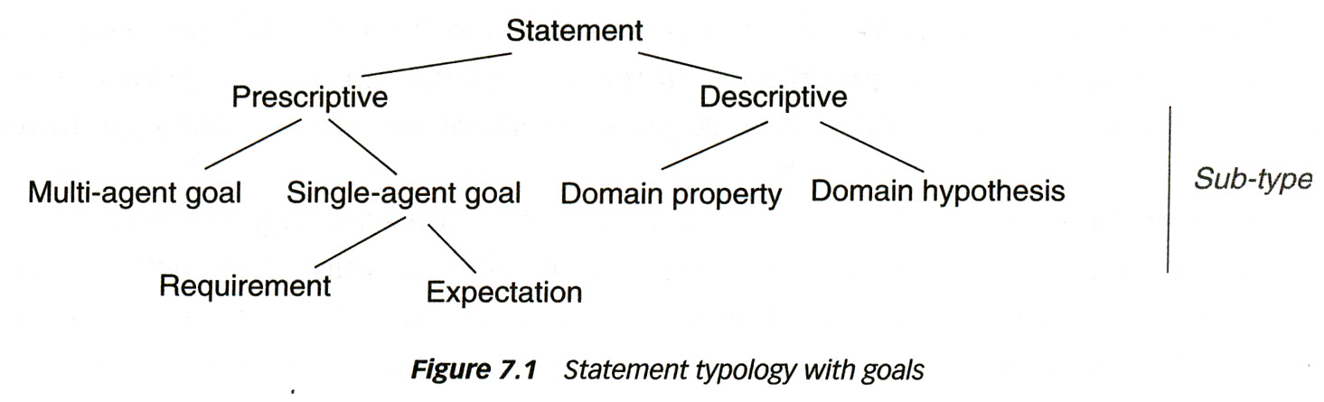
Different types of statements
Descriptive: describes some (existing) situation
Prescriptive: describes some situation that is desired to be true
Goal: “a prescriptive statement of intent that the system should satisfy through the cooperation of its agents”
  Goal satisfaction may involve a variety of agents, such as actors in the system’s environment, as well as the system as a whole or its components
Requirement: a goal under the responsibility of a single agent (the system-to-be or a component of it)
Expectation: a goal under the responsibility of a single agent in the environment of the system-to-be. Note: this is an assumption that the system can make

Slide 7
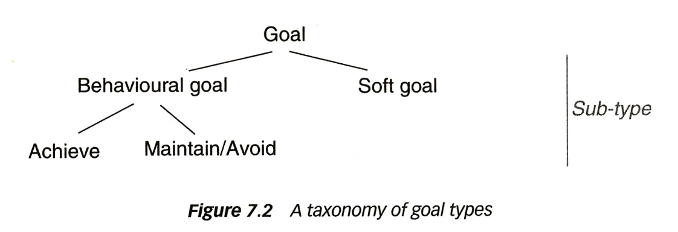
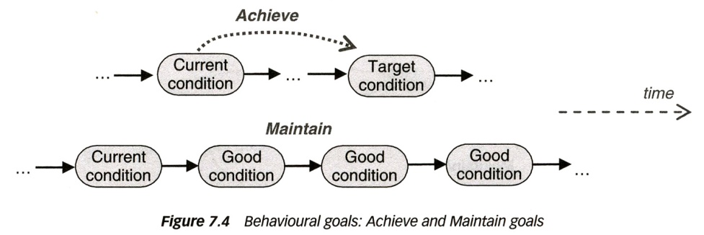
Different types of goals
Behavioral goal: establishment of goal can be checked
  Describes intended behavior declaratively
  Implicitly defines a maximal set of admissible behaviors
    Achieve: points to future (like “eventually” operator in Temporal Logic)
    Maintain/Avoid: states property that always holds (like “always” operator)
Soft-Goal: are more or less fulfilled by different alternatives of (external) design – often difficult to quantify – one says, some alternative may “satisfice” the goal

Slide 8
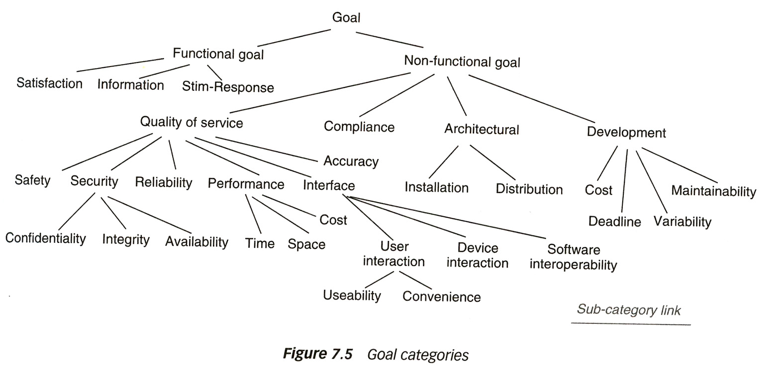
Different categories of goals (requirements)
This is the same as the classification of requirements into functional and non-functional (with all its sub-categories)

Slide 9
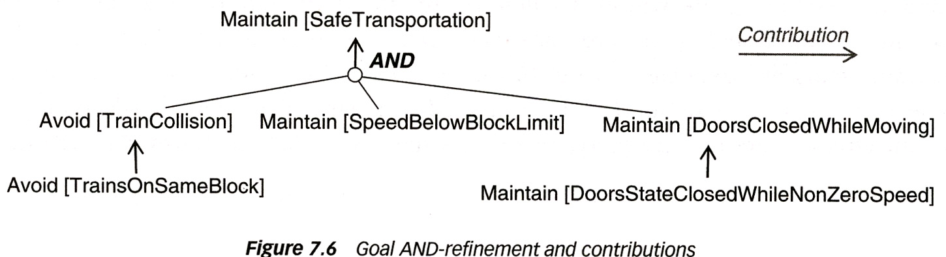
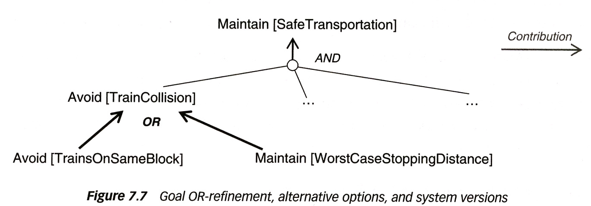
Goal refinement
Goal refinement: expressing how a more abstract goal can be established by a set of more low-level goals – AND and OR refinement

Slide 10
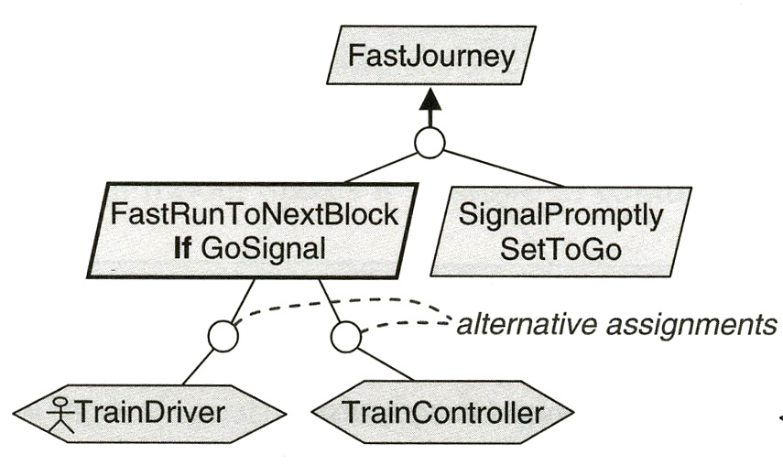
Goal - responsibility assignment
Responsibility assignment: who are the responsible agents ?
  Note: For a high-level goal, there are often several agents involved.
Example: only one agent - but two alternatives
Goal
Agent

Slide 11
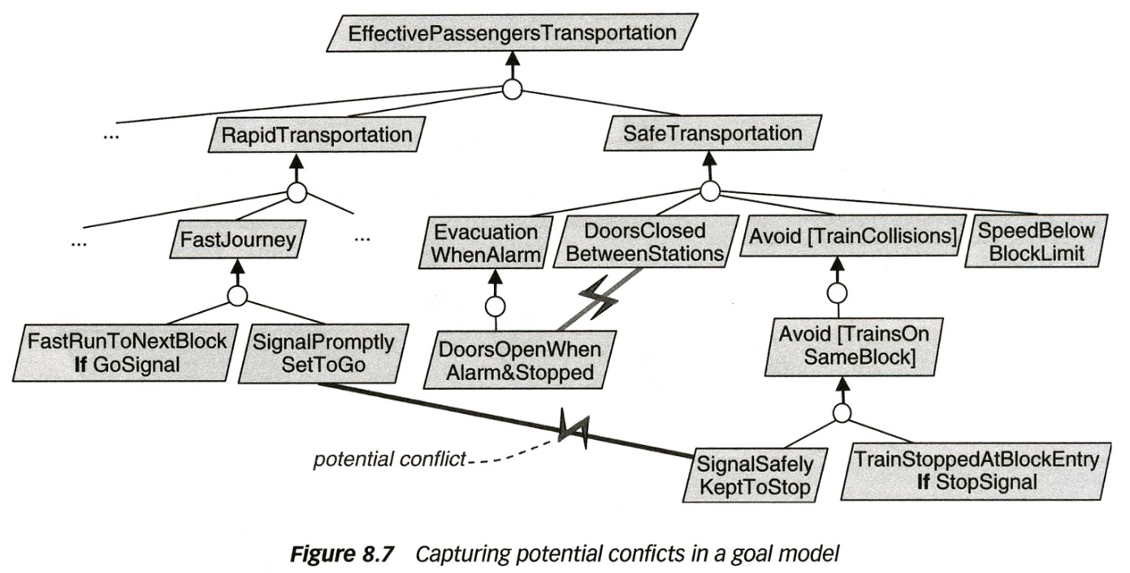
Risks – obstacles - conflicts
Risk: “uncertain factor whose occurrence may result in the loss of attainment of some corresponding objective” - “goal negation”
Obstacle to a goal: a pre-condition for the non-satisfaction of the statement – that is, if the obstacle is true then the goal cannot be satisfied
Conflict between several goals/requirements: conflicts between requirements are often due to conflicts between the underlying goals, which may belong to different stakeholders – need for conflict resolution with stakeholders

Slide 12
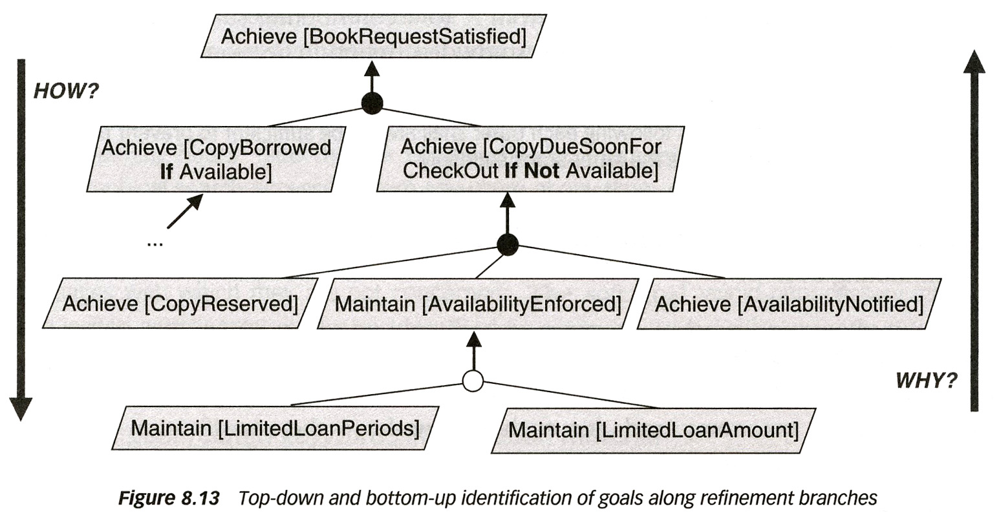
Reasoning about goals
Goal refinement
- decomposition
For precisely defined behavioral goals and corresponding refinement tree, one can present proofs of correctness for the reasoning.
Rationale: reasoning behind some (external) design choice or the statement of some goal contribution

Slide 13
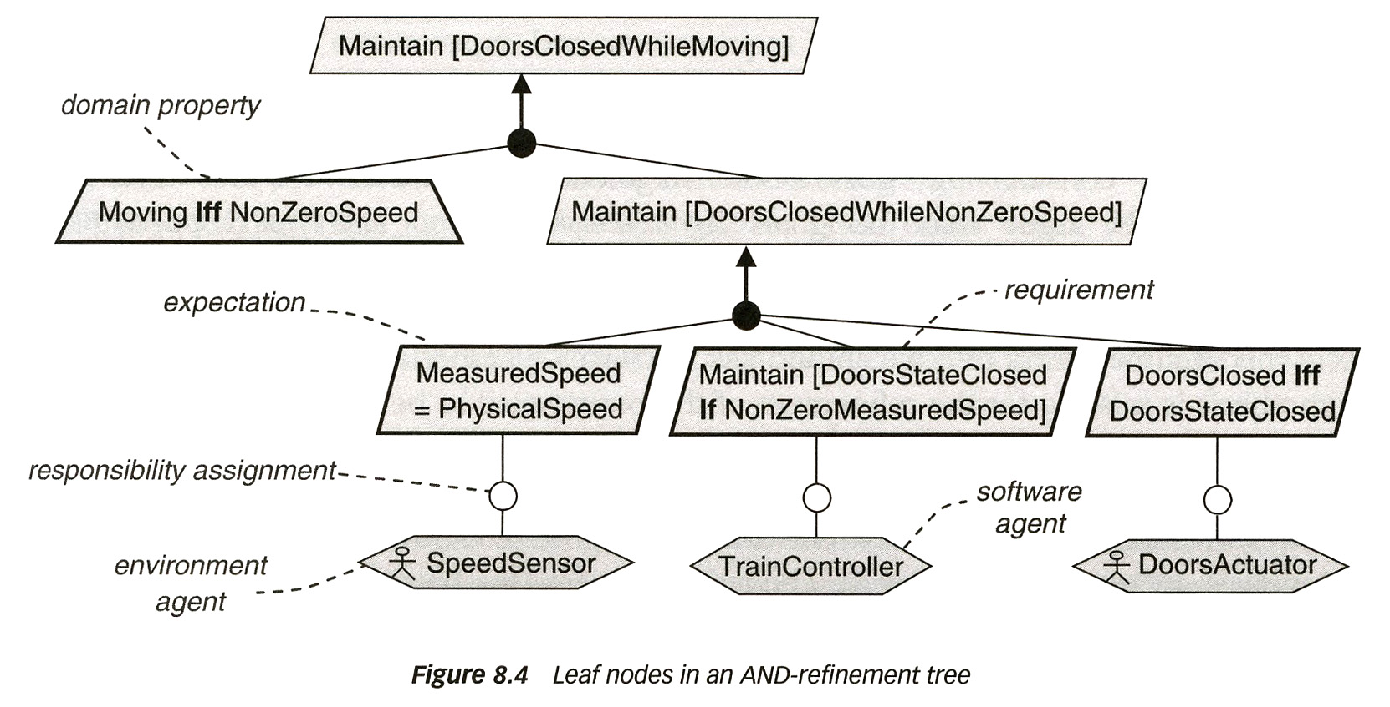
Example: a goal decomposition that can be verified

Slide 14
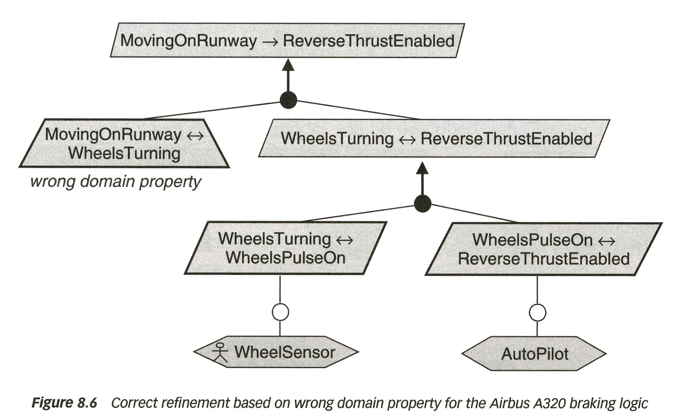
Example: a faulty assumption in the rationale

Slide 15
Example: a faulty assumption in the rationale

Slide 16
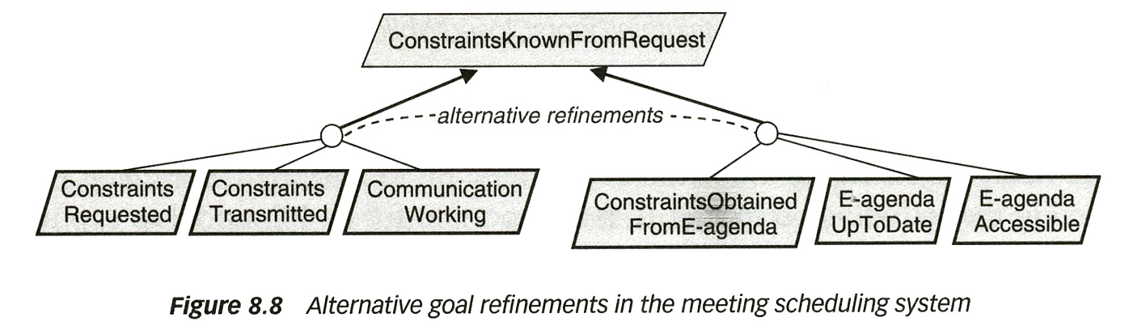
Example: alternative goal refinements
This means, different alternatives for the (external) design
Given some other soft goal (not mentioned above), this goal may be satisficed to different degrees by the two alternatives.
This may become the rationale for selecting one of the alternatives.

Slide 17
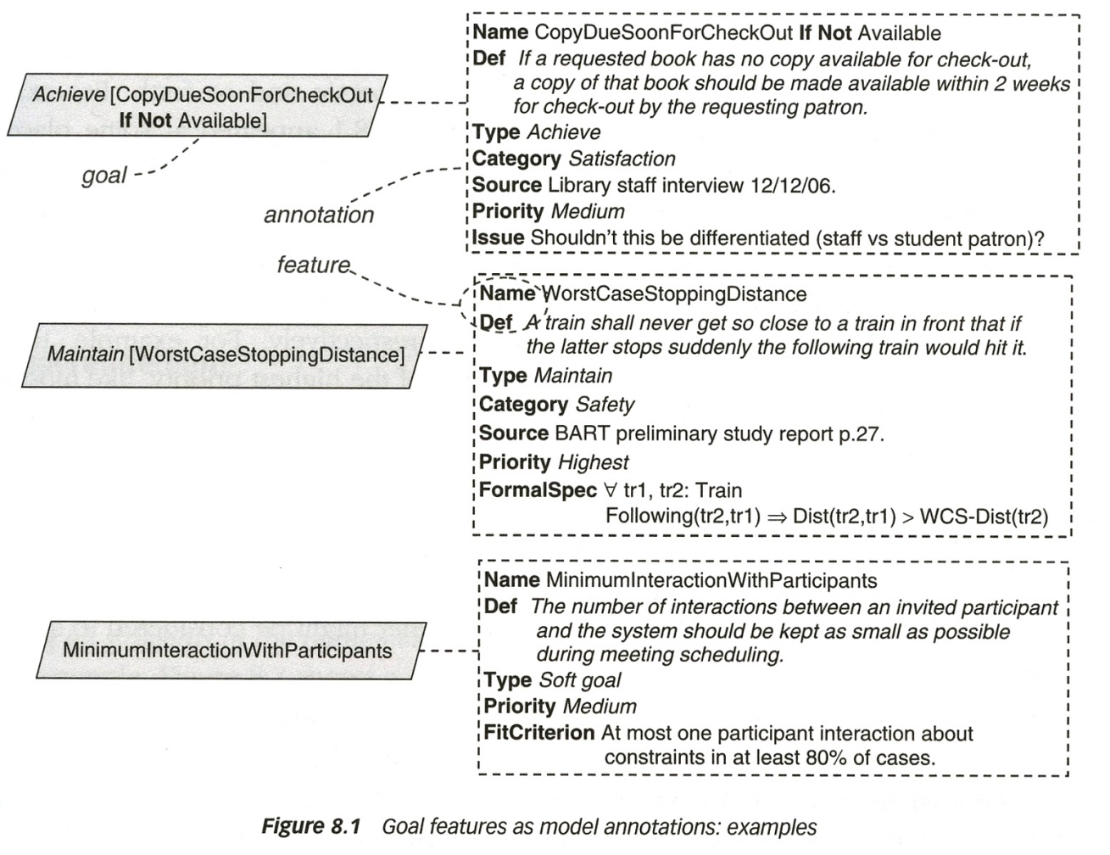
Templates / notations for defining goals and contributions
There are many notations for goals and goal contributions
  Notation from the book by Lamsweerde
  i* = istar (developed at the University of Toronto) and GRL (see below)

Slide 18
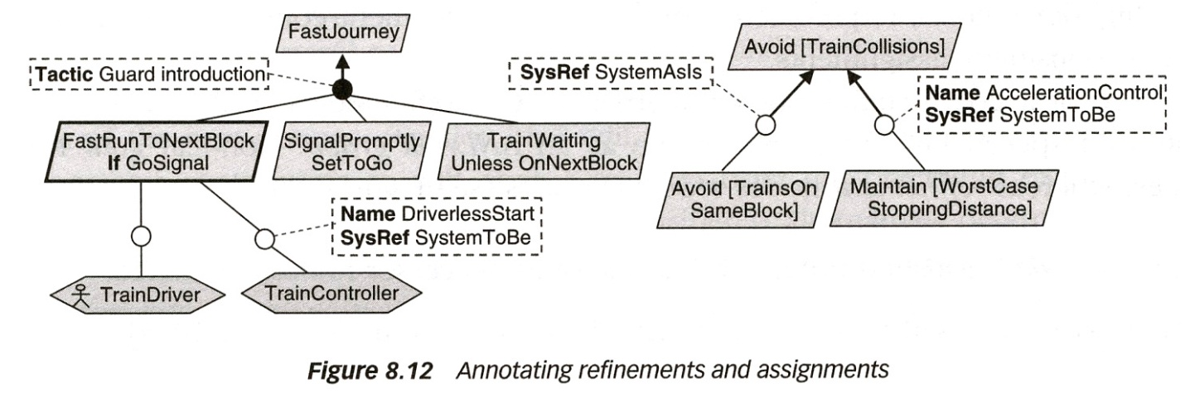
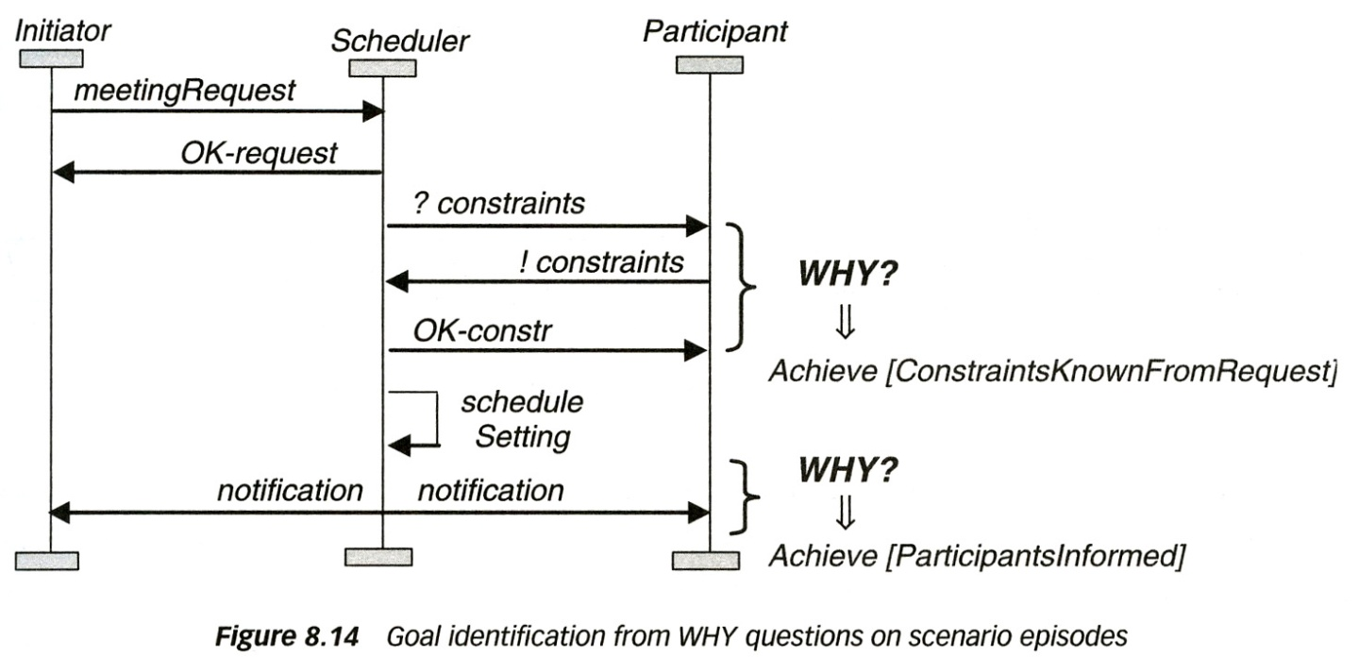
Goal contributions – tracability (examples of notations)

Slide 19
The central role of goals in requirements engineering
Goal refinement provides a natural mechanism for structuring complex specifications at different levels of concern.
Goals provide the rationale for requirements.
Goals drive the identification of requirements to support them.
Goals provide a richer structure for satisfaction arguments.
Goals provide a basis for showing the alignment of the system-to-be with the organization’s strategic objectives.
Goals provide a precise criterion for requirements completeness.
Goals provide a precise criterion for requirements pertinence.
Goals provide a natural way of structuring the RD.
Goals provide anchors for risk analysis.
Goals provide the roots for managing conflicts among requirements.
Goals provide a criterion for delimiting the scope of the system.
Goals support the analysis of dependencies among agents.
Goals provide a basis for reasoning about alternative options.
Goals support traceability management.
Goals provide essential information for evolution support.

Slide 20
Another definition of “goal”
Goal: high level objective of the business, organization or system
  A requirement specifies how a goal should be accomplished by a proposed system
Operationalization: the process of defining a goal with enough detail so that its sub-goals have an operational definition.
Decomposition: the process of subdividing a set of goals into a logical sub-grouping so that system requirements can be more easily understood, defined and specified.
Obstacles: behaviours or other goals that prevent or block the achievement of a given goal.
  Abstracting and identifying goal obstacles allows one to consider the possible ways for goals to fail and anticipate exception cases.

Slide 21
Comments* on previous slide
This alternative definition of “goal” appears to be less useful.
It seems to correspond to what Lamsweerde called SoftGoal
Example of SoftGoals and their use for choosing between alternative (external) designs: Consider an ATM terminal
Question: Alternative Authentication Mechanisms?
References: Service: Authenticate (this is a Goal)
Criteria 1:
ATM Unit Cost
Criteria 2:
Privacy
Option 1: Account number
+
–
Option 2: Fingerprint reader
–
+
Option 3: Smart Card + PIN
+
+
Criteria 1 and 2 are SoftGoals
* Source: G.v.B.

Slide 22
GOAL-ORIENTED REQUIREMENTS LANGUAGE
(GRL)

Slide 23
GRL Overview (1)
The Goal-oriented Requirement Language (GRL)
  Graphical notation
  Connects requirements to business objectives
  Allows reasoning about (non-functional) requirements
  Is based on i* (concepts / syntax) and the NFR Framework (evaluation mechanism)
GRL models the “why” aspect
  Model goals and other intentional concepts
  Little or no operational details
  Supports goal and trade-off analysis and evaluations

Slide 24
GRL Overview (2)
GRL is used to …
  Visually describe business goals, objectives, stakeholders’ priorities, alternative solutions, rationale, and decisions
  Decompose high-level goals into alternative solutions called tasks (this process is called operationalization)
  Model positive & negative influences of goals and tasks on each other
  Capture dependencies between actors (i.e., stakeholders)
  Reason about alternatives and trade-offs
In essence …
GRL can be used for what we discussed above using the notation from Lamsweerde’s book. GRL uses a different notation and has some additional concepts.
GRL is mainly designed for SoftGoals with their fuzzy satisfaction criteria. Not intended for the verification of behavioral goals, as in some of the examples above.
There is a tool, called jUCMNav, that supports this language.

Slide 25
GRL Notation – an example
GRL Example: Tiny Online Business
Resource
Business
Owner
Online Shopper
Increase
Sales
Payment
Offer Online
Shopping
+
+
Dependency
Contribution
System
Security
Actor
Softgoal
Cost of
Terminal
+
+
.
Correlation
_
Security of
Terminal
Security
of Host
+
.
+
.
+
Decomposition
Access
Authorization
Encryption
Biometrics is no
regular, off-the-shelf
technology
Authentication
AND
OR
Task
Belief
Identification
Fingerprint
Password
Cardkey
Goal

Slide 26
GRL Concepts
Concepts already discussed in Lamsweerde’s notation
  Goal, Softgoal, contributions including AND, OR, also XOR relationships (the GRL correlation is similar)
    Note: Achievement of softgoal is qualifiable but not measurable; it is quantifiable for goals (Softgoals are often non-functional, goals functional)
  Actor : appears to be a subtype of Agent
  Belief : appears to be the same as a Rationale
Other concepts:
  Task: a proposed solution that achieves a goal or satisfices a softgoal
    This appears to be similar to the concept of agent responsible for realizing some goal
  Dependency: An actor (the depender) depends on another actor (the dependee) for something (the dependum), e.g. the business owner depends on the online shopper for payment (the dependum is optional)
  Resource: used in dependencies as dependum

Slide 27
GRL Notation (2)
GRL Contributions Types:
(qualitative)
Contribution and Correlation Links
  Contribution describes desired impact,
  correlation shows side effects
  Qualitative or quantitative contribution types
  are used for these links
Note: In GRL, contributions can be negative, that is, the contributor (sub-goal or task) may be an obstacle.
Break
Make
Some+
Some-
Hurt
?
Help
Unknown

Slide 28
GRL Notation (3)
GRL graphs can be allocated to actors
Dependencies can be defined between actors
together with
intermediate
resources or
other
elements
Provides a strategic view

Slide 29
Why GRL?
These are essentially arguments that were already given when we discussed goals above.
Goals become an important driver for requirements elaboration – yet, stakeholders goals and objectives are complex and will conflict…
GRL expresses and clarifies tentative, ill-defined, and ambiguous requirements
  Supports argumentation, negotiation, conflict detection & resolution, and in general decisions
  Captures decision rationale and criteria (documentation!)
GRL identifies alternative requirements and alternative system boundaries
GRL provides clear traceability from strategic objectives to technical requirements
GRL allows reuse of stable higher-level goals when the system evolves
There is nothing like this in UML…

Slide 30
GRL – Strategies and Evaluation Mechanism (1)
GRL allows a particular configuration of intentional elements to be defined in a strategy (i.e., one possible solution)
  Captures the initial, user-defined satisfaction levels for these elements separately from the GRL graphs
  Strategies can be compared with each other for trade-off analyses
In order to analyze the goal model and compare solutions with each other, jUCMNav’s customizable evaluation mechanism executes the strategies
  Propagating satisfaction levels to the other elements and to actors shows impact of proposed solution on high level goals for each stakeholder
  Propagation starts at user-defined satisfaction levels of intentional elements (usually bottom-up)

Slide 31
GRL – Strategies and Evaluation Mechanism (2)
Evaluations of GRL graphs show the impact of qualitative decisions on high-level softgoals
Evaluation mechanism takes into consideration
  Initial satisfaction levels of children (intentional elements)
  Links, types of these links, and contribution/decomposition types
  Importance defined for intentional elements
More complete than simple pros/cons tables or criteria evaluation matrices
For details, see Chapter 11.1 and Appendix II of the Z.151 standard
  Standard provides minimum requirements

Slide 32





GRL – Qualitative or Quantitative Approach
GRL Satisfaction Levels:
(qualitative)
Qualitative Approach
  Contribution types: from Make to Break
  Importance: High, Medium, Low, or None
  Qualitative satisfaction levels
Quantitative Approach
  Contribution types: [-100, 100]
  Importance: [0, 100]
  Quantitative satisfaction levels: [-100, 100]
Hybrid Approach is also possible
  Qualitative contribution types
  Quantitative importance
  Quantitative satisfaction levels
Satisfied
Weakly
Satisfied
Unknown
Weakly
Denied
Denied
Conflict
None

Slide 33
GRL – Strategy Execution (Strategy 1)
GRL Example: Tiny Online Business
42
25
Business
Owner
*
*
100
100
Payment
Payment
Offer Online
Shopping
+
Offer Online
Shopping
high
+
44
high
System
Security
Importance
System
Security
medium
75
Cost of
Terminal
Cost of
Terminal
+
25
+
.
*
100
Security of
Terminal
_
Security of
Terminal
+
.
+
.
+
-75
*
100
Access
Authorization
Access
Authorization
Encryption
Biometrics is no
regular, off-the-shelf
technology
100
Encryption
Authentication
Authentication
AND
OR
*
*
-75
Initial
Satisfaction
Level
0
100
0
Identification
Fingerprint
Fingerprint
Password
Password
Cardkey
Cardkey

Slide 34
GRL – Strategy Execution (Strategy 2)
GRL Example: Tiny Online Business
Business
Owner
-34
-17
*
*
Increase
Sales
Online Shopper
100
100
Online Shopper
-23
Payment
Payment
Offer Online
Shopping
+
Offer Online
Shopping
high
+
high
-31
System
Security
System
Security
medium
-75
Cost of
Terminal
Cost of
Terminal
+
+
.
*
-75
100
Security of
Terminal
_
Security of
Terminal
+
.
+
.
+
-75
0
Access
Authorization
Access
Authorization
Encryption
Biometrics is no
regular, off-the-shelf
technology
100
Encryption
Authentication
Authentication
AND
OR
*
*
-75
100
0
0
Identification
Identification
Fingerprint
Fingerprint
Password
Password
Cardkey
Cardkey

Slide 35
GRL – Strategy Execution (Strategy 3)
Business
Owner
52
51
*
*
Increase
Sales
Online Shopper
100
100
Online Shopper
Payment
Payment
Offer Online
Shopping
+
Offer Online
Shopping
high
+
90
high
System
Security
System
Security
medium
0
Cost of
Terminal
Cost of
Terminal
+
+
.
*
100
100
Security
of Host
Security of
Terminal
Security
of Host
_
Security of
Terminal
+
.
+
.
+
0
*
100
Access
Authorization
Access
Authorization
Encryption
Biometrics is no
regular, off-the-shelf
technology
Encryption
Authentication
Authentication
AND
OR
0
0
0
0
Identification
Identification
Fingerprint
Fingerprint
Password
Password
Cardkey
Cardkey

Slide 36
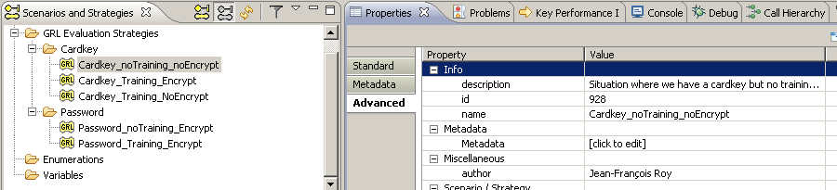
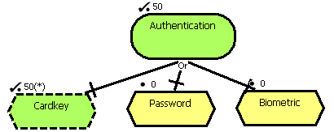
Strategies in jUCMNav
A star (*) indicates an
initial value part of
a given strategy (element
also shown in dashed lines).
All the others are evaluated
through a propagation
algorithm.

Slide 37
Quant. Alg. – Decompositions and Contributions
Minimum for AND, maximum for OR
Contributions are additive but normalized and take a tolerance into account

Slide 38
Quantitative Algorithm – Dependencies and Actors
Depender’s
satisfaction
level is not
more than
the dependum’s
(and the dependee’s)
Evaluations deal with negotiations between stakeholders
Actor evaluations help analyzing and comparing the satisfaction levels of each actor based
on the selected strategy
Computed from importance attribute
and satisfaction levels of intentional
element references bound to actors

Slide 39
Qualitative Algorithm – AND Decomposition

Slide 40
Qualitative Algorithm – OR Decomposition

Slide 41
Qualitative Algorithm – Contributions and Actors

Slide 42
Qualitative Algorithm – Dependencies

Slide 43
GRL Example I – Context
New service for wireless network
  Where to put the service logic?
  Where to put the service data?

Slide 44
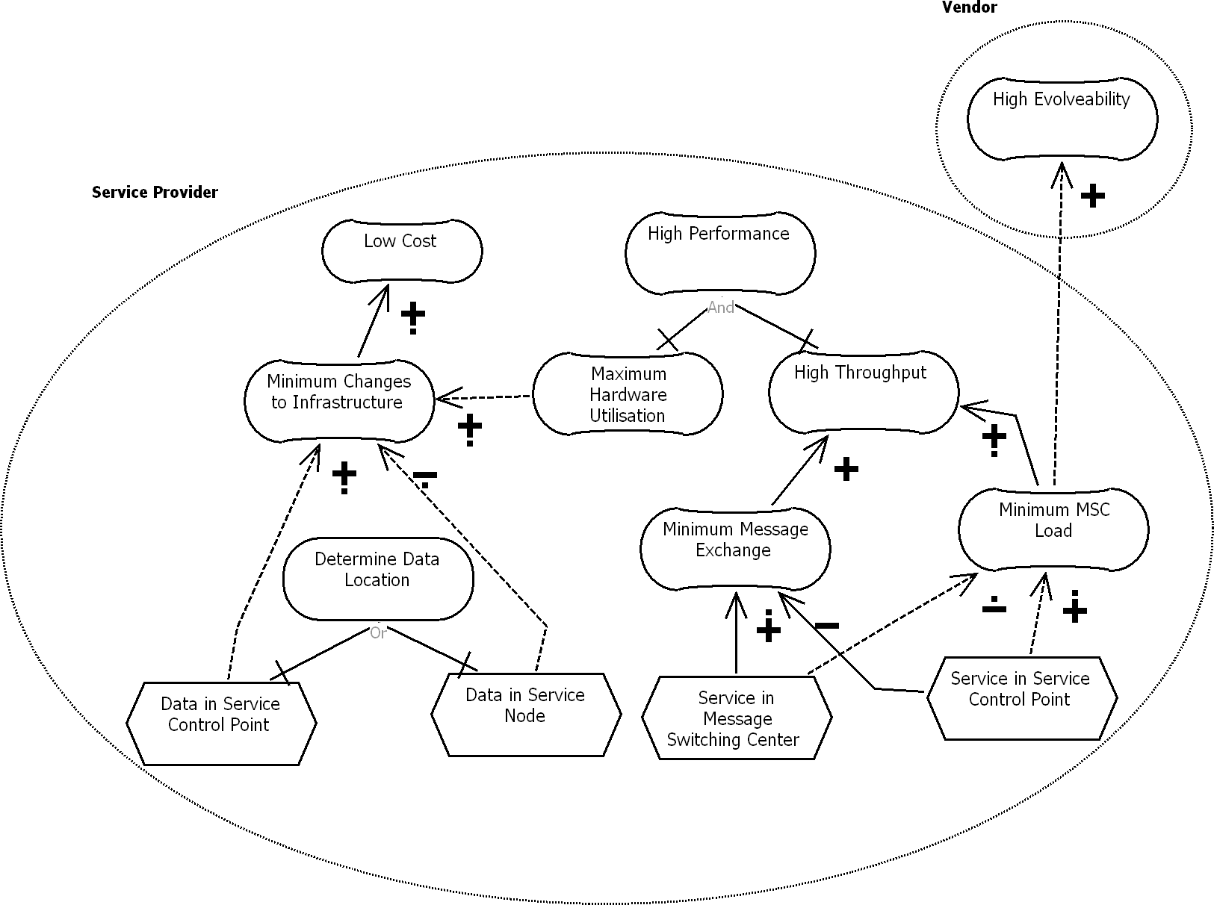
GRL Example I – Intentional Elements and Actors

Slide 45
GRL Example I – Links

Slide 46
GRL Example I – Contribution Types
Qualitative
or
quantitative

Slide 47
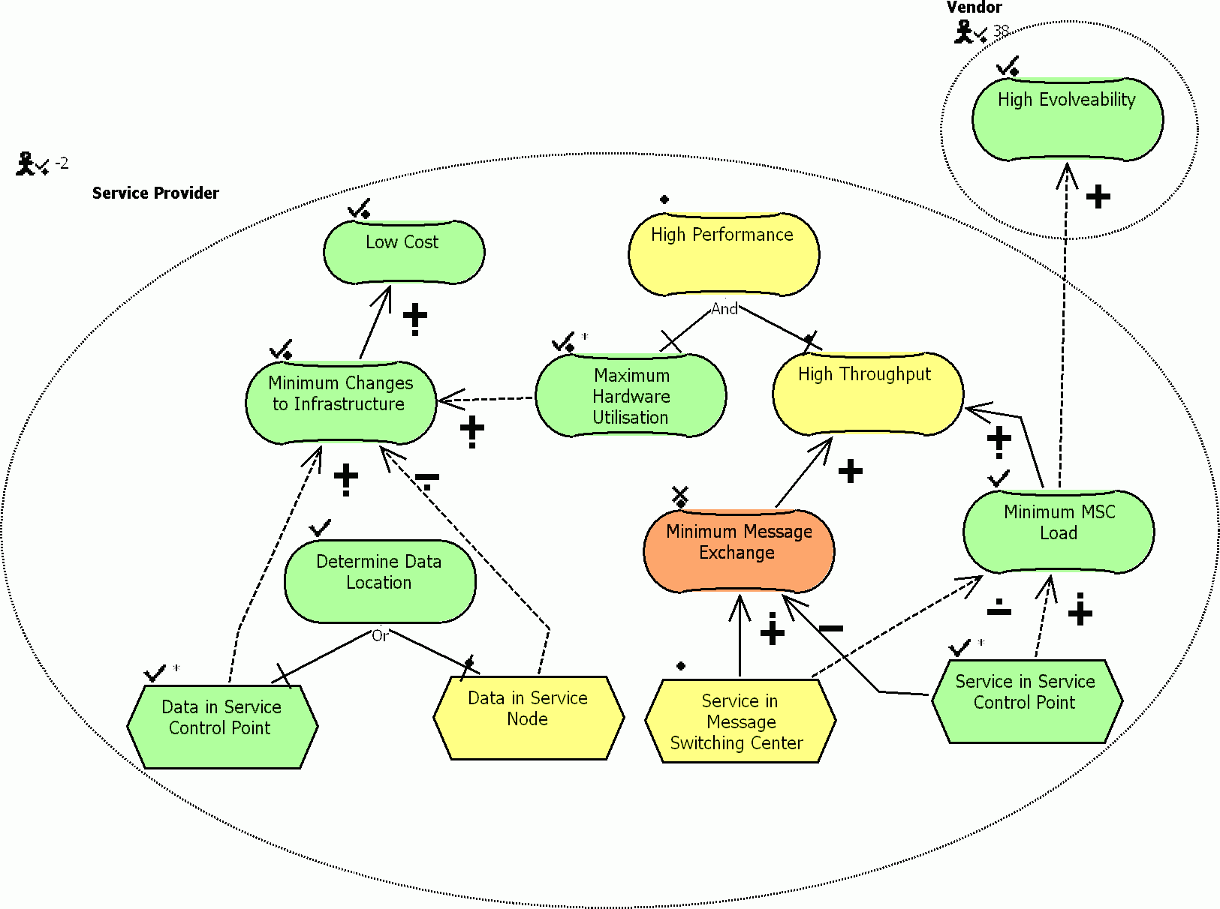
GRL Example I – Qualitative Model Evaluation

Slide 48
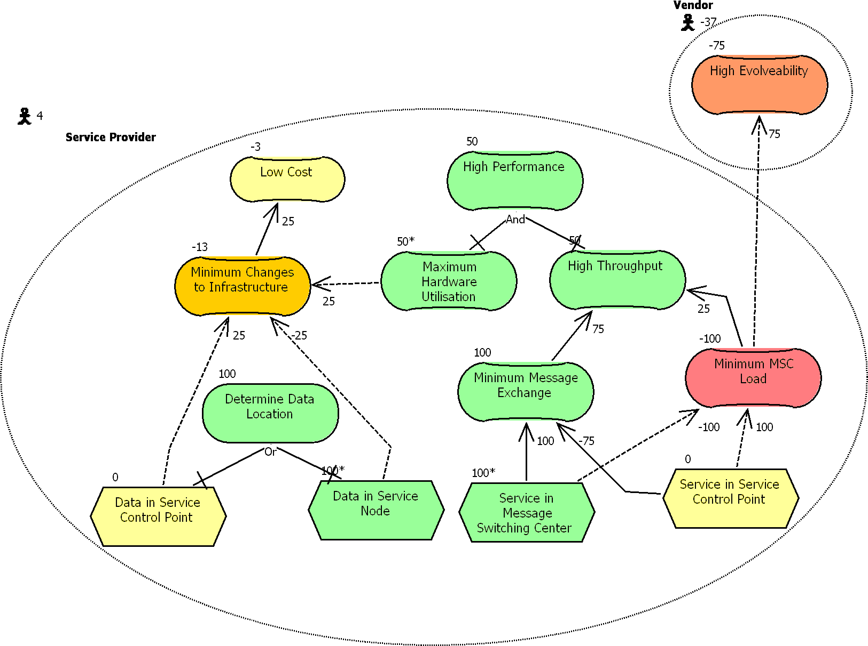
GRL Example I – Quantitative Model Evaluation

Slide 49
GRL Example II – Context
GRL model that addresses privacy protection in a hospital environment
  Researchers want access to patient data but the Health Information Custodian (HIC – i.e., the hospital) needs to protect patient privacy, as required by law (PHIPA in Ontario).
  The process of accessing databases must ensure privacy. As required by law, a Research Ethics Board (REB) is usually involved in assessing privacy risks for the research protocol proposed by a researcher.
  DB administrators also want to ensure that DB users are accountable for their acts.

Slide 50
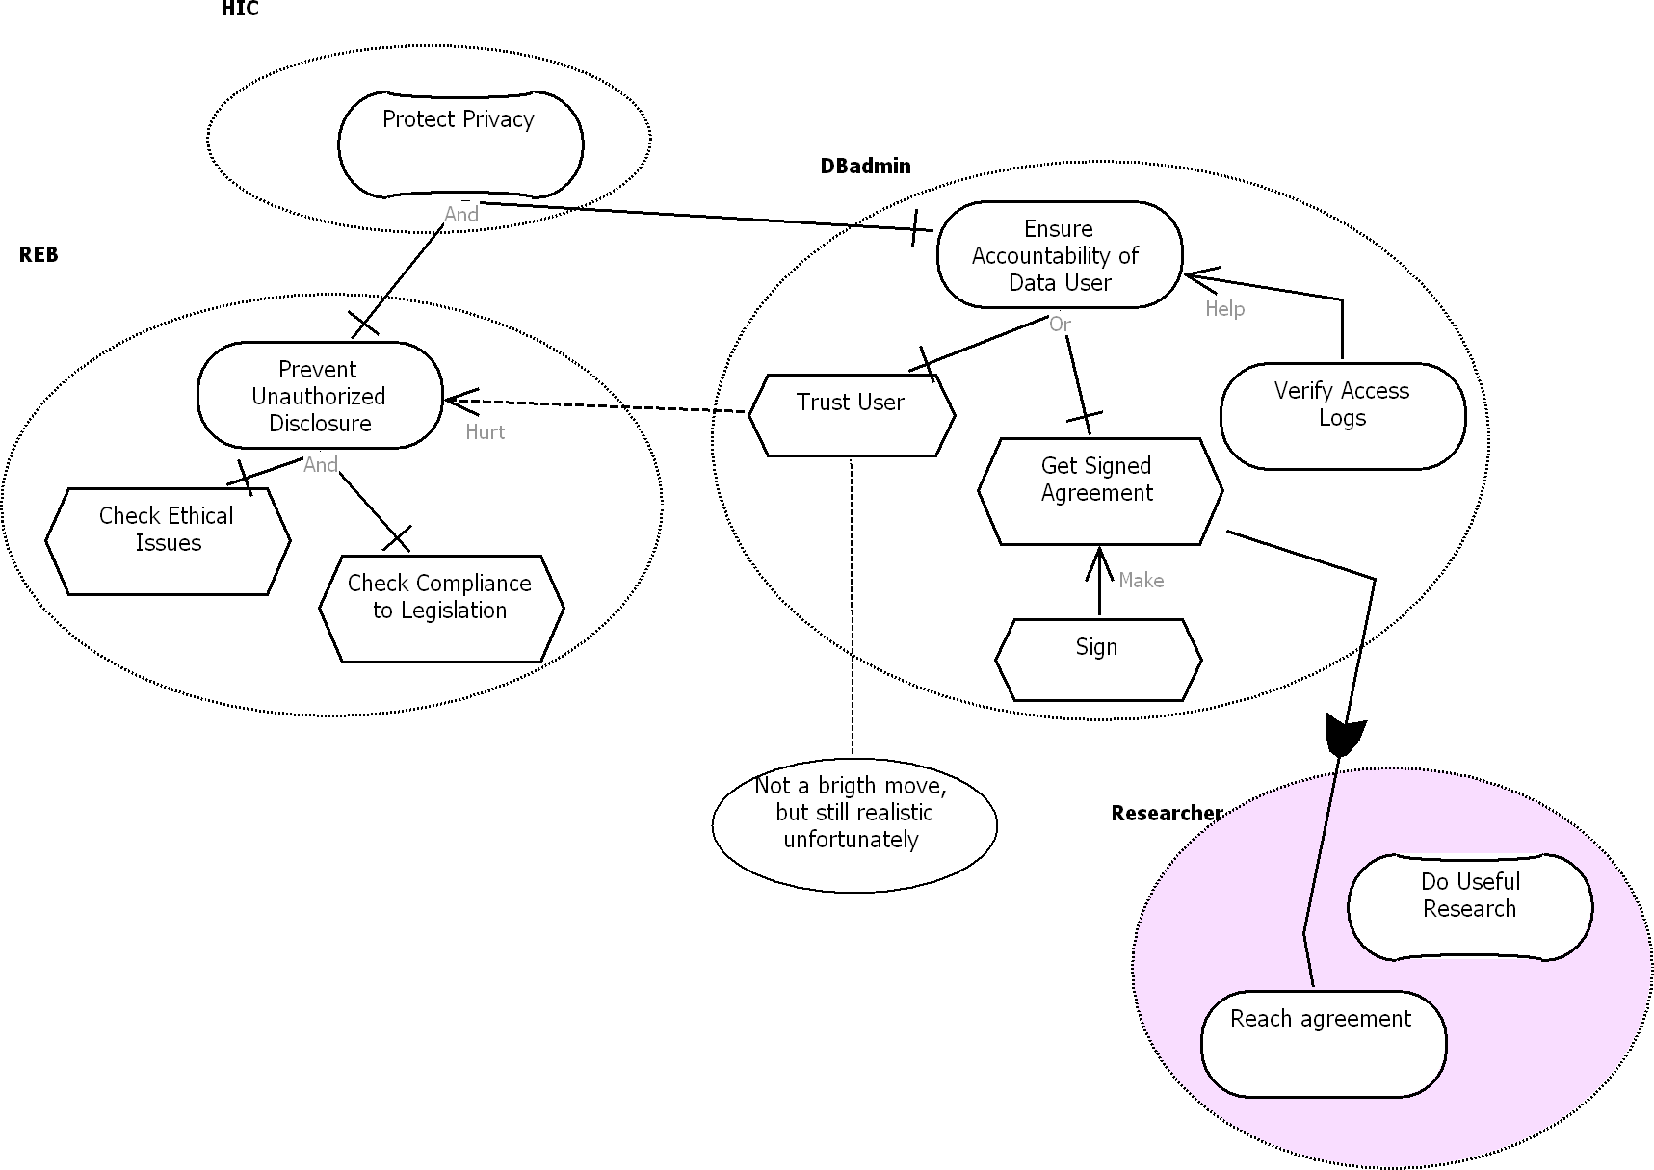
GRL Example II – GRL Model

Slide 51
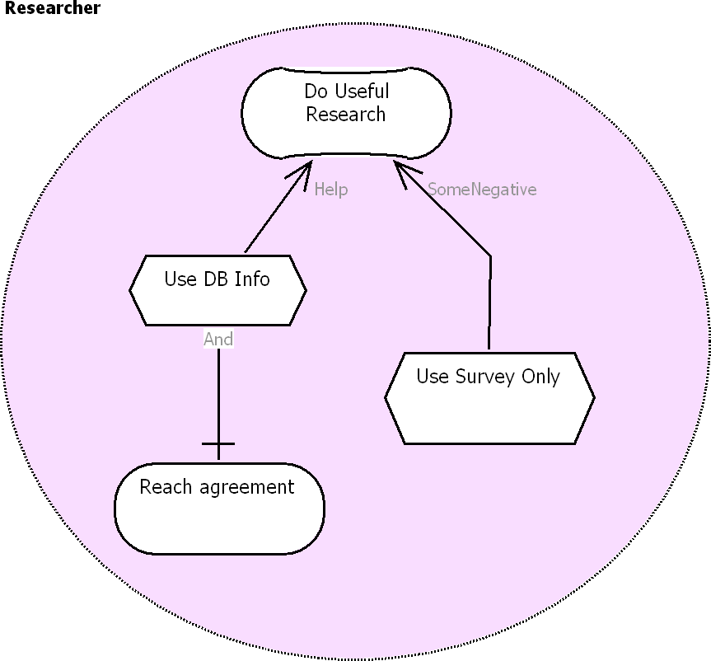
GRL Example II – One GRL Model, Many Diagrams

Slide 52
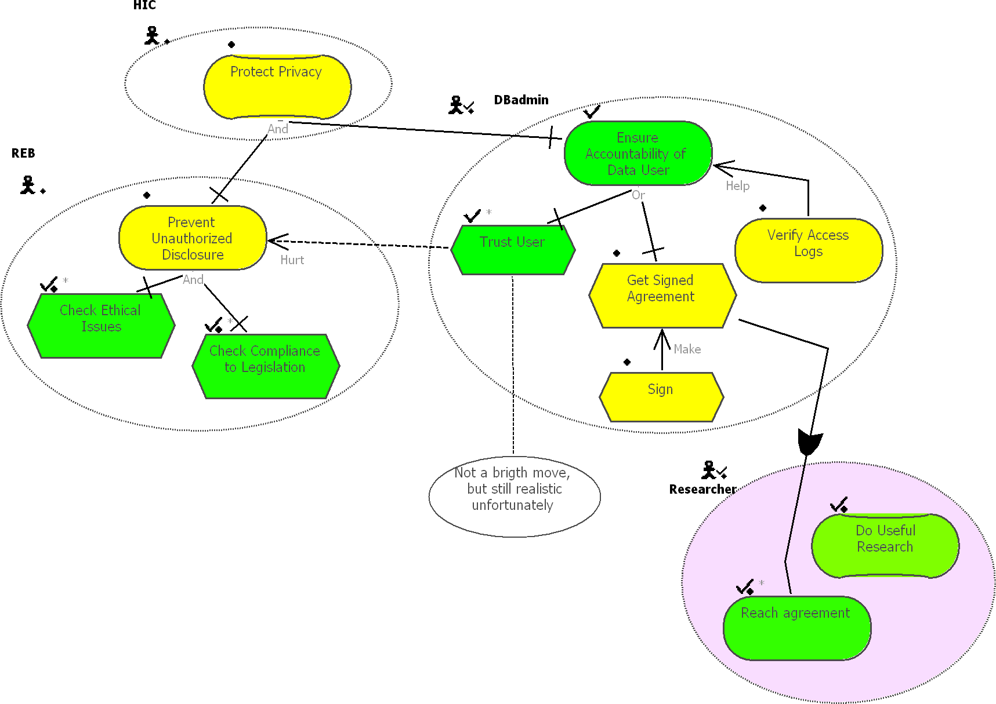
GRL Example II – Qualitative Model Evaluation

Slide 53
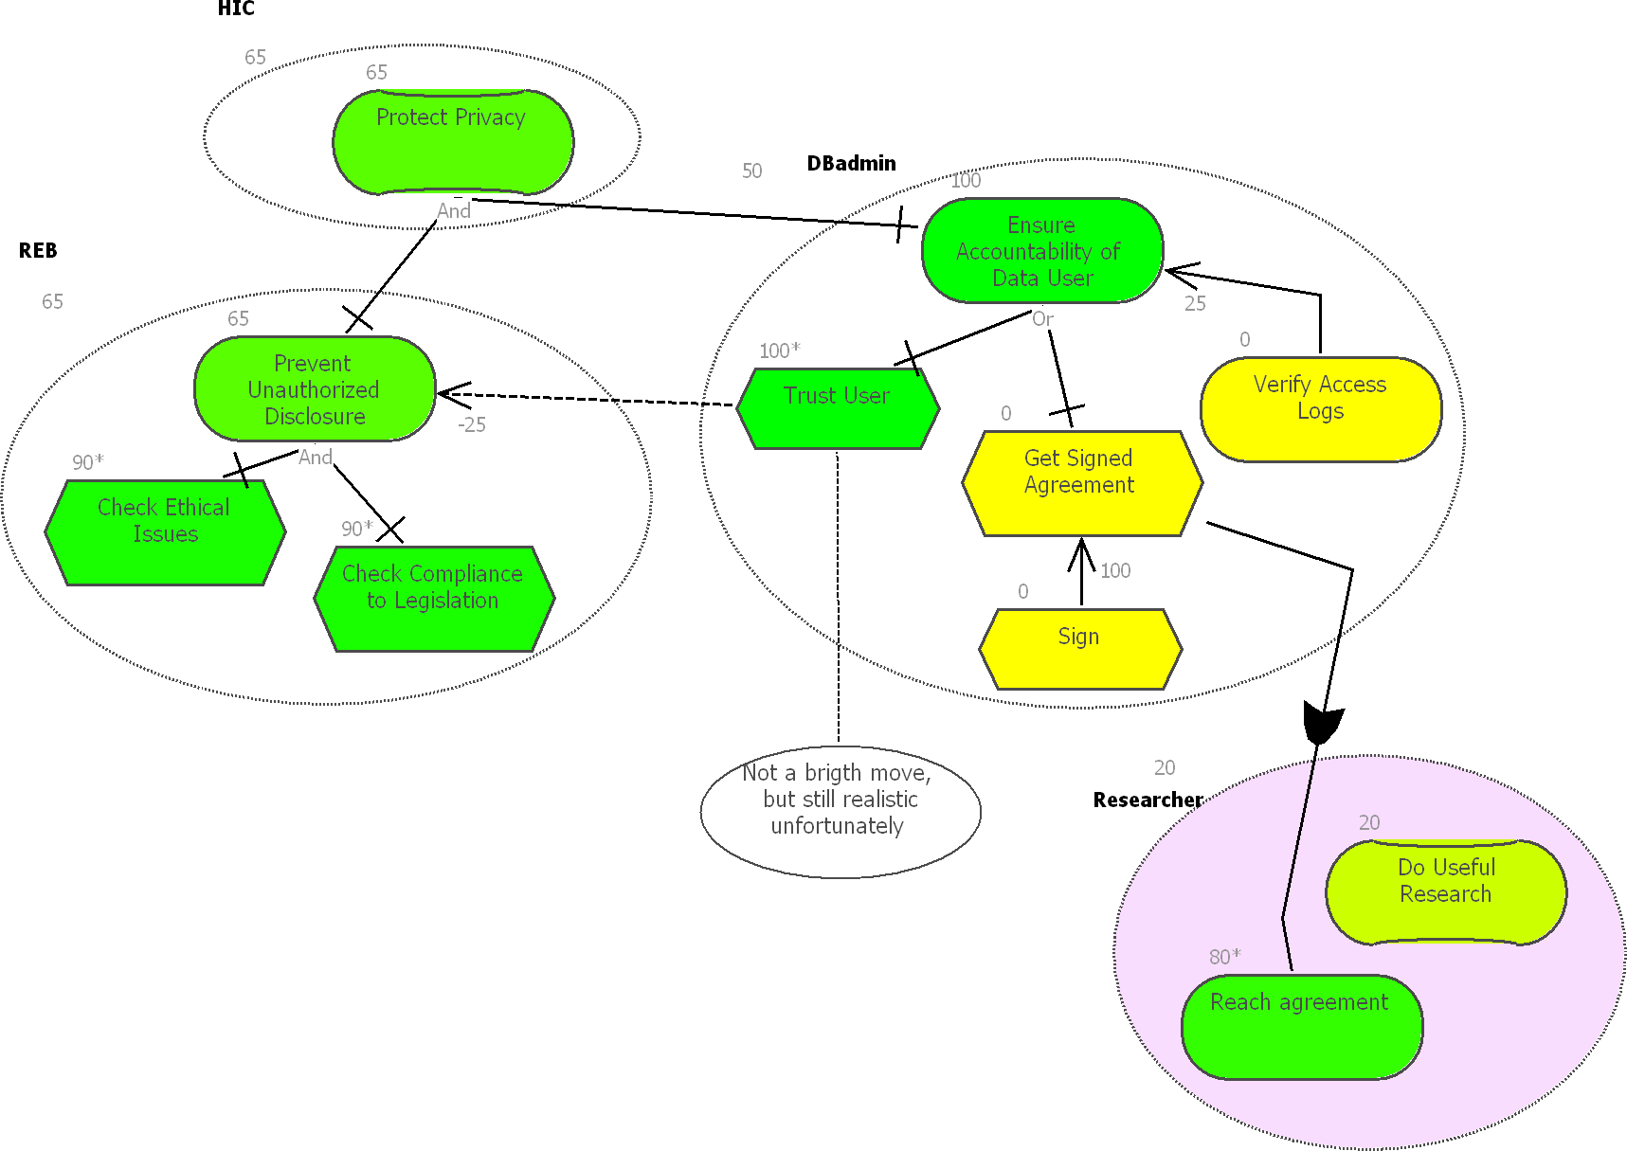
GRL Example II – Quantitative Model Evaluation
In addition to the
qualitative approach,
strategies and evaluations can also be
quantitative ([-100, 100] scale)
Hybrid algorithms can also be defined

Slide 54
GRL Example III – Context
Information system for a Financial Institution
  Provides support for point of sale systems for financial transactions
  Remote input at Retailers allows customers to make payments
  Need to address security when producing, deploying, and updating the financial software at the financial institution and at the Retailers site
    Software itself must be secured (in source and object form)
    Access (e.g. for update) also need to be secured
  Possible tradeoffs with
    Ease of use
    Performance
    Cost

Slide 55
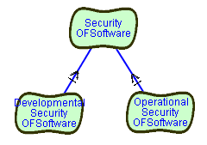
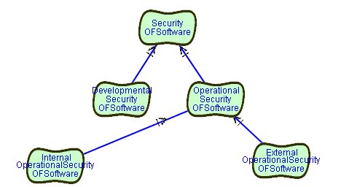
GRL Example III – First Goal Refinements
Security includes
  Security during operation (e.g. updating,
  regular operation…)
  Security during software development
Operational Security includes
  Financial institution
  Retailer sites

Slide 56
GRL Example III – More Goal Refinements
System includes
  Base Station connected to a set of Terminals
  Host Computer at Financial Institution
Refinement of terminal security into
  Confidentiality, integrity, availability
Each operation (update, download, storage) needs to be secured

Slide 57
GRL Example III – Thinking About Solutions
How to provide confidentiality for
download?
Three possibilities
  Provide access authorisation
    Authentication
    Identification
  Provide encryption
  Provide limited exposure to
  accessing the software

Slide 58
GRL Example III – More Solutions
Authentication possible through
  Digital signatures
  Biometrics
  Card key and card reader
  Password protection
Different possibilities for
identification too

Slide 59
GRL Example III – Side Effects
Alternatives have set of tradeoffs with
other requirements
  Biometrics will provide a high level of
  security but will be expensive
  Cardkey less expensive, user friendly,
  but equipment needed too
  Password protection is least expensive,
  but not as user friendly as Cardkey
Can be model using
correlation links to
other nodes

Slide 60
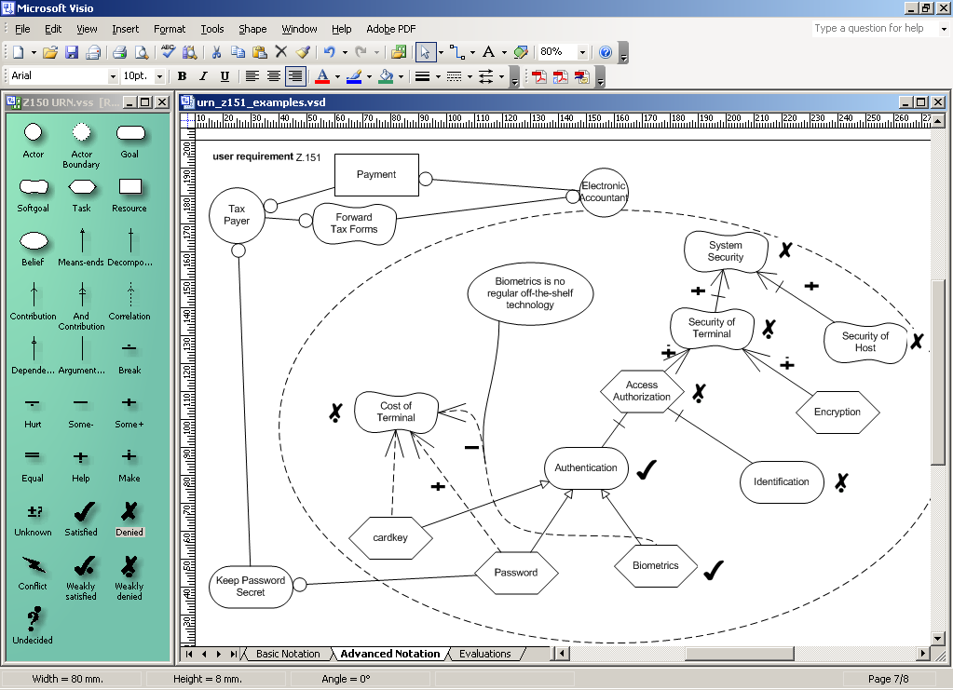
Tool Support – SanDriLa (Plug-in for Visio)

Slide 61
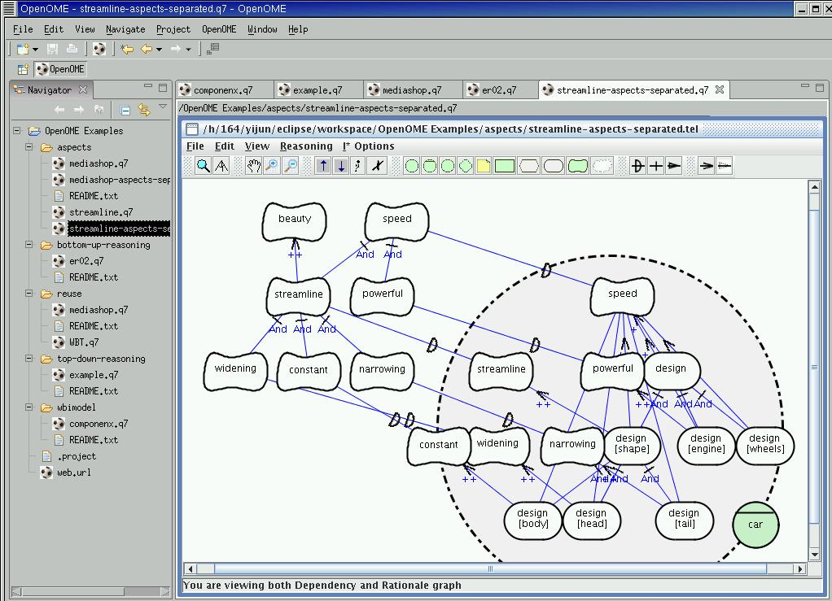
Tool – OpenOME, with Eclipse Plug-in

Slide 62
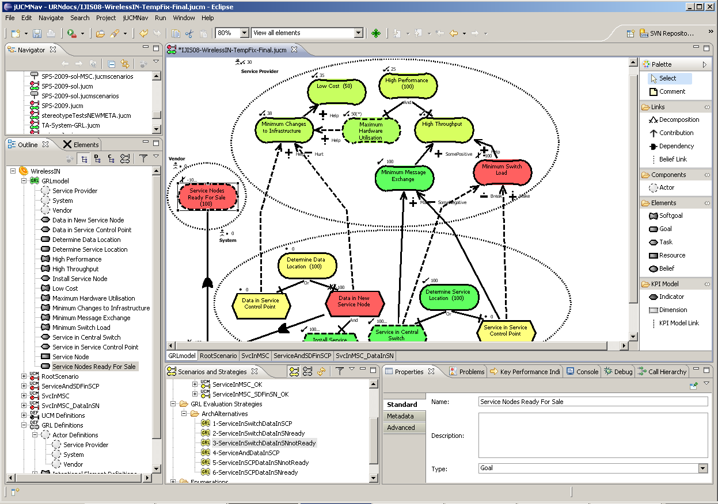
jUCMNav (Eclipse Plug-in)
Features for GRL
  4 GRL evaluation algorithms, with color highlight
  One model, multiple diagrams
  References to actors and intentional elements
    Drag&drop from outline or via properties
  Auto-layout
  Catalogues
    For exporting/importing/reusing
    common models
  Export graphics (.bmp, .gif, .jpg)
  Export strategy evaluations (.csv)
  URN links (for integration with
  UCMs)
  Export to DOORS
Toolbar
Navigator view
Editor
Outline
view
Palette
Scenarios and Strategies view
Properties
view

Slide 63
Inclusion of Measures in Goal Models
GRL includes a notion of goal satisfaction, with qualitative and quantitative ([-100..100]) scales.
However, there is often a need to better relate observations about the real world to the goal model, with domain-specific units such as:
  Currencies (e.g., revenues in $)
  Durations (e.g., waiting time in a hospital, in hours)
  Counts (e.g., number of new students admitted in SEG)
GRL has non-standard extensions to support this kind of information, and integrate it in the rest of the goal model
  Key Performance Indicator (KPI)
KPIs help measure goals and NFRs with quantifiable metrics
GRL KPIs can also be fed from external sources of information, hence turning the GRL model into a monitoring engine (e.g., a dashboard).

Slide 64
GRL Key performance Indicators
In GRL, a KPI is defined as an intentional element, but with additional characteristics
  Attributes (for a given GRL strategy)
    An evaluation value (observed, or simulated in a what-if strategy)
    A target value (the KPI is fully satisfied if the evaluation value reaches it)
    A worst-case value (the KPI is fully denied if the evaluation value reaches it)
    A threshold value (the KPI is neutral if the evaluation value equals it)
    A unit (e.g., $)
  Associations (for a given GRL model)
    Can be part of contributions or decompositions
    New: can be analysed from multiple dimensions
      For example, a time dimension might enable the study of a KPI according to a year, a month, a week, a day, or an hour.

Slide 65
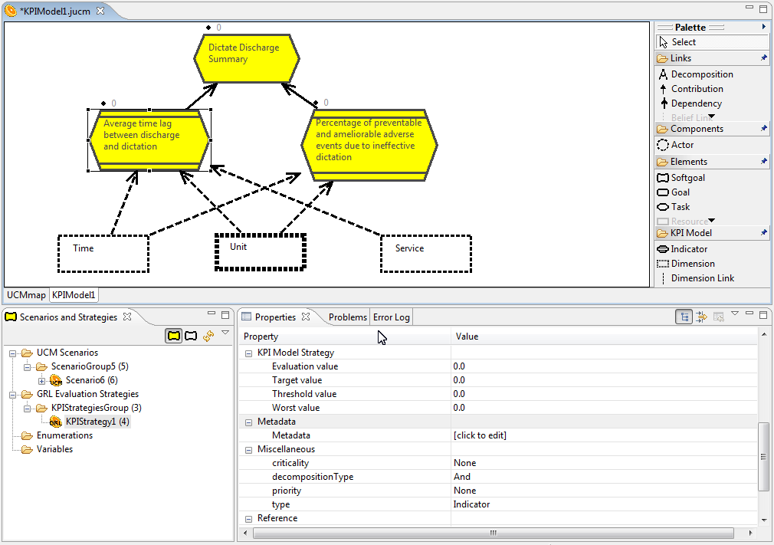

Slide 66
From KPIs to GRL Satisfaction Levels
Note: Linear interpolation is currently being used to compute the satisfaction,
which is a function of the evaluation, target, threshold, and worst values.

Slide 67
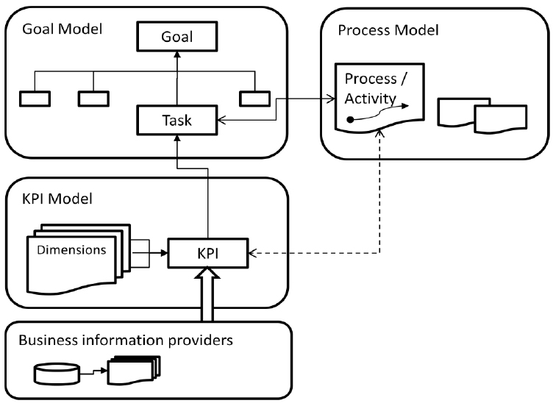
Evaluations Involving KPIs
KPIs can contribute to goals in GRL
KPIs can be fed by external sources
KPIs can be linked to scenarios

Slide 68
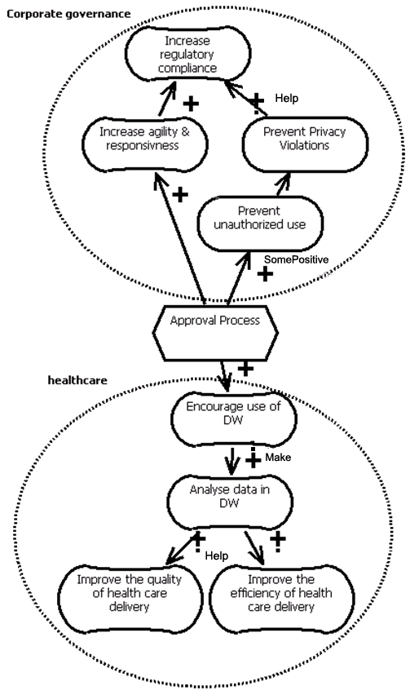
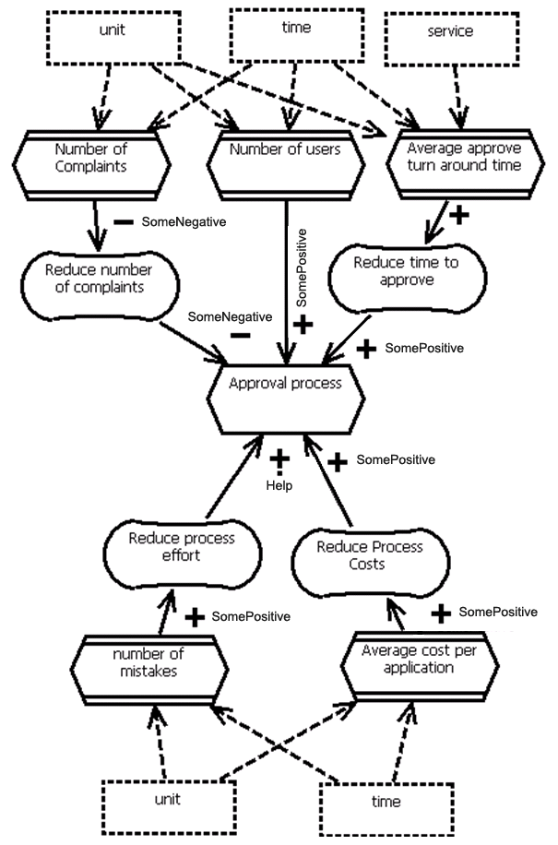
Multiple Views
Process Model
Performance Model
Goal Model

Slide 69
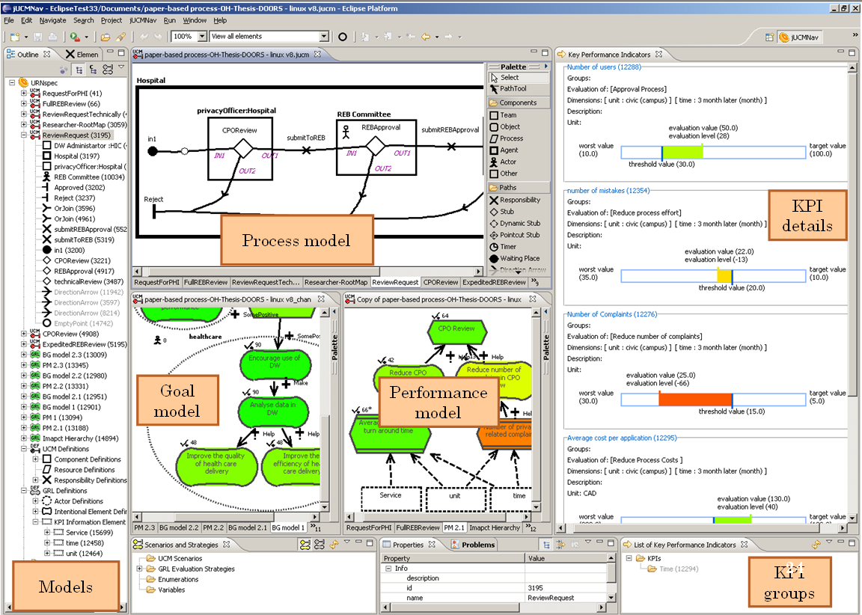
jUCMNav Extensions for KPI and Monitoring

Slide 70
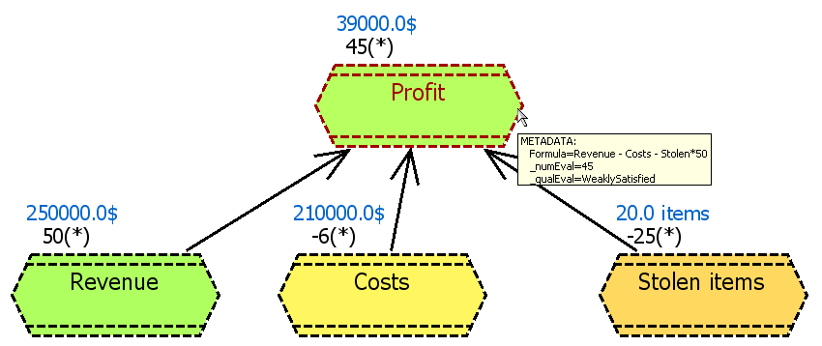
KPI Aggregation
In jUCMNav, KPI values can also be computed (aggregated) from other KPIs,
in a way similar to Excel.
Formula-based GRL evaluation algorithm

Slide 71
URN Abstract Metamodel

Slide 72
GRL Abstract Metamodel

Slide 73
GRL Strategies Abstract Metamodel

Slide 74
Concrete GRL Metamodel (for Diagrams)

Slide 75
Appendix: GRL Notation
Goal
Softgoal
Task
Resource
Denied
Weakly
Denied
Weakly
Satisfied
Satisfied
Conflict
Unknown
None
Belief
Actor with Boundary
Collapsed
Actor
(c) GRL Satisfaction Levels
(a) GRL Elements
Make
Some Positive
Help
Unknown
Contribution
Correlation
Dependency
Decomposition
Hurt
Some Negative
Break
(d) GRL Contributions Types
Make
100
100
i) Icon only
ii) Text only
iii) Icon and text
iv) Number only

Slide 76
Thank you

