Slide 1
REQUIREMENTS MANAGEMENT
PERTEMUAN 14
AGUNG MULYO WIDODO
TEKNIK INFORMATIKA

Slide 2
KEMAMPUAN AKHIR YANG DIHARAPKAN
Introduction to Requirements Management
Traceability
Baselines
Change Management
Requirements Management Tools
A factor present in every successful project and absent in every unsuccessful project is sufficient attention to requirements.¹
Notes:
a

Slide 3

BUKU PEMBELAJARAN
Jeremy Dick, Elizabeth Hull, Ken Jackson, Requirements Engineering, Springer-Verlag, 2004
Soren Lauesen Software Requirements - Styles and Techniques, Addison Wesley, 2002
Ian K. Bray , An Introduction to Requirements Engineering, Addison Wesley,
2002
Colin Hood, Simon Wiedemann , Stefan FichtingerUrte Pautz ,Requirements Management, Springer-Verlag, 2008

Slide 4
REFERENSI
B. A. Nuseibeh and S. M. Easterbrook, Requirements Engineering: A Roadmap. In A. C. W. Finkelstein (ed) The Future of Software Engineering, ACM Press, 2000
http://www.cs.toronto.edu/~sme/papers/2000/ICSE2000.pdf
Simson Garfinkel, History's Worst Software Bugs, Wired News, 2005
http://www.wired.com/news/technology/bugs/0,2924,69355,00.html
INCOSE Requirements Working Group
http://www.incose.org/practice/techactivities/wg/rqmts/
Tools Survey: Requirements Management (RM) Tools
http://www.incose.org/productspubs/products/rmsurvey.aspx
http://www.volere.co.uk/tools.htm
IEEE (1993) Recommended Practice for Software Requirements Specifications. IEEE Std 830-1993, NY, USA.
IEEE (1995) Guide for Developing System Requirements Specifications. IEEE Std P1233/D3, NY, USA.
Requirements Engineering Conference
http://www.requirements-engineering.org/

Slide 5
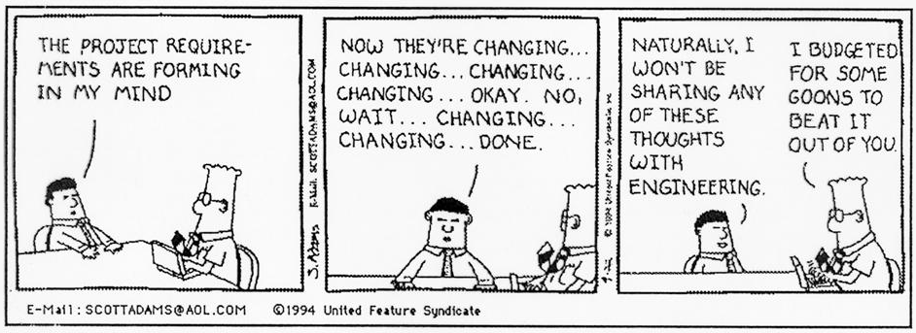

Slide 6
Introduction to Requirements Management

Slide 7
Why Do Requirements Change?
Change in software development: as inevitable as difficult to control!
  Better understanding: new requirements become apparent
  Everything else is changing…
    Business
    Context
    Technologies
    Markets
    …
Possible responses to change
  Add, modify, or remove requirements

Slide 8
Some Problems Due to Changing Requirements
Requirements changing towards the end of development without any impact assessment
Unmatched/outdated requirements specifications causing confusion and unnecessary rework
Time spent coding, writing test cases or documentation for requirements that no longer exist

Slide 9
Requirements Management
A systematic approach to eliciting, organizing, and documenting the requirement of the system, and a process that establishes and maintains agreement between the customer and the project team on the changing requirements of the system.¹

Slide 10
Requirements Management Activities (1)
Requirements management includes all activities intended to maintain the integrity and accuracy of expected requirements
  Manage changes to agreed requirements
  Manage changes to baseline (increments)
  Keep project plans synchronized with requirements
  Control versions of individual requirements and versions of requirements documents
  Manage relationships between requirements
  Managing the dependencies between the requirements document and other documents produced in the systems engineering process
  Track requirements status

Slide 11
Requirements Management Activities (2)

Slide 12
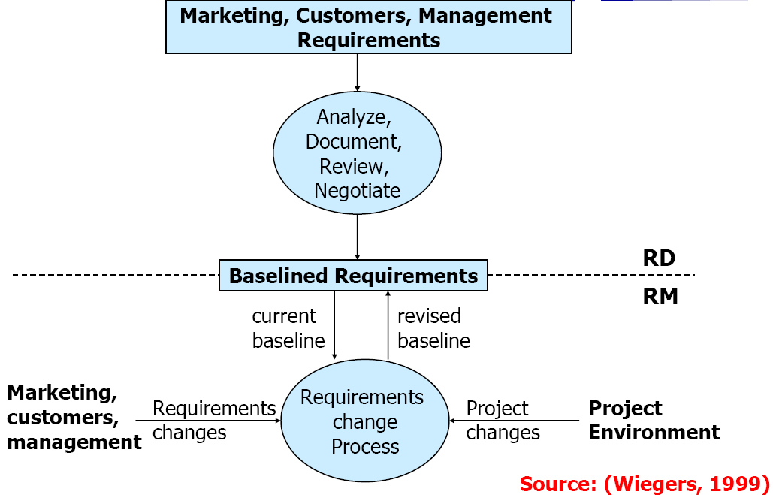
Requirements Development (RD) and
Management (RM)

Slide 13
From Management to Tools
Changes lead to a need for management
There is no management without:
  Traceability
  Baselines enabling comparisons
From a practical point of view, there is no traceability or management without appropriate tools

Slide 14
Requirements Change Factors (1)
Requirements errors, conflicts, and inconsistencies
  May be detected at any phase (when requirements are analyzed, specified, validated, or implemented)
Evolving customer/user knowledge of the system
  When the requirements are developed, customers/users simultaneously develop a better understanding of what they really need
Technical, schedule, or cost problems
  Difficult to plan and know everything in advance
  We may have to revisit the list of requirements and adapt it to the current situation

Slide 15
Requirements Change Factors (2)
Changing customer priorities, new needs
  May be caused by a change in the system environment (technological, business, political...), i.e., the context
  Business and strategic goals may change
  May be caused by the arrival of a new competitor
  Laws and regulations may change
  Collaborating systems may change
  May also be caused by technology changes in the enterprise (migration to a new operating system, DBMS…)
  May be caused by organizational changes (organizational structure, business processes, employees…)

Slide 16
Requirements Volatility
Requirements continuously change
  While the requirements are being elicited, analyzed, specified, and validated and after the system has gone into service
Some requirements are usually more subject to change than others
  Stable requirements are concerned with the essence of a system and its application domain
    Derived from the client’s principal business activities or the domain model
    They change more slowly than volatile requirements
    E.g., a hospital will always have doctors, nurses, patients…
  Volatile requirements are specific to the instantiation of the system in a particular environment for a particular customer at a particular time
    E.g., in a hospital, we can think of requirements related to the policies of the government health system

Slide 17
Types of Volatile Requirements
Mutable requirements
  These are requirements which change because of changes to the environment in which the system is operating
Emergent requirements
  These are requirements which cannot be completely defined when the system is specified but which emerge as the system is designed and implemented
Consequential requirements
  These are requirements which are based on assumptions about how the system will be used
  Once the system is in place, some of these assumptions will be wrong
Compatibility requirements
  These are requirements which depend on other equipment, technology, or processes

Slide 18
Expectations of Requirements Management (1)
Identification of individual requirements
Traceability from highest level requirements to implementation
  Established via links through a requirements database
  Links between requirements and design models, tests, code…
  Coverage and consistency analysis
  What are the traceability policies? What types of links? From where? To where?
Impact assessments of proposed changes
  Analysis tools let you see which other requirements (and other linked artifacts) will be affected by a change

Slide 19
Expectations of Requirements Management (2)
Controlled access to current project information
  A shared database ensures that all users are working with current data (consistency, parallel access)
  A central repository allows all users to see the information that they need to see (visibility)
Change control
  Change proposal system implements controlled process for managing change
  How do we collect, document, and address changes?
Deployment of required tool support
  To help manage requirements change

Slide 20
Identification of Requirements
It is essential for requirements management that every requirement has a unique identification
  The most common approach is requirements numbering based on chapter/section in the requirements document
There are several problems with this approach
  Numbers cannot be unambiguously assigned until the document is complete
  Assigning chapter/section numbers is an implicit classification of the requirements ➔ may mislead readers of the document into thinking that the most important relationships are with requirements in the same section

Slide 21
Requirements Identification Techniques
Dynamic renumbering
  Some word processing systems allow for automatic renumbering of paragraphs and the inclusion of cross references
  As you reorganise your document and add new requirements, the system keeps track of the cross references and automatically renumbers your requirements depending on its chapter, section, and position within the section
Database record identification
  When a requirement is identified, it is entered in a requirements database and a database record identifier is assigned which is then used for all subsequent references to the requirement
Symbolic identification
  Requirements can be identified by giving them a symbolic name which is associated with the requirement itself (e.g., SEC1, SEC2, SEC3… may be used for requirements which relate to system security)

Slide 22
BTW, Requirements Have Attributes!
Apart from an identifier, requirements should have attributes that establish context and background, and go beyond the requirement description
For filtering, analysis, metrics…
  Creation date, Last update, Author, Stakeholders (Owners / Source)
  Version number
  Status, Priority, Importance, Stability
  Rationale, Comments
  Acceptance criteria
  Subsystem / Product release number
  …
The more complex the project, the richer the attributes…
Many attributes are predefined in RM tools, others are defined by requirements engineers as required by the project

Slide 23
Requirements Attributes
Classes and attributes of a requirements management database
Select only the necessary attributes!

Slide 24
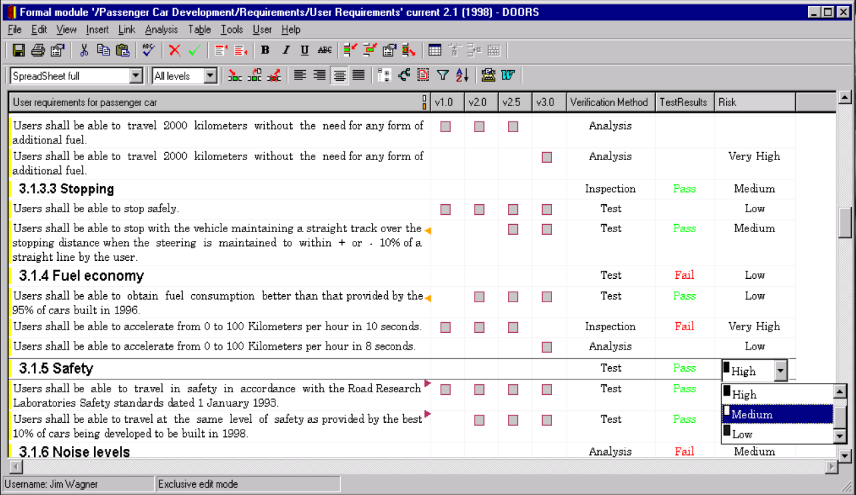
DOORS – Objects and Attributes

Slide 25
Requirements Statuses
Help manage the requirement lifecycle
  Their number and nature depend on the process in place
Example of a set of statuses:
  Proposed: by some stakeholder
  Approved: part of baseline, committed to implement
  Rejected: after evaluation
  Implemented: designed and implemented
  Verified: Relevant tests have passed
  Deleted: Removed from list
RM includes amongst its tasks the tracking of the status of all requirements during the project

Slide 26
Version Control
Another essential aspect of requirements management
  Every version of a requirement needs to be uniquely identified
  The last version of a requirement must be available to all team members
  Changes need to be documented and clearly communicated
  A version identifier must be updated with every change to the requirement
Requirements documents should include
  A revision history: changes, dates, by whom, why...
  Standard markers for revisions (e.g., strikethrough or underlined text, coloring, line markers…)
Version control tool may be used
  To store and manage the revision history
  To store justifications (to add, modify, delete, reject a requirement)

Slide 27
Traceability

Slide 28
Traceability?
"Can I ask you some questions?"
"By all means."
"Okay. Well, for starters I'll have who, what, when and where and then wither, whence and wherefore for a follow-up, and then one bit side-order of why."

Slide 29
Traceability Quotes (1)
Requirements traceability refers to the ability to describe and follow the life of a requirement, in both forwards and backwards direction (i.e., from its origins, through its development and specification, to its subsequent deployment and use, and through all periods of ongoing refinement and iteration in any of these phases)”.¹
A software requirements specification is traceable if the origin of each of its requirements is clear and if it facilitates the referencing of each requirement in future development or enhancement documentation.²
Traceability gives essential assistance in understanding the relationships that exist within and across software requirements, design, and implementation.³
A link or relationship defined between entities.⁴

Slide 30
Traceability Quotes (2)
Traceability is often mandated by contracts and standards.¹
  E.g., military and aerospace
One cannot manage what cannot be traced.²
Traceability information helps assess the impact of changes to requirements, connecting these requirements as well as requirements for other representations of the system.³
Traceability is a property of a system description technique that allows changes in one of the three system descriptions – requirements, specifications, implementation – to be traced to the corresponding portions of the other descriptions. The correspondence should be maintained through the lifetime of the system.⁴

Slide 31
Importance of Traceability (1)
Requirements cannot be managed effectively without requirements traceability
  A requirement is traceable if you can discover who suggested the requirement, why the requirement exists, what requirements are related to it, and how that requirement relates to other information such as systems designs, implementations and user documentation

Slide 32
Importance of Traceability (2)
Benefits of traceability
  Prevents losing knowledge
  Supports the verification process (certification, localization of defects)
  Impact analysis
  Change control
  Process monitoring (e.g., missing links indicate completion level)
  Improved software quality (make changes correctly and completely)
  Reengineering (define traceability links is a way to record reverse engineering knowledge)
  Reuse (by identifying what goes with a requirement: design, code…)
  Risk reduction (e.g., if a team member with key knowledge leaves)

Slide 33
Traceability Difficulties
Various stakeholders require different information
Huge amount of requirements traceability information must be tracked and maintained
Manual creation of links is very demanding
  Likely the most annoying problem
Specialized tools must be used
Integrating heterogeneous models/information from/to different sources (requirements, design, tests, code, documentation, rationales…) is not trivial
Requires organizational commitment (with an understanding of the potential benefits)

Slide 34
Backward and Forward Traceability (1)
Backward traceability
  To previous stages of development
  Depends upon each element explicitly referencing its source in earlier documents
Forward traceability
  To all documents spawned by a document
  Depends upon each element in the document having a unique name or reference number

Slide 35
Backward and Forward Traceability (2)
Top to bottom from requirements’ point of view
  Forward-to traceability
    Links other documents (which may have preceded the requirements document) to relevant requirements
    Help validation
    Help evaluate which requirements are affected by changes to users’ needs
  Forward-from traceability
    Links requirements to the design and implementation components
    Help assure that all requirements have been satisfied

Slide 36
Backward and Forward Traceability (3)
Bottom to top from requirements’ point of view
  Backward-to traceability
    Links design and implementation components back to requirements
    Help determine why each item is designed/implemented
  Backward-from traceability
    Links requirements to their sources in other documents or people
    Help validation
    Help evaluate how changes to requirements impact stakeholders needs

Slide 37
Types of Traceability (1)
Requirements – source traceability
  Links requirements with a person or document
Requirements – rationale traceability
Requirements – requirements traceability
  Links requirements with other requirements which are, in some way, dependent on them
Requirements – architecture traceability
  Links requirements with the subsystems where these requirements are implemented (particularly important where subsystems are being developed by different subcontractors)
Requirements – design traceability
  Links requirements with specific hardware or software components in the system which are used to implement the requirement

Slide 38
Types of Traceability (2)
Requirements – interface traceability
  Links requirements with the interfaces of external systems which are used in the provision of the requirements
Requirements – feature traceability
Requirements – tests traceability
  Links requirements with test cases verifying them (used to verify that the requirement is implemented)
Requirements – code traceability
  Generally not directly established, but can be inferred

Slide 39
Representation – Traceability Table
Show the relationships between requirements or between requirements and other artifacts
Table can be set up to show links between several different elements
Backward and forward traceability
Difficult to capture different types of links

Slide 40
Representation – Traceability Matrix
Define links between pairs of elements
  E.g., requirements to requirement, use case to requirement, requirement to test case…
Can be used to defined relationships between pairs
  E.g., specifies/is specified by, depends on, is parent of, constrains…
More amenable to automation than traceability table

Slide 41
Representation – Traceability List
Traceability matrices become more of a problem when there are hundreds or thousands of requirements as the matrices become large and are sparsely populated
A simplified form of a traceability matrix may be used where, along with each requirement description, one or more lists of the identifiers of related requirements are maintained

Slide 42
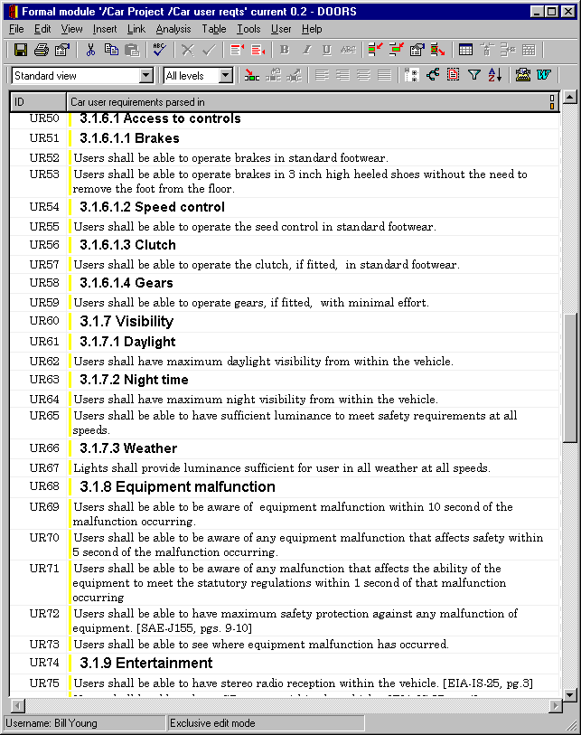
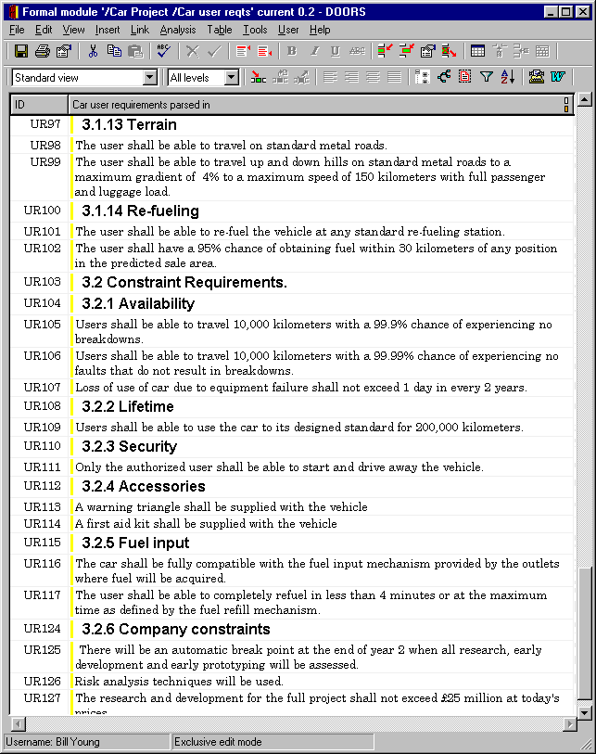
Example – DOORS Links
A relationship between two objects in the DOORS database is established using a link
  One source object and one destination object
Links can be followed in either direction
Possible to have many links between the same two objects
  Links also have types and attributes!

Slide 43
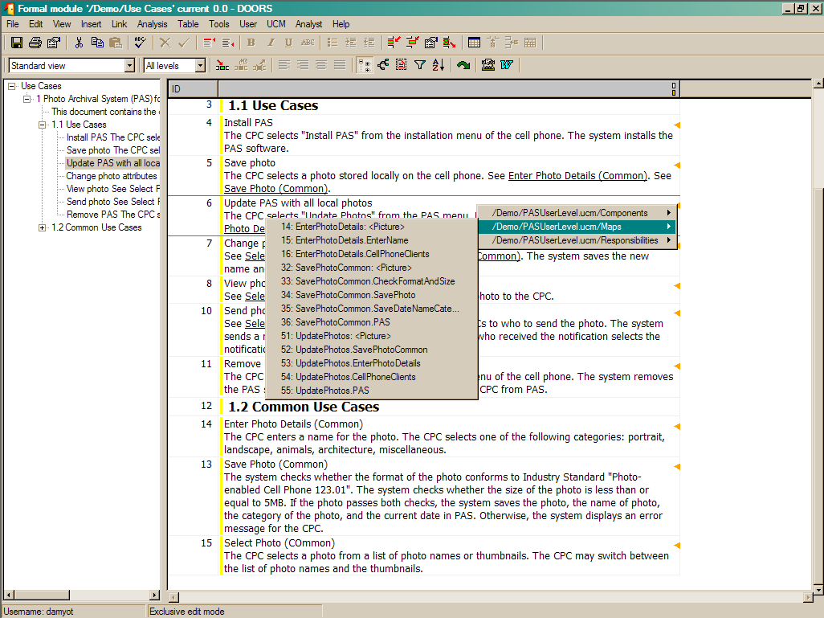
DOORS – Creating and Accessing Links

Slide 44
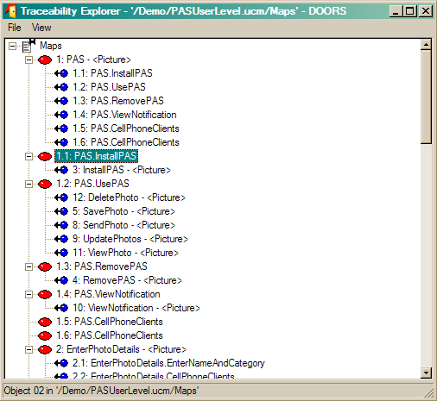
DOORS – Exploring Traceability Links

Slide 45
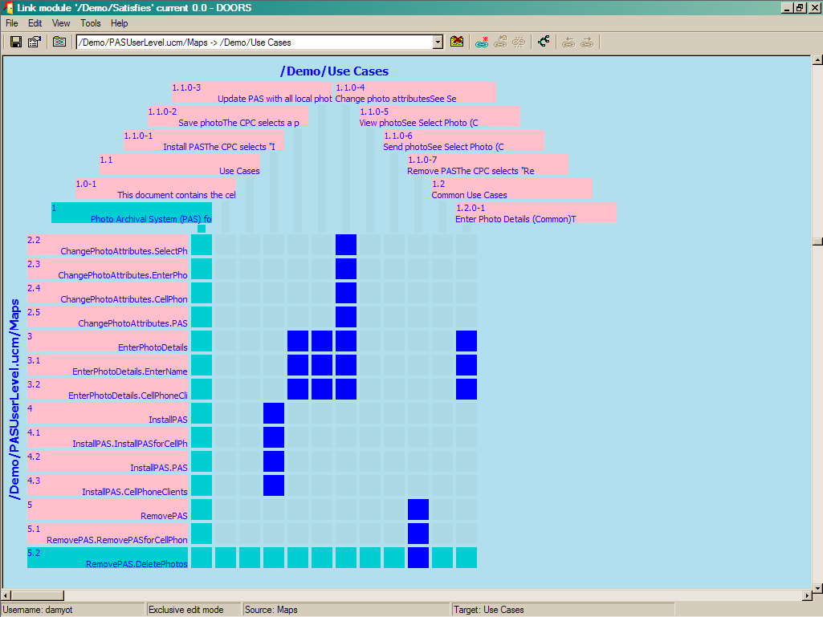
DOORS – Link Matrix View

Slide 46
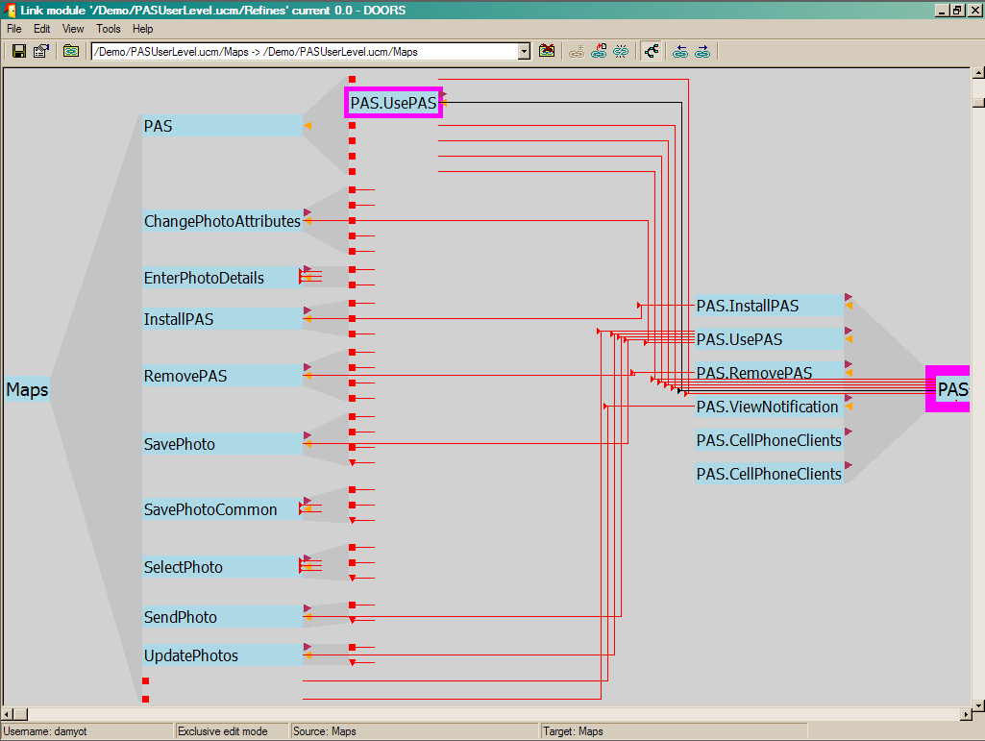
DOORS – Hierarchical Link View

Slide 47
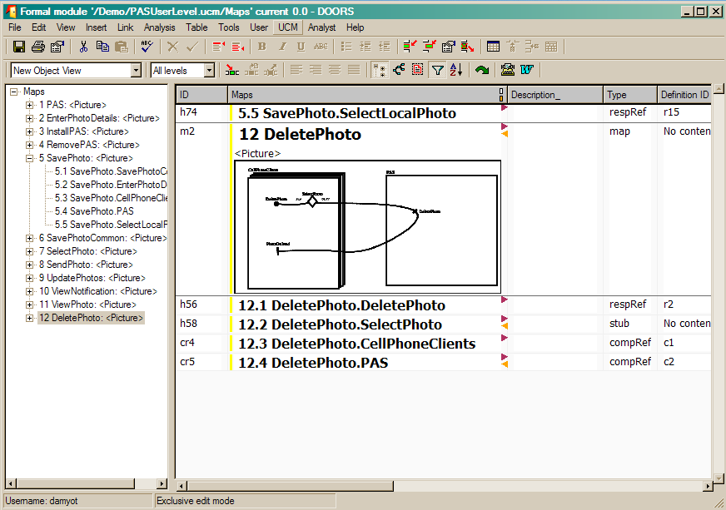
DOORS – Filtering View (Query on Attributes)

Slide 48
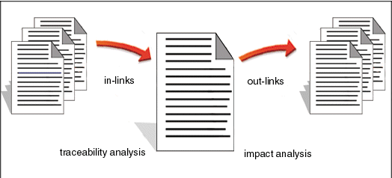
DOORS – Types of Analysis
Impact Analysis
  Analyze out-links (which objects in other modules are affected when this module is changed)
Traceability Analysis
  Analyze in-links (changes in these objects will affect this module)
May involve multiple levels of objects/documents

Slide 49
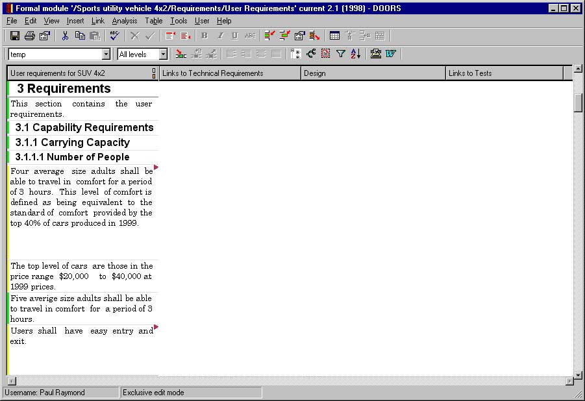
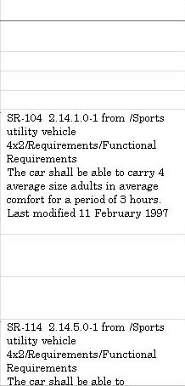
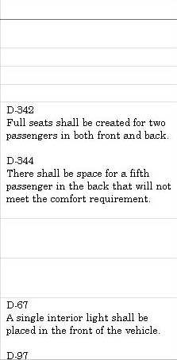
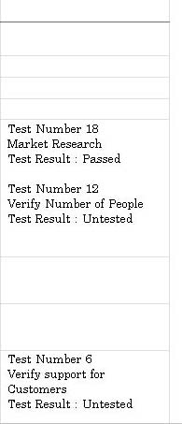
DOORS – Multi-Module Traceability
User Reqts
Technical Reqts
Design
Test Cases

Slide 50
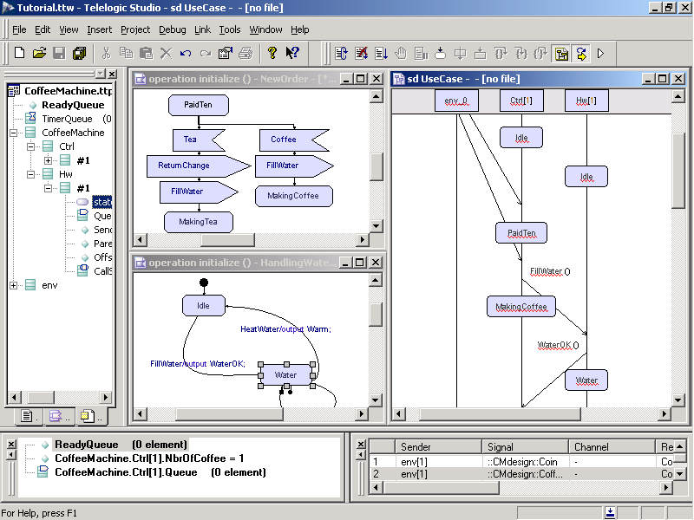
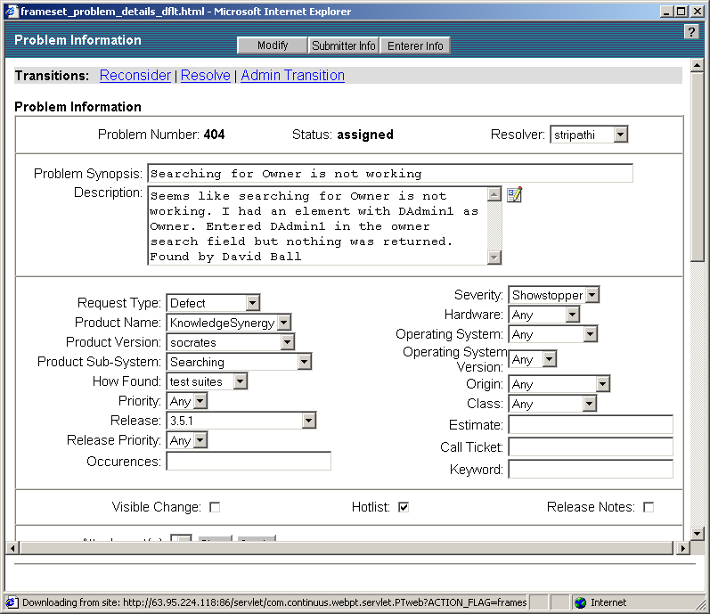
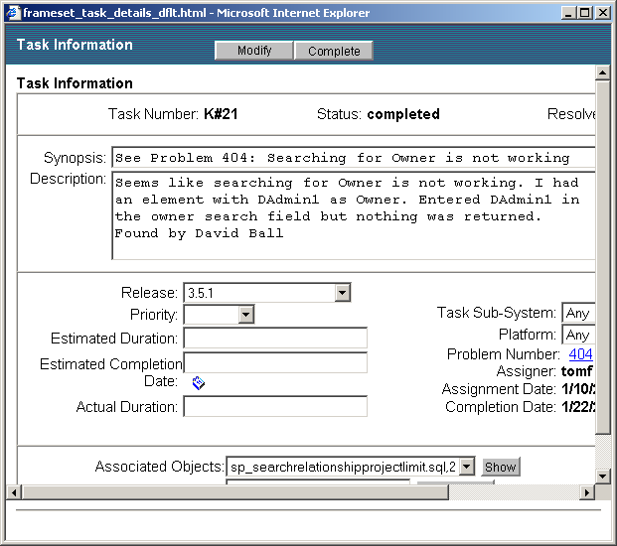
DOORS – Traceability and Software Artefacts
DOORS:
Requirements Management & Traceability
TAU/Architect & TAU/Developer:
System Modeling & Code Generation
SYNERGY/Change:
Work Orders
SYNERGY/CM:
Engineering Tasks
ActiveCM:
Controlled Code Modules

Slide 51
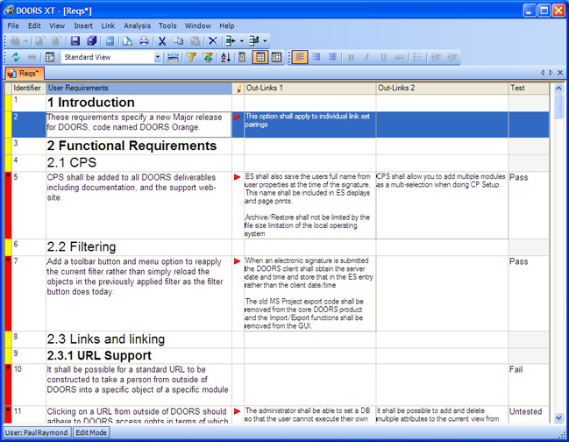
DOORS – Analysis with Wizard
Orphans indicate missing links

Slide 52


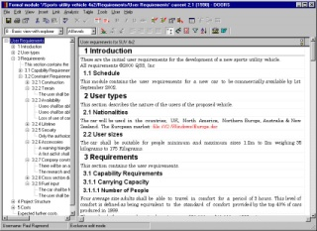
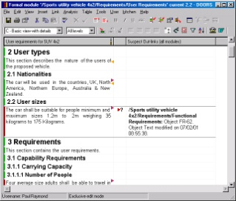
What are Suspect Links?
Proactively know when changes effect your requirements
Suspect link indicates that element may have been affected by a change
Help ensure ripple effects of changes are considered
If documents are linked …
… a change by this user here…
… shows up as a warning flag to this user here.

Slide 53
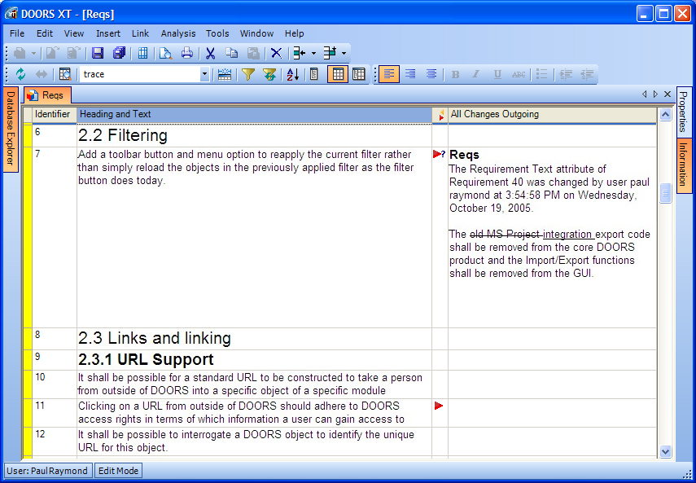
Suspect Links
Visible as indicators or with change notes (added/deleted)

Slide 54
Traceability Planning
Planning traceability? Yes, just like any other project!
  Who are the stakeholders?
  What are the needs (analysis, reports…)?
    Useful, measurable, feasible objectives
  Definition of links and attributes
    Can some be inferred automatically?
  Process (who collects and when to collect traceability information)
    Roles, access
    Data/link input and updates
    Exceptional situations (e.g., lack of time)
  Representations, queries, tools
  …
  Traceability policies define what and how traceability information should be maintained

Slide 55
Factors to Consider during Planning (1)
Number of requirements
  The greater the number of requirements, the more the need for formal traceability policies
Expected system lifetime
  More comprehensive traceability policies should be defined for systems which have a long lifetime
Maturity level of organization
  Detailed traceability policies are more likely to be implemented and used properly in a cost-effective way in organizations which have a higher level of process maturity
Size of project and team
  The larger the project or team, the greater the need for formal traceability policies

Slide 56
Factors to Consider during Planning (2)
Type of system
  Critical systems such as hard real-time control systems or safety-critical systems need more comprehensive traceability policies than non-critical systems
Additional constraints from customer
  E.g., compliance to military standard
Traceability links should be defined by whoever has the appropriate information available

Slide 57
Modeling Traceability
The types of links to use (and their attributes) must be defined for different types of requirements
  It is a design problem!
May be modeled with a UML class diagram (metamodel)
  Object types (classes)
  Object attributes (attributes)
  Structure of folders, modules, objects
    Stereotypes, composition…
  Link types (associations)
    Satisfies, tests, refines, contains, contributes to, threatens, justifies…
  Link attributes (association classes)
  …

Slide 58
Example – UCM Models Imported in DOORS
Associations describe internal links

Slide 59
Example – UCM External Links in DOORS
User
Requirements
(Use Cases)
System
Requirements
Software
Requirements
(Subsystem)
…
Satisfies
Satisfies
Satisfies
Satisfies
Satisfies
Satisfies
UCMs
(User Level)
UCMs
(System Level)
Tests
Tests
Tests
Tests
Acceptance
Tests
Functional
Tests
conventional links
external UCM links

Slide 60
Example – UCM External Links in DOORS
Important to minimize the manual effort for link creation
From system requirements to user-level UCMs to user reqs.
User
Level
UCMs (Maps)
UCMs
(Resp.)
manual links
Map
manual & generated links
User
Requirements
(Use Cases)
Refines
Refines
generated links
* Map.Stub
UCMs
(Scenarios)
* Map.Resp
References
Bound To
Bound To
Traced By
Scenario.Resp
System
Requirements
* Map.Comp
UCMs
(Comp.)
References

Slide 61
Example – Automatic Link Generation (2)
From tests to system-level UCMs to system requirements
System
Level
UCMs (Maps)
UCMs
(Resp.)
manual links
Map
manual & generated links
System
Requirements
Refines
Refines
generated links
* Map.Stub
generated links
(incomplete)
UCMs
(Scenarios)
* Map.Resp
References
Bound To
Bound To
Traced By
Scenario.Resp
Functional
Tests
* Map.Comp
UCMs
(Comp.)
References

Slide 62
Types of Traceability Links
Note the types of links in the previous examples, as well as the types of objects they relate
  Satisfies, Tests
  Refines, References, Contains...
Others could be created
  Contributes, Contradicts, Justifies, Depends on...

Slide 63
Other Example of Traceability Links

Slide 64
Cardinality of Traceability Links
Depending on the traceability information, the cardinality of traceability links may be
  One-to-one
    E.g., one design element to one code module
  One-to-many
    E.g., one functional requirement verified by multiple test cases
  Many-to-many
    E.g., a use case may lead to multiple functional requirement, and a functional requirement may be common to several use cases

Slide 65
Advice for DOORS Links
Direction of links
  From the most concrete to the most abstract
  To avoid access rights issues
  To make use of the integrated analysis routines of DOORS
Link Modules
  One module per type of link
  NEVER use default module (should not even be offered)
  To avoid maintenance problems
  Specific types facilitate analysis and filtering

Slide 66
Baselines

Slide 67
Baseline
Non-modifiable (read-only) version of a document
  Describes a moment in time
  May include multiple documents at the same time
Enables document comparison and management
Comes with a change history for the document
  Information on objects, attributes, and links created, deleted, or edited since the creation of the baseline
  Often also contains information on user sessions (when the document was opened, by whom…)
Requires access control
It is advisable to establish a baseline for a new document that is imported into the document management system
  In order not to lose any changes

Slide 68
Baseline for Requirements
Represents the set of functional and non-functional requirements that the development team has committed to implement in a specific release
Before going into the baseline, the requirements should be reviewed and approved by stakeholders
Once in the baseline, all changes should follow a defined change control process
Baseline
Different viewpoints
No formal documents
Always changing
Shared understanding
Configuration management
Change management

Slide 69
Baseline Usage
Baselines may be
  Created
    Complete image of requirements state at a given time
  Deleted
  Visualized
    Possibility to go back
  Compared
    To see changes since a certain time
  Copied
  Signed
    For authorization, contract

Slide 70
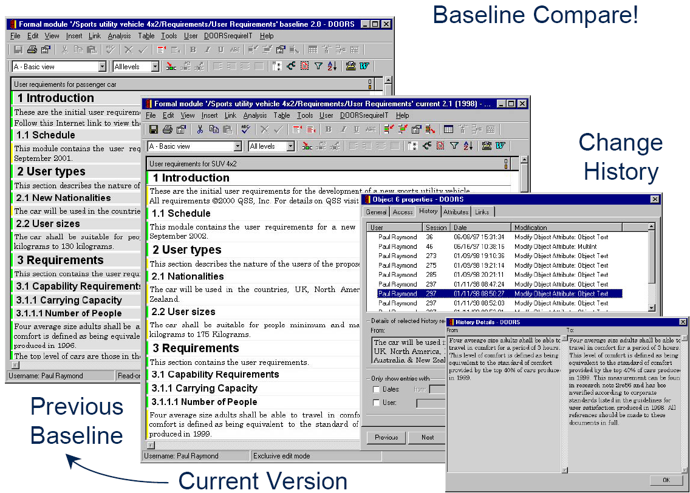
DOORS – Baseline Compare

Slide 71
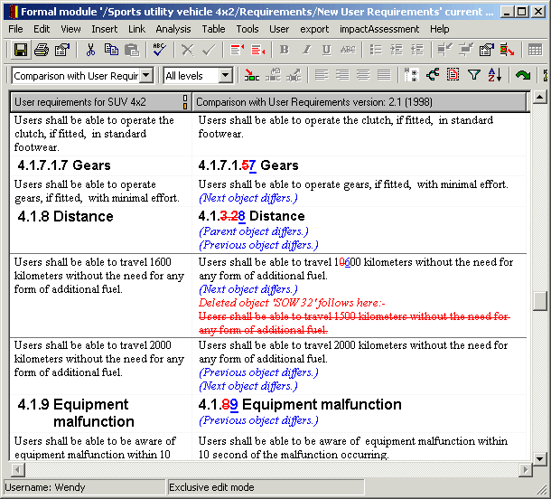
DOORS – Module Compare
Change analysis between versions

Slide 72
Change Management

Slide 73
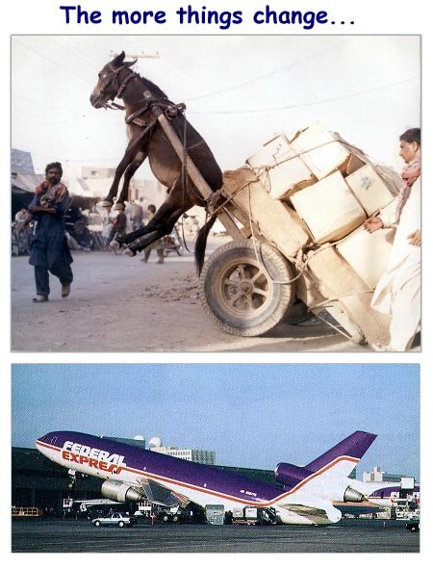
Change Management (1)
The more things change…
If you see change not as
an enemy, but as a
welcome friend, you will
secure the most valuable
prize of all – the future…

Slide 74
Change Management (2)
Concerned with the procedures, processes, and standards which are used to manage changes to a system requirements
Change management policies may cover
  The change request process and the information required to process each change request
  The process used to analyse the impact and costs of change and the associated traceability information
  The membership of the body that formally considers change requests
  Software support (if any) for the change control process
A change request may have a status as well as requirements
  E.g., proposed, rejected, accepted, included...

Slide 75
Change Management Process
Some requirements problem is identified
  Could come from an analysis of the requirements, new customer needs, or operational problems with the system
  The requirements are analysed using problem information and requirements changes are proposed
The proposed changes are analysed
  How many requirements (and, if necessary, system components) are affected? Roughly how much would cost, in both time and money?
The change is implemented
  A set of amendments to the requirements document or a new document version is produced (of course this should be validated with whatever normal quality checking procedures are in place)

Slide 76
Change Request Form
Proposed changes are usually recorded on a change request form which is then passed to all of the people involved in the analysis of the change
Change request forms may include
  Date, Customer, Requester, Product including version
  Description of change request including rationale
  Fields to document the change analysis
  Signature fields
  Status
  Comments

Slide 77
Change Analysis and Costing – Example
customers may misunderstand requirements and their context and suggest unnecessary changes
with the help of traceability information
negotiations with customers
consequential changes may be unacceptable to user/customer
cost/time required for the implementation of change is too high/long

Slide 78
Different Management Aspects
Change Management
  How does a customer submit change requests?
  How is this request being monitored, prioritized, and implemented?
Configuration Management
  Versioning, labelling, and tracking code and other components during the development cycle of software
Release Management
  Defines how and when different hardware and software will be made available together as a product

Slide 79
Tool Support for Change Management
May be provided through requirements management tools or through configuration management tools
Tool facilities may include
  Electronic change request forms which are filled in by different participants in the process
  A database to store and manage requests
  A change model which may be instantiated so that people responsible for one stage of the process know who is responsible for the next process activity
  Electronic transfer of forms between people with different responsibilities and electronic mail notification when activities have been completed
  Electronic signatures
  Discussion forums
  In some cases, direct links to a requirements database

Slide 80
Example – DOORS Change Proposal System (1)
The Change Proposal System (CPS) allows people to access DOORS modules and to propose changes (without immediately changing the modules)
This allows for feedback and the application of changes in a controlled manner
An administrator controls the visibility of data as well as who is allowed to propose change requests
DOORS can also be integrated with SYNERGY
  Version/change management system

Slide 81
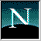
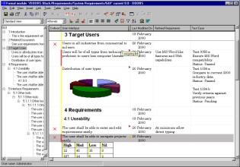
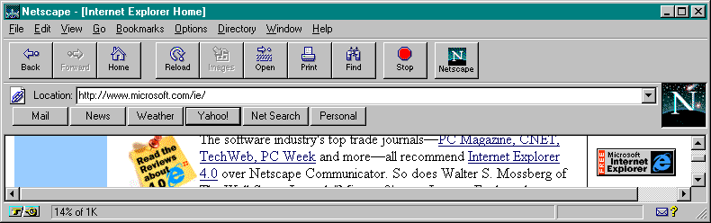
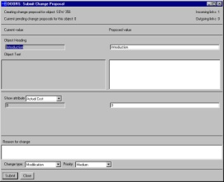

Example – DOORS Change Proposal System (2)
Manage change;
no surprises
E-mail
Changes from all
users including
DOORSnet
Submitted
Accepted
Changes reviewed
on-line
Read-only
user submits
“Change Proposal”
In Review
Further Research
Next Release
On Hold
Rejected

Slide 82
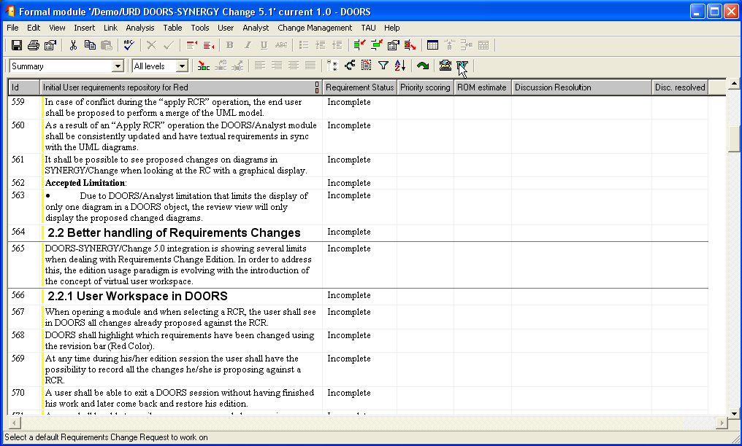
Change Management with DOORS/SYNERGY (1)
Standard DOORS module

Slide 83
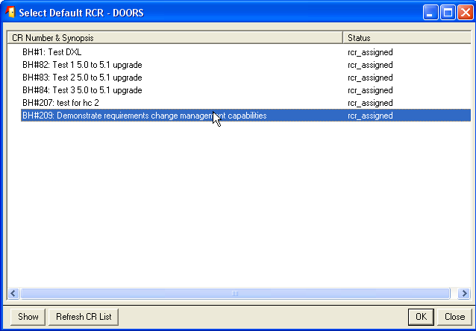
Change Management with DOORS/SYNERGY (2)
Select a SYNERGY change request

Slide 84
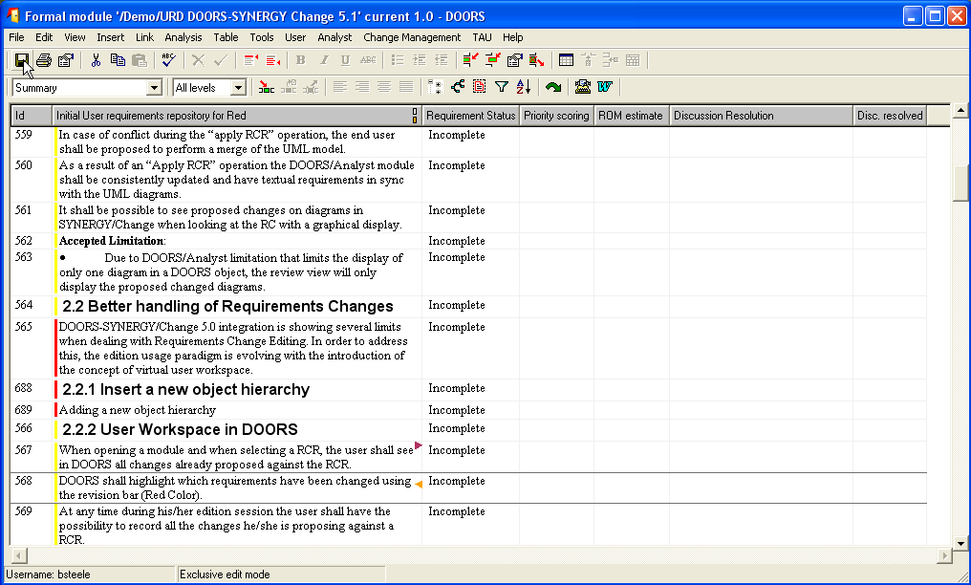
Change Management with DOORS/SYNERGY (3)
Perform appropriate changes

Slide 85
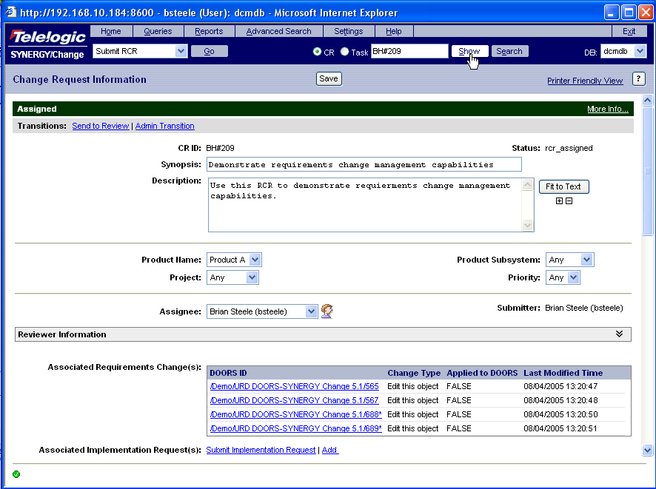
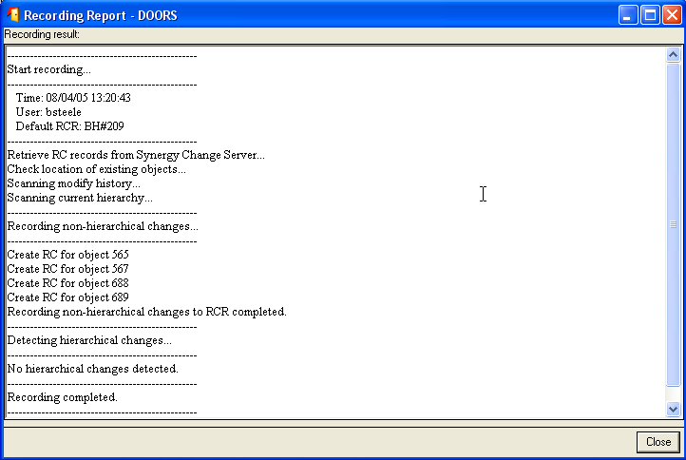
Change Management with DOORS/SYNERGY (4)
Changes managed by SYNERGY/Change

Slide 86
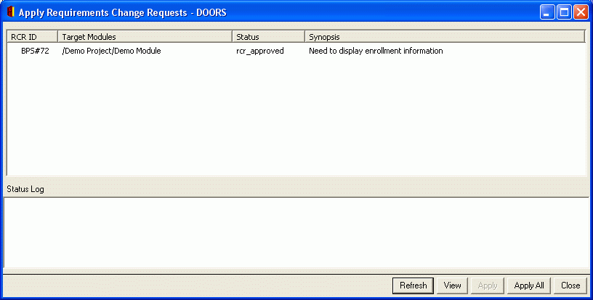
Change Management with DOORS/SYNERGY (5)
Once approved, the change request can be applied to DOORS

Slide 87
Requirements Management Tools

Slide 88
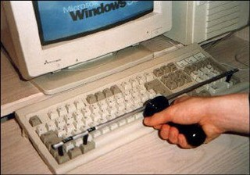
What Kind of Tool Do We Need?
Different companies will use different tools, which may or may not be tailored to the requirements management task
  Word processor (Microsoft Word with templates…)
  Spreadsheet (Microsoft Excel…)
  Industrial-strength, commercial RM tools
    IBM/Telelogic DOORS, IBM Requisite Pro, Borland CaliberRM…
  Internal tools
    GenSpec (Hydro-Quebec)…
  Open source RM tools
    OSRMT: http://sourceforge.net/projects/osrmt
  Bug tracking tools (free or not)
    Bugzilla…
  Collaboration tools (free or not)
    TWiki…

Slide 89
What Should We Look For in a Tool?
Types/attributes for requirements and links
Specifications and models
Version and change management
Database repository
Traceability
Analysis (impact, completeness, style, differences…)
Automatic inspection of requirements (according to rules)
Visualization and reports
Requirements document generation
Monitoring of requirements statuses
Access control
Import/export
Communication with stakeholders
Scripting language (for automation)
Reuse of requirements, models, projects
…

Slide 90
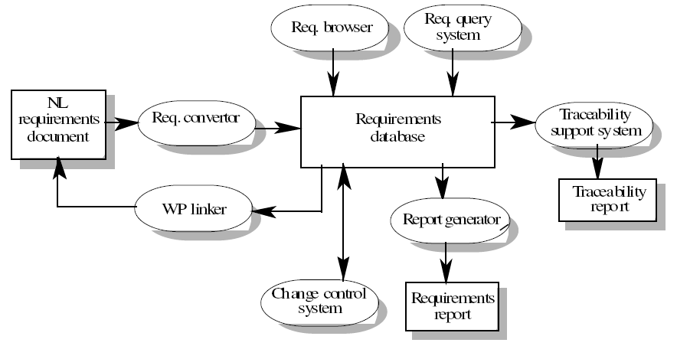
RM Tool Architecture – Example

Slide 91
Requirements Management Implies Integration!

Slide 92
Approaches – Document or Database? (1)
Requirements have to be stored in such a way that they can be accessed easily and related to other requirements
Document (e.g., Word)
  Easy to use, easy to access, simple training
  Requirements are all stored in the requirements document
  It is easy to produce the final requirements document
  But: Traceability? Status reports? Granularity of requirements? Search and navigation facilities? Change management? Version control? Analysis? Simultaneous access control?...

Slide 93
Approaches – Document or Database? (2)
Database (e.g., DOORS)
  Good for management, controlled access, links, analysis, reports
  Good query and navigation facilities
  Support for change and version management
  But: hard (and costly) to configure, manage, and use; link between the database and the requirements document must be maintained (final requirements document must be generated)
Ideally: Target the benefits of both
  E.g., DOORS and RequisitePro offer integrations with Word (import/export) as well as document-oriented views (for the “look and feel”…)

Slide 94
How About Evolving the Process Itself?
Evolution of requirements types
  Adding / modifying / deleting
    Attributes
    Link types
    Requirements status
    …
Evolution of change management
  Adding / modifying / deleting
    Attributes
    Lifecycle status
    Forms
    …

Slide 95
Thinking About Getting a RM Tool?
The list of potential criteria and the list of products can be rather long…
  See the INCOSE study:
  http://www.incose.org/ProductsPubs/Products/rmsurvey.aspx
    About 25 tools and 80 criteria, with explanations
Which are relevant to you, in your context (project, organization…)?
  Need a goal model to define criteria and for assessment!

Slide 96
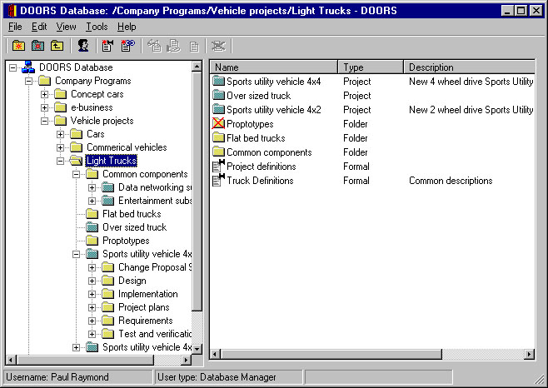
DOORS – Database View
Deleted Folder
Folders
Projects
Formal Modules
Link modules

Slide 97
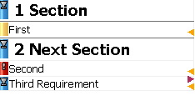
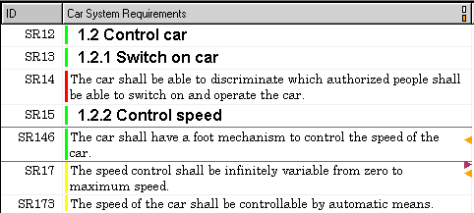
DOORS – Displayed Information
Object or Section Number
Column
Heading
“No change since baseline”
change-bar (green / blue)
Object
Heading
Use in
Graphical view
Use as
DataTip
Object Identifier
Link
Indicator
Object Text
“Changed this session”
change-bar, unsaved (red)
Current
Object
“Changed since baseline”
change-bar, saved (yellow)

Slide 98
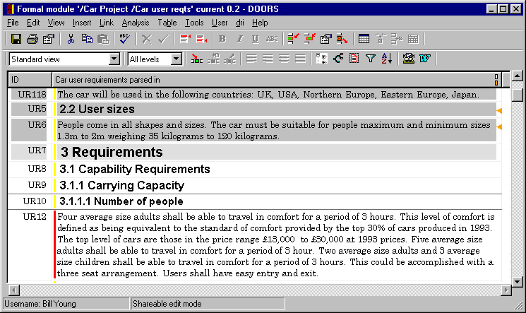
DOORS – Multi-User Editing
Make required edits, and unlock to allow others access
Mode

Slide 99
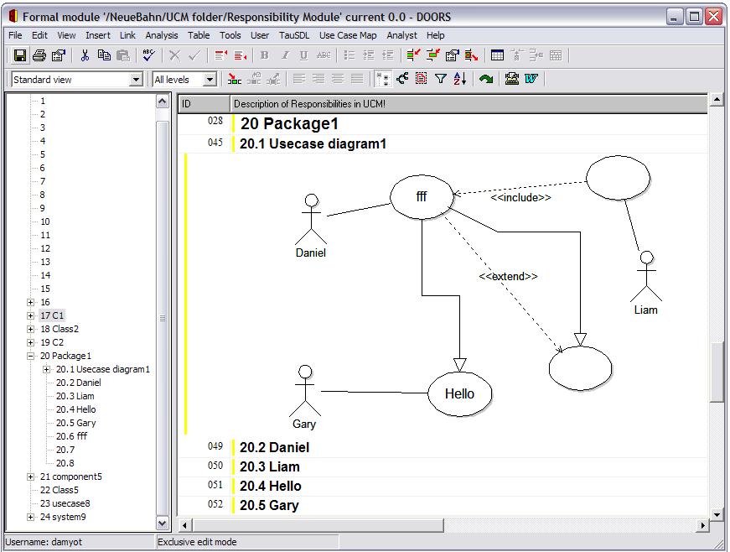
DOORS – Integration with UML 2.0

Slide 100
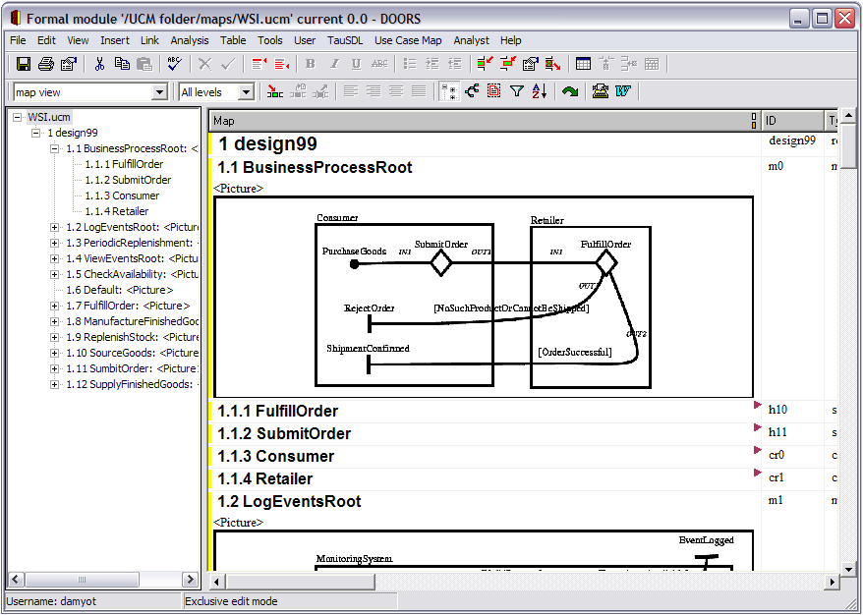
DOORS – Integration with URN

Slide 101
TWiki Overview
A generic Wiki tool (TWiki.org)
  Promotes collaboration
  Database-driven
  Access and version control
  Forms and queries
  State-based workflows (processes)
  Text and graphics
  Lightweight, extensible (plug-in architecture)
Example of Forms and Queries
  Requirements: http://cserg0.site.uottawa.ca/twiki/bin/view/ProjetSEG/UCMNavRequirements
  Library: http://cserg0.site.uottawa.ca/twiki/bin/view/UCM/UCMVirtualLibrary
  Use Cases: http://cserg0.site.uottawa.ca/seg/bin/view/CSI4900/UseCases

Slide 102
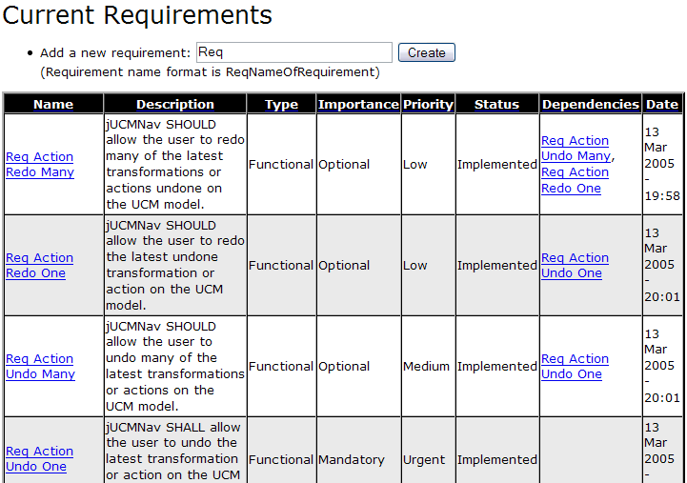
TWiki for Requirements Management

Slide 103
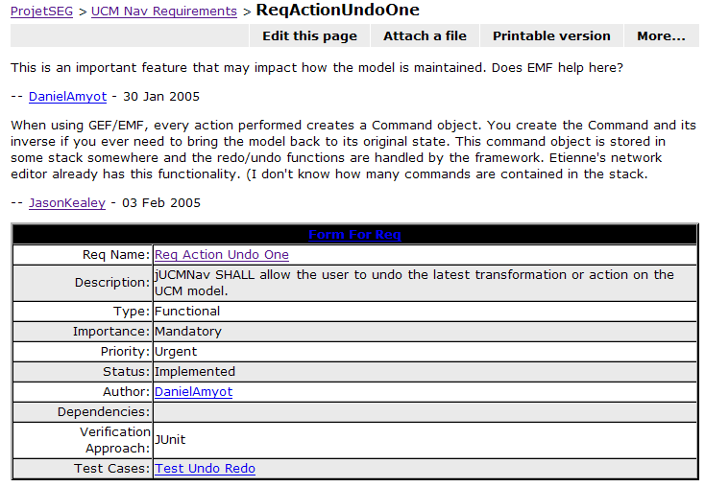
Twiki – Requirement Example

Slide 104
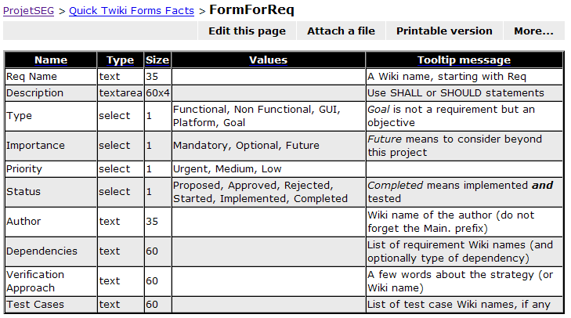
TWiki – Requirement Form Example

Slide 105
Using TWiki…
We have:
  Requirement types description with configurable statuses & attributes
  Bidirectional links (WikiWords)
  Configurable requests, filtering, reports
  Access control and version management (showing differences)
  Change management (again with forms, process, etc.)
  Discussions, attachment of documents/images
  Export (HTML)
  Scripting language (Perl)
But do we really have:
  Graphical view of traceability?
  Editable tables (à la Excel/Word)?
  Baselines? Tool integration? Imports? Analysis?

Slide 106
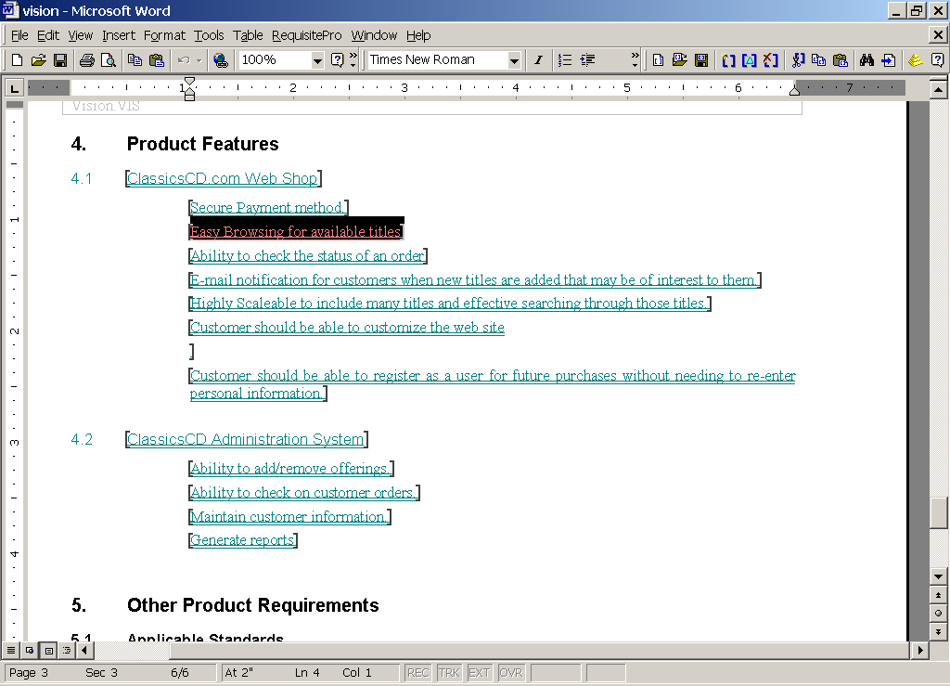
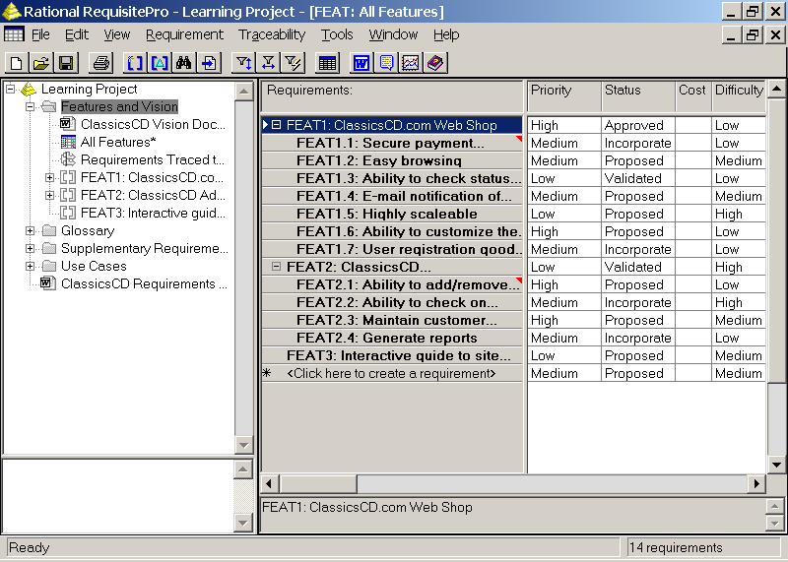
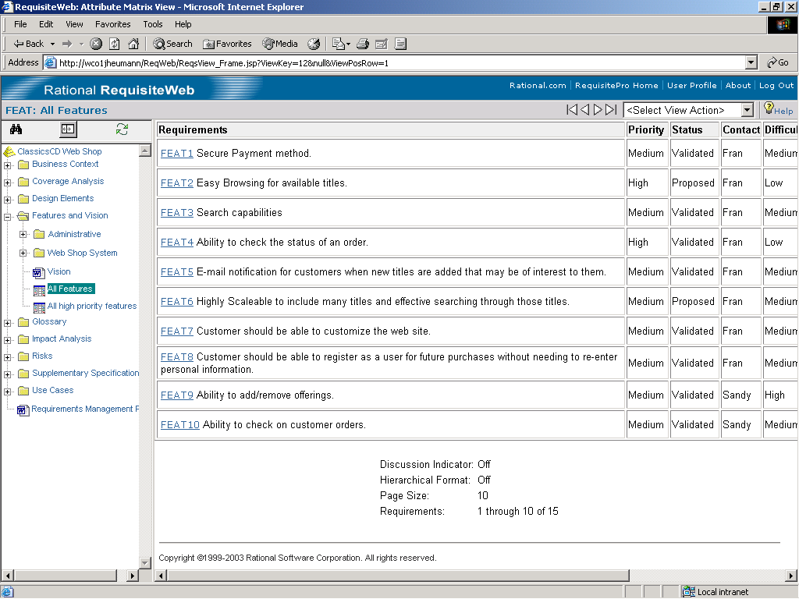
IBM Requisite Pro
Keep your team on track
Database
3 interfaces - work the way you
want
Document centric or database
centric - your choice

Slide 107
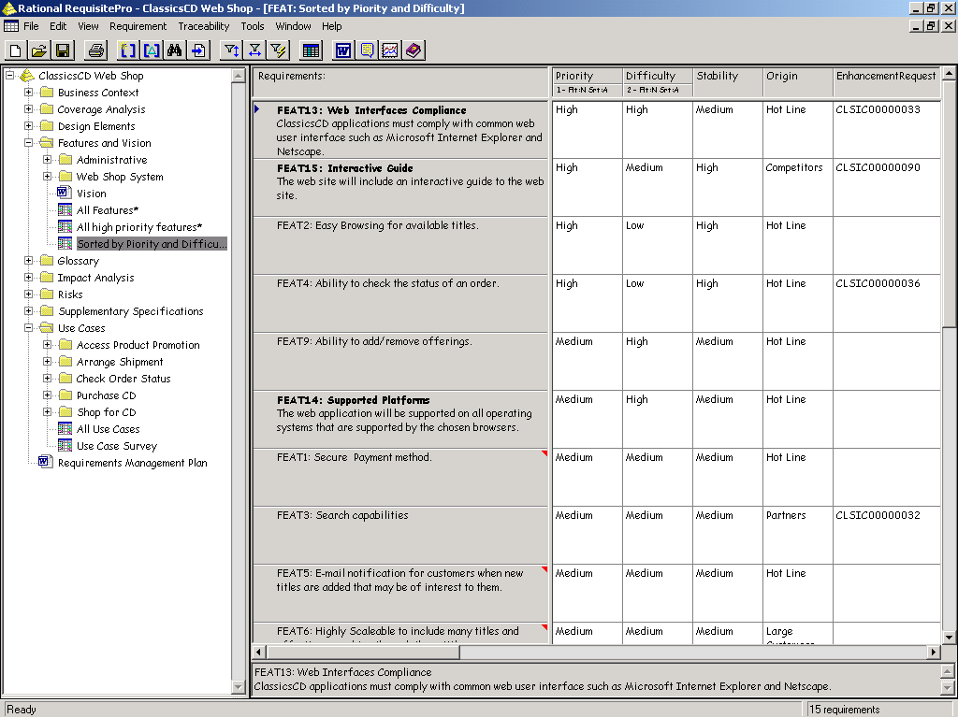
IBM Requisite Pro – Types, Attributes, and Views
User defined requirement types
User defined attributes
User defined filters (views)
Saved views

Slide 108


IBM Requisite Pro – Traceability

Slide 109

IBM Requisite Pro – Change Management

Slide 110


IBM Requisite Pro – Integration
IBM Rational TestManager
Testers view current state
of requirements from their tool
IBM Rational XDE and IBM Rational Rose, Rational Software Architect and Rational Software Modeler
Developers view current state of requirements from their tool

Slide 111
Genspec

Slide 112

Genspec – Automated Inspection of Specification

Slide 113
Thank you

