Slide 1
RE BASICS :
PURPOSE AND NATURE OF REQUIREMENTS
PERTEMUAN 7
AGUNG MULYO WIDODO
TEKNIK INFORMATIKA

Slide 2
KEMAMPUAN AKHIR YANG DIHARAPKAN
Definition and Importance of Requirements
Types of Requirements
Notes:
a

Slide 3

BUKU PEMBELAJARAN
Jeremy Dick, Elizabeth Hull, Ken Jackson, Requirements Engineering, Springer-Verlag, 2004
Soren Lauesen Software Requirements - Styles and Techniques, Addison Wesley, 2002
Ian K. Bray , An Introduction to Requirements Engineering, Addison Wesley,
2002
Colin Hood, Simon Wiedemann , Stefan FichtingerUrte Pautz ,Requirements Management, Springer-Verlag, 2008

Slide 4
REFERENSI
B. A. Nuseibeh and S. M. Easterbrook, Requirements Engineering: A Roadmap. In A. C. W. Finkelstein (ed) The Future of Software Engineering, ACM Press, 2000
http://www.cs.toronto.edu/~sme/papers/2000/ICSE2000.pdf
Simson Garfinkel, History's Worst Software Bugs, Wired News, 2005
http://www.wired.com/news/technology/bugs/0,2924,69355,00.html
INCOSE Requirements Working Group
http://www.incose.org/practice/techactivities/wg/rqmts/
Tools Survey: Requirements Management (RM) Tools
http://www.incose.org/productspubs/products/rmsurvey.aspx
http://www.volere.co.uk/tools.htm
IEEE (1993) Recommended Practice for Software Requirements Specifications. IEEE Std 830-1993, NY, USA.
IEEE (1995) Guide for Developing System Requirements Specifications. IEEE Std P1233/D3, NY, USA.
Requirements Engineering Conference
http://www.requirements-engineering.org/

Slide 5
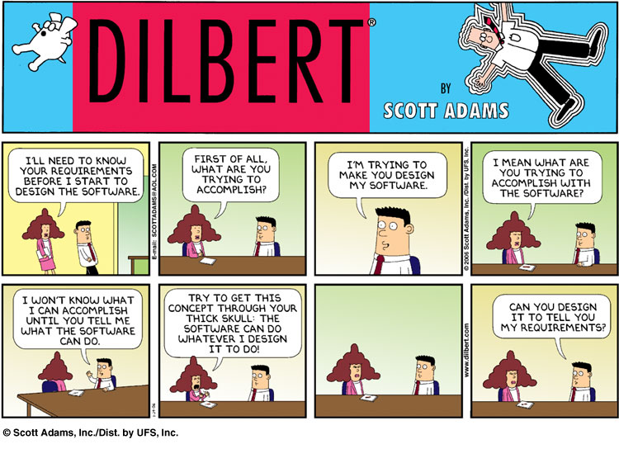

Slide 6
Mars Climate Orbiter
In 1999, the Mars Climate Orbiter disappears around Mars
Cost: about $125M US
Problem caused by a misunderstanding between a team in Colorado and one in California
One team used the metric system while the other used the English system for a key function…

Slide 7
GIRES
GIRES¹ (Gestion intégrée des ressources)
  Integrated management of resources
  To replace >1000 existing systems
  In 140 organisations / departments
  Affecting 68000 employees!
8-year project of the Quebec government, started 1998
$80 million budget
Could not cope with changes to the requirements…
  Cost of $400 millions after 5 years, and very late
  Project cancelled in 2003

Slide 8
Canadian Gun Registry
Law adopted in 1995
Was supposed to cost $119M, with revenues
of $117M (net cost of $2M)
30 types of permits, long questionnaires, 90%
of errors in requests
Rising costs ($327M in 2000, $688M in 2002, plus others…)
Many political and legal issues, and a few scandals…
Customer asked for over 2000 changes in the computer system!
~$1B in 2004, probably ~$2B by the time the system is fully functional
Tons of unhappy customers and taxpayers…
Not required to register as of May 17, 2006!

Slide 9
Definition and Importance of Requirements

Slide 10
A requirement is:
  Capturing the purpose of a system
  An expression of the ideas to be embodied in the system or application under development
  A statement about the proposed system that all stakeholders agree must be made true in order for the customer’s problem to be adequately solved
    Short and concise piece of information
    Says something about the system
    All the stakeholders have agreed that it is valid
    It helps solve the customer’s problem

Slide 11
A requirement is defined as:
  A condition or capability needed by a user to solve a problem or achieve an objective
  A condition or a capability that must be met or possessed by a system … to satisfy a contract, standard, specification, or other formally imposed document …

Slide 12
Requirements Engineering (RE) is:
  The activity of development, elicitation, specification, analysis, and management of the stakeholder requirements, which are to be met by a new or evolving system
  RE is concerned with identifying the purpose of a software system… and the contexts in which it will be used
    How/where the system will be used
    Big picture is important
  Captures real world needs of stakeholders affected by a software system and expresses them as artifacts that can be implemented by a computing system
    Bridge to design and construction
    How to communicate and negotiate?
    Is anything lost in the translation between different worlds?

Slide 13
Requirements Engineering Activities
Requirements Engineering
Requirements Inception
Requirements Development
Requirements Management
Elicitation
Analysis
Specification
Verification

Slide 14
About these RE Activities…
Inception
  Start the process (business need, market opportunity, great idea, ...), business case, feasibility study, system scope, risks, etc.
Requirements elicitation
  Requirements discovered through consultation with stakeholders
Requirements analysis and negotiation
  Requirements are analyzed and conflicts resolved through negotiation
Requirements specification
  A precise requirements document is produced
Requirements validation
  The requirements document is checked for consistency and completeness
Requirements management
  Needs and contexts evolve, and so do requirements!

Slide 15
General Problems with the Requirements Process
Lack of the right expertise (software engineers, domain experts, etc.)
Initial ideas are often incomplete, wildly optimistic, and firmly entrenched in the minds of the people leading the acquisition process
Difficulty of using complex tools and diverse methods associated with requirements gathering may negate the anticipated benefits of a complete and detailed approach

Slide 16
Statistics from NIST Report
NIST (National Institute of Standards and Technology) has published a comprehensive (309 pages) and very interesting report on project statistics and experiences based on data from a large number of software projects¹
  70% of the defects are introduced in the specification phase
  30% are introduced later in the technical solution process
  Only 5% of the specification inadequacies are corrected in the specification phase
  95% are detected later in the project or after delivery where the cost for correction on average is 22 times higher compared to a correction directly during the specification effort
  The NIST report concludes that extensive testing is essential, however testing detects the dominating specification errors late in the process

Slide 17
Why Focus on Requirements ?
Distribution of Effort to Fix Defects
Distribution of Defects
Code
7%
Requirements
56%
Other
10%
Code
1%
Other
4%
Design
13%
Requirements
82%
Design
27%

Slide 18
View of the Software Engineering Institute (SEI)
Improve software development with the CMM/CMMI model for software development
  Capability Maturity Model (CMM)
  For software development, superseded by Capability Maturity Model Integration (CMMI)
SEI’s vision is:
  The right software, delivered defect free, on time & on cost, every time
  “Right software” implies software that satisfies requirements for functionality and qualities (e.g., performance, cost…) throughout its lifetime
  “Defect free” software is achieved either through exhaustive testing after coding or by developing the code right the first time

Slide 19
CHAOS Report (2004)

Slide 20
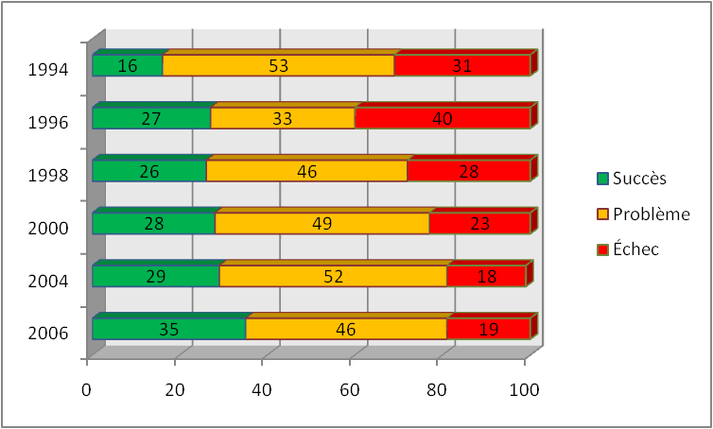
Progression since 1994

Slide 21
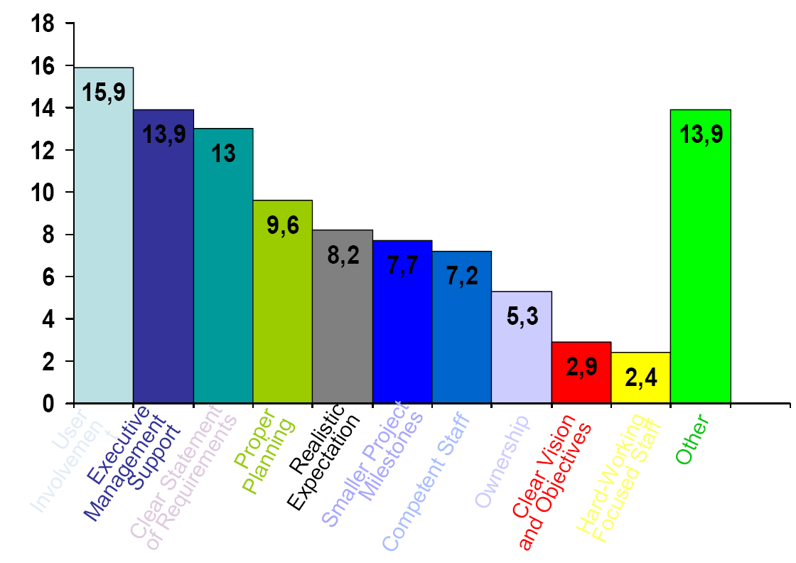
Success Factors

Slide 22
Problem Causes

Slide 23
Evolution of Success Factors

Slide 24
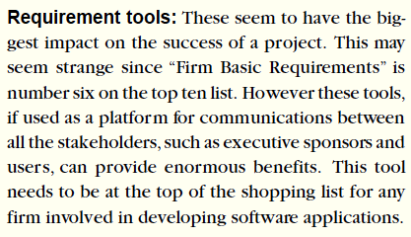
Managing Evolving Requirements
“Changing requirements is as certain as death and taxes”

Slide 25
Types of Requirements

Slide 26
So Many “Requirements”… (1)
A goal is an objective or concern that guides the RE process. It can be used to discover and evaluate functional and non-functional requirements
  A goal is not yet a requirement…
Note: All requirements must be verifiable (by some test, inspection, audit etc.)
A functional requirement is a requirement defining functions of the system under development
  Describes what the system should do
A non-functional requirement is a requirement that is not functional. This includes many different kinds of requirements. – Therefore one often considers the following sub-categories:

Slide 27
Different types of non-functional requirements
Performance requirements, characterizing system properties such as expected performance, capacity, reliability, robustness, usability, etc.
Design constraints (also called process requirements), providing constraints on how the system should be designed and built – related to development process, documentation, programming language, maintainability, etc.
Commercial constraints, such as development time frame and costs.

Slide 28
So Many “Requirements”… (2)
A user requirement is a desired goal or function that a user and other stakeholders expect the system to achieve
  Does not necessarily become a system requirement
Application domain requirement (sometimes called business rules) are requirements derived from business practices within a given industrial sector, or in a given company, or defined by government regulations or standards.
  May lead to system requirements. Can be functional or non-functional
Problem domain requirements should be satisfied within the problem domain in order to satisfy some of the goals
System requirements are the requirements for the system to be built, as a whole
  A system is a collection of interrelated components working together towards some common objective (may be software, mechanical, electrical and electronic hardware and be operated by people)
  Systems Engineering is a multidisciplinary approach to systems development – software is only a part (but often the problematic part)

Slide 29
So Many “Requirements”… (3)
Important note: Software Requirements Engineering is a special case of Requirements Engineering. Many topics discussed in this course are quite general and apply to requirements engineering, in general.
In a system containing software, software requirements are derived from the system requirements. The system then consists of hardware and software, and the hardware (and often the operating system and other existing software modules) are part of the environment in which the software is used.

Slide 30
Functional Requirements
What inputs the system should accept
What outputs the system should produce
What data the system should store other systems might use
What computations the system should perform
The timing and synchronization of the above
Depend on the type of software, expected users, and the type of system where the software is used
Functional user requirements may be high-level statements of what the system should do, but functional system requirements should describe the system services in detail

Slide 31
Examples of Functional Requirements
The user shall be able to search either all of the initial set of databases or select a subset from it.
The system shall provide appropriate viewers for the user to read documents in the document store.
Every order shall be allocated a unique identifier (ORDER_ID) which the user shall be able to copy to the account’s permanent storage area.

Slide 32
Non-Functional Requirements (NFR) (1)
Non-functional requirements are important
  If they are not met, the system is useless
  Non-functional requirements may be very difficult to state precisely (especially at the beginning) and imprecise requirements may be difficult to verify
They are sometimes called quality requirements, quality of service, or extra-functional requirements.
Three main categories ¹:
  Performance requirements reflecting: usability, efficiency, reliability, maintainability and reusability (note: also security requirements)
    Response time, throughput
    Resource usage
    Reliability, availability
    Recovery from failure
    Allowances for maintainability and enhancement
    Allowances for reusability

Slide 33
Non-Functional Requirements (NFR) (2)
  Design constraints: Categories constraining the environment and technology of the system.
    Platform (minimal requirements, OS, devices…)
    Technology to be used (language, DB, …)
  Commercial constaints: Categories constraining the project plan and development methods
    Development process (methodology) to be used
    Cost and delivery date
      Often put in contract or project plan instead

Slide 34
Various NFR Types
Other ontologies also exist

Slide 35
Examples of Non-Functional Requirements
Product requirement
  It shall be possible for all necessary communication between the APSE and the user to be expressed in the standard Ada character set.
Process requirement
  The system development process and deliverable documents shall conform to the process and deliverables defined in XYZCoSPSTAN95.
Security requirement
  The system shall not disclose any personal information about customers apart from their name and reference number to the operators of the system.

Slide 36
Measurable Non-Functional Requirements
Property
Measure
Speed
Processed transactions/second
User/Event response time
Screen refresh time
Size
K Bytes
Number of RAM chips
Ease of use
Training time
Number of help frames
Reliability
Mean time to failure
Probability of unavailability
Rate of failure occurrence
Availability
Robustness
Time to restart after failure
Percentage of events causing failure
Probability of data corruption on failure
Portability
Percentage of target dependent statements
Number of target systems

Slide 37
Goals
A Goal
  Conveys the intention or the objective of one or many stakeholders
  Can guide the discovery of verifiable non-functional requirements that can be tested objectively

Slide 38
Example of Goal and NFR
A system goal
  The system should be easy to use by experienced controllers and should be organized in such a way that user errors are minimized.
A verifiable usability requirement derived from this goal
  Experienced controllers shall be able to use all the system functions after a total of three hours of training.
  The average number of errors made by experienced controllers shall not exceed two per day.
  Assumption: An experienced controller has at least 2 years experience with the old system (as stated by the stakeholder)

Slide 39
Application-Domain Requirements
Derived from the application domain
Describe system characteristics and features that reflect the domain
May be new functional requirements, constraints on existing requirements, or define specific computations
If domain requirements are not satisfied, the system may be unworkable

Slide 40
Examples of Application-Domain Requirements
Library system
  The system interface to the database must comply with standard Z39.50.
  Because of copyright restrictions, some documents must be deleted immediately on arrival. Depending on the user’s requirements, these documents will first be printed either locally or printed to a network printer and retrieved by the user.
Train protection system
  The deceleration of the train shall be computed as:
  D_{train} = D_{control} + D_{gradient}
  where D_{gradient} is 9.81ms² * compensated gradient / alpha and where the values of 9.81ms² / alpha are known for different types of train.

Slide 41
Problems concerning Application-Domain Requirements
Understandability
  Requirements are expressed in the language of the application domain
  This is often not understood by software engineers developing the system
Implicitness / Tacit knowledge
  Domain specialists understand the area so well that they do not think of making the domain requirements explicit
  People are often unaware of the tacit knowledge they possess and therefore cannot express it to others

Slide 42
Emergent Properties
(when the system consists of several sub-systems)
Properties of the system as a whole
  Requirements which cannot be addressed by a single component, but which depend for their satisfaction on how all the software components interoperate
  Only emerge once all individual subsystems have been integrated
  Dependent on the system architecture
Examples of emergent properties
  Reliability
  Maintainability
  Performance
  Usability
  Security
  Safety

Slide 43
Thank you

